Slide 1



Influence and Negotiation Skills
The Negotiating & Influencing Process
Prepared by:
Dr. Bothaina Mahmoud Fouad
College of
Entrepreneurship and Innovation
Code ENT623
Week 8

Slide 2

Lec. 7 Overview
The main points:
Upon successful completion of this lecture, you will be able to:
Demonstrate the negotiation types
Describe the stages in the process of negotiation and Influence
Case studies

Slide 3
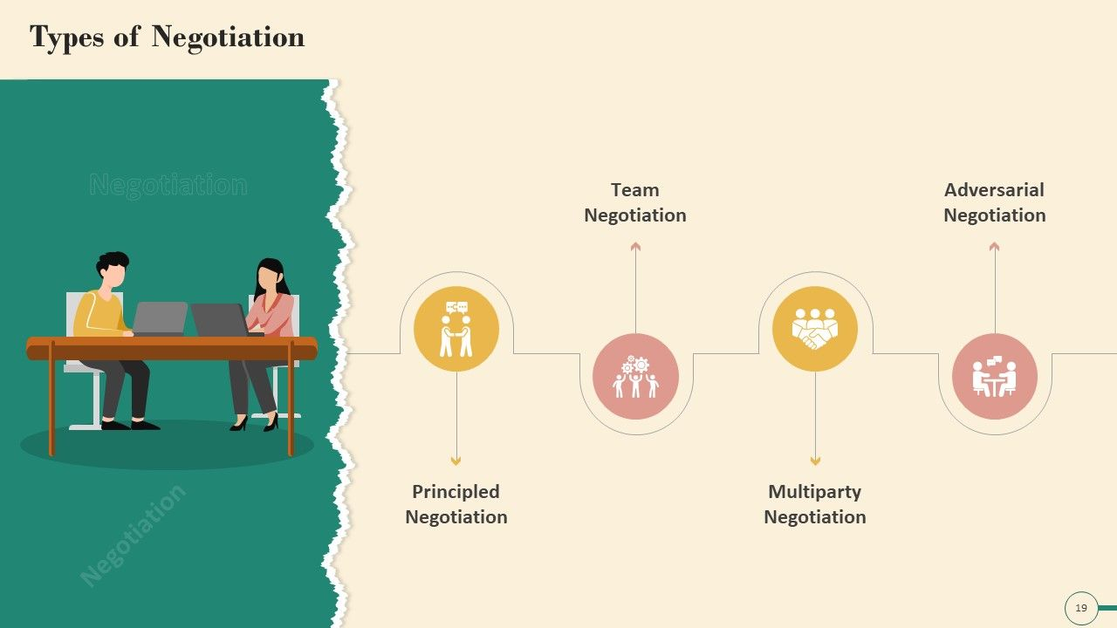


Negotiation Types

Slide 4
Negotiations types
There are two opposite types or schools of negotiation: integrative and distributive. Both types are essential to negotiating successfully in business.

Slide 5

Distributive negotiation
Integrative Negotiation

Slide 6
Distributive negotiation
is a type of negotiation in which parties bargain for shares of a fixed resource. Also known as distributive bargaining, it can be used in labor negotiations, sales, and in any problem-solving scenario where people are trying to divvy up things of value

Slide 7
Distributive negotiation
In the real world of negotiations, two teams enter discussions with the goal of claiming as much value as possible. The seller wants to go after the best price they can obtain. The buyer wants to pay the lowest price to achieve the best bargain. It’s good old-fashioned haggling.

Slide 8
two characteristics of distributive negotiation
The distributive negotiation is
generally very competitive (a win-lose situation) and does not foster cooperative behavior.
seeks to grab as much possible in that negotiation.

Slide 9

Distributive Bargaining Basics
Give little or no information to the other side. The less the other negotiator knows about our interests, the better our position. This can include why we want to make the purchase, our preferences, or the point at which we’d decline the deal. Expressing eagerness or need reveals a weakness that could be exploited.
The opposite is equally true – Try to obtain as much information from the other side as you can. Any further information uncovered is potential leverage to negotiate a better deal.
https://www.negotiations.com/articles/negotiation-types/

Slide 10
Distributive Bargaining Basics
Let the other side know you have options – The only information we should reveal is the fact we have options. This includes other sellers we can purchase from at a competitive price. Reminding the seller of their competition shows our willingness to walk if necessary. It also lets the seller know there will be no negative consequences for us
Make the first offer – Whatever the first offer is will generally act as a negotiation anchor. The anchor becomes the point on which the rest of the negotiation will likely revolve. Try to make the first offer to ensure discussions set off in your favor.
Be realistic – Being too greedy or too stingy will likely result in no agreement. So, keep expectations realistic.

Slide 11
Integrative Negotiation
Distributive negotiation

Slide 12

Integrative Negotiation
Integrative negotiations need a more developed type of business negotiation skills. For this reason, we typically start our negotiation skills training with simple distributive bargaining role-plays. We then build up to more complex team-based integrative negotiation role-plays

Slide 13
Integrative Negotiation
In the real world of business, the results often tilt in favor of one side over the other. This is because it’s unlikely that both sides will come to the table at equal strength when talks begin.
Nonetheless, there are many advantages when both teams take a cooperative approach. Skillful mutual problem-solving generally involves some form of making value-for-value concessions. This is usually in conjunction with creative problem-solving.

Slide 14
Integrative Negotiation
Generally, integrative negotiations are future-focused, with long-term relationships in mind. The aim of our on-site negotiation training is to create ongoing mutual gains. This mutually beneficial type of negotiation outcome is often described as the win-win scenario.

Slide 15
Integrative Negotiation Basics
Multiple Issues – Integrative negotiations usually involve many issues that are up for discussion. Each side wants to get something of value while trading something of lesser value. In contrast, distributive negotiations generally revolve around the price or a single issue.
Sharing – To understand each other’s situation, both sides should share as much information as possible. This helps each side understand the other’s interests. You can’t solve a problem without knowing the parameters. Cooperation is essential.
https://www.negotiations.com/articles/negotiation-types/

Slide 16
Integrative Negotiation Basics
Problem Solving – Find solutions to each other’s problems. For example, offer something valuable to the other side that is of lesser value to you. If you can make this trade while realizing your goal, you have integrated your problems into a positive solution.
Bridge Building – More and more businesses are engaging in long-term relationships. Relationships offer greater security and the promise of future success.
https://www.negotiations.com/articles/negotiation-types/

Slide 17
We often use the two types of negotiation mentioned above in our business and personal lives. Sometimes, these two usually distinct forms of negotiation can even overlap. By understanding these negotiating types, we can be better prepared in different situations.

Slide 18
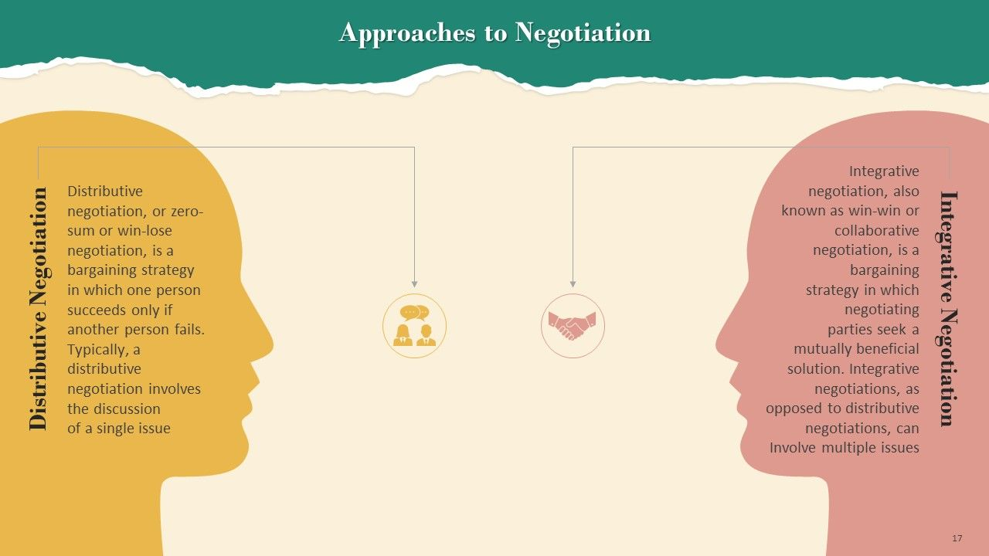
Negotiation Types

Slide 19
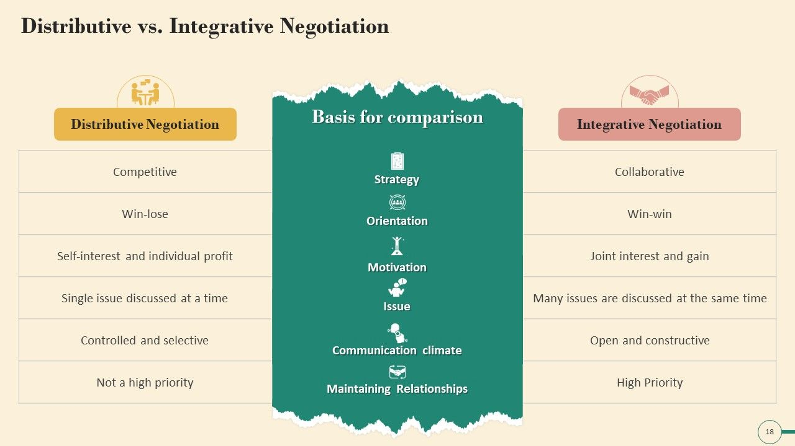
Negotiation Types

Slide 20
The Negotiation Process
The Influencing Process

Slide 21
Negotiations Process
Most often, negotiation is a process that involves many unique elements and aspects of consideration. In business fields, the negotiation process must account for internal factors, such as people (workers), equipment, procedures, and external business ventures, including the economic climate, market competition, and interests of business partners and shareholders. When utilizing the negotiation process, all parties must consider the consequences of their choices and determine the best possible outcomes to present to other negotiating parties before a final decision is reached.

Slide 22
Negotiations Process
For example, if one company chose to buy out another company and both parties were mutually interested in creating the best merger outcome. The negotiation process would likely be used to reach a final decision. When the company being acquired is fully integrated into the acquiring company, negotiations may decide that all employees from the prior company would retain their positions with equal benefits. Likewise, the equipment from the acquired company would be incorporated into the acquiring company. Inevitably, both negotiating parties realize that the merger will create a stronger, more competitive business that will interest both the buyer and the company being acquired.

Slide 23
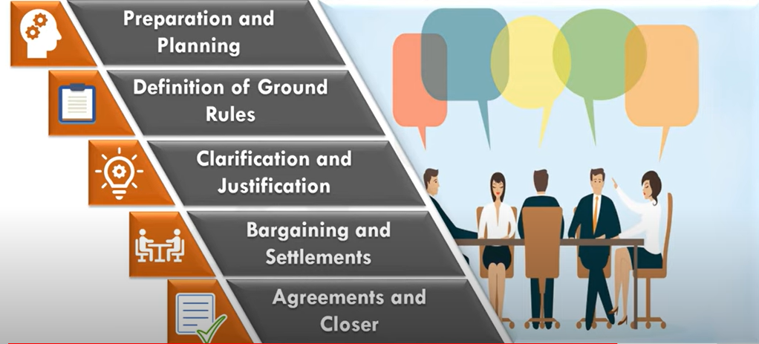
5 stages foe the Negotiations Process

Slide 24
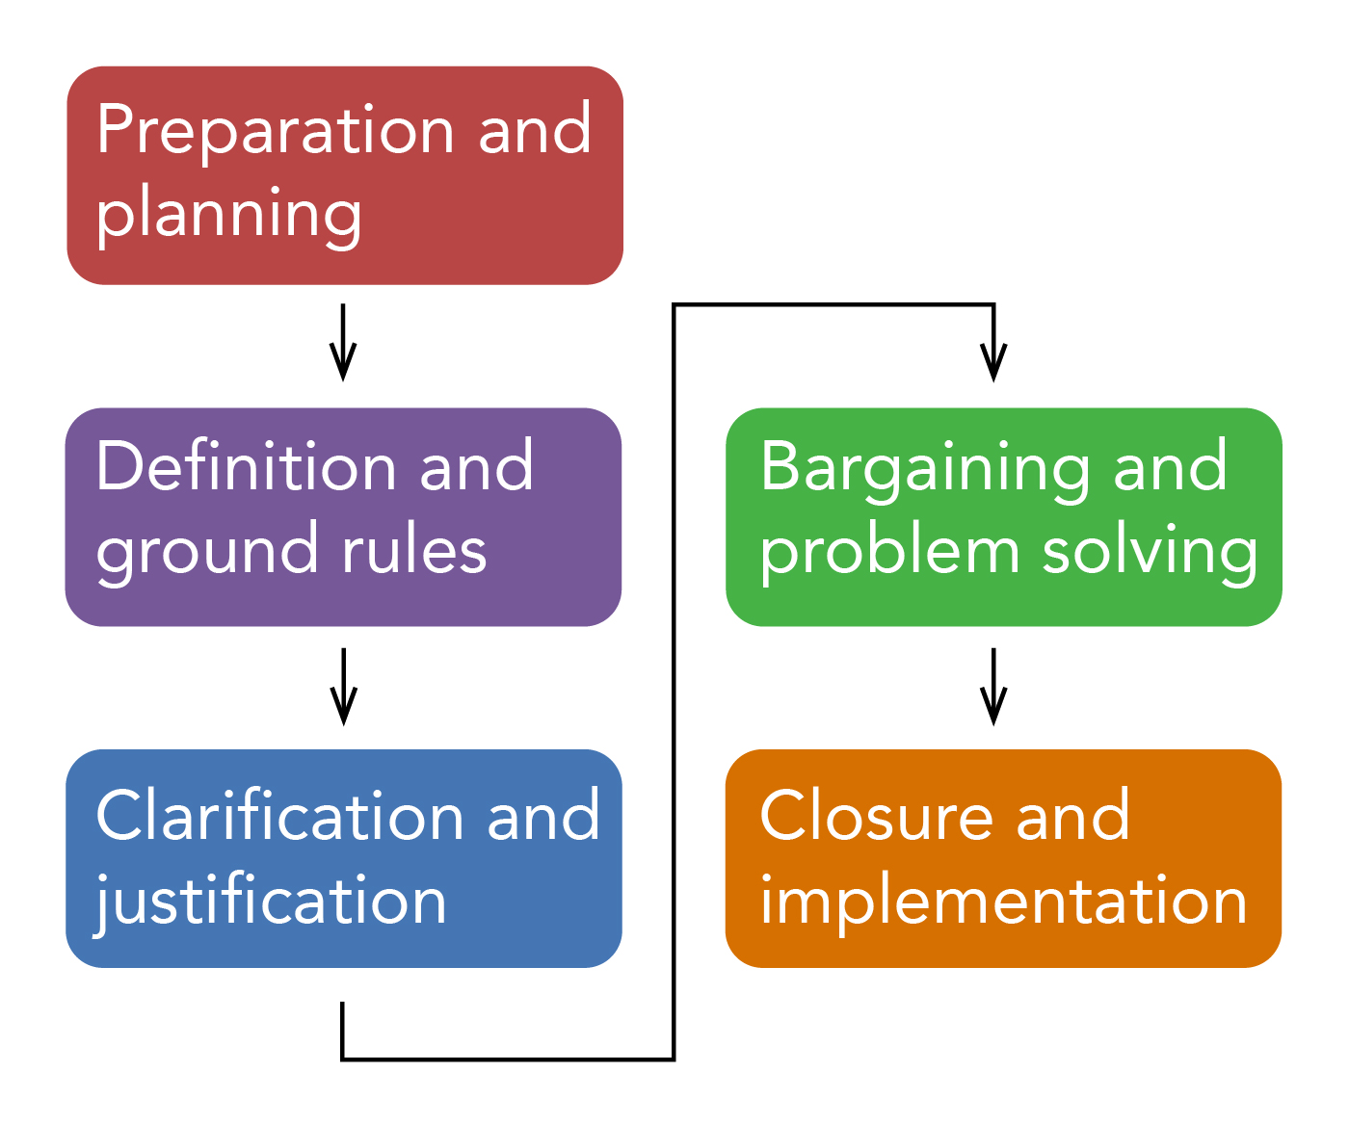
Negotiations Process

Slide 25
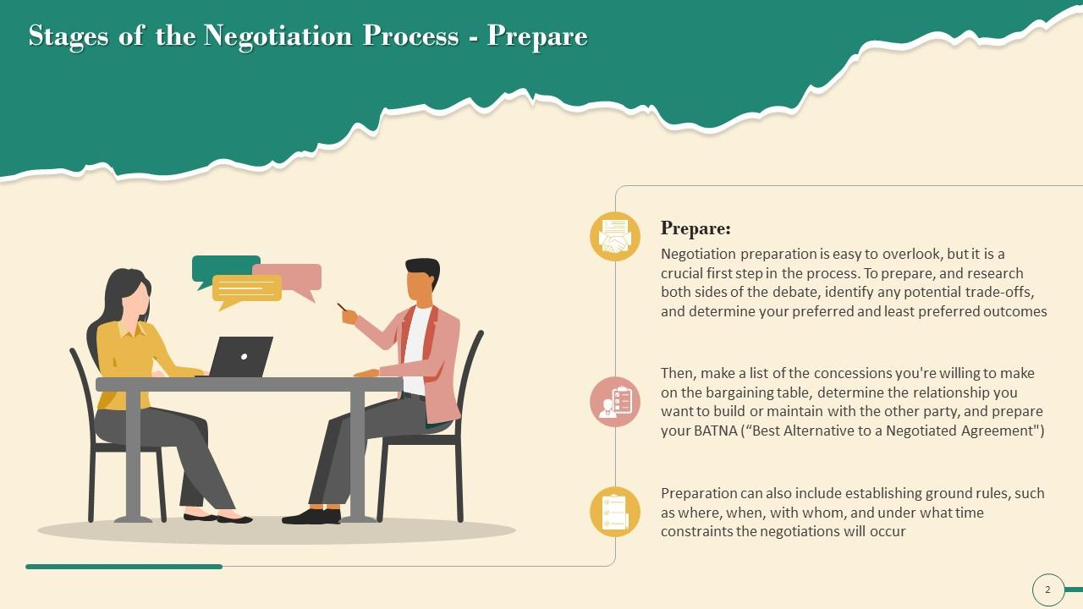
In the preparation and planning stage, you (as a party in the negotiation) need to determine and clarify your own goals in the negotiation. This is a time when you take a moment to define and truly understand the terms and conditions of the exchange and the nature of the conflict. What do you want to walk away with?
You should also take this moment to anticipate the same for the other party. What are their goals in this negotiation? What will they ask for? Do they have any hidden agendas that may come as a surprise to you? What might they settle for, and how does that differ from the outcome you’re hoping for?
Stage
Preparation and Planning
01

Slide 26
To prepare and research both sides of the debate:
Identify any potential trade-offs
Determine your preferred and least preferred outcomes
Make a list of the concessions you’re willing to make on the bargaining table
Determine the relationship you want to build or maintain with the other party.
Prepare your BATNA ( best Alternatives to a Negotiated Agreement)
Stage
Preparation and Planning
01
This stage can include establishing ground rules such as where, when, with whom and under what time constraints the negotiation will occur

Slide 27
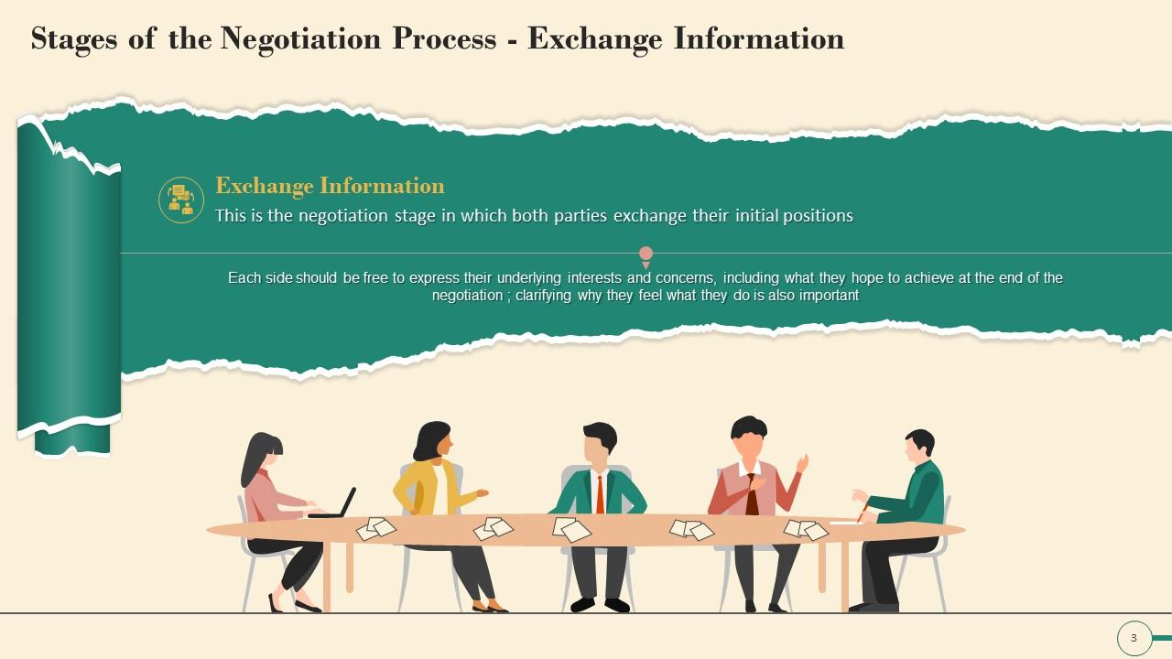
After the planning and strategy development stage is complete, it’s time to work with the other party to define the ground rules and procedures for the negotiation.
Each side should be free to express their underlying interests and concerns
Including what they hope to achieve at the end of negotiation
Clarifying why they feel what they do is also important.
Stage
Definition of Ground Rules
02
Exchange Information stage

Slide 28
This is the time when you and the other party will come to agreement on questions like:
Who will do the negotiating—will we do it personally or invite a third party?
Where will the negotiation take place?
Will there be time constraints placed on this negotiation process?
Will there be any limits to the negotiation?
If an agreement can’t be reached, will there be any specific process to handle that?
Stage
Definition of Ground Rules
02
Exchange Information stage

Slide 29
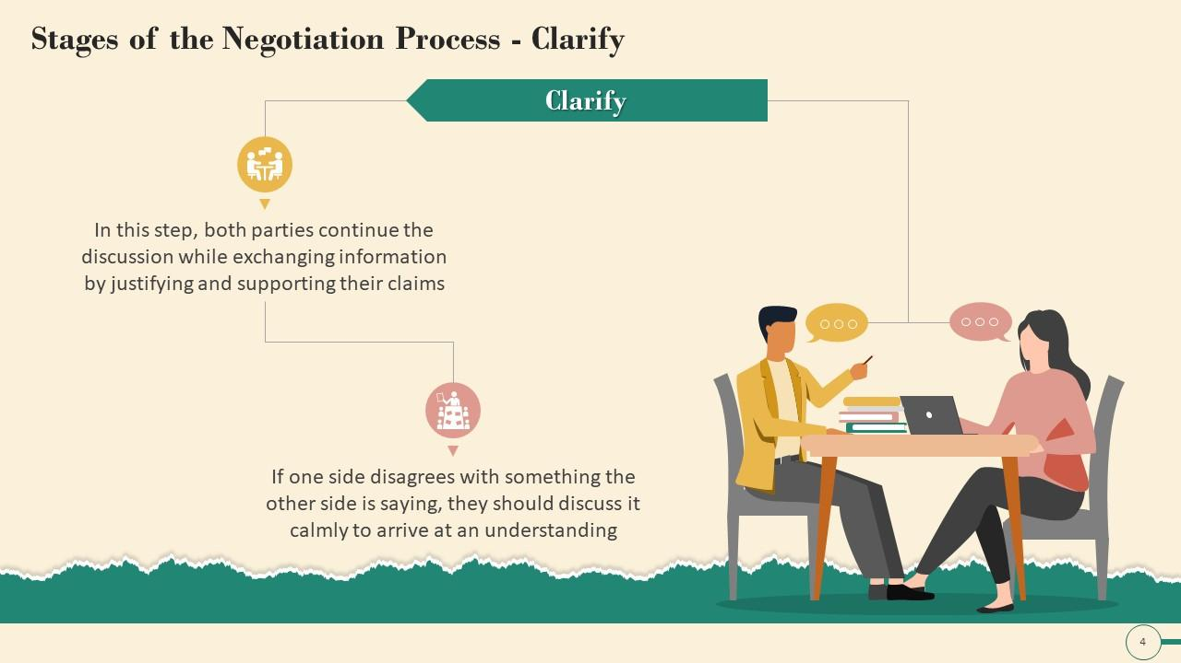
Once initial positions have been exchanged, the clarification and justification stage can begin. Both you and the other party will explain, clarify, bolster and justify your original position or demands. For you, this is an opportunity to educate the other side on your position, and gain further understanding about the other party and how they feel about their side. You might each take the opportunity to explain how you arrived at your current position, and include any supporting documentation. Each party might take this opportunity to review the strategy they planned for the negotiation to determine if it’s still an appropriate approach.
Stage
Clarification and Justification
03

Slide 30
This doesn’t need to be—and should not be—confrontational, though in some negotiations that’s hard to avoid. But if tempers are high moving into this portion of the negotiation process, then those emotions will start to come to a head here. It’s important for you to manage those emotions so serious bargaining can begin.
Stage
Clarification and Justification
03

Slide 31
In this step:
Both parties continue the discussion while exchanging information by justifying and supporting their claims.
If one side disagrees with something the other side is saying, they should discuss it calmly to arrive at an understanding
Stage
Clarification and Justification
03

Slide 32
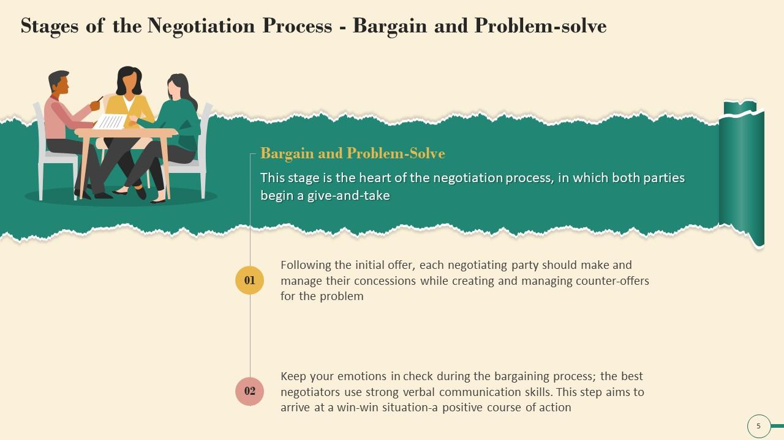
You and the other party will use various negotiation strategies to achieve the goals established during the preparation and planning process. You will use all the information you gathered during the preparation and planning process to present your argument and strengthen your position, or even change your position if the other party’s argument is sound and makes sense.
Stage
Bargaining and Problem Solving
04
This is the essence and the heart of the negotiation process, where the give and take begins

Slide 33
The communication skills of active listening and feedback serve the parties of a negotiation well. It’s also important to stick to the issues and allow for an objective discussion to occur. Emotions should be kept under control. Eventually, both parties should come to an agreement.
Stage
Bargaining and Problem Solving
04
This stage aims to arrive at a win- win situation

Slide 34
Following the initial offers, each negotiating party should make and manage their concessions while creating and managing counter – offers for the problem
Keep your emotions in check during the bargaining process, the best negotiators use strong verbal communication skills
Stage
Bargaining and Problem Solving
04
This stage aims to arrive at a win- win situation

Slide 35
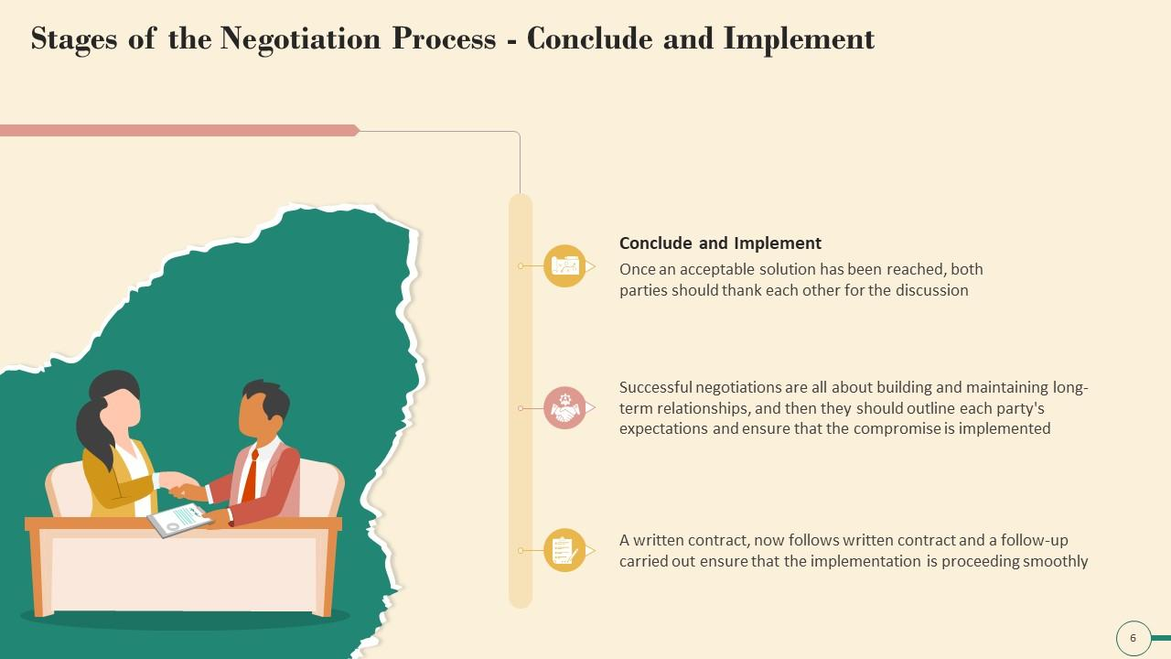
Once an agreement has been met, this is the stage in which procedures need to be developed to implement and monitor the terms of the agreement. They put all of the information into a format that’s acceptable to both parties, and they formalize it
Stage
Closure and Implementation
05

Slide 36
Once an acceptable solution has been reached, both parties should thank each other for the discussion
A written contract now follows written contract and a follow –up carried out ensured that the implementation is proceeding smoothly
Stage
Closure and Implementation
05

Slide 37
Successful negotiations are all about building and maintaining long- term relationships and then they should outline each party’s expectations and ensure that the compromise is implemented

Slide 38

Salesco Case study

Slide 39
A team from a retail organization, Salesco, is looking to purchase widgets for resale directly to the consumer. You lead a team from WholesaleCo and are interested in negotiating an offer to sell these widgets to them at a wholesale cost.

Slide 40
Preparation and Planning.
You know that WholesaleCo will be going up against Other Company, who is likely to outbid you on price. You research, as best you can, the price and quantity Other Company is willing to come to the table with. You also know, from your earlier research, that Salesco is a company that values quality and if they’re going to say no to Other Company, it’ll be because they have a reputation for skimping on quality. Your company produces the better, but more expensive, widget. Armed with this information, you put together your proposal.

Slide 41
2.Definition of Ground Rules.
Salesco, as your customer, has let you know that they expect widgets to be manufactured and delivered in the first quarter of the following year. They’d like to sign with a 25% deposit. Your company usually requires 50% down, but you counter with 30%, provided you have a signed contract before the end of the year, which is approaching quickly. You offer Salesco your proposal. Salesco does not share Other Company’s offer.

Slide 42
3. Clarification and Justification.
Salesco wants to understand more about your deposit requirements, and you’d like to know if your offer is otherwise in the ballpark for them. You reiterate that you provided them the best price you could for the quality product you produce. Salesco assures you your offer is good but they’ll review it further with their legal team

Slide 43
4.Bargaining and Problem Solving.
Salesco understands that WholesaleCo is not providing them the best price but that the quality they look to provide their customers will only come from WholesaleCo, and never OtherCompany. They’d still like to go with a 25% deposit because that’s all they have budgeted for the remainder of the fiscal year. As a representative of Wholesale, you offer to go with a 25% deposit if a second payment can be made at the beginning of the next quarter, which would allow them to pay it out of next year’s budget. Agreements are made.

Slide 44
5. Closure and Implementation.
WholesaleCo makes changes to the contract for the widgets and a representative from Salesco signs. The new contract outlines the changes in the deposit structure, and a full delivery schedule of widgets to Salesco’ distribution centers by an agreed-upon date.

Slide 45
The Influencing Process
The Negotiation Process

Slide 46
Influence is the force a person exerts on another person to change their opinion or alter their behaviors. Leaders frequently use a combination of influence strategies. It is a well-known fact that people who use a wider variety of tactics are typically perceived as having greater power and influence. Leaders have to determine the method that is most likely to influence others by considering the individuals, groups, and situations involved.

Slide 47
The Influencing Process
Influence processes refer to the five ways leaders shape organizational variables including people and resources. The five influence processes are direct decisions, allocation of resources, reward system, selection and promotion of other leaders and role modeling

Slide 48
The Influencing Process
1. Direct decisions
Direct decisions provide the leaders the ability to influence the choices of their followers. This ability to influence comes with the control leaders have in formulating mission and vision aspects of an organization. The most important aspect giving power to leader in the organizational structure is their ability to influence the variables affecting their followers through direct decisions. Leaders’ ability to make decisions influencing organizational structure give them the power to dictate decision making in the organization and set overall direction of the organization.

Slide 49
The Influencing Process
2. Allocation of resources
Leaders make use of their power over various organizational resources such as human, money and technological resources to significantly impact the way work is carried out in an organization. For example if a department is in serious need of funds a leader has the power to grant additional money to the department in addition to the portion allocated to the department in the annual budget.

Slide 50
The Influencing Process
3. Reward system
Leader can make use of their power to reward to influence the actions and behaviors of their employees. A leader can offer monetary incentive to followers in case the followers conform to certain behavioral standards and achieve goals necessary for meeting the overall organization objective

Slide 51
The Influencing Process
4. Selection and promotion of other leaders
Leaders can also influence their followers by making use of their power to promote the leaders who meet individual as well as organizational goals and objectives

Slide 52
The Influencing Process
5. Role modeling
Finally one of the most important ways leaders can mould the behavior and opinion of their followers is by acting as a role model. Followers always follow the path leader is taking. If a leader possesses high moral and ethical standard there are greater chances that their followers will also have high ethical and moral standards.

Slide 53
Avon Corporation Case Study

Slide 54
Direct decisions: The CEO of Avon Corporation, Andrea Jung has taken numerous successful decisions that have changed the image of Avon in the beauty and cosmetics industry. She emphasized the importance of sales force saying that they were at the heart of Avon and that Avon’s future success depends on their efforts. She also strongly emphasized the importance of internet sales. Andrea Jung also worked to change Avon’s traditional focus from the 30-55 year old women to the younger 16-24 year old women citing the reason that this segment of around 17 million women has a purchasing power of over $100. She also eliminated seven layers of management and got rid of 25% of the senior staff

Slide 55
Allocation of resources: Andrea Jung strongly favors allocation of huge budget for the Research and development function of her organization, believing that it has potential to give off higher benefits in return. Andrea Jung’s decision to invest heavily in R&D paid off when the company’s sales increased by 45% in 2004.

Slide 56
Reward system: Sales representatives making huge profits for the company are rewarded with paid holiday trips to eye-catching tourist attractions like Tenerife, Cyprus and Madeira.

Slide 57
Selection and promotion of other leaders: When Andrea Jung took over Avon Corporation there were no women past middle management. Today 85% of Avon’s top management team in U.S. being composed of females

Slide 58
Role modeling: Andrea Jung with her determination, courage and distinctive managerial style is a wonderful role model for coming generations of female leaders.

Slide 59



