Slide 1

Establishing the context
Lecture 6
Everyone’s Smart
University
PMG510
Project Risk Management

Slide 2

Scope of the context
ISO 31000 states that the first stage in the risk management process is to establish the context, which is shown in the Figure below as ‘scope, context, criteria’.

Slide 3
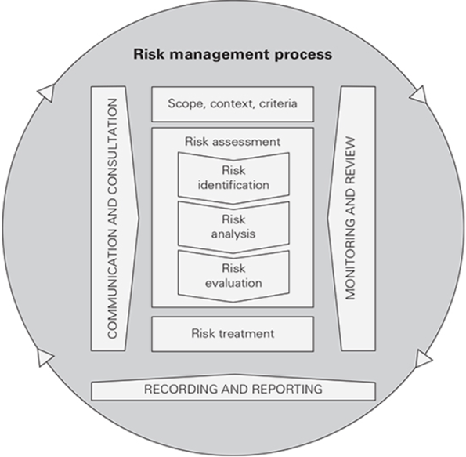
Scope of the context

Slide 4
Scope of the context
The former Australian Standard AS 4360 referred to context as having three components, in addition to the risk management process. These components are the risk management context, internal context and external context.
The relationship between the three contexts is illustrated in the figure below:

Slide 5
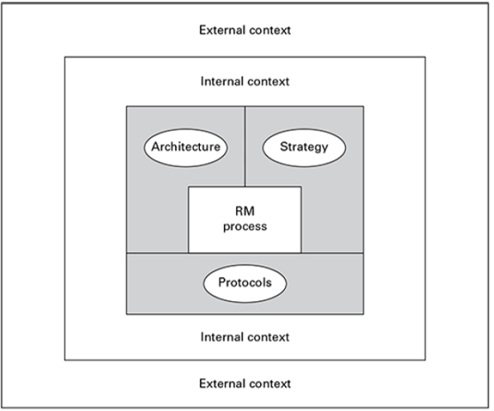

Scope of the context

Slide 6
Scope of the context
The three components of context may be considered as follows:
  Risk management context: architecture, strategy and protocols or the risk management framework. This framework must fulfil two functions: provide support for the risk management process within the organization; ensure that the outputs from the risk management process are communicated to internal and external stakeholders.
  Internal context refers to the organization itself, the activities it undertakes, the range of skills and capabilities available within the organization, and how it is structured. Internal stakeholders and their expectations are part of the internal context.
  External context is the environment within which the organization exists. This environment will include consideration of the business sector within which the organization operates, external stakeholders and their expectations and the external financial environment. This may be considered to be the opportunities and threats.

Slide 7
Scope of the context
The key question is what the risk management process is expected to achieve or the answer to the question of why the organization has risk management activities in place.
The risk management context also includes consideration of who will be responsible and identifies the resources that will be required in order to fulfil risk management activities.
Another important consideration within the risk management context is the establishment of risk appetite or risk criteria.
This will help the organization decide what controls should be put in place and whether the residual or current level of risk is acceptable.

Slide 8
Scope of the context
The internal context is about the culture of the organization, the resources that are available, receiving outputs from the risk management process and ensuring that these influence behaviours, and supporting and providing governance of risk and risk management. The internal context concerns objectives, the capacity and capabilities of the organization, as well as the business core processes that are in place.

Slide 9
Scope of the context
The external context is about stakeholder expectations, industry regulations and regulators, the behaviour of competitors and the general economic environment within which the organization operates. The external context also considers the drivers and trends that can affect the success of the organization and its ability to achieve objectives.

Slide 10
External context
Establishing the context is represented in the ISO 31000 diagram, and reproduced as Figure 6.4, as ‘scope, context, criteria.’
Establishing the context is a fundamentally important aspect of successful risk management.
There are three levels to establishing the context for risk management activity, and these are related to the external context, internal context and the risk management context.

Slide 11
External context
Establishing the external context must take account of the expectations of external stakeholders.
For many organizations, the most important group of external stakeholders will be customers.
The external context for an organization will be significantly influenced by the nature of the customers and the products or services that they are being offered.

Slide 12
External context
Having identified the expectations of external stakeholders, including consideration of customers and the services and products offered to customers, an organization can then view in more detail the factors that influence the external context for the organization. The FIRM risk scorecard provides a structure for carrying out a detailed.

Slide 13
External context
the reputational component of the external context for an organization defines the external perception of the organization and the desire of customers to trade with the organization and the level of customer retention.

Slide 14
External context
when evaluating the reputational component of the external context, the following issues should be addressed:
  public perception of the industry sector in which the organization operates;
  corporate social responsibility standards achieved by the organization;
  governance standards and whether the sector is highly regulated;
  quality of products or services and/or after-sales service standards.

Slide 15
External context
when evaluating the marketplace component of the external environment, the following issues should be addressed:
  level of revenue generation in the marketplace and return on investment;
  presence of aggressive competitors and/or high customer expectations;
  level of economic stability, including exposure to interest rates and foreign exchange rates;
  complexity of the supply chain and volatility of raw material costs;
  exposure to international disruption because of political risks, war and terrorism.

Slide 16
External context
The overall purpose of evaluating the external context is to determine the level of riskiness associated with the external environment within which the organization operates.
This will enable the organization to validate the existing business model and develop strategy for the future, together with the tactics for implementing that strategy.

Slide 17
Internal context
Establishing the internal context of an organization must take account of the expectations of internal stakeholders.
There will be a range of internal stakeholders, but the most important group will be the people on whom the organization directly depends.
This will include members of staff and people providing services on an outsourced, contracted and/or supplier basis.

Slide 18
Internal context
Having identified the expectations of internal stakeholders, including identification of the importance of these stakeholders to the operations and compliance activities of the organization, it will then be possible to view in more detail the factors that influence the internal context.
The financial and infrastructure components are primarily related to the internal context and the reputational and marketplace components are primarily related to the external context.

Slide 19
Internal context
the financial component of the internal context of an organization defines the financial procedures and the means by which money is managed and profitability is achieved. In particular, when evaluating the financial component of the internal context, the following issues should be addressed:
  availability of adequate funds to fulfil strategic plans;
  existence of robust procedures for correct allocation of funds for investment;
  nature of internal financial control environment to prevent fraud;
  availability of funds to meet historical and anticipated future liabilities.

Slide 20
Internal context
The other component relevant to the internal context is infrastructure.
when evaluating the infrastructure component of the internal context, the following issues should be addressed:
  senior management structure and the nature of the risk culture;
  availability of adequate people resources and people skills, including intellectual property;
  availability of adequate physical assets to support operational activities;
  information technology infrastructure sufficient to achieve resilience and protect data;
  business continuity plans in place to ensure continuity of activities following major disruption;
  arrangements for service delivery and/or transportation and reliable communication infrastructure.

Slide 21
Risk management context
The risk attitude and risk appetite of the organization, as defined by the risk criteria for different types of risks, helps to define the risk management context of the organization and to provide the basis for undertaking risk assessments and recording the results in the risk register.
The risk management context must contribute to the success of the organization and be supportive of the delivery of stakeholder expectations, both external and internal.

Slide 22
Risk management context
The purpose of the risk register is to form an agreed record of the significant risks that have been identified.
Also, the risk register will serve as a record of the control activities that are currently undertaken. It will also be a record of the additional actions that are proposed to improve the control of the particular risk.

Slide 23
Using a risk register
A well-constructed and dynamic risk register is at the heart of a successful risk management initiative. However, there is a danger that the risk register may become a static document that records the status of risk management activities at a moment in time.
It is better to think of the risk register as a risk action plan that records the status of the organization with respect to risk management, but also provides a record of the critical controls that are in place, together with the details of any additional controls that need to be introduced. In producing such a risk action plan, the responsibility for undertaking the actions identified will be clearly established.

Slide 24
Using a risk register
the information held in the risk register may be available on the intranet of the organization, and this will help with risk understanding and communication.
In some organizations, the risk register is given the status of a controlled document to be used by internal audit as one of the key reference documents for undertaking an audit of risk management activities.

Slide 25
Using a risk register
Details of the risks faced by the project, as recorded in the risk register, should be discussed at every project review meeting.
A project risk register has to be a very dynamic document.
formal. When a strategic decision has to be taken at board level, the risk assessment of that strategy should be attached to the proposal.

Slide 26
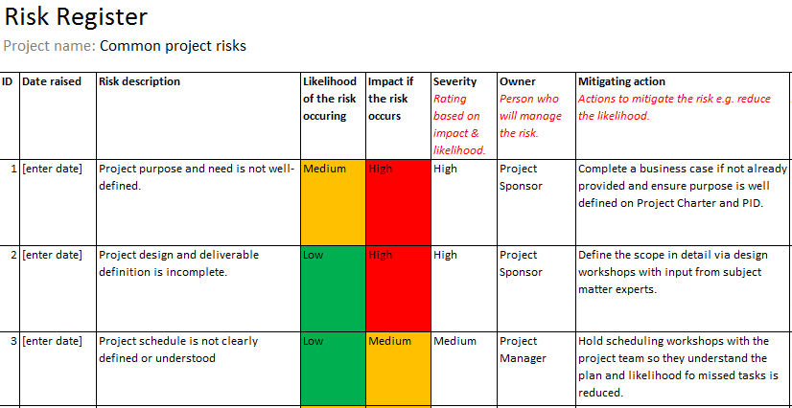
Using a risk register

