Slide 1


Human Resources
Analytics
Prepared by Dr. Samah Abdelfatah
HRM 623
Lecture 4

Slide 2



MORE THAN COMPENSATION
Chapter
03
Lecture 04
HRM 623
Prepared by
Dr. Samah Abdelfatah
www.midocean.ae

Slide 3

Chapter
MAIN TOPICS
03
Attracting, motivating, and retaining employees, now and in the future—The Role of a Global Association— Why Analytics Is Important —Total-Rewards Model
www.midocean.ae

Slide 4
ATTRACTING,MOTIVATING, AND RETAINING EMPLOYEES,NOW AND IN THE FUTURE
Chapter
03
Total rewards: All of the tools available to an employer that may be used to attract, motivate, and retain employees.
Total rewards can include anything the employee perceives to be of value resulting from the employment relationship
www.midocean.ae

Slide 5
Chapter
03
THE ROLE OF A GLOBAL ASSOCIATION
In 2000, after facilitating a discussion with leading thinkers in the field, WorldatWork introduced its first total-rewards framework intended to advance the concept and help practitioners think and execute in new ways.
The model focused on three elements:
Compensation
Benefits
The work experience: acknowledgment, balance (of work and life), culture, development (career/professional), and environment (workplace)
www.midocean.ae

Slide 6
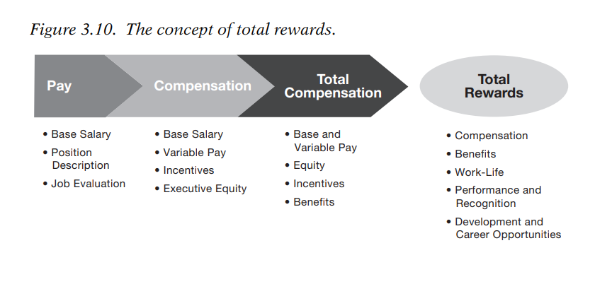
Chapter
THE CONCEPT OF TOTAL REWARDS
03
www.midocean.ae

Slide 7
THE ASSOCIATION’S FIRST TOTAL-REWARDS MODEL (2000)
Chapter
03
By mid-decade, survey data from WorldatWork members revealed that professionals were primarily using the terms total rewards, total compensation, or compensation and benefits to describe the collective strategies deployed by their companies to attract, motivate, and retain talent, as shown in Figure 3.11.
www.midocean.ae

Slide 8
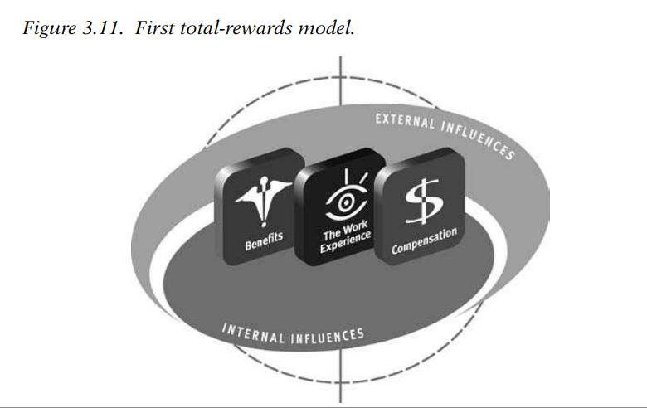
The Association’s First Total-Rewards Model (2000)
www.midocean.ae

Slide 9
Chapter
THE NEW TOTAL REWARD MODEL
03
The new model contained five total-rewards elements, each of which included programs, practices, elements, and dimensions that collectively defined an organization’s strategy to attract, motivate, and retain employees.
The five elements were: compensation, benefits, work life, performance and recognition, and development and career opportunities.
www.midocean.ae

Slide 10
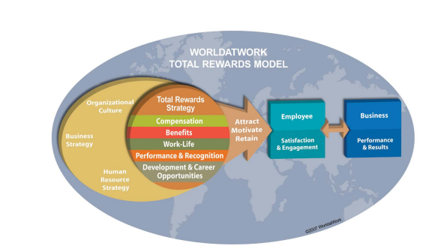
THE NEW TOTAL REWARD MODEL
www.midocean.ae

Slide 11

COMPENSATION
Includes fixed (base) pay and variable pay (pay at risk).
Also includes several forms of variable pay, such as short- and long-term incentives.
The most traditional element in total rewards and a key to business success
Chapter
03
www.midocean.ae

Slide 12

BENEFITS
Benefits: Programs that protect employees and their families from financial risks.
Includes traditional programs such as medical, dental, and retirement,
as well as newer, nontraditional programs such as identity theft and pet insurance.
Chapter
03
www.midocean.ae

Slide 13

WORK LIFE
Work life: Any programs that help employees do their job effectively, such as flexible scheduling, telecommuting, and child-care programs.
Some organizations have indicated that work life is the ‘‘secret’’ to their success in attracting, motivating, and retaining talent.
Chapter
03
www.midocean.ae

Slide 14

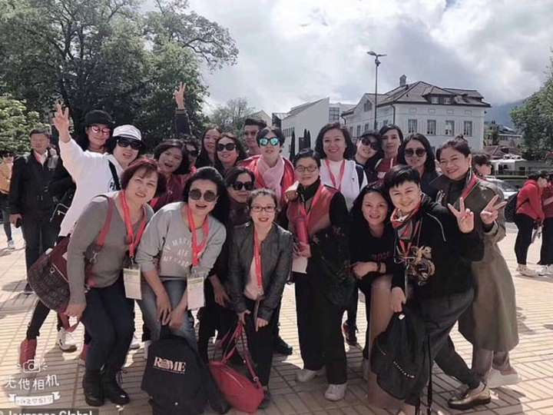

PERFORMANCE AND RECOGNITION
Performance and Recognition: The alignment of organizational and individual goals toward business success.
Recognition is a way for employers to pay special attention to workers for their accomplishments, behaviors, and successes.
It reinforces the value of performance improvement and fosters positive communication and feedback.
Recognition can be programmatic or cultural in its execution.
Chapter
US company rewards its employees with $ 100,000 per person
A Chinese company rewards its employees by traveling to Switzerland
And another one rewards them with a 5-star trip to the Maldives
03
www.midocean.ae

Slide 15

DEVELOPMENT AND CAREER OPPORTUNITIES
The concept of motivating and
engaging the workforce through planning for the advancement and/or change in responsibilities to best suit individual skills, talents, and desires.
Tuition assistance, professional development, sabbaticals, coaching and mentoring opportunities, succession planning, and apprenticeships are all
examples of career-enhancement programs.
Chapter
03
www.midocean.ae

Slide 16
Chapter
THE CONCEPT OF TOTAL REWARDS
03
The concept of total rewards strives to cause employees to behave in a way that achieves the highest performance levels.
Motivation comprises two types:
Intrinsic Motivation.
Extrinsic Motivation.
Linked to factors that include an employee’s sense of achievement, respect for the whole person, trust, and appropriate advancement opportunities, intrinsic motivation consistently results in higher performance levels.
Most frequently associated with tangible rewards such as pay, working conditions, co-worker relations, benefits, and such.
www.midocean.ae

Slide 17
Chapter
APPLYING A TOTAL-REWARDS MODEL
03
Some companies are beginning to brand their own versions of total rewards—a type of ‘‘internal branding’’ that seems the next move in this field
Notre Dame University promotes total rewards to its employees compensation to top performers.
Dominos pizza encourages employees to get their ‘‘piece of the pie,’’ referring to its variety of rewards programs. Reportedly, the company extends the pizza analogy to its employee collateral materials, showing how various elements of its programs can be combined to customize a ‘‘benefits pizza.’’
Starbucks has branded its total rewards concept as ‘‘your special blend,’’ again, making an obvious play on its coffee products. ‘‘Your special blend’’ indicates the ability that employees have to customize their total-rewards offering.
www.midocean.ae

Slide 18
HUMAN CAPITAL AND
BUSINESS MANAGEMENT FOR
SUSTAINABILITY
Chapter
03
Human Capital Management Survey, aimed at understanding the discriminators on people management among the best companies in Brazil.
The companies’ scores in the survey are based on the following pillars:
* Business value creation
* Safety and health
* Labor and union relationships
* Retention
* Equity and internal income distribution
* Learning, training, and development
* HR professionals and HR team
www.midocean.ae

Slide 19
Chapter
COMPANY MISSION, VISION, AND VALUES
03
The identified values include:
*Teamwork
* Respect for the internal and external client
*Innovation
* Respect for the employees
* Individual and group responsibility
* Common good
* Commitment
* Ethics
* Respect for the environment
www.midocean.ae

Slide 20
Chapter
COMPANY MISSION, VISION, AND VALUES
03
In each case, it is considered critical that
(1) all employees understand and, furthermore, commit themselves to the company’s mission and vision.
(2) that they put these values into daily practice.
For these companies, HR is responsible for communicating these principles to every new employee, ensuring full understanding and maintenance. Management has the responsibility to disseminate and guarantee these practices in all levels of the organization. In practice, there is constant focus on adding value to all that is done.
www.midocean.ae

Slide 21
HR STRATEGIES
AND BEST PRACTICES
Chapter
03
The role of HR is to attract, maintain, develop, and retain people; strengthen attitudes and behaviors aligned to the company’s strategy and culture; and give meaning to work, generating pride in the team’s accomplishments, facilitating organizational changes, and fostering learning and human growth via new scenarios aligned to values and company culture
www.midocean.ae

Slide 22
HR STRATEGIES
AND BEST PRACTICES
Chapter
03
HR pursues the following points of excellence:
Alignment focused on the company’s strategic planning
Speed in problem solving
High quality in techniques, methodologies, systems, and people support
Information system to properly support strategic decisions
www.midocean.ae

Slide 23
HR STRATEGIES
AND BEST PRACTICES
Chapter
03
HR departments, though they adopt different processes, programs, and systems to attract and retain excellent people who are committed and engaged with the company through the following:
*Integration and company culture acquisition
* Performance development and evaluation
* Internal acquisition, career, and succession
* Leadership development
* Climate management and quality of life
* Communication: listen, listen, listen
* Learning organization
www.midocean.ae

Slide 24
Chapter
A PARTNERSHIP BETWEEN HR AND EXECUTIVES
03
HR function acts as a strategic partner for the line managers
HR works with simplicity and objectivity
In all of the best companies, leaders are responsible for people management and they share the final decisions with HR, which provides instruments, methodology, and systems to support the whole process
www.midocean.ae

Slide 25
Chapter
COMMUNICATIONS WITH THE EMPLOYEES
03
The best companies assume that communication is an integral part of achieving planned results.
Key actions in this area are keeping the employees informed about all relevant matters, with speed and transparency, and evaluating the effectiveness of the ongoing process.
There is freedom of expression in all levels, on all topics.
Communications happen naturally and are multidirectional
www.midocean.ae

Slide 26
ORGANIZATIONAL CLIMATE MANAGEMENT
Chapter
03
All the best companies manage their organizational climate and show results above 80 percent for responses to the survey question, ‘‘Are you proud to belong to . . . ?’’
For all companies, it is important that there be a healthy relationship between the executives and employees, in all levels and directions. Solid leadership is fundamental in this process, as good internal relationships.
www.midocean.ae

Slide 27
Chapter
SUSTAINABILITY ACTIONS
03
All companies follow sustainability guidelines that are part of a complete chain linking the internal community, customers/suppliers, and the external community/society/environment.
Guidelines for action start with employee participation: The social responsibility is shared, which enhances the employees’ feelings of ‘‘belonging.’’
www.midocean.ae

Slide 28
Chapter
GOING BEYOND THE ‘‘WHAT’’ TO THE ‘‘HOW’’
03
The best management practice is not always the same for those that operate in the same economic sector or in the same region.
Best practices rely exclusively on an enlightened way of being, thinking, feeling, and wanting.
This way is unique to each company .
It’s imperative to understand how these results have been achieved.
www.midocean.ae

Slide 29
Chapter
GOING BEYOND THE ‘‘WHAT’’ TO THE ‘‘HOW’’
03
The‘ ‘how’’ of good HR management naturally respects the individual company’s particular way of doing business, so knowing the culture of an organization is essential to ensuring people’s commitment to sustainable development
In these best companies, there has been a search for coherence between theory and practice.
www.midocean.ae

Slide 30
Chapter
GOING BEYOND THE ‘‘WHAT’’ TO THE ‘‘HOW’’
03
For them, success has been the result of healthy internal relations; engagement; and commitment to the common goal, a sharing of values and principles, and overall caring for the company.
More than systems and processes, it has been relationships that have made the DNA workforce different.
A good working environment and healthy relationships guided by respect and genuine interest promote the integration and strengthening of a group that feels proud to belong.
www.midocean.ae

Slide 31
HUMAN RESOURCES VERSUS HUMAN
CAPITAL PLANNING
Chapter
04
HCM:21, or the new HR model, is shown in Figure 4.1. This management model for human capital development is an integrated, comprehensive approach that aligns each HR function with the business vision, values, and plan, as well as with each other HR function.
www.midocean.ae

Slide 32
HUMAN RESOURCES VERSUS HUMAN
CAPITAL PLANNING
Chapter
04
Models are common in organizations.
Production has a model for managing material and processes.
Finance has a model for managing cash flow.
Marketing has a model for managing customer relations.
Information technology has a model for delivering data and intelligence.
However, human resources’ traditional ‘‘operating model’’ can be compared to the man who jumped on his horse and rode off in all directions.
www.midocean.ae

Slide 33
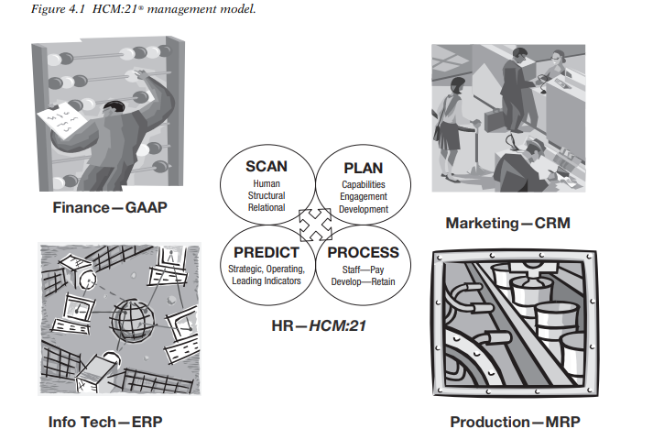
Chapter
www.midocean.ae

Slide 34
The Why of HCM: Capability Planning
Chapter
04
HCM can be integrated only if we think beyond HR processes
With the results of the environmental scan, described earlier in you can begin to design a capability plan
With capability planning, the focus is on the success of the organization. Your conclusions and recommendations are driven by the data you collected in the scan and your risk assessment.
Capability planning is a live, ongoing program. It doesn’t happen once a year and then shut down, the way workforce planning does.
Your organization must function at a high level, no matter what the future may bring.
www.midocean.ae

Slide 35
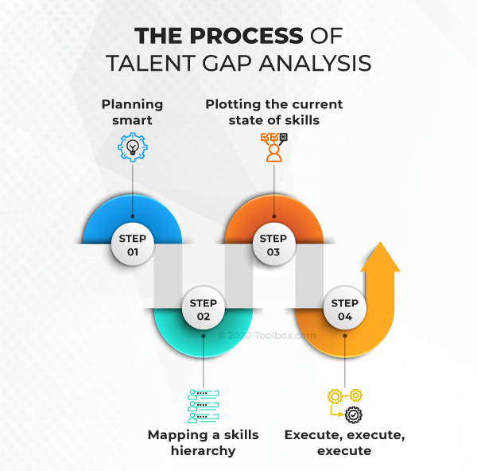
www.midocean.ae

Slide 36
THE SEGMENTATION OF SKILLS
Chapter
04
Capability planning starts with skills segmentation.
While all people are important, all skills are not of equal importance. Instead, subdivide the workforce into four categories, in terms of valued capabilities
www.midocean.ae

Slide 37
Chapter
THE SEGMENTATION OF SKILLS
04
Mission Critical. A few capabilities are absolutely key to ongoing
success. If you think about it you know what these are. They can relate to technology, leadership, finance, sales, production, or anything else that represents a make-or-break situation. The question is, do you currently have sufficient mission-critical capabilities in place? Do you have backups being developed? This is where you start capability planning
www.midocean.ae

Slide 38
THE SEGMENTATION OF SKILLS
Chapter
04
Differentiating. Given your current or desired future market position, which capabilities separate your organization from the competition? These can be unique technical, financial, service, or knowledge that only your organization has or needs to acquire.
These often augment the mission-critical capabilities, but are not identical.
www.midocean.ae

Slide 39
THE SEGMENTATION OF SKILLS
Chapter
04
Operational. Certain skills are necessary to keep the operation
going. These are often characterized as administrative and maintenance, but also include technical skills. At times they are taken for granted or ignored. They need to be reviewed as insurance, as their absence would reduce efficiency, impair timely response to customer needs, and increase operating costs.
www.midocean.ae

Slide 40
THE SEGMENTATION OF SKILLS
Chapter
04
Movable. As markets, customers, and products change, some skills
become less important or even obsolete.
Companies sometimes forget this and allow these to remain, causing operational expenses to build.
This situation became such a massive problem in the 1980s that American businesses had to lay off 3 million people to regain competitive cost structures. People in these positions need to be retrained, reassigned, or let go, and the processes outsourced, if needed at all.
www.midocean.ae

Slide 41
THE SEGMENTATION OF SKILLS
Chapter
04
So, the question is: What new capabilities do you need to acquire or
build to meet changing market trends?
Changes in technology, customers, market niches, competition, or other forces signal this need to develop new capabilities.
At this initial point, you are better able to build the scenarios for planning, acquiring, deploying, developing, and retaining those new capabilities.
Next Lecture we will be dealing with this topic
www.midocean.ae

Slide 42



Thank You

