Slide 1


Project Time Management
مقرر: إداره وقت المشروع
Prepared by Dr. Amira Elfekky
PMG 212
Lecture 4

Slide 2

Agenda
Projects Life Cycle
The Stage-Gate Process
The Stage-Gate Main Roles
The Stage-Gate Checklists
Gatekeepers
The Stage-Gate Most Common Decisions
The Major Benefits of the Stage-Gate
Pitfalls That May Disrupt the Process
The Stage-Gate Vs life-cycle
www.midocean.ae

Slide 3
Agenda
Projects Life Cycle
The Stage-Gate Process
The Stage-Gate Main Roles
The Stage-Gate Checklists
Gatekeepers
The Stage-Gate Most Common Decisions
The Major Benefits of the Stage-Gate
Pitfalls That May Disrupt the Process
The Stage-Gate Vs life-cycle
www.midocean.ae

Slide 4
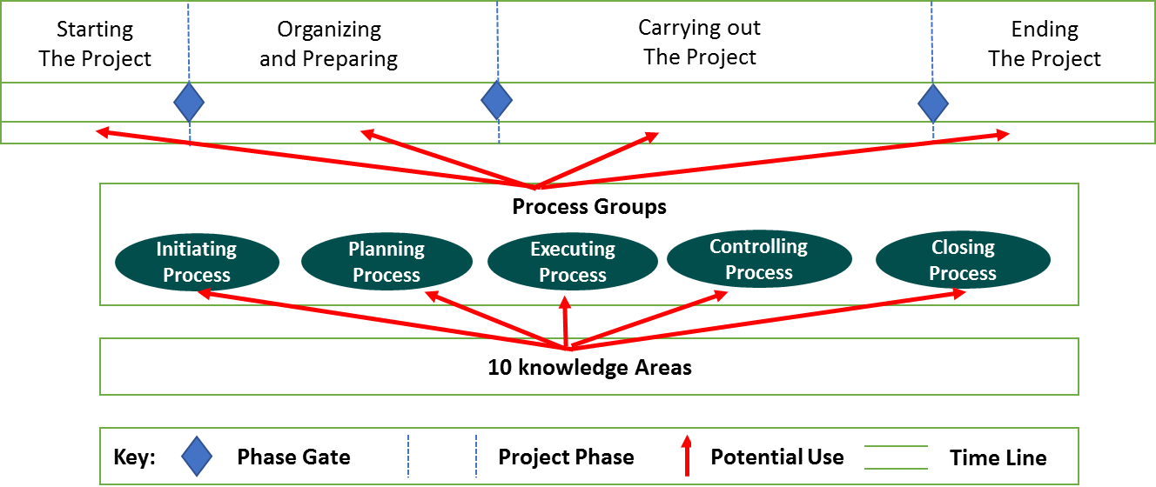
Chapter
Projects Life Cycle
4
www.midocean.ae

Slide 5
Agenda
Projects Life Cycle
The Stage-Gate Process
The Stage-Gate Main Roles
The Stage-Gate Checklists
Gatekeepers
The Stage-Gate Most Common Decisions
The Major Benefits of the Stage-Gate
Pitfalls That May Disrupt the Process
The Stage-Gate Vs life-cycle
www.midocean.ae

Slide 6
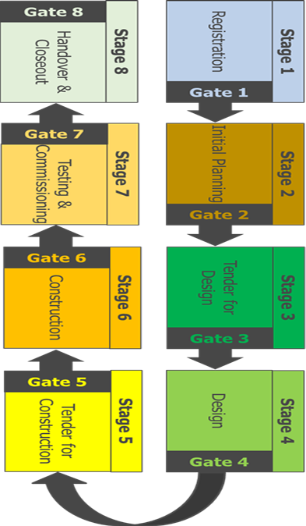
Chapter
The Stage-Gate Process
4
Provides a project delivery systematic process
1
Contains a list of critical deliverables for each of the 8 stages over the life cycle of the project
2
Ensures that a project does not proceed unless key stage deliverables are completed
3
www.midocean.ae

Slide 7
Chapter
The Stage-Gate Process
4
Allows project stakeholders to make a responsible decision on project advancement to the next stage
4
Responsible and educated decision making based on facts on which projects proceed
5
6
Eliminate risks as project goes from stage to stage
www.midocean.ae

Slide 8
Agenda
Projects Life Cycle
The Stage-Gate Process
The Stage-Gate Main Roles
The Stage-Gate Checklists
Gatekeepers
The Stage-Gate Most Common Decisions
The Major Benefits of the Stage-Gate
Pitfalls That May Disrupt the Process
The Stage-Gate Vs life-cycle
www.midocean.ae

Slide 9
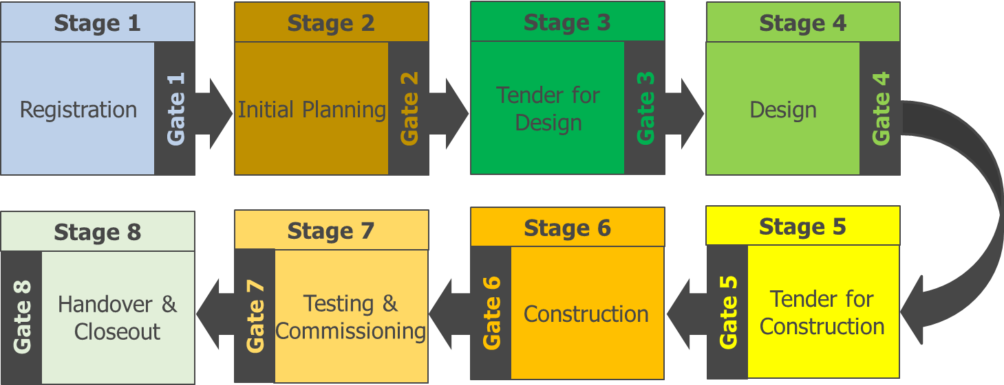
Chapter
The Stage-Gate Main Roles
4
Align Kick-off meeting and Gate Review Meeting to the project schedule
Participate in the kick-off meeting
Approve the stage deliverables.
Decide on “Go / No-go” to the next stage.
Assign the Gate Coordinator.
Gate Keeper
www.midocean.ae

Slide 10
Chapter
The Stage-Gate Main Roles
4
Establish the Gate Committee.
Issue the Stage Gate Checklist.
Chair the Stage Kick-off Meeting.
Finalize the Stage Deliverable Checklist
Gate Coordinator
www.midocean.ae

Slide 11
Chapter
The Stage-Gate Main Roles
4
Schedule the Gate Review Meeting
Chair the Gate Review Meeting
Prepare the Gate Review Summary sheet
Coordinate resolution of any deliverable deficiencies with Functional Departments
Gate Coordinator
www.midocean.ae

Slide 12
Chapter
The Stage-Gate Main Roles
4
Participate in the Stage Kick-off Meeting.
Agree on the Stage Deliverable Checklist.
Confirm all Gate deliverables are complete.
Typical make-up: Project level Functional Department representatives from Engineering, Construction, Safety, Contracts, Quality, etc.
Gate Committee
www.midocean.ae

Slide 13
Chapter
The Stage-Gate Main Roles
4
Functional Departments
Agree on the key stage deliverables.
Complete the assigned stage deliverables.
Support the Gate Committee by resolving any deliverable deficiencies.
www.midocean.ae

Slide 14
Chapter
The Stage-Gate Process
4
The stage-gate process was created because the traditional organizational structure was designed primarily for top-down, centralized management, control, and communications, all of which were no longer practical for organizations that use project management and horizontal work flow.
www.midocean.ae

Slide 15
Chapter
The Stage-Gate Process
4
stage-gate process eventually evolved into life-cycle phases. Just as the words imply, the process is composed of stages and gates.
Stages are groups of activities that can be performed either in series or parallel based upon the magnitude of the risks the project team can endure.
The stages are managed by cross-functional teams.
www.midocean.ae

Slide 16
Chapter
The Stage-Gate Process
4
The gates are structured decision points at the end of each stage.
Good project management processes usually have no more than six gates.
With more than six gates, the project team focuses too much attention on preparing for the gate reviews rather than on the actual management of the project.
www.midocean.ae

Slide 17
Chapter
The Stage-Gate Process
4
Project management is used to manage the stages between the gates, and can shorten the time between the gates.
This is a critical success factor if the stage-gate process is to be used for the development and launch of new products.
A good corporate methodology for project management will provide checklists, forms, and guidelines to make sure that critical steps are not omitted.
www.midocean.ae

Slide 18
Agenda
Projects Life Cycle
The Stage-Gate Process
The Stage-Gate Main Roles
The Stage-Gate Checklists
Gatekeepers
The Stage-Gate Most Common Decisions
The Major Benefits of the Stage-Gate
Pitfalls That May Disrupt the Process
The Stage-Gate Vs life-cycle
www.midocean.ae

Slide 19
Chapter
The Stage-Gate Checklists
4
Checklists for gate reviews are critical. Without these checklists, project managers can waste hours preparing gate review reports. Good checklists focus on answering these questions:
● Where are we today (i.e., time and cost)?
● Where will we end up (i.e., time and cost)?
● What are the present and future risks?
● What assistance is needed from management?
www.midocean.ae

Slide 20
Agenda
Projects Life Cycle
The Stage-Gate Process
The Stage-Gate Main Roles
The Stage-Gate Checklists
Gatekeepers
The Stage-Gate Most Common Decisions
The Major Benefits of the Stage-Gate
Pitfalls That May Disrupt the Process
The Stage-Gate Vs life-cycle
www.midocean.ae

Slide 21
Chapter
Gatekeepers
4
Project managers are never allowed to function as their own gatekeepers.
The gatekeepers are either individuals (i.e., sponsors) or groups of individuals designated by senior management and empowered to enforce the structured decision-making process.
www.midocean.ae

Slide 22
Chapter
Gatekeepers
4
The gatekeepers are authorized to evaluate the performance to date against predetermined criteria and to provide the project team with additional business and technical information.
Gatekeepers must be willing to make decisions
www.midocean.ae

Slide 23
Agenda
Projects Life Cycle
The Stage-Gate Process
The Stage-Gate Main Roles
The Stage-Gate Checklists
Gatekeepers
The Stage-Gate Most Common Decisions
The Major Benefits of the Stage-Gate
Pitfalls That May Disrupt the Process
The Stage-Gate Vs life-cycle
www.midocean.ae

Slide 24
Chapter
The Stage-Gate Most Common Decisions
4
The four most common decisions are:
● Proceed to the next gate based upon the original objectives
● Proceed to the next gate based upon revised objectives
● Delay making a gate decision until further information is obtained
● Cancel the project
www.midocean.ae

Slide 25
Chapter
The Stage-Gate Most Common Decisions
4
Sponsors must also have the courage to terminate a project. The purpose of the gates is not only to obtain authorization to proceed, but to identify failure early enough so that resources will not be wasted but will be assigned to more promising activities.
www.midocean.ae

Slide 26
Agenda
Projects Life Cycle
The Stage-Gate Process
The Stage-Gate Main Roles
The Stage-Gate Checklists
Gatekeepers
The Stage-Gate Most Common Decisions
The Major Benefits of the Stage-Gate
Pitfalls That May Disrupt the Process
The Stage-Gate Vs life-cycle
www.midocean.ae

Slide 27
Chapter
The Major Benefits of the Stage-Gate:
4
● Providing structure to project management
● Providing possible standardization in planning, scheduling, and control (i.e., forms, checklists, and guidelines)
● Allowing for a structured decision-making process
www.midocean.ae

Slide 28
Agenda
Projects Life Cycle
The Stage-Gate Process
The Stage-Gate Main Roles
The Stage-Gate Checklists
Gatekeepers
The Stage-Gate Most Common Decisions
The Major Benefits of the Stage-Gate
Pitfalls That May Disrupt the Process
The Stage-Gate Vs life-cycle
www.midocean.ae

Slide 29
Chapter
Pitfalls That May Disrupt the Process:
4
● Assigning gatekeepers and not empowering them to make decisions
● Assigning gatekeepers who are afraid to terminate a project
● Denying the project team access to critical information
● Allowing the project team to focus more on the gates than on the stages
www.midocean.ae

Slide 30
Agenda
Projects Life Cycle
The Stage-Gate Process
The Stage-Gate Main Roles
The Stage-Gate Checklists
Gatekeepers
The Stage-Gate Most Common Decisions
The Major Benefits of the Stage-Gate
Pitfalls That May Disrupt the Process
The Stage-Gate Vs life-cycle
www.midocean.ae

Slide 31
Chapter
The Stage-Gate Vs life-cycle
4
The stage-gate process appears to have been replaced by life-cycle phases. Although there is some truth in this, the stage-gate process is making a comeback.
Since the stage-gate process focuses on decision-making more than life-cycle phases, the stage gate process is being used as an internal, decision-making tool within each of the lifecycle phases.
www.midocean.ae

Slide 32
Chapter
The Stage-Gate Vs life-cycle
4
The advantage is that, while life-cycle phases are the same for every project, the stage-gate process can be custom-designed for each project to facilitate decision making and risk management.
The stage-gate process is now an integral part of project management, whereas previously it was used primarily for new product development efforts.
www.midocean.ae

Slide 33
Chapter
The Stage-Gate Vs life-cycle
4
Every program, project, or product has certain phases of development known as life-cycle phases.
A clear understanding of these phases permits managers and executives to better control resources to achieve goals.
www.midocean.ae

Slide 34

www.midocean.ae

Slide 35


Thank You

