Slide 1


Entrepreneurial Leadership & Organizational Behaviour
ENT 612
Master of Entrepreneurship Program
Introduction

Slide 2
Lecture 7
Organizational Behaviour

Slide 3
Lecture 7
The previous lecture covered the following topics
Organizational Behavior (OB) Defined
Effective versus Successful Managerial Activities
Complementing Intuition with Systematic Study
Systematic study
Disciplines That Contribute to the OB Field
Challenges and Opportunities for OB
Coming Attractions: Developing An OB Model
Attitudes and Stress
Task Performance
Organizational Citizenship Behavior (OCB)
Diversity in Organizations

Slide 4
Lecture 7
This lecture covers the following topics
Dimensions of Intellectual Ability
General mental ability (GMA)
Intellectual Ability and Job Satisfaction
Physical Abilities
Implementing Diversity Management Strategies
Positive diversity climate
Diversity management
Diversity in Groups
Diversity Programs
Attitudes and Job Satisfaction
The three components of an attitude.

Slide 5
Lecture 7
Dimensions of Intellectual Ability
Ability
An individual’s capacity to perform the various tasks in a job.
Intellectual abilities
The capacity to do mental activities—thinking, reasoning, and problem solving.
Dimensions of Intellectual Ability
The seven most frequently cited dimensions making up intellectual abilities are number aptitude, verbal comprehension, perceptual speed, inductive reasoning, deductive reasoning, spatial visualization, and memory. Exhibit 2-2 describes these dimensions.

Slide 6
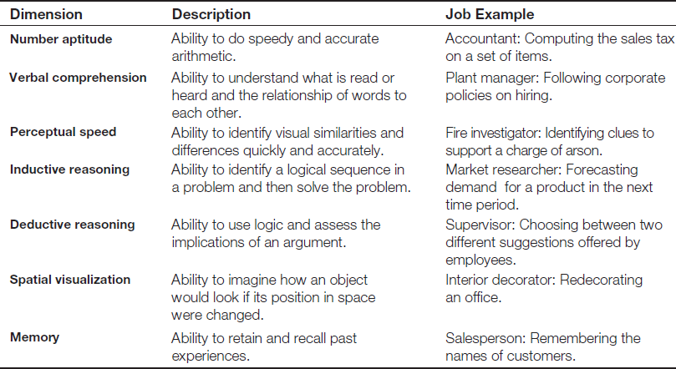
Lecture 7
Dimensions of Intellectual Ability

Slide 7
Lecture 7
General mental ability (GMA)
An overall factor of intelligence, as suggested by the positive correlations among specific intellectual ability dimensions.
Intellectual Ability and Job Satisfaction
While intelligence is a big help in performing a job well, it doesn’t make people happier or more satisfied with their jobs. Why not? Although intelligent people perform better and tend to have more interesting jobs, they are also more critical when evaluating their job conditions. Thus, smart people have it better, but they also expect more.

Slide 8
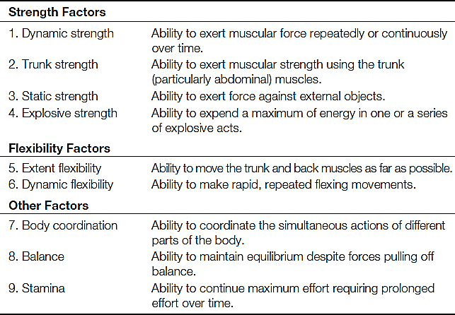
Lecture 7
Physical Abilities
Though the changing nature of work suggests intellectual abilities are increasingly important for many jobs, physical abilities have been and will remain valuable. Research on hundreds of jobs has identified nine basic abilities needed in the performance of physical tasks. These are described in Exhibit 2-3. High employee performance is likely to be achieved when the extent to which a job requires each of the nine abilities matches the abilities of employees in that job.

Slide 9
Lecture 7
Types of Physical Abilities
Physical abilities
The capacity to do tasks that demand stamina, dexterity, strength, and similar characteristics.
Organizations are increasingly aware that an optimally productive workforce includes all types of people and does not automatically exclude anyone on the basis of broad categories of abilities. For example, a pilot program of software company SAP in Germany, India, and Ireland has found that employees with autism perform excellently in precision-oriented tasks like debugging software. The potential benefits of diversity are enormous for forward-thinking managers. Of course, integrating diverse people into an optimally productive workforce takes skill. We discuss how to bring the talents of a div­erse workforce together in the next section.

Slide 10
Lecture 7
Implementing Diversity Management Strategies
Implementing Diversity Management Strategies
As we mentioned before, discrimination—for any reason—leads to increased turnover, which is detrimental to organizational performance. While a better representation of all racial groups in organizations remains a goal, an individual of minority status is much less likely to leave the organization if there is a feeling of inclusiveness, known as a positive diversity climate. Although the reasons aren’t completely understood, a positive climate for diversity can also lead to increased sales, suggesting there are organizational performance gains associated with reducing racial and ethnic discrimination.

Slide 11
Lecture 7
Positive diversity climate
Positive diversity climate
In an organization, an environment of inclusiveness and an acceptance of diversity.
How do we move beyond the destructiveness of discrimination? The answer is in understanding one another’s viewpoints. Evidence suggests that some people find interacting with other racial groups uncomfortable unless there are clear behavioral scripts to guide their behavior, so creating diverse work groups focused on mutual goals could be helpful, along with developing a positive diversity climate.
Active diversity management makes everyone more aware of and sensitive to the needs and differences of others. This definition highlights the fact that diversity programs include and are meant for everyone, regardless of characteristics and in light of varying specific abilities. Diversity is much more likely to be successful when we see it as everyone’s business than when we believe it helps only certain groups of employees.

Slide 12
Lecture 7
Diversity management
Diversity management
The process and programs by which managers make everyone more aware of and sensitive to the needs and differences of others.
Attracting, Selecting, Developing, and Retaining Diverse Employees
One method of enhancing workforce diversity is to target recruitment messages to specific demographic groups that are underrepresented in the workforce. This means placing advertisements in publications geared toward those groups; pairing with colleges, universities, and other institutions with significant numbers of underrepresented minorities, such as what Microsoft is doing to encourage women to pursue technology studies; and forming partnerships with associations like the Society of Women Engineers or the National Minority Supplier Development Council.

Slide 13
Lecture 7
Attracting, Selecting, Developing, and Retaining Diverse Employees
Research has shown that women and minorities have a greater interest in employers that make special efforts to highlight a commitment to diversity in their recruiting materials. Diversity advertisements that fail to show women and minorities in positions of organizational leadership send a negative message about the diversity climate at an organization.80 Of course, to show the pictures, organizations must actually have diversity in their management ranks.
The selection process is one of the most important places to apply diversity efforts. Hiring managers need to value fairness and objectivity in selecting employees and focus on the productive potential of new recruits. When managers use a well-defined protocol for assessing applicant talent and the organization clearly prioritizes non-discrimination policies, qualifications become far more important factors than demographic characteristics in determining who gets hired.

Slide 14
Lecture 7
Diversity in Groups
Diversity in Groups
Most contemporary workplaces require extensive work in group settings. When people work in groups, they need to establish a common way of looking at and accomplishing the major tasks, and they need to communicate with one another often. If they feel little sense of membership and cohesion in their groups, all group attributes are likely to suffer.
In some cases, diversity in various traits can hurt team performance, whereas in other cases it can facilitate performance. Whether diverse or homogeneous teams are more effective depends on the characteristic of interest. Demographic diversity (in gender, race, and ethnicity) does not appear to help or hurt team performance in general, although racial diversity in management groups may increase organizational performance in the right conditions.

Slide 15
Lecture 7
Diversity in Groups
Teams of individuals who are highly intelligent, conscientious, and interested in working in team settings are more effective. Thus, diversity in these variables is likely to be a bad thing—it makes little sense to try to form teams that mix in members who are lower in intelligence or conscientiousness, or who are uninterested in teamwork. In other cases, diversity can be a strength. Groups of individuals with different types of expertise and education are more effective than homogeneous groups. Similarly, a group made entirely of assertive people who want to be in charge, or a group whose members all prefer to follow the lead of others will be less effective than a group that mixes leaders and followers.
Regardless of the composition of the group, differences can be leveraged to achieve superior performance. The most important factor is to emphasize the similarities among members. Managers who emphasize higher-order goals and values in their leadership style are more effective in managing diverse teams.

Slide 16
Lecture 7
Diversity Programs
Diversity Programs
Organizations use a variety of diversity programs in recruiting and selection policies, as well as in training and development practices. Effective, comprehensive workforce programs encouraging diversity have three distinct components. First, they teach managers about the legal framework for equal employment opportunities and encourage fair treatment of all people regardless of their demographic characteristics. Second, they teach managers how a diverse workforce will be better able to serve a diverse market of customers and clients. Third, they foster personal development practices that bring out the skills and abilities of all workers, acknowledging how differences in perspective can be a valuable way to improve performance for everyone.
Most negative reactions to employment discrimination are based on the idea that discriminatory treatment is unfair. Regardless of race or gender, people are generally in favour of diversity-oriented programs, including affirmative action programs (AAP), to increase the representation of minority groups and ensure everyone a fair opportunity to show their skills and abilities.

Slide 17
Lecture 7
Diversity Programs
Organizational leaders should examine their workforces to determine whether target groups have been underutilized. If groups of employees are not proportionally represented in top management, managers should look for any hidden barriers to advancement. Managers can often improve recruiting practices, make selection systems more transparent, and provide training for those employees who have not had adequate exposure to diversity material in the past. The organization should also clearly communicate its policies to emplo­yees so they can understand how and why certain practices are followed. Communications should focus as much as possible on qualifications and job performance; emphasizing certain groups as needing more assistance could backfire.

Slide 18
Lecture 7
Attitudes and Job Satisfaction

Slide 19
Lecture 7
The three components of an attitude.
Attitudes
Attitudes are evaluative statements—either favourable or unfavourable—about objects, people, or events. They reflect how we feel about something. When you say “I like my job,” you are expressing your attitude about your work.
Attitudes
Evaluative statements or judgments concerning objects, people, or events.
Typically, researchers assume attitudes have three components: cognition, affect, and behaviour. The statement “My pay is low” is a cognitive component of an attitude—a description of or belief in the way things are. It sets the stage for the more critical part of an attitude—its affective component. Affect is the emotional or feeling segment of an attitude reflected in the statement “I am angry over how little I’m paid.” The effect can lead to behavioural outcomes. The behavioural component of an attitude describes an intention to behave a certain way toward someone or something—as in, “I’m going to look for another job that pays better.”

Slide 20
Lecture 7
The three components of an attitude.
Cognitive component: The opinion or belief segment of an attitude.
Affective component: The emotional or feeling segment of an attitude.
Behavioral component: An intention to behave in a certain way toward someone or something.
Viewing attitudes as having three components—cognition, affect, and behavior—helps us understand their complexity and the potential relationship between attitudes and behavior. For example, imagine you just realized that someone treated you unfairly. Aren’t you likely to have feelings about this, occurring virtually instantaneously along with the realization? Thus, cognition and affect are intertwined.
Exhibit 3-1 illustrates how the three components of an attitude are related. In this example, an employee didn’t get a promotion he thought he deserved. His attitude toward his supervisor is illustrated as follows: The employee thought he deserved the promotion (cognition); he strongly dislikes his supervisor (affect); and he has complained and taken action (behavior). Although we often think cognition causes affect, which then causes behavior, in reality these components are difficult to separate

Slide 21
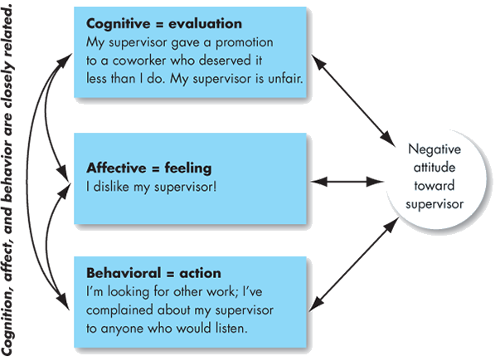
Lecture 7
The three components of an attitude.
In organizations, attitudes are important for their behavioral component. If workers believe, for example, that managers, auditors, and engineers are in a conspiracy to make employees work harder for less money, we should try to understand how this attitude formed, how it impacts job behavior, and how it might be changed.

Slide 22
Lecture 7
Attitudes and Behavior
Early research on attitudes assumed they were causally related to behavior—that is, the attitudes people hold determine what they do. However, one researcher—Leon Festinger—argued that attitudes follow behavior. Other researchers have agreed that attitudes predict future behavior.
Cognitive dissonance
Any incompatibility between two or more attitudes or between behavior and attitudes.
People seek consistency among their attitudes, and between their attitudes and their behavior. Any form of inconsistency is uncomfortable, and individuals will therefore att­empt to reduce it. People seek a stable state, which is a minimum of dissonance. When there is dissonance, people will alter either the attitudes or the behavior, or they will develop a rationalization for the discrepancy. Recent research found, for instance, that the attitudes of employees who experienced emotionally challenging work events improved after they talked about their experiences with co-workers. Social sharing helped these empl­oyees adjust their attitudes to behavioral expectations.

Slide 23
Lecture 7
Cognitive dissonance
The most powerful moderators of the attitudes relationship are the importance of the attitude, its correspondence to behavior, its accessibility, the presence of social pressures, and whether a person has direct experience with the attitude.6 Important attitudes reflect our fundamental values, self-interest, or identification with individuals or groups we value. These attitudes tend to show a strong relationship to our behavior. However, discrepancies between attitudes and behaviors tend to occur when social pressures to behave in certain ways hold exceptional power, as in most organizations. You’re more likely to remember attitudes you frequently express, and attitudes that our memories can easily access are more likely to predict our behavior. The attitude–behavior relationship is also likely to be much stronger if an attitude refers to something with which we have direct personal experience.

Slide 24
Lecture 7
Job Attitudes
We have thousands of attitudes, but OB focuses on a very limited number that forms positive or negative evaluations employees hold about their work environments. Much of the research has looked at three attitudes: job satisfaction, job involvement, and organizational commitment. Other important attitudes include perceived organizational support and employee engagement.
Job Satisfaction and Job Involvement
When people speak of employee attitudes, they usually mean job satisfaction, a positive feeling about a job resulting from an evaluation of its characteristics. A person with high job satisfaction holds positive feelings about the work,
Job involvement
The degree to which a person identifies with a job, actively participates in it, and considers performance important to their self-worth.

Slide 25
Lecture 7
Psychological empowerment
Psychological empowerment
Employees’ belief in the degree to which they affect their work environment, their competence, the meaningfulness of their job, and their perceived autonomy in their work.
Research suggests that empowerment initiatives need to be tailored to desired behavioral outcomes. Research in Singapore found that good leaders empower their employees by fostering their self-perception of competence—through involving them in decisions, making them feel their work is important, and giving them discretion to “do their own thing.”

Slide 26
Lecture 7
Organizational commitment
Organizational commitment
The degree to which an employee identifies with a particular organization and its goals and wishes to maintain membership in the organization.
Employees who are committed will be less likely to engage in work withdrawal even if they are dissatisfied because they have a sense of organizational loyalty or attachment. Even if employees are not currently happy with their work, they are willing to make sacrifices for the organization if they are committed enough.

Slide 27
Lecture 7
Perceived Organizational Support
Perceived Organizational Support
Perceived organizational support (POS) is the degree to which employees believe the organization values their contributions and cares about their well-being. An excellent example is Research and Development (R&D) engineer John Greene, whose POS is sky-high because when he was diagnosed with leukemia, CEO Marc Benioff and 350 fellow Salesforce.com employees covered all his medical expenses and stayed in touch with him throughout his recovery. No doubt stories like this are part of the reason Salesforce.com was the eighth of Fortune’s 100 Best Companies to Work For in 2015.
Perceived organizational support (POS)
The degree to which employees believe an organization values their contribution and cares about their well-being.
People perceive their organizations as supportive when rewards are deemed fair, when employees have a voice in decisions, and when they see their supervisors as supportive.

Slide 28
Lecture 7
Employee engagement
Employee Engagement
Employee engagement is an individual’s involvement with, satisfaction with, and enthusiasm for the work he or she does. To evaluate engagement, we might ask employees whether they have access to resources and opportunities to learn new skills, whether they feel their work is important and meaningful, and whether interactions with co-workers and supervisors are rewarding. Highly engaged employees have a passion for their work and feel a deep connection to their companies; disengaged employees have essentially checked out, putting time but not energy or attention into their work. Engagement becomes a real concern for most organizations because so few employees—between 17 percent and 29 percent, surveys indicate—are highly engaged by their work.

Slide 29
Lecture 7
Employee engagement
Employee engagement
An individual’s involvement with, satisfaction with, and enthusiasm for the work he or she does.
Engagement levels determine many measurable outcomes. Promising research findings have earned employee engagement a following in many business organizations and management consulting firms. However, the concept generates active debate about its usefulness, partly because of the difficulty of identifying what creates engagement. The two top reasons for engagement that participants gave in a recent study were: (1) having a good manager they enjoy working for; and (2) feeling appreciated by their supervisor. However, most of their other reasons didn’t relate to the engagement construct. Another study in Australia found that emotional intelligence was linked to employee engagement. Other research suggested that engagement fluctuates partially due to daily challenges and demands.

Slide 30
Lecture 7
Measuring Job Satisfaction
Measuring Job Satisfaction
Our definition of job satisfaction—a positive feeling about a job resulting from an evaluation of its characteristics—is broad. Yet that breadth is appropriate. A job is more than just shuffling papers, writing programming code, waiting on customers, or driving a truck. Jobs require interacting with coworkers and bosses, following organizational rules and policies, determining the power structure, meeting performance standards, living with less-than-ideal working conditions, adapting to new technologies, and so forth. An employee’s assessment of satisfaction with the job is thus a complex summation of many discrete elements. How, then, do we measure it?

Slide 31
Lecture 7
Approaches to Measurement
Approaches to Measurement
Two approaches are popular. The single global rating is a response to one question, such as “All things considered, how satisfied are you with your job?” Respondents circle a number between 1 and 5 on a scale from “highly satisfied” to “highly dissatisfied.” The second method, the summation of job facets, is more sophisticated. It identifies key elements in a job, such as the type of work, skills needed, supervision, present pay, promotion opportunities, culture, and relationships with co-workers. Respondents rate these on a standardized scale, and researchers add the ratings to create an overall job satisfaction score.
Is one of these approaches superior? Intuitively, summing up responses to a number of job factors seems likely to achieve a more accurate evaluation of job satisfaction. Research, however, doesn’t support intuition. This is one of those rare instances in which simplicity seems to work as well as complexity, making one method essentially as valid as the other. Both methods can be helpful. The single global rating method isn’t very time-consuming, while the summation of job facets helps managers zero in on problems and deal with them faster and more accurately.

Slide 32
Lecture 7
Measured Job Satisfaction Levels
Measured Job Satisfaction Levels
Are most people satisfied with their jobs? Generally, yes, to the tune of 49–69 percent of employees worldwide. Job satisfaction levels can remain quite consistent over time. For instance, average job satisfaction levels in the United States were consistently high from 1972 to 2006. However, economic conditions tend to influence job satisfaction rates. In late 2007, the economic contraction precipitated a drop-off in job satisfaction; the lowest point was in 2010, when only 42.6 percent of U.S. workers reported satisfaction with their jobs. Thankfully, the job satisfaction rate increased to 47.7 percent in 2014, but the level was still far off the 1987 level of 61.1 percent. Job satisfaction rates tend to vary in different cultures worldwide, and of course there are always competing measurements that offer alternative viewpoints.

Slide 33
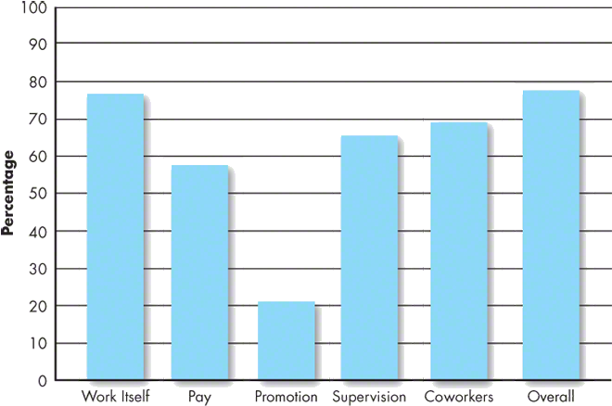
Lecture 7
The facets of job satisfaction levels can vary widely. As shown in Exhibit 3-2, people have typically been more satisfied with their jobs overall, the work itself, and their sup­ervisors and co-workers than they have been with their pay and promotion opportunities.

Slide 34
Lecture 7
What Causes Job Satisfaction?
Think about the best job you’ve ever had. What made it the best? The reasons can differ greatly. Let’s consider some characteristics that likely influence job satisfaction, starting with job conditions.
Job Conditions
Generally, interesting jobs that provide training, variety, independence, and control satisfy most employees. Interdependence, feedback, social support, and interaction with co-workers outside the workplace are also strongly related to job satisfaction, even after accounting for the characteristics of the work itself. As you may have guessed, managers also play a big role in employees’ job satisfaction. Employees who feel empowered by their leaders experience higher job satisfaction, according to one study of a large Hong Kong telecommunications corporation.

Slide 35
Lecture 7
Personality
As important as job conditions are to job satisfaction, personality also plays an important role. People who have positive core self-evaluations (CSEs)—who believe in their inner worth and basic competence—are more satisfied with their jobs than people with negative (CSEs). Additionally, in the context of a commitment to one’s career, (CSE) influences job satisfaction. People with high levels of both (CSE) and career commitment may realize particularly high job satisfaction.
Core self-evaluation (CSE)
Believing in one’s inner worth and basic competence.

Slide 36
Lecture 7
Corporate Social Responsibility (CSR)
Corporate Social Responsibility (CSR)
Would you be as happy to work for an organization with a stated social welfare mission as you would for an organization without one? An organization’s commitment to corporate social responsibility (CSR), or its self-regulated actions to benefit society or the environment beyond what is required by law, increasingly affects employee job satisfaction. Organizations practice CSR through environmental sustainability initiatives, nonprofit work, charitable giving, and other globally attuned philanthropy.
Corporate social responsibility (CSR)
An organization’s self-regulated actions to benefit society or the environment beyond what is required by law.

Slide 37
Lecture 7
Corporate Social Responsibility (CSR)
CSR is good for the planet and good for people. Employees whose personal values fit with the organization’s CSR mission are often more satisfied. In fact, of 59 large and small organizations recently surveyed, 86 percent reported they have happier employees as a result of their (CSR) programs.
The relationship between (CSR) and job satisfaction is particularly strong for millennials. “The next generation of employees is seeking out employers that are focused on the triple bottom line: people, planet, and revenue,” said Susan Cooney, founder of philanthropy firm Givelocity. (CSR) allows workers to serve a higher purpose or contribute to a mission. According to researcher Amy Wrzesniewski, people who view their work as part of a higher purpose often realize higher job satisfaction. However, an organization’s (CSR) efforts must be well governed and its initiatives must be sustainable for long-term job satisfaction benefits.

Slide 38
Lecture 7
This lecture covered the following topics
Dimensions of Intellectual Ability
General mental ability (GMA)
Intellectual Ability and Job Satisfaction
Physical Abilities
Implementing Diversity Management Strategies
Positive diversity climate
Diversity management
Diversity in Groups
Diversity Programs
Attitudes and Job Satisfaction
The three components of an attitude.

Slide 39
Lecture 7
References:
Organizational Behavior 14th Edition by Stephen P Robbins and Timothy A Judge.

