Slide 1



Network
Programming
in Python
Prepared by Dr. Hamada I. AbdulWakel
Lecture 1

Slide 2



Basics of Computer
Networking
Lecture 1
Prepared by
Dr. Hamada I. AbdulWakel
www.midocean.ae

Slide 3

Lecture
LECTURE MAIN POINTS
01
Network definition.
Importance of networks.
Networking components and types.
Network programming and programming levels.
Dealing with virtual environments.
www.midocean.ae

Slide 4
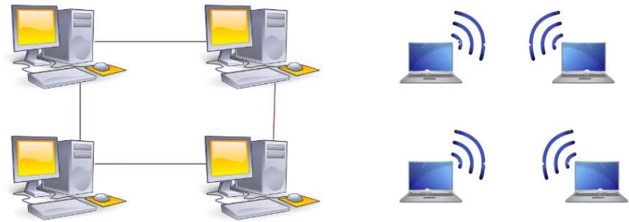
Lecture
01
NETWORK DEFINITION
A collection of devices connected to one another allowing for data to be shared and used.
  Devices count.
    At least 2 devices.
  Device type:
    Any device.
  Connection type:
    Wired.
    Wireless.
www.midocean.ae

Slide 5
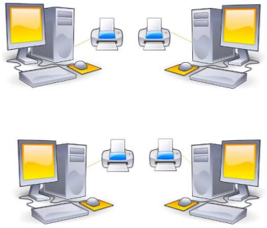
Lecture
01
IMPORTANCE OF NETWORKS
Scenario 1: without networks
  Violating efficient use of resources.
www.midocean.ae

Slide 6
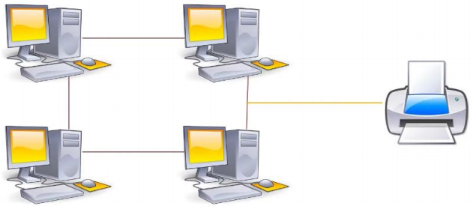
Lecture
01
IMPORTANCE OF NETWORKS
Cont'd
Scenario 1: with networks
  Efficient use of resources.
www.midocean.ae

Slide 7
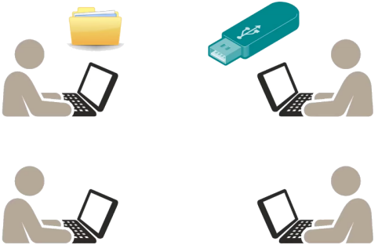
Lecture
01
IMPORTANCE OF NETWORKS
Cont'd
Scenario 2: without networks
  Reducing teamwork collaboration and data synchronization.
www.midocean.ae

Slide 8
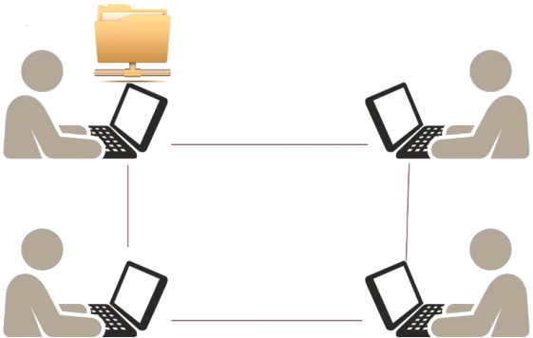
Lecture
01
IMPORTANCE OF NETWORKS
Cont'd
Scenario 2: with networks
  Increasing teamwork collaboration and data synchronization.
www.midocean.ae

Slide 9
Lecture
01
IMPORTANCE OF NETWORKS
Cont'd
Share resources such as Data and Hardware.
Save a lot of money.
Increase workgroups collaborations.
Increase productivity.
Protect company data.
www.midocean.ae

Slide 10
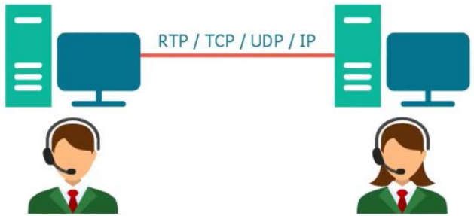
Lecture
01
NETWORK COMPONENTS
Any network must have:
  Computer systems.
  Network media.
    Cables:
      Electrical signals.
      Pulses of light.
    Wireless:
      Radio frequencies.
www.midocean.ae

Slide 11
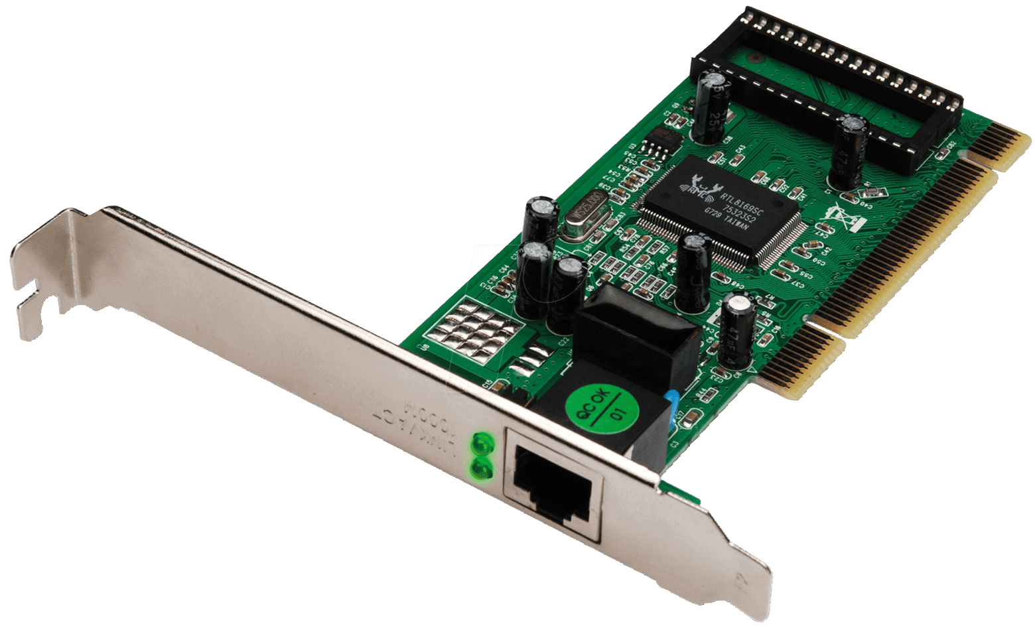
Lecture
01
NETWORK COMPONENTS
Cont'd
Any network must have:
  Network interface.
    A point of interconnection between a computer and a network.
      Physical form or implemented in software.
    Convert data to suitable formats for media used.
www.midocean.ae

Slide 12
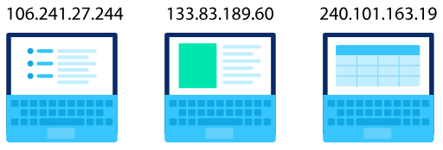
Lecture
01
NETWORK COMPONENTS
Cont'd
Any network must have:
  Network protocol.
    A protocol is a standard rules for how the connected devices are communicate and exchange information.
      IP: a set of standards for addressing and routing data on the Internet.
www.midocean.ae

Slide 13
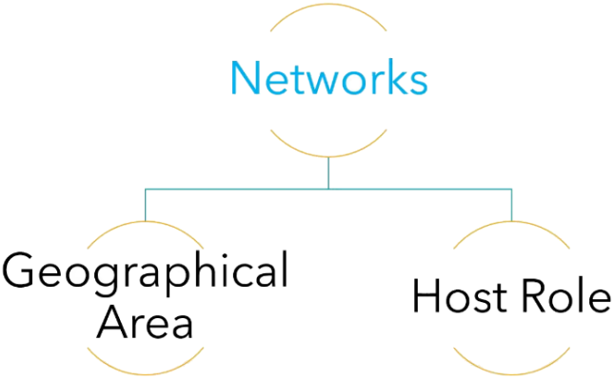
Lecture
01
NETWORK TYPES
www.midocean.ae

Slide 14
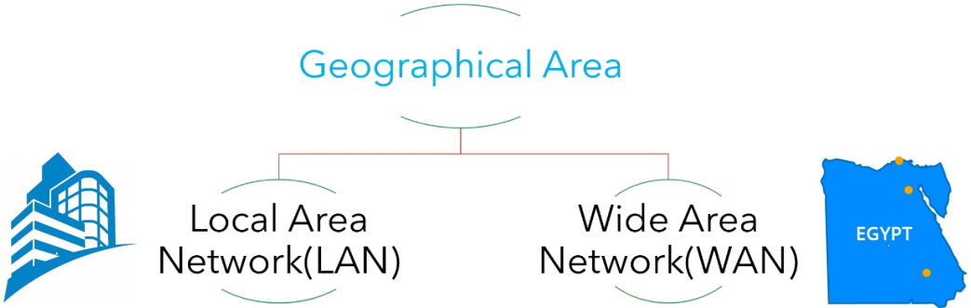
Lecture
01
NETWORK TYPES
Cont'd
www.midocean.ae

Slide 15
Lecture
01
NETWORK TYPES
Cont'd
The LAN network features:
  Short for Local Area Network.
  Connects a group of computers within a limited geographic area such as school, university, or hospital.
  High bandwidth for data transfer.
  Owned by private companies or individuals.
  Limited to 100 to 1000 meters.
  Lower setup cost due to inexpensive devices.
www.midocean.ae

Slide 16
Lecture
01
NETWORK TYPES
Cont'd
The WAN network features:
  Short for Wide Area Network.
  Covers a large geographic area such as state, or country.
  Low bandwidth for data transfer.
  Established under distributed ownership.
  Spans a huge area of 100000 kilometers.
  Higher setup cost than LAN.
www.midocean.ae

Slide 17
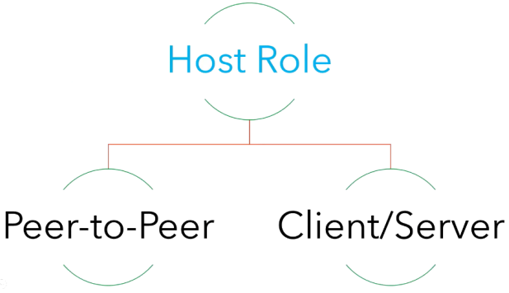
Lecture
01
NETWORK TYPES
Cont'd
Host Roles:
1- Client which request service.
2- Server which provide service.
www.midocean.ae

Slide 18

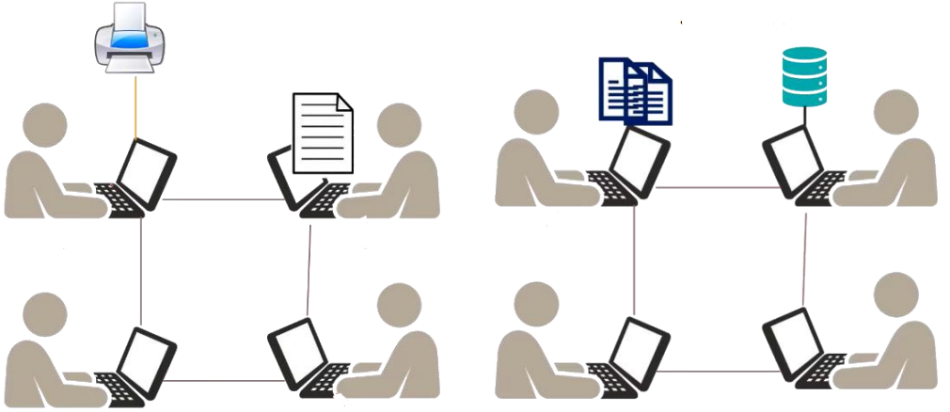
Lecture
01
NETWORK TYPES
Cont'd
www.midocean.ae

Slide 19
Lecture
01
NETWORK TYPES
Cont'd
The peer-to-peer network features:
  Simple network forms.
  Less costs to forming.
  Roles could be switched.
  No centralized administration.
  Security is its main problem.
www.midocean.ae

Slide 20

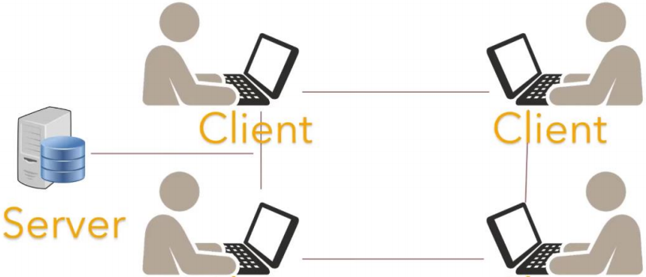
Lecture
01
NETWORK TYPES
Cont'd
www.midocean.ae

Slide 21
Lecture
01
NETWORK TYPES
Cont'd
The client/server network features:
  Scalable network forms.
  The server costs is high and requires experience to manage.
  Roles do not switch.
  The server considers the centralized administration.
  Security maintained by the server.
www.midocean.ae

Slide 22
Lecture
01
NETWORK PROGRAMMING
A network allows arbitrary applications to communicate.
Network programming is the act of using computer code to write programs that can communicate with other programs across a network.
A "programmable" network has programs in its infrastructure that the developers can use to program applications and other components to interact directly with the network.
www.midocean.ae

Slide 23
REASONS FOR USING PYTHON ON NETWORK PROGRAMMING
Lecture
01
The simplicity and high readability.
The most powerful language.
Helpful libraries for network engineers.
Python increases network reliability.
www.midocean.ae

Slide 24
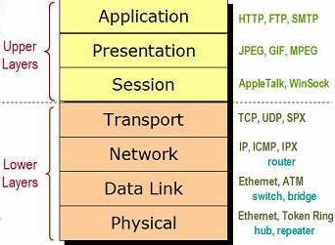
NETWORK PROGRAMMING LEVELS
Lecture
01
Python provides two levels of access to network programming:
  Low-level access.
  High-level access.
www.midocean.ae

Slide 25
NETWORK PROGRAMMING LEVELS
Lecture
01
Cont'd
Python provides two levels of access to network programming:
  Low-level access:
    Access the basic socket support for the operating system using Python's libraries.
    Implement client and server for both connection-oriented and connectionless protocols.
  High-level access:
    Implement protocols like HTTP, FTP, etc. using Python's libraries.
www.midocean.ae

Slide 26
REQUIREMENTS FOR PYTHON NETWORK PROGRAMMING
Lecture
01
Python basics and OOP.
PyPi website to find, install Python packages.
Python package installer (pip).
  Linux OS:
  sudo apt install python3-pip
  Windows OS: can be installed from the pip official website.
Integrated Development Environment such as VScode or Pycharm.
www.midocean.ae

Slide 27
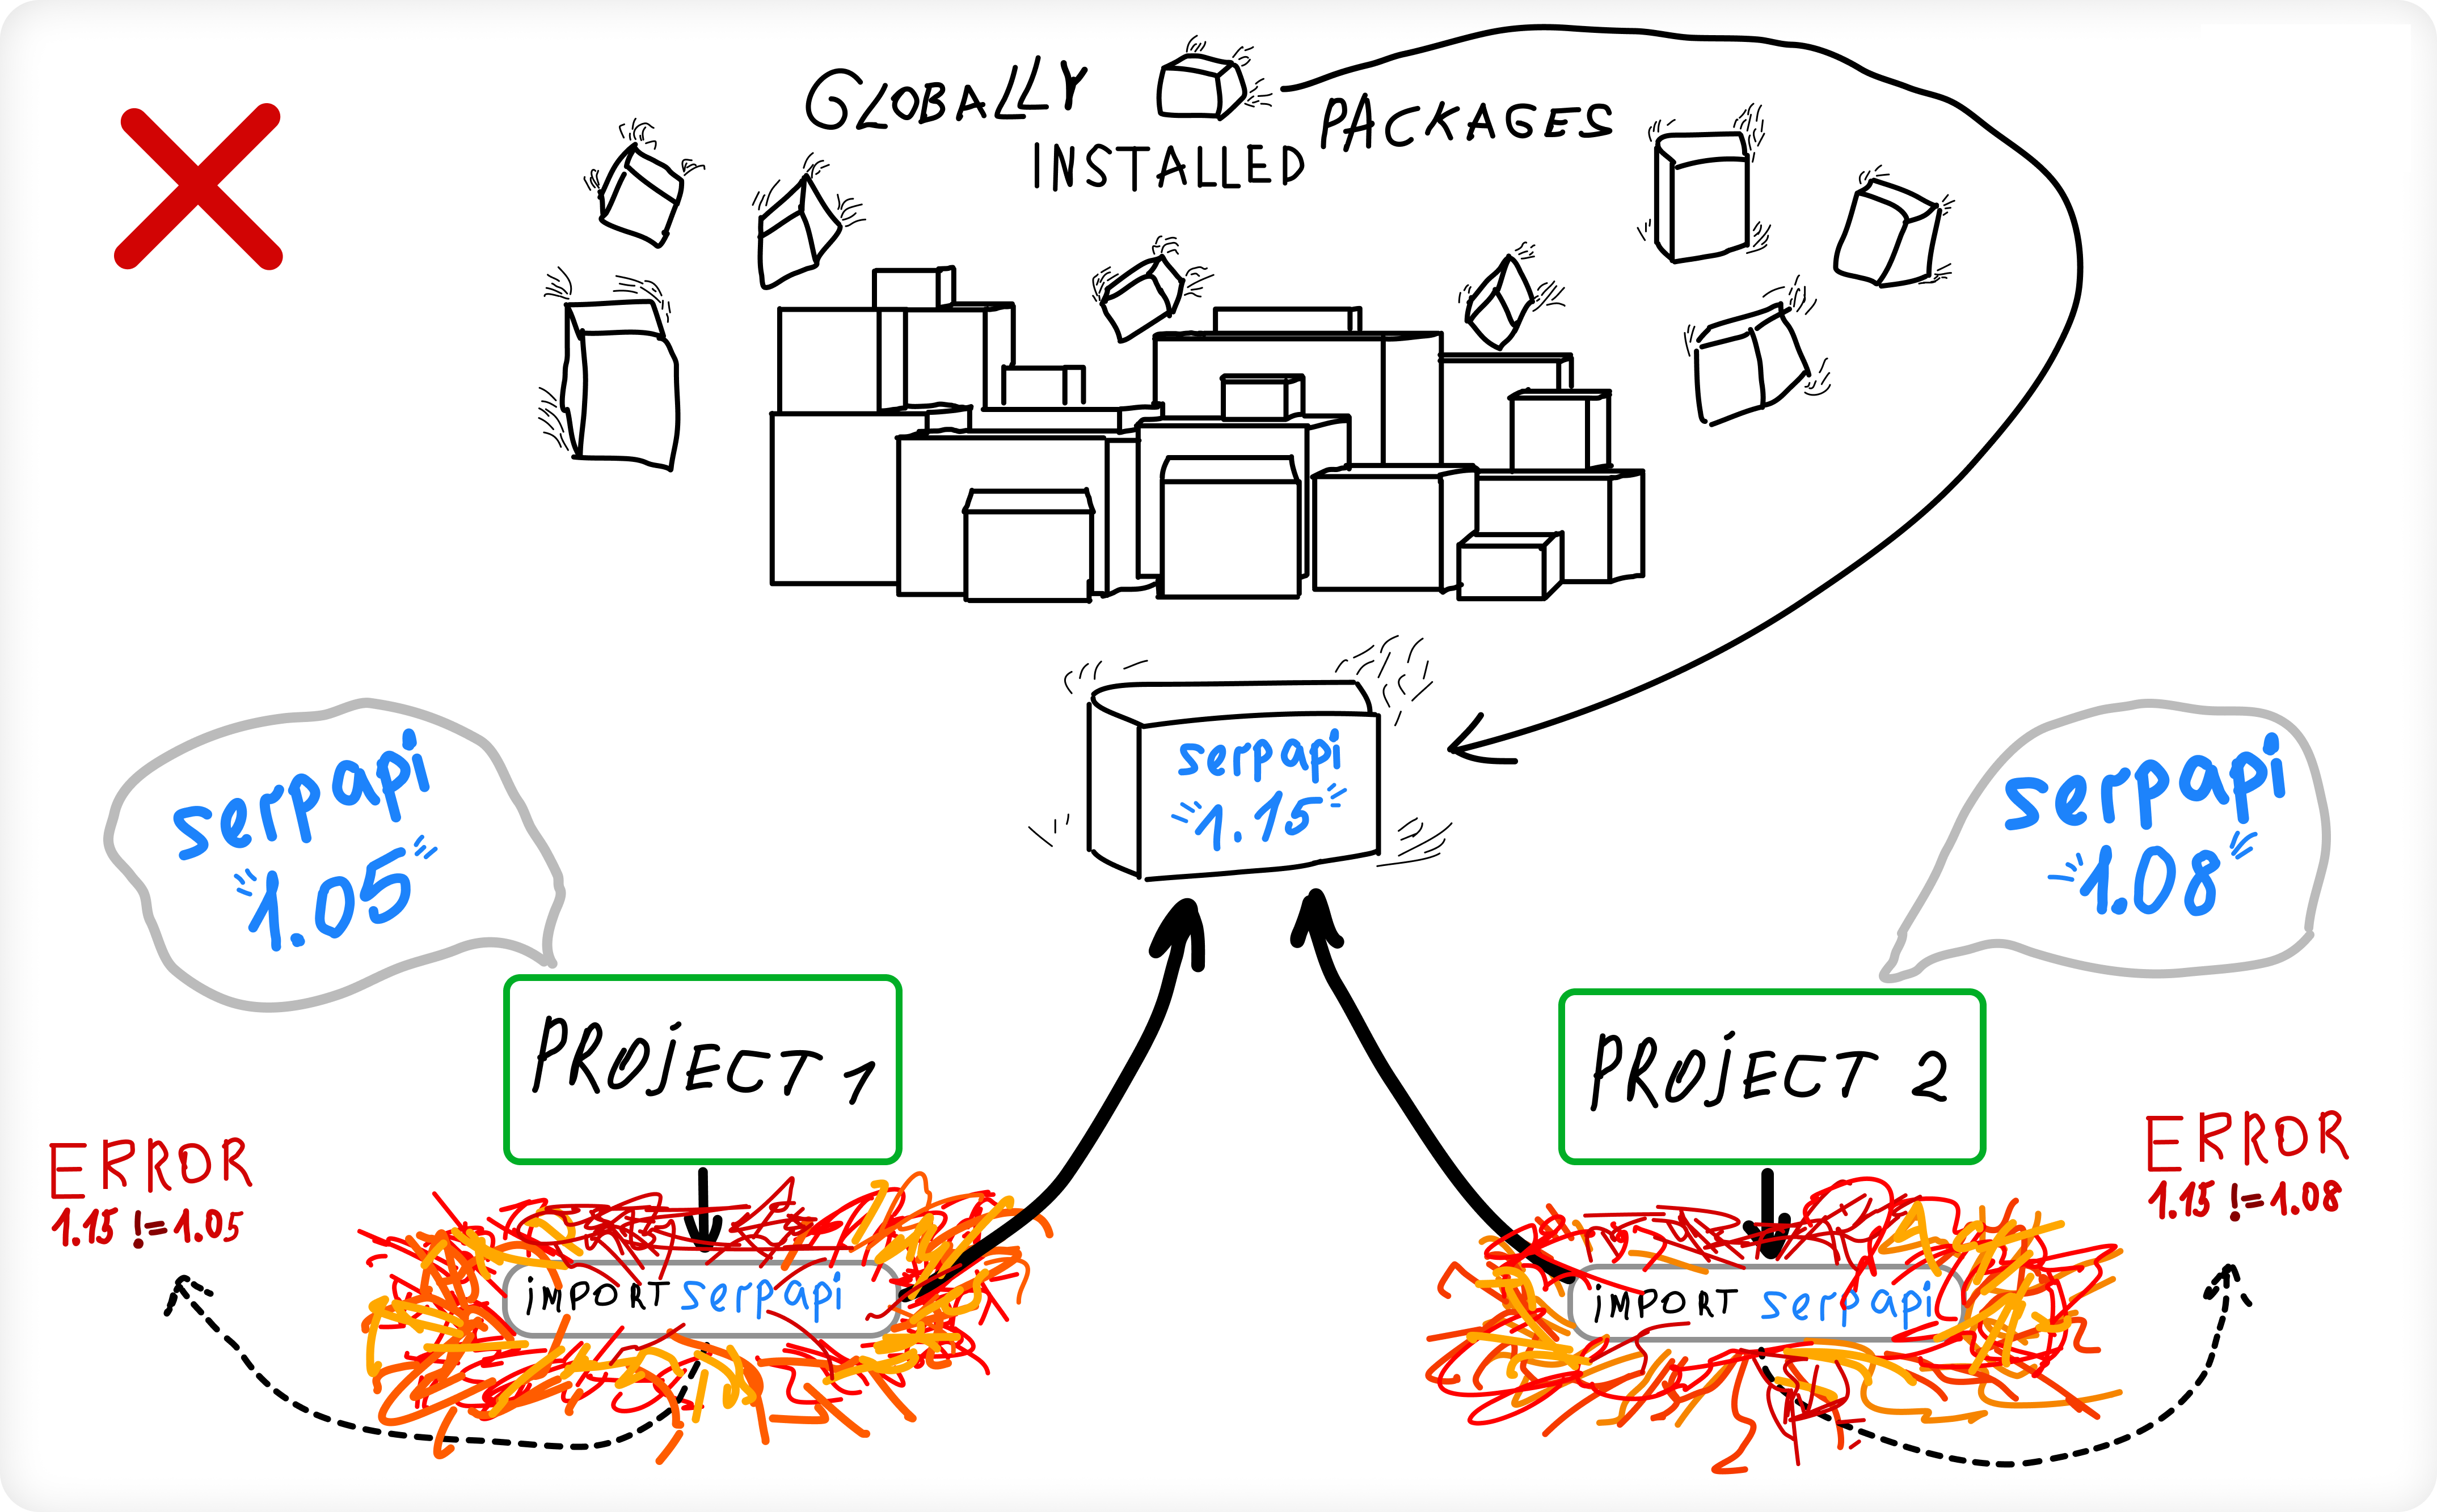
Lecture
01
VIRTUAL ENVIRONMENTS
www.midocean.ae

Slide 28
Lecture
01
VIRTUAL ENVIRONMENTS
Cont'd
Python considers a package-based language.
When a package is installed globally, it's made available to all users. Typically, that means Python and all packages will get installed to a directory under:
  On Linux:
  /usr/local/bin/
  On Windows:
  \Program Files\
www.midocean.ae

Slide 29
Lecture
01
VIRTUAL ENVIRONMENTS
Cont'd
Virtual environment (Venv) is a tool that helps to keep dependencies required by different projects separate by creating isolated python virtual environments for them.
Isolation means any changes on dependencies installed in a virtual environment don’t affect the dependencies of the other virtual environments or the system-wide (default python) libraries.
We can create multiple virtual environments with different/same Python versions and different/same libraries versions on the same machine.
www.midocean.ae

Slide 30
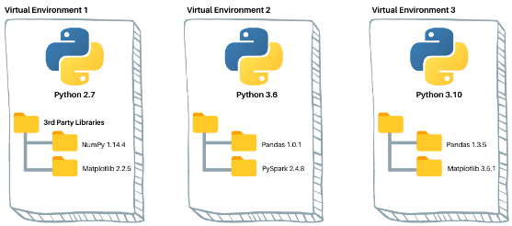
Lecture
01
VIRTUAL ENVIRONMENTS
Cont'd
Any virtual environment consists of two components:
  The python interpreter.
  A folder contains the third-party libraries installed in the venv.
www.midocean.ae

Slide 31
Lecture
01
VIRTUAL ENVIRONMENTS
Cont'd
Venv does not related to your created codes, it just for handling packages needed to run/use in your codes.
Program codes must not be inside the Venv folder.
www.midocean.ae

Slide 32
Lecture
01
VIRTUAL ENVIRONMENTS
Cont'd
Using a module named virtualenv to create isolated python environments.
Install virtualenv:
pip install virtualenv
sudo apt install python3-virtualenv (3.10)
virtualenv --version
www.midocean.ae

Slide 33
Lecture
01
CREATING VIRTUAL ENVIRONEMNT
Cont'd
Create the location for venvs on your machine.
mkdir Myenvs && cd Myenvs
Create your venvs as your projects required.
  On Windows:
  python –m venv Your_venv_Name
  On Linux and Mac:
  python3 –m venv Your_venv_Name (3.10)
www.midocean.ae

Slide 34
ACTIVITING/DEACTIVITING
VIRTUAL ENVIRONEMNT
Lecture
01
Cont'd
To activate the required venv.
  On Windows:
  source Your_venv_Name/Scripts/activate
  On Linux and Mac:
  source Your_venv_Name/bin/activate
To deactivate your venv.
deactivate
www.midocean.ae

Slide 35
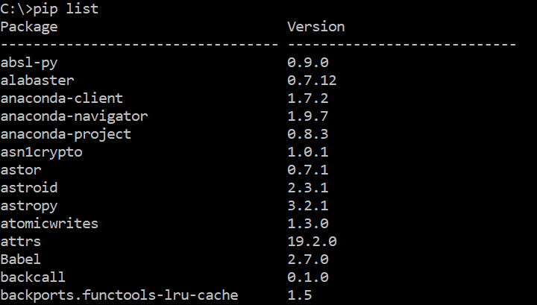
PACKAGE ISOLATION IN VIRTUAL ENVIRONEMNTS
Lecture
01
Cont'd
Run the below command to
see the list of installed
packages.
  On default python path.
pip list
….. and more
www.midocean.ae

Slide 36
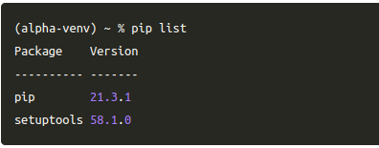
PACKAGE ISOLATION IN VIRTUAL ENVIRONEMNTS
Lecture
01
Cont'd
Run the below command to see the list of installed packages.
  On virtual environment.
pip list
www.midocean.ae

Slide 37
PACKAGE ISOLATION IN VIRTUAL ENVIRONEMNTS
Lecture
01
Cont'd
Install a package in your venv.
pip install ascii-train
Make a python code file and write the following code.
import ascii_train
print(ascii_train.train("Midocean University"))
Run the code. If you got an error, then make sure you activate the correct venv.
Your_venv_Name/bin/python3 "/path/to/code file/test.py"
www.midocean.ae

Slide 38
Lecture
01
QUESTIONS FOR ONLINE DISCUSSION
Suggest a scenario for using networks which highlights its importance.
Is there is any other types of networks?
Give an example for the low-level and high-level network programming?
Give a real-world example which can be solving using virtual environments in your work?
www.midocean.ae

Slide 39


Thank You

