Slide 1
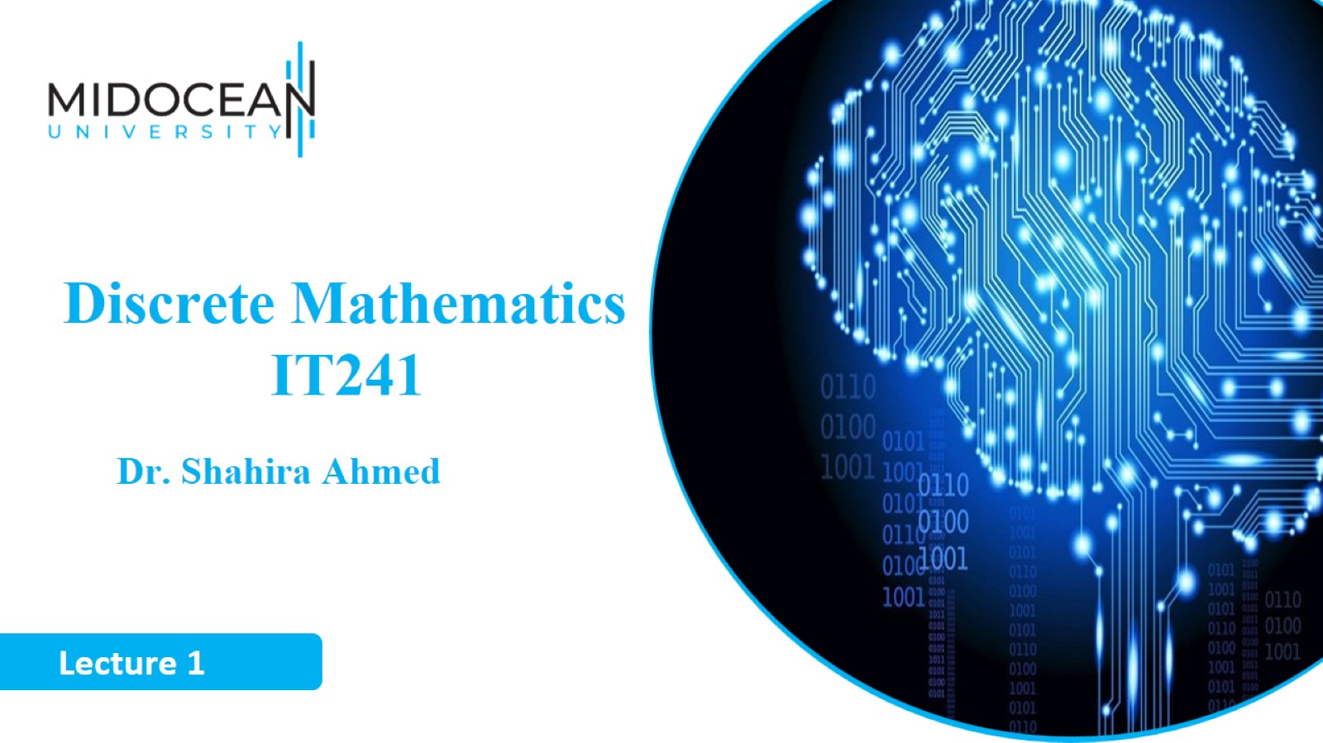

Slide 2
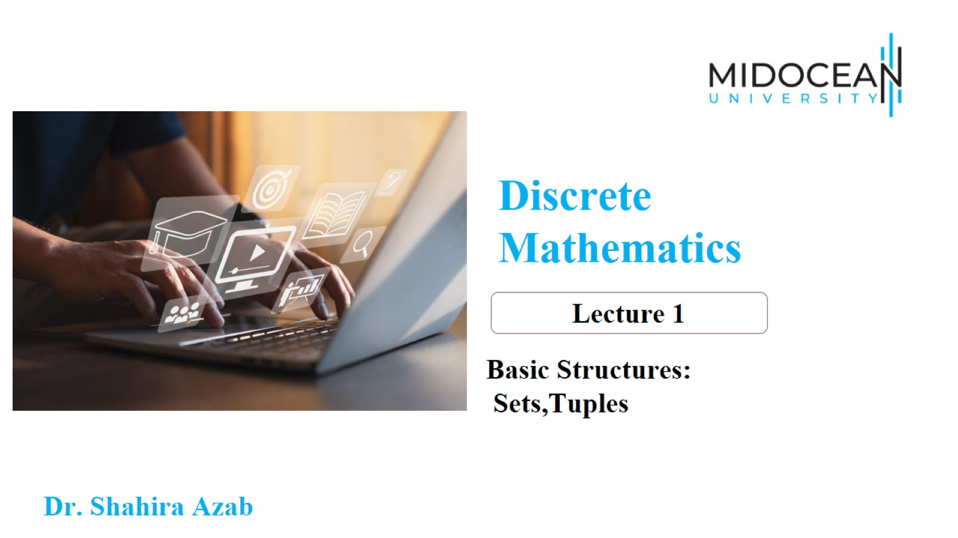

Slide 3
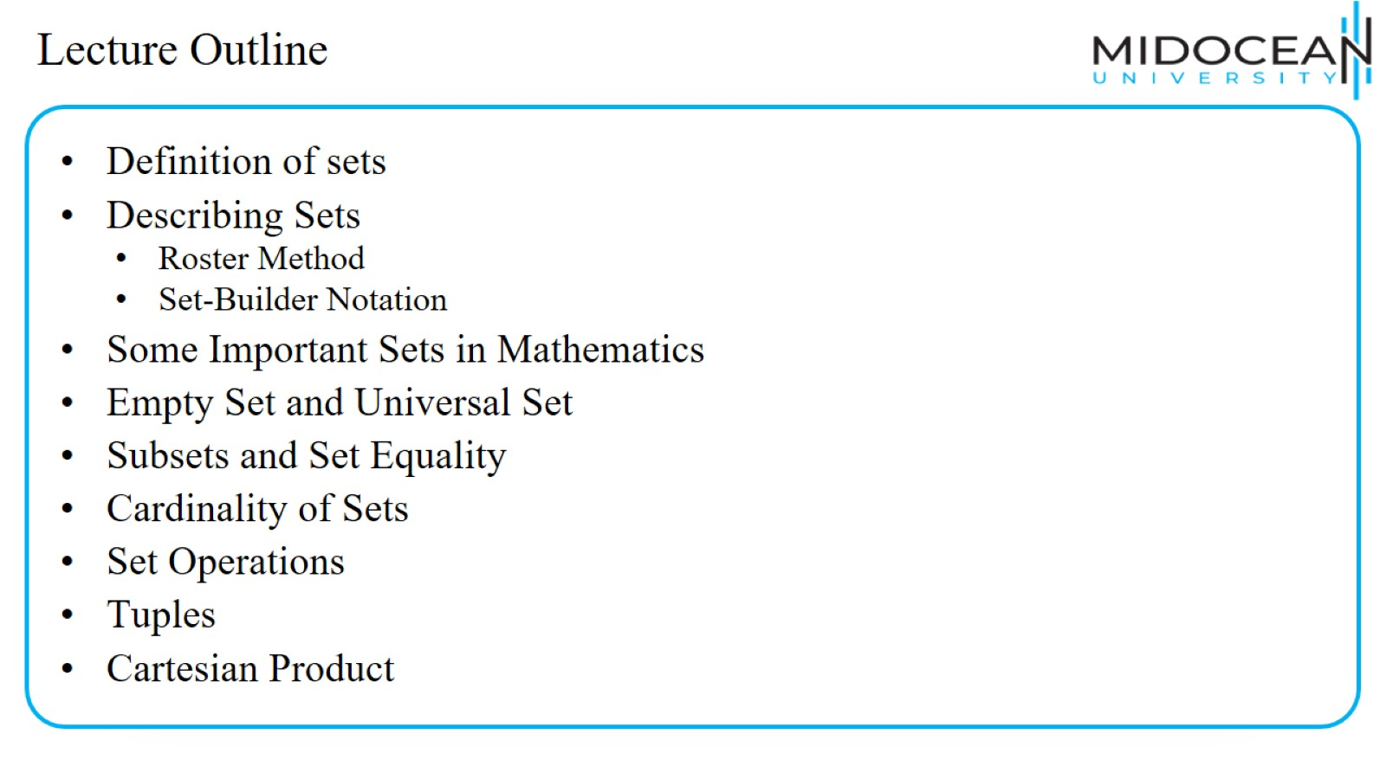
Lecture Outline

Slide 4
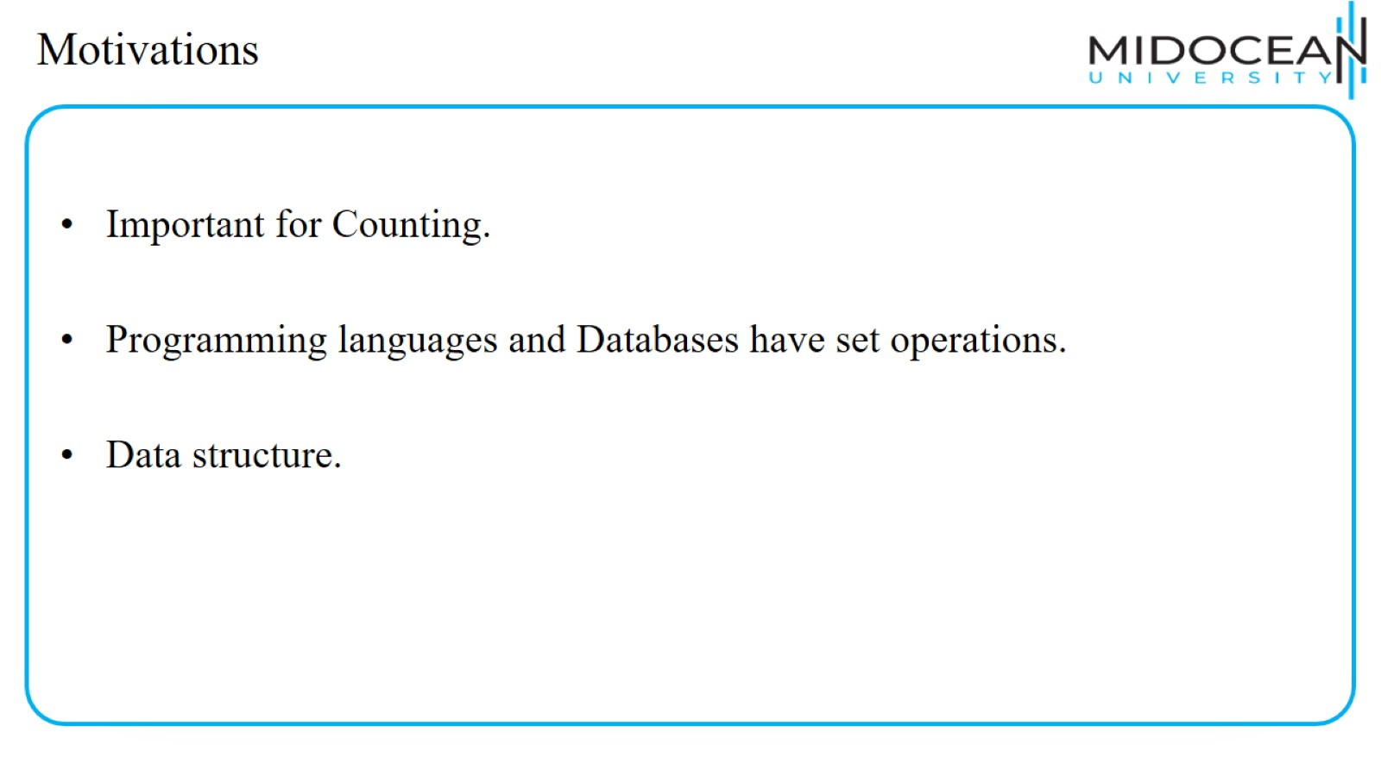
Motivations

Slide 5
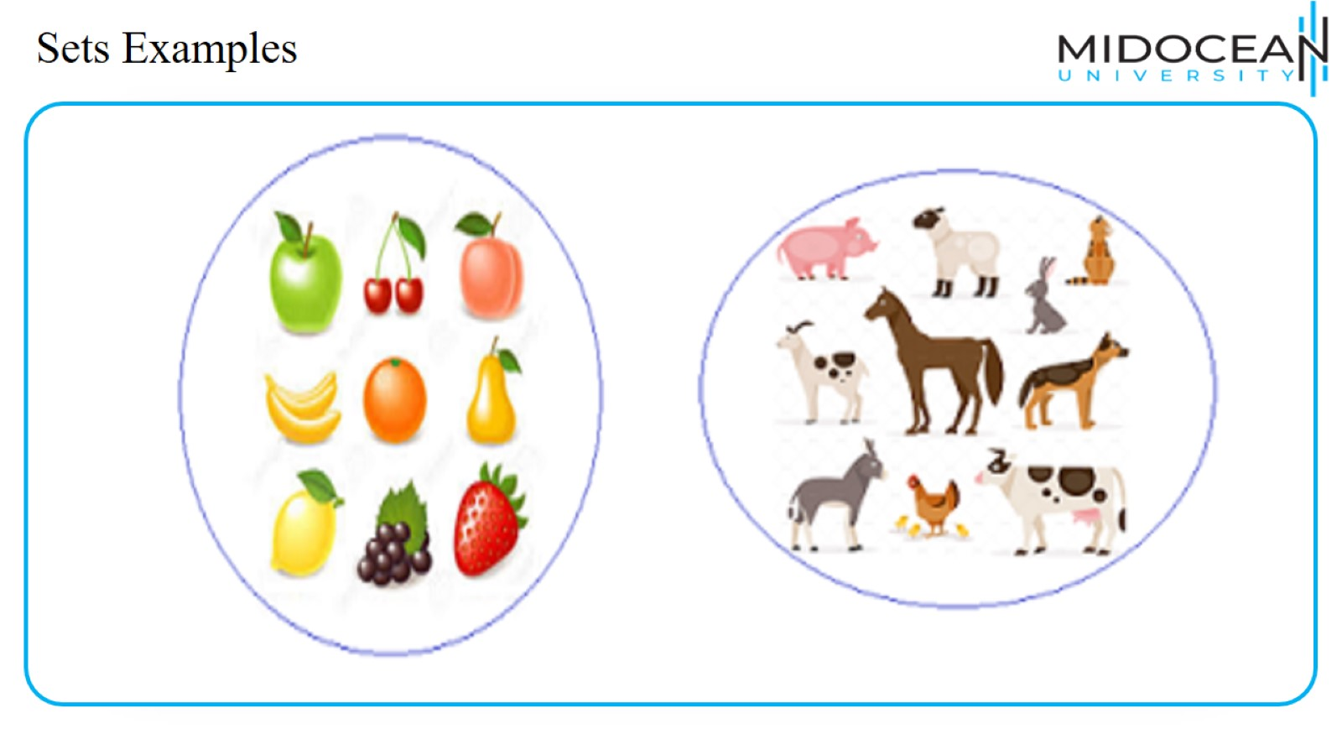
Sets Examples

Slide 6

Sets Examples

Slide 7
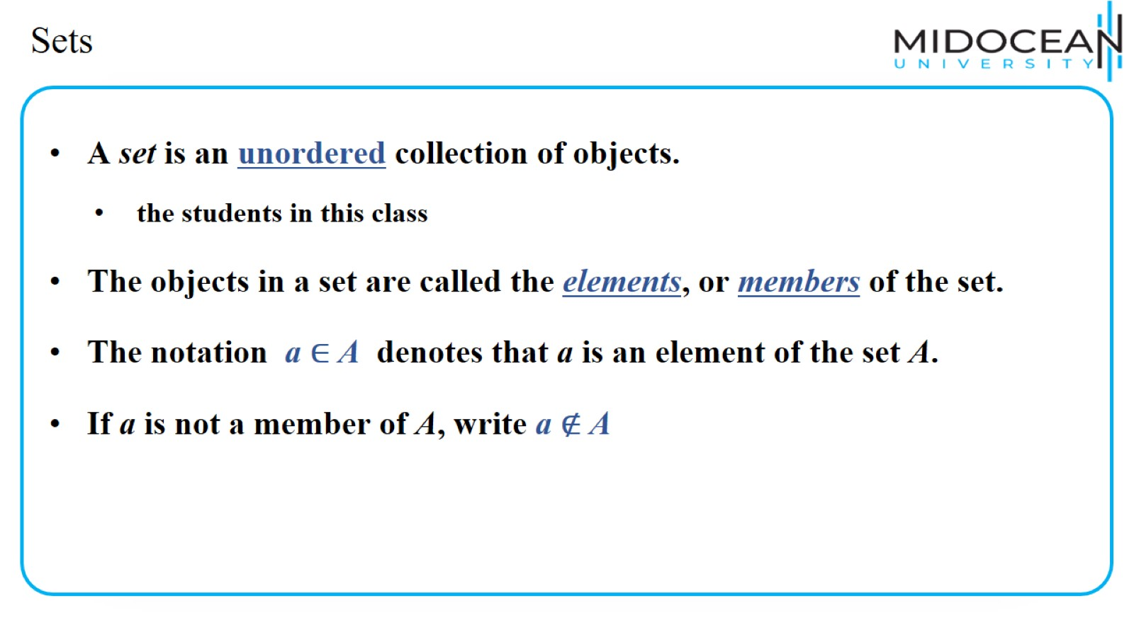
Sets

Slide 8
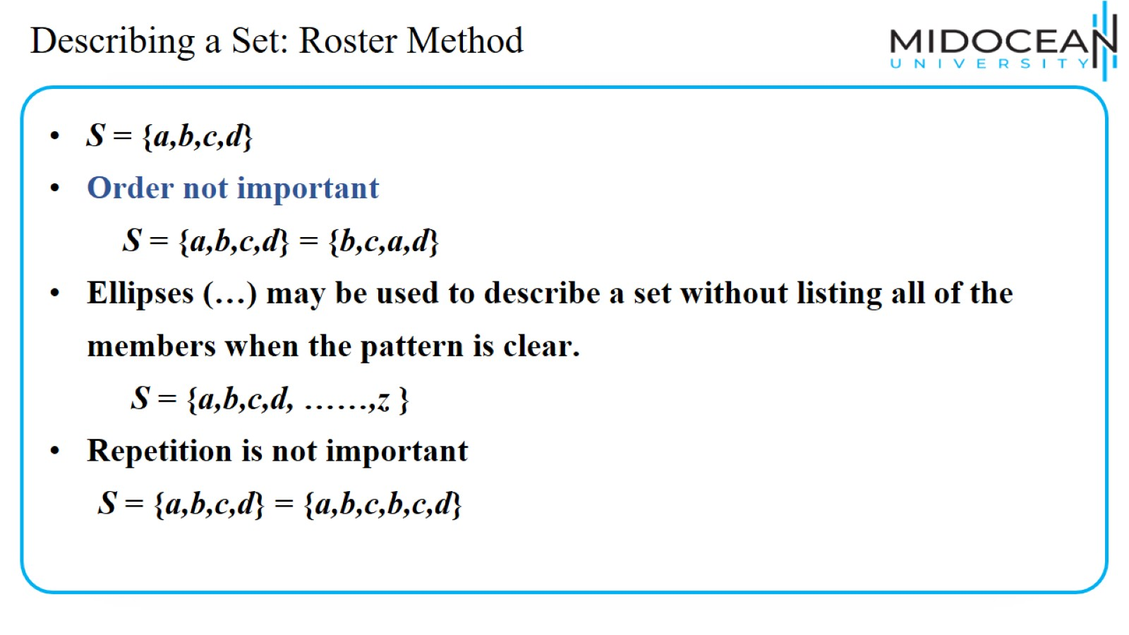
Describing a Set: Roster Method

Slide 9
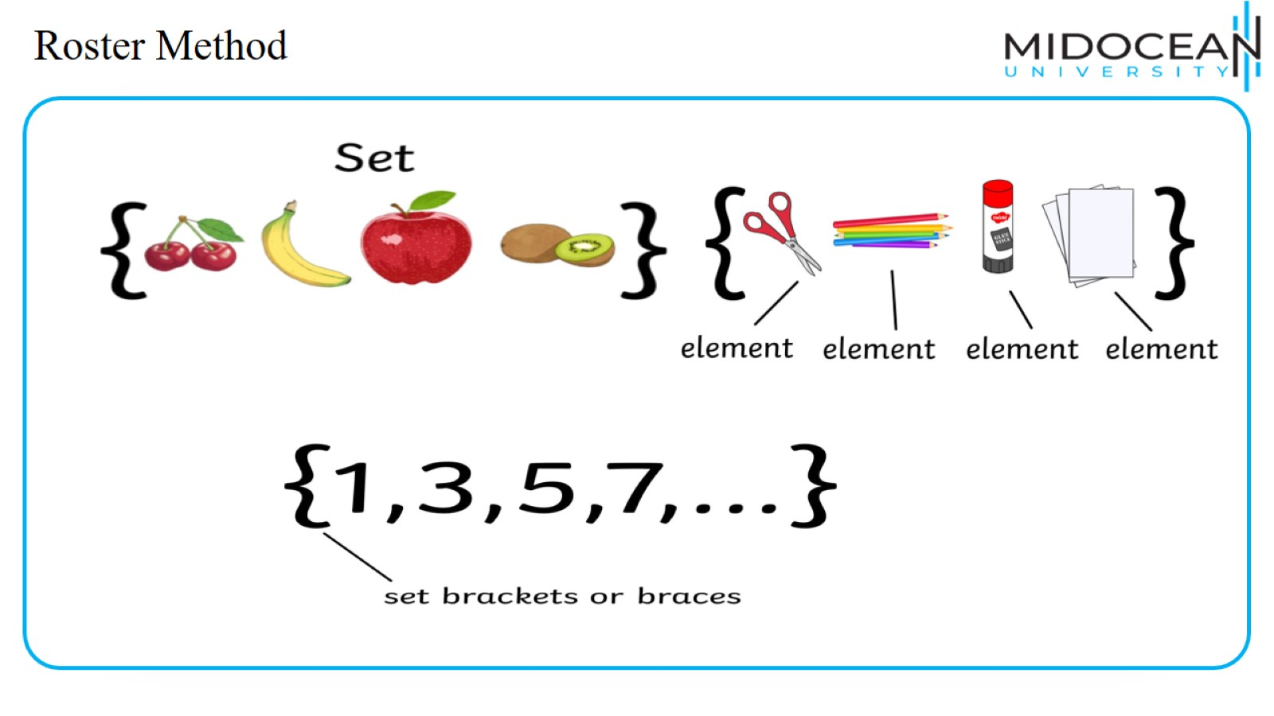
Roster Method

Slide 10
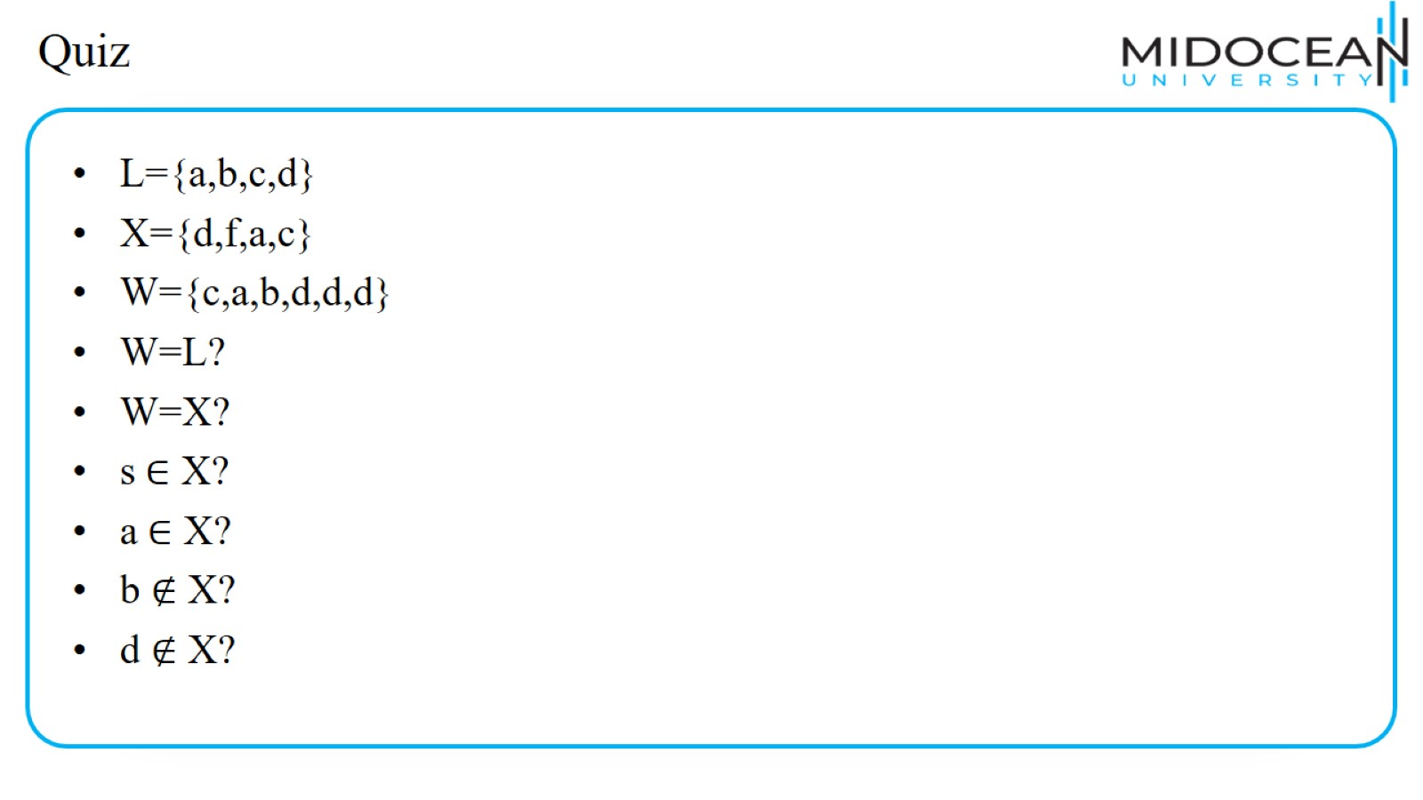
Quiz

Slide 11
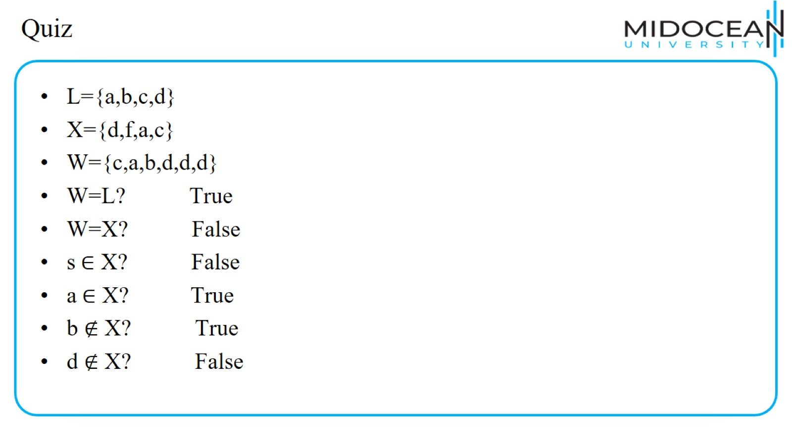
Quiz

Slide 12
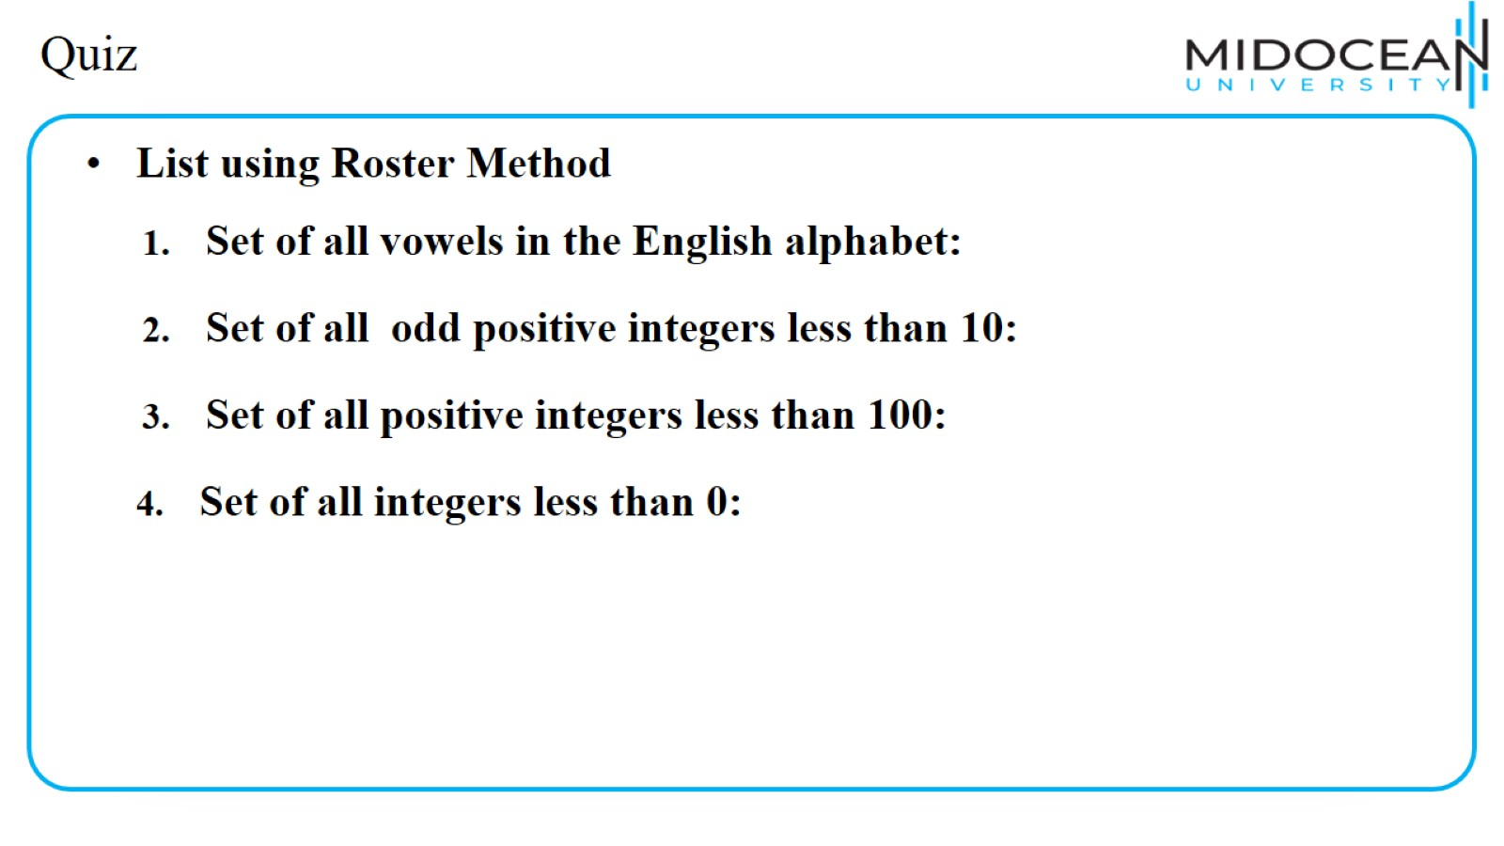
Quiz

Slide 13
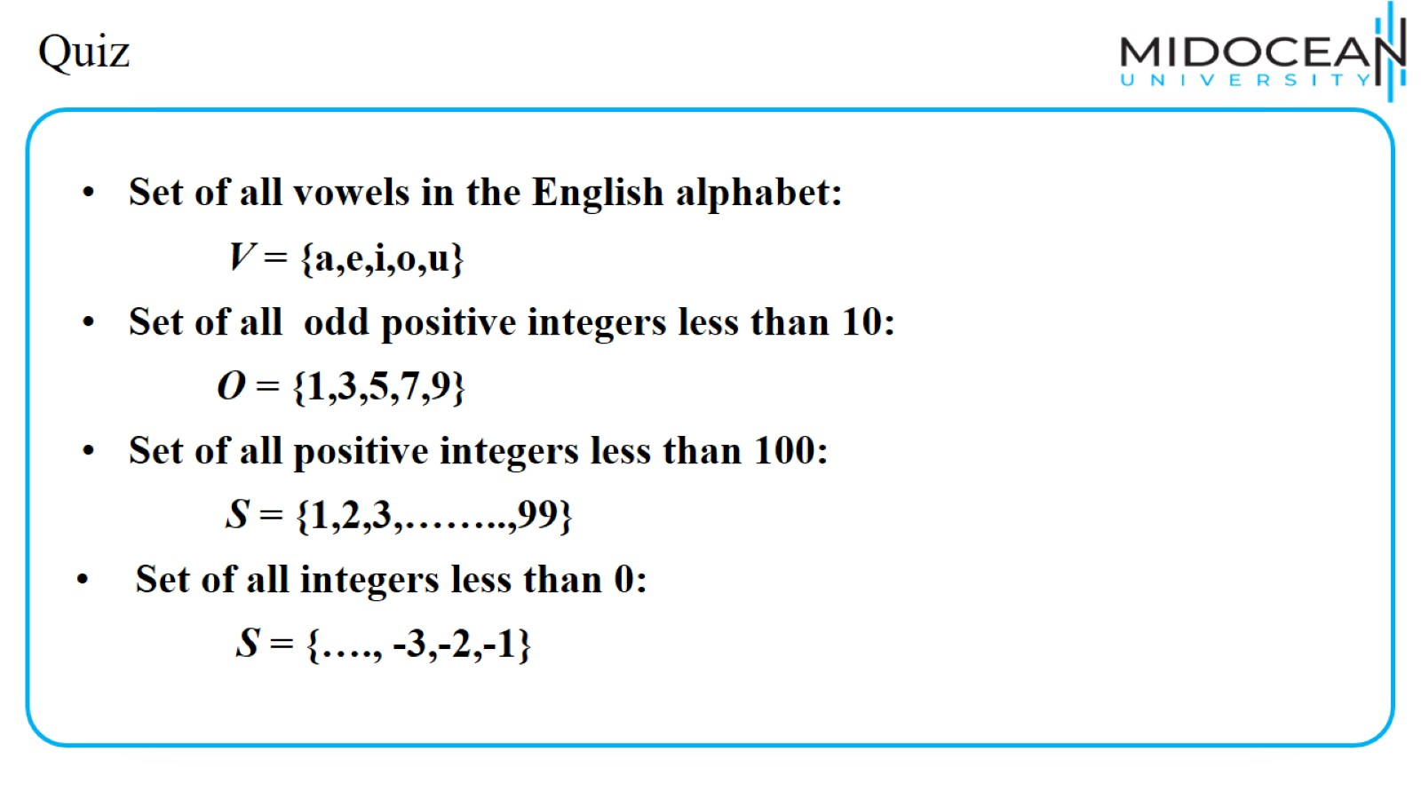
Quiz

Slide 14
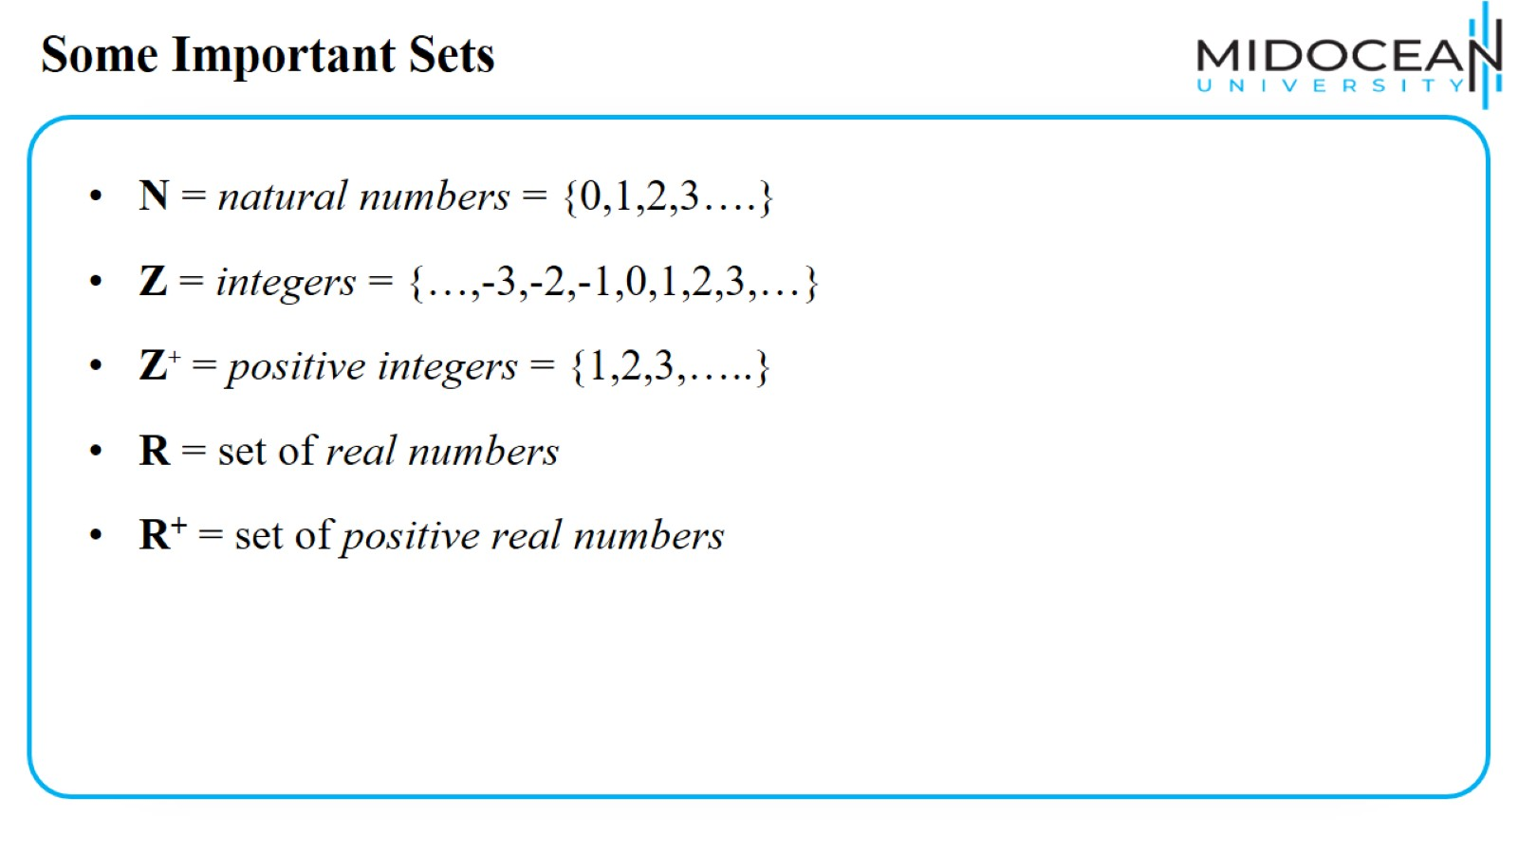
Some Important Sets

Slide 15
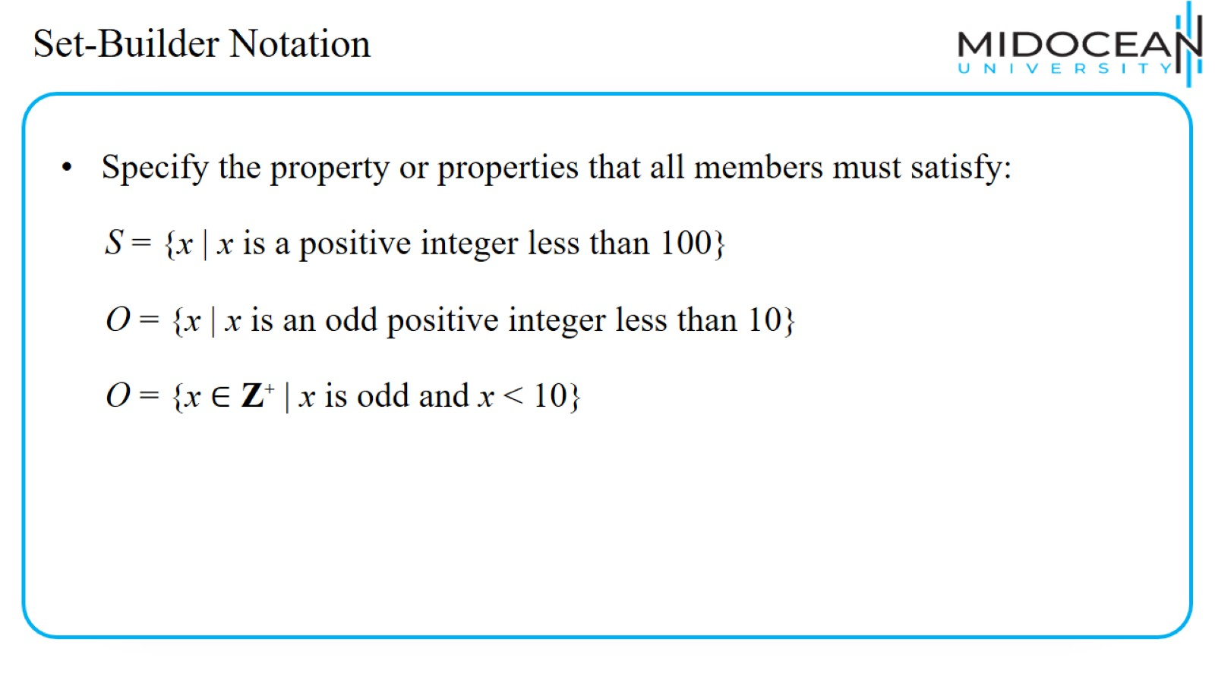
Set-Builder Notation

Slide 16
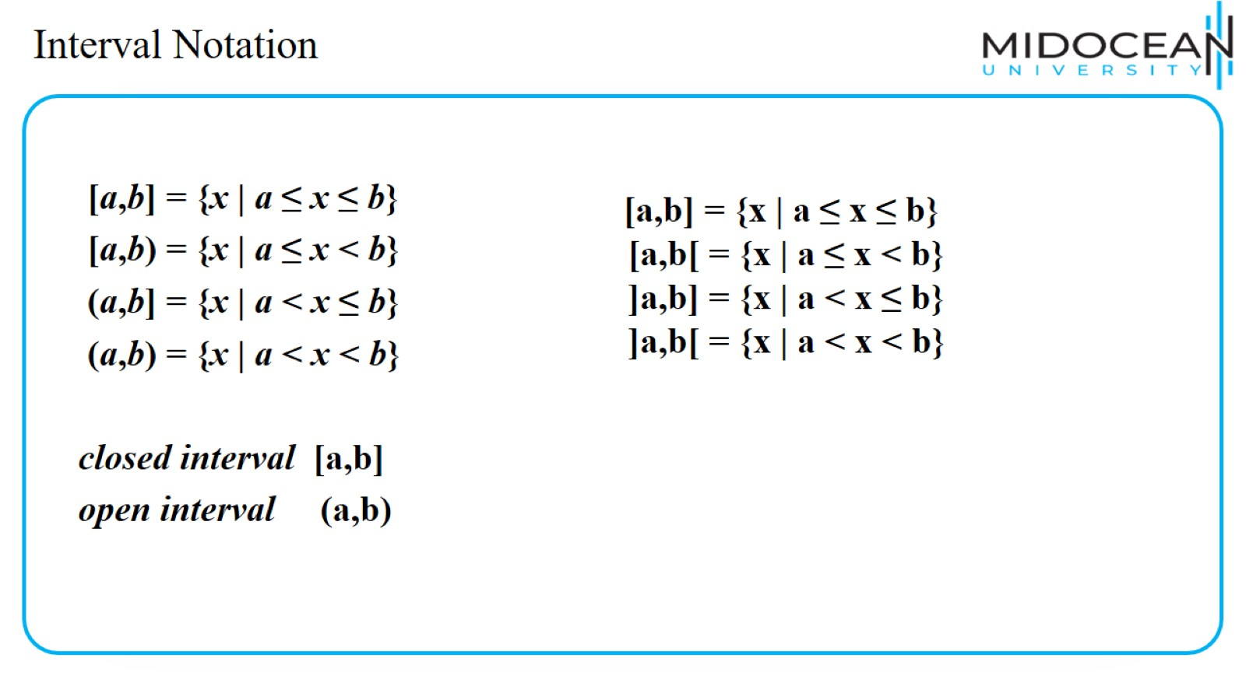
Interval Notation

Slide 17
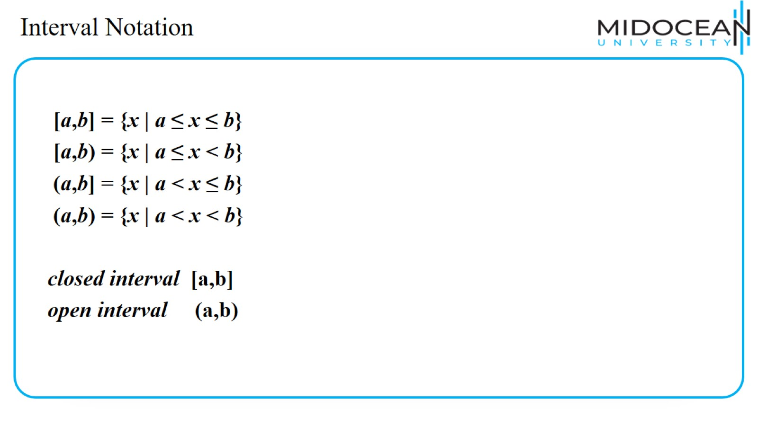
Interval Notation

Slide 18
Interval Notation

Slide 19
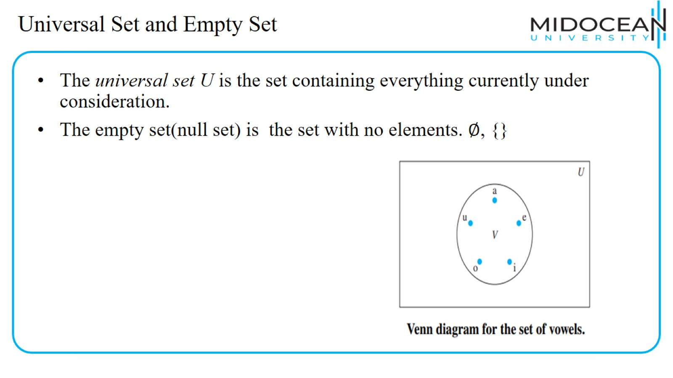
Universal Set and Empty Set

Slide 20
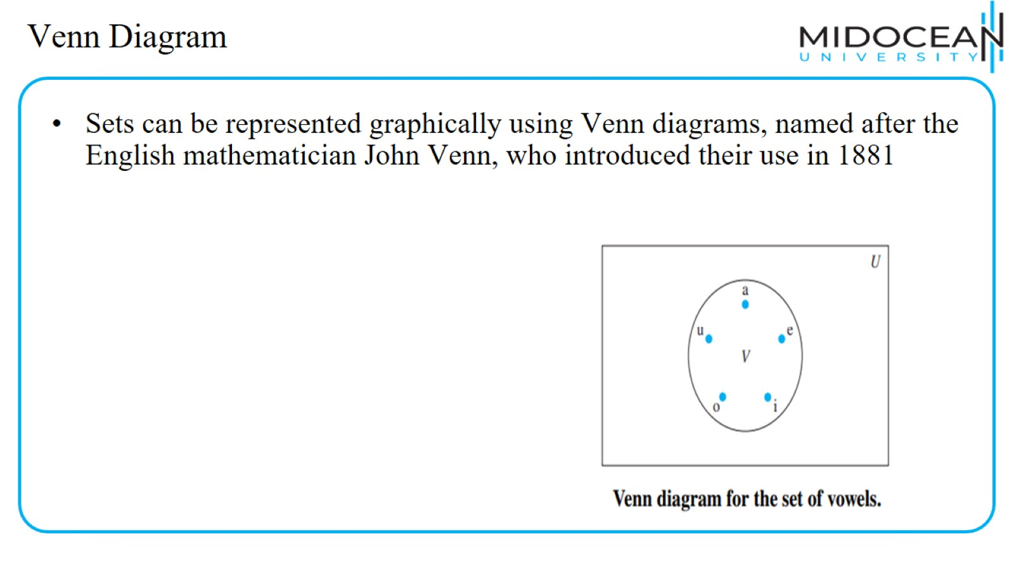
Venn Diagram

Slide 21
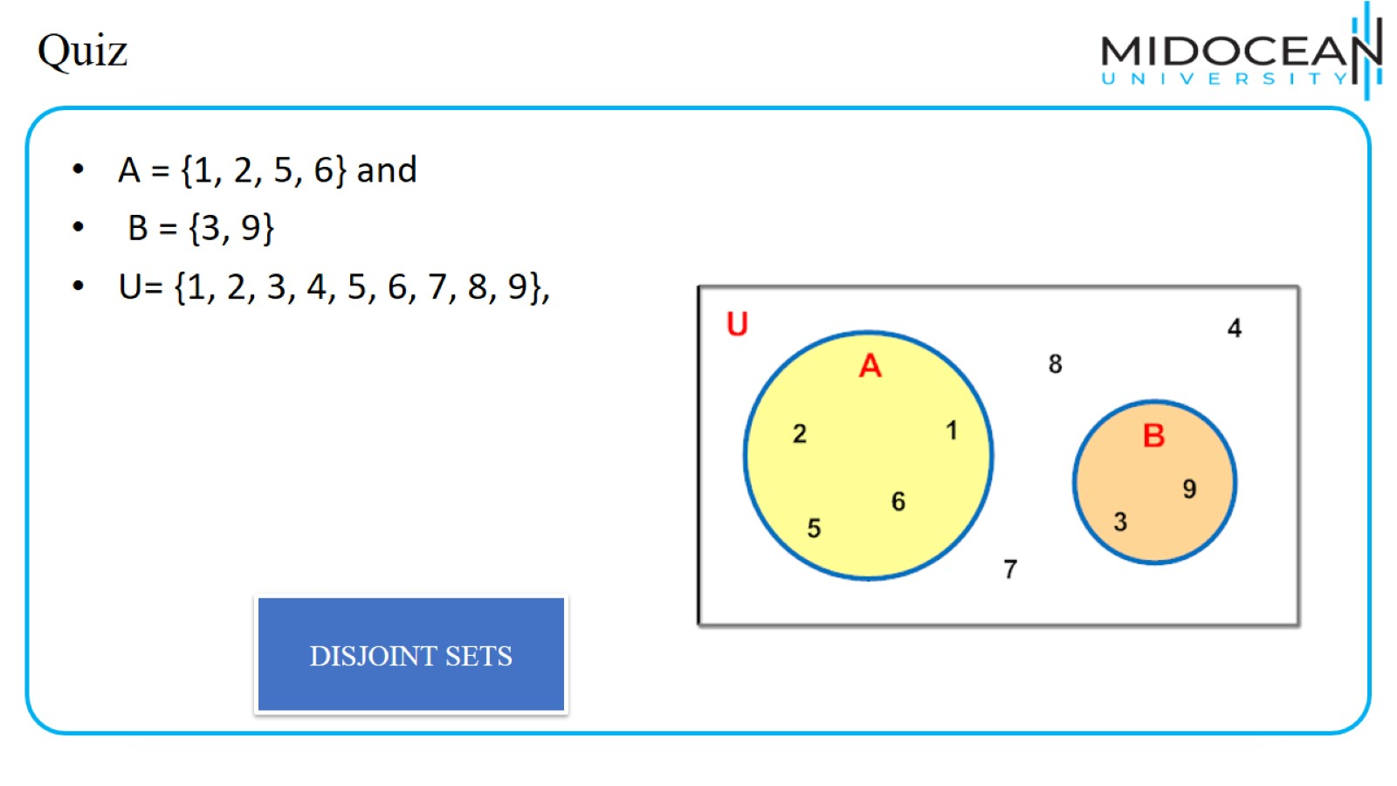
Quiz

Slide 22
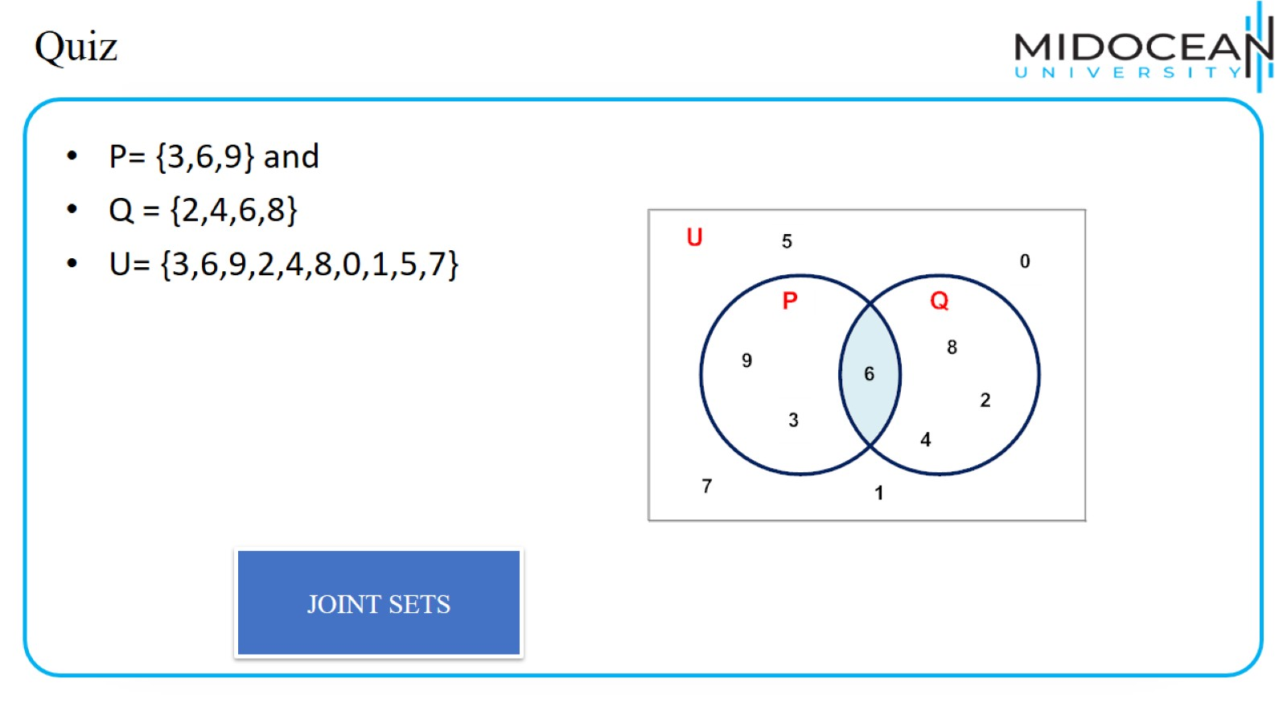
Quiz

Slide 23
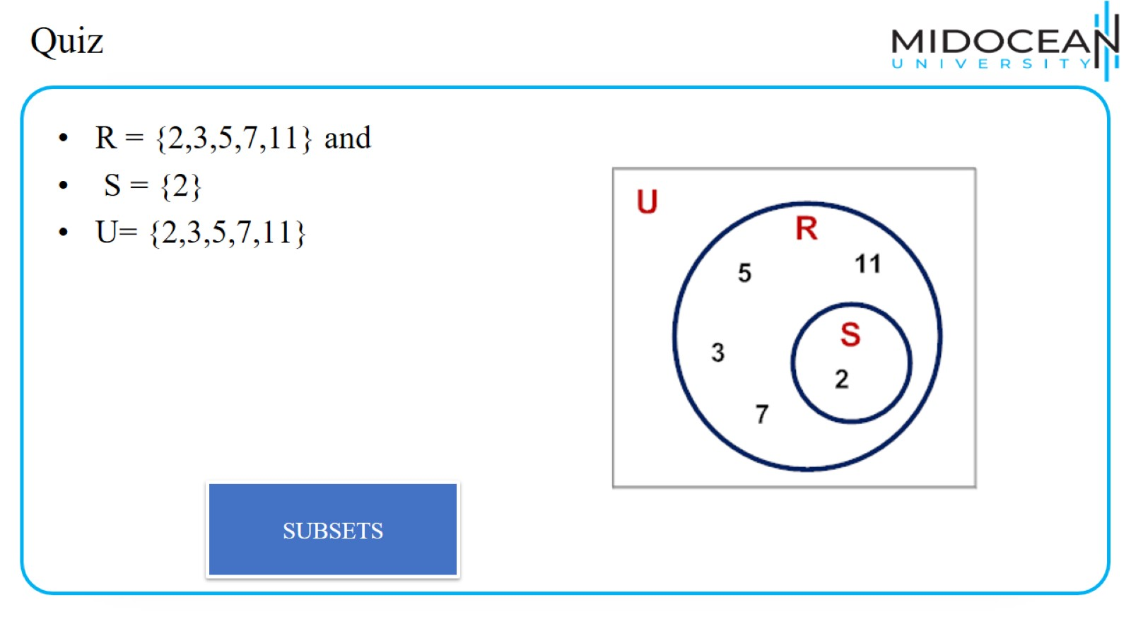
Quiz

Slide 24
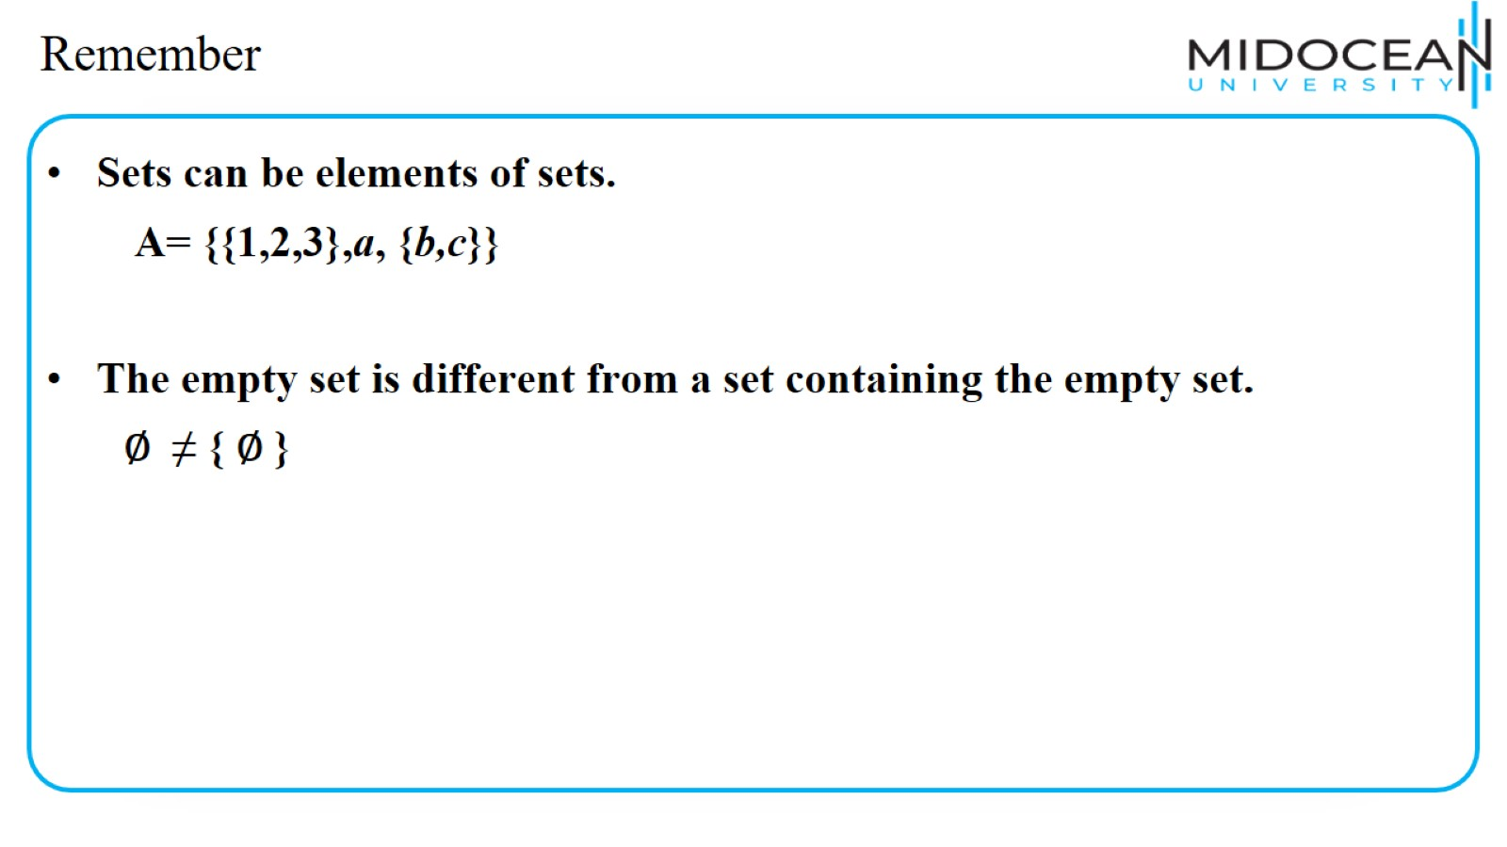
Remember

Slide 25
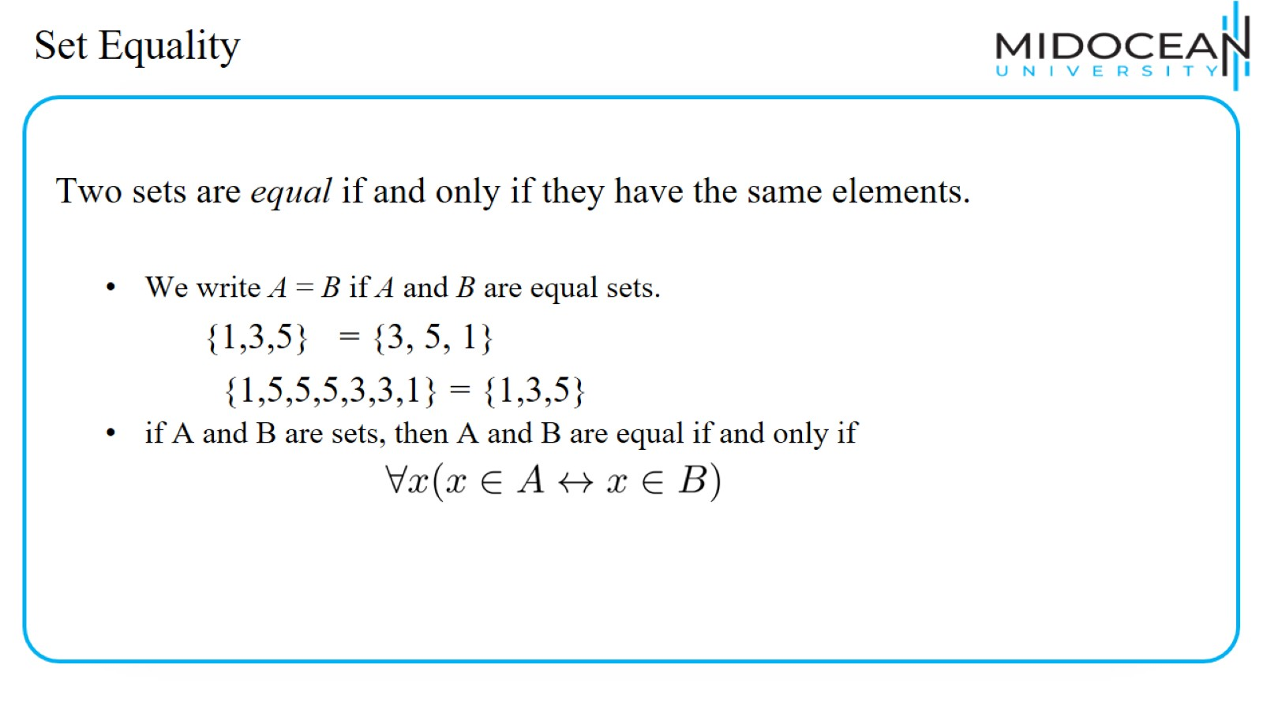
Set Equality

Slide 26
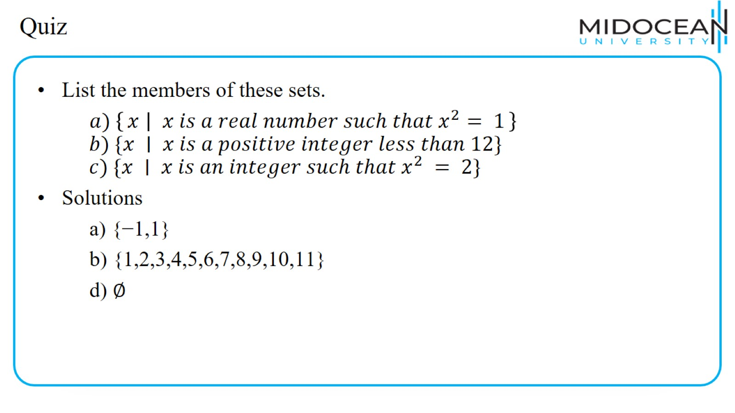
Quiz

Slide 27
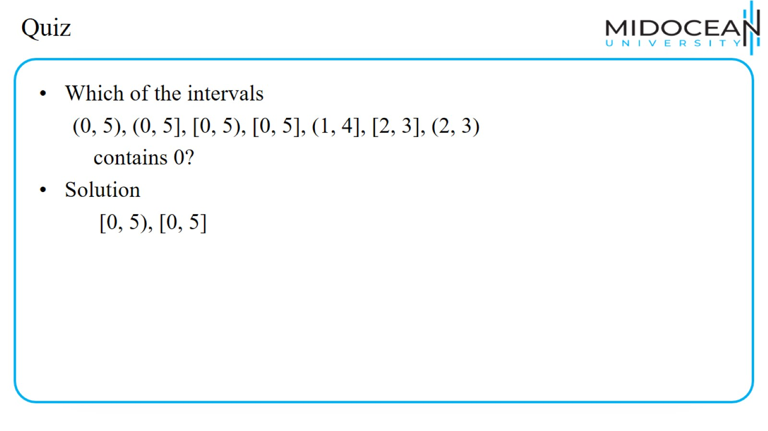
Quiz

Slide 28
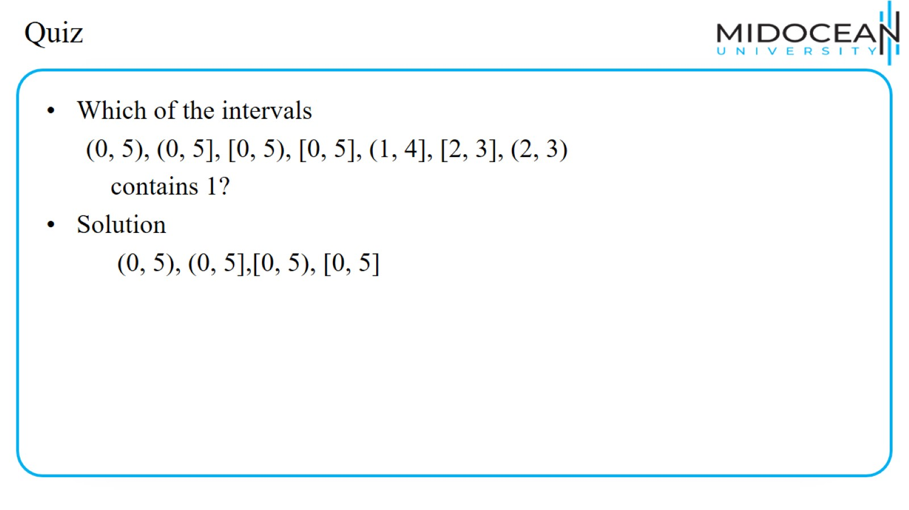
Quiz

Slide 29
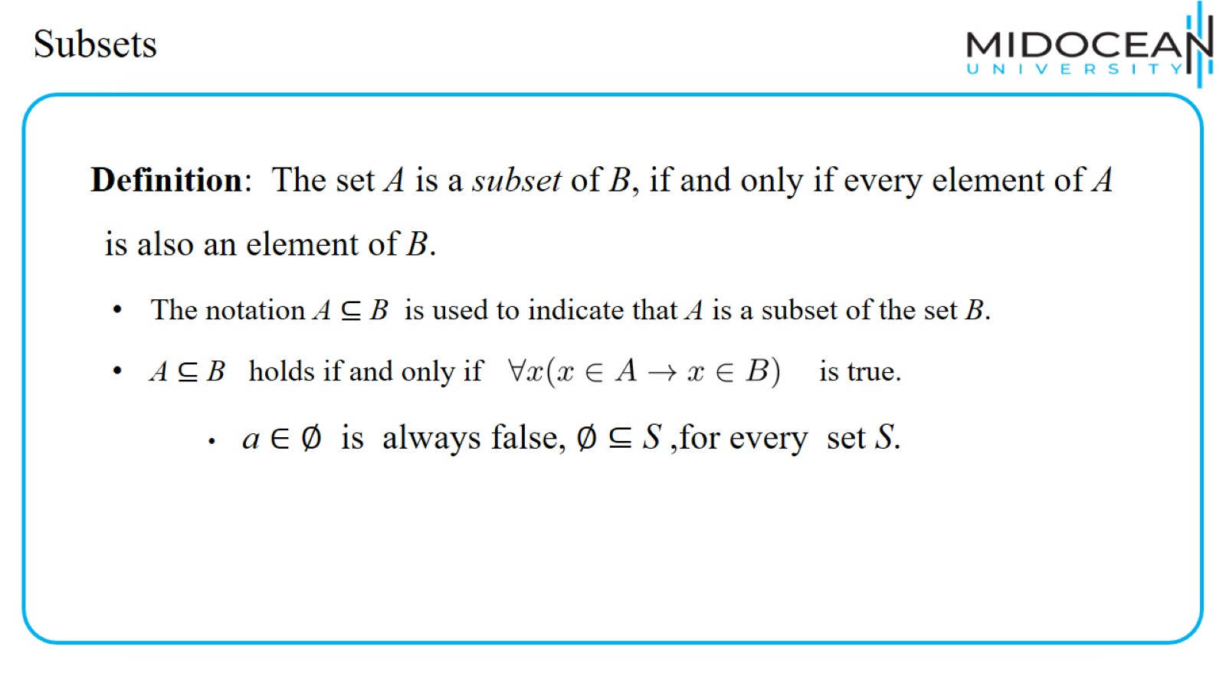
Subsets

Slide 30
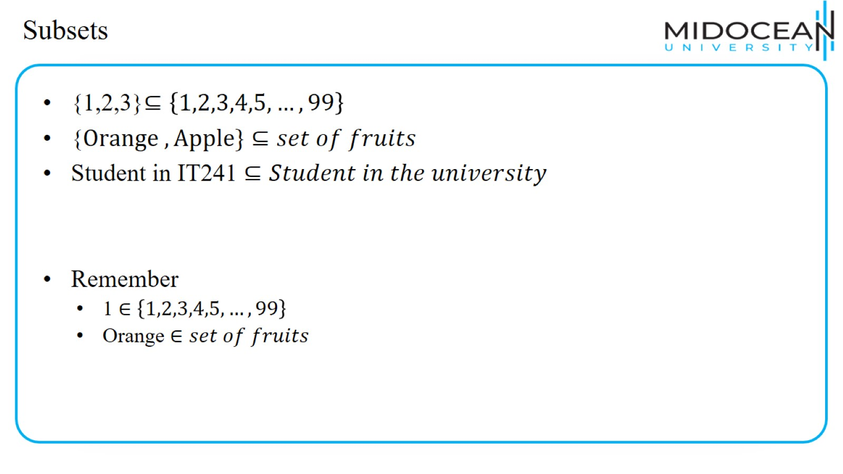
Subsets

Slide 31
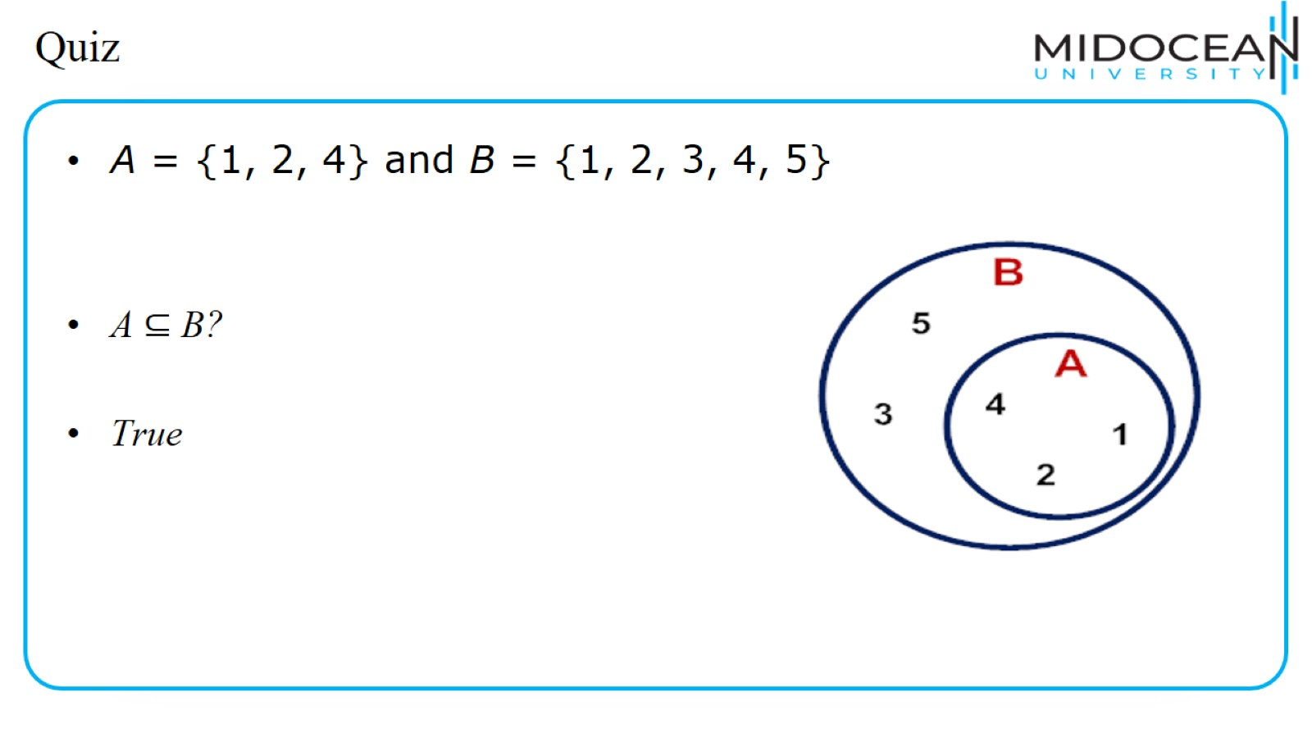
Quiz

Slide 32
Quiz

Slide 33
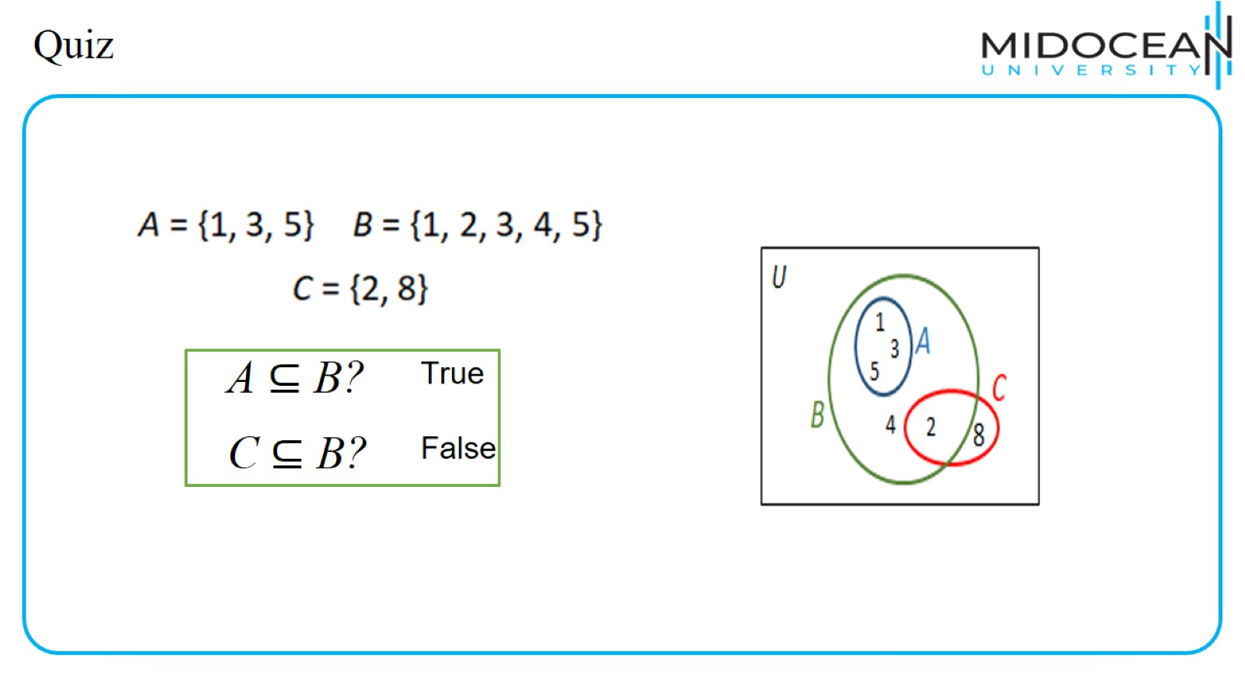
Quiz

Slide 34
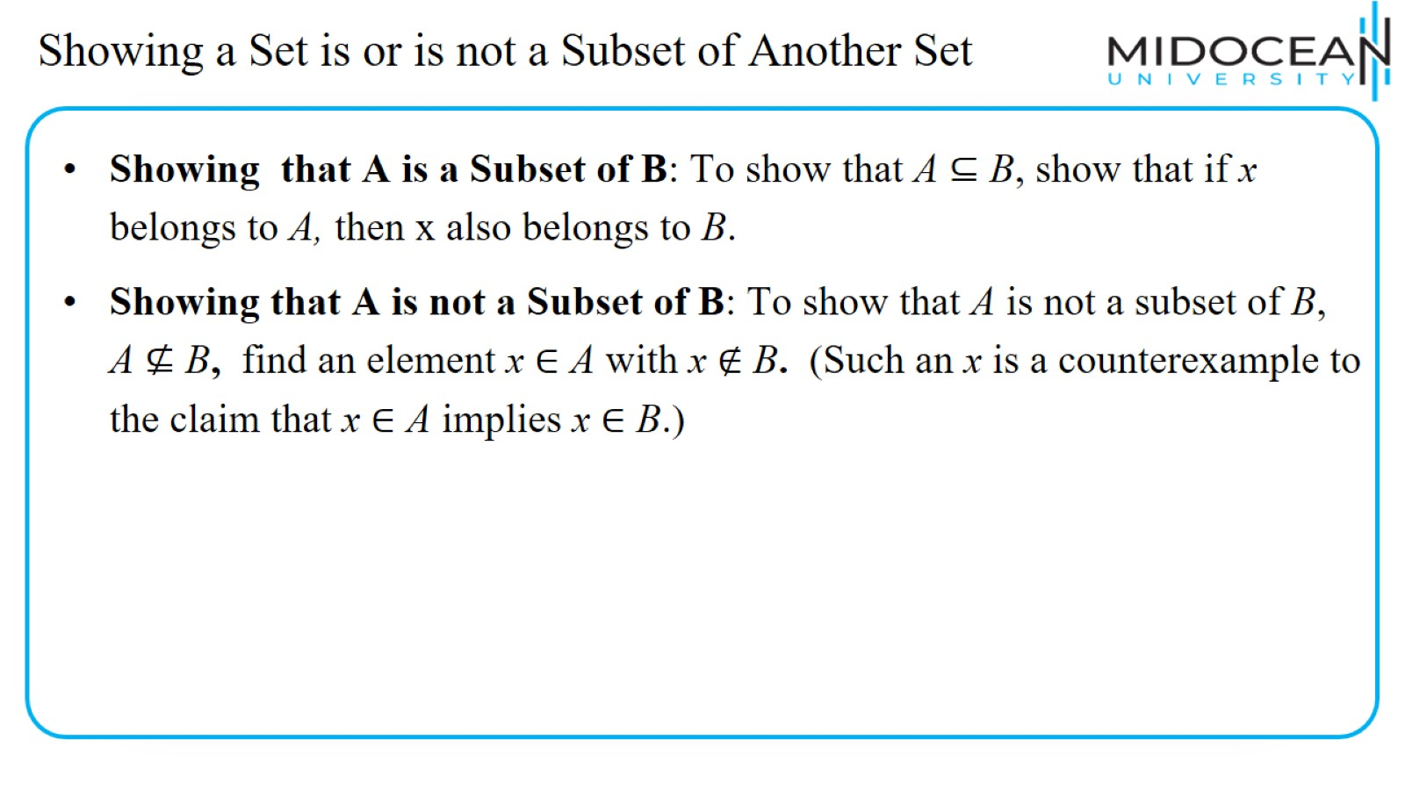
Showing a Set is or is not a Subset of Another Set

Slide 35
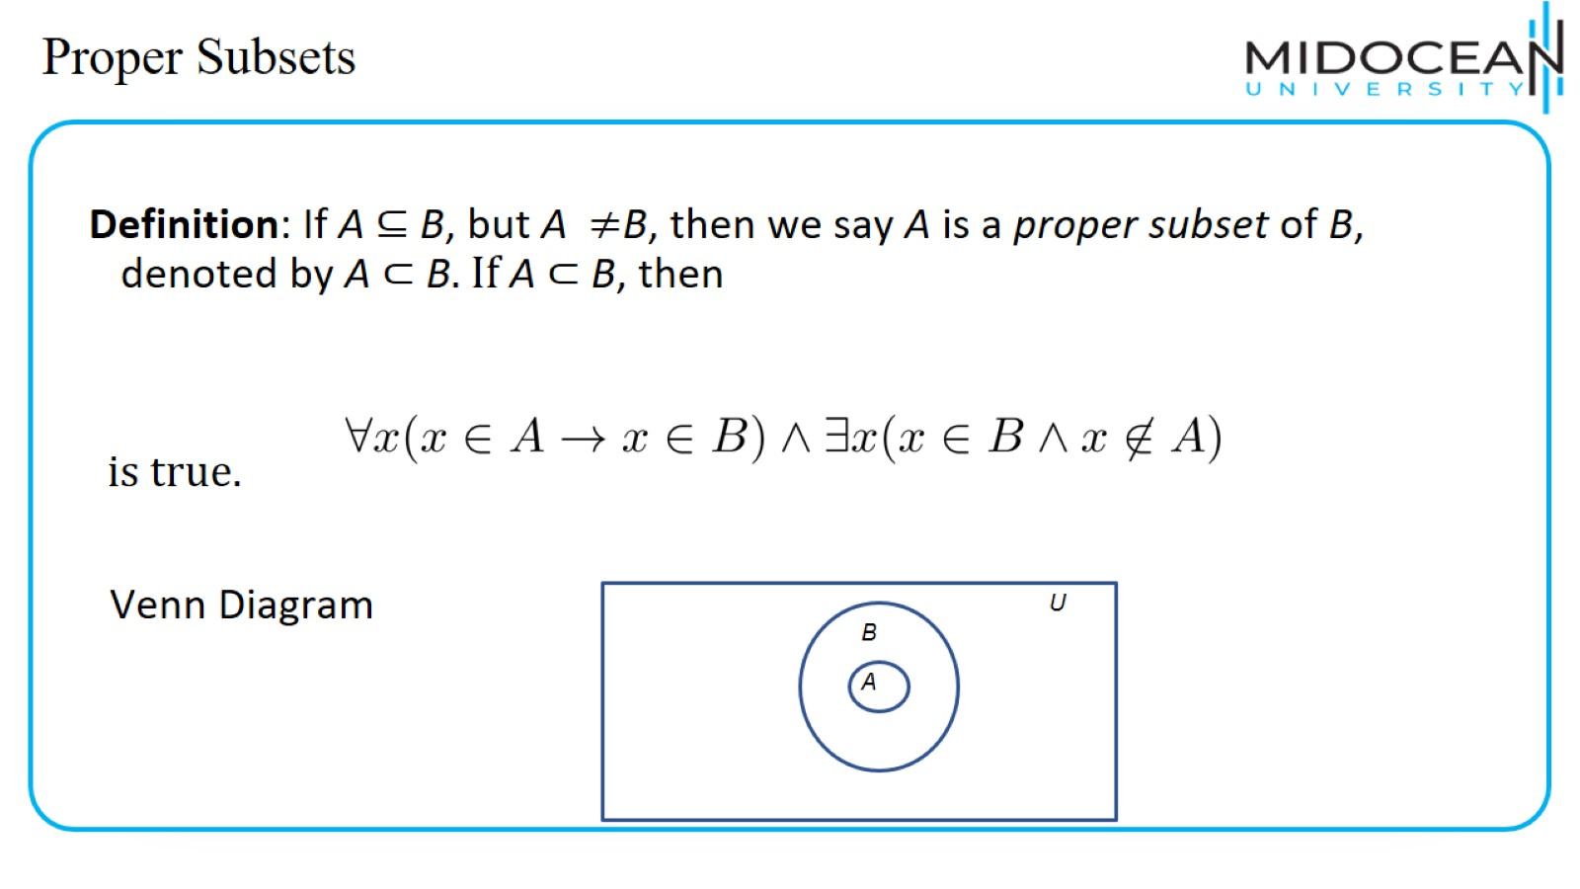
Proper Subsets

Slide 36
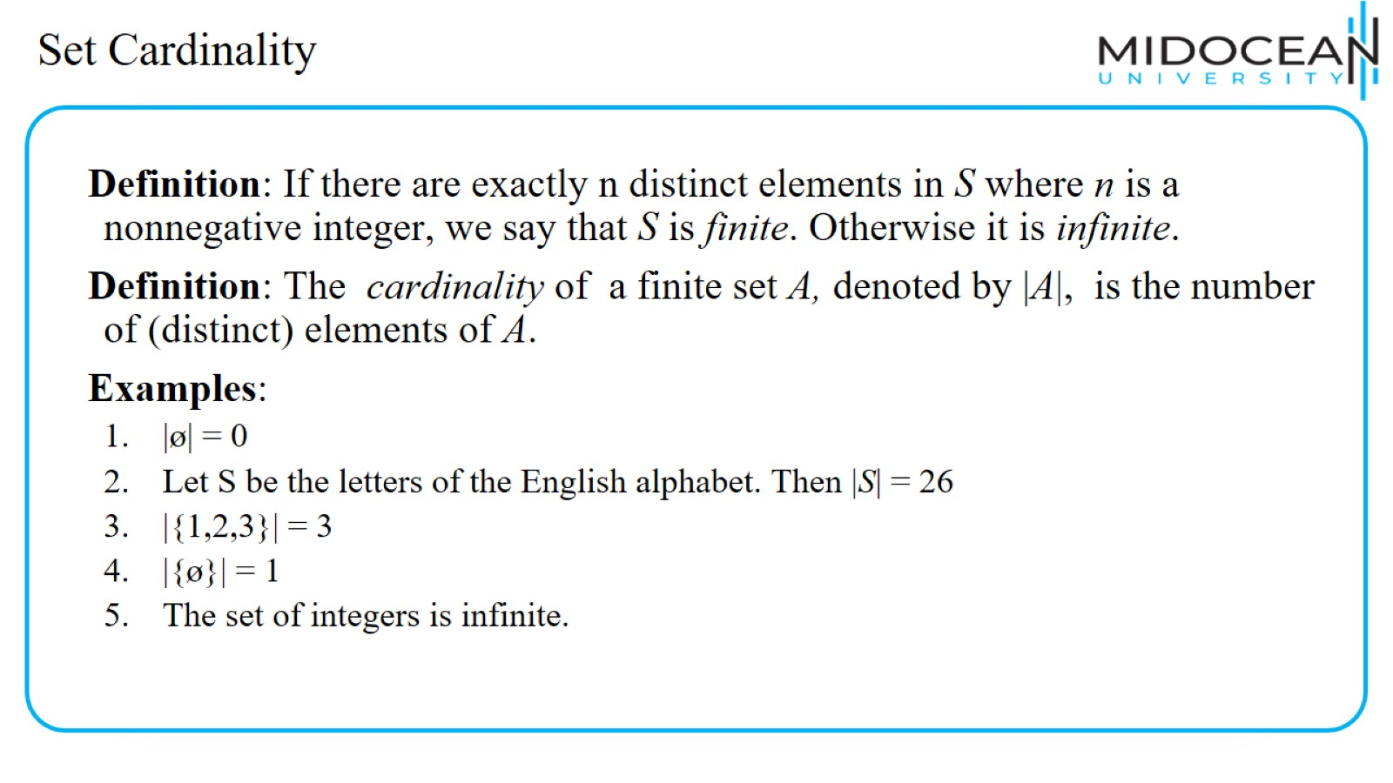
Set Cardinality

Slide 37
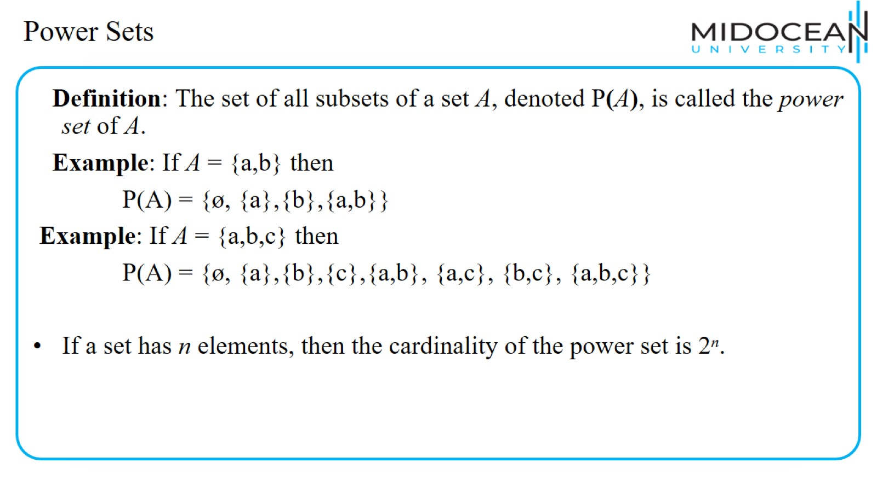
Power Sets

Slide 38
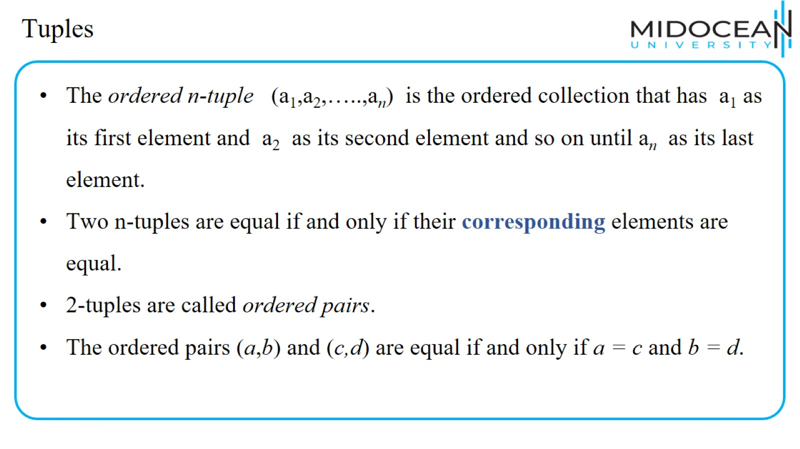
Tuples

Slide 39
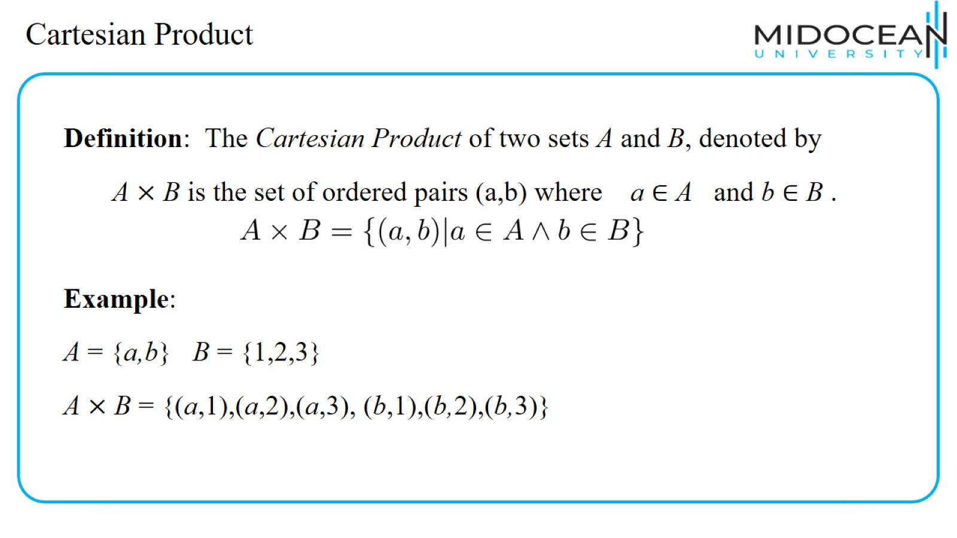
Cartesian Product

Slide 40
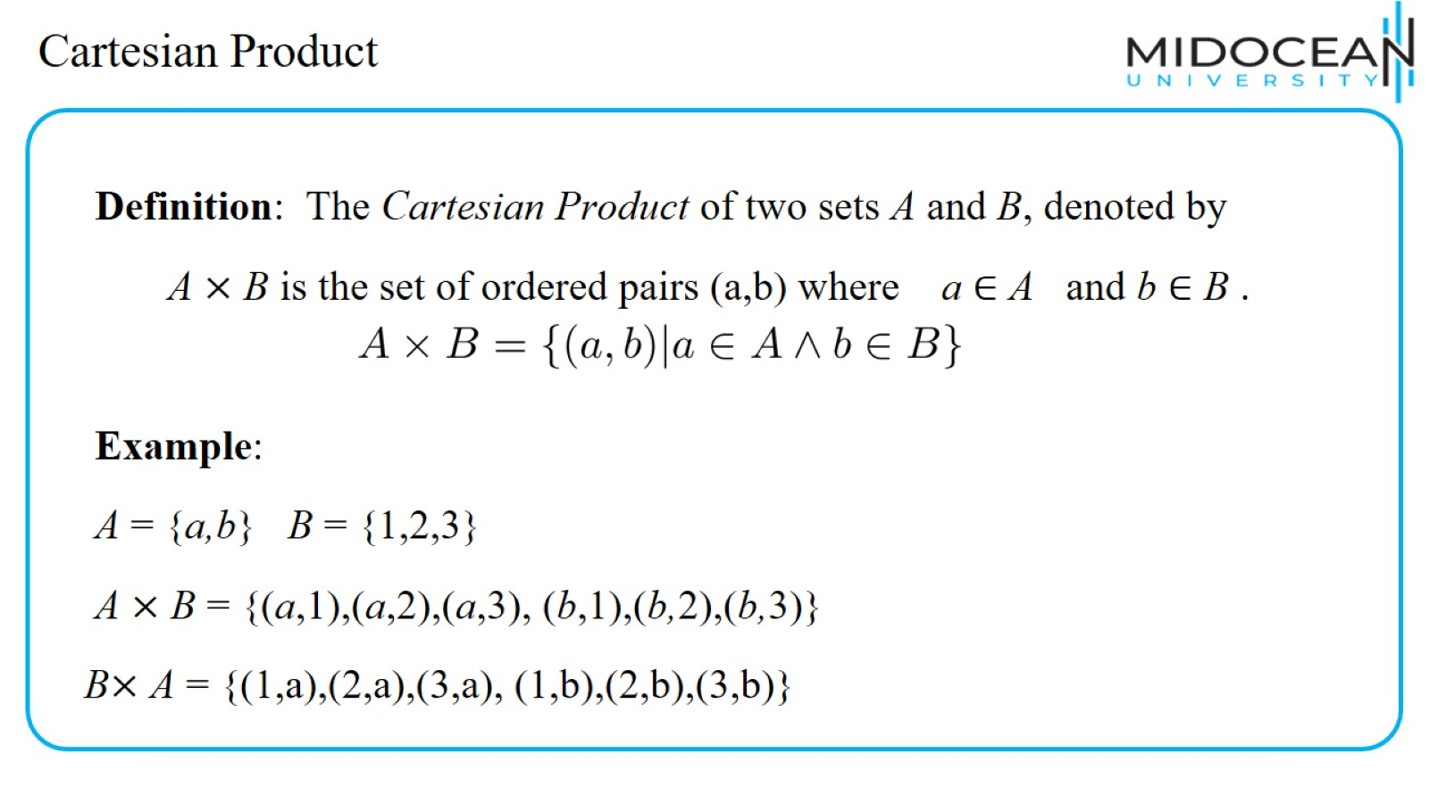
Cartesian Product

Slide 41
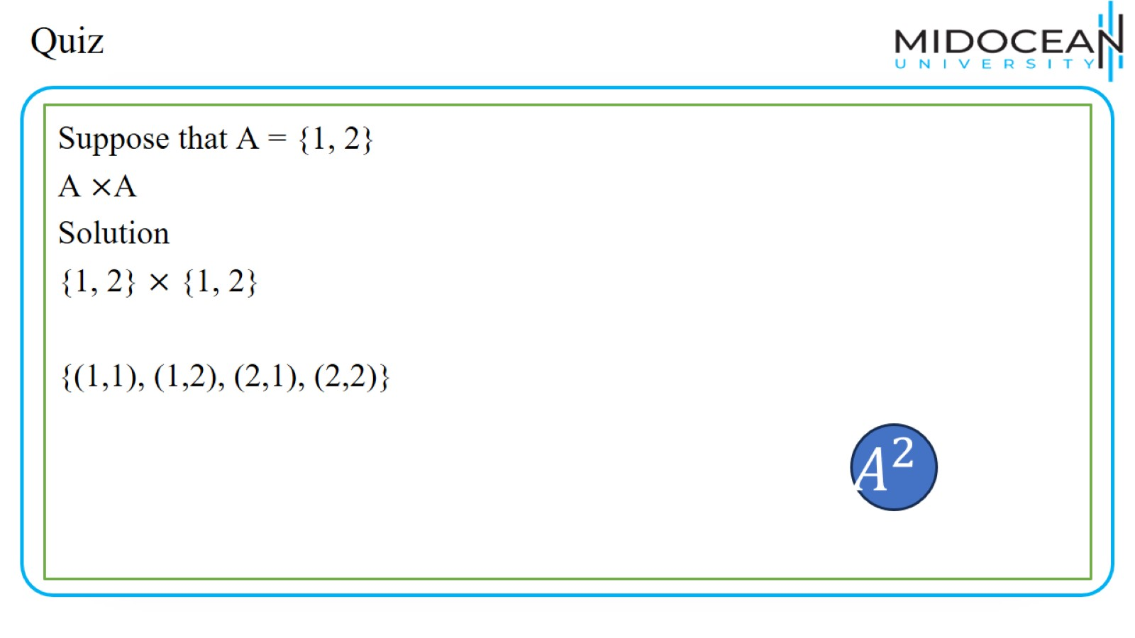
Quiz

Slide 42
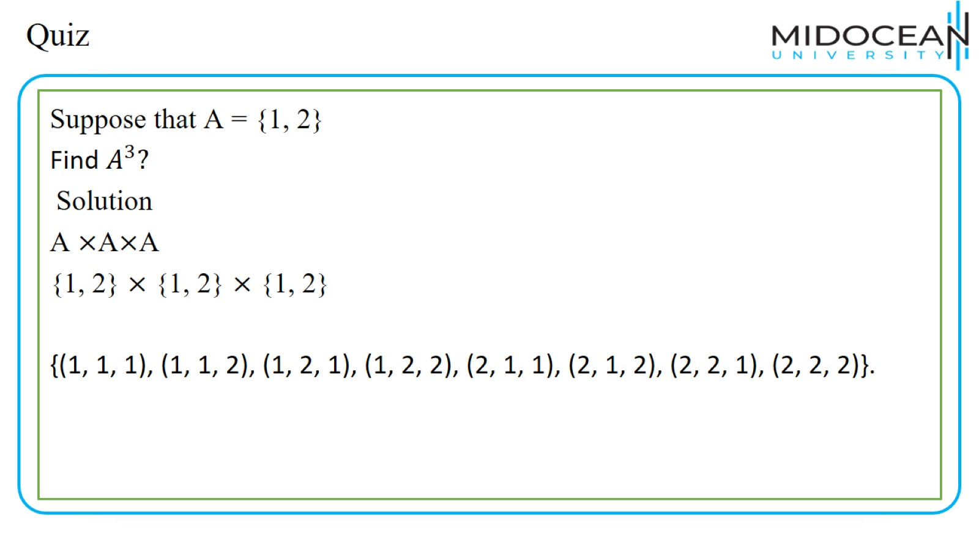
Quiz

Slide 43
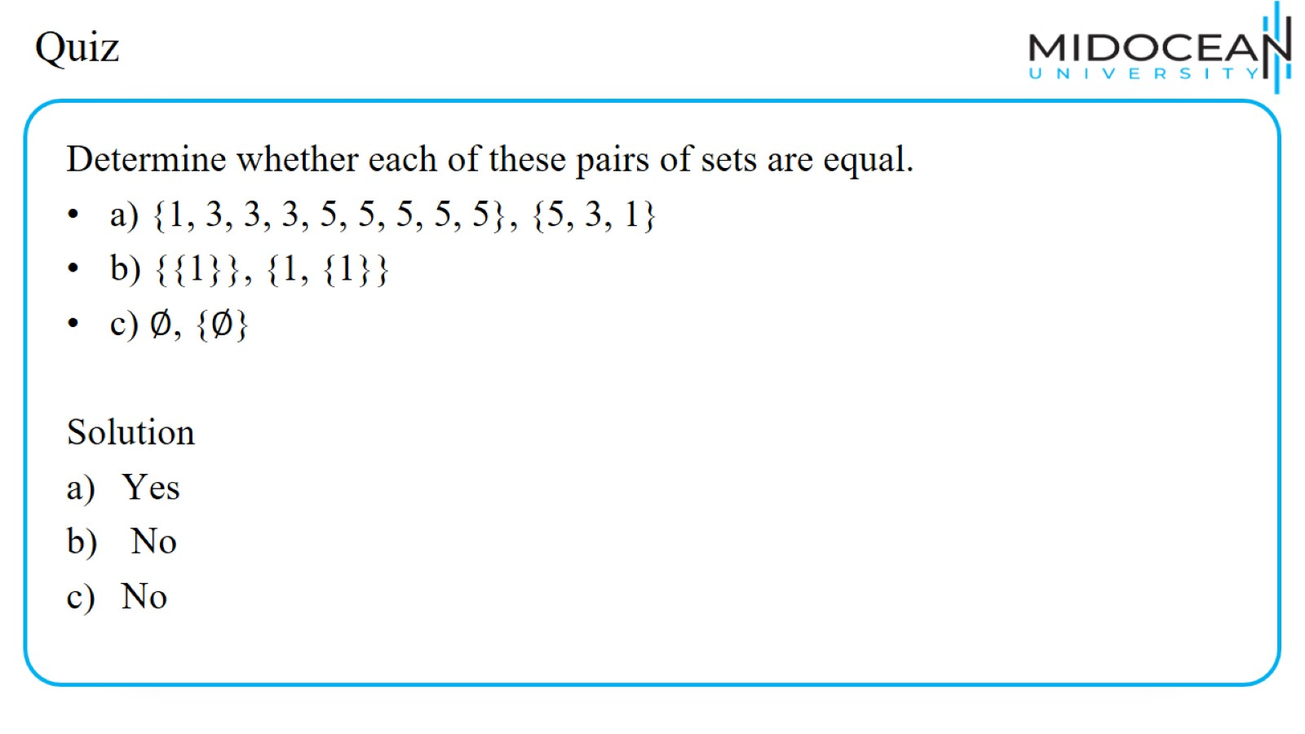
Quiz

Slide 44
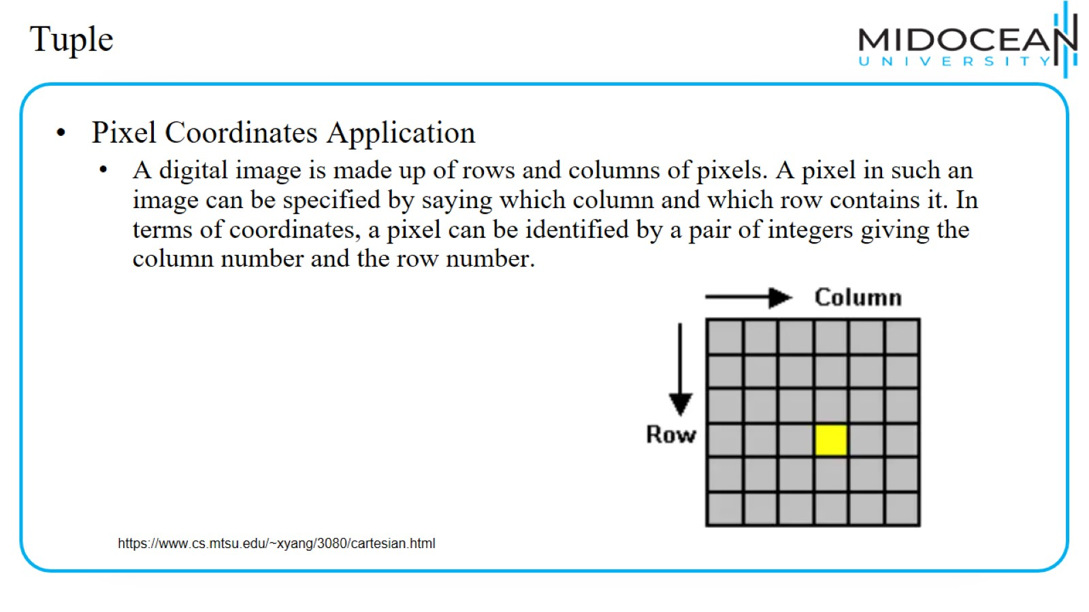
Tuple

Slide 45
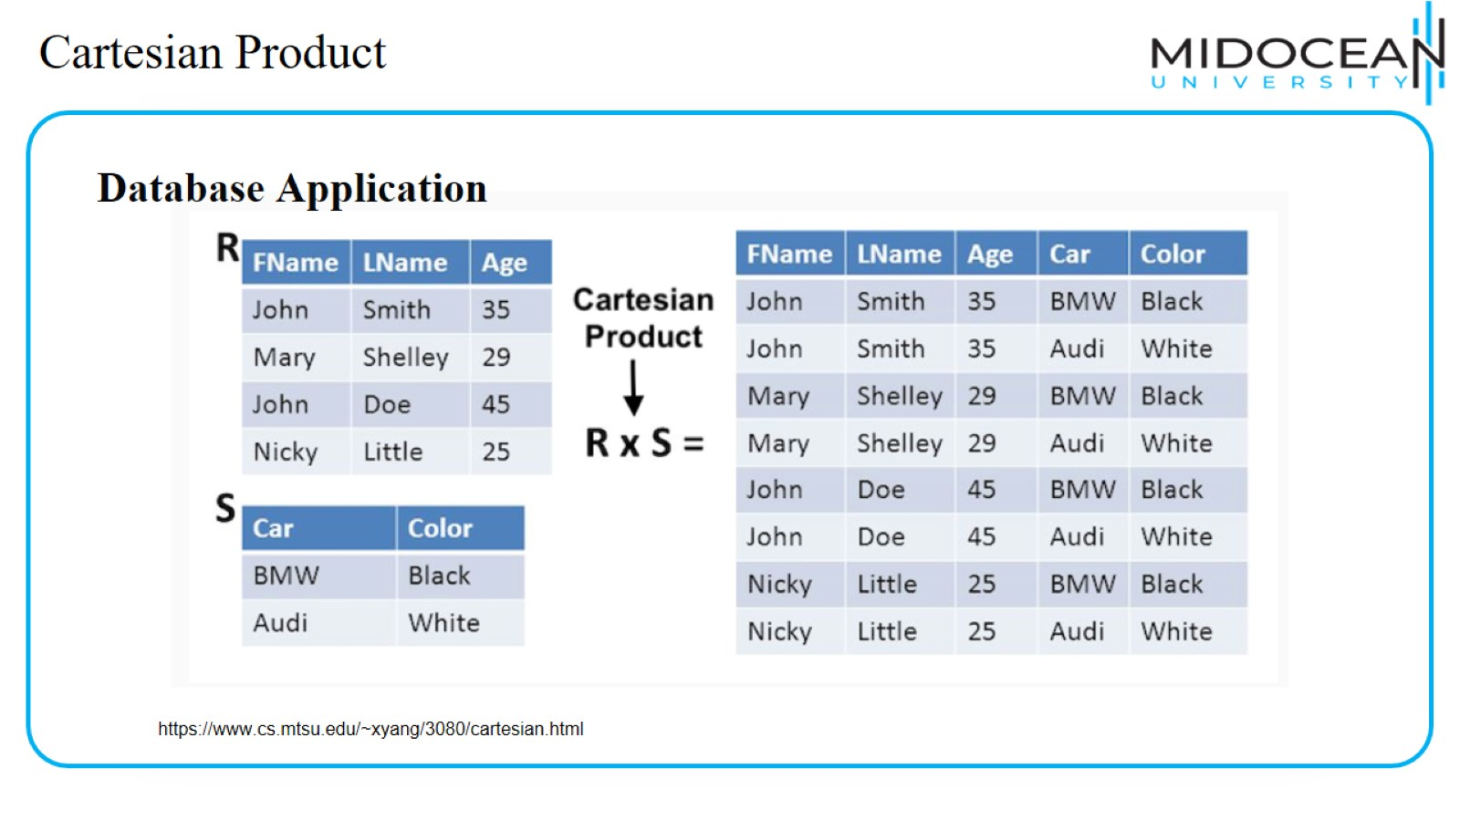
Cartesian Product

Slide 46

Set Operations

Slide 47
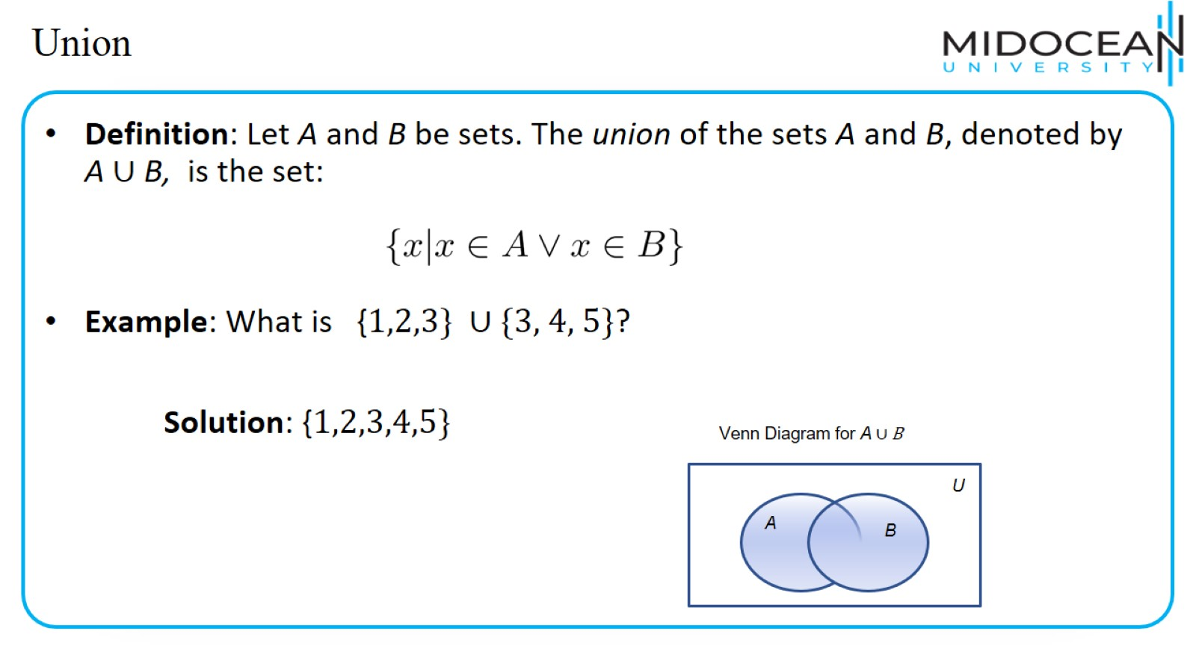
Union

Slide 48
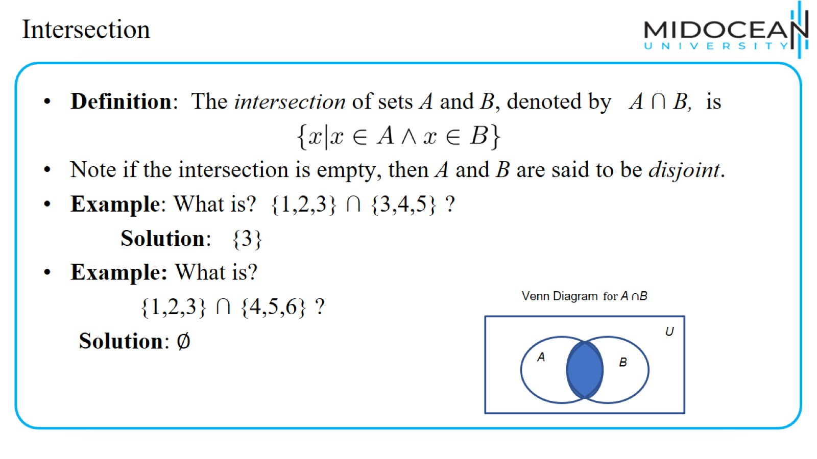
Intersection

Slide 49
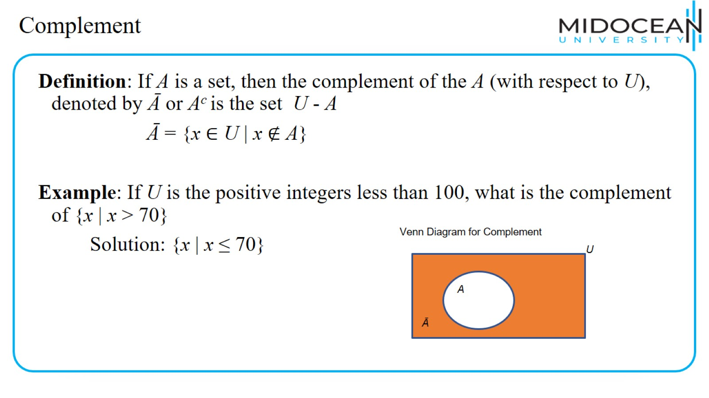
Complement

Slide 50
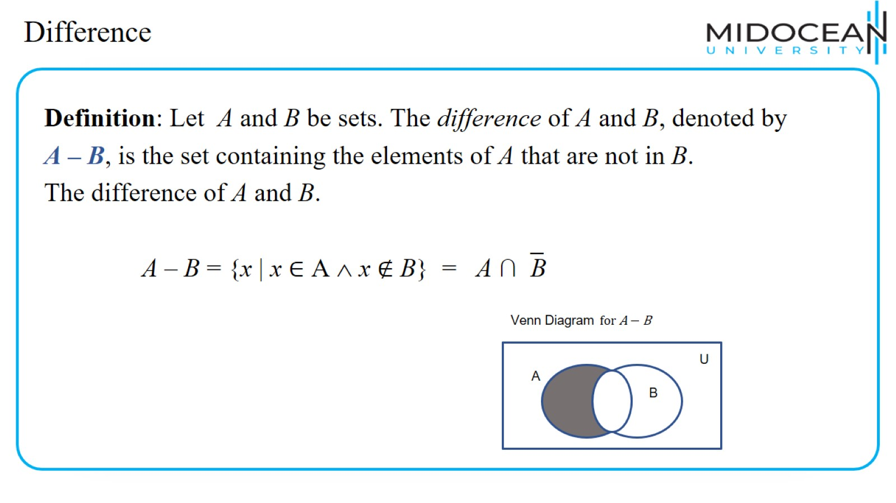
Difference

Slide 51
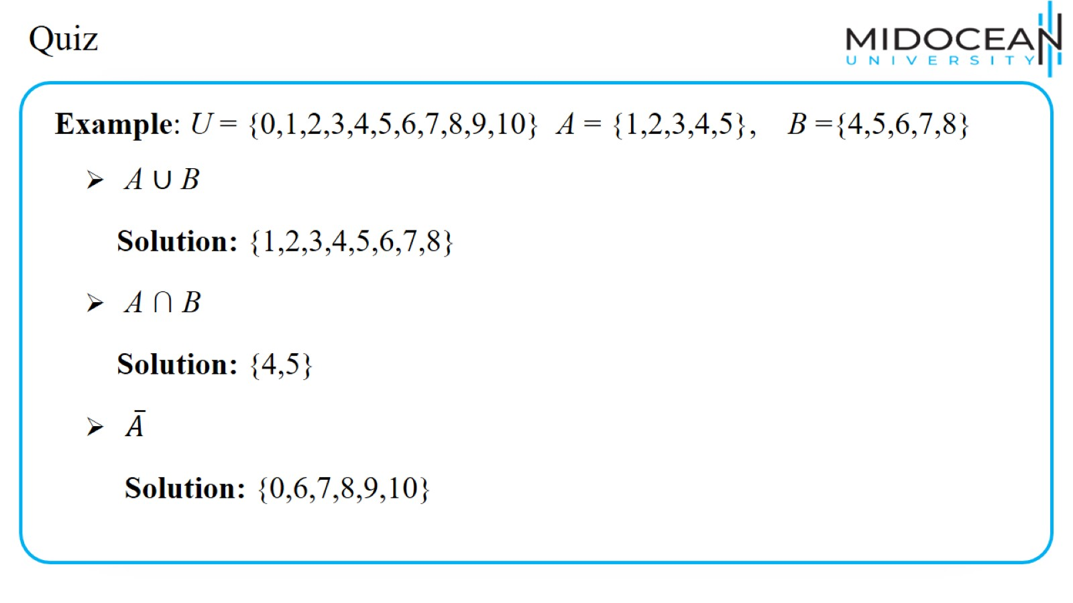
Quiz

Slide 52
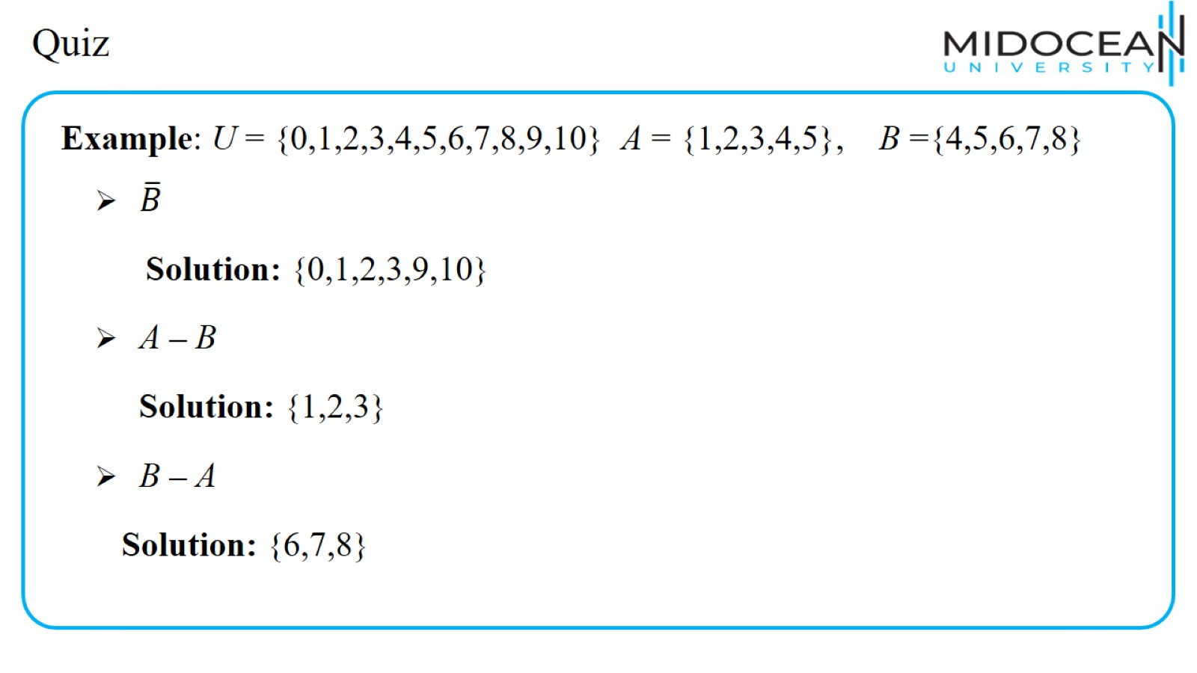
Quiz

Slide 53
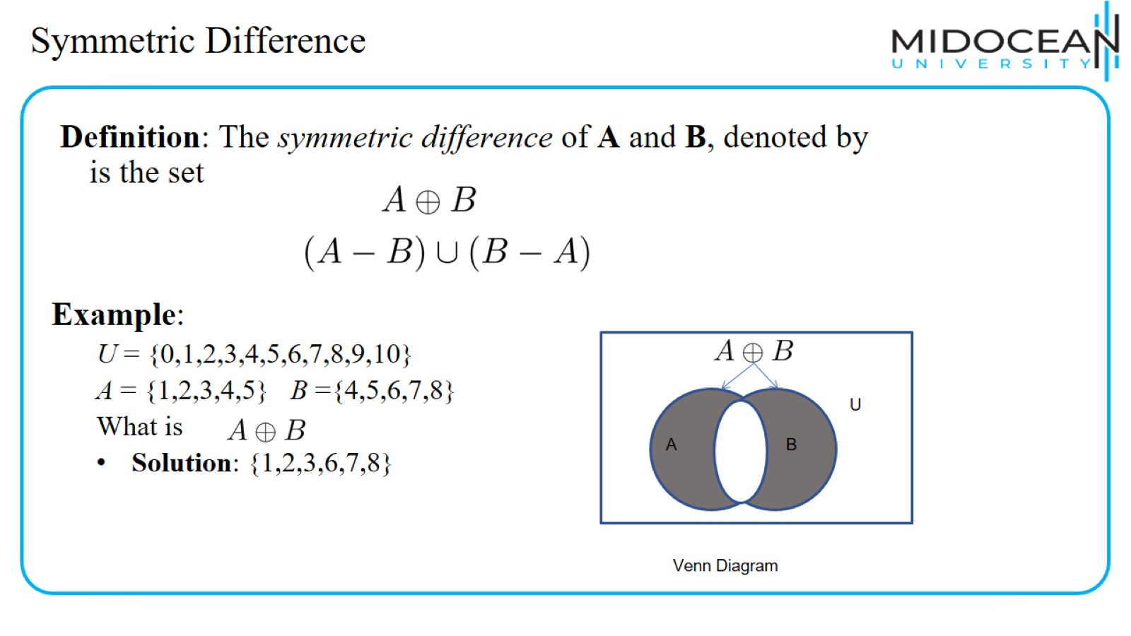
Symmetric Difference

Slide 54
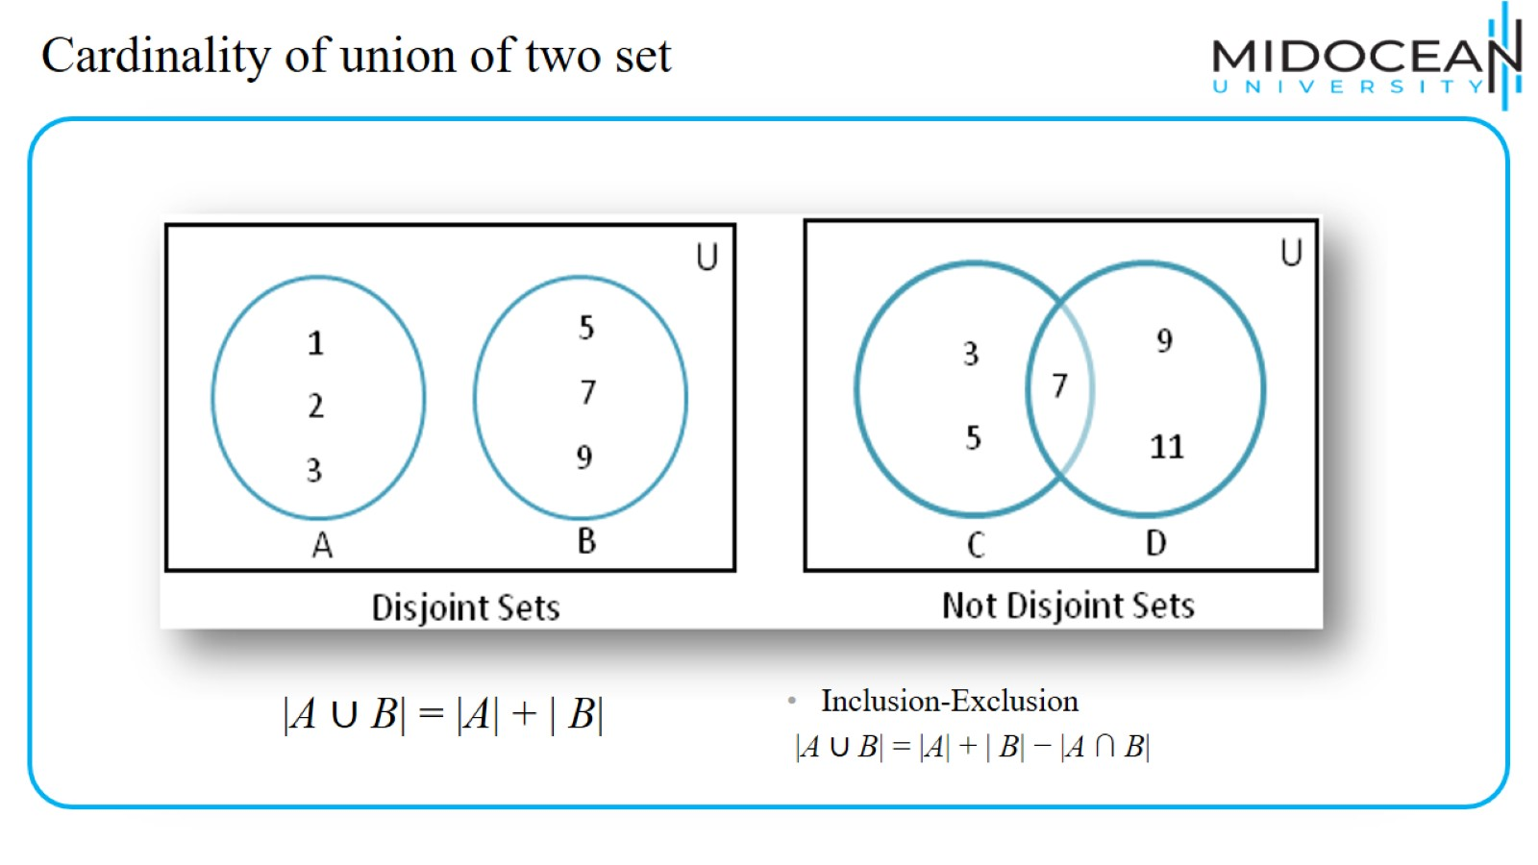
Cardinality of union of two set

Slide 55

Set Identities

Slide 56

Set Identities

Slide 57

Set Identities

Slide 58

Quiz

Slide 59

Quiz

Slide 60

Quiz

Slide 61

Quiz

Slide 62

Quiz

Slide 63

Quiz

Slide 64

Quiz

Slide 65

Summary

Slide 66


