Slide 1


Red Hat System Administration I
Dr. Eng. Gamal Selim
Lecture 07

Slide 2
Agenda
Chapter 12: Install and Update Software Packages
Red Hat Linux Administration I
Lecture 07
Dr. Eng. Gamal Selim

Slide 3
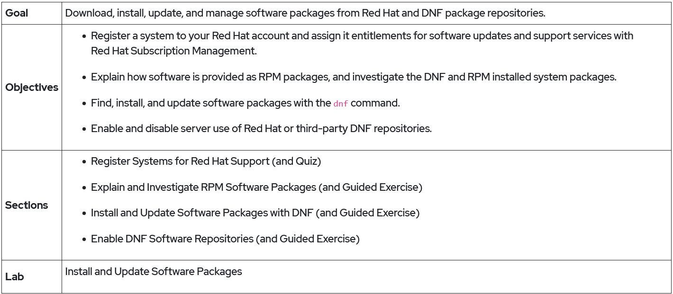
Red Hat Linux Administration I
Lecture 07
Dr. Eng. Gamal Selim

Slide 4
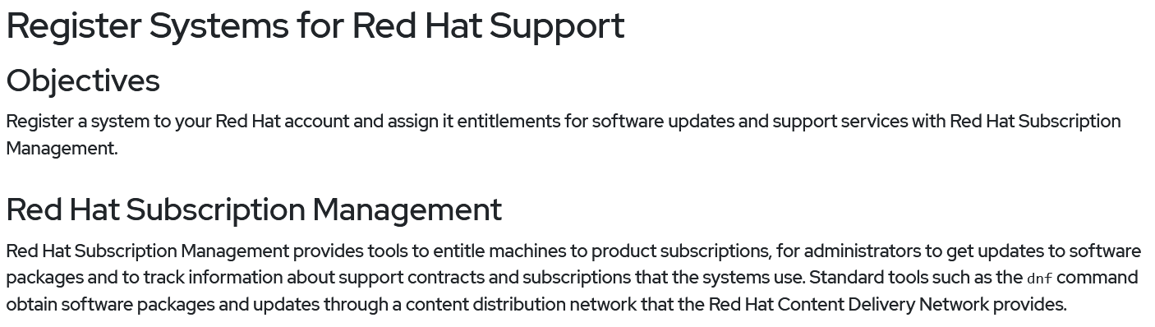
Red Hat Linux Administration I
Lecture 07
Dr. Eng. Gamal Selim

Slide 5
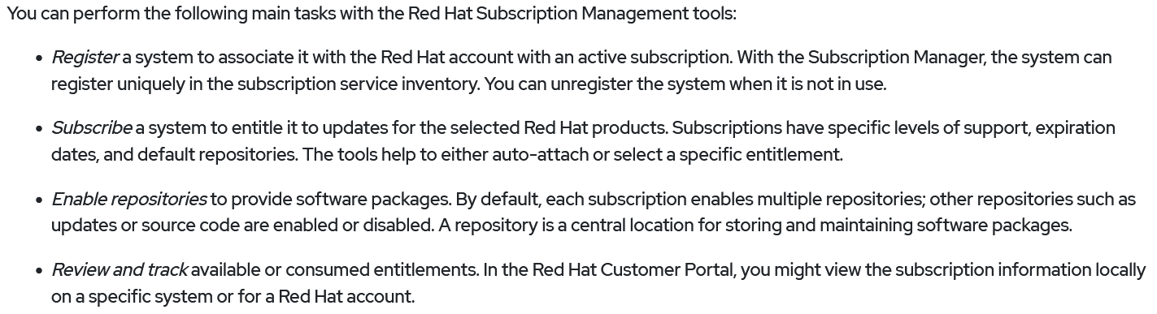
Red Hat Linux Administration I
Lecture 07
Dr. Eng. Gamal Selim

Slide 6
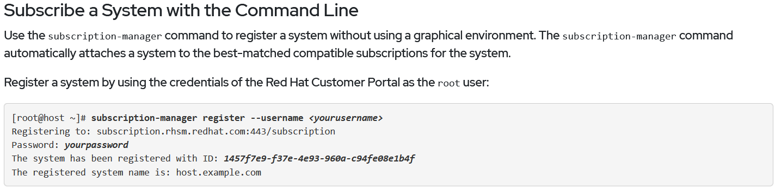
Red Hat Linux Administration I
Lecture 07
Dr. Eng. Gamal Selim

Slide 7
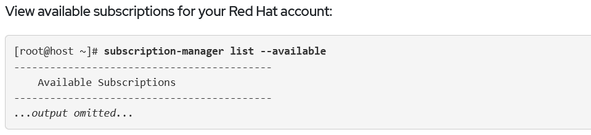
Red Hat Linux Administration I
Lecture 07
Dr. Eng. Gamal Selim

Slide 8
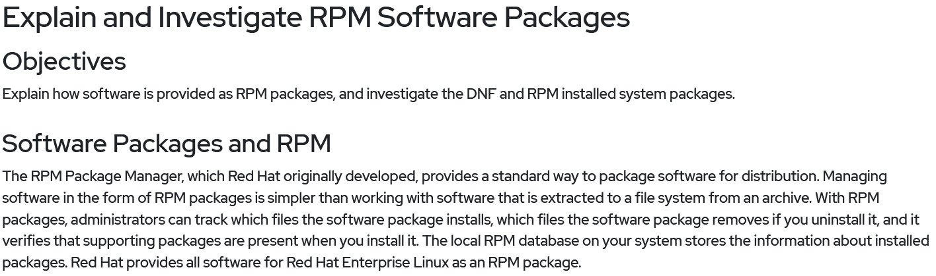
Red Hat Linux Administration I
Lecture 07
Dr. Eng. Gamal Selim

Slide 9
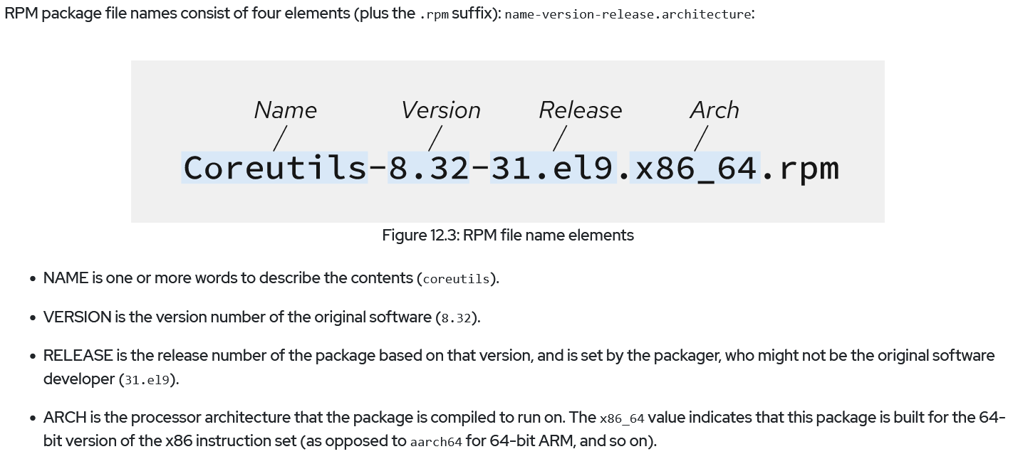
Red Hat Linux Administration I
Lecture 07
Dr. Eng. Gamal Selim

Slide 10
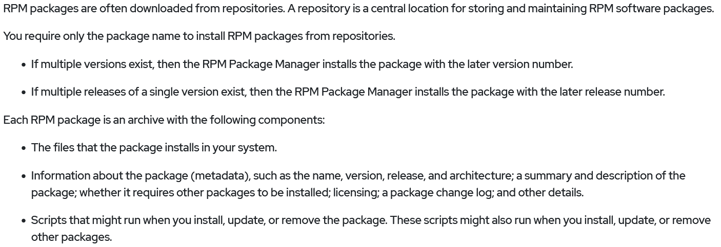
Red Hat Linux Administration I
Lecture 07
Dr. Eng. Gamal Selim

Slide 11
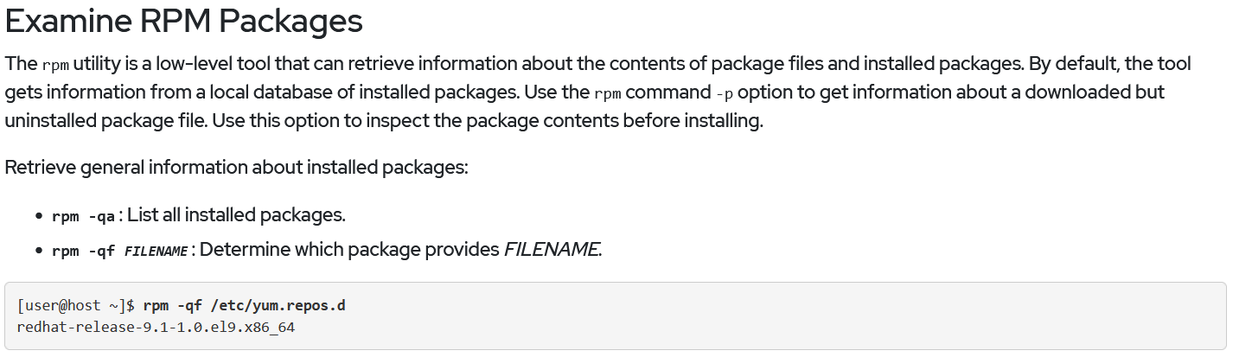
Red Hat Linux Administration I
Lecture 07
Dr. Eng. Gamal Selim

Slide 12
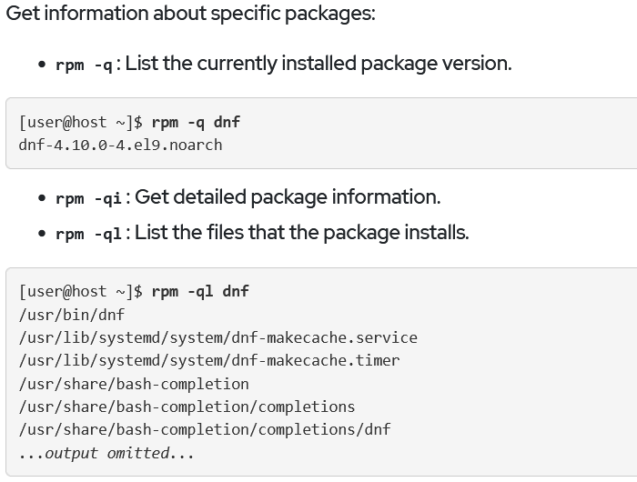
Red Hat Linux Administration I
Lecture 07
Dr. Eng. Gamal Selim

Slide 13
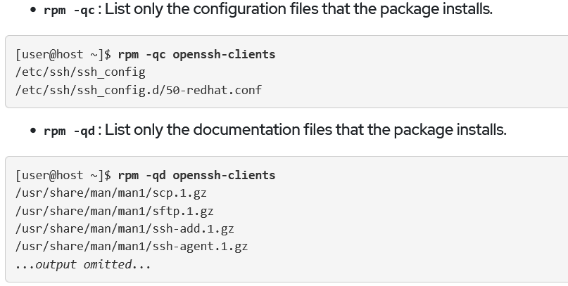
Red Hat Linux Administration I
Lecture 07
Dr. Eng. Gamal Selim

Slide 14
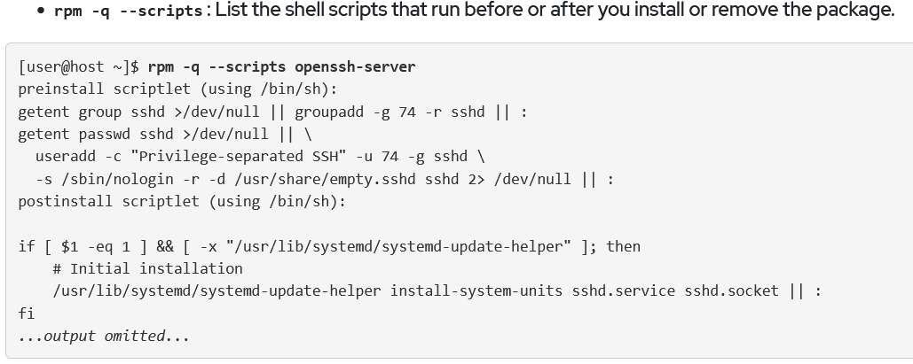
Red Hat Linux Administration I
Lecture 07
Dr. Eng. Gamal Selim

Slide 15
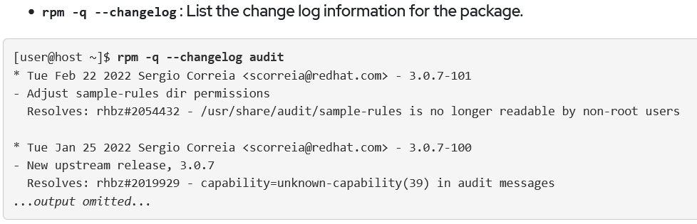
Red Hat Linux Administration I
Lecture 07
Dr. Eng. Gamal Selim

Slide 16
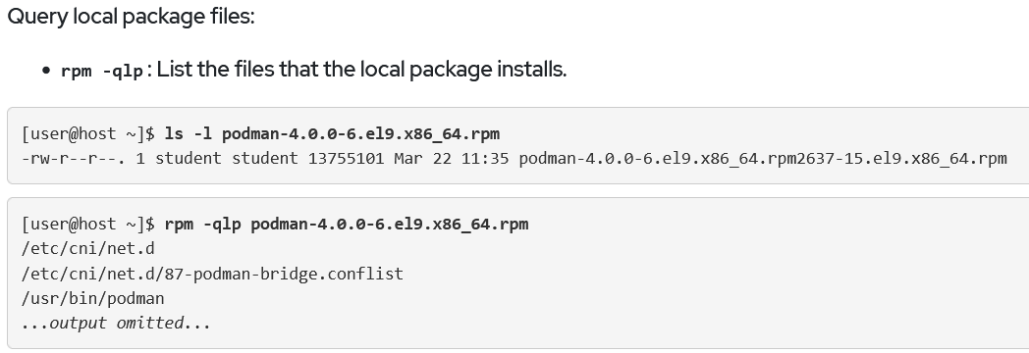
Red Hat Linux Administration I
Lecture 07
Dr. Eng. Gamal Selim

Slide 17
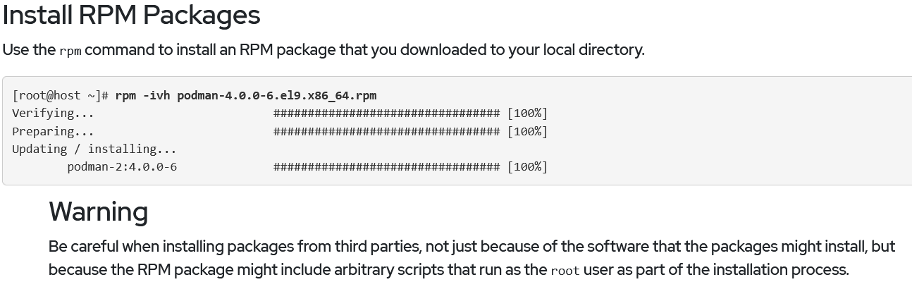
Red Hat Linux Administration I
Lecture 07
Dr. Eng. Gamal Selim

Slide 18
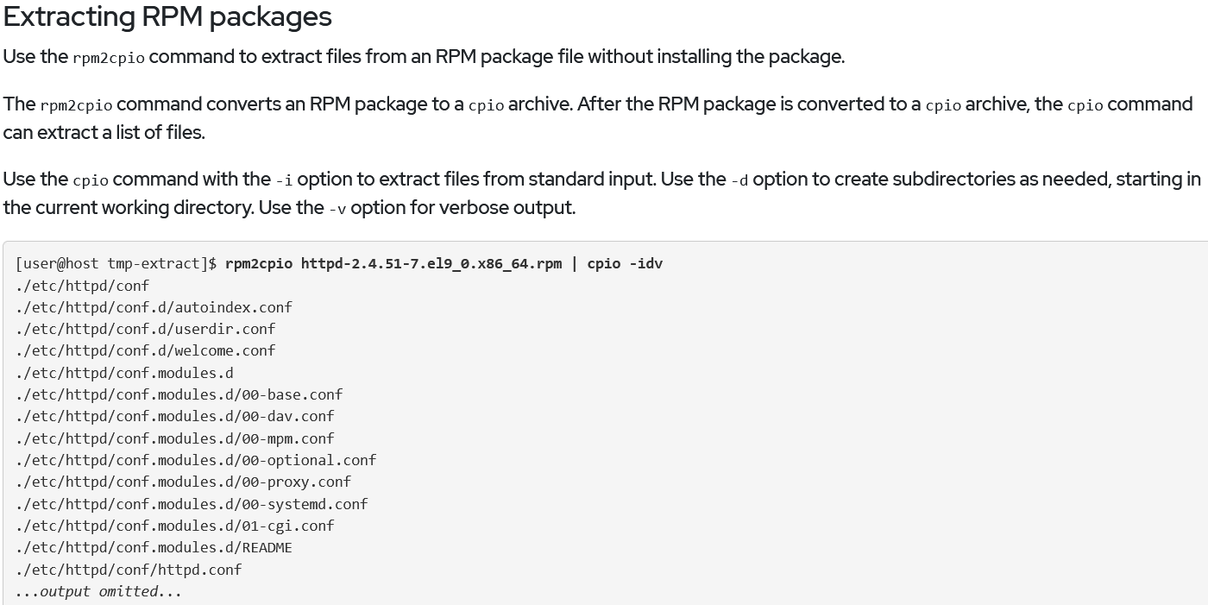
Red Hat Linux Administration I
Lecture 07
Dr. Eng. Gamal Selim

Slide 19
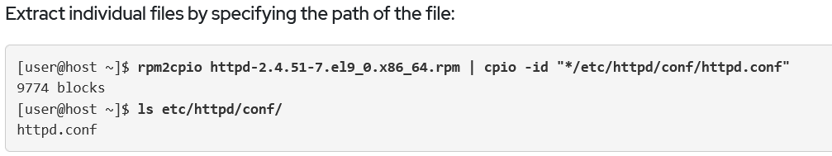
Red Hat Linux Administration I
Lecture 07
Dr. Eng. Gamal Selim

Slide 20
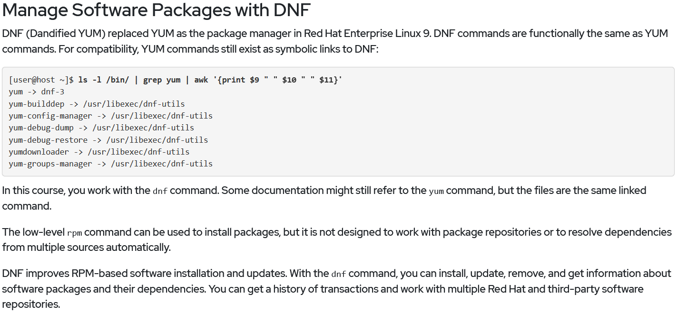
Red Hat Linux Administration I
Lecture 07
Dr. Eng. Gamal Selim

Slide 21
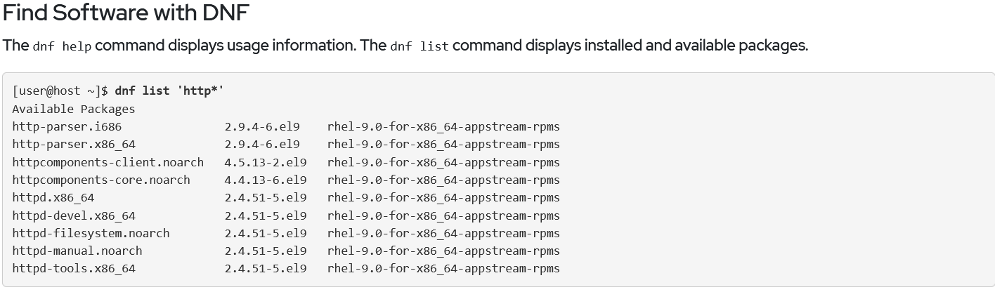
Red Hat Linux Administration I
Lecture 07
Dr. Eng. Gamal Selim

Slide 22
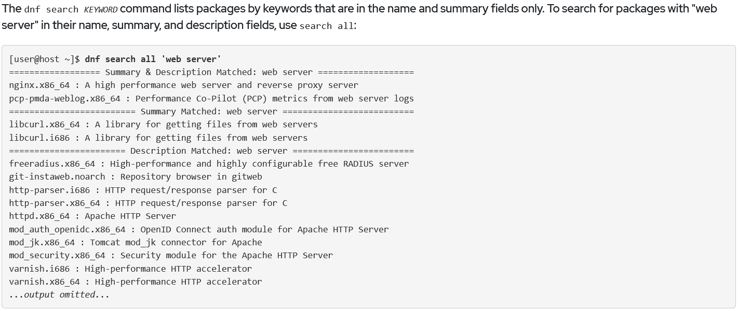
Red Hat Linux Administration I
Lecture 07
Dr. Eng. Gamal Selim

Slide 23
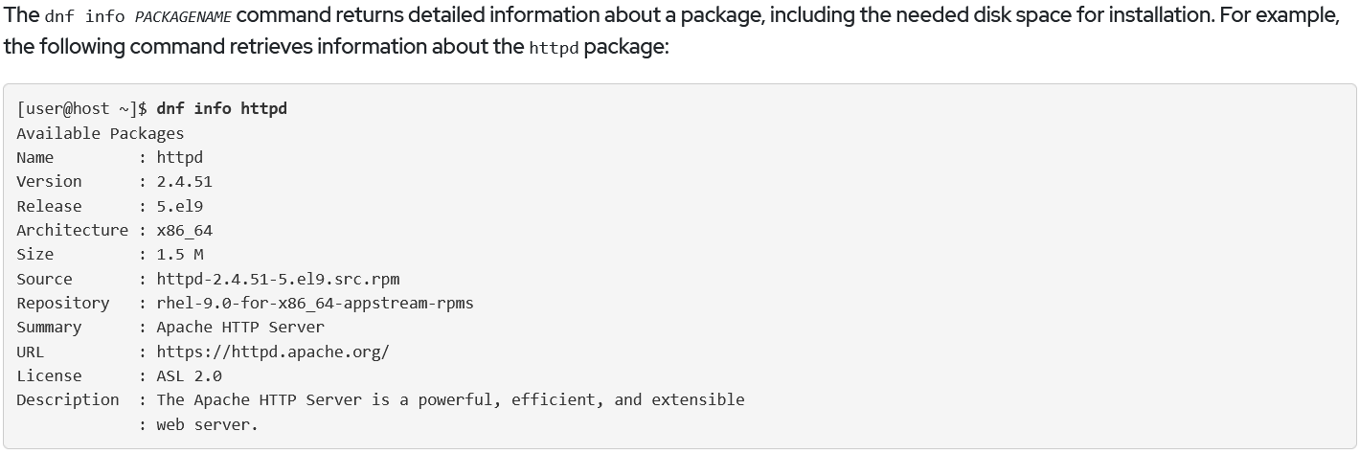
Red Hat Linux Administration I
Lecture 07
Dr. Eng. Gamal Selim

Slide 24
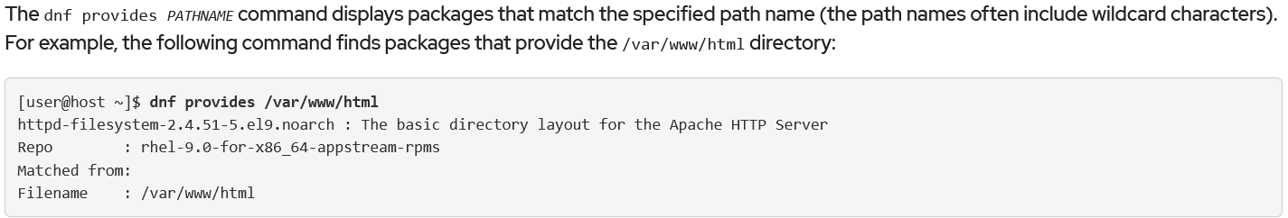
Red Hat Linux Administration I
Lecture 07
Dr. Eng. Gamal Selim

Slide 25
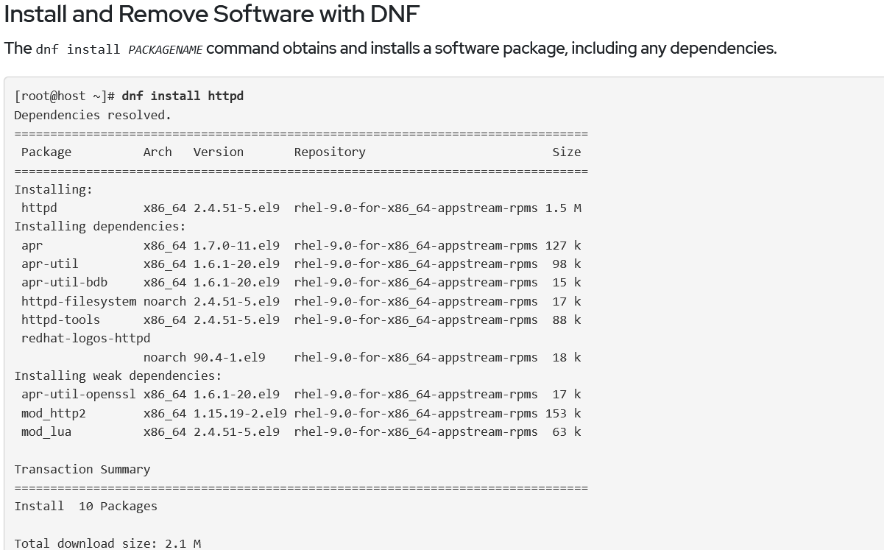
Red Hat Linux Administration I
Lecture 07
Dr. Eng. Gamal Selim

Slide 26
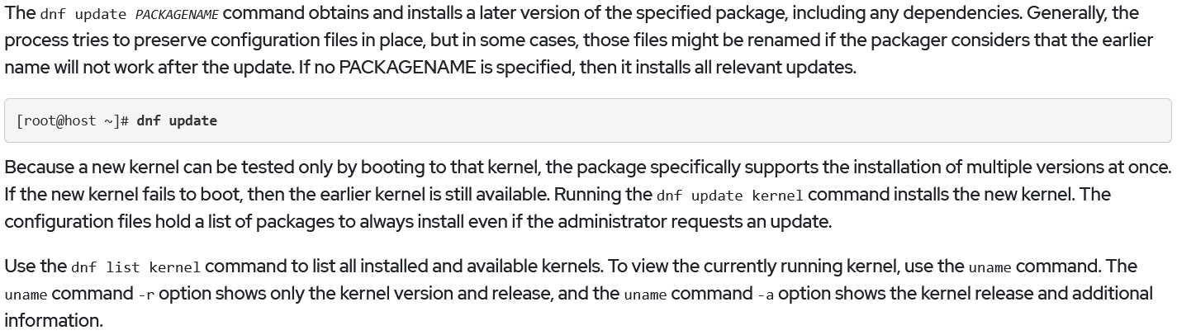
Red Hat Linux Administration I
Lecture 07
Dr. Eng. Gamal Selim

Slide 27
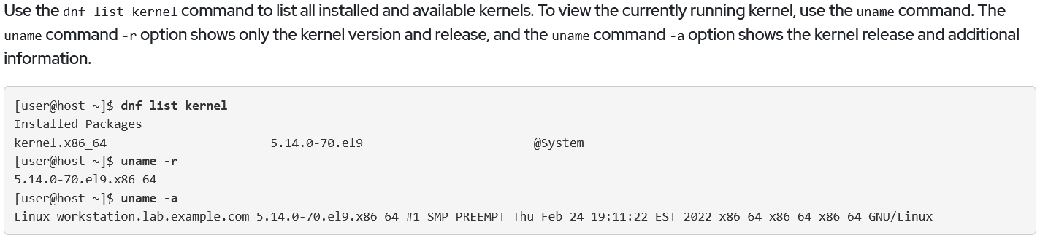
Red Hat Linux Administration I
Lecture 07
Dr. Eng. Gamal Selim

Slide 28
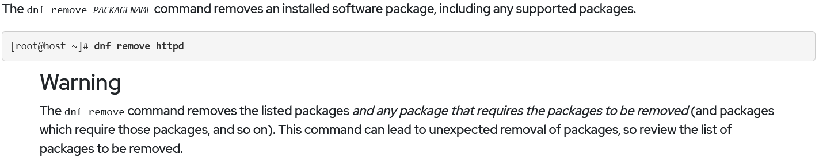
Red Hat Linux Administration I
Lecture 07
Dr. Eng. Gamal Selim

Slide 29
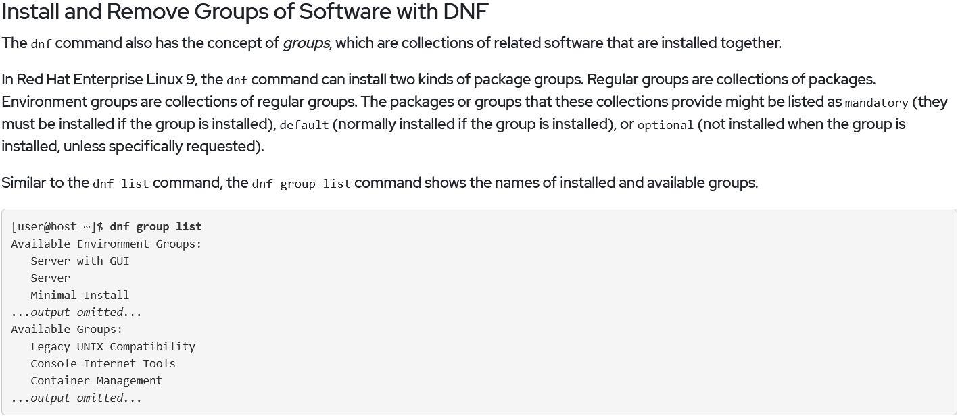
Red Hat Linux Administration I
Lecture 07
Dr. Eng. Gamal Selim

Slide 30
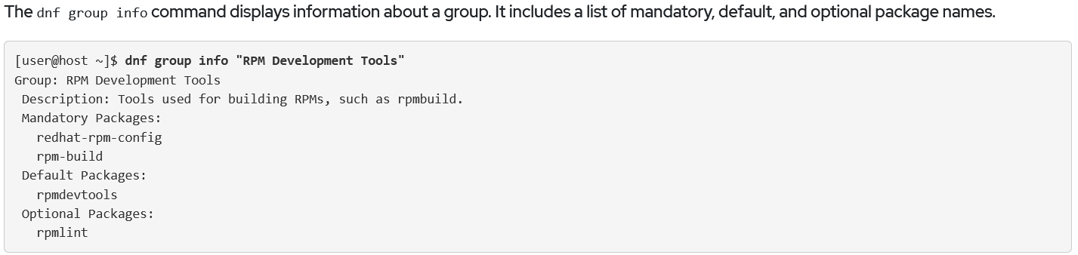
Red Hat Linux Administration I
Lecture 07
Dr. Eng. Gamal Selim

Slide 31
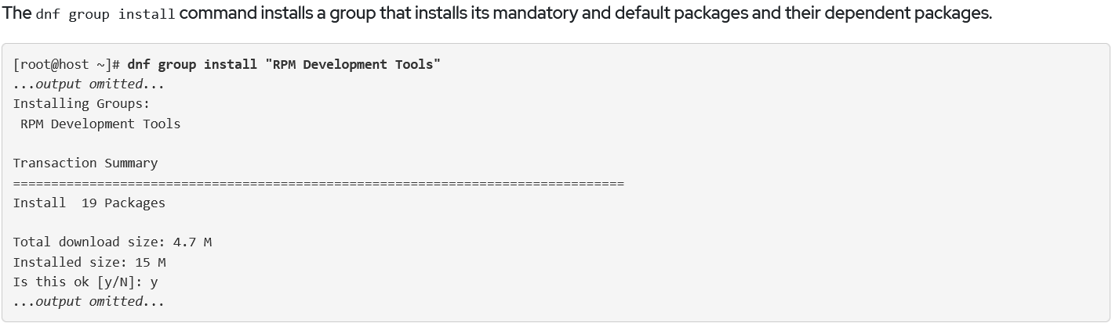
Red Hat Linux Administration I
Lecture 07
Dr. Eng. Gamal Selim

Slide 32
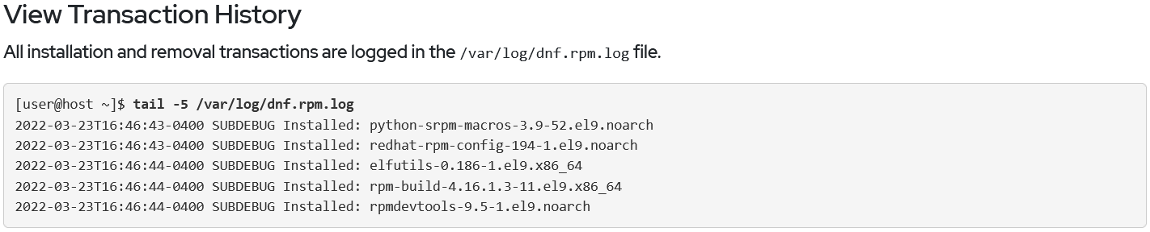
Red Hat Linux Administration I
Lecture 07
Dr. Eng. Gamal Selim

Slide 33
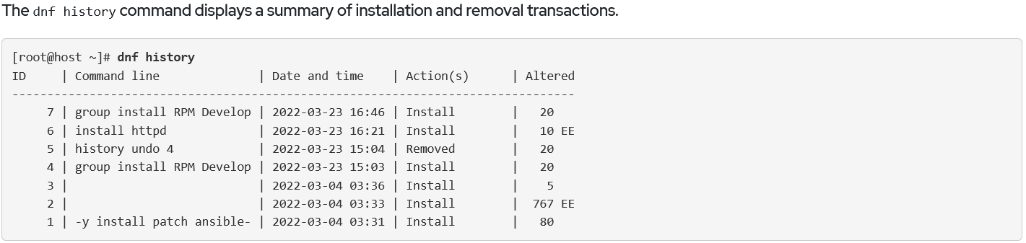
Red Hat Linux Administration I
Lecture 07
Dr. Eng. Gamal Selim

Slide 34
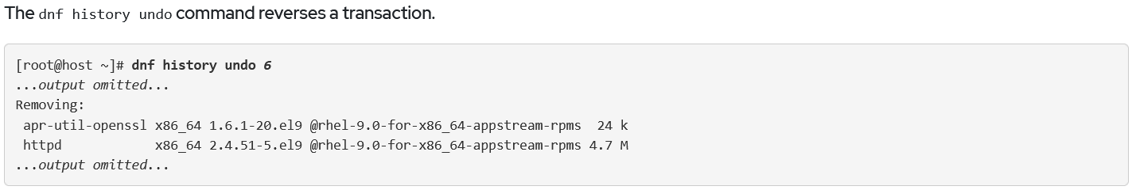
Red Hat Linux Administration I
Lecture 07
Dr. Eng. Gamal Selim

Slide 35
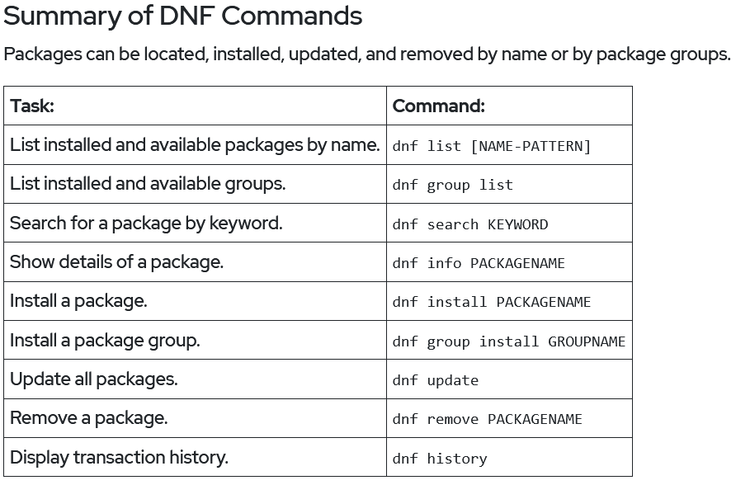
Red Hat Linux Administration I
Lecture 07
Dr. Eng. Gamal Selim

Slide 36
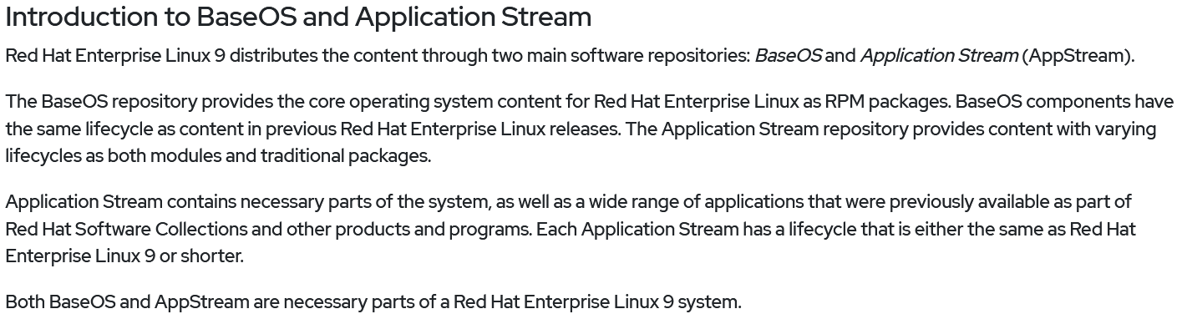
Red Hat Linux Administration I
Lecture 07
Dr. Eng. Gamal Selim

Slide 37
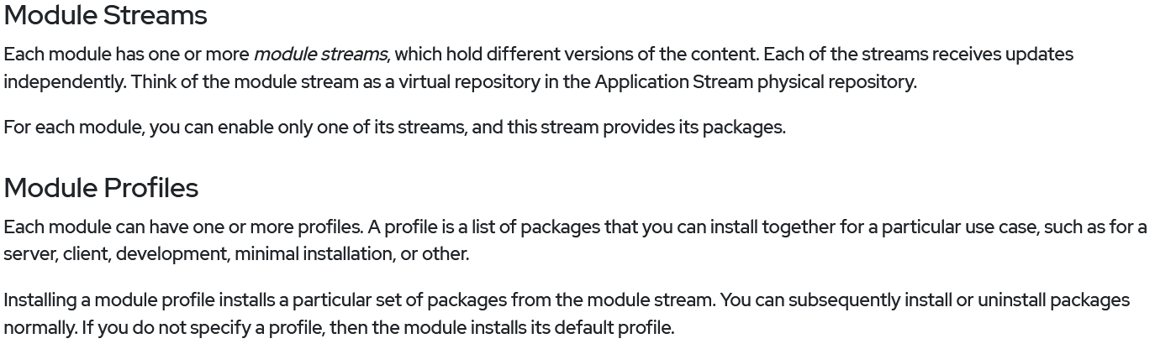
Red Hat Linux Administration I
Lecture 07
Dr. Eng. Gamal Selim

Slide 38
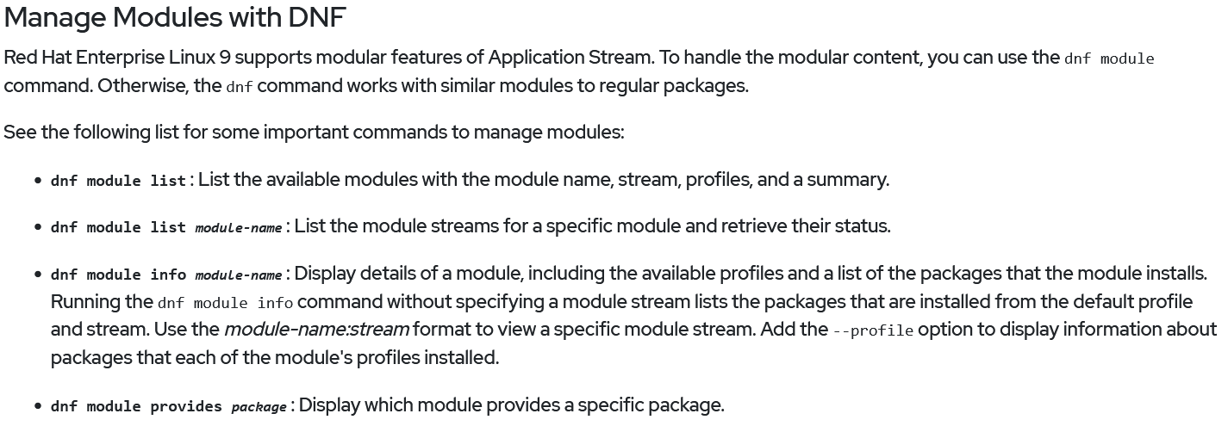
Red Hat Linux Administration I
Lecture 07
Dr. Eng. Gamal Selim

Slide 39
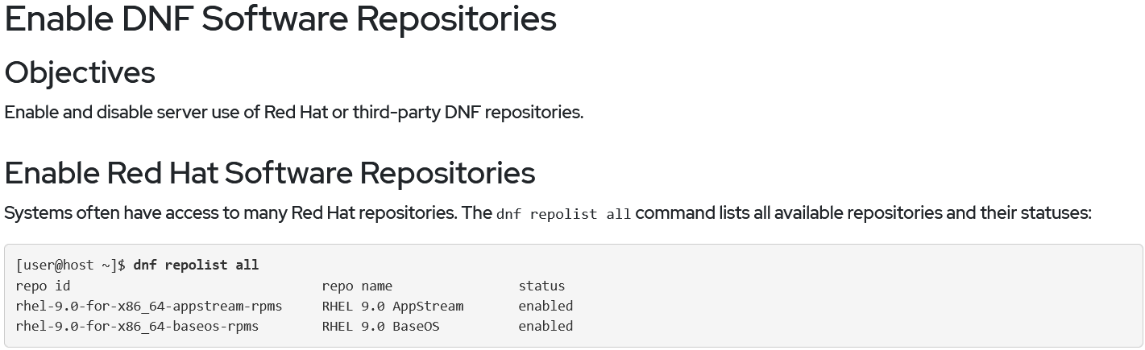
Red Hat Linux Administration I
Lecture 07
Dr. Eng. Gamal Selim

Slide 40
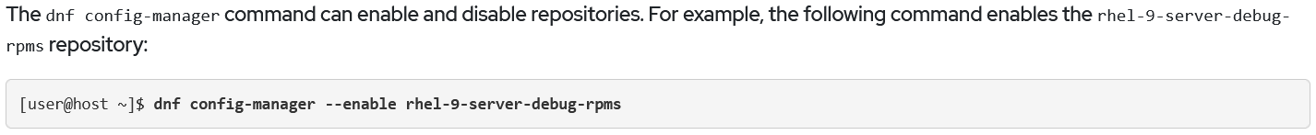
Red Hat Linux Administration I
Lecture 07
Dr. Eng. Gamal Selim

Slide 41
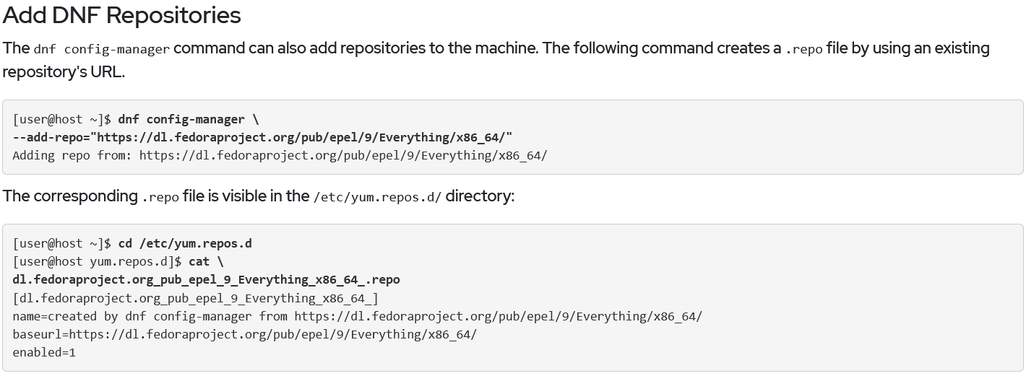
Red Hat Linux Administration I
Lecture 07
Dr. Eng. Gamal Selim

Slide 42
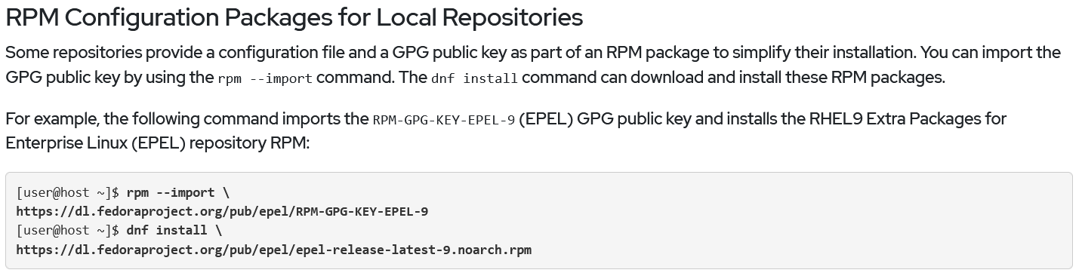
Red Hat Linux Administration I
Lecture 07
Dr. Eng. Gamal Selim

Slide 43
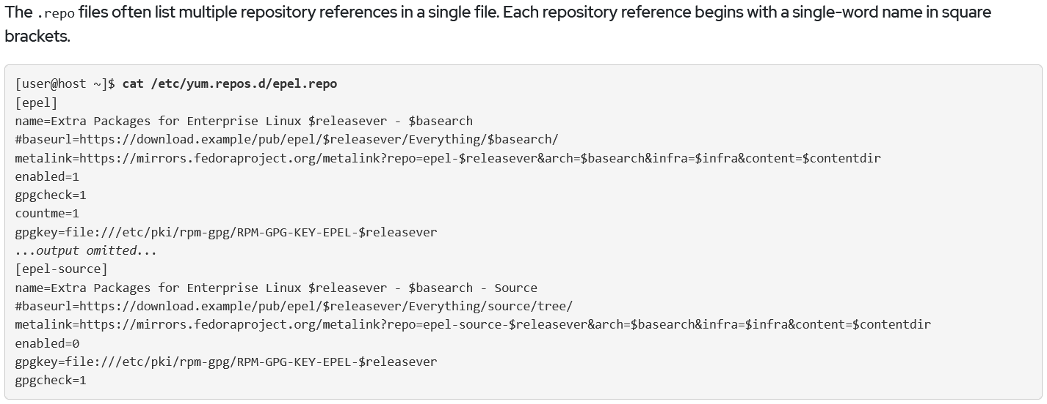
Red Hat Linux Administration I
Lecture 07
Dr. Eng. Gamal Selim

Slide 44
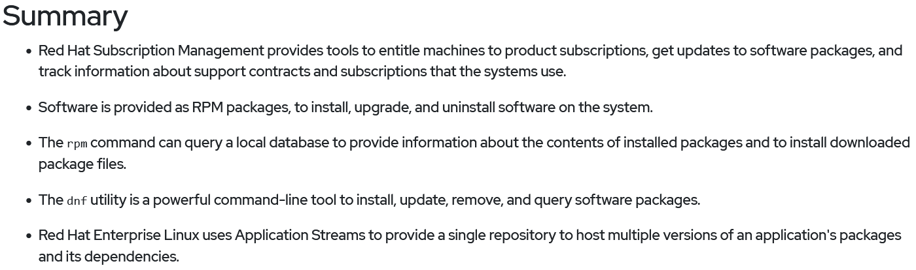
Red Hat Linux Administration I
Lecture 07
Dr. Eng. Gamal Selim

Slide 45
End of Chapter 12
Red Hat Linux Administration I
Lecture 07
Dr. Eng. Gamal Selim

Slide 46


