Slide 1


Health Law and Ethics
Prepared by Dr. Aya Mohamed
MHA 633
A practical approach to ethics
Lecture 1

Slide 2

Chapter
A practical approach to ethics
01
Think about the concept of Ethics
Levels of moral response
What is Ethics?
The Fact-Value Distinction
Ethical reasoning
Ethics Dilemmas
Basic principles of medical ethics
Why Ethics Become Important?
Ethics and Morality ……What are they?
Ethics Vs Law
Ethical Codes

Slide 3






Which one would you drink?
Place matters? WHY?

Slide 4
Less embarrassing choices…
I need to pass the exam..cheat or not?
I need the organs of this dying patient... Let him die fast?
I need the money of this Pharma company... Shall I change the results of my research on their drug?
I need to be trained ...tell the patient you’re a doctor?
Ethics is about making choices...
Usually hard ones!

Slide 5
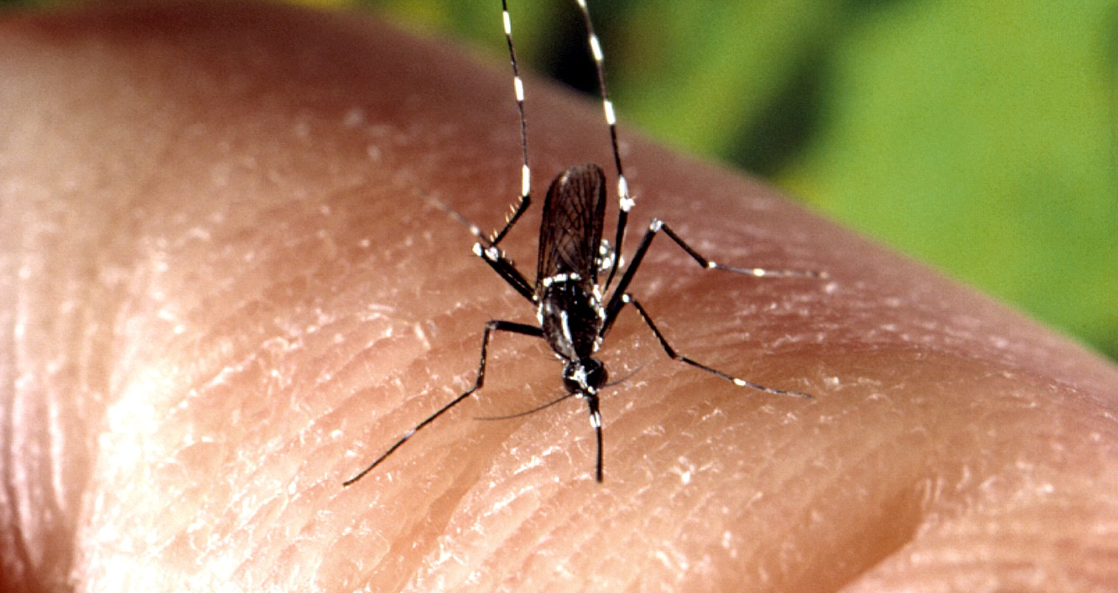
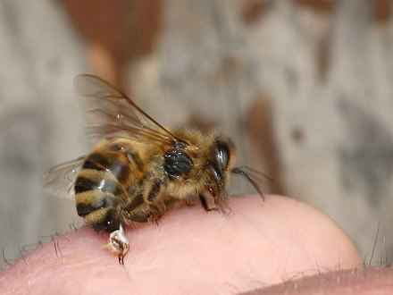
What do you think?
He Killed Her!!
It Cured Him!!

Slide 6
Levels of moral response
The expressive level (unanalyzed expressions or feeling that, by themselves, don’t provide reasons or justification)
The pre-reflective level (justification via law, religious tenets, social values, codes of ethics, etc.; accepted uncritically)
The reflective level (reasoned ethical argument/defense based on ethical principles, rules, virtues, values to which we consciously subscribe; justification provided)
Thomas J and Waluchow W, 1998

Slide 7
Ethics
explicit critical reflection on moral beliefs, practices and problems
philosophical study of morality
This is at the reflective level…
- also known as "moral philosophy" and "philosophical ethics"
- refers to philosophical reflection on the nature and function of morality (that is, philosophical reflection on social conventions about right and wrong human conduct--on social principles about doing good, avoiding harm, respecting others, observing rules of justice, etc.)
Notes:
- also known as "moral philosophy" and "philosophical ethics"
- refers to philosophical reflection on the nature and function of morality (that is, philosophical reflection on social conventions about right and wrong human conduct--on social principles about doing good, avoiding harm, respecting others, observing rules of justice, etc.)
descriptive ethics: more social science, empirical; attempts to describe and explain moral views that are held
A systematic understanding of right and wrong as it relates to:
- rules or standards of right conduct
- good character, virtuous behaviour

Slide 8
What is Ethics?
Ethics is a system of moral principles. They affect how people make decisions and lead their lives.
Ethics is concerned with what is good for individuals and society and is also described as moral philosophy.

Slide 9
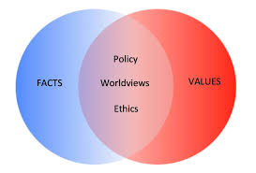
The Fact-Value Distinction
Fact: description of the way the world is; an actual state of affairs (“is”)
Value: judgment about the way things should be (“ought”)
  no “ought” can be deduced from an “is”

Slide 10
Ethical reasoning
Values and ethical principles
Value = something a person/community has identified as important (e.g., autonomy/self-determination)
Values by themselves don't tell us what we ought to do
Key values in bioethics have corresponding ethical principles meant to guide action (e.g., principle of respect for autonomy)
Notes:
- principles meant to guide action for all in similar circumstances—e.g., principle of respect for autonomy directs us to act in ways that honour the free and informed decisions and actions of others

Slide 11
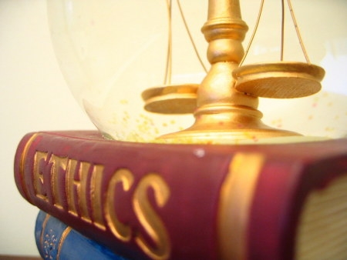
Introduction
The Greek word ethike means habit, action, character.
The Latin word mos (morals) means habit or custom.
In simple words, Ethics is a set of philosophical beliefs and practices concerned
with the distinction between right and wrong.

Slide 12
What is ethics?
A system of moral principles or standards governing conduct.
A system of principles by which human actions and proposals may be judged good or bad, right or wrong;
A set of rules or a standard governing the conduct of a particular class of human action or profession;
Any set of moral principles or values recognized by a particular religion, belief or philosophy;
The principles of right conduct of an individual.
(UNESCO/IUBS/Eubios Living Bioethics Dictionary version 1.4)

Slide 13
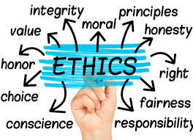
Ethics Dilemmas
Ethics covers the following dilemmas:
How to live a good life
Our rights and responsibilities
The language of right and wrong
Moral decisions - what is good and bad?

Slide 14
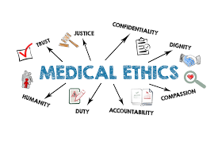
What is Medical Ethics?
Medical ethics
is a system of moral principles that apply values and judgments to the practice of medicine.

Slide 15

Basic principles of medical ethics
Chapter
01
A) Respect for patient autonomy.
b) Not inflicting harm on patients.
c) A positive duty to contribute to the welfare of patients .
d) Justice or fair treatment of patients.

Slide 16
Why Ethics Become Important?
Nowadays, conflicts of interests between the government and medical institutions, between medical institutions and medical personnel, between physicians and patients are getting more and more serious and complex.
High technologies not only brought us hopes of cure but have also created a heavy economic burden.
The ethical dilemmas of high technology medicine-brain death, organ transplantation, and concerns about quality of life-have become increasingly prominent.
A new and more specific code of ethics must be developed to meet the demands of social development and medical service.
This new code integrates the traditional medical ethics with modern principles and values

Slide 17
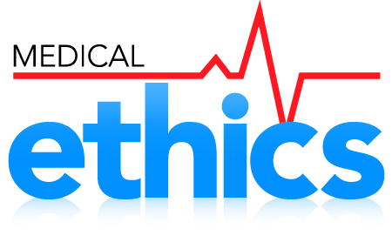
Importance of Medical Ethics
Ethical principles such as respect for persons, informed consent and confidentiality are basic to the physician-patient relationship.
Application of these principles in specific situations is often problematic , since physicians, patients, their family members and other healthcare personnel may disagree about what is the right way to act in a situation.

Slide 18
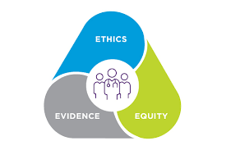
Importance of Medical Ethics
The study of ethics prepares medical professionals to recognize difficult situations and to deal with them in a rational and principled manner.
Ethics is also important in physicians’ interactions with society and their colleagues and for the conduct of medical research.

Slide 19
Ethics and Morality
What are they?
The terms ethics and morality are often used interchangeably - indeed, they usually can mean the same thing, and in casual conversation there isn't a problem with switching between one and the other.
However, there is a distinction between them in philosophy!

Slide 20
Ethics and Morality
What are they?
Ethics and morals both relate to “right” and “wrong” conduct. However, ethics refer to the series of rules provided to an individual by an external source. e.g. their profession. On the other hand, morals refer to an individual’s own principles regarding right and wrong.

Slide 21

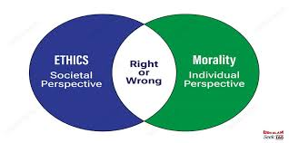
Chapter
How to Differentiate between Ethics &
Moral?
01

Slide 22
Ethics and Morality
Comparison
Ethics
Moral
The rules of conduct recognized in respect to a particular class of human actions or a particular group, culture, etc. It defines how thing are according to the rules.
Principles or habits with respect to right or wrong conduct . It defines how things should work according to an individuals' ideals and principles.

Slide 23
Ethics and Morality
Comparison
Ethics
Moral
Social system – External
Why we do it?
Because society says it is the right thing to do.
What if we don't do it?
We may face peer/societal disapproval or even be fired from our job.
Individual – internal
Why we do it ?
Because we believe in something being right or wrong.
What if we don't do it?
Doing something against one's morals and principles can have different effects on different people, they may feel uncomfortable, remorseندمان, depressed etc.

Slide 24
Ethics and Morality
Comparison
Ethics
Moral
Acceptability
Ethics are governed by professional and legal guidelines within a particular time and place
Acceptability
Morality transcends cultural norms

Slide 25
Ethics are not …
Ethics are not the same as feelings
Ethics are not religion
Ethics are not following the law
Ethics are not following culturally accepted norms
Ethics are not science

Slide 26
Ethics are …
Moral Principles
What is good and bad
What is right and wrong
Based on value system
Ethical norms are not universal – depends on the subculture of the society

Slide 27


Ethics refers to standards of behavior that tell us how human beings ought to act in the many situations in which they find themselves
as friends, parents, children, citizens, businesspeople, teachers, professionals, and so on.

Slide 28

1. Ethics are rules of conduct.
Laws are rules developed by governments in order to provide balance in society and protection to its citizens.
2. Ethics comes from people’s awareness of what is right and wrong.
Laws are enforced by governments to its people.
Ethics Vs Law

Slide 29
3. Ethics are moral codes which every person must conform to.
Laws are codifications of ethics meant to regulate society.
4. Ethics does not carry any punishment to anyone who violates it.
The law will punish anyone who happens to violate it.
5. Ethics comes from within a person’s moral values.
Laws are made with ethics as a guiding principle.
Ethics Vs Law

Slide 30
Historically…
Medical ethics may be traced to guidelines on the duty of physicians such as the Hippocratic oath
A physician must recognize responsibility to patients first and foremost, as well as to society, to other health professionals, and to self. These are not laws, but standards of conduct which define the essentials of honorable behavior for the physician.

Slide 31
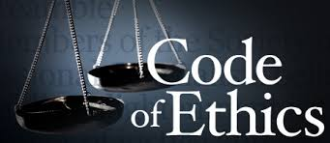
Ethical Codes
Hippocratic Oath – 5th century BC
Nuremberg Code -1948
Declaration of Geneva - 1948
Universal Declaration of Human Rights-1948
Helsinki Declaration -1964
International Code of Medical ethics
Indian Medical Council (Professional Conduct, Etiquettes and Ethics) Regulations, 2002

Slide 32
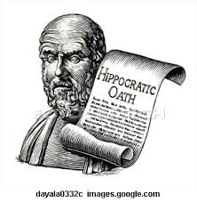
Hippocratic Oath
One of the earliest document in medical ethics – 5th century BC.
Traditionally all doctors recite this oath at swearing in. It is considered sacred for its religious foundation and sanctity.

Slide 33
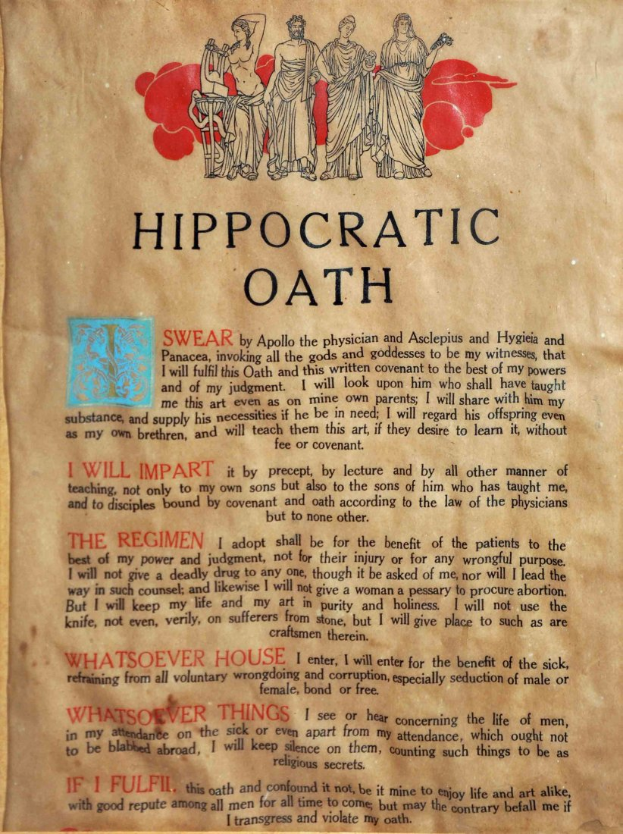

Slide 34
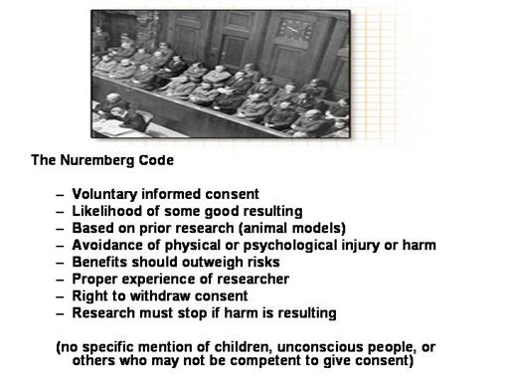
Nuremberg Code - 1948

Slide 35
Declaration of Geneva
Adopted at World Medical Association General Assembly in 1948.
Amended in 1968, 1984, 1994, 2005 and 2006.
Declaration of physicians’ dedication to the humanitarian goals of medicine.

Slide 36
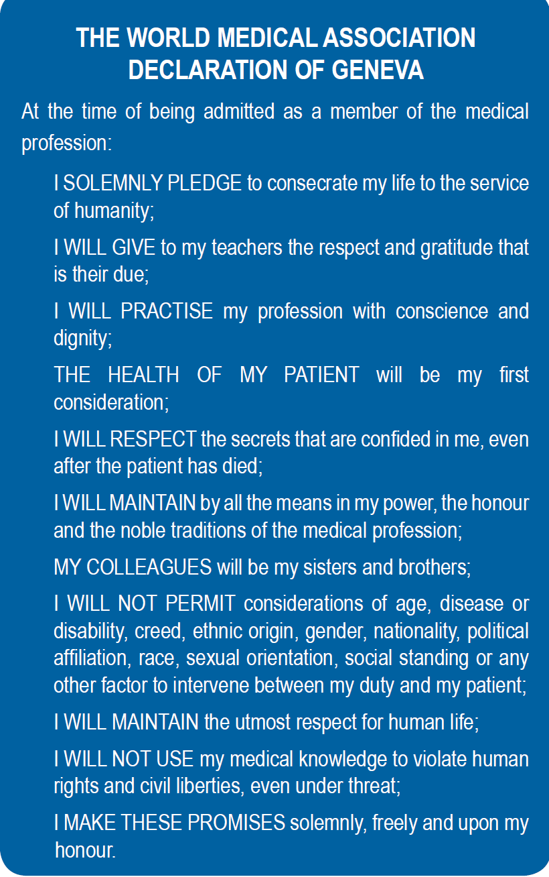

Slide 37
Helsinki Declaration
Set of ethical principles regarding human experimentation developed by the World Medical Association in 1964.
Undergone 6 revisions since then. Last revision in 2008.
More specifically addressed clinical research, reflecting changes in medical practice from the term 'Human Experimentation' used in the Nuremberg Code.

Slide 38
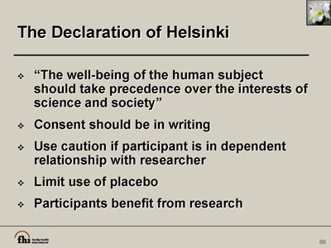

Slide 39
International Code of Medical Ethics -2006
Given by World Medical Association
The code applies both in peace and war.
It codifies the duties of physician in general, duties to patients and colleagues.

Slide 40
MCI Regulations - 2002
The Medical Council of India notified the “Indian Medical Council (Professional Conduct, Etiquettes and Ethics) Regulations, 2002” on 11 March 2002.
Last amended in 2010.

Slide 41
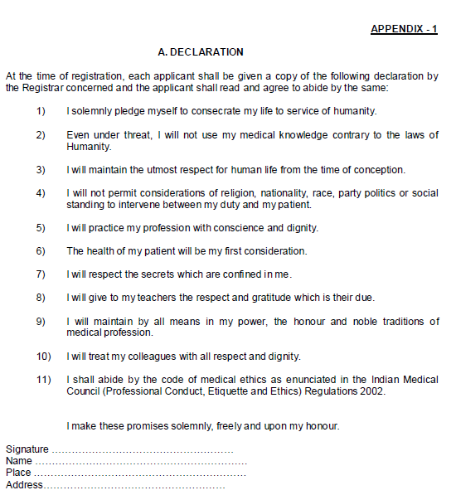
Declaration-
Each applicant, at the time of making an application for registration under the provisions of the Act, shall be provided a copy of the declaration and shall submit a duly signed Declaration.

Slide 42
Conclusion
"A good doctor treats the disease; a great doctor treats the patient who has the disease." – William Osler.
"The art of medicine consists of amusing the patient while nature cures the disease." – Voltaire.
"Wherever the art of medicine is loved, there is also a love of humanity." – Hippocrates.
Ethics is knowing the difference between what you have a right to do and what is right to do. A man without ethics is a wild beast loosed upon this world.

Slide 43
Chapter
A practical approach to ethics
01
Think about the concept of Ethics
Levels of moral response
What is Ethics?
The Fact-Value Distinction
Ethical reasoning
Ethics Dilemmas
Basic principles of medical ethics
Why Ethics Become Important?
Ethics and Morality ……What are they?
Ethics Vs Law
Ethical Codes

Slide 44



Thank You

