Slide 1


Reinforcement Learning
(AI644)
Prepared by Dr. Ashraf Elsayed
Lecture 3

Slide 2



Reinforcement Learning
Lecture 3
Prepared by
Dr. Ashraf Elsayed
www.midocean.ae

Slide 3
Markov Decision Processes
www.midocean.ae

Slide 4
The objectives of this lecture is to:
Understand Markov Decision Processes
Understand Episodic Tasks and Continuing Tasks
Define and explain Deterministic Policy and Stochastics Policy
www.midocean.ae

Slide 5
Introduction
The k-Armed Bandit problem does not account for the fact that different situations call for different actions.
A bandit rabbit would only be concerned about immediate reward and so it would go for the carrot. But a better decision can be made by considering the long-term impact of our decisions.
Now, let's look at how the situation changes as the rabbit takes actions.
We will call these situations states. In each state the rabbits selects an action.
www.midocean.ae

Slide 6
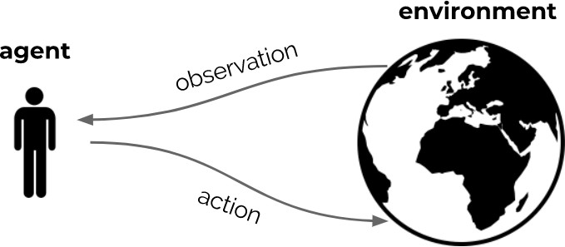
Markov Decision Processes
We will discuss a mathematical formulation of the agent-environment interaction
This is called a Markov Decision Process (MDP)
Enables us to talk clearly about the objective and how to achieve it
www.midocean.ae

Slide 7
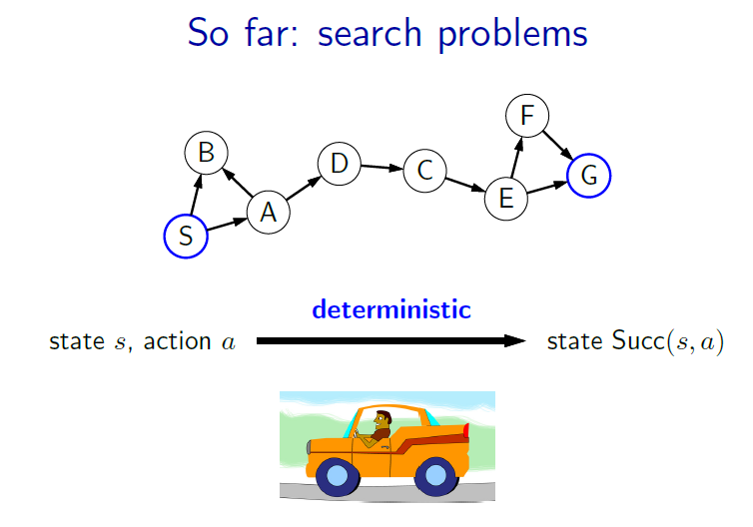
www.midocean.ae

Slide 8
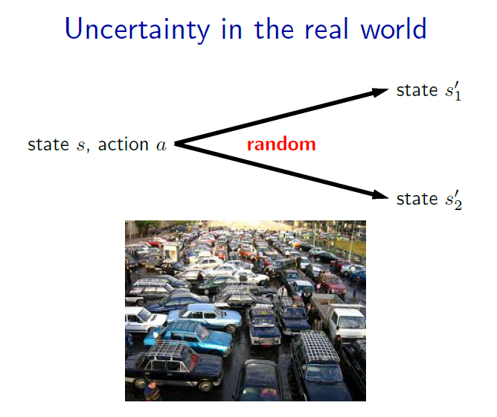
www.midocean.ae

Slide 9
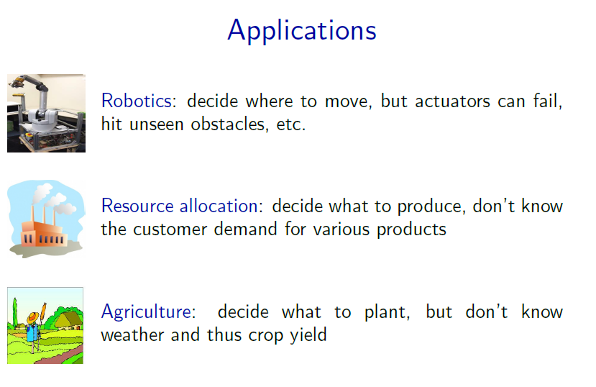
www.midocean.ae

Slide 10
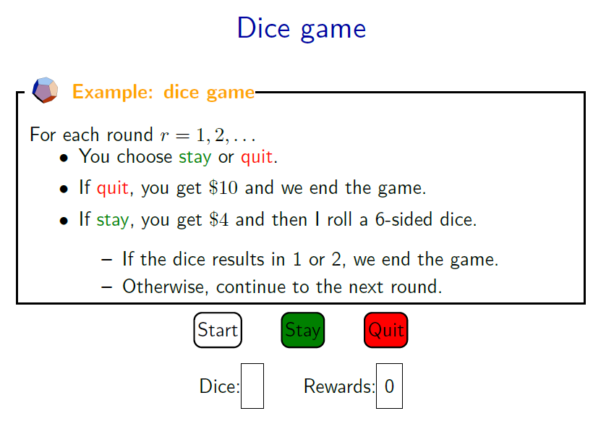
www.midocean.ae

Slide 11
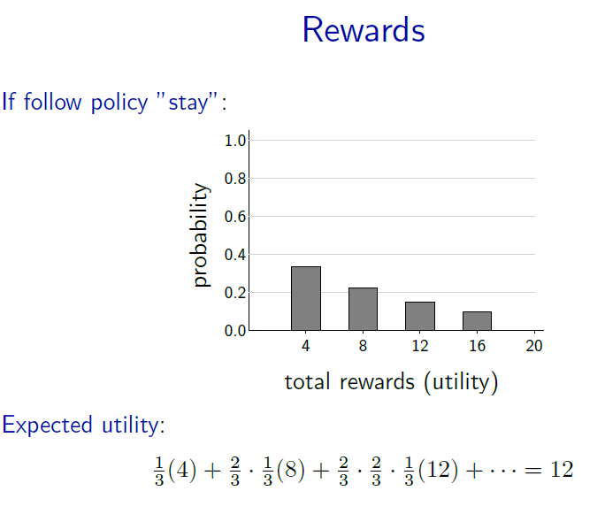
www.midocean.ae

Slide 12
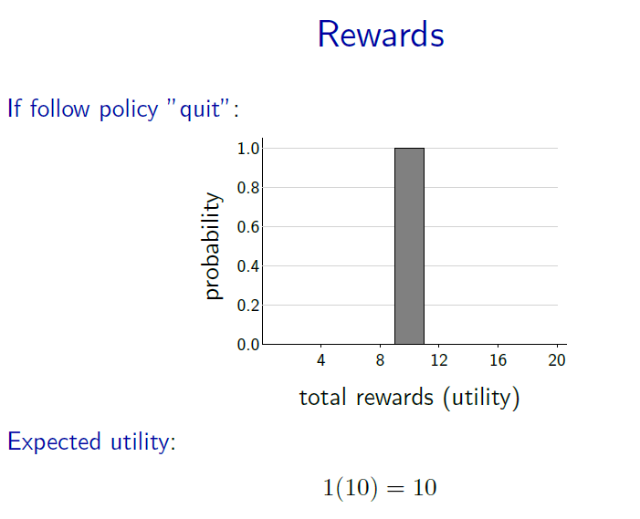
www.midocean.ae

Slide 13
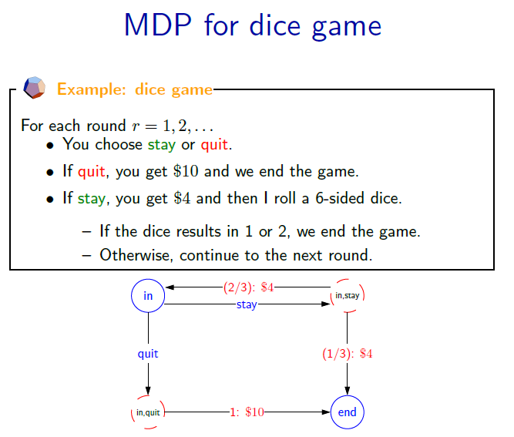
www.midocean.ae

Slide 14
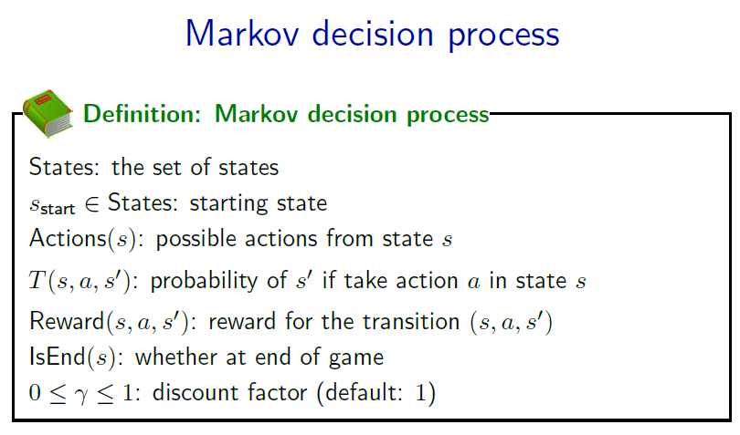
www.midocean.ae

Slide 15
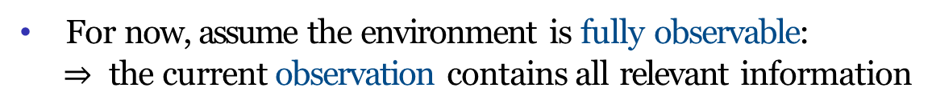
MDP: Definition
www.midocean.ae

Slide 16
Dynamics Function
From a set of State-Action the agent receive a Reward and ended in state S_{t+1}
The transition dynamics function p, formalizes this notion.
Given a state S and action a, p tells us the joint probability of next state S’ and reward R.
We will typically assume that the set of states, actions, and rewards are finite.
Since p is a probability distribution, it must be non-negative and it's sum over all possible next states and rewards must equal one.
www.midocean.ae

Slide 17
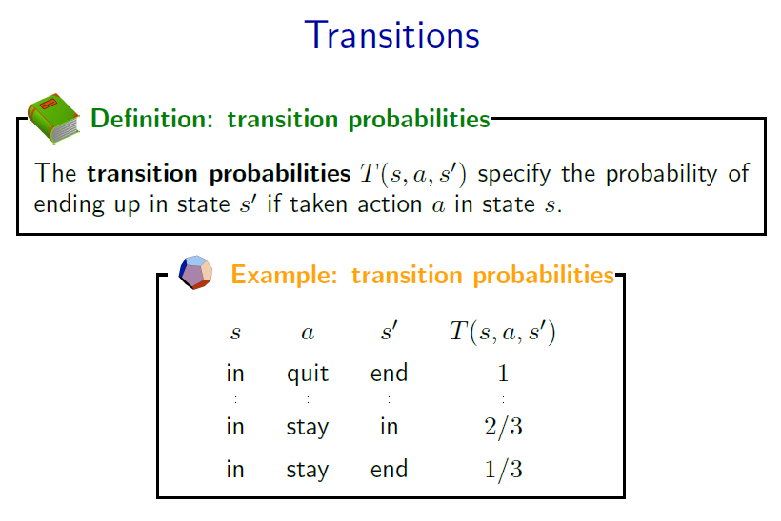
www.midocean.ae

Slide 18
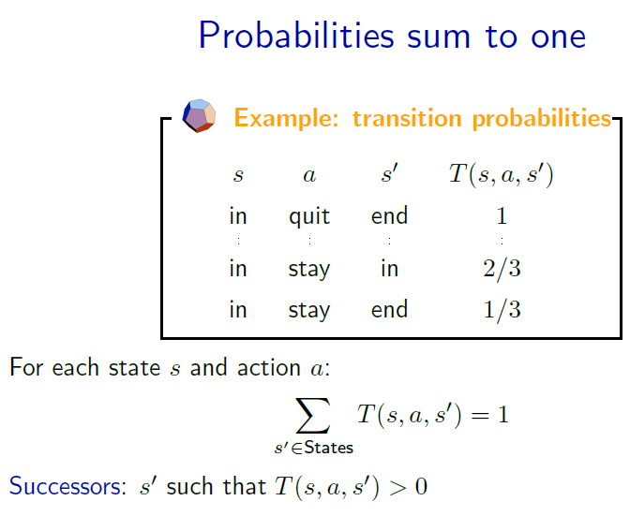
www.midocean.ae

Slide 19
Markov Property
Note that future state and reward only depends on the current state and action.
This is called the Markov property.
It means that the present state is sufficient and remembering earlier states would not improve predictions about the future.
www.midocean.ae

Slide 20
Markov Property
www.midocean.ae

Slide 21
Example of MDP: Cleaning Robot
Consider a robot that cleans soda cans
Two states: high battery charge or low battery charge
Actions: {wait, search} in high, {wait, search, recharge} in low
Dynamics may be stochastic
  p(S_{t+1} = high | S_{t} = high, A_{t} = search) = α
  p(S_{t+1} = low | S_{t} = high, A_{t} = search) = 1 − α
Reward could be expected number of collected cans (stochastic), or actual number of collected cans (deterministic)
www.midocean.ae

Slide 22
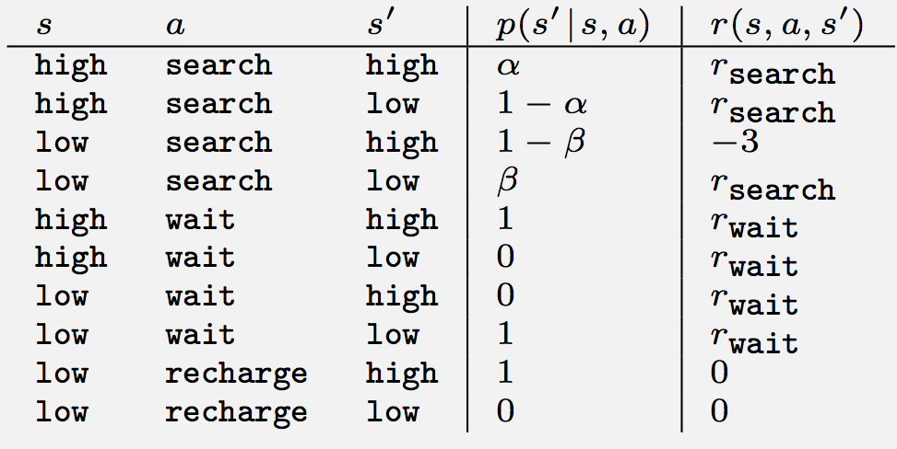
Example: robot MDP
r_{rescued}
www.midocean.ae

Slide 23
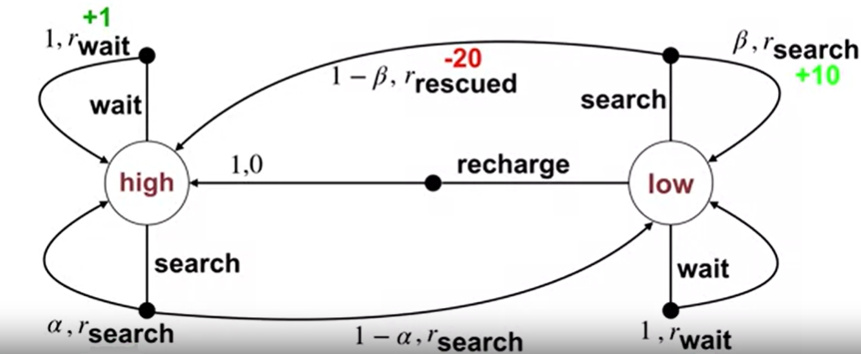
Example: robot MDP
www.midocean.ae

Slide 24
The Goal of Reinforcement Learning
In reinforcement learning, the agent's objective is to maximize future reward.
What looked good in the short-term, might not be the best in the long-term.
The return at time step t, is simply the sum of rewards obtained after time step t.
The return G is a random variable because the dynamics of the MDP can be stochastic.
We need to maximize it
Finite
Final time step reward
www.midocean.ae

Slide 25
Episodic Tasks
In the simplest case, the interaction naturally breaks into chunks called episodes.
Each episode begins independently of how the previous one ended.
At termination, the agent is reset to a start state.
Every episode has a final state which we call the terminal state.
We call these tasks episodic tasks.
www.midocean.ae

Slide 26
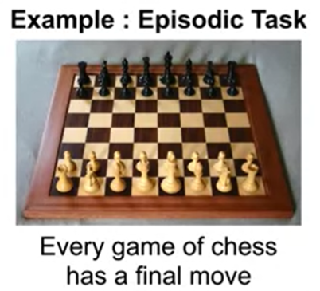
Episodic Tasks
www.midocean.ae

Slide 27
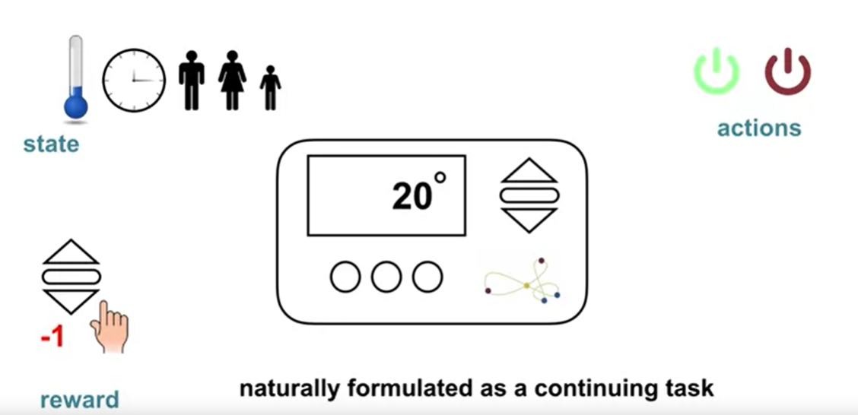
Continuing Tasks
There is a problem when implementing the Return representation of episodic tasks into continuing tasks.
Episodic Tasks
  Interaction breaks naturally into episodes
  Each episode ends in a terminal state
  Episodes are independent
Continuing Tasks
  Interaction goes on actually
  No terminal state
www.midocean.ae

Slide 28
Discounting
The return formulation can then be modified to include discounting.
The effect of discounting on the return is simple, immediate rewards contribute more to the sum.
Rewards far into the future contribute less because they are multiplied by Gamma raised to successively larger powers of k.
The last expression will be finite as long as . We have to guarantee the discounting with .
www.midocean.ae

Slide 29
Why continuing tasks G_{t} is finite?
Assume R_{max} is the maximum reward the agent can receive
An upper bound of G_{t}
www.midocean.ae

Slide 30
Effect of γ on agent behavior
with γ = 0
With γ = 0, it is evident that the agent only cares about the immediate reward. This is called a Short-sighted agent.
With γ → 1, agent takes future rewards into account more strongly. This is called a Far-sighted agent.
www.midocean.ae

Slide 31
Recursive nature of returns
www.midocean.ae

Slide 32
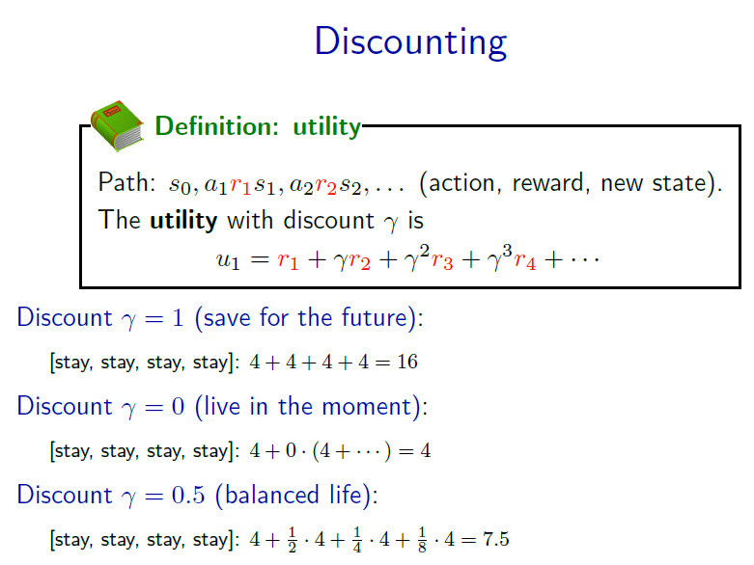
www.midocean.ae

Slide 33
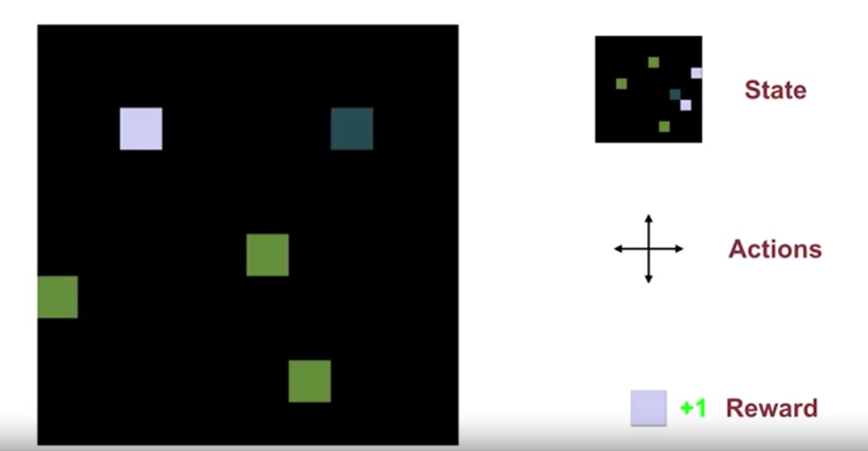
Example of Episodic Task
www.midocean.ae

Slide 34
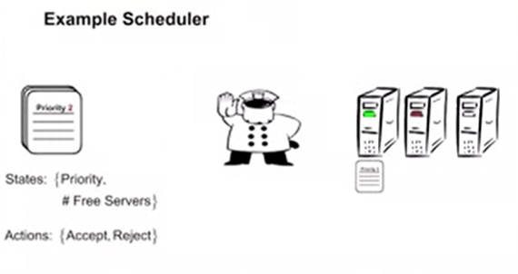
Example of Continuing Task
(Scheduler)
www.midocean.ae

Slide 35
Policies
Policies are how an agent selects actions.
In the simplest case, a policy maps each state to a single action. This kind of policy is called the deterministic policy.
We will use the fancy Greek letter π to denote a policy.
π(S) represents the action selected in state S by the policy π.
In this example, π selects the action A₁ in state S₀ and action A₀ in states S₁ and S₂. We can visualize a deterministic policy with a table.
Notice that the agent can select the same action in multiple states,
and some actions might not be selected in any state
www.midocean.ae

Slide 36
Deterministic Policy
The arrows in this example describe one possible policy, which moves the agent towards its house.
Each arrow tells the agent which direction to move in each state.
In general, a policy assigns probabilities to each action in each state.
www.midocean.ae

Slide 37
Stochastic Policy
We use the notation π(a|s), to represent the probability of selecting action A in a state S.
A stochastic policy is one where multiple actions may be selected with non-zero probability.
www.midocean.ae

Slide 38
Stochastic Policy
www.midocean.ae

Slide 39
Valid and invalid Policies
It is important that policies depend only on the current state, not on things like time or previous states.
The state defines all the information used to select the current action.
In this MDP, we can define a policy that chooses to go either left or right with equal probability.
We might also want to define a policy that chooses the opposite of what it did last, alternating between left and right actions.
However, that would not be a valid policy because this is conditional on the last action.
www.midocean.ae

Slide 40
Valid and invalid Policies
In MDPs, we assume that the state includes all the information required for decision-making.
If alternating between left and right would yield a higher return, then the last action should be included in the state.
www.midocean.ae

Slide 41
Value Functions
Value functions are crucial in reinforcement learning.
They allow an agent to query the quality of its current situation instead of waiting to observe the long-term outcome.
The value function summarizes all the possible futures by averaging over returns.
Value function enable us to judge the quality of different policies.
Value functions predict rewards into the future.
State value function refers to the expected return from a given state under a specific policy.
Action value function refers to the expected return from a given state after selecting a particular action and then following a given policy.
www.midocean.ae

Slide 42
State-Value Function
The objective of RL is to learn a policy that achieves the most reward in the long run.
Value functions formalize what this means.
A state value function is the future award an agent can expect to receive starting from a particular state.
The definition of state-value functions can be seen in the next equation
The definition of state-value functions with respect to a policy π is
www.midocean.ae

Slide 43
Action-Value Function
An action-value function describes what happens when the agent first selects a particular action.
For example, in a chess game, it allows us to assess the probability of winning for each possible move (action) given we follow some policy π.
More formally, the action value of a state is the expected return if the agent selects action A and then follows policy π.
www.midocean.ae

Slide 44
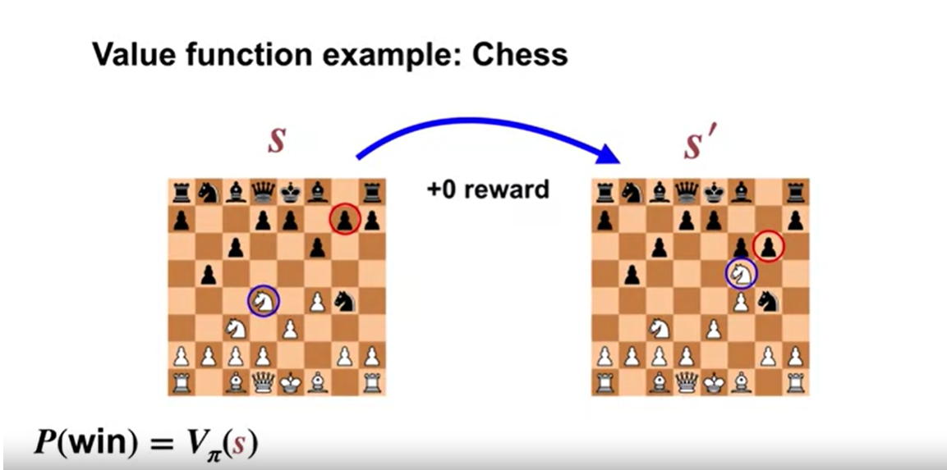
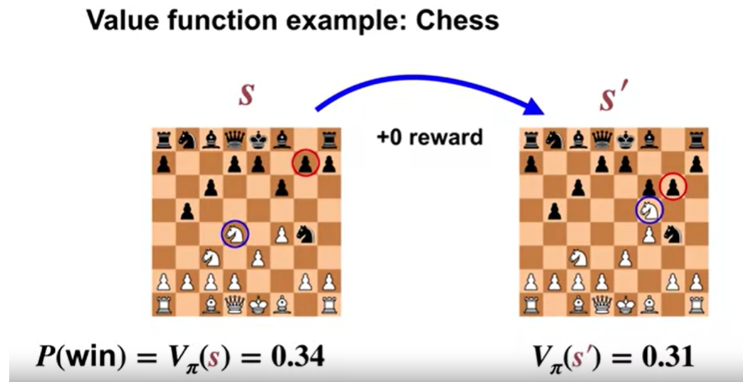
Example: Chess
In a chess game, the state-value is equal to the expected sum of future rewards.
Since the only possible non-zero reward is plus one for winning, the state value is simply the probability of winning if we follow the current policy π.
In this two player game, the opponent's move is part of the state transition. For example, the environment moves both the agents piece, circled in blue, and the opponent's piece, circled in red.
This puts the board into a new state, S’.
Since the value of state S’ is lower than the value of state S. This means we are less likely to win the game from this new state assuming we continue following policy π.
www.midocean.ae

Slide 45
Example: Grid World
In the Grid World, the states are defined by the locations on the grid, the actions move the agent up, down, left, or right.
The agent cannot move off the grid and bumping generates a reward of -1. Most other actions yield no reward.
There are two special states however, these special states are labeled A and B.
Every action in state A yields plus 10 reward and plus 5 reward in state B.
Every action in state A and B transitions the agents to states A’ and B’ respectively.
www.midocean.ae

Slide 46
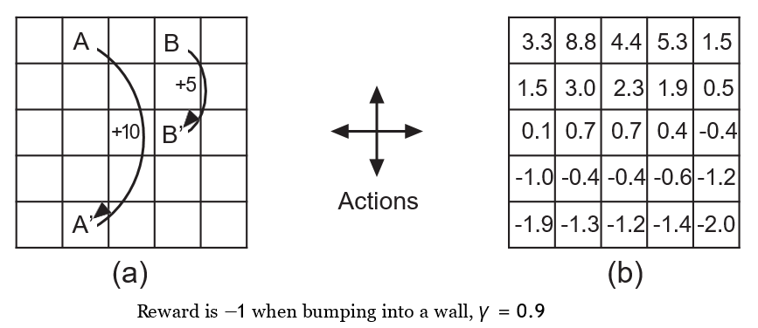
Example: Grid World
www.midocean.ae

Slide 47
Example: Grid World
First, notice the negative values near the bottom, these values are low because the agent is likely to bump into the wall before reaching the distance states A and B.
Remember, A and B are both the only sources of positive reward in this MDP.
State A has the highest value, notice that the value is less than 10 even though every action from state A generates a reward of plus 10, why?
  Because every transition from A moves the agent close to the lower wall and near the lower wall, the random policy is likely to bump and get negative reward.
www.midocean.ae

Slide 48
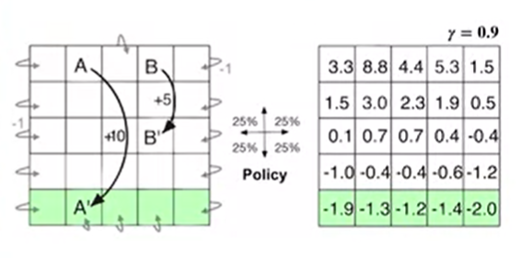
Example: Grid World
Now why the value of state B is slightly greater than 5 ?
www.midocean.ae

Slide 49


Thank You

