Slide 1


Data Structures and Algorithms
Prepared by Prof. Shereen Taie
IT251
Information Technology Department
Lecture 5

Slide 2




Data Structures and
Algorithms
Lecture 5
IT251
Information Technology Department
Prepared by
Prof. Shereen Taie
www.midocean.ae

Slide 3
DATA STRUCTURES
Chapter
03
www.midocean.ae

Slide 4
Data Structures:
Data may be organized in many different ways logical or mathematical model of a program particularly organization of data. This organized data is called “Data Structure”.
Or
The organized collection of data is called a ‘Data Structure’.
Data Structure = Organized data + Allowed operations
Chapter
03
www.midocean.ae

Slide 5

Chapter
03
Data Structure Goals
www.midocean.ae

Slide 6
Data Structure Goals:
Data Structure involves two complementary goals:
  The first goal:
  is to identify and develop useful, mathematical entities and operations
  and to determine what class of problems can be solved by using these
  entities and operations.
Chapter
03
www.midocean.ae

Slide 7
Data Structure Goals:
Data Structure involves two complementary goals:
  The second goal:
  is to determine representation for those abstract entities to implement
  abstract operations on this concrete representation.
Chapter
03
www.midocean.ae

Slide 8
Data Structure Categories
Chapter
03
www.midocean.ae

Slide 9
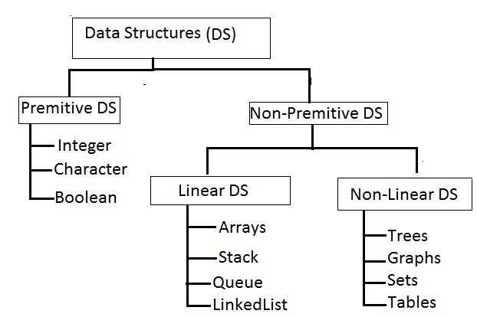
Important for all other branches of computer science
Chapter
03
www.midocean.ae

Slide 10
Primitive Data structures:
Primitive Data structures are directly supported by the programming language.
i.e; any operation is directly performed in these data items.
Ex: integer, Character, Real numbers etc.
Chapter
03
www.midocean.ae

Slide 11
Non-primitive data structures:
Non-primitive data types are not defined by the programming language, but are instead created by the programmer.
Chapter
03
www.midocean.ae

Slide 12
Non-primitive data structures subcategories:
1. Linear data structures.
2. Non-Linear data structures.
Chapter
03
www.midocean.ae

Slide 13
Linear Data structures:
Linear data structures organize their data elements in a linear fashion, where data elements are attached one after the other.
Linear data structures are very easy to implement, since the memory of the computer is also organized in a linear fashion.
Some commonly used linear data structures are arrays, linked lists, stacks and queues.
Chapter
03
www.midocean.ae

Slide 14
Nonlinear Data structures:
In nonlinear data structures, data elements are not organized in a sequential fashion.
Data structures like multidimensional arrays, trees, graphs, tables and sets are some examples of widely used nonlinear data structures.
Chapter
03
www.midocean.ae

Slide 15
Chapter
03
Operations on the Data Structures
www.midocean.ae

Slide 16
Operations on the Data Structures :
Following operations can be performed on the data structures:
  1. Traversing
  2. Searching
  3. Inserting
  4. Deleting
  5. Sorting
  6. Merging
Chapter
03
www.midocean.ae

Slide 17
Operations on the Data Structures :
1. Traversing عبور: It is used to access each data item exactly once so that it can be processed.
2. Searching: It is used to find out the location of the data item if it exists in the given collection of data items.
Chapter
03
www.midocean.ae

Slide 18
Operations on the Data Structures :
3. Inserting: It is used to add a new data item in the given collection of data items. queues.
4. Deleting: It is used to delete an existing data item from the given collection of data items.
Chapter
03
www.midocean.ae

Slide 19
Operations on the Data Structures :
5. Sorting: It is used to arrange the data items in some order i.e. in ascending or descending order in case of numerical data and in dictionary order in case of alphanumeric data.
6. Merging: It is used to combine the data items of two sorted files into single file in the sorted form.
Chapter
03
www.midocean.ae

Slide 20
STACKS AND QUEUES
Chapter
03
www.midocean.ae

Slide 21
Chapter
03
STACKS AND QUEUES
www.midocean.ae

Slide 22
STACKS:
A Stack is linear data structure.
A stack is a list of elements in which an element may be inserted or deleted only at one end, called the top of the stack.
Chapter
03
www.midocean.ae

Slide 23
STACKS:
Stack principle is LIFO (last in, first out). Which element inserted last on to the stack that element deleted first from the stack.
As the items can be added or removed only from the top i.e. the last item to be added to a stack is the first item to be removed.
Chapter
03
www.midocean.ae

Slide 24
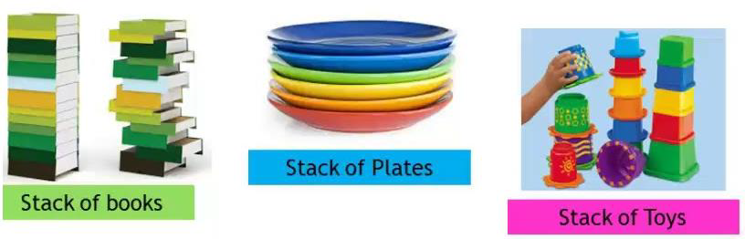
Real life examples of stacks are:
Chapter
03
www.midocean.ae

Slide 25
Operations on stack:
The two basic operations associated with stacks are:
  1. Push
  2. Pop
Chapter
03
www.midocean.ae

Slide 26
Operations on stack:
While performing push and pop operations the following test must be conducted on the stack.
  a. Stack is empty or not
  b. Stack is full or not
Chapter
03
www.midocean.ae

Slide 27
1. Push:
Push:
Push operation is used to add new elements in to the stack. At the time of
addition first check the stack is full or not. If the stack is full it generates an
error message "stack overflow".
Chapter
03
www.midocean.ae

Slide 28
2. Pop:
Pop:
Pop operation is used to delete elements from the stack. At the time of
deletion first check the stack is empty or not. If the stack is empty it
generates an error message "stack underflow“.
Chapter
03
www.midocean.ae

Slide 29
Representation of Stack (or) Implementation of stack
Chapter
03
www.midocean.ae

Slide 30
The stack should be represented in two ways:
1. Stack using array
2. Stack using linked list
Chapter
03
www.midocean.ae

Slide 31
1. Stack using array:
Let us consider a stack with 6 elements capacity.
This is called as the size of the stack.
The number of elements to be added should not exceed the maximum size of the stack.
Chapter
03
www.midocean.ae

Slide 32
1. Stack using array:
Let us consider a stack with 6 elements capacity.
This is called as the size of the stack.
The number of elements to be added should not exceed the maximum size of the stack.
Chapter
03
www.midocean.ae

Slide 33
Stack Overflow :
Similarly, you cannot remove elements beyond the base of the stack.
If such is the case, we will reach a stack underflow condition.
Chapter
03
www.midocean.ae

Slide 34
Operation Performed in Stack push & pop & display
Chapter
03
www.midocean.ae

Slide 35
1.push():
push():
When an element is added to a stack, the operation is performed by
push().
Chapter
03
www.midocean.ae

Slide 36
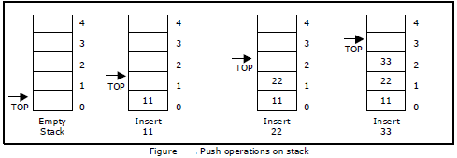
Below Figure shows the creation of a stack and addition of elements using push()
Chapter
03
www.midocean.ae

Slide 37
2.pop():
pop():
When an element is taken off from the stack, the operation is performed by
pop().
Chapter
03
www.midocean.ae

Slide 38
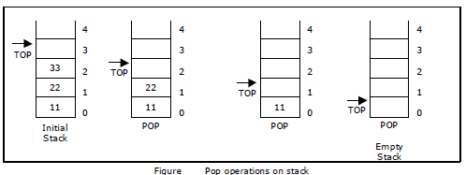
Below figure shows a stack initially with three elements and shows the deletion of elements using pop()
Chapter
03
www.midocean.ae

Slide 39
3. display():
display():
This operation performed display the elements in the stack.
We display the element in the stack check the condition is stack is empty or not, otherwise display the list of elements in the stack.
Chapter
03
www.midocean.ae

Slide 40
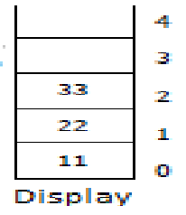
Display the elements in the stack
Chapter
03
www.midocean.ae

Slide 41



Thank You

