Slide 1


Marketing Management
MGM612
Dr. Ayman Hassan
  Lecture -2 -Introduction to Marketing Management

Slide 2

Introduction to Marketing Management
Lecture 2
Dr. Ayman Hassan

Slide 3

Learning Outcomes
Which Concept of Marketing
Is The Best?
The marketing functions
Pricing
Channel Management
Promotion
Selling
Product/Service
Management
Marketing-Information
Management

Slide 4


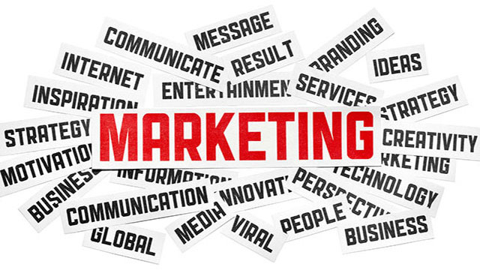
Chapter
2
  Lecture - 2 - Introduction to Marketing Management

Slide 5
Chapter
2
In the previous lecture,
we discussed the five marketing concepts and explained each concept separately....
The question that remains in our minds is:
Which of the marketing concepts is better?
Didn't this question come to your mind?

Slide 6
Chapter
2
Which Concept of Marketing Is The Best?
The concept of marketing you choose depends on your business nature, your product or service, and your relationship with your customers.
There are also many other factors to consider.
For example, the concept of mass production Mass production has many issues.
It is often environmentally destructive and may involve exploitation of the workers who make the product.
This is not to say that this is the case for all mass-produced items, but it is true in many cases.
Using this concept as the basis for any marketing effort assumes that consumers are primarily interested in the ease of access to your product and the low price.

Slide 7

Chapter
2
Which Concept of Marketing Is The Best?
If you are looking to build a long-term business, you must consider the needs of your customers.
In this age of mass consumption, you need to ensure that your business practices are ethical. Also, that your product is environmentally friendly, and that you are addressing a real need of your customer.
By incorporating the concepts of social marketing and community marketing into your marketing strategy, you are creating a solid foundation to foster the long-term growth of your business.

Slide 8
Chapter
2
Pay attention
Use these marketing concepts to get customers’ attention
To build a strong marketing campaign for your business, it’s essential to understand the five marketing concepts. If you don’t know what your customers need, your marketing efforts are unlikely to succeed.
Trying to close a sale with a reluctant buyer will never end well, and you may see a higher rate of returns and refunds, which can negatively impact your business’s reputation.
On the other hand, if you’re trying to sell a product that isn’t in demand or customers who aren’t ready to buy, you won’t have a viable business.
To avoid these pitfalls, you should focus your marketing efforts on targeting the right people, understanding the buyer’s journey, and offering customers products and services that solve their problems.
Being trustworthy isn’t just the right thing to do, it also makes the most sense for your business.
Are you ready to implement these marketing concepts and convert buyers to action at full speed?

Slide 9
Chapter
2
Let's agree that…
We can certainly distinguish which concept is better according to the criteria of the nature of the business and your relationship with customers, if we discuss the advantages and disadvantages of each concept? Agreed?

Slide 10


Chapter
2
The Production Concept
Advantages
The existence of mass production can lower product prices and benefits for consumers.
The availability of abundant products allows consumers to purchase at an affordable price.
Developing a positive relationship between the supplier and the primary producer.
Disadvantages
The excessive focus on the production process's efficiency can cause the product's quality to be less guaranteed.
Not targeting specific market niches and producing goods generally because basic needs become a secondary interest to the production concept.
It is less relevant to existing market conditions because the product is mass-produced.
One of the countries that implemented this kind of marketing concept is China. The majority of companies in China produce goods to fulfill consumer desires. The company produces electronic equipment at low prices.

Slide 11
Chapter
2
Production Concept Examples
On Amazon or retail stores, the market is flooded with cheap products from China. Everything from cheap plastic products from China is in the customer’s shopping cart right now.
The second best example of the production concept is a company outsourcing its production to another specialized company or investing in countries where it can produce in large quantities at a much lower cost. As you know, many American companies produce their products abroad for this reason. If you look at companies like Apple, their smartphones are produced in Asia where they can produce more at a lower cost.
The fourth example of the successful implementation of the production concept is when the Ford Motor Company began mass producing its cars. Ford believed that the more cars he produced, the more people would buy his products. In the early 20th century, the more he produced, the more people bought his products. So much so that simple increases in production, optimal distribution, and economies of scale led to the Ford Motor Company becoming one of the most successful companies in history.

Slide 12
Chapter
2
The Product Concept
Advantages
Giving priority to quality above quantity.
Focusing on satisfying the customer's curiosity.
Generates a high-profit margin with a product price comparable to quality
Disadvantages
This concept is less suitable for customers who prefer low prices.
The features are irrelevant and less practical. It is a lack of attention to the interests of customers.
“Apple” is a company that applies this marketing concept with great success. Apple products are famous for their excellent user experiences, such as the iPhone, TV, iPad, and Macbooks.
This product is designed to be easy to use, set up, and update. Every part of their products, from the slim packaging to the sleek design and intuitive control, showcases luxury in their products.
Apple sets premium prices for their products, but their loyal fans are willing to pay for the best quality and user experience they offer.
When customers buy Apple products, they clearly understand what they get. Apple also prioritizes accessibility, which distinguishes its products in the market

Slide 13
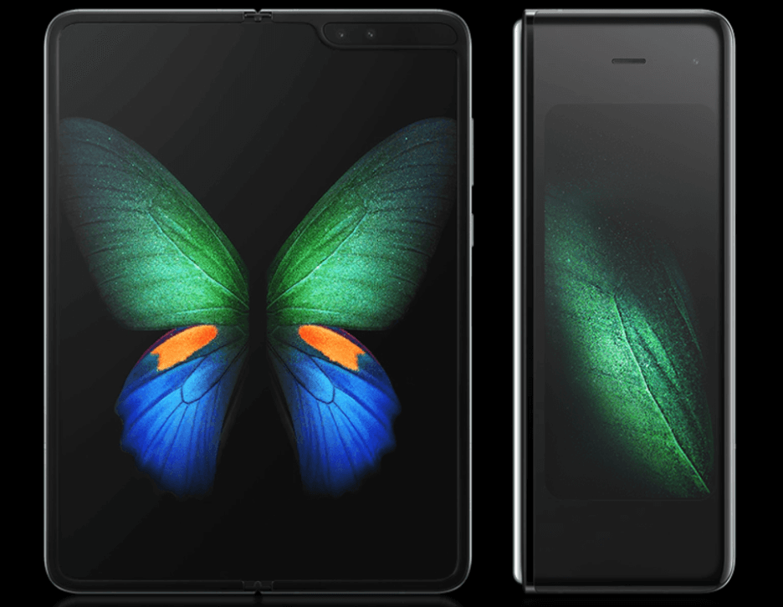
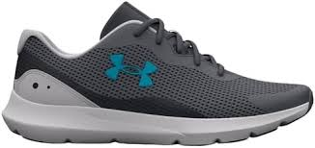
Chapter
2
Product Concept Examples
Samsung’s folding screens
Samsung wanted to supply customers with larger screen space, but also knew that portability was a key concern for its customers. In 2021, Samsung came up with a foldable screen – the S foldable — with a bi-fold design that opens to 7.2 inches.
Now, Samsung could see the interest in foldable tech due to propositions from other manufacturers like LG, but by moving fast and getting a product concept to launch, they now lead the way within the telecommunications market.
Under Armour
The HOVR Infinite shoe by Under Armour for runners is another great product concept.
The team at Under Armour knew just how much runners obsess over their footwear. And why wouldn’t they? After all, every step a runner takes has the impact of 2-4x their body weight, holding them down and contributing to injury.
With HOVR, Under Armour wanted to create a new product that combined both cushioning, responsiveness and energy return to essentially lift runners up.

Slide 14
Chapter
2
The Selling Concept
Advantages
Increase in Sales
This type of marketing philosophy helps companies to increase their sales volume. Markets are competitive everywhere, and if the companies are unable to pursue customers for their products and services, then it will be difficult for the businesses to survive.
Focus on Sales and Marketing
Since the companies try to target the majority of customers in the market, it is understandable that the products would be visible to these targeted people. So, there are two benefits i.e., selling and marketing the products at the same time. If the companies do not follow this concept, then customers’ minds will never change, and they will always buy established brands.
No Unsold Stock Issues
The basic idea behind using the selling concept is to sell every product the company produces without keeping in mind the needs of the consumers. As a result, the company will not face unsold stock issues that mean the company can use its working capital for other productive activities.
Disadvantages
Ignore Customer Needs
One of the drawbacks of this concept is that it avoids the need and wants and focus remains on the sales of products and services. Companies sell whatever they produce rather than providing customers what they want.
Ignore Customer Feedback and Reviews
According to this concept, the company does not pay any attention to feedback and reviews of the customers, which is not right. Because with the help of customers’ feedback, companies can improve the product. Since there is no such thing, companies will never know the negative comments that can badly affect the reputation of the company.
Short-term Focus
It focuses on the short-term goals and objectives of the company, and that is to finish the stock. In this way, the companies have no working capital issue and can use it the other profitable projects

Slide 15

Chapter
2
Selling Concept Examples
Here are some examples of the Selling concept in action. Notice that the selling concept is still alive in products that do not necessarily have a lot of differentiation.
Insurance companies applying the sales concept
There is very less differentiation between Insurance products. As a result, most insurance companies are looking for higher sales transactions so that they can sell more units. Insurance agents are given clear monthly targets to achieve which they must achieve.
Low-cost Electronics like Water purifiers and Vacuum Cleaners
If you look at low-cost consumer electronics like low-cost smartphones, water purifiers, or vacuum cleaners, even now the focus is on aggressive selling tactics and not on pulling the customers.
As these are mass products with little differentiation, the products sell on the basis of availability and whoever reaches the customer first.
Cold Calling and Cold Emails
let us not ignore your own email inbox. Any cold emails that you are getting for buying software, or buying a subscription plan, is in fact you being sold to. There may not be a great supply or limitation of inventory when it comes to software products, but people still get a lot of cold emails because the software maker just needs to find the right customer who will buy the product. Similarly, you would receive a lot of cold calls for Banking products

Slide 16
Chapter
2
The Marketing Concept
Advantages
Doing market research to understand customers.
Building a strong branding.
Promoting business to the audience.
Disadvantages
Higher marketing costs due to various channels used to run a campaign.
It takes time and effort to create the right campaign.
Coca-Cola is one of the brands that has implemented this marketing concept. They're using the 4P marketing strategy, which refers to product, price, promotion, and place.
They implement this digital marketing strategy by displaying ads on various social media platforms. In addition, "Coca-Cola" has also sponsored several prominent events, such as the American Idol and the Olympics, and has succeeded in attracting markets globally.

Slide 17
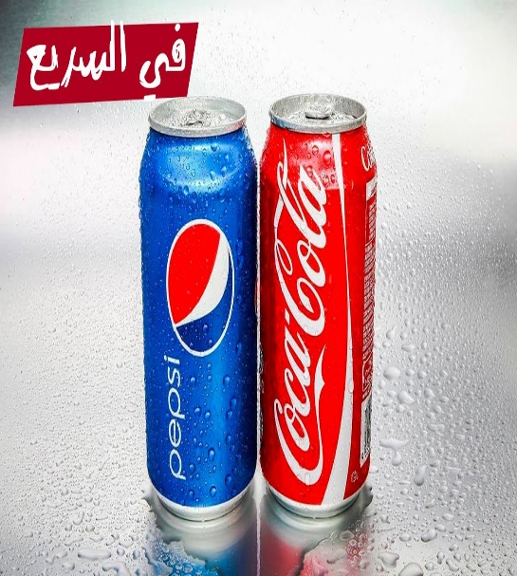
Chapter
2
Marketing Concept Examples
the fact that a good marketing concept focuses on the consumer’s experience starting with the production and up to the social responsibility. Therefore, a good marketing concept example is the product in concept state.
A concept car for example or a concept smartphone.
If you need a real-life example, you can try to analyze a little bit two of the mostl competitors of the last century, Pepsi and Coca-Cola.
They are both using solid and well-designed marketing concepts, with a constant focus on customer experience and how the brand reaches the customer, and how it is perceived. The difference is the concepts are focusing on different things.
While Pepsi targets the younger audiences, Coca-Cola focuses on a holistic approach, where the marketing strategies are based on the business as a whole and not on individual experiences or products.

Slide 18
Chapter
2
The Societal Marketing Concept
Advantages
Create a positive branding.
Increase customer loyalty by providing eco-friendly products.
Making an impact on the community and the surrounding environment
Disadvantages
Works in small segments because it focuses on customers who are interested in social and environmental issues.
Expensive product price.
One of the brands that implement this kind of social marketing concept is "The Body Shop". Their products are cruelty-free and use herbal ingredients.
Furthermore, they are quite active in humanitarian and environmental campaigns. For the humanitarian campaign, they established a charitable foundation that aims to protect animals, human rights, and the environment worldwide.
The beauty brand also conducted an environmental campaign called BBOB or "Bring Back Our Bottle". For customers who participate in such a packaging recycling program, will earn points that can be redeemed for their product purchase voucher.
Through those explanations, it is possible to conclude that the marketing concept is a concept that is implemented in the business world to optimize profits through consumer needs, increase sales, and win over competitors.
www.midocean.ae
www.midocean.ae

Slide 19




Chapter
2
Examples of societal marketing concept
One of the most common examples of societal marketing campaigns is the Coca Cola Super Bowl Commercial 2014 “America The Beautiful.”
Another recent example comes from Nestlé.
The company is on a mission to make farming and farmer’s life better. So they will have resources to cultivate quality cocoa that will be transformed into premium chocolate.
Samsung is also a great example of ways of applying the societal marketing concept. Samsung Technical School is a project that empowers girls to follow their dreams.

Slide 20
Chapter
2
Key Takeaways
Having said all that, here’s what should you bear in mind going forward:
The production concept: It’s about building more products inexpensively and as quickly as you can crank it out. Focus on this when saturating the market benefits you.
The product concept: It takes a detailed, holistic view of your product and highlights everything good about it. This is what you focus on when you want your customers to know what problems your product solves.
The selling concept: It recognizes some important business truths and brings the sales process to the fore to counteract them. This can be a business-saving approach, especially when things aren’t going your way.
The marketing concept: It’s what you emphasize when you find yourself in a market with many similar products. How do you stand out? The marketing concept tries to segment and capture a piece of your industry’s target audience.
The societal concept: When consumers want socially responsible companies, the societal concept answers the call. This by its very nature places “the good” over profit, but it can be tricky to pull off for that same reason.

Slide 21

Chapter
2
Now that we have covered the five marketing concepts.
let's move on to the second part.
The marketing functions
Pricing
Channel Management
Promotion
Selling
Product/Service
Management
Marketing-Information
Management

Slide 22
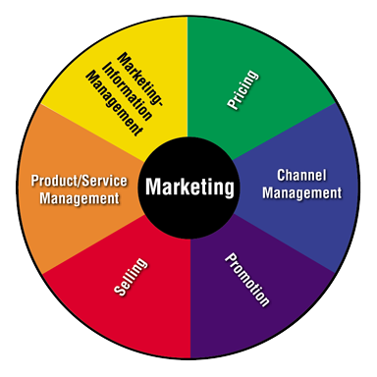
Chapter
2
What Are the Marketing Functions?
Interrelated activities working together to get products from producers to customers
  Product Service management
  Marketing information management
  Pricing
  Channel management
  Promotion
  Selling

Slide 23
Chapter
2
Product/Service Management
Product Service Management (PSM) means shaping a company’s offerings based on market demand fluctuations.
It involves coordinating:
Product development – Marketing - Service delivery - Customer support - Market research
And many more domains, all to ensure a seamless and satisfying user experience.
PSM aims to align product features and service offerings, ensuring that both components complement each other effectively and enhance the product’s value proposition.
This holistic approach helps businesses:
Maintain competitive advantage
Improve customer satisfaction
Deliver comprehensive solutions rather than standalone products or services

Slide 24
Chapter
2
So….. Product/Service Management
Obtains, develops, maintains, and improves product/service mix
Plans, directs, and controls a product’s life cycle
Generates ideas for new products
Improves or updates existing products
Removes products from the market
Importance of Product/Service Management
Helps to determine the business’s image/brand
Must offer products that customers want and need

Slide 25
Chapter
2
Marketing-Information Management
What is marketing information management, and why is it important for your business?
Marketing information management is the systematic process by which marketing operations teams collect, organize, and evaluate internal and external data (competitive intelligence) to prepare marketing research.
Marketing information management ensures that accurate and relevant information is available about customers, competing products, and competitors.
Marketing operations teams understand the importance of having organized, easy-to-understand data. In many cases, they use marketing information management to achieve this goal.
Understanding these key details about prospects and customers can be the deciding factor in making or breaking deals. It can be anything from a disappointing contract renewal to a lucrative upsell. This underscores the importance of having robust procedures in place to capture and manage user data. Many companies use marketing resource management software to accomplish this essential task.
Marketing information management has the potential to provide invaluable insights. Furthermore, it enables your marketing team to build a winning strategy, facilitating successful decision-making processes.

Slide 26
Chapter
2
Benefits of marketing information management
The benefits of having well-organized and easily accessible data are truly countless.
Leveraging user data enables marketers to develop strategies that increase leads and revenue.
The basic concept is to present data for better understanding, enabling your team to make more informed decisions.
Remember
Your information is your power
Information = Power
Here are some of the many benefits associated with developing a successful marketing information system

Slide 27
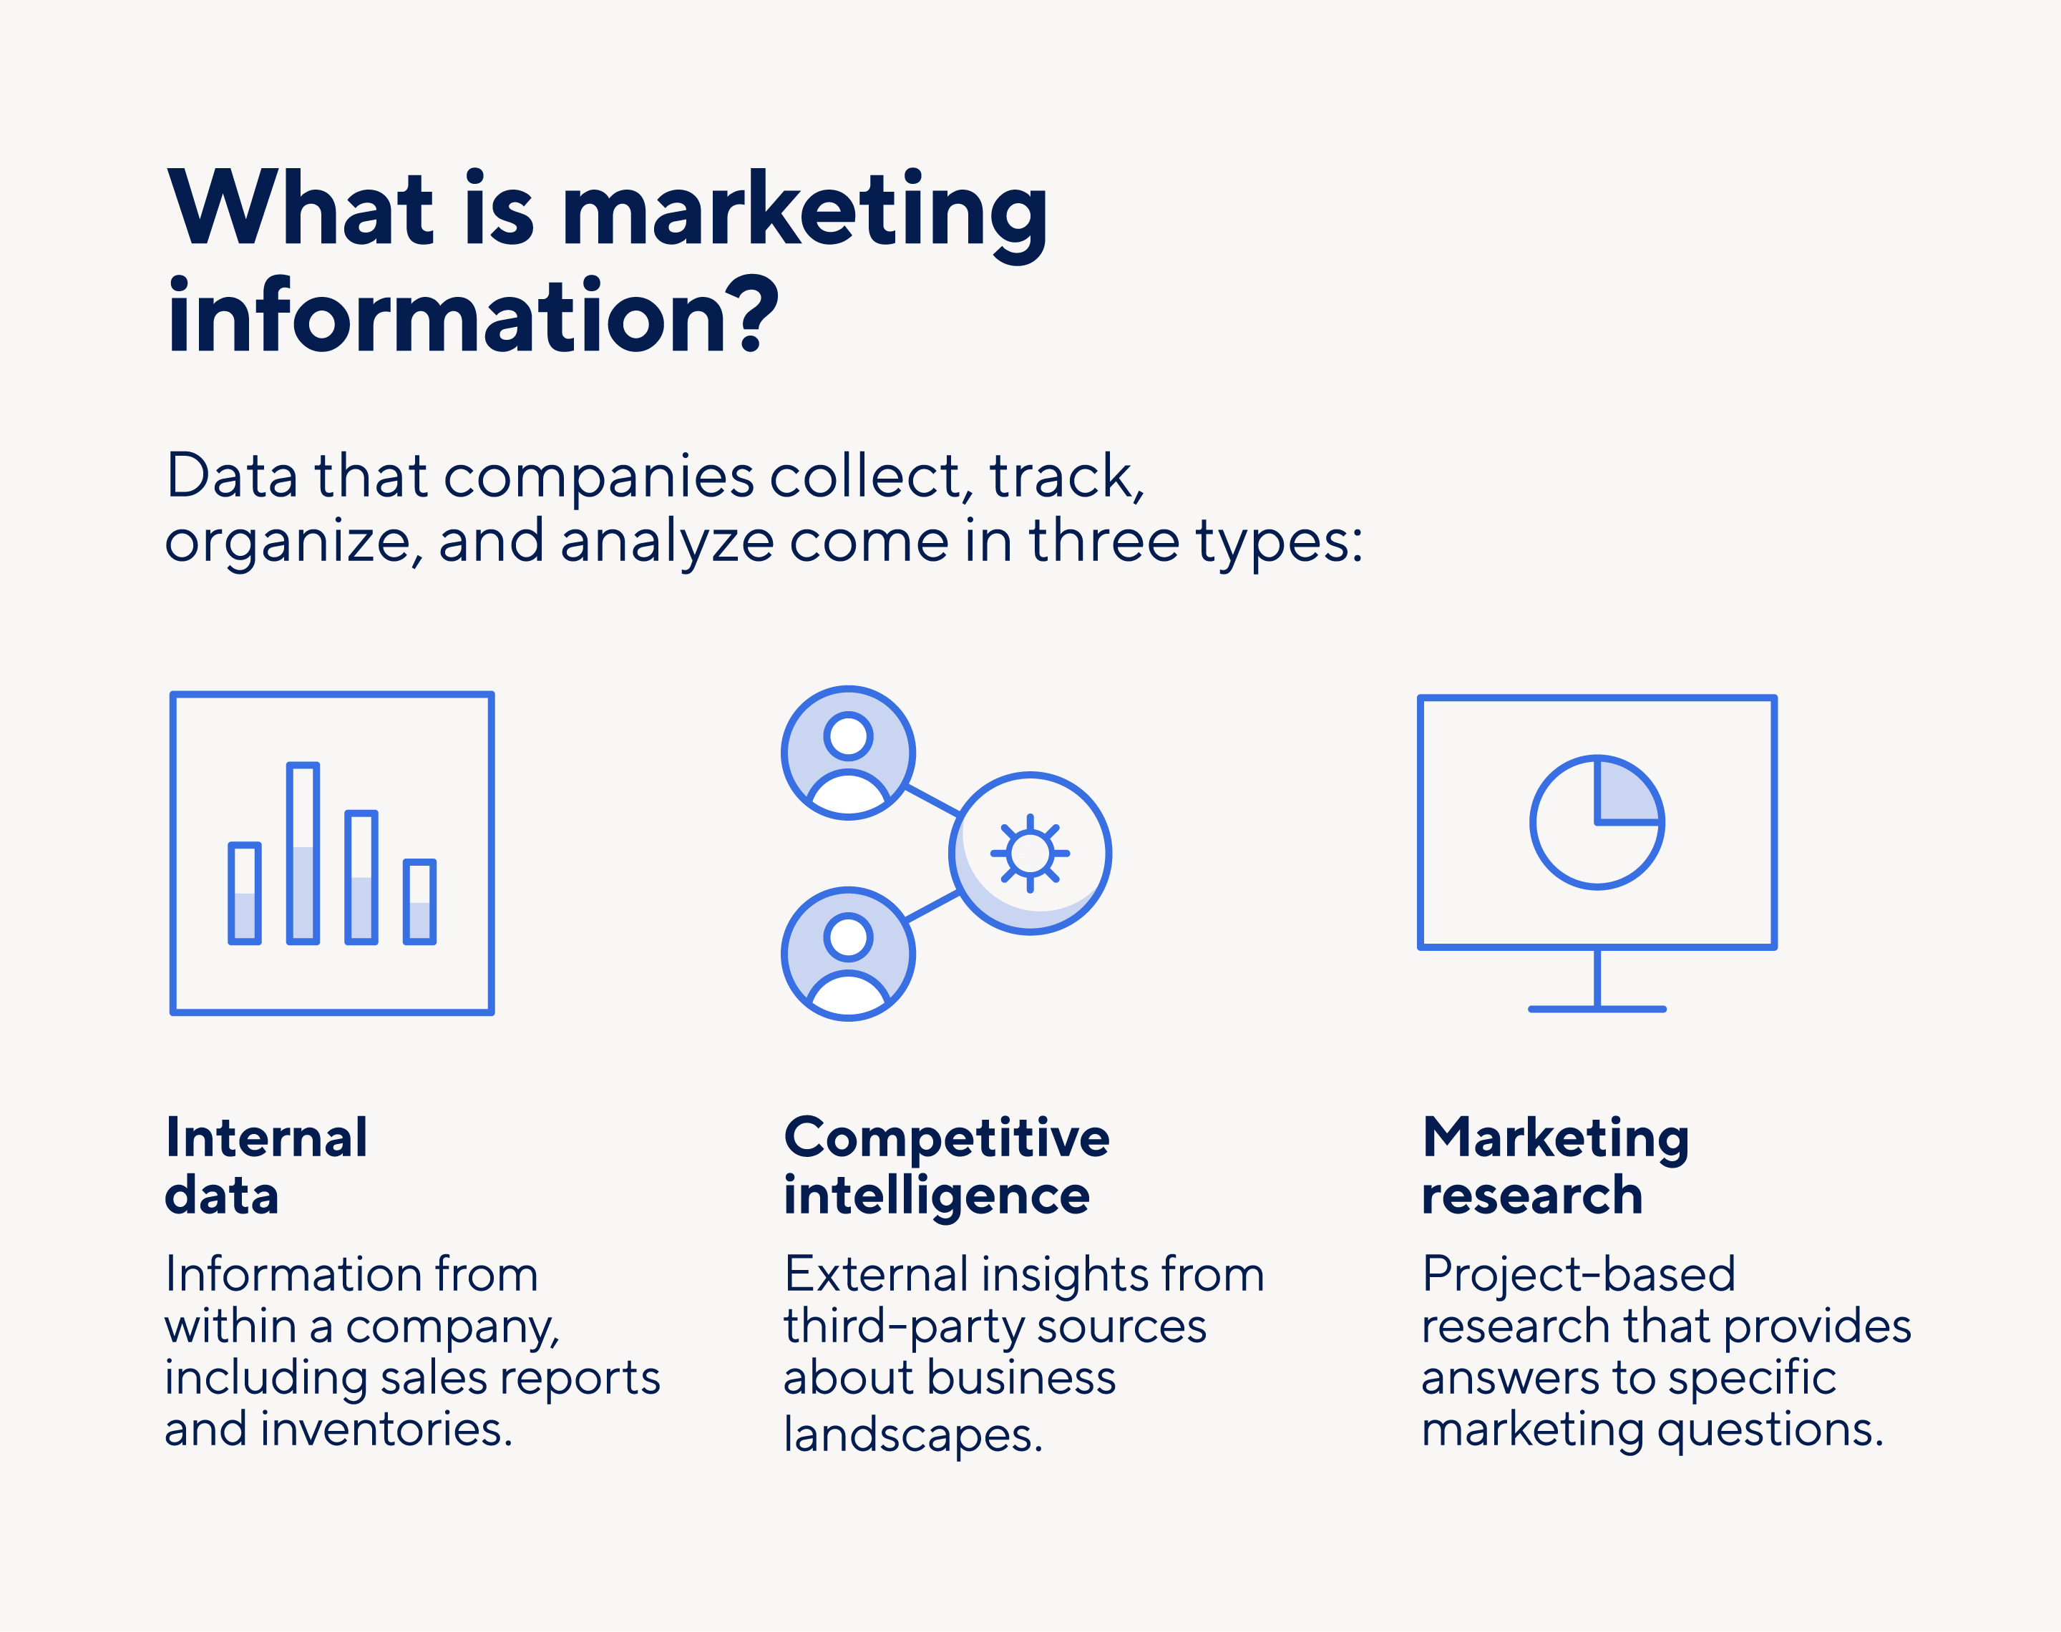
Chapter
2
Benefits of marketing information management
Enhanced comprehension of customer demographics and buying cycles
Deeper insight into competitive positioning
Increased lead conversions and revenue
Up-to-date compliance and security practices

Slide 28
Chapter
2
So….Marketing-Information Management
Gathers, accesses, synthesizes, evaluates, and disseminates information
Importance of Marketing-Information Management
Prevents guessing
Helps businesses to:
  Learn about their customers
  Predict the future
  Find out if customers are satisfied

Slide 29
Chapter
2
Pricing
Meaning of Pricing : Pricing is a process of fixing the value that a manufacturer will receive in the exchange of services and goods.
Pricing method is exercised to adjust the cost of the producer’s offerings suitable to both the manufacturer and the customer.
The pricing depends on the company’s average prices, and the buyer’s perceived value of an item, as compared to the perceived value of competitors product.
A business starts with a motive and intention of earning profits. This ambition can be acquired by the pricing method of a firm. While fixing the cost of a product and services the following point should be considered:
The identity of the goods and services
The cost of similar goods and services in the market
The target audience for whom the goods and services are produces
The total cost of production (raw material, labour cost, machinery cost, transit, inventory cost etc).
External elements like government rules and regulations, policies, economy, etc.

Slide 30
Chapter
2
Objectives of Pricing
Survival
The objective of pricing for any company is to fix a price that is reasonable for the consumers and also for the producer to survive in the market.
Expansion of current profits
Most of the company tries to enlarge their profit margin by evaluating the demand and supply of services and goods in the market. So the pricing is fixed according to the product’s demand and the substitute for that product. If the demand is high, the price will also be high.
Ruling the market
Firm’s impose low figure for the goods and services to get hold of large market size. The technique helps to increase the sale by increasing the demand and leading to low production cost.
A market for an innovative idea
Here, the company charge a high price for their product and services that are highly innovative and use cutting-edge technology. The price is high because of high production cost. Mobile phone, electronic gadgets are a few examples

Slide 31
Chapter
2
Types of Pricing Method
The pricing method is divided into two parts
Cost Oriented Pricing Method– It is the base for evaluating the price of the finished goods, and most of the company apply this method to calculate the cost of the product. This method is divided further into the following ways.
Market-Oriented Pricing Method- Under this category, it is determined on the base of market research

Slide 32
Chapter
2
1- Cost Oriented Pricing Method
Cost Oriented Pricing Method
It is the base for evaluating the price of the finished goods, and most of the company apply this method to calculate the cost of the product. This method is divided further into the following ways.
  Cost-Plus Pricing- In this pricing, the manufacturer calculates the cost of production sustained and includes a fixed percentage (also known as mark up) to obtain the selling price. The mark up of profit is evaluated on the total cost (fixed and variable cost).
  Markup Pricing- Here, the fixed number or a percentage of the total cost of a product is added to the product’s end price to get the selling price of a product.
  Target-Returning Pricing- The company or a firm fix the cost of the product to achieve the Rate of Return on Investment.

Slide 33
Chapter
2
2- Market-Oriented Pricing Method
Market-Oriented Pricing Method
Under this category, it is determined on the base of market research
  Perceived-Value Pricing- In this method, the producer establish the cost taking into consideration the customer’s approach towards the goods and services, including other elements such as product quality, advertisement, promotion, distribution, etc. that impacts the customer’s point of view.
  Value pricing- Here, the company produces a product that is high in quality but low in price.
  Going-Rate Pricing- In this method, the company reviews the competitor’s rate as a foundation in deciding the rate of their product. Usually, the cost of the product will be more or less the same as the competitors.
  Auction Type Pricing- With more usage of internet, this contemporary pricing method is blooming day by day. Many online platforms like OLX, Quickr, eBay, etc. use online sites to buy and sell the product to the customer.
  Differential Pricing- This method is applied when the pricing has to be different for different groups or customers. Here, the pricing might differ according to the region, area, product, time etc

Slide 34
Chapter
2
So… Pricing
Determines and adjusts prices to:
  Maximize return
  Meet customers’ perceptions of value
Importance of Pricing
Affects how well a product will sell
Impacts how much profit the business will make
Must set prices customers are willing to pay
Helps decide when to adjust prices
Must cover costs

Slide 35
Chapter
2
Channel Management
What is channel management?
Channel management refers to the various methods that companies use to promote and distribute their products and services to the general market.
In advertising, companies use channel management to promote marketing campaigns through mediums such as television commercials, social and digital advertising, radio programs, and print media, such as newspapers and magazines.
These platforms are the channels that companies use to deliver their products to their target market.
In addition to channel management for marketing, companies use channel management for product distribution.
Product distribution refers to the processes by which a company delivers its products and services to its customers.
In terms of channel management, organizations establish partnerships with external companies such as agents, vendors, manufacturers, wholesalers, and retailers, which make products available for general purchase.
A company’s channel management needs depend on its size and structure.
A company that sells products directly to its customers may not have any channels to manage, but a company with extensive marketing needs and distribution chains may have several.

Slide 36
Chapter
2
Why is channel management important?
Channel management is important for connecting with customers, supporting third-party partners and managing vendors.
Good channel management involves careful planning that helps you track how your channels contribute to your business goals.
When companies manage their channels effectively, they ensure they deliver the products customers want, when they're most in demand, while optimizing their profits and developing positive relationships with their partners.
Although channel management requires extensive planning and can become more complicated for businesses that work with many channels, it's an essential part of improving your business strategies and reaching your target markets

Slide 37
Chapter
2
So….. Channel Management
Identifies, selects, monitors, and evaluates sales channels
Puts products in the customers’ hands
Importance of Channel Management
Gets products from producers to customers
Makes products available when and where customers want to buy
Determines which channel members should do

Slide 38
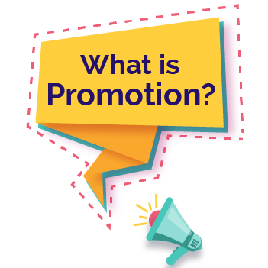
Chapter
2
Promotion
Promotion
is a fundamental component of the marketing mix, which has 4 Ps: product, price, place, and promotion. It is also an essential element promotional plan or mix, which includes advertising, self and sales promotion, direct marketing publicity, trade shows, events, etc.,
Some methods of this procedure contain an offer, coupon discounts, free sample distribution, trial offer, buy two items in the price of one, contest, festival discounts, etc.
The promotion of a product is important to help companies improve their sales because customers reaction towards discounts and offers are impulsive. In other words, promotion is a marketing tool that involves enlightening the customers about the goods and services offered by an organization.

Slide 39
Chapter
2
Types of Promotion
Advertising
The company uses advertising as a promotional tool as it reaches a mass of people in a few seconds.
An advertisement is communicated through many traditional media such as radio, television, outdoor advertising, newspaper or social media.
Other contemporary media that supports advertisement are social media, blogs, text messages, and websites.
Direct Promotion
It is that kind of advertising where the company directly communicates with its customers. This communication is usually done through various new approaches like email marketing, text messaging, websites, fliers, online adverts, promotional letters, catalog distributors, etc.
Sales Promotion
This utilizes all sorts of a marketing tool to communicate with the customers and increase sales. However, it is for a limited time, used to expand customers demand, refresh market demand and enhance product availability

Slide 40
Chapter
2
Types of Promotion
Self-promotion
It is a process where the enterprises send their agents directly to the customers to pitch for their product or service. Here, the response for the feedback of the customer is prompt and therefore, easy to build trust.
Public Relation
Popularly know as PR is exercised to broadcast the information or message between a company (NGO, Government agency, business), an individual or a public. A powerful PR campaign can be valuable to the company.
Online Promotion
This includes almost all the elements of the promotion mix. Starting from the online promotion with pay per click advertising. Direct marketing by sending newsletters or emails.

Slide 41

Chapter
2
So……Promotion
Communicates information about goods, services, images, and/or ideas to achieve a desired outcome
Informs, persuades, or reminds customers about a business and/or its products
Uses a variety of methods to communicate with customers
Importance of Promotion
Helps create the business’s image
Tells customers about products
Generates product demand

Slide 42
Chapter
2
Selling
What is selling in marketing?
Selling in marketing refers to the strategic process of persuading potential customers to purchase a product or service by effectively communicating its value proposition and meeting their needs.
It involves various techniques and tactics aimed at influencing buying decisions, closing sales, and driving revenue growth

Slide 43
Chapter
2
What are the benefits of selling in marketing?
Sales in marketing offer many benefits to companies
Increased revenue and profitability
Customer acquisition and retention
Market expansion and competitive advantage
Brand reputation and credibility
Don't forget
Personal and direct selling through a professional sales team... a successful way to generate feedback that helps in effective planning

Slide 44
Chapter
2
So….. Selling
Determines client needs and wants
Responds through planned, personalized communication
Influences purchase decisions
Enhances future business opportunities
Provides customers with the products they want
Importance of Selling
Involves contact with customers
Meets customers’ needs
Sells customers the most appropriate products
Benefits businesses, customers, and society

Slide 45
Chapter
2
We will continue in our next lecture

Slide 46
Chapter
2
Resources and References
Marketing 101 - The Five Marketing Concepts - Rock Content
The 5 Essential Marketing Concepts Explained + Examples (disruptiveadvertising.com)
What is the Marketing Concept | VCMO
Marketing Concepts: Definitions, Advantages, and Examples (visuwisu.co)

Slide 47

Thanks for listening.
01
Best wishes
Dr. Ayman Hassan

