Slide 1


Design Thinking
Prepared by Dr. Aya Mohamed
ENT 621
Master of Entrepreneurship
Lecture 5

Slide 2

In The previous Lecture: Design Thinking
Topics
v
Co-design, co-production and co-creation
Innovation in Business
Innovation Frameworks
What makes co-design work or fail, and what co-production really is ?
Co creation and co production in Education
Co-design
Co-production
Co-creation

Slide 3
In This Lecture: Design Thinking
Topics
v
The Holistic approach of Design thinking
Key principles and mindset of design thinking
FOUNDATION BUILDING FOR DESIGN THINKING PROJECT
STEEP analysis
Case Study
Holistic
Foundation
STEEP

Slide 4
The Holistic Approach of Design Thinking
1-
v
Design Thinking believes (and has been proven) that the people who face problems are the ones who hold the key to their problem’s answer.
Design Thinking is Human-centered problem-solving tool which emphasize on Empathy, Collaboration, Co-creation and Stakeholder feedback to unlock Creativity and Innovation, which devises feasible and viable Big Idea/solutions.
The key to the process is empathizing with the users (citizen) to uncover unmet needs by understanding their beliefs, values, motivations, behaviors, pains, gains and challenges and to provide innovative solution concepts.

Slide 5
The Holistic Approach of Design Thinking
1-
v
Design Thinking Practitioners:
DT practitioners work on real projects by designing needs and solutions with communities (users/citizen), to deeply understand the people they’re looking to serve, to dream up scores of ideas, and to create innovative new solutions rooted in people’s actual needs using Design Thinking through step-by-step guide with samples and ready to use templates.
DT practitioners offers a comprehensive set of Methods & Tools and activities that will take you from framing up your design challenge to getting it to the decision makers for implementation and users.

Slide 6
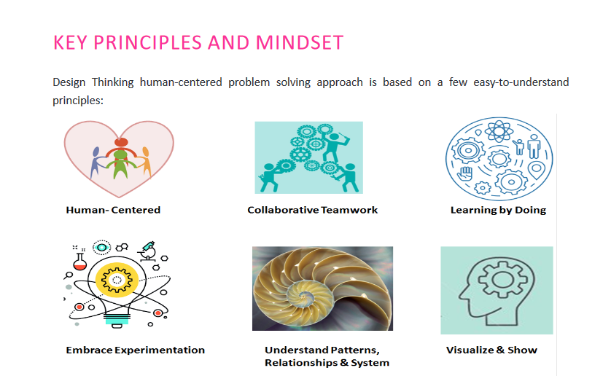

Slide 7
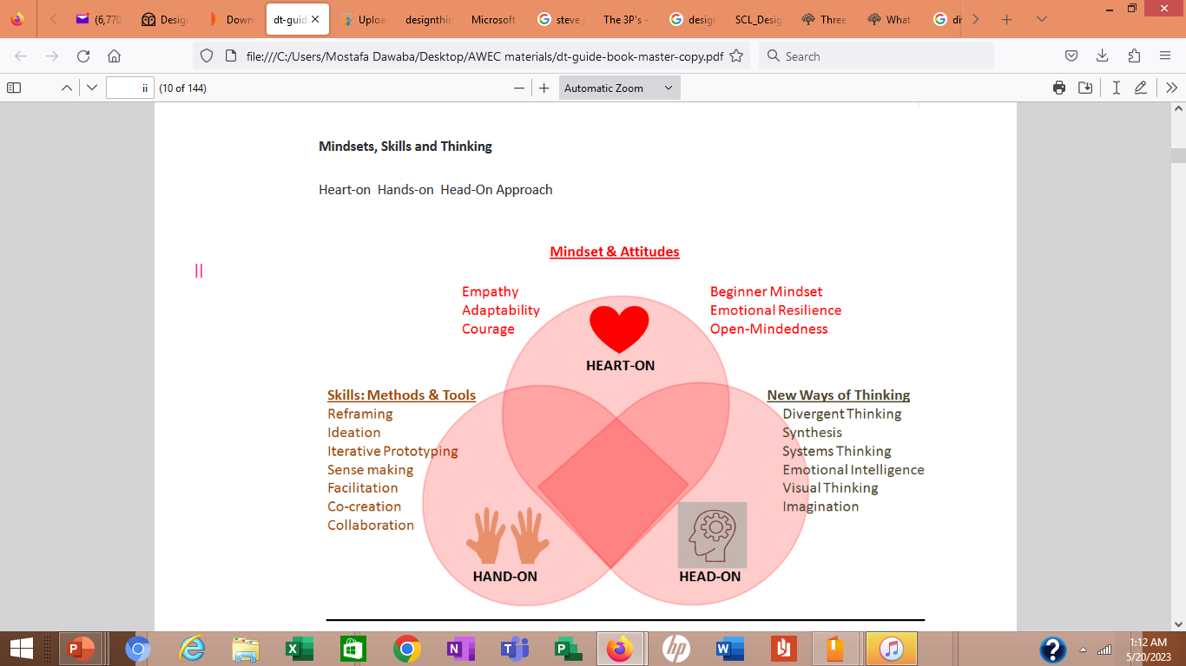

Slide 8

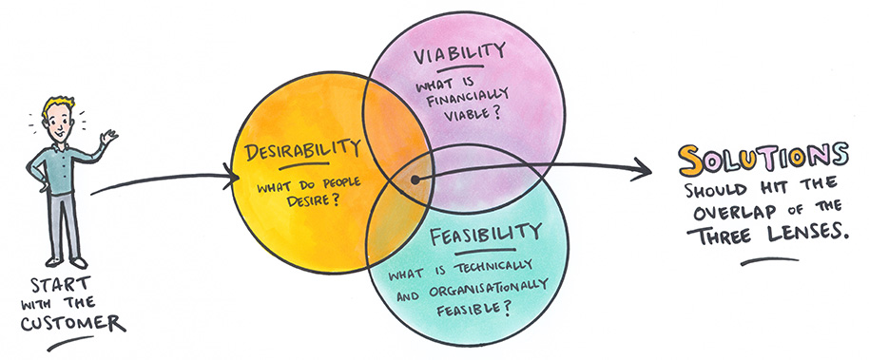

Slide 9
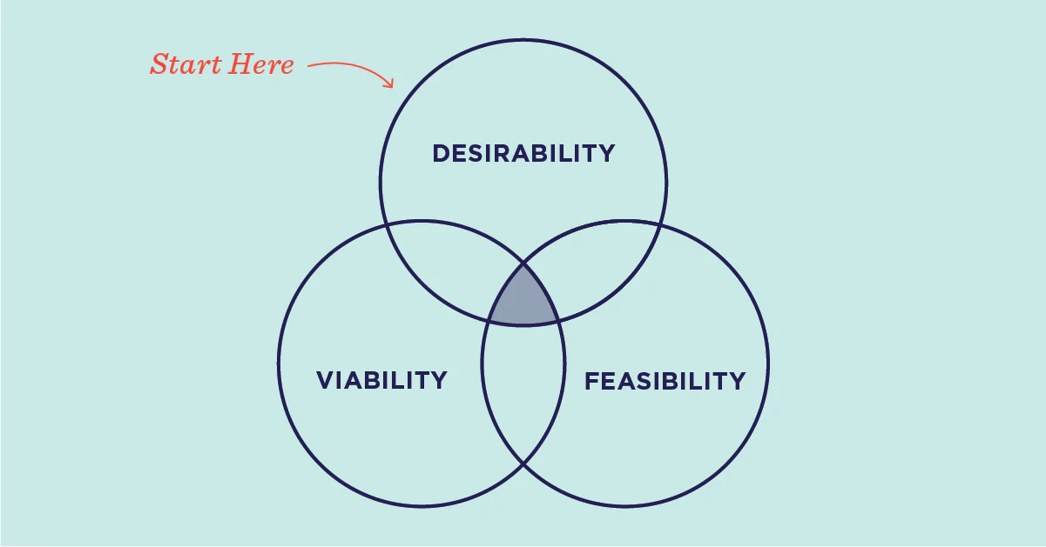
Design Thinking
2-
v
By employing design thinking, we pull together what’s desirable from a human point of view with what is technologically feasible and economically viable. It also allows those who aren't trained as designers to use creative techniques, methods, and mindsets to address a vast range of challenges.
Desirability: What makes sense to people and for people?
Feasibility: What is technically possible within the foreseeable future
Viability: What is likely to become part of a sustainable business model?
The design thinking process starts with taking action and understanding the right questions. It’s about embracing simple mindset shifts and tackling problems from a new direction.

Slide 10

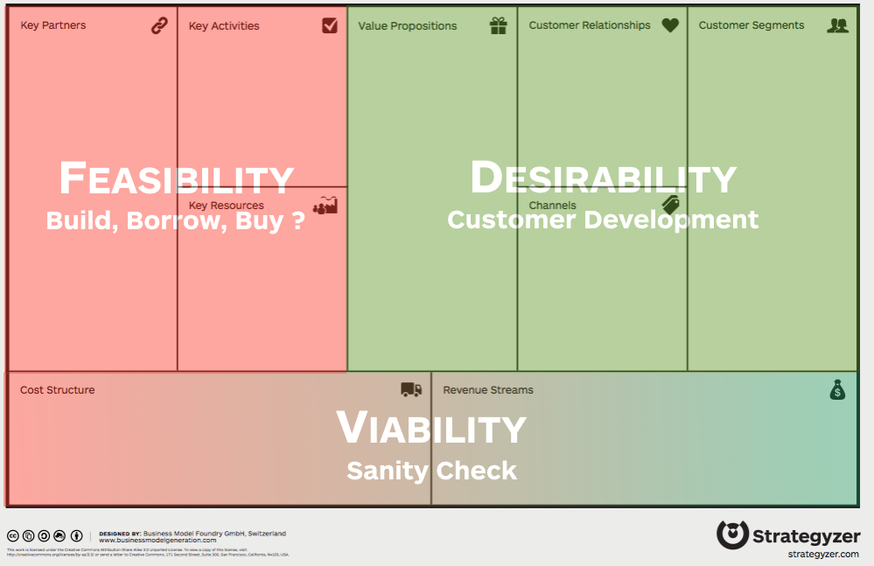

Slide 11

Design Thinking
2-
v
Design Thinking is not a perfectly linear process, and each project invariably has its own contours and character.
Generally, you will move through three main modules: Inspiration, Ideation, and Implementation which includes 5 phases.
When you move through the 5 phases, you will move from divergent thinking (create choices) to convergent thinking (make choices).

Slide 12
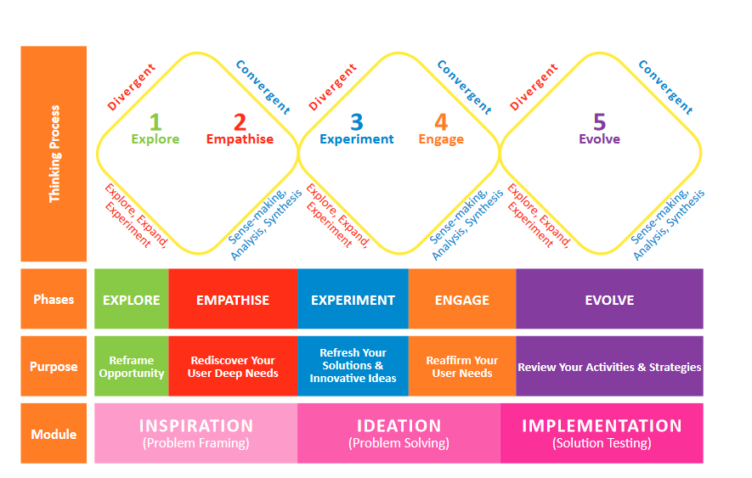

Slide 13
Design Thinking
2-
v
By going through these phases in turn, you will build deep empathy with the communities (user/citizen) and individuals you are designing for, figure out how to turn what you have learned into a chance to design a new solution and co-create and test your ideas before finally putting them out into the world.
You can also follow specific phase or a Method & Tool individually at your workplace to solve a problem.

Slide 14
Design Thinking
2-
v
Though no two Design Thinking projects are alike, you can use the same Methods and Tools for each of the phases for every project.
For example, to maintain creativity and energy, you work in teams, to build deep empathy with the people you conduct interviews, to keep your ideas visual, practical and relevant, you make tangible prototypes and since you rarely get it right the first time, you share what you have made and iterate based on the feedback you get through co-creation.

Slide 16
3-
FOUNDATION BUILDING FOR DESIGN THINKING PROJECT
v
Scoping of design challenge
When you want to work on real project using Design Thinking, begin the process with a specific and purposeful situation or problem to solve called Design Challenge.
The Design Challenge should be doable, clear, actionable and hopefully inspiring.
Your problem statement should be an outcome and not a solution.

Slide 17
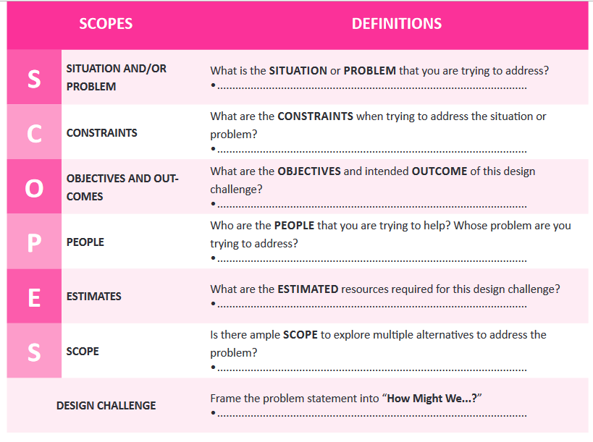
v
SCOPES as a tool to brainstorm and frame your problem

Slide 18
EXPLORE
v
Once you know your design challenge, you need to understand the context of your design challenge which
can be done through STEEP analysis to determine the impacts of macro environmental trend related to the design challenge to understand what possible (possible innovative ideas)
STEEP analysis
S Social
T Technological
E Economical
E Environmental
P Political

Slide 19
v
What is STEEP Analysis?
STEEP Analysis is a tool to explore and determine the impact of macro-environmental trends in the context
of the project topic (design challenge) as you should not limit your thinking just to the people you are designing for.
Used to consider governments, international partner and other stakeholders.
STEEP Analysis is used:

Slide 20
v
What is STEEP Analysis?
STEEP Analysis is a tool to explore and determine the impact of macro-environmental trends in the context
of the project topic (design challenge) as you should not limit your thinking just to the people you are designing for.
Used to consider governments, international partner and other stakeholders.
STEEP Analysis is used:
• To understand the future opportunities and challenges.
• To keep an eye on the future while focusing on the possibilities of the current as new services,
processes, administration and public policies may have to be developed in response to these trends.
• To cultivate thinking which leads to future implications of the present changes?

Slide 21
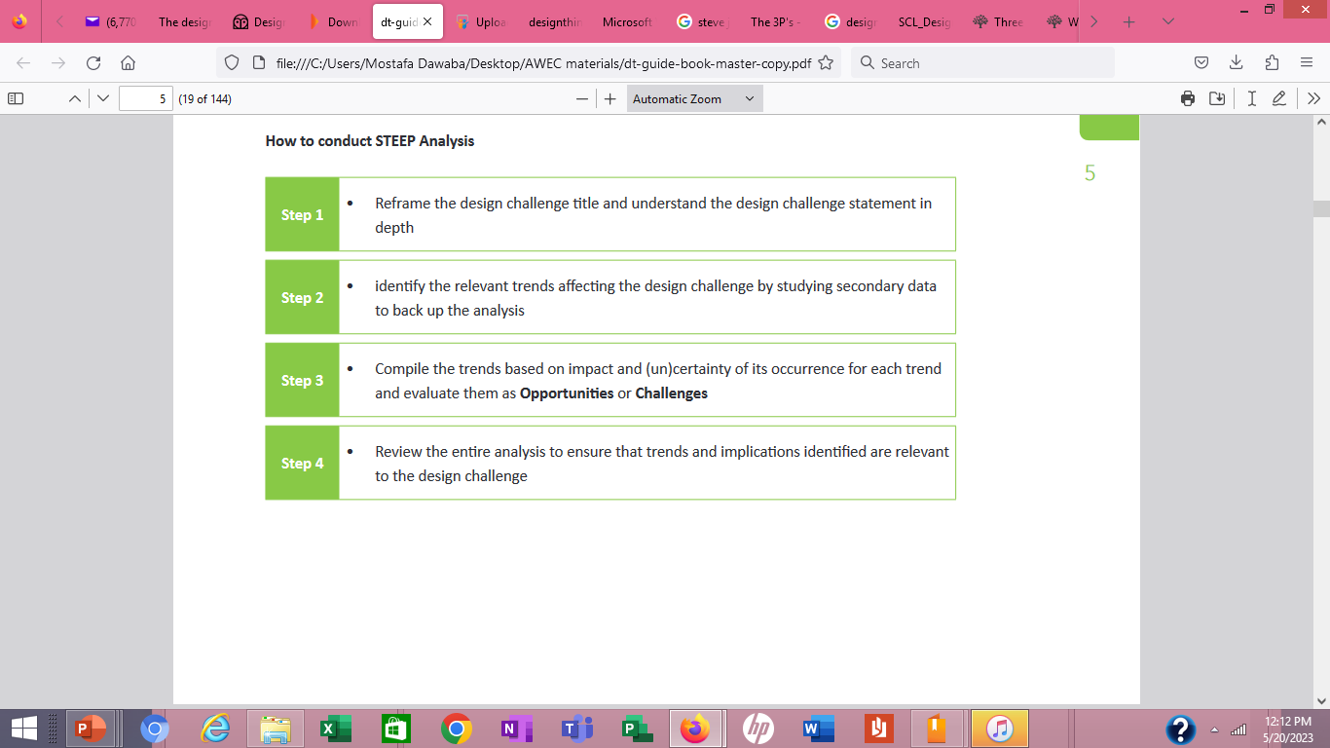

Slide 22
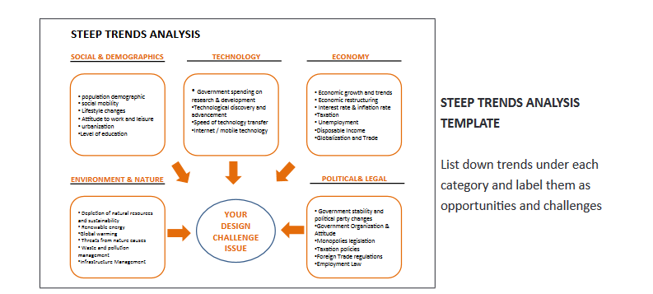

Slide 23
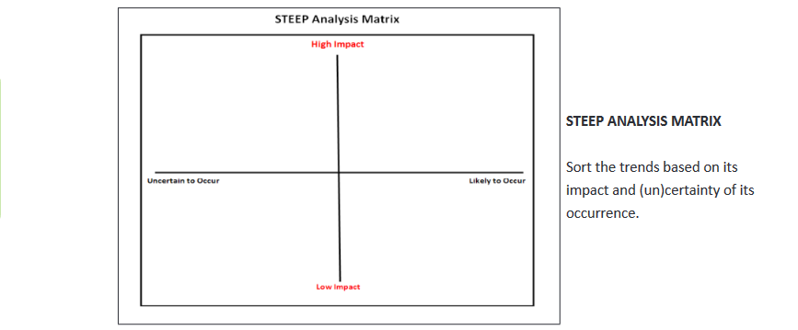

Slide 24
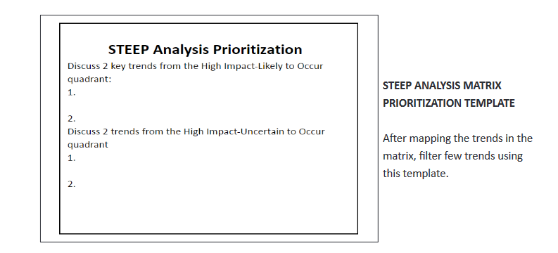

Slide 25

Step 2: Understand strategic priorities
v
STRATEGIC PRIORITIES
This tool is used after the STEEP Analysis. A Strategic Priorities Matrix is used to explore from multiple perspectives to gain insights and deep understanding of the design challenge (to see the whole and its parts).
What is Strategic Priorities?
Strategic Priorities Matrix is a tool with which you will look through multiple perspectives
Provide better understand the context and the real issues with your design challenge
help you synthesize and formulate a point of view or theory to explain your design challenge problem.

Slide 26
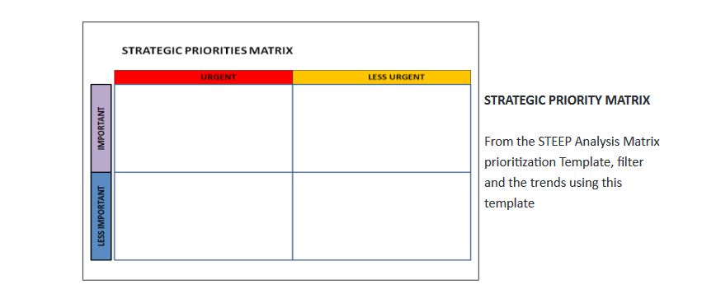

Slide 27
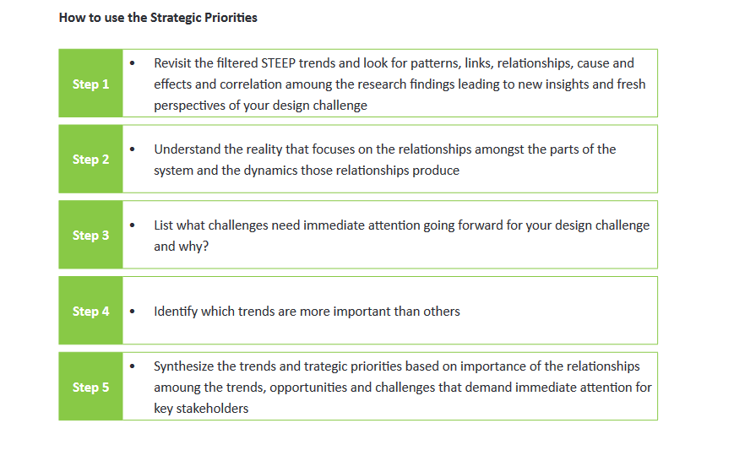

Slide 28
Case Study STEEP analysis of Starbucks
v
Background of Starbucks
It is crucial to have an idea about Starbucks to do a STEEP analysis of Starbucks. The knowledge about the company's background can help them to have a better idea about the possibilities of their future growth. Starbucks is one of the largest coffee-chain based in the US. They have outlets in more than 31,000 locations and serve coffees to millions of people every day. Starbucks offers varieties of flavored coffees and a wide range of baked products to their customers.

Slide 29
Basic Information of Starbucks
v
Company Name | Starbucks Corporation
Company’s Former Names | II Giornale Coffee Outlets
CEO | Kevin Johnson
Company Type | Public
Year Founded | 1971
Number of Employees | 346,000 (2019) (approximately)
Area served | Worldwide
Annual Revenue | US$ 26.50 Billion (2019)
Founder | Jerry Baldwin, Zev Seigl, Gordon Bowker
Headquarters | 2401 Utah Avenue South, Seattle, Washington
Operating income | US$ 4.07 Billion (2019)

Slide 30

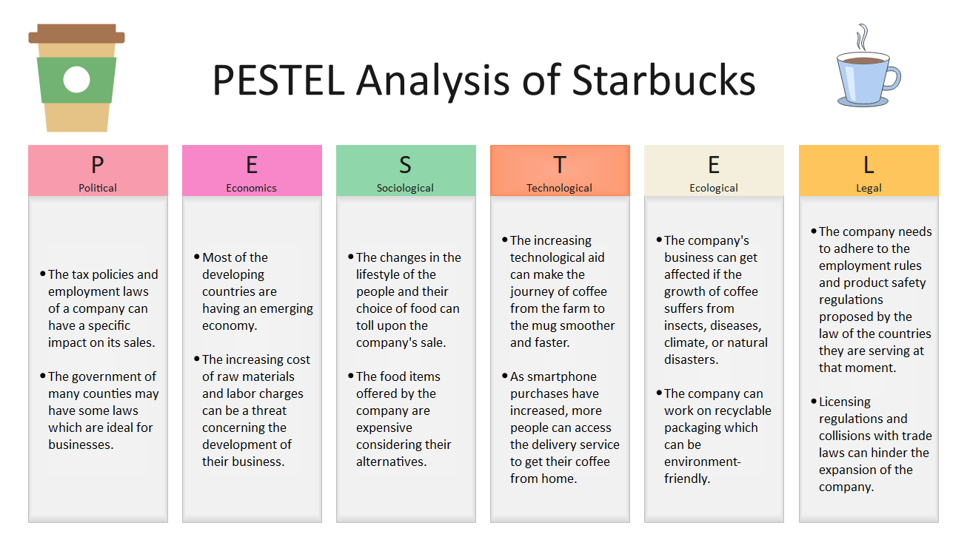
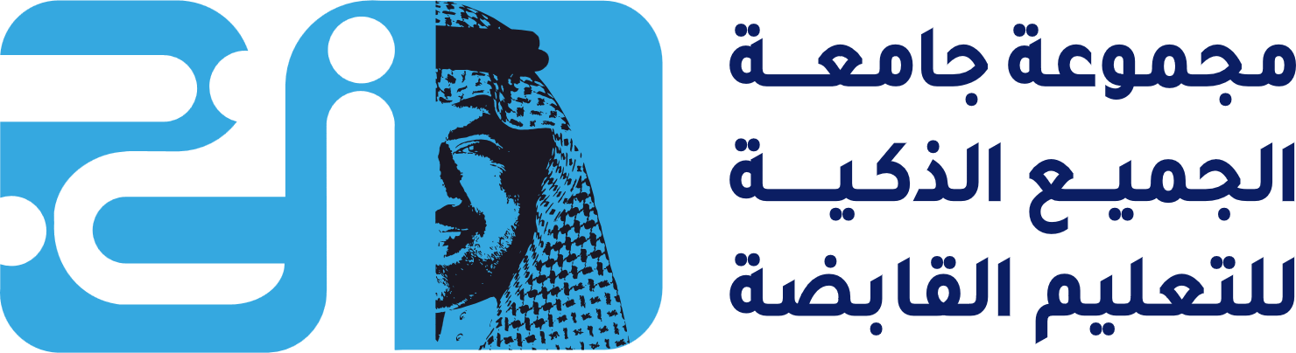


Slide 31
Case Study STEEP analysis of Starbucks
v
The STEEP analysis Starbucks helps to point out the key factors that can affect the growth of the business. The company has several threats and opportunities as well. They can improve their product based on the changing scenario and make demands. They can carefully weigh the risk factors and generate strategies for expansion while existing in the competitive market
Discuss the different Factors that affect the expansion of Starbucks
plot the strategic priorities matrix based on the STEEP analysis.

Slide 32
v
Political Factors:
Political factors can affect the expansion of a company in several ways. The political condition of the countries where a company operates may impact its progress. If the political condition is stable, the company may get a good environment for business. Several political conditions can affect the sales of Starbucks:
The tax policies and employment laws of a company can have a specific impact on its sales. If the tax policies are fair, the company may earn good revenue from the business.
The government of many counties may have some laws which are ideal for businesses. Starbucks can get a good chance of expansion in those countries.

Slide 33
v
Economic Factors:
Economic conditions of a country are directly linked to the business of a company. If a company desires improved sales, it may look for regions with stable market conditions. Here are some economic issues which can impact the sales of the company:
Most of the developing countries are having an emerging economy. It can be a good sign for the countries that are willing to expand their business.
The increasing cost of raw materials and labor charges can be a threat concerning the development of their business.
There are several alternatives of Starbucks, which are gradually getting hold of the market. The competitive market scenario can be a threat to the business of the company

Slide 34
v
Social Factors:
Social conditions are key factors that can affect the sales of any business. PESTEL analysis Starbucks can show how the social conditions of the operating area can impact the sales of the company:
The changes in the lifestyle of the people and their choice of food can toll upon the company's sale. People are more tending to have a healthy, low-calorie diet, which can decrease the sales of their sugary beverages.
The food items offered by the company are expensive considering their alternatives. It is the reason they are losing customers from lower and middle-income groups.
As the coffee culture is getting new meaning worldwide, the cafe chain can utilize it. It will help to expand its business.

Slide 35
v
Technological Factors:
Though technological conditions may not be a direct threat to the company's growth. In the long run, they may affect the business. The Pestel analysis Starbucks can show how technology can work in hindering or catalyzing the expansion of Starbucks:
The increasing technological aid can make the journey of coffee from the farm to the mug smoother and faster. The easy transport and high-tech coffee machine both can contribute to this.
As smartphone purchases have increased, more people can access the delivery service to get their coffee from home.
The company may see a drop in their sales because of the easy availability of good quality coffee machines in the market

Slide 36
v
Ecological Factors:
Ecological factors may not impact the business of a company directly. However, they can influence its progress indirectly. Here are some environmental issues that can affect the business of Starbucks:
The company's business can get affected if the growth of coffee suffers from insects, diseases, climate, or natural disasters.
The company can concentrate on following the business sustainability trend, which can make the customers support the company for their policies, and this can earn more environment-conscious customers.
The company can work on recyclable packaging which can be environment-friendly. They can support social and environment-related campaigns, which can be a fair opportunity to promote their business.

Slide 37
v
Legal Factors:
Many legal issues can directly or indirectly impact the growth of a company. If a company has some legal cases going on, that can create a negative impression. It may destroy its reputation. PESTEL analysis Starbucks can help to identify those legal factors:
The company needs to adhere to the employment rules and product safety regulations proposed by the law of the countries they are serving at that moment. Failing to do so may cancel their trade license.
Licensing regulations and collisions with trade laws can hinder the expansion of the company.
The company must ensure employee rights and customer safety regulations while expanding its business in a country. Otherwise, their business may suffer

Slide 38
Conclusion:
Frame project (design challenge) into design opportunity
Design Thinking is Human-centered problem-solving tool which emphasize on Empathy, Collaboration, Co-creation and Stakeholder feedback to unlock Creativity and Innovation, which devises feasible and viable Big Idea/solutions.
Heart-on Hands-on Head-On Approach

Slide 39
In This Lecture: Design Thinking
Wrap Up
v
The Holistic approach of Design thinking
Key principles and mindset of design thinking
FOUNDATION BUILDING FOR DESIGN THINKING PROJECT
STEEP analysis
Case Study
Holistic
Foundation
STEEP

Slide 40



Thank You

