Slide 1



Digital Analytics
MKT631
Lecture 5
Prepared by
Dr. Karim Ahmed
www.midocean.ae

Slide 2
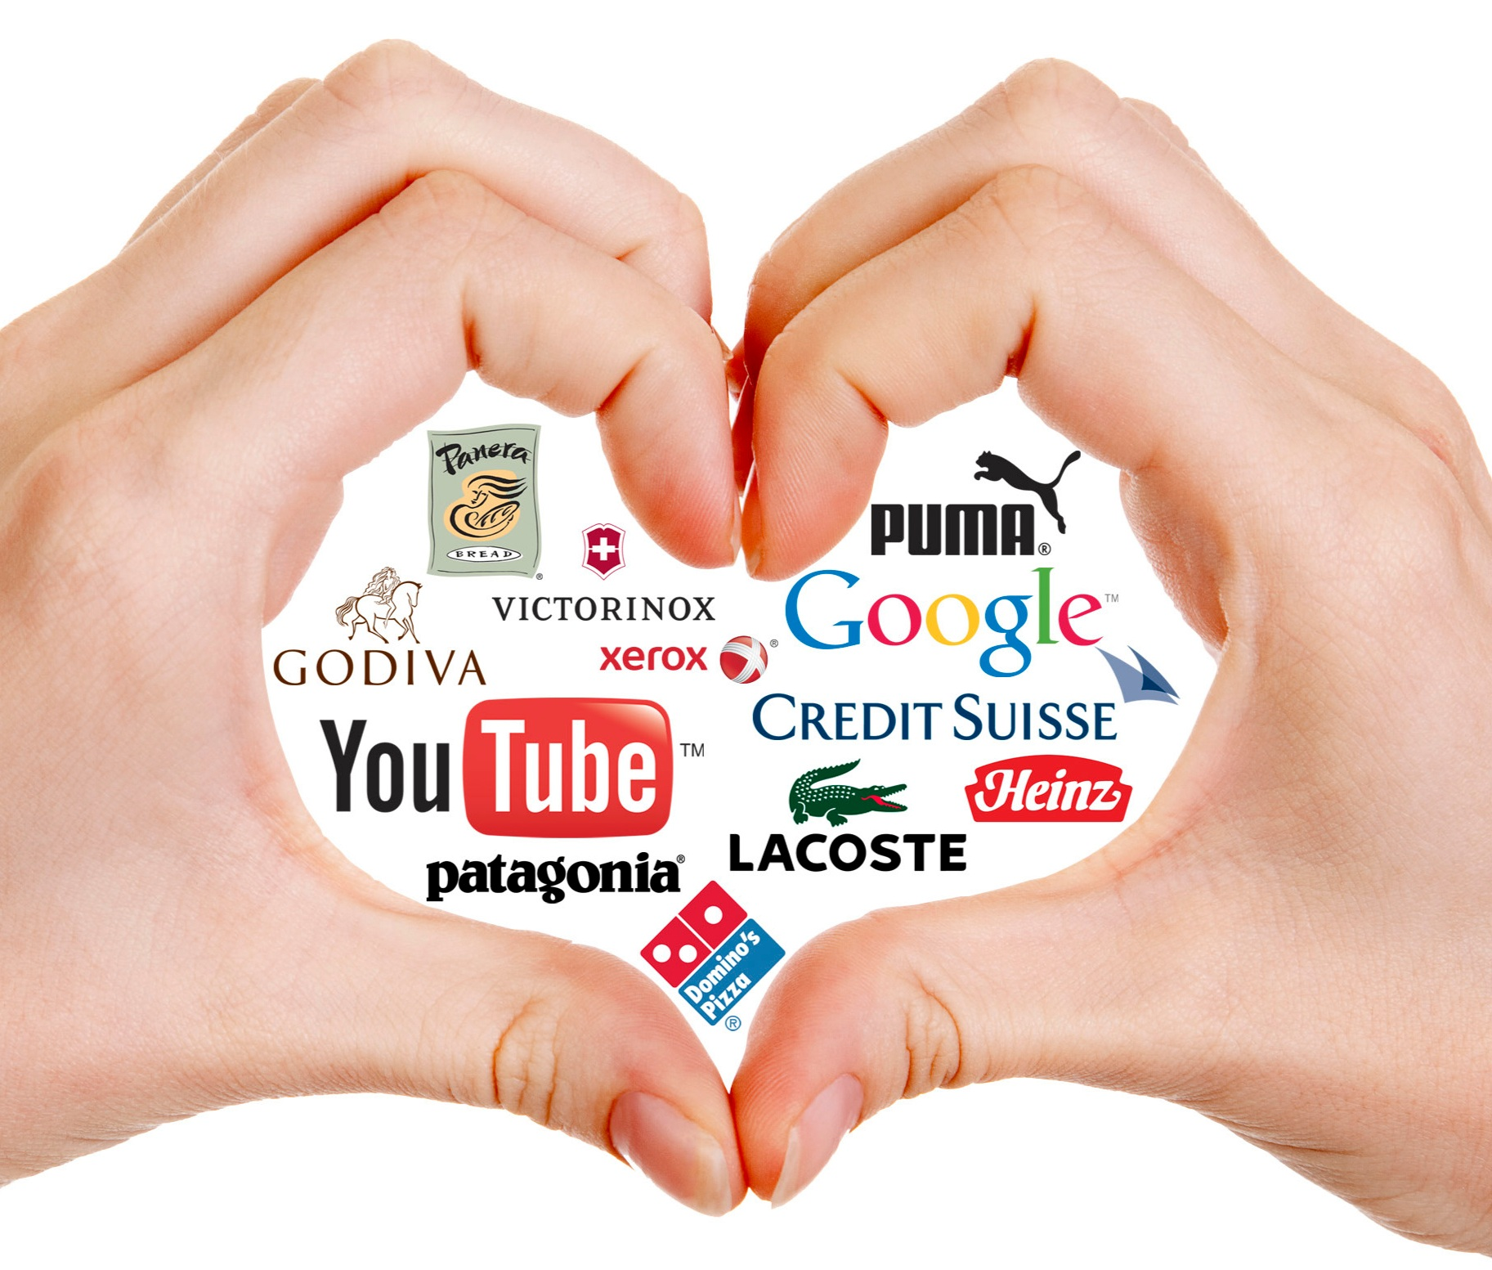
Consumer/Brand Relationships

Slide 3


Lecture Content
Online Video
Display Media
Social Media
www.midocean.ae

Slide 4
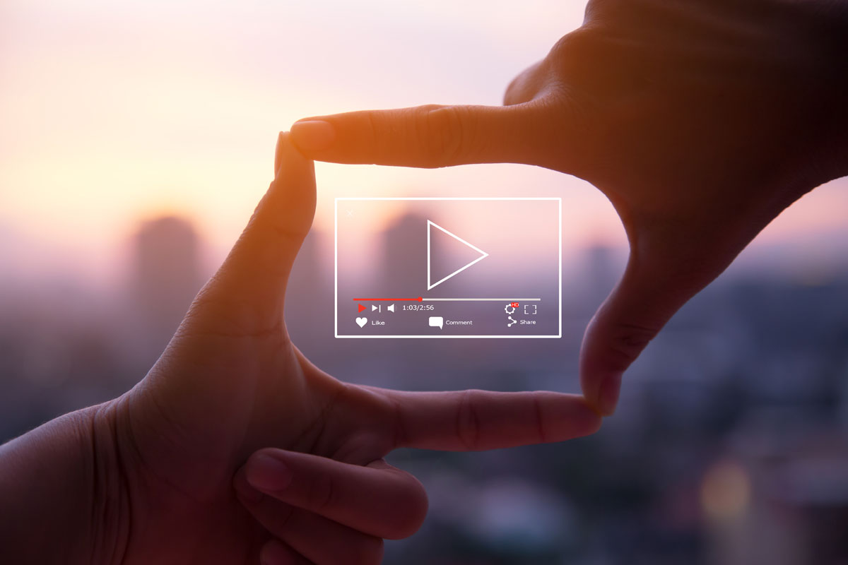
ONLINE VIDEO

Slide 5
Online Video
Online video (OLV) is a very important way for brands to engage consumers through multisensory experiences – sight, sound, and motion – and its emergence has revolutionized the entertainment industry, as well as the way people around the world use the internet. The 2016 announcement that OLV stars are eligible for Emmy nominations demonstrates this shift and is a testament to the fact that short-form digital content can be high-quality entertainment, regardless of where people view it.
www.midocean.ae

Slide 6
Online Video
By developing content that resonates with the interests and passions of viewers today, OLV creators have created authentic connections with their fans and amassed large followers. Stars such as PewDiePie (111 M. subscribers), Smosh (26.5 M. subscribers), and Jenna Marbles (19.7 M. subscribers) are frequently considered more popular and influential than many mainstream celebrities. In fact, a recent Variety study found that YouTube sensation PewDiePie was more popular than basketball great LeBron James among Generation Z males.
www.midocean.ae

Slide 7
Online Video
Online Video (OLV) Market Share
OLV is comprised of “user-generated content” models such as YouTube and Facebook, but also includes full episode players (FEP) and over-the-top (OTT) streaming services, including Shahid, Netflix, and Disney+. YouTube remains the largest online video platform, reaching 90 percent of the U.S. population, according to AudienceProject. comScore reports that 90 percent of internet users in the U.S. view online video. Brands are a critical component of the OLV experience, as
marketing strategists estimate the average internet user is served 11,250 ads per month.
www.midocean.ae

Slide 8
Online Video
Consumer Behavior and OLV
Google documented several interesting trends affecting consumer behavior in ways beyond how people access entertainment. In fact, OLV plays a significant role in shopping behaviors:
- Watch time for shopping-related videos on YouTube grew in the U.S. by more than five times over the past two years.
- Over the past three years, the number of YouTube channels with more than
1 billion views has grown by five times.
www.midocean.ae

Slide 9
Online Video
Consumer Behavior and OLV
- More than half of shoppers say online video has helped them decide which brand or product to buy.
- More than 90 percent of people say they discover new brands or products on YouTube.
- More than 40 percent of global shoppers say they’ve purchased products they discovered on YouTube.
www.midocean.ae

Slide 10
Online Video
Such shifts in consumer behavior have been a poignant illustration of the power of digital platforms. Moreover, changes in consumer behavior have left traditional linear television companies scrambling to reimagine the way they deliver entertainment. The culmination of these influences has led marketers to rethink their approaches to advertising. The implications for analysts are far-reaching.
www.midocean.ae

Slide 11
Online Video
Who is watching traditional and digital video is an equally important question. Apparent demographic differences among consumers are driving the shift from traditional television to digital video. Younger viewers, frankly, don’t watch TV like past generations. According to eMarketer, Generation Z consumers (under the age of 23) spent less than one-third as much time in front of the television as boomers (age 56 and older). Millennials (age 24 to 39 in 2020) and Generation X consumers (age 40 to 55) watch less TV than boomers as well.
www.midocean.ae

Slide 12
Online Video
Digital video, on the other hand, exhibits greater usage among younger consumers. More than 90 percent of U.S. teens and adults under the age of 45 used digital platforms (including 98 percent of Americans age 18 to 24) while fewer than 70 percent of boomers visit such sites. Understanding the demographic makeup of consumers can inform analysts’ recommendations on which platforms are ideal for reaching consumer segments.
www.midocean.ae

Slide 13
Online Video
OLV’s influence on shopping behaviors and entertainment choices offers
opportunities for brands to create content that influences consumers. Doing
so effectively requires understanding how to measure the success of those
efforts.
www.midocean.ae

Slide 14
Online Video
Key OLV Measures
Reach
Reach is a measurement of the size of the audience that watches an ad. This is a classic metric used as a key measure of success for most traditional media, particularly television.
Frequency
Frequency is the number of times the ad was exposed to an average person or household during a given period. For example, if the ad reached 30 million households in an audience or region that has 10 million households, its frequency would be three. Frequency is also used to assess television and other traditional media.
www.midocean.ae

Slide 15
Online Video
Key OLV Measures
Gross Rating Points (GRPs)
GRPs measure the total of all Rating Points an advertiser earns during a campaign. The measure is calculated by simply summing the Rating Points of all ads run during the campaign. Alternatively, GRPs can be calculated by multiplying a campaign’s reach by its average frequency. For example, if a campaign reached 30% of the market and the consumers reached saw the ad an average of 4 times (i.e., a frequency of 4), the campaign earned 120 GRPs. As you can see, this metric can be greater than (even much greater than) 100.
www.midocean.ae

Slide 16
Online Video
Key OLV Measures
Effective reach
Effective reach is a target detailing the number of people who see an ad with a frequency at or above the number of times deemed to be most effective. For example, “1+ Reach” means everyone who saw the ad at least once. This is also a measure used extensively to track traditional media channels.
Rating Points
Expressed as a percentage, a Rating Point is 1 percent of the potential audience. For example, if 25 percent of all targeted viewers saw an advertiser’s commercial, the advertiser has achieved 25 rating points. Rating Points were conceived to track the effectiveness of traditional television campaigns but are used increasingly to track OLV.
www.midocean.ae

Slide 17
Online Video
Key OLV Measures
Engagement Rate
Often, brands want consumers to do more than watch videos. Engagement rate – the percentage of consumers who engage in additional behavior (e.g., sharing the video, clicking a link in the video, etc.) – can provide insight into the video’s ability to encourage those desired behaviors.
Share of Audience (SOA)
Measuring a brand’s relevance to consumers provides a sense for awareness, interest, and many other key brand attributes. Share of audience (SOA) is one way to quantify relevance. To calculate SOA, divide the number of subscribers to an OLV channel by total subscribers for brand channels in the category. SOA is inexact – after all, the same person can subscribe to any
number of OLV channels – but it can provide a directional idea of a brand’s popularity.
www.midocean.ae

Slide 18
Online Video
Online Video Summary
OLV is an important way for brands to engage with consumers. OLV’s blend of sight, sound and motion provides brands with unique opportunities to craft consumer experiences in a rapidly evolving marketplace. While YouTube is the world’s largest online video platform, streaming services from traditional video creators and new entrants are adding new content choices for consumers. These services seek to realize benefits created by the significant
shifts in consumer behavior in the way video content is enjoyed, its role in entertainment choices, and the influence it has on purchase decisions. Measuring successful online video campaigns requires new metrics, as well as traditional video measures that have been adapted for online video delivery.
www.midocean.ae

Slide 19
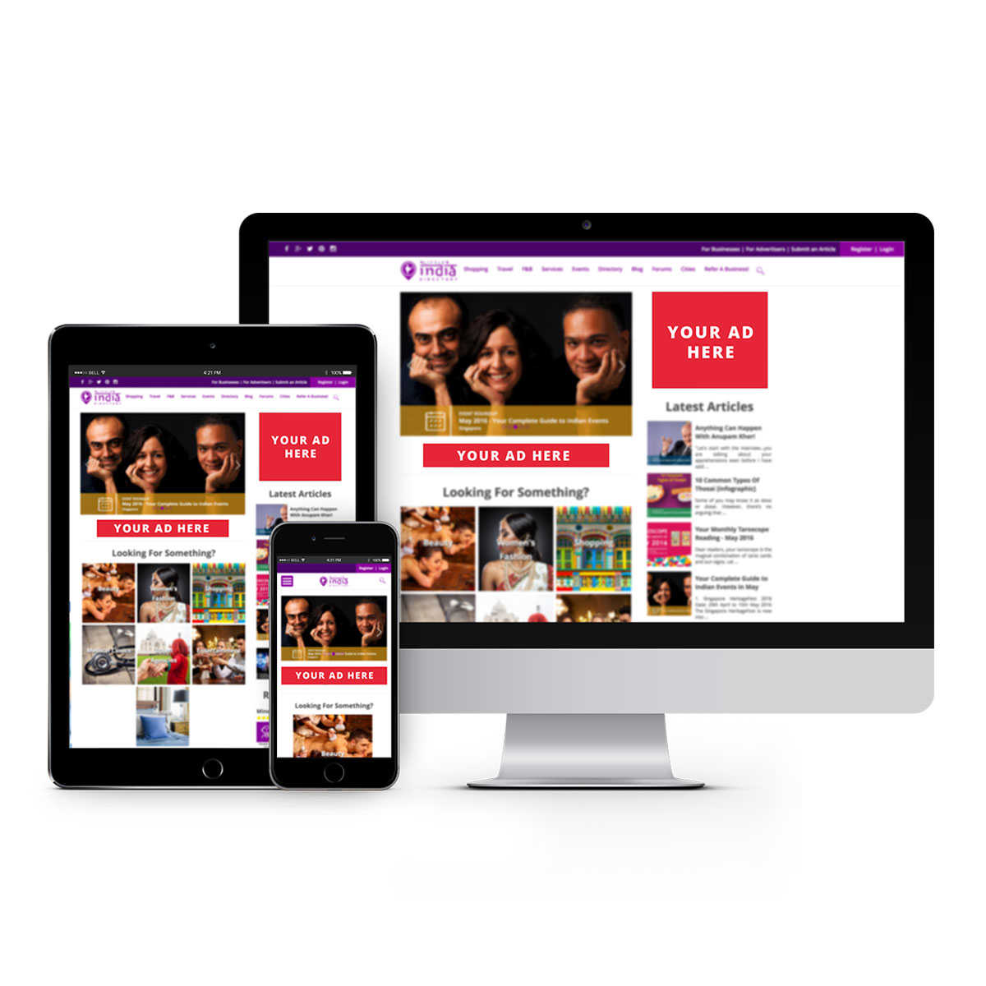
DISPLAY MEDIA

Slide 20
Display Media
The display ad of today hardly resembles the banner ads of 25 years ago. Introduced in 1994, display ads are one of the oldest forms of digital advertising and signaled a change in the way brands could interact with consumers online. Display ads contributed to the rise of data analytics as we know it today. But the static ads of yesterday have been updated to include video, dynamic content, and other forms of immersive experience that are designed to engage consumers at key moments in their purchasing journeys.
Coupled with marketing technology, the display ad can play a critical and efficient role in a brand's advertising and marketing efforts.
www.midocean.ae

Slide 21
Display Media
Display Media Market Share
Digital display ads come in many formats. The primary types of digital display ads include banners and similar executions, video ads that aren’t in a player, rich media ads that integrate streaming activity (often through the use of Flash or JavaScript to allow users to interact with content), and sponsorships in which advertisers pay for custom content and/or experiences presented in a display format.
www.midocean.ae

Slide 22
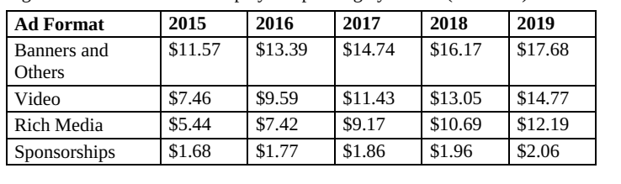
Display Media
Display Media Market Share
Estimated U.S. display ad spending by format ($Billions)
www.midocean.ae

Slide 23
Display Media
Display media has evolved with new formats and features aimed at increasing
consumer engagement. Video, rich media, and custom-constructed sponsorships are examples of formats that build on the static banner concept by introducing attention-grabbing motion, sound, and content. Display ads have primarily evolved, however, in how they can target specific consumers on the internet.
www.midocean.ae

Slide 24
Display Media
You’ve probably experienced display ads’ targeting capabilities. After visiting a retailer’s page to check out a pair of shoes, you likely noticed those shoes popping up in display ads on nearly every page you subsequently visited. This is because digital data placed on your device when you checked out the shoes can inform the bidding strategies of sophisticated display advertisers, ensuring they remind you of the items. A recent study by Washington Post technology columnist Geoffrey A. Fowler found that in one week of browsing the internet with Google Chrome, more than 11,000 tracking cookies were deposited into his browser.
www.midocean.ae

Slide 25
Display Media
Key Display Media Measures
Click-Through Rate
As with search ads, click-through rate is an important metric for display media. Tracking the percentage of consumers who saw a brand’s display ad and clicked on it gauges the effectiveness of display strategies that target consumers, as well as the effectiveness of the display ad’s creative to engage consumers.
Engagement Rate
Similar to the metric used to gauge video engagement, the engagement rate of
a display ad tracks the rate by which consumers interact with the ad.
www.midocean.ae

Slide 26
Display Media
Key Display Media Measures
Conversion rate
Conversion rate is calculated as the percent of consumers who, after clicking on a display ad, take action on the linked page. Tracked actions could be making a purchase on the page, or any number of activities the brand deems to be positive.
Cost Per Action
Cost per action (CPA) takes the cost invested in a display campaign and divides that cost by the number of tracked consumer actions. As with search, the action could be clicks on the display ad (cost per click, or CPC), or any other action the brand deems important.
www.midocean.ae

Slide 27
Display Media
Display Media Summary
Display ads have evolved significantly since they debuted in 1994, adding a number of features to increase consumer engagement. Today’s digital display comes in many formats, including banners, video, rich media, and sponsorships. Each category of display ads grew consistently and steadily from 2015 to 2019. Display ads have primarily evolved in their ability to target specific consumers across the internet, but privacy concerns have cast
doubt on how effective display ads will be in the future. Measuring the effectiveness of display strategies, campaigns, and creative can be done in much the same way as with search media.
www.midocean.ae

Slide 28
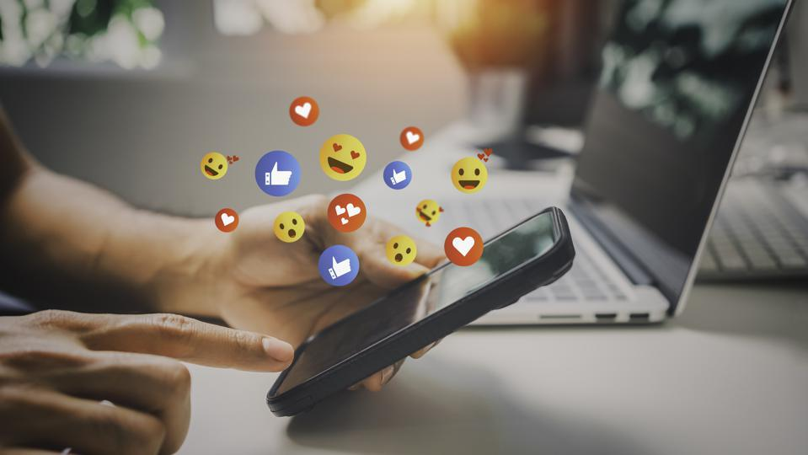
SOCIAL MEDIA

Slide 29
Social Media
Since its founding in 2004, Facebook has been the dominant social media platform in the world. It’s changed the way people communicate, maintain personal relationships, and investigate brands for the 3.2 billion users of social media today. Behind Facebook and its image-based social media property, Instagram, stands platforms that include Pinterest, Twitter/X, Snapchat, and LinkedIn. Combined, these six players represent the majority of social media engagement, and each has carved a unique niche in the social media landscape.
www.midocean.ae

Slide 30
Social Media
Social Media Market Share
Social media use is increasing around the world. Without a doubt, it’s one of the most popular online activities for people of all ages. According to Yapmedia, in 2019, 3.2 billion social media users were active, and that number is growing worldwide. That equates to about 42 percent of Earth’s population.
www.midocean.ae

Slide 31
Social Media
Consumer Behavior and Social Media
The social platform a user chooses typically depends on need. For business connections, a person turns to LinkedIn, while someone who wants to connect with others on a personal level is more likely to fire up Facebook.
Age also affects platform choice. Approximately 78 percent of 18- to 24-year-olds use Snapchat and a sizeable majority of these users (71 percent) visit the platform multiple times per day.
www.midocean.ae

Slide 32
Social Media
Consumer Behavior and Social Media
Furthermore, social media has matured to become a strong influencer in buying decisions. Social media channels give customers an easy way to contact brands. Customers can learn about brands’ organizations and browse their friends’ opinions. In late 2019, Lyfe Marketing documented three facts that support the power social media has on the consumer decision journey:
81 percent of customers make buying decisions based on their friends’ social media posts (Market Force). In other words, when followers engage with an advertiser’s page, they not only connect with those consumers, but also potentially influence all of their connections.
www.midocean.ae

Slide 33
Social Media
Consumer Behavior and Social Media
71 percent say social media referrals make them more likely to purchase an item (HubSpot). When people refer a brand on social media, the advertiser boosts its sales potential with everyone who sees that post.
133 percent increase in conversions when shoppers on mobile see good reviews about a brand before they buy an item (Bazaarvoice). Great reviews on Facebook and other social media sites can help convince people to try a business.
www.midocean.ae

Slide 34
Social Media
How Brands Use Social Media
A sponsored post integrated into a user’s feed is the most common ad product social media platforms sell. These posts can feature all types of digital advertising mentioned thus far: display ads, video ads, and even search ads from a social media platform’s search page.
www.midocean.ae

Slide 35
Social Media
How Brands Use Social Media
Advertisers can use each social media network to realize a unique objective, despite the commonality in ad formats. Facebook’s enormous reach and consumer data allow brands to connect to a great number of consumers in a highly targeted, personalized way. Twitter’s connectedness and unique format (i.e., limited character content delivered in short bursts) enables brands to reach targeted segments of consumers quickly and efficiently through rapid sharing. Pinterest’s use of “image pinning” reveals internet browsing behavior. Instagram works in conjunction with Facebook’s social network, allowing advertisers to connect with consumers in different ways while complementing simultaneous Facebook campaigns.
www.midocean.ae

Slide 36
Social Media
How Brands Use Social Media
Guiding an advertiser in the successful use of social media – including the leading networks mentioned here and those that weren’t discussed – requires a clear understanding of each network’s position in the social media market. Through this understanding, the analyst can design objectives that fit each network while carefully weighing its pros and cons.
www.midocean.ae

Slide 37
Social Media
Key Social Media Measures
Audience Growth
When tracking audience growth, analysts look at how many people are connected to a brand on social media. “Followers” are a common designation on social media platforms for people who have agreed to receive content updates from brands (e.g., Twitter followers). Picking two points in time and measuring the increase in followers provides audience growth. Clearly, the faster a brand increases its audience and the bigger the audience is, the better for that brand.
www.midocean.ae

Slide 38
Social Media
Key Social Media Measures
Amplification rate
Amplification rate measures the advocacy that consumers show toward content on a brand’s social media platform. For example, if consumers share videos or comments from a brand’s social media feed on their social channels, that’s amplification. Amplification rate tracks the volume of “shares” for a piece of content, or the rate at which those shares are collected (i.e., the number of consumers who shared the content / the total number of consumers who saw the content).
www.midocean.ae

Slide 39
Social Media
Key Social Media Measures
Amplification rate
Amplification is important for many reasons – namely, when brands talk to consumers, brands want consumers to relay their messages to others. A brand gains credibility when consumers share the brand’s words. In addition, consumer endorsements are perceived as being more credible than marketing messages. The higher the amplification rate, the better for the brand.
www.midocean.ae

Slide 40
Social Media
Key Social Media Measures
Applause rate
Applause rate is different from amplification rate. Applause rate measures the degree to which consumers react positively to a brand’s work. Positive reactions can come from a “Like” on Facebook, a favoriting of a tweet on Twitter, or saving an image to a Pinterest account. Applause rate is calculated as the percent of users who see the content that has the desired positive reaction. Applause is not sharing the content, so this measure stops short of quantifying brand advocacy. Applause rate can still be an effective measurement for identifying the content that does or doesn’t work for consumers.
www.midocean.ae

Slide 41
Social Media
Key Social Media Measures
Click-Through Rate
As with search and display ads, click-through rate is an important metric for social media ads and campaigns when a consumer can click on an ad and be sent to another destination, such as the advertised company’s website. Tracking the percent of consumers who saw a brand’s ad and clicked on it gauges the effectiveness of display strategies that target consumers, as well as the effectiveness of the display ad’s creative to engage consumers.
www.midocean.ae

Slide 42
Social Media
Key Social Media Measures
Engagement Rate
In the context of social media, engagement rate measures the percentage of consumers who engage in additional behavior (e.g., comments on Facebook, re-pins on Pinterest, brand mentions on Twitter, etc.). Similar to the way this metric works with OLV, engagement rate can provide insight into the video’s ability to encourage those desired behaviors.
www.midocean.ae

Slide 43
Social Media
Key Social Media Measures
Reach
As with OLV, reach, in the context of social media, is a measurement of the
size of the audience that sees an ad. Reach applies to video ads, sponsored
posts, and any other ad types on a social media platform.
www.midocean.ae

Slide 44
Social Media
Key Social Media Measures
Share of voice
Brands can measure their relevance by conducting a share of voice (SOV) analysis. To calculate SOV, divide the number of social mentions for a brand by total social mentions for brands in the category. SOV can be conducted at a company level, brand level, or product level, and can compare the item being mentioned by consumers against the entire market or a select group of key competitors.
www.midocean.ae

Slide 45
Social Media
Social Media Summary
The emergence of other social media platforms has offered consumers additional choices. Each platform plays a unique role in the market and, therefore, enjoys a unique role in creating consumer relationships for brands. Which social media platform a consumer uses varies significantly with age and purpose. While each major social media platform offers unique positioning to consumers, Facebook and Instagram are the dominant players in the market. Brands most frequently use social media through the use of sponsored posts that seek to influence consumer decisions authentically and organically. Measuring the success of a brand’s social media efforts requires metrics that are unique to the social media and those that apply across a brand’s marketing channels.
www.midocean.ae

Slide 46
In this lecture, we discussed:
Online Video
Display Media
Social Media
(Market share – consumer behavior – Key measures – How brands use it?)
www.midocean.ae

Slide 47


Thank You

