Slide 1



Strategic and Operational
Management
MGM 630
Lecture 10
Prepared by
Dr. Ahmad AL-Naimi

Slide 2

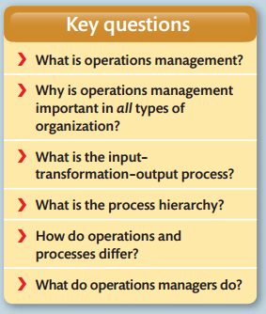
Lecture
LECTURE OUTLINE
10
Operations management
2–2

Slide 3
Lecture
LEARNING OBJECTIVES
10
Introduction:
operations management is about how organizations create and deliver services and products. everything you wear, eat, sit on, use, read or knock about on the sports field comes to you courtesy of the operations managers who organized its creation and delivery.
2–3

Slide 4

Lecture
TITLE OF LECTURE
Operations management
10
1. What is Operations Management?
Operations management is the activity of managing the resources that create and deliver services and products. The operations function is the part of the organization that is responsible for this activity. Every organization has an operations function because every organization creates some types of services and/or products. However, not all types of organization will necessarily call the operations function by this name. (Note in addition that we also use the shorter terms ‘the operation’ or ‘operations’ interchangeably with the ‘operations function’.)
www.midocean.ae

Slide 5
Lecture
TITLE OF LECTURE
Operations management
10
Operations managers are the people who have particular responsibility for managing some, or all, of the resources that make up the operations function. Again in some organizations, the operations manager could be called by some other name. For example, he or she might be called the ‘fleet manager’ in a distribution company, the ‘administrative manager’ in a hospital, or the ‘store manager’ in a supermarket.
Table 1.1 shows some of the activities of the operations function for various types of organization.
www.midocean.ae

Slide 6

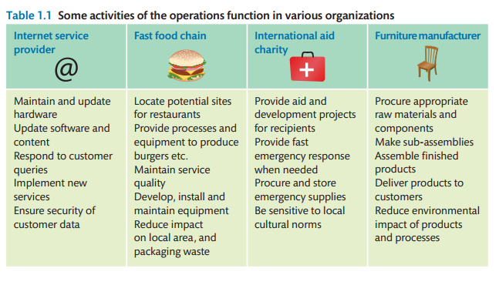
Lecture
TITLE OF LECTURE
Operations management
10
www.midocean.ae

Slide 7

Lecture
TITLE OF LECTURE
Operations management
10
- Operations in the organization
The operations function is central to the organization because it creates and delivers services and products, which is its reason for existing. The operations function is one of the three core functions of any organization. These are:
● the marketing (including sales) function – which is responsible for communicating the organization’s services and products to its markets in order to generate customer requests;
● the product/service development function – which is responsible for coming up with new and modified services and products in order to generate future customer requests;
● the operations function – which is responsible for the creation and delivery of services and products based on customer requests.
www.midocean.ae

Slide 8

Lecture
TITLE OF LECTURE
Operations management
10
It is fundamental to modern management that functional boundaries should not hinder efficient internal processes. Figure 1.2 illustrates some of the relationships between operations and other functions in terms of the flow of information between them. Although it is not comprehensive, it gives an idea of the nature of each relationship. However, note that the support functions have a different relationship with operations than the other core functions. Operations management’s responsibility to support functions is primarily to make sure that they understand operations' needs and help them to satisfy these needs.
www.midocean.ae

Slide 9

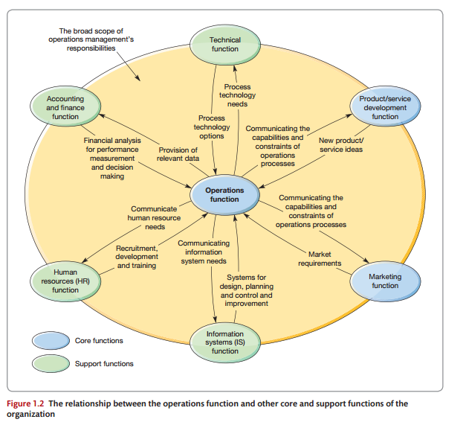
Lecture
TITLE OF LECTURE
Operations management
10
www.midocean.ae

Slide 10

Lecture
TITLE OF LECTURE
Operations management
10
2. Why is Operations Management important in ALL types Of Organization?
In some types of organization it is relatively easy to visualize the operations function and what it does, even if we have never seen it. For example, most people have seen images of an auto-mobile assembly. But what about an advertising agency? We know vaguely what these agencies do – they create the advertisements that we see in magazines and on television – but what is their operations function? The clue lies in the word ‘create’. Any business that creates something must use resources to do so, and so must have an operations activity.
www.midocean.ae

Slide 11
Lecture
TITLE OF LECTURE
Operations management
10
Also the automobile plant and the advertising agency do have one important element in common: both have a higher objective – to make a profit from creating and delivering their products or services. Yet not-for-profit organizations also use their resources to create and deliver services, not to make a profit, but to serve society in some way. Look at the following examples of what operations management does in five very different organizations and some common themes emerge.
www.midocean.ae

Slide 12
Lecture
TITLE OF LECTURE
Operations management
10
So whatever terminology is used there is a common theme and a common purpose to how we can visualize the operations activity in any type of organization – small or large, service or manufacturing, public or private, profit or not-for-profit. Operations management uses ‘resources to appropriately create outputs that fulfil defined market requirements’ (see Fig. 1.3). However, although the essential nature and purpose of operations management is the same in any type of organization, there are some special issues to consider, particularly in smaller organizations and those whose purpose is to maximize something other than profit.

Slide 13
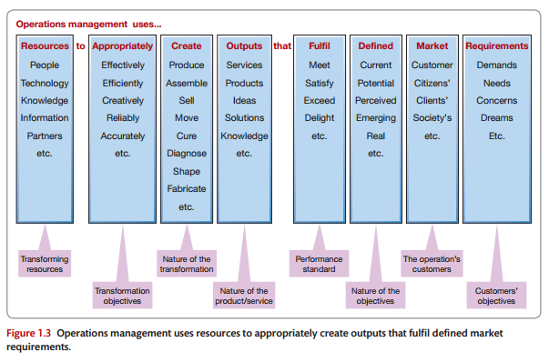
Lecture
TITLE OF LECTURE
Operations management
10
www.midocean.ae

Slide 14
Lecture
TITLE OF LECTURE
Operations management
10
- Operations management in the smaller organization
Operations management is just as important in small organizations as it is in large ones. Irrespective of their size, all companies need to create and deliver their service and products efficiently and effectively. However, in practice, managing operations in a small or medium-size organization has its own set of problems. Large companies may have the resources to dedicate individuals to specialized tasks but smaller companies often cannot, so people may have to do different jobs as the need arises.
www.midocean.ae

Slide 15
Lecture
TITLE OF LECTURE
Operations management
10
Such an informal structure can allow the company to respond quickly as opportunities or problems present themselves. But decision making can also become confused as individuals' roles overlap. Small companies may have exactly the same operations management issues as large ones but they can be more difficult to separate from the mass of other issues in the organization. However, small operations can also have significant advantages.
www.midocean.ae

Slide 16
Lecture
TITLE OF LECTURE
Operations management
10
- Operations management in not-for-profit organizations
Terms such as ‘competitive advantage’, ‘markets’ and ‘business’, which are used in this book, are usually associated with companies in the for-profit sector. Yet operations management is also relevant to organizations whose purpose is not primarily to earn profits. Managing the operations in an animal welfare charity, hospital, research organization or government department is essentially the same as in commercial organizations .Operations have to take the same decisions – how to create and deliver service and products, invest in technology, contract out some of their activities, devise performance measures, improve their operations performance, and so on.
www.midocean.ae

Slide 17
Lecture
TITLE OF LECTURE
Operations management
10
- the new operations agenda
Over the last few years, changes in the business environment have had a significant impact on the challenges faced by operations managers. Some of them are in response to changes in the nature of the demand side. Many (although not all) industries have experienced increasing cost-based competition while simultaneously their customers' expectations of quality and variety have increased. Markets have become more global, sometimes meaning a demand for a higher variety, or even totally customized products and services. Rapidly developing (often digital) technologies are leading to more frequent, new product/service introductions.
www.midocean.ae

Slide 18
Lecture
TITLE OF LECTURE
Operations management
10
Customers have increased ethical and environmental sensitivity. Also, the impact of new process technologies, in both manufacturing and service, is having a dramatic effect, radically altering the operating practices of almost every industry. This leads to operations having to change the way they create their products and services, serve their customers, relate to stakeholders and involve their workforce. Just as importantly, globalized supply markets are opening new options in how operations source input goods and services.
www.midocean.ae

Slide 19
Lecture
TITLE OF LECTURE
Operations management
10
3. What is the input–transformation–output Process?
All operations create and deliver service and products by changing inputs into outputs using an ‘input–transformation–output’ process. Figure 1.5 shows this general transformation process model that is the basis of all operations. Put simply, operations are processes that take in a set of input resources which are used to transform something, or are transformed them-selves, into outputs of services and products. And although all operations conform to this general input–transformation–output model, they differ in the nature of their specific inputs and outputs.
www.midocean.ae

Slide 20
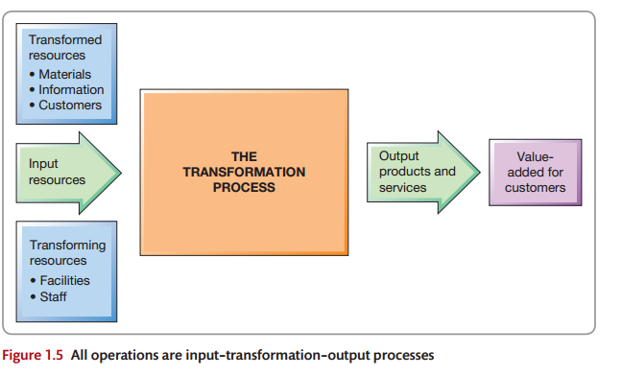
Lecture
TITLE OF LECTURE
Operations management
10
www.midocean.ae

Slide 21
Lecture
TITLE OF LECTURE
Operations management
10
- inputs to the process
One set of inputs to any operation’s processes is transformed resources. These are the resources that are treated, transformed or converted in the process. They are usually a mixture of the following:
● Materials– operations which process materials could do so to transform their physical properties(shape or composition, for example). Most manufacturing operations are like this. Other operations process materials to change their location(parcel delivery companies, for example). Some, like retail operations, do so to change the possession of the materials. Finally, some operations store materials, such as warehouses.
www.midocean.ae

Slide 22
Lecture
TITLE OF LECTURE
Operations management
10
● Information– operations which process information could do so to transform their informational properties(that is, the purpose or form of the information); accountants do this. Some change the possession of the information, for example market research companies sell information. Some store the information, for example archives and libraries. Finally, some operations, such as telecommunication companies, change the location of the information.
www.midocean.ae

Slide 23
Lecture
TITLE OF LECTURE
Operations management
10
● Customers– operations which process customers might change their physical properties in a similar way to materials processors: for example, hairdressers or cosmetic surgeons.
● facilities – the buildings, equipment, plant and process technology of the operation;
● staff – the people who operate, maintain, plan and manage the operation. (Note that we use the term ‘staff’ to describe all the people in the operation, at any level.)
www.midocean.ae

Slide 24
Lecture
TITLE OF LECTURE
Operations management
10
- Outputs from the process
Products and services are different. Products are usually tangible things whereas services are activities or processes. A car or a newspaper or a restaurant meal is a product, whereas a service is the activity of the customer using or consuming that product. Some services do not involve products. Consultancy advice or a haircut is a processes (though some products may be supplied in support of the service, such as a report or a hair gel). Also, while most products can be stored, at least for a short time, service only happens when it is consumed or used. So accommodation in an hotel room for example will perish if it is not sold that night, a restaurant table will remain empty unless someone uses it that evening.
www.midocean.ae

Slide 25
Lecture
TITLE OF LECTURE
Operations management
10
- Customers
Customers may be an input to many operations (see earlier) but they are also the reason for their existence. If there are no customers (whether business customers, users or consumers), there will be no operation. So it is critical that operations managers are aware of customers’ needs, both current and potential. This information will determine what the operation has to do and how it has to do it (the operation’s strategic performance objectives) which in turn defines the service/product offering to be designed, created and delivered.
www.midocean.ae

Slide 26
Lecture
TITLE OF LECTURE
Operations management
10
4. What is the Process hierarchy?
So far we have discussed operations management, and the input–transformation–output model, at the level of ‘the operation’. For example, we have described ‘the web designer’, ‘the bank’, ‘the sandwich shop’, ‘the disaster relief operation’, and so on. But look inside any of these operations. One will see that all operations consist of a collection of processes (though these processes may be called ‘units’ or ‘departments’) interconnecting with each other to form a network.
www.midocean.ae

Slide 27
Lecture
TITLE OF LECTURE
Operations management
10
Each process acts as a smaller version of the whole operation of which they form a part, and transformed resources flow in between them. In fact, within any operation the mechanisms that actually transform inputs into outputs are these processes. A ‘process’ is an arrangement of resources and activities that transform inputs into outputs that satisfy (internal or external) customer needs. They are the ‘building blocks’ of all operations, and they form an ‘internal network’ within an operation. Each process is, at the same time, an internal supplier and an internal customer for other processes.
www.midocean.ae

Slide 28
Lecture
TITLE OF LECTURE
Operations management
10
This ‘internal customer’ concept provides a model to analyze the internal activities of an operation. It is also a useful reminder that, by treating internal customers with the same degree of care as external customers, the effectiveness of the whole operation can be improved. Table 1.3 illustrates how a wide range of operations can be described in this way.
www.midocean.ae

Slide 29

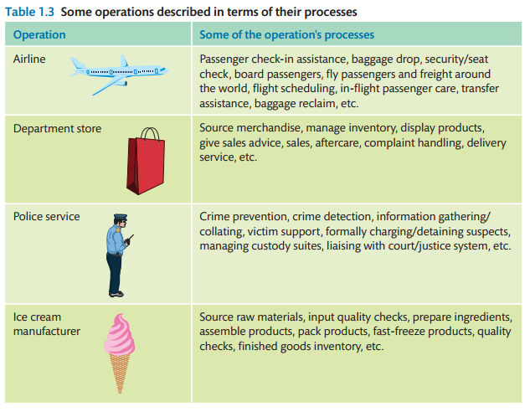
Lecture
TITLE OF LECTURE
Operations management
10
www.midocean.ae

Slide 30
Lecture
TITLE OF LECTURE
Operations management
10
- Operations management is relevant to all parts of the business
The example in Figure 1.7 demonstrates that it is not just the operations function that manages processes; all functions manage processes. For example, the marketing function will have processes that create demand forecasts, processes that create advertising campaigns and processes that create marketing plans. These processes in the other functions also need managing using similar principles to those within the operations function. Each function will have its ‘technical’ knowledge.
www.midocean.ae

Slide 31
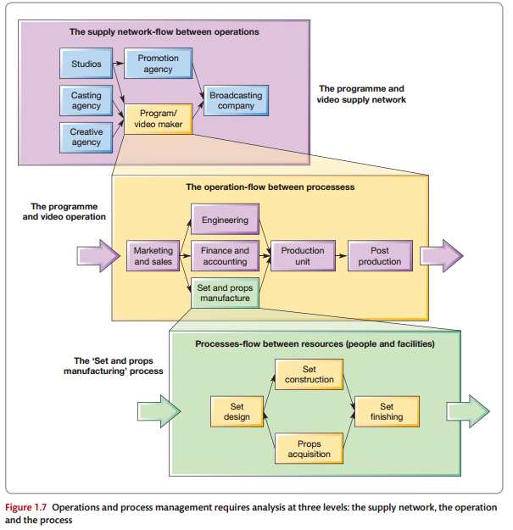
Lecture
TITLE OF LECTURE
Operations management
10
www.midocean.ae

Slide 32
Lecture
TITLE OF LECTURE
Operations management
10
- Business processes
Whenever a business attempts to satisfy its customers’ needs it will use many processes, both in its operations and in its other functions. Each of these processes will contribute some part to fulfilling customer needs.
www.midocean.ae

Slide 33
Lecture
TITLE OF LECTURE
Operations management
10
5. How Do Operations and Processes Differ?
Although all operations processes are similar in that they all transform inputs, they do differ in a number of ways, four of which, known as the four Vs, are particularly important:
● The volume of their output.
● The variety of their output.
● The variation in the demand for their output.
● The degree of visibility which customers have of the creation of their output.
www.midocean.ae

Slide 34
Lecture
TITLE OF LECTURE
Operations management
10
6. What Do Operations Managers Do?
The exact details of what operations managers do will, to some extent, depend on the way an organization defines the boundaries of the function. Yet there are some general classes of activities that apply to all types of operation irrespective of whether they are service, manufacturing, private or public sector, and no matter how the operations function is defined. We classify operations management activities under the four headings: direct, design, deliver and develop.
www.midocean.ae

Slide 35
Lecture
TITLE OF LECTURE
Operations management
10
● Directing the overall strategy of the operation. A general understanding of operations and processes and their strategic purpose and performance, together with an appreciation of how strategic purpose is translated into reality, are prerequisites to the detailed design of operations and process.
● Designing the operation’s resources and processes. Design is the activity of determining the physical form, shape and composition of operations and processes in line with the services and products that they create.
www.midocean.ae

Slide 36
Lecture
TITLE OF LECTURE
Operations management
10
● Planning and control process delivery. After being designed, the delivery of services and products from suppliers and through the total operation to customers must be planned and controlled.
● Developing process performance. Increasingly it is recognized that operations managers, or any process managers, cannot simply routinely deliver services and products in the same way that they always have done. They have a responsibility to develop the capabilities of their processes to improve process performance.
www.midocean.ae

Slide 37
Lecture
TITLE OF LECTURE
Operations management
10
- Operations management impacts environmental sustainability
It is worth noting at this point that many of the activities of operations managers have a huge impact on their organization’s environmental sustainability. Environmental sustain-ability means (according to the Brandt and Report from the United Nations) ‘ meeting the needs of the present without compromising the ability of future generations to meet their own needs’.
www.midocean.ae

Slide 38
Lecture
TITLE OF LECTURE
Operations management
10
Put more directly, it means the extent to which business activity negatively impacts the natural environment. It is clearly an important issue, not only because of the obvious impact on the immediate environment of hazardous waste, air, and even noise, pollution, but also because of the less obvious, but potentially far more damaging, issues around global warming.
www.midocean.ae

Slide 39
Lecture
TITLE OF LECTURE
Operations management
10
- the model of operations management
We can now combine two ideas to develop the model of operations and process management that will be used throughout this book. The first is the idea that operations and the processes that make up both the operations and other business functions are transformation systems that take in inputs and use process resources to transform them into outputs.
www.midocean.ae

Slide 40
Lecture
TITLE OF LECTURE
Operations management
10
The second idea is that the resources both in an organization’s operations as a whole and in its individual processes need to be managed in terms of how they are directed, how they are designed, how delivery is planned and controlled, and how they are developed and improved.
www.midocean.ae

Slide 41

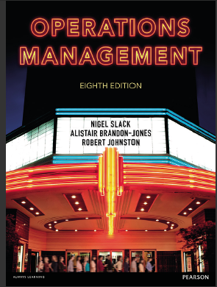

TITLE OF LECTURE
Operations management
Operations management, Eighth edition By Nigel Slack Alistair Brandon-Jones Robert Johnston.
Thank You
www.midocean.ae

