Slide 1



Accounting for
Managers
Prepared by Dr. Sara Ahmed
MGM 341
Lecture 1- Chapter 1

Slide 2



Chapter 1: Introduction to Managerial Accounting
Lecture 2
Prepared by
Dr. Sara Ahmed

Slide 3


Chapter
Learning Objectives
01
Identify the managers’ three primary responsibilities
Distinguish between Managerial Accounting and Financial Accounting
Describe the roles and skills required of management accountants within the organization
Discuss the business trends and regulations affecting management accounting

Slide 4
Chapter
01
What is Managerial Accounting?
Management accounting also is known as managerial accounting and can be defined as a process of providing financial information and resources to the managers in decision making.
Managerial accounting, also called management accounting, is a method of accounting that creates statements, reports, and documents that help management in making better decisions related to their business' performance.

Slide 5
Managerial accounting is the process of “identification, measurement, analysis, and interpretation of accounting information” that helps business leaders make sound financial decisions and efficiently manage their daily operations.
Managerial accounting differs from financial accounting because the intended purpose of managerial accounting is to assist users internal to the company in making well-informed business decisions.

Slide 6
Chapter
Managerial Accounting: Key Takeaways
01
Managerial accounting involves the presentation of financial information for internal purposes to be used by management in making key business decisions.
Techniques used by managerial accountants are not dictated by accounting standards, unlike financial accounting.
The presentation of managerial accounting data can be modified to meet the specific needs of its end-user.

Slide 7
Managerial accounting encompasses many facets of accounting, including product costing, budgeting, forecasting, and various financial analysis.
This differs from financial accounting, which produces and disseminates official financial statements for public consumption that conform to prevailing accounting standards.

Slide 8

Chapter
Managers’ Three Primary Responsibilities of Decision Making
01
Planning
Directing
Controlling

Slide 9

Chapter
Planning
01
Establish Goals.
Specify How Goals
Will Be Achieved.
Develop Budgets.

Slide 10
Chapter
Controlling
01
The control function gathers feedback to
ensure that plans are being followed.
Feedback in the form of performance reports
that compare actual results with the budget
are an essential part of the control function.

Slide 11
Chapter
Decision Making
01
Decision making involves
making a selection among
competing alternatives.
What should
we be selling?
Who should
we be serving?
How should
we execute?

Slide 12

Managerial Accounting Activities:
Marketing Majors
Planning
How much should we budget for TV, print, and internet advertising?
How many salespeople should we plan to hire to serve a new territory?

Slide 13
Managerial Accounting Activities:
Marketing Majors
Controlling
Is the budgeted price cut increasing unit sales as expected?
Are we accumulating too much inventory during the holiday shopping season?

Slide 14
Managerial Accounting Activities:
Marketing Majors
Decision
Making
Should we sell our services as one bundle or sell them separately?
Should we sell directly to customers or use a distributor?

Slide 15
Managerial Accounting Activities:
Supply Chain Management Majors
Planning
How many units should we plan to produce next period?
How much should we budget for next period’s utility expense?

Slide 16
Managerial Accounting Activities:
Supply Chain Management Majors
Controlling
Did we spend more or less than expected for the units we actually produced?
Are we achieving our goal of reducing the number of defective units produced?

Slide 17
Managerial Accounting Activities:
Supply Chain Management Majors
Decision
Making
Should we transfer production of a component part to an overseas supplier?
Should we redesign our manufacturing process to lower inventory levels?

Slide 18
Managerial Accounting Activities:
Human Resource Management Majors
Planning
How much should we plan to spend for occupational safety training?
How much should we plan to spend on employee recruitment advertising?

Slide 19
Managerial Accounting Activities:
Human Resource Management Majors
Controlling
Is our employee retention rate exceeding our goals?
Are we meeting our goal of completing timely performance appraisals?

Slide 20
Managerial Accounting Activities:
Human Resource Management Majors
Decision
Making
Should we hire an on-site medical staff to lower our healthcare costs?
Should we hire temporary workers or full-time employees?

Slide 21
Managerial Accounting Activities:
Human Resource Management Majors
Decision
Making
Should we hire an on-site medical staff to lower our healthcare costs?
Should we hire temporary workers or full-time employees?

Slide 22
Managerial Accounting Basics
Managerial accounting
provides financial and
nonfinancial information
for managers of an
organization and other
decision makers.

Slide 23
Calculation of unit cost: Purposes of Cost Classification
Assigning costs to cost objects
Accounting for costs in manufacturing companies
Preparing financial statements
Predicting cost behavior in response to changes in activity
Making decisions

Slide 24

Chapter
Managers’ Three Primary Responsibilities of Decision Making
01
Purpose of Managerial Accounting
Planning
Develop new products?
Expand into new markets?
Build a new factory?
Control
Are costs too high?
Are services profitable?
Are customers satisfied?

Slide 25
Chapter
Needs of Management
01
Financial accounting is concerned with reporting financial information to external parties, such as stockholders, creditors, and regulators.
Managerial accounting is concerned with providing information to managers within an organization so that they can formulate plans, control operations, and make decisions.

Slide 26
Financial and Managerial Accounting:
Key Differences

Slide 27
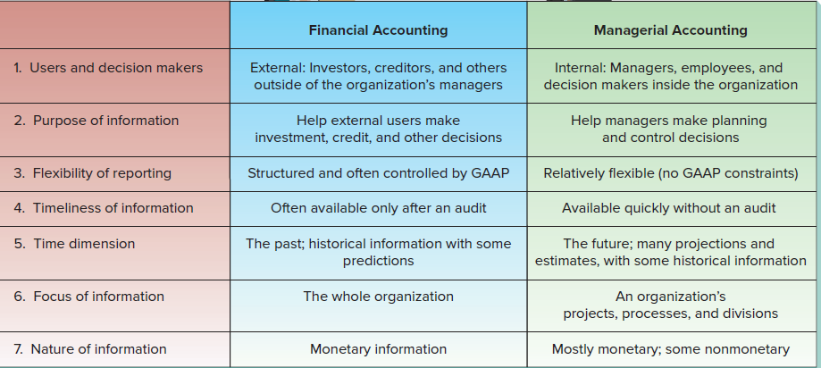
Nature of Managerial Accounting

Slide 28
Chapter
Career Paths
01
Managerial accounting information is used in many careers:
Marketing staff need sales and cost data to decide which products to promote.
Management needs sales force details to evaluate performance.
Entrepreneurs use costs, budgets, and financial statements.
Nonbusiness majors use accounting information as their careers advance.

Slide 29
Chapter
Management Accountants’ Roles and Skills
01
Planning
The primary purpose of this course is to teach measurement skills that managers use to support planning, controlling, and decision-making activities.
Controlling
Decision
Making

Slide 30
Measurement skills help managers answer important questions.
What net income should my company report to its stockholders?
Measure and report historical data that complies with applicable rules.
How will my company serve its customers?
Measure and analyze mostly non-financial, process-oriented data.
Will my company need to borrow money?
Measure and analyze estimated future cash flows.

Slide 31
Chapter
Professional Ethics
01
The Institute of Management Accountant’s (IMA) Statement of Ethical Professional Practice provides guidelines for ethical behavior.
Recognize and communicate professional limitations that preclude responsible judgment.
Maintain professional competence.
Competence
Follow applicable
laws, regulations,
and standards.
Provide accurate, clear, concise, and timely decision support information.

Slide 32
Chapter
Professional Ethics
01
IMA Guidelines for Ethical Behavior
Do not disclose confidential information unless legally obligated to do so.
Do not use confidential information for unethical or illegal advantage.
Confidentiality
Ensure that subordinates do not disclose confidential information.

Slide 33
Chapter
Professional Ethics
01
IMA Guidelines for Ethical Behavior
Mitigate conflicts of interest and advise others of potential conflicts.
Refrain from conduct that would prejudice carrying out duties ethically.
Integrity
Abstain from activities that might discredit the profession.

Slide 34
Chapter
Professional Ethics
01
IMA Guidelines for Ethical Behavior
Communicate information fairly and objectively.
Disclose delays or deficiencies in information timeliness, processing, or internal controls.
Credibility
Disclose all relevant information that could influence a user’s understanding of reports
and recommendations.

Slide 35
IMA Guidelines for Resolution of an Ethical Conflict
Follow employer’s established policies.
If this does not work, consider the following:
  Discuss the conflict with immediate supervisor or next highest uninvolved managerial level.
  If immediate supervisor is the CEO, consider the board of directors or the audit committee.
  Contact with levels above the immediate supervisor should only be initiated with the supervisor’s knowledge, assuming the supervisor is not involved.

Slide 36
IMA Guidelines for Resolution of an Ethical Conflict
If following employer’s established policies for conflict resolution do not work, consider these additional practices:
  Except where legally prescribed, maintain confidentiality.
  Clarify issues in a confidential discussion with an objective advisor.
  Consult an attorney as to legal obligations.

Slide 37
Chapter
Why have Ethical Standards
01
Ethical standards in business are essential for a
smooth functioning economy.
Without ethical standards in business, the
economy, and all of us who depend on it for
jobs, goods, and services, would suffer.
Abandoning ethical standards in business would
lead to a lower quality of life with less
desirable goods and services at higher prices.

Slide 38
Management accounting can be viewed as __________.
A. Marketing-oriented Accounting
B. Management-oriented Accounting
C. Accounting-oriented Management
D. Manager-oriented Accounting

Slide 39
________ is the language of Business which used to communicate financial information.
A. Accounting
B. Marketing
C. Profit
D. Pricing

Slide 40
_______ the sub-field of accounting.
A. Management accounting
B. Cost accounting
C. Financial accounting
D. All of the above

Slide 41
The main objective of management accounting is _________
A. To maintain the accounting records
B. To know the amount due from customers and suppliers
C. To ascertain analyse and interpret the results of business operations
D. To record all the business transactions

Slide 42
____________ is the study of managerial aspects of financial accounting
A. Cost accounting
B. Financial accounting
C. Management accounting
D. Business accounting

Slide 43
The purpose of management accounting is to help ______ make decisions
A. managers
B. investors
C. marketers
D. banks

Slide 44
Managerial accounting information is generally prepared for _______
A. managers
B. stakeholders
C. government agencies
D. competitors

Slide 45
The primary task of management accounting is, therefore, to redesign the entire accounting system so that it may serve the ___________ needs of the firm.
A. Marketing
B. Operational
C. Human resource
D. Production

Slide 46
Management accounting provides information to management so that planning organizing directing and controlling of business operations can be done in an orderly manner.
A. controlling planning and directing
B. Planning controlling directing
C. Planning directing controlling
D. planning directing controlling

Slide 47
Management accounting assists the management in_______
A. Planning
B. Directing
C. Controling
D. All of the above

Slide 48


Thank You

