Slide 1

MGM603
Managing People and Organizations
Prepared by Dr. Ayman El-Moesrawy
Lecture 3
Individual Differences

Slide 2

CHAPTER 3
Individual Differences
Outcomes of the chapter:
Explain the nature of individual differences, the concept of fit, and the role of realistic job previews.
Define personality and describe general personality frameworks and attributes that affect behavior in organizations.
Identify and discuss other important personality traits that affect behavior in organizations.
Discuss different kinds of intelligence that affect behavior in organizations.
Describe different learning styles that influence how people process information and that affect behavior in organizations.

Slide 3
CHAPTER 3
Individual Differences
Introduction:
Chapter 1, discussed managers strive to enhance performance behaviors, enhance commitment and engagement, promote citizenship behaviors, and minimize dysfunctional behaviors by their employees.
Chapter 2 identified how various environmental factors—diversity, globalization, technology, ethics, and new employment relationships—all impact organizational behavior.
Chapter 3 identifies and discusses critical individual characteristics that affect people’s behaviors in organizations.
The discussion of other important individual characteristics is continued in Chapter 4. Core theories and concepts that drive employee motivation are introduced and discussed in Chapter 5. Finally, in Chapter 6 we focus on how managers can implement motivation theories and concepts.

Slide 4
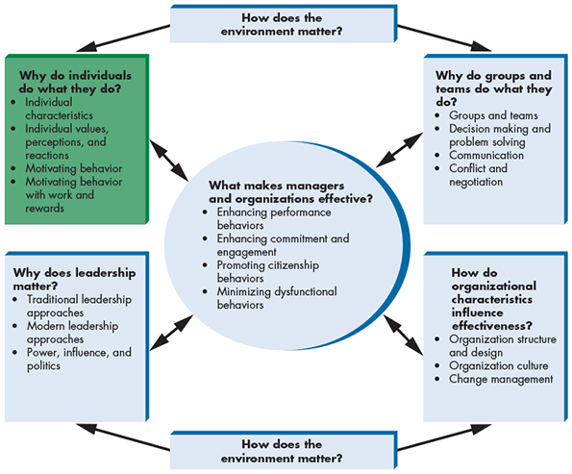
CHAPTER 3
Individual Differences
Introduction:

Slide 5
CHAPTER 3
Individual Differences
Real-World Challenge :
Individual Differences That Make a Difference at Southwest Airlines:
Fun and friendly customer service is essential to the success of Southwest Airlines’ business strategy.
Because Southwest believes that fun is about attitude, it hires for personality and attitude
The airline wants employees who have a drive to excel and innovate, who put others first, and who take their work seriously but not themselves
Southwest Airlines’ mission statement is “Dedication to the highest quality of Customer Service delivered with a sense of warmth, friendliness, individual pride, and Company Spirit.”
Southwest’s learning-oriented, fun culture gives employees the freedom to be themselves and become passionate about their jobs.
Southwest asks for your advice about how to better hire empathetic employees with creativity and fun-loving characteristics who fit with the company’s unique culture.

Slide 6
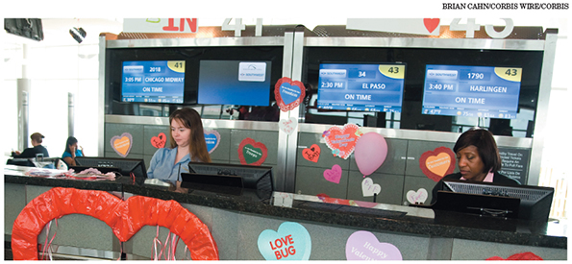
CHAPTER 3
Individual Differences
Real-World Challenge :
Individual Differences That Make a Difference at Southwest Airlines:

Slide 7

CHAPTER 3
Individual Differences
Real-World Challenge :
Think about human behavior as a jigsaw puzzle.
Puzzles consist of various pieces that fit together in precise ways. And of course, no two puzzles are exactly alike.
They have different numbers of pieces, the pieces are of different sizes and shapes, and they fit together in different ways.
The same can be said of human behavior and its determinants
Each of us is a whole picture, like a fully assembled jigsaw puzzle, but the puzzle pieces that define us and the way those pieces fit together are unique.
Every person in an organization is fundamentally different from everyone else. To be successful, managers must recognize that these differences exist and attempt to understand them.
Notes:
Microsoft® Translator
فكر في السلوك البشري كلغز بانوراما. الألغاز تتكون من القطع المختلفة التي تناسب معا بطرق دقيقة. وبالطبع، لا يوجد لغزان متشابهان تماما. لديهم أعداد مختلفة من القطع، وقطع من أحجام وأشكال مختلفة، وأنها تناسب معا بطرق مختلفة. ويمكن قول الشيء نفسه عن السلوك البشري ومحدداته كل واحد منا هو صورة كاملة، مثل أحجية تجميعها بالكامل، ولكن قطع اللغز التي تحدد لنا والطريقة التي تناسب تلك القطع معا هي فريدة من نوعها. كل شخص في منظمة يختلف اختلافا جوهريا عن أي شخص آخر. لكي ينجح المديرون، يجب أن يدركوا وجود هذه الاختلافات وأن يحاولوا فهمها.

Slide 8
CHAPTER 3
Individual Differences
Individual Differences:
Individual differences Categories of individual The Concept of Fit | defined as personal attributes that vary from one person to another. Individual differences may be physical, psychological, and emotional. basic categories of individual differences include personality, intelligence, learning styles, attitudes, values and emotions, perception, and stress. Why are some very talented people undesirable coworkers or employees despite being very talented at what they do? The answer lies in the many ways in which people need to fit with an employment opportunity to be a successful match.
Notes:
الاختلافات الفردية
تعرف بأنها سمات شخصية تختلف من شخص لآخر. قد تكون الاختلافات الفردية جسدية ونفسية وعاطفية.
فئات الأفراد
وتشمل الفئات الأساسية من الاختلافات الفردية الشخصية والذكاء وأساليب التعلم والمواقف والقيم والعواطف والإدراك والإجهاد.
مفهوم المناسب
لماذا بعض الموهوبين جدا زملاء العمل غير المرغوب فيها أو الموظفين على الرغم من كونها موهوبة جدا في ما يفعلونه؟ الجواب يكمن في العديد من الطرق التي يحتاج الناس لتناسب مع فرصة عمل لتكون مباراة ناجحة.

Slide 9
CHAPTER 3
Individual Differences
Individual Differences:
Dimensions of Fit
Type of Fit | Possible Dimensions of Fit
Person-Job Fit: Does the person meet the needs of the job and does the job meet the needs of the person? | Intelligence Job-related skills Job knowledge Previous work experience Personality related to performing job tasks
Person-Group Fit: Does the employee fit the workgroup, including the supervisor? | Teamwork skills Knowledge and ability relative to other team members Conflict management style Preference for teamwork Communication skills Personality related to working well with others

Slide 10
CHAPTER 3
Individual Differences
Individual Differences:
Dimensions of Fit
Type of Fit | Possible Dimensions of Fit
Person-Organization Fit: Do the individual’s values, beliefs, and personality fit the values, norms, and culture of the organization? | Alignment between personal motivations and the organization’s culture, mission, and purpose Values Goals
Person-Vocation Fit: Do the person’s interests, abilities, values, and personality fit his or her occupation? | Aptitudes Interests Personal values Long-term goals

Slide 11
CHAPTER 3
Individual Differences
Individual Differences:
Person - Job Fit
Person-Job Fit | is the fit between a person’s abilities and the demands of the job and the fit between a person’s desires and motivations and the attributes and rewards of a job It is important to consider not only the fit between an individual’s talents and the job requirements, but also the fit between an individual’s motivations and the rewards offered by the job. Research suggests that person-job fit leads to higher job performance, satisfaction, organizational commitment, and intent to stay with the company

Slide 12

CHAPTER 3
Individual Differences
Individual Differences:
Person - Job Fit
Fit is an important concept in organizations. Take this woman, for example. Her job appears to require her to deal with binders full of information. She may find this work interesting, or she may find it tedious and boring. Person-job, person-group, person organization, and person-vocation fit are all important factors in organizational behavior.

Slide 13
CHAPTER 3
Individual Differences
Individual Differences:
Person-Group Fit
Person-Group Fit | is the fit between the employee and his or her workgroup and supervisor. Person-group fit leads to improved job satisfaction, organizational commitment, and intent to stay with the company. Teamwork, communication, and interpersonal competencies can be as critical to team performance as team members’ ability to perform core job duties Example: An executive at Men’s Wearhouse once terminated one of the men’s suits retail store’s most successful salesperson because he focused only on maximizing his own sales as opposed to working with the other sales staff as a team. After firing the salesperson, sales at the store where he worked increased significantly.

Slide 14
CHAPTER 3
Individual Differences
Individual Differences:
Person-Organization Fit
Person-Organization Fit | is the fit between an individual’s values, beliefs, and personality and the values, norms, and culture of the organization. Organizational values and norms that are important for person-organization fit include integrity, fairness, work ethic, competitiveness, cooperativeness, and compassion for fellow employees and customers. Person-organization fit has a strong positive relationship with job satisfaction, organizational commitment, and intent to stay with the company and can influence employee attitudes and citizenship behaviors beyond the job requirements, such as helping others or talking positively about the firm

Slide 15

CHAPTER 3
Individual Differences
Individual Differences:
Person-Organization Fit
Person-Organization Fit | Example: even if Maria is technically well qualified as a researcher, if she avoids risk, is indecisive, and tends to ruminate over a decision, she may be unsuccessful in an innovative, fast-paced company. Both online retailer Amazon.com and online shoe retailer Zappos.com offer new employees thousands of dollars to quit to ensure that they are committed to their jobs and to dissuade poor fits from staying.
Person-group fit is the fit between an individual and their group or team. The bored individual on the left may not be a good fit with the rest of her team members, who seem engaged and attentive.

Slide 16
CHAPTER 3
Individual Differences
Individual Differences:
Person-Vocation Fit
Person-Vocation Fit | is the fit between a person’s interests, abilities, values, and personality and a profession. For example, a social individual who is low in conscientiousness and dislikes working with numbers would be a poor fit with the engineering vocation. Although individuals usually choose a vocation long before applying to an organization, understanding person-vocation fit can still be useful to organizations and managers. Companies wanting to develop their own future leaders, or smaller organizations that need employees to fill multiple roles, may be able to use vocational interests in determining whether job applicants would be a good fit with the organization’s future needs.

Slide 17
CHAPTER 3
Individual Differences
Individual Differences:
Realistic Job Previews
Realistic job previews (RJPs) | involve the presentation of both positive and potentially negative information to job candidates. Rather than trying to sell candidates on the job and company by presenting the job opportunity in the most positive light, the company strives to present an accurate picture through an RJP. Giving applicants the opportunity to self-select out of the hiring process if they do not perceive themselves to be good fits with the position or organization increases the likelihood that the applicants ultimately hired will be good fits and will be better employees as a result. If a common reason for employees leaving an organization is that the job is not what they expected, this is a good sign that the recruiting message can be improved.

Slide 18
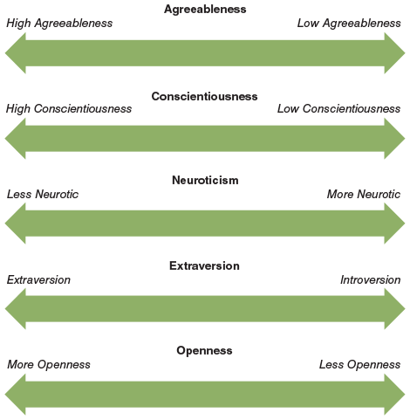
CHAPTER 3
Individual Differences
Personality and Individual Behavior:
1- The “Big Five” Framework:
Researchers have identified five fundamental personality traits that are especially relevant to organizations.
Figure 3.1 shows the “Big Five” personality traits. which is currently very popular among researchers and managers. These five dimensions represent fundamental personality traits presumed to be important in determining the behaviors of individuals in organizations. In general, experts agree that personality traits closer to the left end of each dimension are more positive in organizational settings, whereas traits closer to the right are less positive.

Slide 19
CHAPTER 3
Individual Differences
Personality and Individual Behavior:
1- The “Big Five” Framework:
Agreeableness | Agreeableness refers to a person’s ability to get along with others. Agreeableness causes some people to be gentle, cooperative, forgiving, understanding, and good-natured in their dealings with others. Researchers have not yet fully investigated the effects of agreeableness, but it seems likely that highly agreeable people are better at developing good working relationships with coworkers, subordinates, and higher-level managers, whereas less-agreeable people are not likely to have particularly good working relationships. The same pattern might extend to relationships with customers, suppliers, and other key organizational constituents.

Slide 20
CHAPTER 3
Individual Differences
Personality and Individual Behavior:
1- The “Big Five” Framework:
Conscientiousness | Conscientiousness refers to the extent to which a person can be counted on to get things done. Some people, for example, are organized, detail oriented, responsible, dependable, and plan carefully to meet deadlines. Less-conscientious people may be prone to missing deadlines, overlooking various tasks, being unorganized, and being generally less dependable. In general, research suggests that being strong on conscientiousness is often a good predictor of job performance for many jobs.

Slide 21
CHAPTER 3
Individual Differences
Personality and Individual Behavior:
1- The “Big Five” Framework:
Extraversion | Extraversion reflects a person’s comfort level with relationships. Extroverts are sociable, talkative, assertive, and open to establishing new relationships. Introverts are much less sociable, talkative, and assertive and more reluctant to begin new relationships. Research suggests that extroverts tend to be higher overall job performers than introverts and that they are more likely to be attracted to jobs based on personal relationships, such as sales and marketing positions.

Slide 22
CHAPTER 3
Individual Differences
Personality and Individual Behavior:
1- The “Big Five” Framework:
Extraversion Introversion | Extraversion reflects a person’s comfort level with relationships. Extroverts are sociable, talkative, assertive, and open to establishing new relationships. Introverts are much less sociable, talkative, and assertive and more reluctant to begin new relationships. Research suggests that extroverts tend to be higher overall job performers than introverts and that they are more likely to be attracted to jobs based on personal relationships, such as sales and marketing positions. introversion. An introvert tends to be less comfortable in social situations.

Slide 23
CHAPTER 3
Individual Differences
Personality and Individual Behavior:
1- The “Big Five” Framework:
Openness | openness reflects a person’s rigidity of beliefs and range of interests. People with high levels of openness are willing to listen to new ideas and to change their own ideas, beliefs, and attitudes in response to new information. People with more openness might be expected to be better performers due to their flexibility and the likelihood that they will be better accepted by others in the organization. Openness may also encompass a person’s willingness to accept change; people with high levels of openness may be more receptive to change, whereas people with little openness may resist change.

Slide 24
CHAPTER 3
Individual Differences
Personality and Individual Behavior:
1- The “Big Five” Framework:
Openness | openness reflects a person’s rigidity of beliefs and range of interests. People with high levels of openness are willing to listen to new ideas and to change their own ideas, beliefs, and attitudes in response to new information. People with more openness might be expected to be better performers due to their flexibility and the likelihood that they will be better accepted by others in the organization. Openness may also encompass a person’s willingness to accept change; people with high levels of openness may be more receptive to change, whereas people with little openness may resist change.

Slide 25

CHAPTER 3
Individual Differences
Personality and Individual Behavior:
1- The “Big Five” Framework:
Conscientiousness refers to the extent that a person can be counted on to get things done. This group is acknowledging the work of one of their colleagues and his efforts to help them complete a project on time. He most likely has a high level of conscientiousness. Further, given how his colleagues seem to genuinely like him he most likely also has a high degree of agreeableness.

Slide 26
CHAPTER 3
Individual Differences
Personality and Individual Behavior:
The “Big Five” Framework: Limitations
Even assessment using the most rigorous and valid measures is likely to be somewhat imprecise.
There are also times when using more specific personality traits to predict outcomes such as turnover or performance are more useful than the more general Big Five traits because the more specific trait more directly influences the intended outcome.
For example, if you are trying to hire a strong team player for a diverse creative team, individual differences including a preference for teamwork and other group orientation (a preference for working with diverse others) may outperform any of the Big Five traits in predicting performance.
Another limitation of the Big Five framework is that it is primarily based on research conducted in the United States. Thus, generalizing it to other cultures presents unanswered questions. Even within the United States, a variety of other factors and traits are also likely to affect behavior in organizations.

Slide 27
CHAPTER 3
Individual Differences
Personality and Individual Behavior:
2- The Myers-Briggs Framework:
The Myers-Briggs framework | The Myers-Briggs framework is also a popular framework that some people use to characterize personality. Many people know of this framework through a widely used questionnaire called the Myers-Briggs Type Indicator (MBTI). It is based upon Carl Jung’s work on psychological types. Psychologist Carl Jung was a contemporary of Sigmund Freud and a leading exponent of Gestalt personality theory. The MBTI was first developed by Isabel Briggs Myers (1897–1979) and her mother, Katharine Cook Briggs, to help people understand themselves and each other so that they could find work that matches their personality.

Slide 28
CHAPTER 3
Individual Differences
Personality and Individual Behavior:
2- The Myers-Briggs Framework:
The Myers-Briggs framework | The MBTI uses four scales with opposite poles to assess four sets of preferences. 1- Extroversion (E)/Introversion (I): Extroverts are energized by things and people. They are interactors and “on the fly” thinkers whose motto is “ready, fire, aim.” Introverts find energy in ideas, concepts, and abstractions. 2- Sensing (S)/Intuition (N): Sensing people are detail oriented. They want and trust facts. Intuitive people seek out patterns and relationships among the facts that they have learned. 3- Thinking (T)/Feeling (F): Thinkers value fairness and decide things impersonally based on objective criteria and logic. Feelers value harmony and focus on human values and needs as they make decisions or judgments.

Slide 29
CHAPTER 3
Individual Differences
Personality and Individual Behavior:
2- The Myers-Briggs Framework:
The Myers-Briggs framework | 4- Judging (J)/Perceiving (P): Judging people are decisive and tend to plan. They focus on completing tasks, take action quickly, and want to know the essentials. They develop plans and follow them, adhering to deadlines. Perceptive people are adaptable, spontaneous, and curious. They start many tasks and often find it difficult to complete them. Deadlines are meant to be stretched. The possible combinations of these preferences result in sixteen personality types, which are identified by the four letters that represent one’s tendencies on the four scales. For example, ENTJ reflects extraversion, intuition, thinking, and judging. You can complete a brief Myers-Briggs type self-assessment online at http://www.humanmetrics.com/cgi-win/JTypes2.asp.

Slide 30
Thanks

