Slide 1

Prepared by
Dr. Hamada I. AbdulWakel
Lecture 6
CYB615
Network Programming

Slide 2
Module4: Socket Programming using
Python – Part III

Slide 3


Lecture 6
Agenda
Broadcasting Client/Server Model.
Securing Sockets.
SSL Module.

Slide 4
Lecture 6
Casting
Many applications transmit the same data at one time to multiple receivers:
  Broadcasts of Radio or Video.
  Video conferencing.
  Shared applications.
The cast term signifies some data (stream of packets) is being transmitted to the client(s) from a server over the communication channel.

Slide 5
Lecture 6
Casting/Communication Types
There are three casting types:
  Unicasting.
  Multicasting.
  Broadcasting.

Slide 6
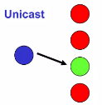
Lecture 6
Casting/Communication Types
Cont'd
Unicasting.
  One-to-one communication.
  One device on the network to another device on the network.
  Example:
    Browsing a website.
    Downloading a file from a FTP server.

Slide 7
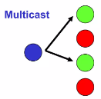
Lecture 6
Casting/Communication Types
Cont'd
Multicasting.
  One-to-many communication.
  One device on the network to many, but not all, devices on the network.
  Devices which are interested in a particular multicast must join to that a multicast group to receive data.
  Multicasting only supports UDP communication protocol.
  Example:
    Sending an email to a mailing list.

Slide 8
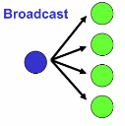
Lecture 6
Casting/Communication Types
Cont'd
Broadcasting.
  One-to-all communication.
  One device on the network to all devices on the network.
  Network should be a local network.
  Example:
    Video & Radio.

Slide 9
Lecture 6
Broadcasting Client/Server UDP Example
import socket, threading, queue
messages = queue.Queue()
clients = []
server = socket.socket(socket.AF_INET, socket.SOCK_DGRAM)
port = 9999
server.bind( ( "localhost", port) )
def receive():
while True:
message, addr = server.recvfrom(1024)
messages.put((message, addr))

Slide 10
Lecture 6
Broadcasting Client/Server UDP Example
Cont'd
def broadcast():
while True:
while not messages.empty():
message, addr = messages.get()
print(message.decode())
if addr not in clients: clients.append(addr)
for client in clients:
try:
if message.decode().startswith("SIGNUP_TAG:"):
name = message.decode()[message.decode().index(":")+1 : ]
server.sendto(f"{name} joined!".encode(), client)
else:
server.sendto(message, client)
except:
clients.remove(client)
t1 = threading.Thread(target=receive); t2 = threading.Thread(target=broadcast); t1.start(); t2.start()

Slide 11
Lecture 6
Broadcasting Client/Server UDP Example
Cont'd
import socket, threading, random
client = socket.socket(socket.AF_INET, socket.SOCK_DGRAM)
client.bind( ("localhost", random.randint(8000, 9000)) )
name = input("Your name: ")
def receive():
while True:
message, _ = client.recvfrom(1024)
print(message.decode())

Slide 12
Lecture 6
Broadcasting Client/Server UDP Example
Cont'd
t = threading.Thread(target=receive)
t.start()
client.sendto(f"SIGNUP_TAG:{name}".encode() , ("localhost", 9999))
while True:
message = input()
if message == "Q":
break
else:
client.sendto(f"{name}: {message}".encode() , ("localhost", 9999))

Slide 13
Lecture 6
Securing Connections
Network security is important for office, home, and business networks.
Network Attacker completely owns the network:
  Controls Wi-Fi, DNS, routers, his own websites, can listen to any packet, modify packets in transit, inject his own packets into the network.

Slide 14
Lecture 6
Security Terminologies
Cipher: an algorithm for performing encryption or decryption.
Encryption/Decryption: Encryption is the process of converting human-readable plaintext to incomprehensible text, also known as ciphertext.
Hashing: the process of transforming any given key or a string of characters into another value. To know if the data is modified for not.
Symmetric/Asymmetric:
  In Symmetric-key encryption the message is encrypted by using a key and the same key is used to decrypt the message.
  In Asym.-key encryption it based on public and private key encryption techniques.

Slide 15
Lecture 6
SSL: Secure Sockets Layer
Widely deployed security protocol
  Supported by almost all browsers and web servers.
SSL provides:
  Confidentiality.
  Integrity.
  Authentication.
Goals:
  Web E-commerce transactions.
  Encryption (especially credit-card numbers)).
  Web-server authentications.

Slide 16
Lecture 6
SSL: A Simple Secure Channel
Handshake: A and B use their certificates, private keys to authenticate each other and exchange shared secret.
Key derivation: A and B use shared secret to derive set of keys.
  Considered bad to use same key for more than one cryptographic operation.
Data transfer: data to be transferred is broken up into series of records.
Connection closure: special messages to securely close connection.

Slide 17
Lecture 6
OpenSSL Toolkit
Install the OpenSSL toolkit.
Create the Private Key and Certificate Signing Request (CSR) files.
Submit CSR to your certificate authority (CA) of choice (e.g., GoDaddy, Verisign).
Retrieve your certificate from the certificate authority.
Download the “root certificate” from the same certificate authority.

Slide 18
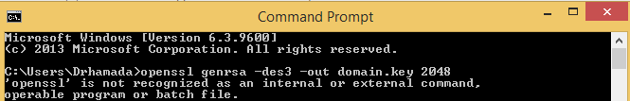
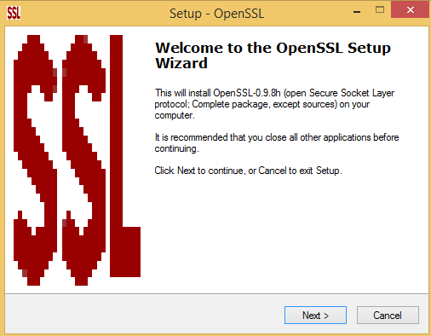
Lecture 6
OpenSSL Toolkit

Slide 19
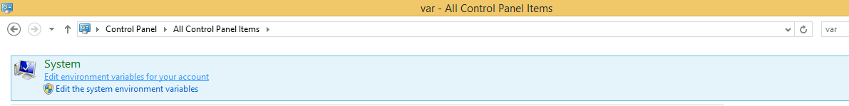
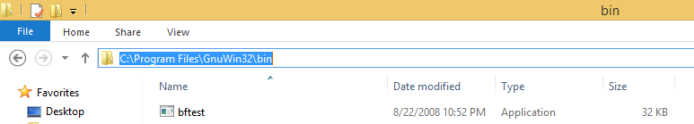
Lecture 6
OpenSSL Toolkit

Slide 20
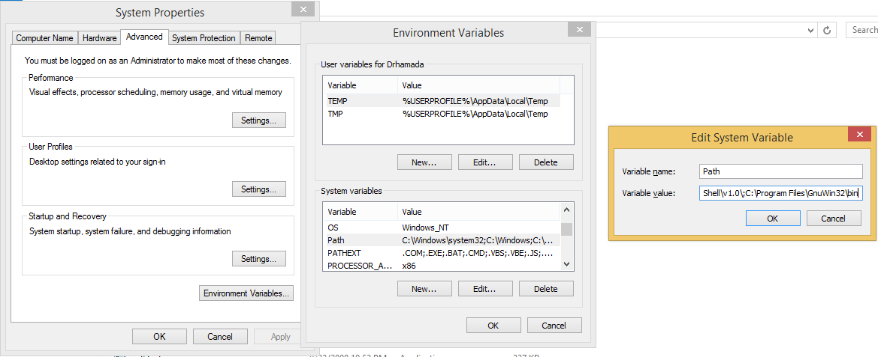
Lecture 6
OpenSSL Toolkit

Slide 21

Lecture 6
OpenSSL Toolkit

Slide 22
Lecture 6
OpenSSL Generation of Certification
Create a CA folder.
- openssl genrsa -aes256 -out caKey.pem 4096
- openssl req -new -x509 -sha256 -days 365 -key caKey.pem -out caCert.pem
- openssl genrsa -out certKey.pem 4096
- openssl req -new -sha256 -subj "/CN=<NAME>" -key certKey.pem -out certQuery.csr
- echo subjectAltName=IP:127.0.0.1 > extfile.cnf
- openssl x509 -req -sha256 -days 365 -in certQuery.csr -CA /path/to/caCert.pem -CAkey /path/to/caKey.pem -out certServer.pem -extfile extfile.cnf -CAcreateserial

Slide 23
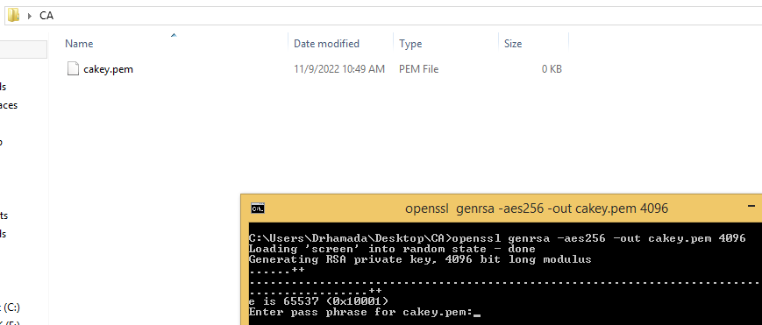
Lecture 6
OpenSSL Toolkit

Slide 24
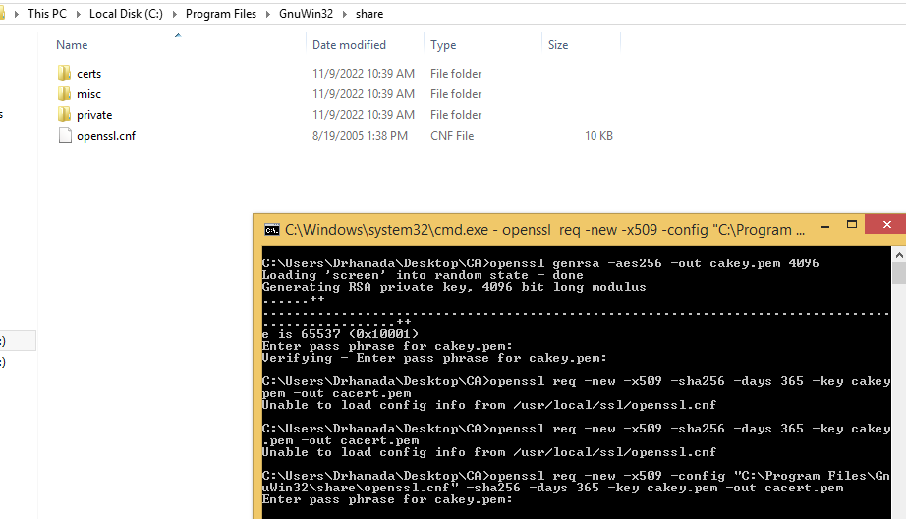
Lecture 6
OpenSSL Toolkit

Slide 25
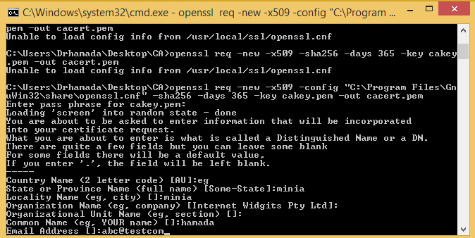
Lecture 6
OpenSSL Toolkit

Slide 26
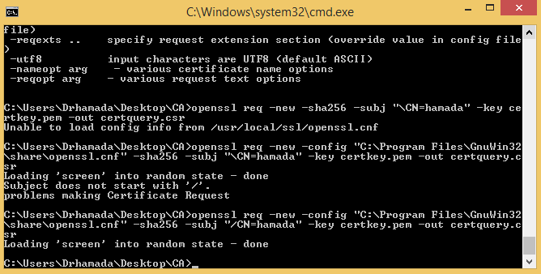
Lecture 6
OpenSSL Toolkit

Slide 27
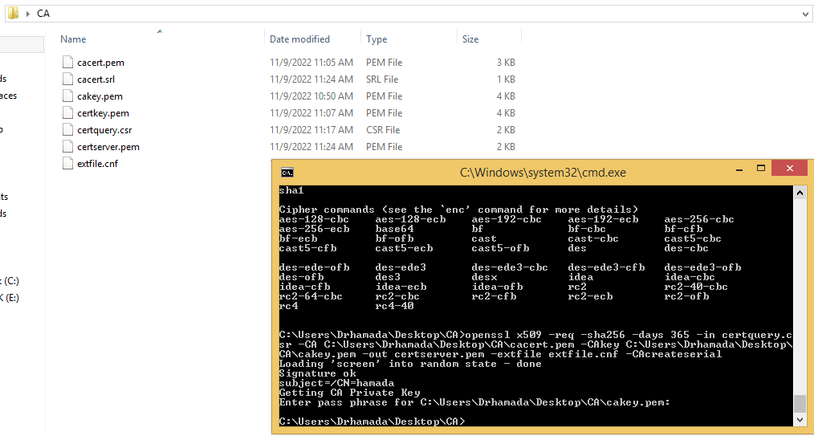
Lecture 6
OpenSSL Toolkit

Slide 28
Lecture 6
SSL Client/Server TCP Example
Cont'd
import socket, ssl
host = "192.168.1.7"; port = 10500
sock = socket.socket(socket.AF_INET, socket.SOCK_STREAM)
#contex creation
ctxt = ssl.SSLContext(ssl.PROTOCOL_TLS_SERVER)
ctxt.load_cert_chain("/mnt/3126DF085226C5FC/Codes/CA/cert/cert-server.pem", "/mnt/3126DF085226C5FC/Codes/CA/cert/cert-key.pem")
sock.bind((host, port)) #start server
sock.listen(5)
print("Server start")

Slide 29
Lecture 6
SSL Client/Server TCP Example
Cont'd
#secure the server
sslServer = ctxt.wrap_socket(sock, server_side=True)
#accept connection
client, ip = sslServer.accept()
print("The IP", ip, " is connected")
#receive message
msg = client.recv(1024).decode()
print("Client: ", msg)

Slide 30
Lecture 6
SSL Client/Server TCP Example
Cont'd
import socket, ssl
host = "192.168.1.7"; port = 10500
sock = socket.socket(socket.AF_INET, socket.SOCK_STREAM)
ctxt = ssl.SSLContext(ssl.PROTOCOL_TLS_CLIENT) #context creation
ctxt.load_verify_locations("/mnt/3126DF085226C5FC/Codes/CA/ca-cert.pem")
sslClient = ctxt.wrap_socket(sock, server_hostname=host) #secure the client
sslClient.connect((host, port))
msg = input(":> ").encode() #exchange message
sslClient.send(msg)

Slide 31
Lecture 6
Sheet
Exercise 1:
Update the SSL TCP client/server code to send and receive messages until connection closed by the client.

Slide 32
THANK YOU

