Slide 1


Information Security Operations Center
(Info SOC)
Lecture 1
Network Security Monitoring
Prepared by
Dr. Ibrahim Gomaa

Slide 2

Lecture
Contents
1
Topic Title | Topic Objective
Introduction | Monitoring, Alerting, and what they can do for you.
War Stories | Explain why networks and data are attacked.
Threat Actors | Explain the motivations of the threat actors behind specific security incidents.
Threat Impact | Explain the potential impact of network security attacks.
The Modern Security Operations Centre | Explain the mission of the Security Operations Center (SOC).
Becoming a Defender | Describe resources available to prepare for a career in cybersecurity operations.
Information Security Operations Center
Lecture 1
Dr. Ibrahim Gomaa

Slide 3
Lecture
Introduction
1
Monitoring
  is the process of maintaining surveillance over the existence and magnitude of state change and data flow in a system.
  the process of becoming aware of the state of a system.
  the process of measurement, which might not necessarily involve any human interaction
This is done in two ways, Proactive and Reactive
The former involves watching visual indicators, such as time series and dashboards, and is sometimes what administrators mean by monitoring.
The latter involves automated ways to deliver notifications to operators to bring to their attention a grave change in system’s state; this is usually referred to as alerting
Information Security Operations Center
Lecture 1
Dr. Ibrahim Gomaa

Slide 4
Lecture
Introduction
1
Monitoring, Alerting, and What They Can Do for You
* Early Problem Detection * Availability
* Decision Making * Performance
* Baselining * Predictions
* Automation
* Autonomic Computing
  An architecture in which the system is capable of regulating itself and thus enabling self management and self-healing. The goal of AC is to minimize the need for human intervention in a similar way, by replacing it with self-regulation
Information Security Operations Center
Lecture 1
Dr. Ibrahim Gomaa

Slide 5

Lecture
War Stories
1
Hijacked People
Hackers can set up open “rogue” wireless hotspots posing as a genuine wireless network.
Rogue wireless hotspots are also known as “evil twin” hotspots.
Information Security Operations Center
Lecture 1
Dr. Ibrahim Gomaa

Slide 6

Lecture
War Stories
1
Ransomed Companies
      Employees of an organization are often lured into opening attachments that install ransomware on the employees’ computers.
      This ransomware, when installed, begins the process of gathering and encrypting corporate data.
      The goal of the attackers is financial gain, because they hold the company’s data for ransom until they are paid.
Information Security Operations Center
Lecture 1
Dr. Ibrahim Gomaa

Slide 7

Lecture
War Stories
1
Targeted Nations
      Some of today’s malware is so sophisticated
      and expensive to create that security experts believe only a nation state or group of nations could possibly have the influence and funding to create it.
      Such malware can be targeted to attack a nation’s vulnerable infrastructure, such as the water system or power grid.
      One such malware was the Stuxnet worm
      that infected USB drives and infiltrated
      Windows operating systems. It then targeted Step 7 software that was developed by Siemens for their Programmable Logic Controllers (PLCs).
Information Security Operations Center
Lecture 1
Dr. Ibrahim Gomaa

Slide 8
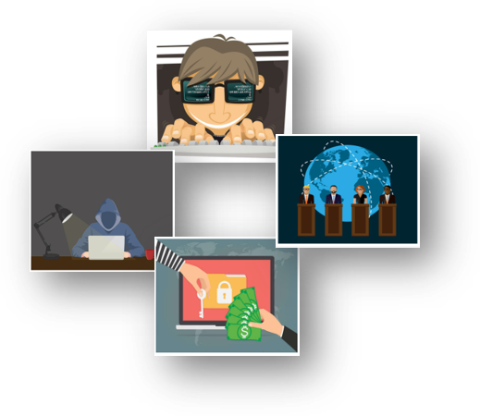
Lecture
Threat Actors
1
Threat Actors
      Threat actors are individuals or groups of individuals who perform cyberattacks. They include, but are not limited to:
          Amateurs
          Hacktivists
          Organized crime groups
          State-sponsored groups
          Terrorist groups
      Cyberattacks are intentional malicious acts meant to negatively impact another individual or organization.
Information Security Operations Center
Lecture 1
Dr. Ibrahim Gomaa

Slide 9


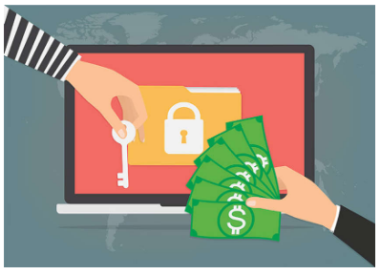

Lecture
Threat Actors
1
      Amateurs
      They are also known as script kiddies and have little or no skill.
      They existing tools or instructions often use found on
      the internet to launch attacks.
      Even though they use basic tools, the results can still be devastating.
      Hacktivists
      These are hackers who publicly protest against a variety of political and social ideas.
      They post articles and videos, leaking sensitive information, and disrupting web services with illegitimate traffic in Distributed Denial of Service (DDoS) attacks.
      Financial Gain
      Much of the hacking activity that consistently threatens our security is motivated by financial gain.
      Cybercriminals want to gain access to bank accounts, personal data, and anything else they can leverage to generate cash flow.
      Trade Secrets and Global Politics
      At times, nation states hack other countries or interfere with their internal politics.
      Often, they may be interested in using cyberspace for industrial espionage.
      The theft of intellectual property can give a country a significant advantage in international trade.
Information Security Operations Center
Lecture 1
Dr. Ibrahim Gomaa

Slide 10

Lecture
Threat Impact
1
PII, PHI, and PSI
Personally Identifiable Information (PII) is any information
that can be used to positively identify an individual, for example, name, social security number, birthdate, credit card numbers etc.
Cybercriminals aim to obtain these lists of PII that can then be sold on the dark web. Stolen PII can be used to create fake financial accounts, such as credit cards and short-term loans.
The medical community creates and maintains Electronic
Medical Records (EMRs) that contain Protected Health
Information (PHI), a subset of PII.
Personal Security Information (PSI), another type of PII, includes usernames, passwords, and other security-related information that individuals use to access information or services on the network.
Information Security Operations Center
Lecture 1
Dr. Ibrahim Gomaa

Slide 11
Lecture
Threat Impact
1
Lost Competitive Advantage
      The loss of intellectual property to competitors is a serious concern.
      An additional major concern is the loss of trust that comes when a company is unable to protect its customers’ personal data.
      The loss of competitive advantage may come from this loss of trust rather than another company or country stealing trade secrets.
Information Security Operations Center
Lecture 1
Dr. Ibrahim Gomaa

Slide 12
Lecture
Threat Impact
1
Politics and National Security
      It is not just businesses that get hacked.
      State-supported hacker warriors can cause disruption and destruction of vital services and resources within an enemy nation.
      The internet has become essential as a medium for commercial and financial activities. Disruption of these activities can devastate a nation’s economy.
Information Security Operations Center
Lecture 1
Dr. Ibrahim Gomaa

Slide 13
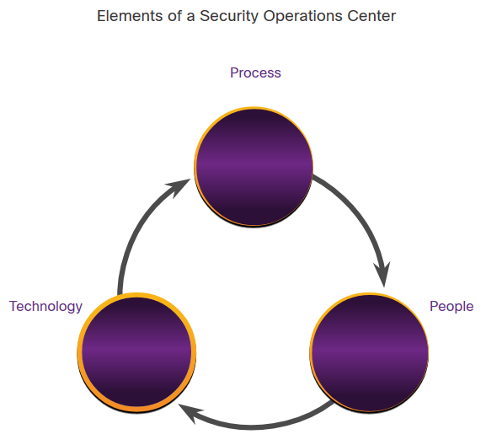
Lecture
The Modern Security Operations Center (SOC)
1
Elements of a SOC
To use a formalized, structured, and disciplined approach for defending against cyber threats, organizations typically use the services of professionals from a Security Operations Center (SOC).
SOCs provide a broad range of services, from monitoring and management, to comprehensive
threat solutions and customized hosted security.
SOCs can be wholly in-house, owned and operated by a business, or elements of a SOC can be contracted out to security vendors.
Information Security Operations Center
Lecture 1
Dr. Ibrahim Gomaa

Slide 14
Lecture
The Modern Security Operations Center (SOC)
1
People in the SOC
SOCs assign job roles by tiers, according to the expertise and responsibilities required for each.
Tiers | Responsibilities
Tier 1 Alert Analyst | Monitor incoming alerts, verify that a true incident has occurred, and forward tickets to Tier 2, if necessary.
Tier 2 Incident Responder | Responsible for deep investigation of incidents and advise remediation or action to be taken.
Tier 3 Threat Hunter | Experts in network, endpoint, threat intelligence, malware reverse engineering and tracing the processes of the malware to determine its impact and how it can be removed. They are also deeply involved in hunting for potential threats and implementing threat detection tools. Threat hunters search for cyber threats that are present in the network but have not yet been detected.
SOC Manager | Manages all the resources of the SOC and serves as the point of contact for the larger organization or customer.
Information Security Operations Center
Lecture 1
Dr. Ibrahim Gomaa

Slide 15
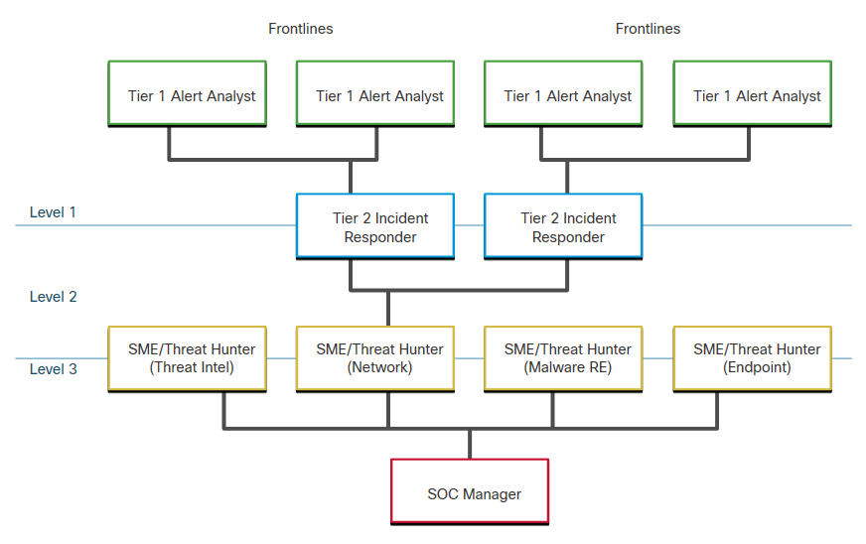
Lecture
The Modern Security Operations Center (SOC)
1
People in the SOC
First tier jobs are more entry level, while third tier jobs require extensive expertise.
The figure, which is originally from the SANS Institute, graphically represents how these roles interact with each other.
Information Security Operations Center
Lecture 1
Dr. Ibrahim Gomaa

Slide 16
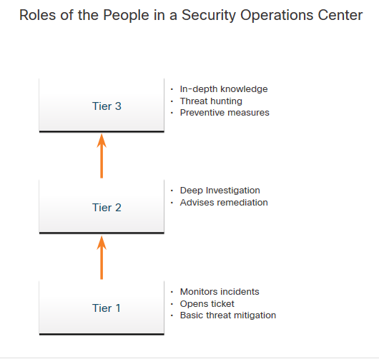
Lecture
The Modern Security Operations Center (SOC)
1
People in the SOC
A Cybersecurity Analyst is required to monitor security alert queues and investigate the assigned alerts. A ticketing system is used to assign these alerts to the analyst’s queue.
The software that generates the alerts can trigger false alarms. The analyst, therefore, needs to verify that an assigned alert represents a true security incident.
When this verification is established, the incident can be forwarded to investigators or other security personnel to be acted upon. Otherwise, the alert is dismissed as a false alarm.
If a ticket cannot be resolved, the Cybersecurity Analyst forwards the ticket to a Tier 2 Incident Responder for deeper investigation and remediation.
If the Incident Responder cannot resolve the ticket, it is forwarded it to a Tier 3 personnel.
Information Security Operations Center
Lecture 1
Dr. Ibrahim Gomaa

Slide 17
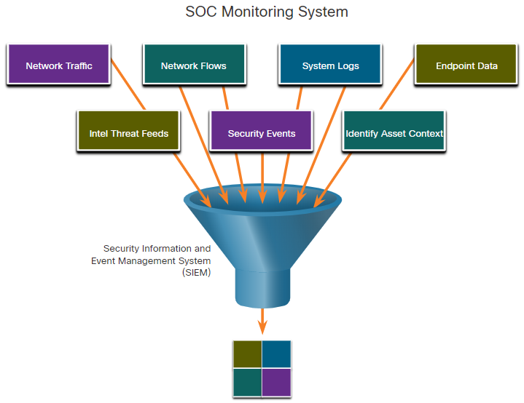
Lecture
The Modern Security Operations Center (SOC)
1
Technologies in the SOC: SIEM
An SOC needs a Security Information and Event
Management (SIEM) system to understand the data that firewalls, network appliances, intrusion detection systems, and other devices generate.
SIEM systems collect and filter data, and detect, classify, analyze and investigate threats. They may also manage resources to implement preventive measures and address future threats.
Information Security Operations Center
Lecture 1
Dr. Ibrahim Gomaa

Slide 18
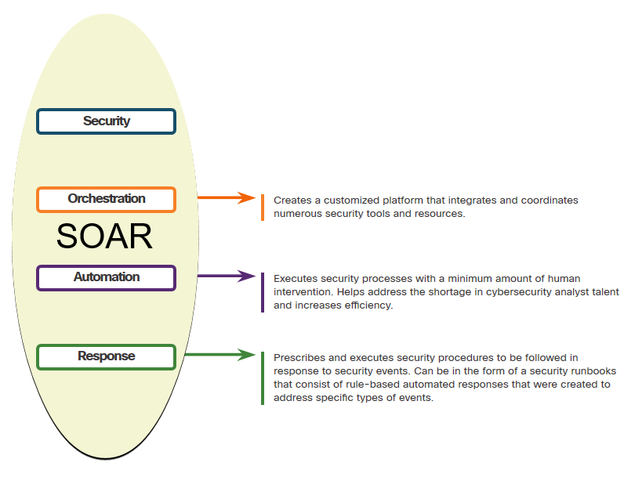
Lecture
The Modern Security Operations Center (SOC)
1
Technologies in the SOC: SOAR
SIEM and Security Orchestration, Automation and Response (SOAR) are often paired together as they have capabilities that complement each other.
Large security operations (SecOps) teams use both technologies to optimize their SOC.
SOAR platforms are similar to SIEMs as they aggregate, correlate, and analyze alerts. In addition, SOAR technology integrate threat intelligence and automate incident investigation and response workflows based on playbooks developed by the security team.
Information Security Operations Center
Lecture 1
Dr. Ibrahim Gomaa

Slide 19
Lecture
The Modern Security Operations Center (SOC)
1
Technologies in the SOC: SOAR
SOAR security platforms:
          Gather alarm data from each component of the system.
          Provide tools that enable cases to be researched, assessed, and investigated.
          Emphasize integration as a means of automating complex incident response workflows that enable more rapid response and adaptive defense strategies.
          Include pre-defined playbooks that enable automatic response to specific threats. Playbooks can be initiated automatically based on predefined rules or may be triggered by security personnel.
Information Security Operations Center
Lecture 1
Dr. Ibrahim Gomaa

Slide 20
Lecture
The Modern Security Operations Center (SOC)
1
SOC Metrics
Many metrics or Key Performance Indicators (KPI) can be devised to measure different aspects of SOC performance. However, five metrics are commonly used as SOC metrics by SOC managers.
Metrics | Definition
Dwell Time | The length of time that threat actors have access to a network before they are detected, and their access is stopped
Mean Time to Detect (MTTD) | The average time that it takes for the SOC personnel to identify valid security incidents have occurred in the network
Mean Time to Respond (MTTR) | The average time it takes to stop and remediate a security incident
Mean Time to Contain (MTTC) | The time required to stop the incident from causing further damage to systems or data
Time to Control | The time required to stop the spread of malware in the network
Information Security Operations Center
Lecture 1
Dr. Ibrahim Gomaa

Slide 21
Lecture
The Modern Security Operations Center (SOC)
1
Enterprise and Managed Security
For medium and large networks, the organization will benefit from implementing an enterprise-level SOC, which is a complete in-house solution.
Larger organizations may outsource at least a part of the SOC operations to a security solutions provider.
Information Security Operations Center
Lecture 1
Dr. Ibrahim Gomaa

Slide 22
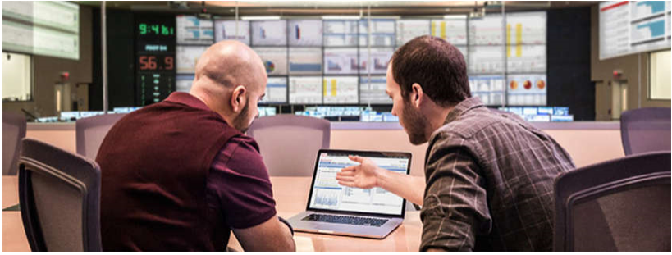
Lecture
Becoming a Defender
1
Certifications
A variety of cybersecurity certifications that are relevant to careers in SOCs are available:
  Cisco Certified CyberOps Associate
  CompTIA Cybersecurity Analyst Certification
  (ISC)² Information Security Certifications
  Global Information Assurance Certification (GIAC)
Search for “cybersecurity certifications” on the
Internet to know more about other vendor
and vendor-neutral certifications.
Information Security Operations Center
Lecture 1
Dr. Ibrahim Gomaa

Slide 23

Lecture
Becoming a Defender
1
Further Education
Degrees: When considering a career in the cybersecurity field, one should seriously consider pursuing a technical degree or bachelor’s degree in computer science, electrical engineering, information technology, or information security.
Python Programming: Computer programming is an essential skill for anyone who wishes to pursue a career in cybersecurity. If you have never learned how to program, then Python might be the first language to learn.
Linux Skills: Linux is widely used in SOCs and other networking and security environments. Linux skills are a valuable addition to your skillset as you work to develop a career in cybersecurity.
Information Security Operations Center
Lecture 1
Dr. Ibrahim Gomaa

Slide 24

Lecture
Becoming a Defender
1
Getting Experience
Internships: Internships are an excellent method for entering the cybersecurity field. Sometimes, internships turn into an offer of full-time employment. However, even a temporary internship allows you the opportunity to gain experience in the inner workings of a cybersecurity organization
Scholarships and Awards: To help close the security
skills gap, organizations have
introduced scholarship and awards programs.
Temporary Agencies: Many organizations use temporary agencies to fill job
openings for the first 90 days. If the employee is a good match, the organization may
convert the employee to a full-time, permanent position.
Your First Job: If you have no experience in the cybersecurity field, working for a call center or support desk may be your first step into gaining the experience you need to move ahead in your career.
Information Security Operations Center
Lecture 1
Dr. Ibrahim Gomaa

Slide 25
Lecture
1
Thanks
Information Security Operations Center
Lecture 1
Dr. Ibrahim Gomaa

