Slide 1



International
Business Management
Prepared by Dr. Noha Adel
Lecture 3

Slide 2



Differences in Culture
Lecture 3
Prepared by
Dr. Noha Adel
www.midocean.ae

Slide 3
Learning Objectives
3-1 Explain what is meant by the culture of a society.
3-2 Identify the forces that lead to differences in social culture.
3-3 Identify the business and economic implications of differences in culture.
3-4 Recognize how differences in social culture influence values in business.
3-5 Demonstrate an appreciation for the economic and business implications of cultural change.

Slide 4
What Is Culture? 1
Scholars have not agreed on a simple definition
  Culture: a system of values and norms shared among a group of people and, when taken together, constitute a design for living
  Society: a group of people sharing a common set of values and norms
What is meant by the culture of a society?
Values refer to abstract ideas about what a group believes to be good, right, and desirable.
Norms are the social rules and guidelines that prescribe appropriate behavior in particular situations.

Slide 5
What Is Culture? 2
Values and Norms
  Values: provide the context within which a society’s norms are established and justified
  Norms: the social rules that govern the actions of people toward one another
    Folkways: routine conventions of everyday life
    Mores: norms that are central to the functioning of a society and its social life
A good example of folkways concerns attitudes toward time in different countries. People are keenly aware of the passage of time in the United States and northern European cultures such as Germany, Netherlands, and the Scandinavian countries. Businesspeople are very conscious about scheduling their time and are quickly irritated when their time is wasted because a business associate is late for a meeting or if they are kept waiting.
Mores include such factors as indictments against theft, adultery, incest, and cannibalism. In many societies, certain mores have been enacted into law.

Slide 6
Planning on Doing Business Internationally?
If a company is planning to export a product, two basic questions need to be asked. Is the product ready to be exported? And, is the company ready to export the product (i.e., does the company have the infrastructure, knowledge, and skills to export the product)?
Culturally, the product is either ready for a global market or not (and, if not, the company can modify it if the market is important enough).
Company readiness is much more culturally sensitive. Having the appropriate cultural knowledge and skills are important. If you have the basic information about a company, you can use global EDGE’s diagnostic tool called CORE (Company Readiness to Export) to assess both product and company readiness to export. Which do you think is the most important: product readiness or company readiness?
Sources: globalEDGE’s CORE diagnostic tool, http://globalEDGE.msu.edu; Badenhausen, K., “America’s Best Small Companies,” Forbes, October 9, 2013.

Slide 7
What Is Culture? 3
Culture, Society, and the Nation-State
  Society reflects people who are bound together by a common culture
    Nation-states are political creations that can contain a single culture or several cultures
    Some cultures embrace several nations
    Also possible to talk about culture at different levels within societies
There is not a strict one-to-one correspondence between a society and a nation-state. Nation-states are political creations that may contain a single culture or several subcultures. Cultures can embrace several nations.
To complicate things further, it is also possible to talk about culture at different levels. It is reasonable to talk about “American society” and “American culture,” but there are several societies within America, each with its own culture. For example, in the United States of America, which is one country, one can talk about African American culture, Cajun culture, Chinese American culture, Hispanic culture, Indian culture, Irish American culture, and Southern culture.

Slide 8
What Is Culture? 4
Determinants of Culture
  Values and norms of a culture evolve based on:
    Prevailing political and economic philosophies
    Society’s social structure
    Dominant religion, language, and education
Notes:
LO 4-2 Identify the forces that lead to differences in social culture.

Slide 9
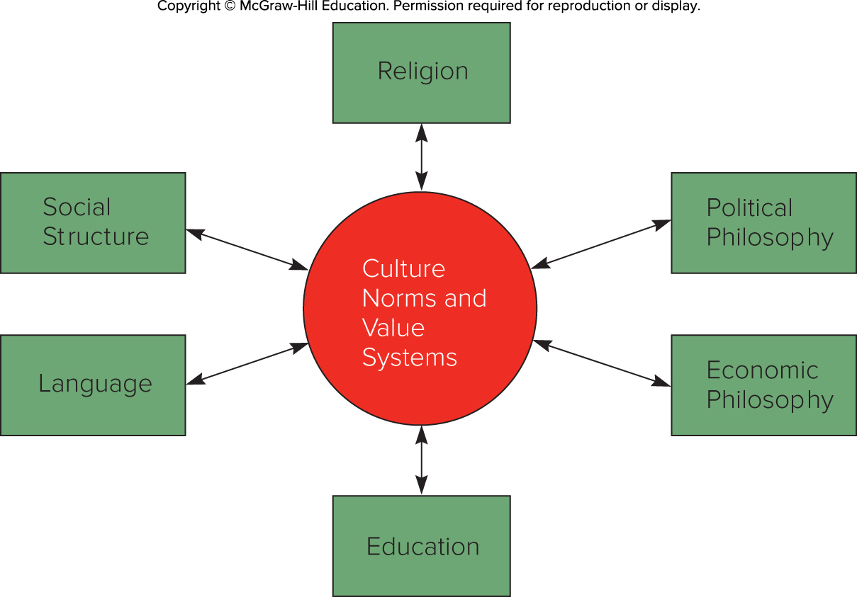
Figure 4.1 Determinants of Culture

Slide 10
Social Structure 1
A society's social structure is its basic social organization
  Two dimensions to consider:
    Degree to which the basic unit of social organization is the individual, as opposed to the group
    Degree to which a society is stratified into classes or castes

Slide 11
Social Structure 2
Individuals and Groups
  Group: association of two or more individuals who have a shared sense of identity and who interact with each other in structured ways on the basis of a common set of expectations about each other’s behavior

Slide 12
Social Structure 4
Individuals and Groups continued
The Group
  Emphasized in non-Westernized societies, such as Japan
  Cooperation and team work are encouraged and lifetime employment is common
  Individual initiative and creativity may be suppressed
In traditional Japanese society, the group was the family or village to which the individual belonged. Today, the group has frequently come to be associated with the work team or business organization.
In a now-classic study of Japanese society, Nakane noted how this expresses itself in everyday life. Nakane goes on to observe that the primacy of the group to which an individual belongs often evolves into a deeply emotional attachment in which identification with the group becomes all-important in one’s life. One central value of Japanese culture is the importance attached to group membership.

Slide 13
Social Structure 3
Individuals and Groups continued
The Individual
  Emphasized in Western societies
  Encourages individual achievement and entrepreneurship
  Fosters managerial mobility
  Encourages job switching and lack of loyalty to the firm
Notes:
LO 4-3 Identify the business and economic implications of differences in culture.
In many western societies, the individual is the basic building block of social organization. This is reflected not just in the political and economic organization of society but also in the way people perceive themselves and relate to each other in social and business settings.

Slide 14
Social Structure 5
Social Stratification
  All societies are stratified on a hierarchical basis into social categories, or social strata
    Often defined by family background, occupation, and income
  Societies differ in terms of:
    Degree of mobility between social strata
    Significance attached to social strata in a business context
Notes:
LO 4-2 Identify the forces that lead to differences in social culture.

Slide 15
Social Structure 6
Social Stratification continued
  Four basic principles of social stratification
    It is a trait of society, not a reflection of individual differences
    It carries over from one generation to the next
    It is generally universal but variable
    It involves not just inequality but also beliefs

Slide 16
Social Structure 7
Social Stratification continued
  Social mobility: the extent to which individuals can move out of the strata they are born into
    Caste system: social position is determined by the family into which a person is born, and change in that position is unlikely
    Class system: position a person has by birth, but can be changed through achievement or luck
      Social mobility in class system varies from society to society
Notes:
The most rigid system is the caste system. The class system is less rigid.
Historically, British society was divided into three main classes: the upper class, which was made up of individuals whose families for generations had wealth, prestige, and occasionally power; the middle class, whose members were involved in professional, managerial, and clerical occupations; and the working class, whose members earned their living from manual occupations. The middle class was further subdivided into the upper-middle class, whose members were involved in important managerial occupations and the prestigious professions (e.g., lawyers, accountants, doctors), and the lower-middle class, whose members were involved in clerical work (e.g., bank tellers) and the less prestigious professions (e.g., schoolteachers).
In China, there have been long-standing differences between the life chances of the rural peasantry and urban dwellers. At the high point of communist rule, mobility was virtually impossible. Today, reforms have allowed greater movement between classes.
In the United States, upper, middle, and working classes are present. Mobility between the classes is based on individual economic achievements.

Slide 17
Social Structure 8
Social Stratification continued
  Significance
    Class consciousness: people perceive themselves in terms of class background
    Shapes relationships with members of other classes
      Evident in the United Kingdom and India
      Antagonism between labor and management can raise the costs of doing business
Notes:
LO 4-3 Identify the business and economic implications of differences in culture.

Slide 18
Religious and Ethical Systems 1
Religion: system of shared beliefs and rituals that are concerned with the realm of the sacred
Ethical system: set of moral principles, or values, that are used to guide and shape behavior
Religions with the greatest following are:
  Christianity (2.20 billion adherents)
  Islam (1.60 billion adherents)
  Hinduism (1.10 million adherents)
  Buddhism (535 million adherents)
  Confucianism shapes culture in many parts of Asia
Notes:
LO 4-2 Identify the forces that lead to differences in social culture.

Slide 19
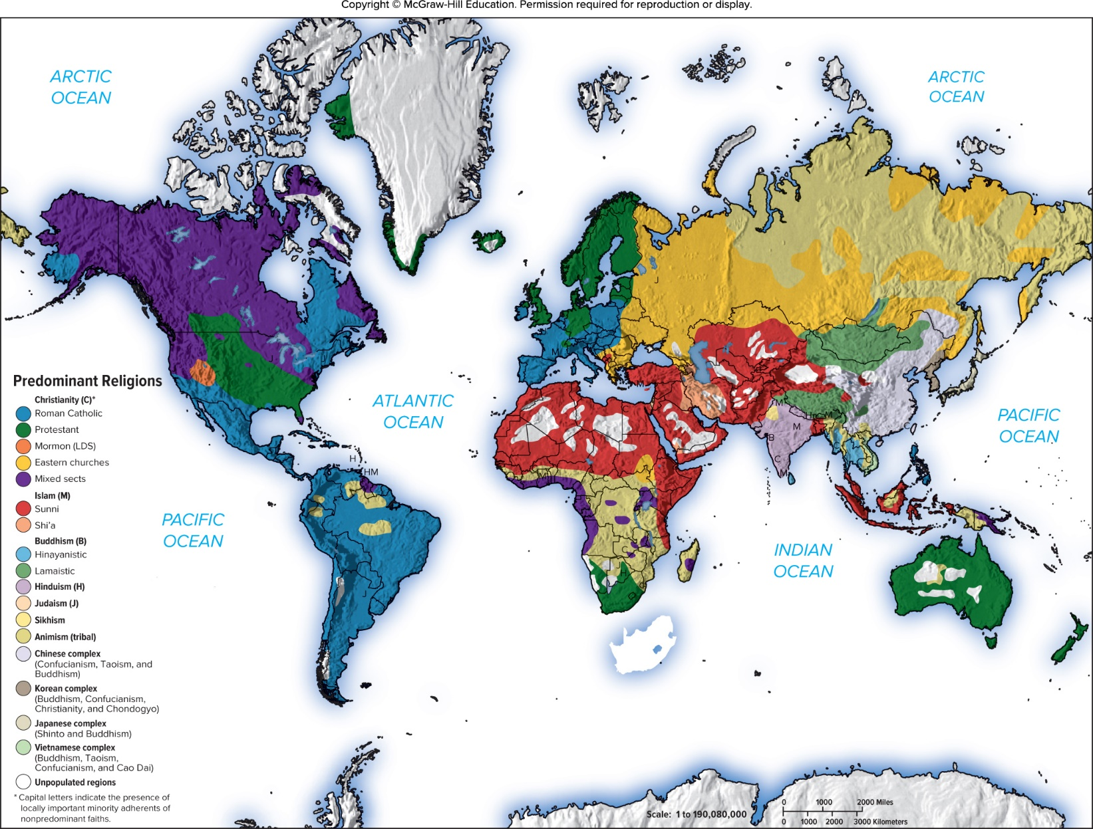
Map 3.1 World Religions
Jump to long description in appendix
Source: “Map 14,” in Allen, John L., and Sutton, Christopher J., Student Atlas of World Politics, 10th ed. New York, NY: McGraw-Hill Companies, Inc., 2013.

Slide 20
Religious and Ethical Systems 2
Christianity
  Most widely practiced religion
  In 1904, Max Weber suggested that the Protestant work ethic was the driving force of capitalism
    Focus on hard work, wealth creation, and frugality
  Protestantism gave individuals more freedom to develop own relationship with God, which may have paved way to economic freedom
Notes:
LO 4-3 Identify the business and economic implications of differences in culture.
Max Weber argued that Protestant ethics emphasizes the importance of hard work and wealth creation (for the glory of God) and frugality (abstinence from worldly pleasures). According to Weber, this kind of value system was needed to facilitate the development of capitalism. Protestants worked hard and systematically to accumulate wealth.

Slide 21
Religious and Ethical Systems 3
Islam
  Adherents of Islam are referred to as Muslims
  One true omnipotent God, Allah
  Those who forgo worldly ambitions to seek the favor of Allah may gain the greater treasure—entry into paradise
  In Western media, Islamic fundamentalism is associated with militants, terrorists, and violent upheavals
  Fundamentalists have gained political power in many Muslim countries and tried to make Islamic law the law of the land
Notes:
LO 4-2 Identify the forces that lead to differences in social culture.
Major principles of Islam include (1) honoring and respecting parents, (2) respecting the rights of others, (3) being generous but not a squanderer, (4) avoiding killing except for justifiable causes, (5) not committing adultery, (6) dealing justly and equitably with others, (7) being of pure heart and mind, (8) safeguarding the possessions of orphans, and (9) being humble and unpretentious. Obvious parallels exist with many of the central principles of both Judaism and Christianity.

Slide 22
Religious and Ethical Systems 4
Islam continued
  Economic Implications of Islam
    Koran establishes explicit economic principles many of which are pro-free enterprise
    Under Islam, people do not own property but only act as trustees for God and thus must take care of what they are entrusted with
    Stresses living up to contractual obligations, keeping one’s word, and abstaining from deception
Notes:
LO 4-3 Identify the business and economic implications of differences in culture.
Given the Islamic proclivity to favor market-based systems, Muslim countries are likely to be receptive to international businesses as long as those businesses behave in a manner that is consistent with Islamic ethics, customs, and business practices. Businesses that are perceived as making an unjust profit through the exploitation of others, by deception, or by breaking contractual obligations are unlikely to be welcomed in an Islamic country. In Islamic countries where fundamentalism is on the rise, general hostility toward Western-owned businesses is likely to increase.

Slide 23
Religious and Ethical Systems 5
Economic Implications of Islam continued
  Prohibits payment or receipt of interest
  Mudarabah is similar to profit sharing
  Murabaha includes a markup price for the bank
Notes:
Under mudarabah, when an Islamic bank lends money to a business, rather than charging that business interest on the loan, it takes a share in the profits that are derived from the investment. Many believe that a mudarabah system is less efficient than a conventional Western banking system.
In a murabaha contract, when a firm wishes to purchase something using a loan—let’s say a piece of equipment that costs $1,000—the firm tells the bank after having negotiated the price with the equipment manufacturer. The bank then buys the equipment for $1,000, and the borrower buys it back from the bank at some later date for, say, $1,100, a price that includes a $100 markup for the bank.

Slide 24
Religious and Ethical Systems 6
Hinduism
  World’s oldest religion
  Moral force in society requires acceptance of certain responsibilities called dharma
  Believe in reincarnation and karma
  Individuals can eventually achieve nirvana
  Economic Implications of Hindisusm
    Max Weber: Hinduism does not foster entrepreneurism
    Modern India is a dynamic entrepreneurial society
    Mahatma Gandhi embodied Hindu asceticism
Notes:
LO 4-2 Identify the forces that lead to differences in social culture.
Given the emphasis on an ascetic lifestyle, Weber thought that devout Hindus would be less likely to engage in entrepreneurial activity than devout Protestants.
It has been argued that the values of Hindu asceticism and self-reliance that Gandhi advocated had a negative impact on the economic development of post-independence India.

Slide 25
Religious and Ethical Systems 7
Buddhism
  Suffering originates in people’s desire for pleasure
  Stresses spiritual growth and afterlife, rather than achievement while in this world

Slide 26
Economic Implications of Buddhism
  Does not support caste system
  Recent trend of “Zen” orientation into Western businesses
Buddhism does not support the caste system, so individuals do have some mobility and can work with individuals from different classes
“In business, ‘Zen’ is often a synonym for ordinary nothingness,” blogged Nancy Friedman, a corporate copywriter who consults with businesses on naming and branding. She said that “Zen can be combined with mail to describe ‘an incoming e-mail message with no message or attachments.’ Zen spin is a verb meaning ‘to tell a story without saying anything at all.’ And to zen a computing problem means to figure it out in an intuitive flash—perhaps while you’re plugged into the earphones of your ZEN MP3 player, available from Creative.”

Slide 27
Religious and Ethical Systems 8
Confucianism
  Until 1949, official ethical system of China
  Not a religion
  High moral and ethical conduct and loyalty to others
  Attain personal salvation through right action
  Three key teachings of Confucianism: loyalty, reciprocal obligations, and honesty
    May lead to a lowering of the cost of doing business in Confucian societies
Notes:
In Confucian thought, loyalty to one’s superiors is regarded as a sacred duty—an absolute obligation.
However, in a Confucian culture, loyalty to one’s superiors, such as a worker’s loyalty to management, is not blind loyalty. The concept of reciprocal obligations is important.
Confucian thinkers emphasize that although dishonest behavior may yield short-term benefits for the transgressor, dishonesty does not pay in the long run. The importance attached to honesty has major economic implications.
When companies can trust each other not to break contractual obligations, the costs of doing business are lowered. Expensive lawyers are not needed to resolve contract disputes. In a Confucian society, people may be less hesitant to commit substantial resources to cooperative ventures than in a society where honesty is less pervasive. When companies adhere to Confucian ethics, they can trust each other not to violate the terms of cooperative agreements. Thus, the costs of achieving cooperation between companies may be lower in societies such as Japan relative to societies where trust is less pervasive.

Slide 28
Language 1
Spoken Language
  Countries with more than one spoken language often have more than one culture
    Chinese is the mother tongue of the largest number of people in the world
    English is the most widely spoken language in the world and is becoming the language of international business
Notes:
Knowledge of the local language is beneficial, and in some cases, critical for business success.

Slide 29
Can You Speak the Most Important Languages?
Mastering your own native language is important to doing business in your home country. Mastering the language of a foreign country is also an added value in any cross-cultural relationship. English leads the way in terms of business languages, but which languages are important after English? Spanish? No, not necessarily. The three languages that are important for business after English are Mandarin Chinese, French, and Arabic. Spanish is fifth, so it is clearly important, but not as useful as English, Mandarin, French, and Arabic because of the number of people who speak these languages. Do you agree with the rank order of these languages? Why or why not?
Source: S. Kim, “Top 3 Useful Foreign Languages for Business Excludes Spanish,” ABC News, September 1, 2011, http://abcnews.go.com/business/t/blogEntry?id=14427844.

Slide 30
Language 2
Unspoken Language
  Nonverbal cues
    Examples include facial expressions and hand gestures
    Personal space is the customary distance between two people
  Many nonverbal cues are culturally bound and may be interpreted differently, resulting in misunderstandings
Notes:
LO 4-2 Identify the forces that lead to differences in social culture.

Slide 31
Education
Formal education teaches the language, conceptual, and technical skills that are indispensable in modern society
Educational opportunities can provide a competitive advantage and make a country more or less attractive for expanding businesses
    Porter points to Japan’s excellent education system in explaining its postwar economic success
The general education level of a country is a good indicator of the types of products that might sell or the types of promotional materials that might be successful
Notes:
LO 4-2 Identify the forces that lead to differences in social culture.

Slide 32
Culture and Business 1
Geert Hofstede isolated five dimensions that summarized different cultures
  Power distance
  Individualism versus collectivism
  Uncertainty avoidance
  Masculinity versus femininity
  Long-term versus short-term orientation
  A move to add a sixth dimension: indulgence versus restraint
Notes:
LO 4-4 Recognize how differences in social culture influence values in business.
Hofstede’s power distance dimension focused on how a society deals with the fact that people are unequal in physical and intellectual capabilities.
The individualism versus collectivism dimension focused on the relationship between the individual and his or her fellows.
Hofstede’s uncertainty avoidance dimension measured the extent to which different cultures socialized their members into accepting ambiguous situations and tolerating uncertainty.
Hofstede’s masculinity versus femininity dimension looked at the relationship between gender and work roles.
The long-term versus short-term orientation dimension refers to the extent to which a culture programs its citizens to accept delayed gratification of their material, social, and emotional needs.
Indulgence refers to a society that allows relatively free gratification of basic and natural human drives related to enjoying life and having fun. Restraint refers to a society that suppresses gratification of needs and regulates it by means of strict social norms.

Slide 33
Hofstede’s Framework: Power Distance
The extent to which a society accepts that power in institutions and organizations is distributed unequally.
  Low distance
    Relatively equal power between those with status/wealth and those without status/wealth
  High distance
    Extremely unequal power distribution between those with status/wealth and those without status/wealth
Notes:
Power distance is the extent to which a society accepts that power in institutions and organizations is distributed unequally. Low distance is when there is relatively equal power between those with status/wealth and those without. Higher distance is when there is a lot of unequal power distribution between groups.

Slide 34
Hofstede’s Framework: Individualism
Individualism
  The degree to which people prefer to act as individuals rather than as member of groups
Collectivism
  A tight social framework in which people expect others in groups of which they are a part to look after them and protect them
  Versus
Notes:
The second component in Hofstede’s framework is individualism vs. collectivism. Individualism is the degree to which people prefer to act on their own rather than in a group. Collectivism is the idea that people operate within a social framework where they help others out and they expect help when they need it.

Slide 35
Hofstede’s Framework: Masculinity
Masculinity
  The extent to which the society values work roles of achievement, power, and control, and where assertiveness and materialism are also valued
Femininity
  The extent to which there is little differentiation between roles for men and women
  Versus
Notes:
Hofstede offers a third component in his model that distinguishes between masculinity and femininity. Masculinity is the extent to which the culture prefers achievement, power, and control vs. characteristics that are more feminine in nature.

Slide 36
Hofstede’s Framework: Uncertainty Avoidance
The extent to which a society feels threatened by uncertain and ambiguous situations and tries to avoid them
High Uncertainty Avoidance:
Society does not like ambiguous situations and tries to avoid them.
Low Uncertainty Avoidance:
Society does not mind ambiguous situations and embraces them.
Notes:
The fourth component is uncertainty avoidance. This is the extent to which a society is willing to live with uncertainty and ambiguity. High uncertainty avoidance cultures will try to avoid ambiguous situations as much as possible. Lower uncertainty avoidance cultures do not mind ambiguity.

Slide 37
Hofstede’s Framework: Time Orientation
Long-term Orientation
  A national culture attribute that emphasizes the future, thrift, and persistence
Short-term Orientation
  A national culture attribute that emphasizes the present and the here and now
Notes:
The final component is time orientation. Long-term orientation societies will emphasize the future and what it takes to get to the future they desire, thrift and persistence. Short-term orientation societies will emphasize the here and now.

Slide 38
Hofstede’s Framework: An Assessment
There are regional differences within countries
The original data is old and based on only one company
Hofstede had to make many judgment calls while doing the research
Some results don’t match what is believed to be true about given countries
Despite these problems it remains a very popular framework
Notes:
This framework shows that there are differences in values between cultures and this encouraged research in the area of cultural differences. However, the original data was limited in scope and many judgment calls were made in the conclusions. Even though there are some variances between common perception of cultures and the research, this framework remains extremely popular and is used widely.

Slide 39
Cultural Change
Culture evolves over time, although changes in value systems can be slow and painful
  Social turmoil is an inevitable outcome of cultural change
  Cultural change is particularly common as countries become economically stronger
  As countries get richer, there is a shift from “traditional values” to “secular rational”
  Globalization creating a convergence of cultures: the convergence hypothesis
  Countertrend of some cultures: reemphasizing uniqueness
Notes:
LO 4-5 Demonstrate an appreciation for the economic and business implications of cultural change.
For another illustration of cultural change, consider Japan. Some academics argue that a major cultural shift has been occurring in Japan, with a move toward greater individualism.⁷⁴ The model Japanese office worker, or “salaryman,” is characterized as being loyal to his boss and the organization to the point of giving up evenings, weekends, and vacations to serve the organization, which is the collective the employee is a member of. However, a new generation of office workers may not fit this model.

Slide 40
Focus on Managerial Implications 1
Cultural Literacy and Competitive Advantage
  Need for managers to develop cross-cultural literacy
  Connection between culture and national competitive advantage
  Connection between culture and ethics in decision making

Slide 41
Focus on Managerial Implications 2
Cultural Literacy and Competitive Advantage continued
Cross-Cultural Literacy
  Firms that are ill-informed about practices of another culture are unlikely to succeed in that culture
  Beware of ethnocentric behavior
    Belief in the superiority of one's own culture
Notes:
To combat the danger of being ill-informed, international businesses should consider employing local citizens to help them do business in a particular culture. They must also ensure that home-country executives are well-versed enough to understand how differences in culture affect the practice of business. Transferring executives globally at regular intervals to expose them to different cultures will help build a cadre of knowledgeable executives.

Slide 42
Focus on Managerial Implications 3
Cultural Literacy and Competitive Advantage continued
Culture and Competitive Advantage
  Connection between culture and competitive advantage
    The value systems and norms of a country influence the costs of doing business in that country
    The costs of doing business in a country influence the ability of firms to establish a competitive advantage
  Key points
    The connection suggests which countries are likely to produce the most viable competitors
    The connection has implications for the choice of countries in which to locate production facilities and do business
Notes:
Keep in mind that as important as culture is to people, companies, and society, it is probably less important than economic, political, and legal systems in explaining differential economic growth between nations.

Slide 43



Thank You

