Slide 1


Effective Training
Phase 3
Implementation
Prepared by Dr. Injy Nashaat
Lecture 6

Slide 2



Program
Implementation
www.midocean.ae

Slide 3
Implementation Phase
Input
Process
Output
Training Plan Acquisition List
Instructional Material
Instructional Equipment
Trainee and Trainer Manuals
Room Set up plan
Refreshment list
Trainer readiness
And so on….
Learned KSAs
Dry Run
&
Pilot
Actual
Training
Evaluation Implementation

Slide 4
Implementation Phase
THE TRAINING STRUCTURE:
Icebreaker: is a game or exercise that prompts trainees to get comfortable interacting with other trainees and the trainer. It is designed to be fun but at the same time generate energy that will transfer to the rest of the training.
Provide Variety be sure to provide breaks and activities to keep trainees interested in what you are saying. Keep a watchful eye on the trainees to signal time for a break. Even a five-minute stretch can help.
Exercises or Games are also valuable for gaining and maintaining interest, assuming that the games are relevant. They are especially useful if they provide an entrée to, or an example of, the training objective or a learning point. These tools should be used with a clear and definite purpose.

Slide 5
Implementation Phase
Experiential Learning Model: Let's examine this process more closely.
  Step 1: The Experience: The learning experience begins with some sort of activity that ties into the training topic. This way, all trainees begin by sharing a common experience. This first experience should not be related too closely to the actual work setting.
  Step 2: The Intervention and Reflection: There are two parts to this Step 2, Intervention and Reflect
  Intervention: After the experience, the trainer provides information (e.g., concepts and principles) related to the topic at hand. This can be a lecture, a video, or some other form.
  Reflection: allows the trainee to process the personal experience in the context of the training information.

Slide 6
Implementation Phase
Step 3: Generalization: At this point, it is important for the trainees to see how the learning is relevant to situations outside the training.
(Example: the trainees should decide that the use of job-related information for developing interview questions is appropriate for all jobs).
Step 4: New Experience: The trainees receive another task similar in nature to the first so that they can practice the newly found skill. Note that in this step, the task should be more closely related to the actual job.

Slide 7
Implementation Phase
Tips on Dealing with Different Participant Personalities:
Quiet Trainee: one way to encourage the quiet trainee is to ask each group to rotate the person who is responsible for reporting back to the larger group. The quiet trainee will then take a turn reporting to the larger group, thus increasing his participation.
Talkative Trainee: One approach is to ask others for their opinion. Say something like "We have been making Lex do all the work here so far- how about someone else responding?" Or use the direct questioning technique to get the focus away from the talkative trainee.
Angry Trainee : Some trainees who come to training simply do not want to be there. They set out to ruin the session for everyone. Such trainees must be dealt with early on before they disrupt the class.

Slide 8
Evaluation
of Training
www.midocean.ae

Slide 9
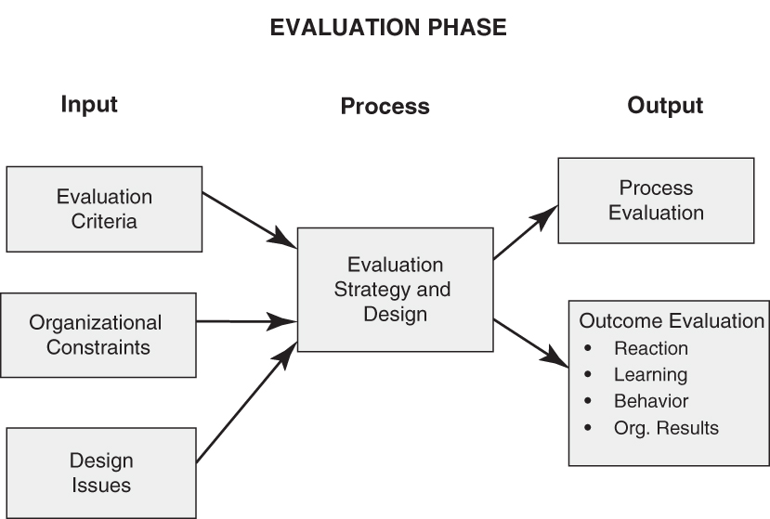
Evaluation Phase

Slide 10
Types of Evaluation
Process Evaluation: sometimes called formative evaluation, is where you determine if the training that was delivered followed the training design.
Outcome Evaluation: sometimes called summative evaluation, measures the degree to which the training has met its objectives.
Forms of Evaluation:
There are five levels of evaluation..
Reaction: measures how trainees feel about training and if trainees find it interesting and/ or relevant to the job
Learning: measures the level of learning that occurred in training.
Behavior: is a measure of how much the learned knowledge, skills, and attitudes (KSAs) are transferred to the job by observing them or making tests
Results: measure any actual improvements in productivity that can be attributed to the KSAs that were transferred to the job.
ROI: calculates the monetary value obtained through the training.

Slide 11
Purpose of Process Evaluation
Identify areas where training process can be improved
Why? Improved process leads to improved outcomes
Research has shown the relationship between reaction, learning, behavior and results is Evidence is corrected.

Slide 12
Questions to answer in a Process Analysis (Before Implementation)
Were needs diagnosed correctly?
Were needs translated into training objectives?
Was an evaluation system designed to measure objectives?
Was the training program designed to meet all the training objectives?
Are the training methods appropriate for the learning objectives?
Were guidelines developed in the design phase used to develop the training content, materials and processes?

Slide 13
Questions to answer in a Process Analysis (During Implementation)
Were the trainer and techniques well matched to the objectives?
Were lecture portions of the training effective?
    Was involvement encouraged/solicited?
    Were questions used effectively?
Did the trainer conduct the various training methodologies (case study, role-play, etc.) appropriately?
    Was enough time allotted and was it used as intended?
    Did trainees follow instructions?
    Was there effective debriefing following exercises?
    Was time allowed for questions?

Slide 14
Who Is Interested in the Process Data
Training Department
Trainer: | Yes, to determine what works well and what does not.
Other trainers: | Yes, to the extent that process is generalizable
Training manager | Only if training is not successful or a problem is shown for a particular trainer.
Customers
Trainees: | No
Trainees’ supervisor | No
Upper management: | No

Slide 15
Who Is Interested in the Outcome Data
 | Outcome Data
 | Reaction | Learning | Behavior | Results
Training Department
Trainer | Yes | Yes | Yes | No
Other Trainers | Perhaps | Perhaps | Perhaps | No
Training Manager | Yes | Yes | Yes | Yes
Customers
Trainees | Yes | Yes | Yes | Perhaps
Trainees’ Supervisor | Not really | Only if no transfer | Yes | Yes
Management | No | No | Perhaps | Yes

Slide 16
Outcome Evaluation
What do you evaluate at the end of training???
Your Training Objectives

Slide 17
Outcome Evaluation
The KEY outcomes achieved by your training
Trainee Reactions
Learning
Transfer to the job
Organizational Results
Objectives
The same as your objectives ☺

Slide 18
Factors Affecting Key Outcomes
Organizational
Results
External environment of the organization
Internal environment of the organization
Employee performance, KSAs, and needs
Job Behavior
Training’s transfer of training effectiveness
Motivational forces in the job setting
Opportunity to apply learned KSAs on the job
Learning
Trainee readiness for the course
Trainee motivation to learn
Design, materials, and content
Reactions
Trainee characteristics
Trainer behavior

Slide 19
Outcome Evaluation Design
Alignment Between TNA and Outcomes
Training Evaluation
Objectives Outcomes
TNA
Measured the same way

Slide 20
Design Evaluation
Determines
Design Phase Activities
Evaluation
Phase
Reactions
Learning
Performance
  Person
  Unit
  Org.
Develop
Training
Objectives
Evaluation
Plan & Design

Slide 21
Reaction Questionnaires
Training reaction questionnaires do not assess learning,
but DO assess the trainee’s attitudes about and perceptions of the training.

Slide 22
Reaction Questionnaires continued
At a minimum, the following categories should be assessed in a reaction questionnaire after completing the training:
  Relevance/value of training (to trainees)
  Training content and materials
  Trainer’s behavior/effectiveness
  Facilities, activities and procedures

Slide 23
Reaction Questionnaires continued
The reaction questionnaire should also provide an
overall evaluation of the training experience.

Slide 24
Steps to Consider in Developing a Reaction Questionnaire (Part 1 of 2)
Determine what you want to find out (look at training objectives).
Develop a written set of questions to obtain the information.
Develop a scale to quantify respondents’ data.

Slide 25
Steps to Consider in Developing a Reaction Questionnaire (Part 1 of 2)
4. Make forms anonymous so participants will feel free to respond honestly.
5. Ask for subgroup information (e.g., young vs. old; minority vs. non-minority).
  This could be valuable in determining effectiveness of training for different cultures, for example, which may be lost in an overall assessment.

Slide 26
Steps to Consider in Developing a Reaction Questionnaire (Part 2 of 2)
6. Allow space for “Additional Comments” to allow participants the opportunity to mention things you might not have considered.
7. Decide the best time to hand out the questionnaire to get the information you want.
    If right after training, ask someone other than the instructor to administer and pick up the information.
    If some time later, develop a mechanism to obtain a high response rate (e.g., encourage the supervisor to allow trainees to complete the questionnaire on company time).

Slide 27
Remember
Training objectives are set in the Design Phase based on “Gaps” identified.
Training objectives are assessed in the Evaluation Phase
Let’s look at some examples of how this is done for reaction objectives.

Slide 28
Financial Evaluation
Actual savings based on outcomes
  Cost of performance prior to training
  Cost of performance after training
  = Performance savings
  - Cost of Training
  = Cost Savings
Return on Investment ratio (ROI)
  = Cost Savings/Cost of Training

Slide 29
Key Areas and the Future of
Organizational Training
www.midocean.ae

Slide 30
ORIENTATION (ONBOARDING)
An effective orientation is a way to assimilate new hires into the company environment. When done properly, it provides the new employee with information on what is required of them, as well as some history of the firm, the company's culture, and its strategic vision.
It begins the socialization process for new employees by helping them learn about the way the organization works and what it values. Orientations can be short (half or one day) or much longer (a week with periodic meetings for months thereafter).

Slide 31
ORIENTATION (ONBOARDING)
Some authors use the term onboarding to define the longer more in-depth orientations that focus on socialization process and orientations are shorter introductions to the organization with some basic training and completion of forms required by Human Resources.
Others use the term onboarding specifically for managers, and still others simply use the terms orientation and onboarding interchangeably.

Slide 32
Outcomes From an Effective Orientation
Reduced anxiety | A better understanding of expectations Getting to meet coworkers
Reduced role ambiguity | Opportunity to know what is required on the job Comfort asking supervisor and co-workers questions
Improved job performance | Better understanding of job requirements Comfort asking for assistance
Reduced turnover | Evidence shows effective orientations reduce turnover.
Higher Commitment | Evidence shows effective orientations increase job involvement and commitment to org. values
More effective organization | All the above lead to a more effective organization

Slide 33
Orientation Practices New Hires Consider More or Less Useful
Most Useful Practices
Manager sets aside a block of uninterrupted time spent with new hire
Workspace was ready
New hire encouraged to watch an associate for a period
Received on-the-job training
An associate assigned as a “buddy” to answer questions
Least Useful Practices
Joining the company announced in an email or newsletter or website
Company t-shirts or other types of company trinkets given to new hire

Slide 34
Advantages of an Effective Diverse Workforce
Larger Applicant Pool | More people applying for jobs = more qualified employees More qualified employees = more effective workforce
Reduced Costs | More diverse organizations have lower turnover Lower legal costs due to discrimination claims Less conflict because of diversity (effective systems to deal with this)
Access to More Markets | Better understanding of diverse markets and better acceptance by diverse populations
Improved problem solving | Diverse employee backgrounds and experiences lead to more solutions and more creative solutions.

Slide 35
10 Ways to Keep Diversity Important (1⁻5)
Develop and implement diversity refresher training
Create a Diversity Council and publicize its activities
Invite managers to the Diversity Council meetings
Address all diversity related concerns in a timely manner
Monitor diversity metrics; praise successes and investigate failures

Slide 36
10 Ways to Keep Diversity Important (6-10)
Ask managers to report diversity activities monthly.
Periodically remind supervisors of guidelines related to employment decisions.
Publicize diversity holidays
Have diversity articles in company newsletter
Set up a diversity booth at company picnics

Slide 37
Harassment
Harassment: is defined as an unwelcome advance of a nature and can take one of two forms:
  quid pro quo and hostile environment.
  Quid pro quo harassment: occurs if an employee higher in the organization makes an offer to a subordinate of some job perk (raise, promotion, or easier job) in return for harassment favours.
  hostile work environment: When words, gestures, and/ or behaviors make someone feel uncomfortable based on their gender.

Slide 38
Strategies for Dealing with Harassment
Develop a clear policy
Get support from the top Management.
Provide training to everyone and periodically provide refresher training
Evaluate training: Test for knowledge
Develop a complaint process
Investigate all complaints quickly and confidentially
Provide severe punishment to anyone violating policy

Slide 39
Necessary Components in a Harassment Policy
Indicate a strong opposition to harassment.
Define harassment and use examples employees understand.
Provide a procedure for reporting harassment in a way that protects the person reporting.
Indicate all reported incidents will be investigated quickly and discretely.
Provide levels of discipline for violators, up to and including dismissal.
State that no retaliation for reporting harassment incidents will be tolerated.

Slide 40



Thank You

