Slide 1

Prepared by Dr. Hamada I. AbdulWakel
Orientation Lecture

Slide 2


Slide 3


Who Am I?
Name
Hamada Ibrahim AbdulWakel
B. Sc. degree
Faculty of Computers & Information, Minia University, Minia, Egypt.
Job
Lecturer at the same faculty.

Slide 4
Who Am I?
M. Sc. & PhD. degrees
In Computer Science from Faculty of Computers and Artificial Intelligence, Cairo University.
Semantic web & Social networking
Internet of Things

Slide 5



Who Am I?
Google Scholar
Publons
ORCID

Slide 6
Course Details
Course Code
CYB550
Course Name
Programming Foundations In Python
Coordinating Unit
Cybersecurity department, Everyone Smart University.

Slide 7

Learning Objectives of this Course
What you'll learn?
New programming language "Python".
Problem-solving techniques.
Application development and prototyping.
Best practice in software development.

Slide 8

Topics Covered in this Course
The main contents:
Introduction to computer programming and Python.
Data types and basic input output operations.
Conditional and loop instructions.
Lists and dictionaries data processing.

Slide 9
Topics Covered in this Course
The main contents:
Functions, modules, and packages.
Object-oriented programming.
Graphical user interface.

Slide 10

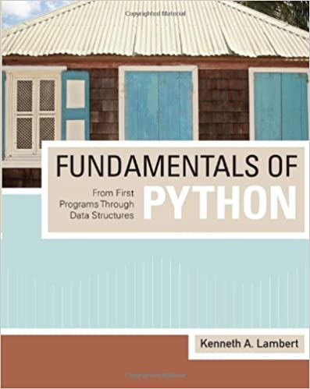
Course Materials
The main contents:
"Fundamentals of Python From First Programs Through Data Structures", by Kenneth A. Lambert
Recorded lectures available on course moodle page.

Slide 11
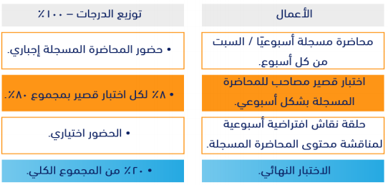
Course Assessment

Slide 12
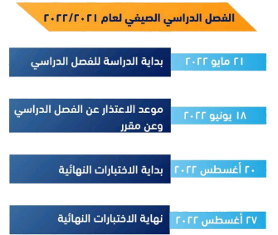
Academic Calendar

Slide 13
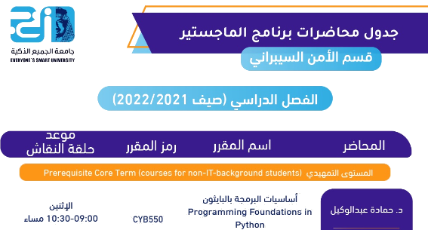
Academic Calendar

Slide 14
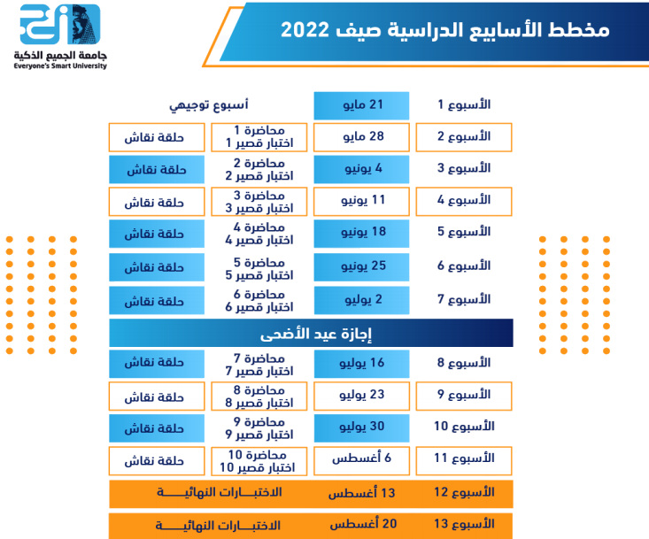
Academic Calendar

Slide 15


