Slide 1




DIGITAL MARKETING STRATEGY
Prepared by
Dr. HEBA ZIAD
Lecture 9
www.midocean.ae

Slide 2
www.midocean.ae
Affiliate Marketing : How to Develop and Manage a Successful Strategy
TABLE OF CONTENTS
What is affiliate marketing?
an overview of how affiliate marketing work
What is an affiliate link?
Affiliate networks:
the niche research process
affiliate program
affiliate marketing content
traffic sources

Slide 3
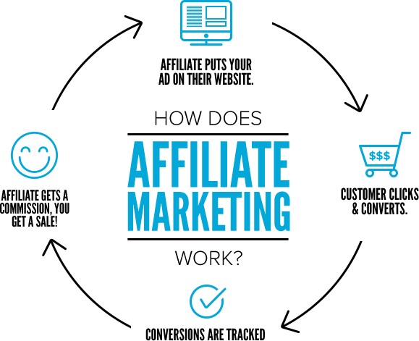
Affiliate MARKETING : How to Develop and Manage a Successful Strategy
www.midocean.ae
What is affiliate marketing?
Affiliate marketing is a business model where brands share revenue with publishers and content creators in exchange for leads and sales. It works similarly to a salesperson being paid a commission for a successful sale.
The more sales you make, the more money you earn. Affiliate commissions can range from cents on the dollar to hundreds of dollars per referral. Done right, affiliate marketing could help you earn more than your current job or diversify the revenue of an existing content business.

Slide 4
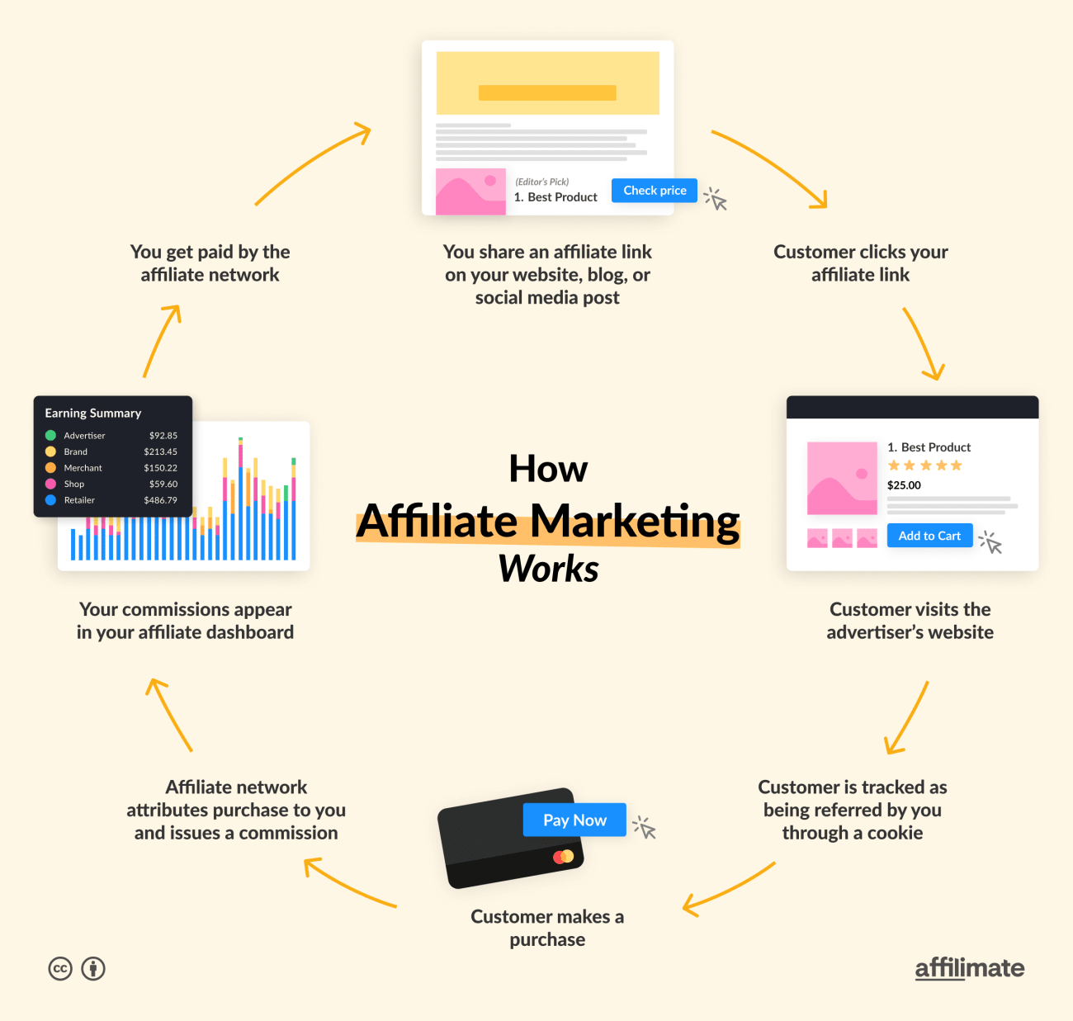
an overview of how affiliate marketing works:
www.midocean.ae

Slide 5
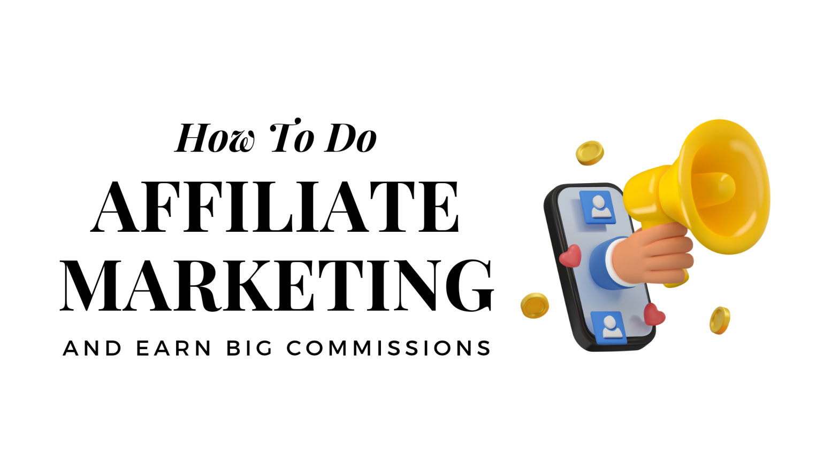
www.midocean.ae
You share an affiliate link on your website, blog, or in a social media post
A customer clicks your affiliate link
Customer is redirected to the advertiser website
Customer is tracked as being referred by you through a cookie
Customer makes a purchase
An affiliate network attributes the purchase to you and issues a commission
Commissions appear in your affiliate dashboard
You get paid (!) by the affiliate network
AN OVERVIEW OF HOW AFFILIATE MARKETING WORKS

Slide 6

www.midocean.ae
There is no single profile for a successful affiliate marketer. They range from independent entrepreneurs to teams at well-known news outlets and online publications.
And since you aren’t responsible for the delivery of a product or service, affiliate marketing is low risk. You don't need a degree in marketing or any specific qualifications to be a successful affiliate marketer. With the right resources, almost anyone can generate affiliate revenue.
the success of an affiliate depends heavily on their ability to capture an audience and attract the right kind of traffic. you need to craft quality content and optimize it for conversion.And it all starts with understanding and creating affiliate links.

Slide 7
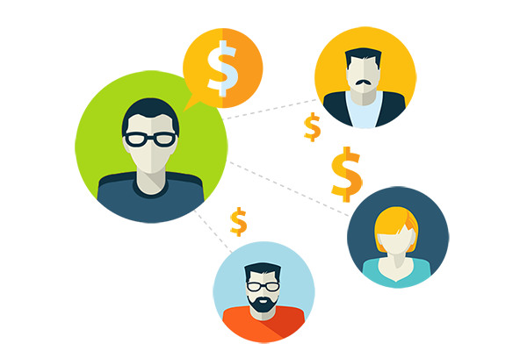
www.midocean.ae
What is an affiliate link?
The main way affiliate marketing works is through affiliate links. Affiliate links are trackable links with a unique URL assigned specifically to you. They help advertisers know that you sent them a specific customer, so they can pay you a commission if that customer makes a purchase.

Slide 8
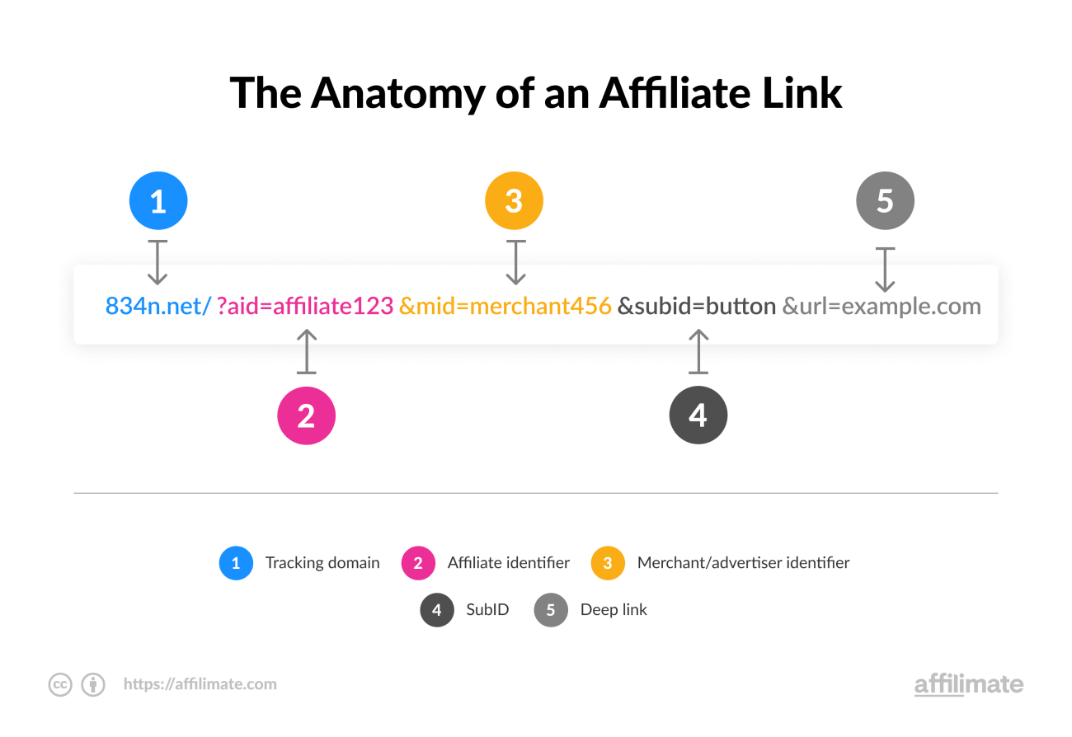
an example of the structure of a typical affiliate link
www.midocean.ae
The most important thing to know is that in order to earn a commission, the customer who converts needs to come through your unique affiliate link. Then there's the way you earn your commissions. For the most part, there are two main models for earning affiliate revenue:

Slide 9

www.midocean.ae
Then there's the way you earn your commissions. For the most part, there are two main models for earning affiliate revenue:
CPA (Cost Per Action): You earn every time someone from your audience completes an action. Depending on the program, the action could be making a purchase, starting a free trial, or filling out a form with contact information.
CPC (Cost Per Click): You get paid for clicks the advertiser considers to be quality visitors, even if they don’t complete a specific action.
Different affiliate programs will offer different payment models, and some may even pay you for both leads and conversions.

Slide 10

www.midocean.ae
a couple more key affiliate marketing terms you should get familiar with. These will also help you pick affiliate programs with a high earning potential:
Cookies: Cookies are small files that are stored on a customer’s device when they click an affiliate link. They help businesses and affiliate networks remember that you referred the customer to them, so they can give you a commission later on.

Slide 11

www.midocean.ae
Cookie duration: Cookies typically have expiration dates. Affiliate links tend to have expiration dates between 15 to 30 days, but they can run for as little as 24 hours up to a year or more. Cookie duration matters to affiliate marketers because customers may come back to a purchase days or weeks after a customer first clicks on an affiliate link.

Slide 12
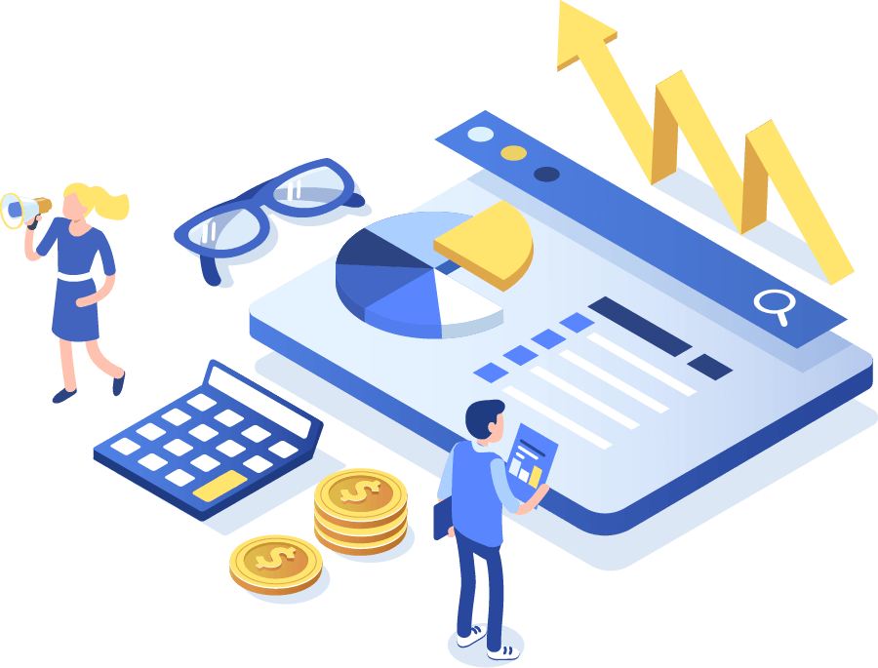
www.midocean.ae
Affiliate networks: Brands typically set up their affiliate programs on third party platforms called Affiliate Networks. These platforms bring brands and affiliate marketers together. There are dozens of affiliate networks, with the most popular including Impact, Flex offers, Click bank

Slide 13

www.midocean.ae
the steps you need to get right from the beginning:
Step 1. Choose a niche based on research
Rushing to catch the latest fads can lead to trouble when these trends end faster than they appear (fidget spinners, anyone?).
Doing niche research is the best thing you can do to make sure your affiliate business has high earning potential and will make money for years to come.
In the process, you'll analyze the competitive landscape, learn about affiliate programs available in your niche, and be able to create a sustainable affiliate marketing strategy and content plan.

Slide 14
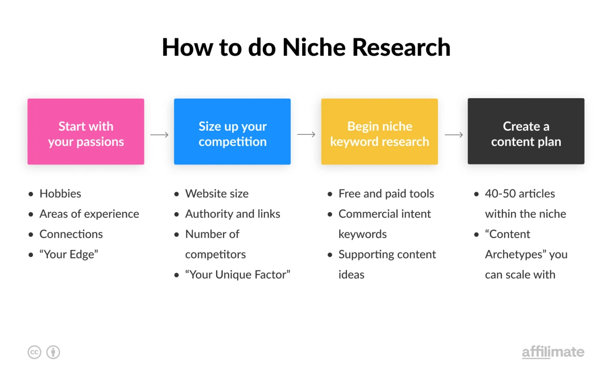
an overview of the niche research process
www.midocean.ae
how to do niche research in 5 steps:
First, you need a niche idea
Size up your competition
Begin niche keyword research
Create a content plan
Evaluate the results (and act!)

Slide 15
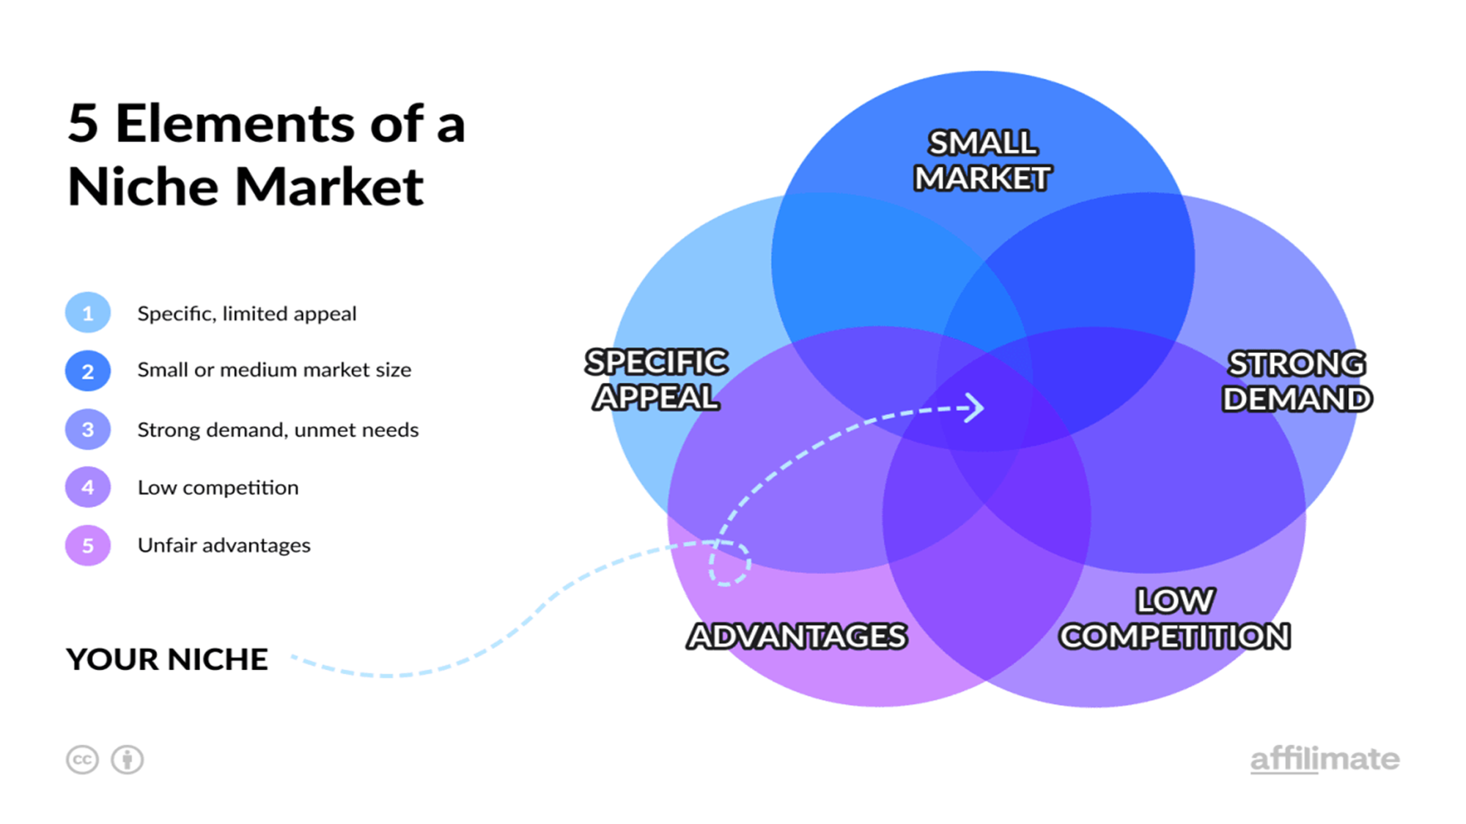
www.midocean.ae
A niche market is a slice of a bigger market, which appeals to a more specific, limited audience whose needs are not met by the broad-market solution.

Slide 16
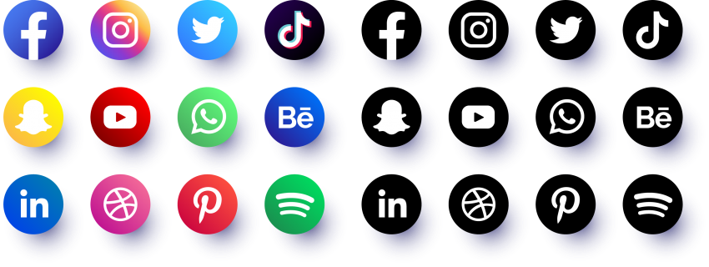
Step 2. Choose the right platform
With a niche in mind, it's time to decide where to host your affiliate content and what type of content you want to create.
There are two main choices for affiliates starting out: a website or a YouTube channel.
YouTube can be an excellent place to grow an audience, build a brand, and promote affiliate products to an audience that trusts your recommendations.
www.midocean.ae

Slide 17
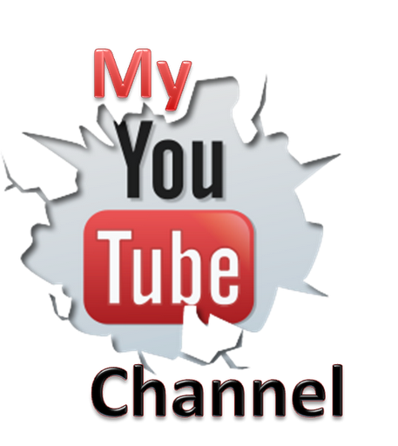
www.midocean.ae
But there are some downsides to starting with only a YouTube channel:
Video takes longer to produce than written content. Which limits the amount of content you can create when starting your project.
Videos are harder to outsource. Especially if you're the face of the channel, it means you'll need to be involved with every video.
Harder to grow your email list. YouTube doesn't have a built-in way to collect email subscribers. Yet email is one of the most effective channels for affiliate marketing.
YouTube channels tend to make less affiliate money. There's simply more friction to getting clicks on your affiliate links from a video compared to a well-optimized blog post.

Slide 18
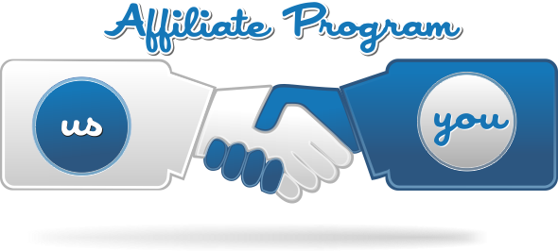
www.midocean.ae
Step 3. Pick profitable affiliate programs
Signing up for affiliate programs is easy. But spreading yourself too thin is one of the top affiliate marketing mistakes beginners make.
You want to start with a finite number of affiliate programs with good commissions, solid conversions, and reliable demand.

Slide 19
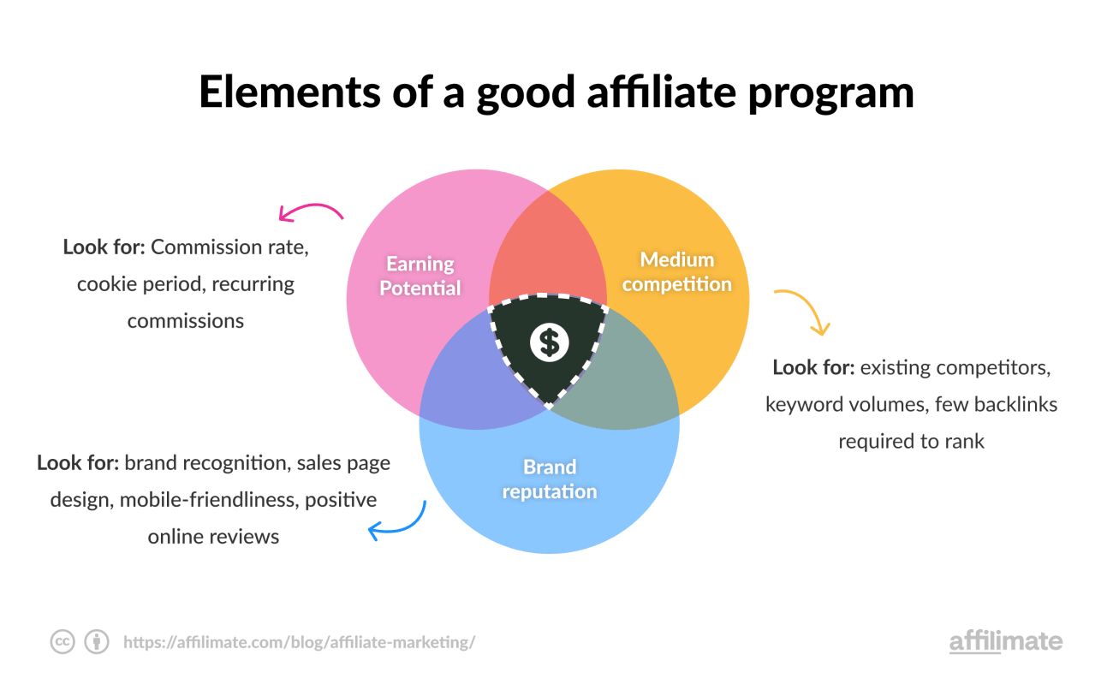
www.midocean.ae
three key ways to pick a good affiliate program:

Slide 20

www.midocean.ae
First, assess earning potential
Affiliate programs vary greatly in terms of payment scale. Some programs offer a few cents per conversion. Others pay out hundreds of dollars for a single lead.
Programs with lower payouts are often easier to join and promote, which makes them appealing but require a higher number of sales for the same amount of revenue.

Slide 21

www.midocean.ae
Second, assess the competition
Some competition can be a good sign. If other people are doing well in the niche, there's a good chance you can too. The easiest way to find competitors is to simply google for the kinds of search terms you'd love your website to show up for.
Then, check which affiliate programs your competitors are promoting most heavily on those pages. Find out what terms they offer, and how to join the program.
This is one of the most effective ways to vet affiliate programs, as long as your competitors are further along than you are.

Slide 22

www.midocean.ae
Third, evaluate brand alignment and reputation
You are building your own brand and image at the same time as you’re promoting the products and services of other businesses. Be selective in choosing who you represent. Working with businesses that don’t align with your brand leads to audience mistrust and harm your brand long term.
You also want to check that the brand you're promoting is likely to convert. That means looking at their sales pages, mobile-friendly design, and other online reviews. Think about what you would consider when buying the product as a consumer.

Slide 23
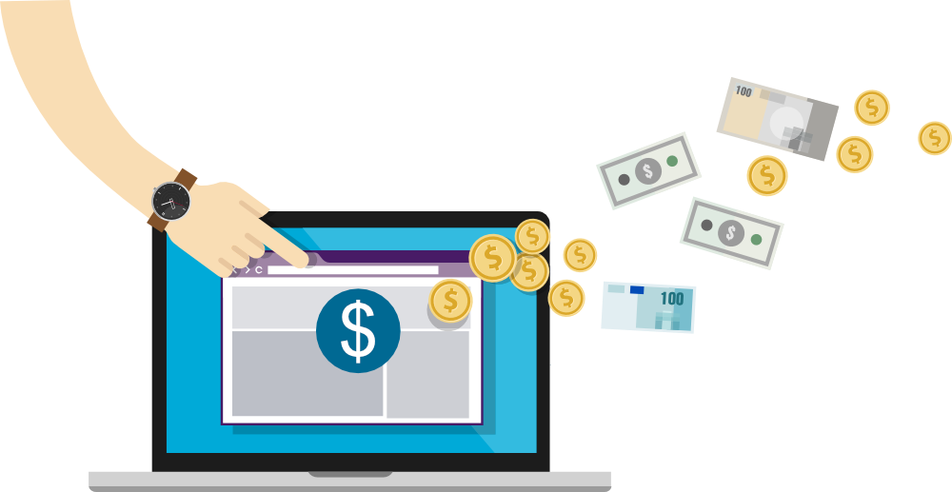
www.midocean.ae
Step 4. Create optimized affiliate content
None of the previous steps matter if you don’t have high-quality content that converts.
Creating content for affiliate marketing is more than simply adding links to an existing blog post. You need to help your audience make a decision on a product or service, directly on your website, through strong copywriting and appealing design.

Slide 24
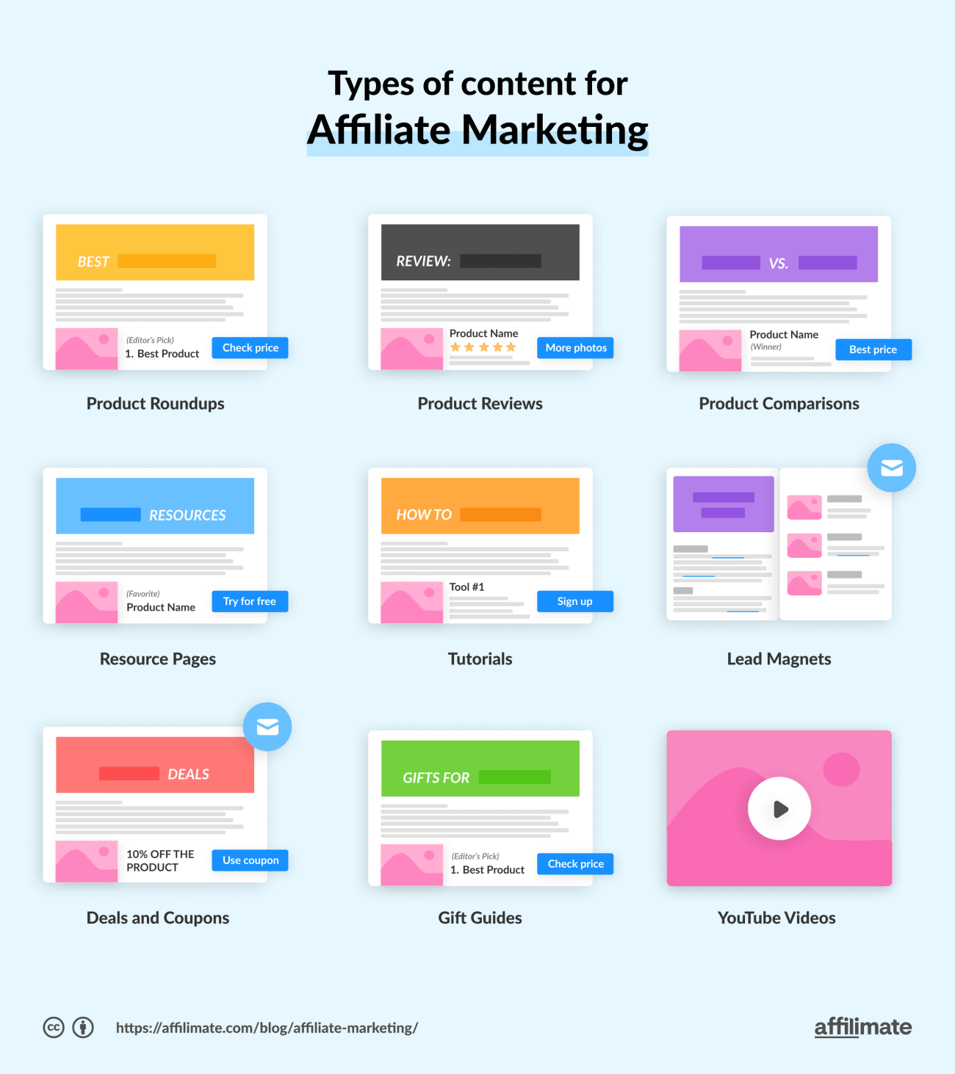
www.midocean.ae
high-converting affiliate marketing content include:

Slide 25

www.midocean.ae
Product reviews: Nearly 97% of consumers look at online reviews before making a purchase decision, so product reviews are a staple amongst affiliate marketers.
Product roundups: Roundups based on a specific theme or category lead different readers to relevant products and diversify your revenue away from a single link.
Product comparisons These are similar to product reviews but place similar products side-by-side to highlight pros and cons. Product comparisons are extremely helpful to orient audiences.

Slide 26
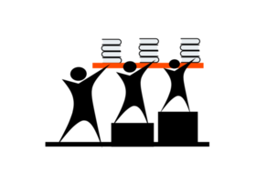
www.midocean.ae
Resource pages: Resource pages are compilations of your favorite tools and resources. Resource pages that focus on solving a problem for your audience won’t be the highest converting pages but will help to present you as an expert to your audience and gather all of your affiliate links in one place.
Tutorials: Tutorials are an opportunity to highlight exactly how a product works in an easy step-by-step process. Customers are likely to trust and buy a product when they can see exactly how it will work for them.

Slide 27

www.midocean.ae
E-books: Topics don’t always fit into a nice blog post or email. This is where eBooks come in. They give you an opportunity to do a deep dive into a topic. As a bonus, you can use the eBook as a lead magnet to build your email list.
Affiliate content also goes by other names, such as commerce content. But no matter what you call it, don't forget to include an affiliate disclosure which informs your audience that you may earn a commission if they buy from your links.

Slide 28
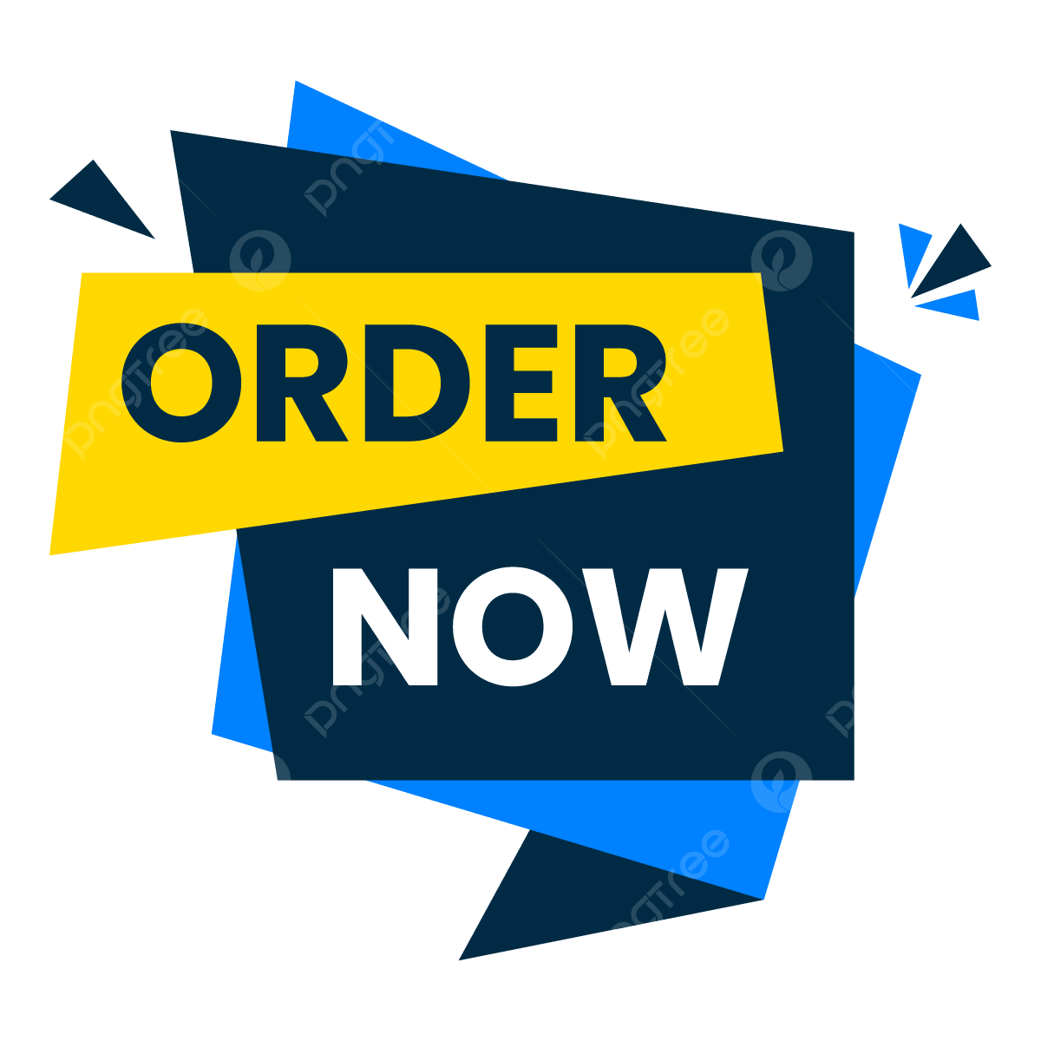
www.midocean.ae
optimize the page for conversion.
Conversion 101 for new affiliates
Here are some of the most important ways you can do that without a ton of complicated plugins.
Button placement: Good button placement and design is particularly important for getting people to respond to your call to action, whether that be to sign up, subscribe, or learn more. Button placement should be noticeable, with CTAs that spark interest like "Read more reviews", "Check the price", and "See more photos".

Slide 29
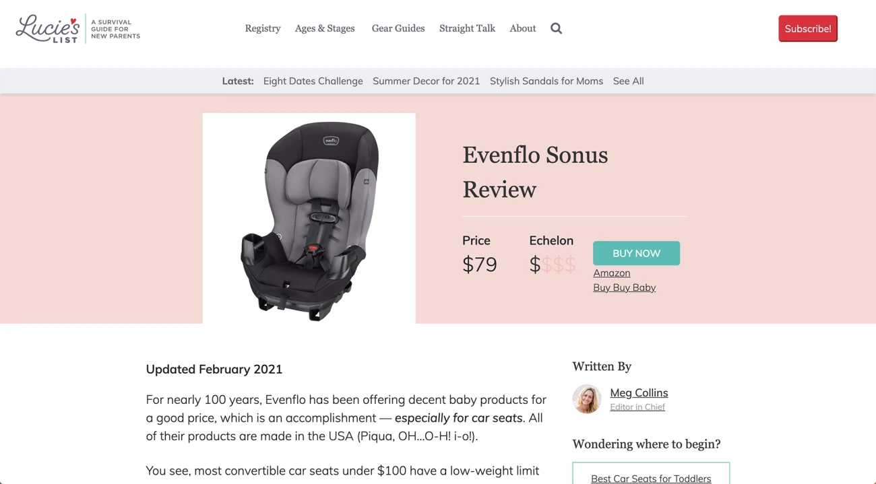
Early buttons in the content make it easy for people who are convinced to scroll to the top and click-through to the affiliate offer.
an example of a product review with a prominent button above the fold of the browser:

Slide 30
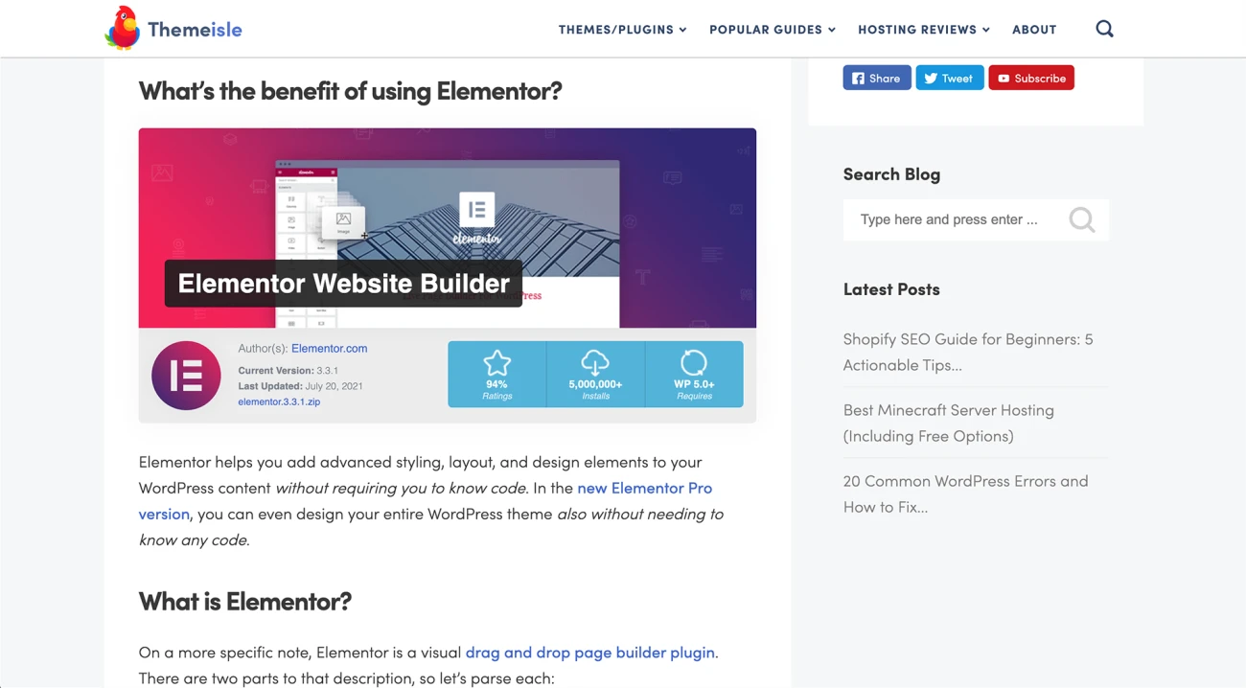
www.midocean.ae
Positive reviews and install count both act as social proof that this product works great.
CALLOUTS: ALSO CALLED TEXT BOXES, THESE VISUALLY SEPARATE IMPORTANT INFORMATION FROM THE REST OF THE BLOG. YOU CAN USE THEM FOR COMPELLING QUOTES OR STATISTICS THAT INFLUENCE YOUR VISITOR'S DECISION IN THEIR BUYER JOURNEY.

Slide 31

www.midocean.ae
Graphs, charts, and comparison tables: As much as quality written content is necessary, visual summaries of information are just as important. Give users a glance overview of key details by including graphs and charts.

Slide 32
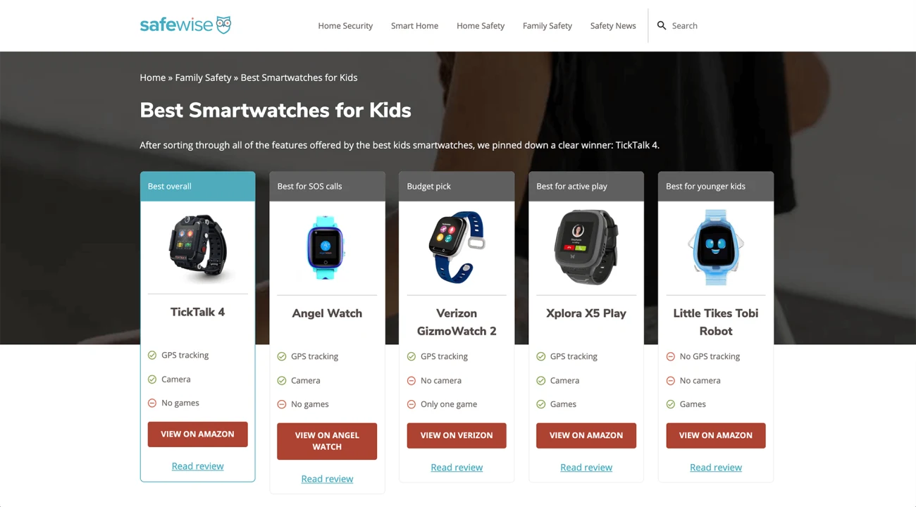
AN EXAMPLE FROM A SITE COMPARING SMART WATCHES FOR KIDS:
www.midocean.ae
Images: People often make purchase decisions based on emotion. Images that reinforce a particular feeling embodied by your content nudge readers towards converting. Even better if you can include photos of the results a product has helped you to achieve.

Slide 33
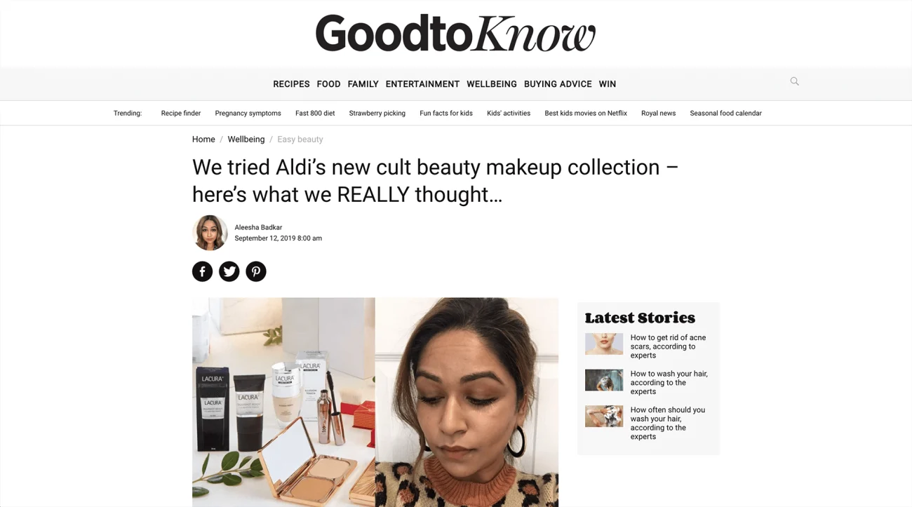
For example, in this makeup review, the author shows themselves trying each product:
www.midocean.ae
Images of the product being used or the results of products help illustrate the benefits.

Slide 34
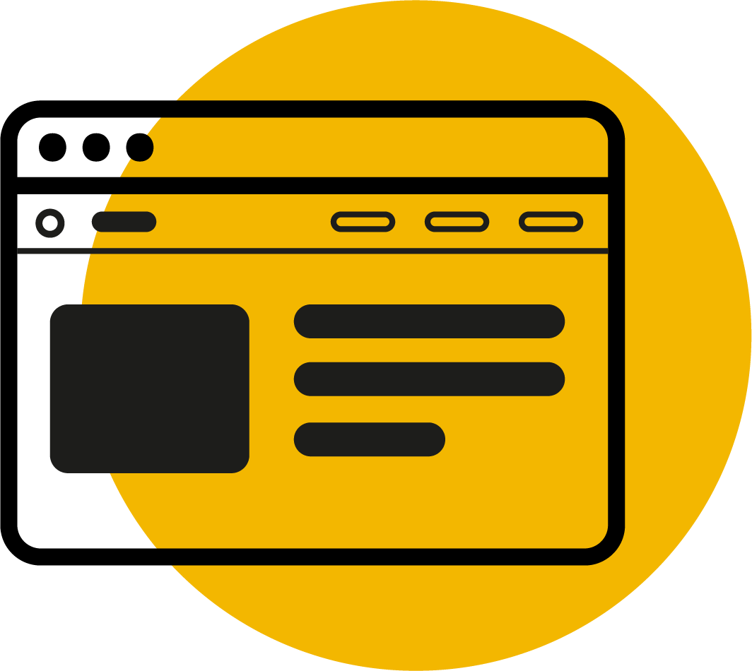
www.midocean.ae
Banners: Banners may be eye-catching and stand out, but they also are easily ignored due to a “banner blindness” and people tend to ignore banners entirely. You can include them, but make sure to have plenty of tasteful text links and buttons — those will be your main conversion drivers.
Popups: Although controversy surrounds popups because they can be annoying, they are also highly effective at converting your readers. Each popup is an opportunity to recapture audience members through strategies like discount codes and limited time offers.
Banner blindness is a phenomenon in web usability where visitors to a website consciously or unconsciously ignore banner-like information.

Slide 35
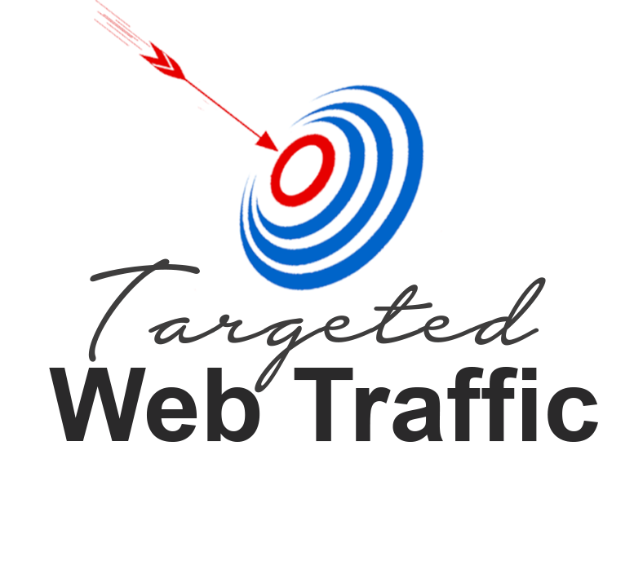
www.midocean.ae
Step 5. Drive traffic to your affiliate site
Now it's time to drive traffic to your carefully selected offer. This can be done through social media platforms, SEO blog posts, and email lists.
The key is you want to either reach people who are looking to buy, or capture their email address to educate and inform readers before prompting the purchase.

Slide 36
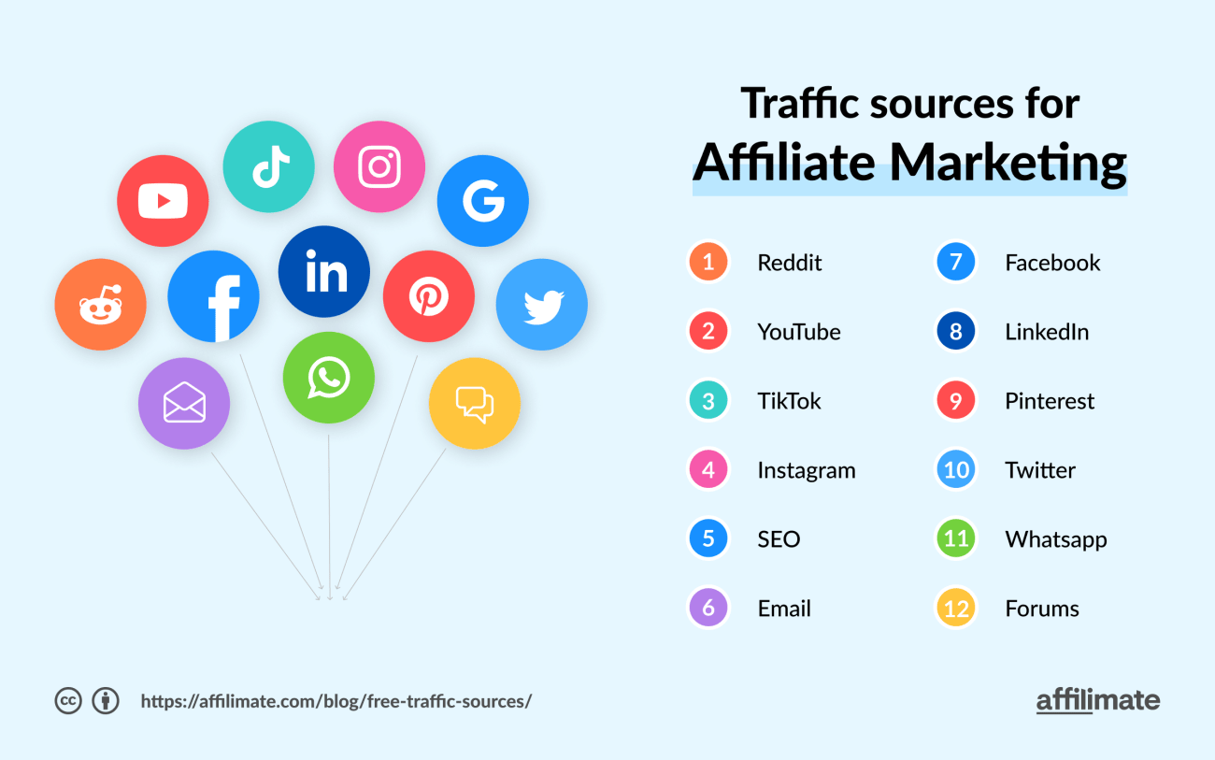
www.midocean.ae
the best free traffic sources for affiliate marketing:

Slide 37
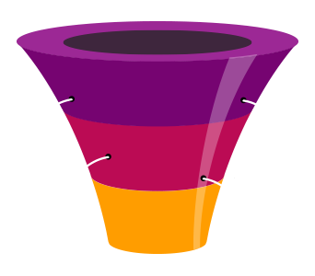
www.midocean.ae
Step 6. Build a simple affiliate marketing funnel
An affiliate marketing funnel is a carefully laid out process that guides users from the start of their buyer journey to the point where they are a repeat customer.
Funnels are critical if you need to take an audience who isn't ready to buy (such as most visitors from Pinterest or other "inspiration"-based channels), and warm them up to your brand and offer.
By using a funnel, the reader sticks with you through all the stages of the buyer's journey. Even if they joined you weeks or months before they're ready to make a purchase.

Slide 38
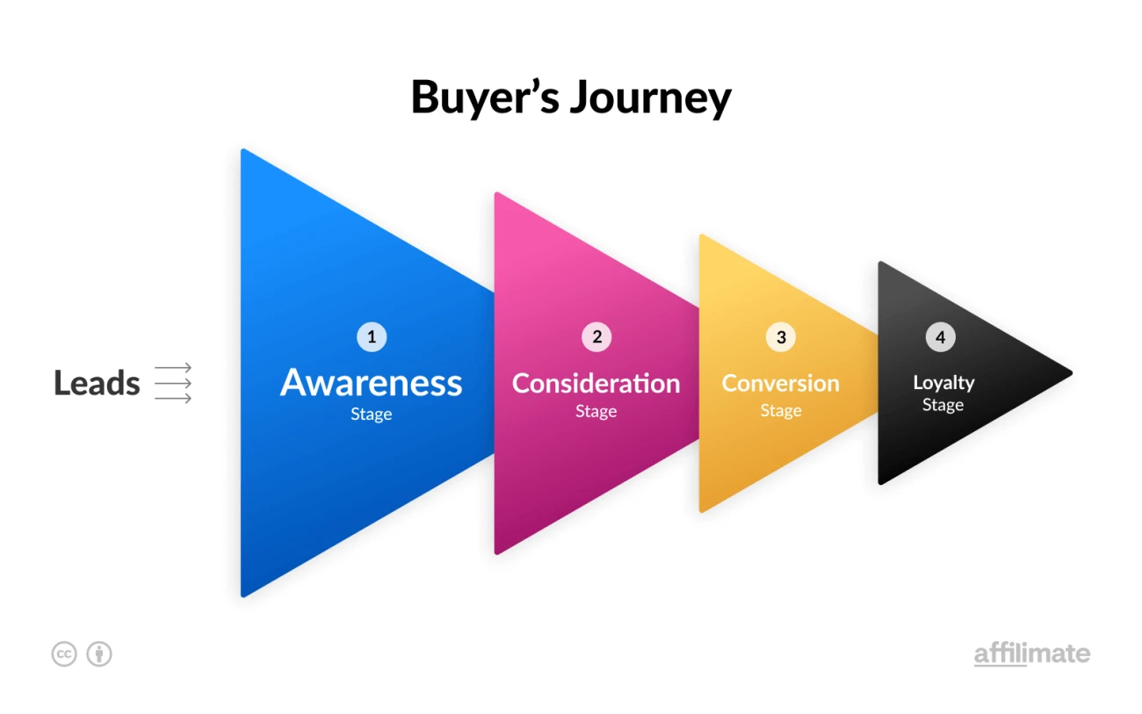
www.midocean.ae
The buyer’s journey consists of four main stages:
Awareness: The prospect notices and identifies their problem
Consideration: The prospect considers possible solutions to their problem
Conversion: The prospect makes a purchase decision and thereby becomes a customer
Loyalty: A positive customer experience leads to trust and repeat purchases

Slide 39

www.midocean.ae
Step 7. Track and increase your affiliate revenue
Finally, it's time to talk tracking.
Proper tracking is one of the most important aspects of successful affiliate marketing.
Giving yourself visibility into what's working and what isn't in your affiliate marketing strategy is what helps you make more money, faster, and with fewer pieces of content.
And there is no better time than the very beginning of your affiliate website to set up a system that will scale with you.

Slide 40
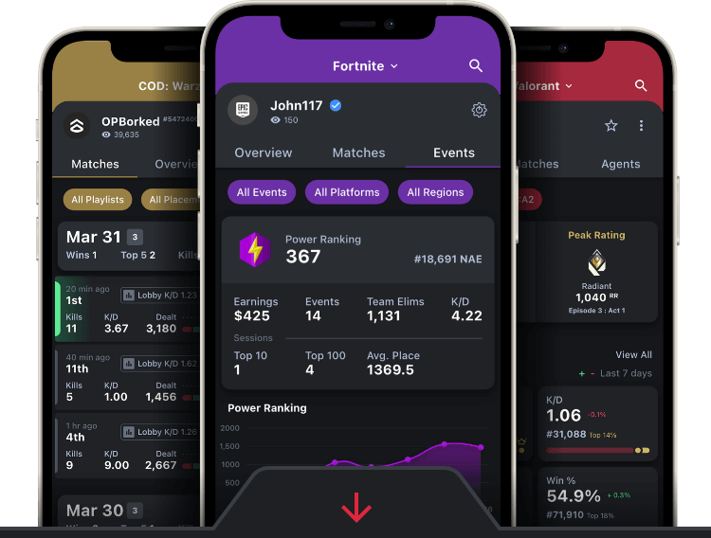
www.midocean.ae
the two main ways to level up your affiliate strategy with tracking:
First, get basic affiliate tracking in place
There are two types of affiliate tracking:
Tracking a network does for you (attributing your sales and telling you which products people bought through your links)
Tracking you have to do for yourself (figuring out which pages, affiliate links, text and visual elements are converting).

Slide 41

www.midocean.ae
summery OF CONTENTS
What is affiliate marketing?
an overview of how affiliate marketing work
What is an affiliate link?
Affiliate networks:
the niche research process
affiliate program
affiliate marketing content
traffic sources

Slide 42



Thank You

