Slide 1


Creative and Scientific Thinking
Prepared by Prof. Shereen Taie
CRE252
Information Technology Department
Lecture 1

Slide 2




Creative and Scientific
Thinking
Lecture 1
CRE252
Information Technology Department
Prepared by
Prof. Shereen Taie
www.midocean.ae

Slide 3
Thinking Scientifically
Chapter
01
www.midocean.ae

Slide 4
Learning Objectives:
Define thinking and scientific thinking
Define Science
State the main goal of Science
Differentiate Science from Technology
Define Scientific Method
Describe the steps in Scientific method
Chapter
01
www.midocean.ae

Slide 5
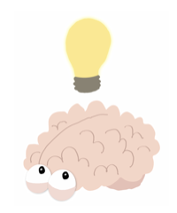
One of the main functions of human mind is
…... THINKING …...
Chapter
01
www.midocean.ae

Slide 6

What is a Thinking?
Thinking is the activity of using your brain by considering a problem, or possibility of creating an idea.
Chapter
01
www.midocean.ae

Slide 7
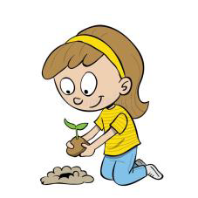
Introduction : The Problem
The Problem
  Everyone thinks ; it is our nature to do so.
  But much of our thinking, is biased, or partial.
  The quality of our life and that of what we produce, make, or build depends precisely on the quality of our thought.
  Shoddy (careless) thinking is costly, both in money and in quality of life.
  Excellence in thought , however, must be systematically cultivated.
Chapter
01
www.midocean.ae

Slide 8
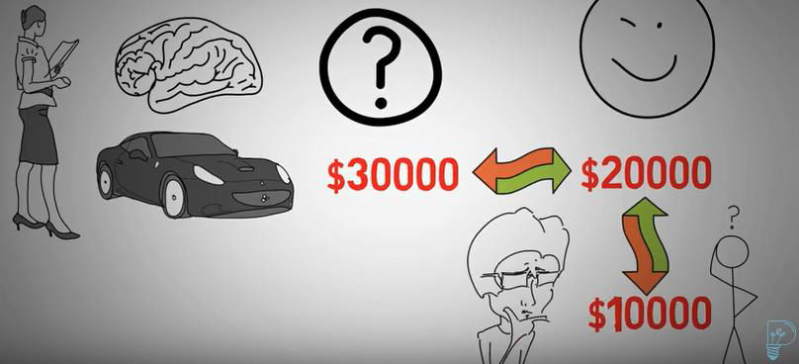
Much of our thinking, is biased, or partial
Chapter
01
www.midocean.ae

Slide 9
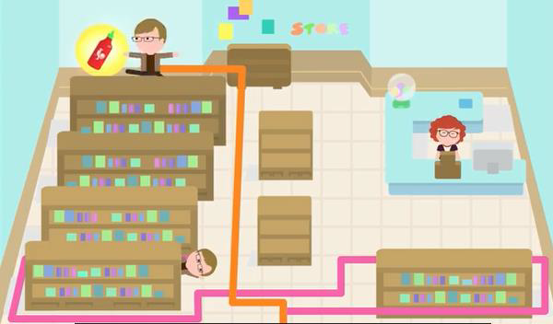
Shoddy (careless) Thinking Is Costly, Both In Money And In Quality Of Life.
Chapter
01
www.midocean.ae

Slide 10


Excellence in thought , however, must be systematically cultivated:
Chapter
01
www.midocean.ae
Notes:
Pursuit: السعي

Slide 11
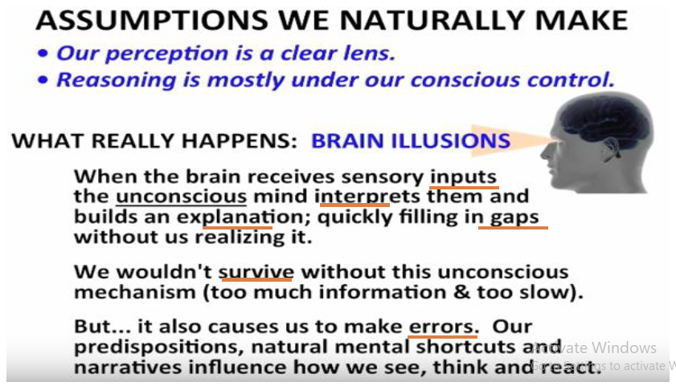
Chapter
01
www.midocean.ae
Notes:
conscious control : التحكم في الإدراك

Slide 12
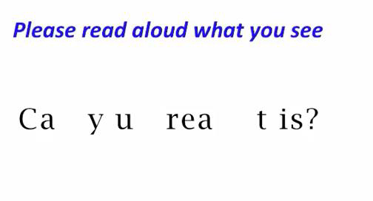
Chapter
01
www.midocean.ae

Slide 13
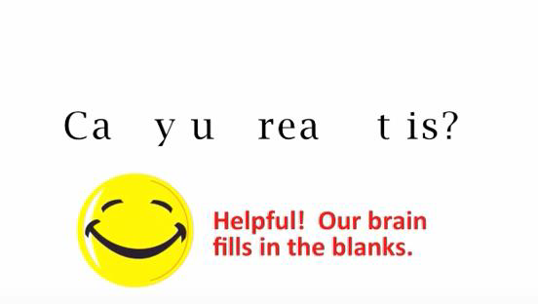
Chapter
01
www.midocean.ae

Slide 14

Chapter
01
www.midocean.ae

Slide 15
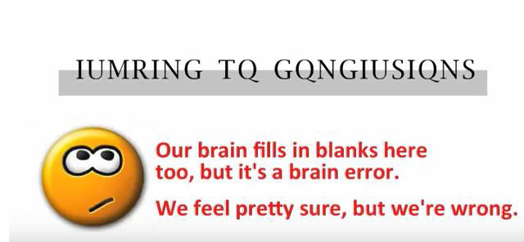
Chapter
01
www.midocean.ae

Slide 16
Introduction : The Solution
Chapter
01
www.midocean.ae

Slide 17
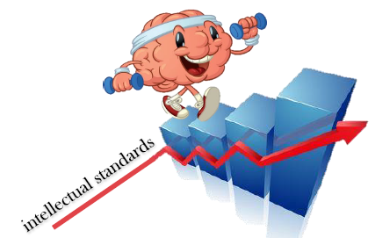
The Solution:
Scientific thinking is that mode of thinking about any scientific subject, content, or problem in which the thinker improves the quality of his or her thinking.
by skillfully taking charge of the structures essential in thinking and imposing intellectual standards upon them.
Chapter
01
www.midocean.ae

Slide 18
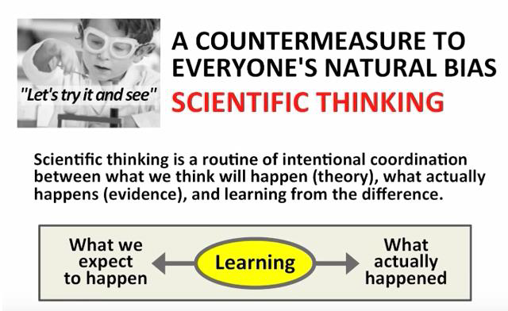
Chapter
01
www.midocean.ae

Slide 19
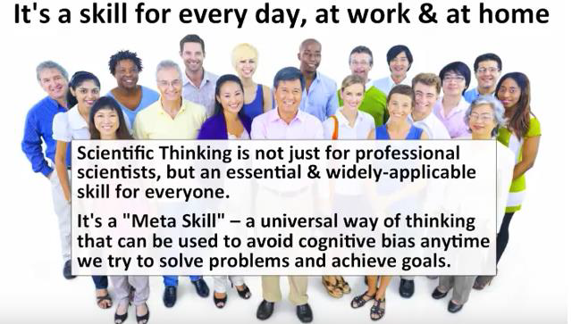
Chapter
01
www.midocean.ae
Notes:
Cognitive: ذهني

Slide 20
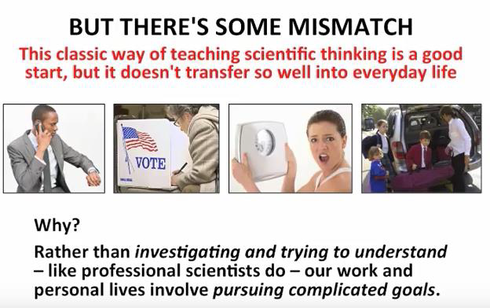
Chapter
01
www.midocean.ae
Notes:
Pursuing: متابعة

Slide 21
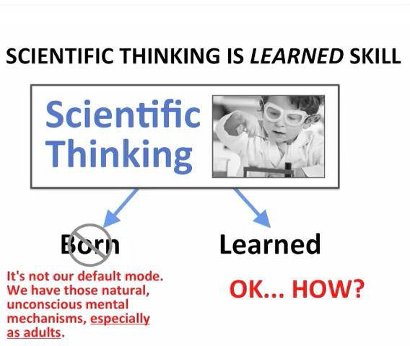
Chapter
01
www.midocean.ae

Slide 22

Chapter
01
www.midocean.ae

Slide 23

Chapter
01
Introduction :The Result
www.midocean.ae

Slide 24
The Result: A well cultivated scientific thinker
Raises vital scientific questions and problems, formulating them clearly and precisely
Gathers and assesses relevant scientific data and information, using abstract ideas to interpret them effectively;
Comes to well reasoned scientific conclusions and solutions, testing them against relevant criteria and standards;
Chapter
01
www.midocean.ae
Notes:
Cultivated : الثقافة

Slide 25
Thinks open mindedly within convergent systems of scientific thought, recognizing and assessing scientific assumptions, implications, and practical consequences; and
Communicates effectively with others in proposing solutions to complex scientific problems.
Chapter
01
www.midocean.ae

Slide 26
Chapter
01
What is a Science?
www.midocean.ae

Slide 27
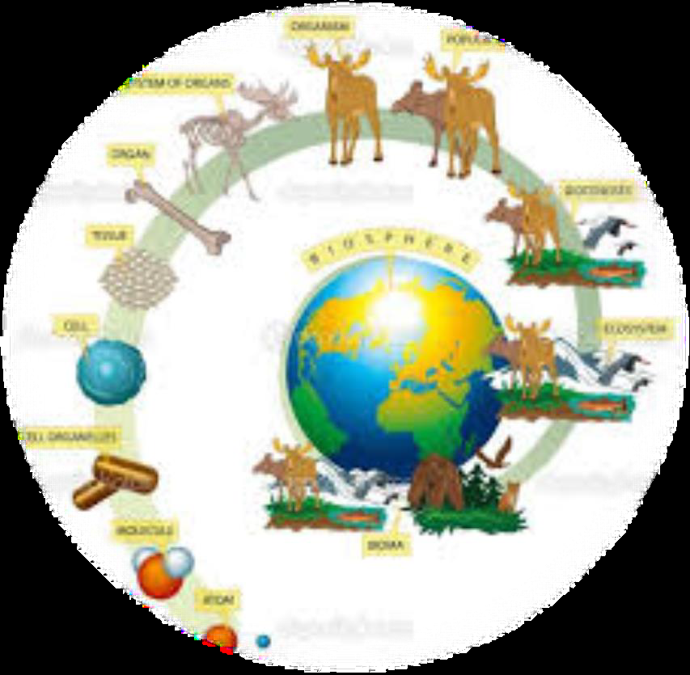
What is a Science?
It is a method used by humans to try to make sense of the world in which they live.
Is derived from the Latin word Scientia for knowledge.
The state of knowledge.
Chapter
01
www.midocean.ae

Slide 28
What is a Science?
Oxford Advanced Learner s Dictionary
• Organized knowledge, especially when obtained by observation and testing of facts, about the physical world, natural laws and society; study leading to such knowledge.
• Branches of such knowledge:
  the natural science, e.g. Biology and geology;
  the physical science, e.g. Physics and Chemistry.
Chapter
01
www.midocean.ae

Slide 29
Chapter
01
Goal of Science
www.midocean.ae

Slide 30
Goal of Science:
• Acquire knowledge about the world.
• To explain the natural world as we observe it as much as possible and to search for ways of applying such knowledge for the benefit of humanity.
Chapter
01
www.midocean.ae

Slide 31
Example:
• The popular phrase “Science tells us that smoking can kill you” really misleads.
• “Science” doesn't tell us anything; people tell us things in this case, people who have used scientific strategies to investigate the relationship of smoking to cancer.
Chapter
01
www.midocean.ae
Notes:
Misleads: يضلل

Slide 32
Chapter
01
Science VS Technology
www.midocean.ae

Slide 33
Technology :
Originates from the Greek word “tekhnologia” and the Latin word “techologia”;
  which means an approach of doing something systematically
Technology is the usage and knowledge of tools, techniques, crafts, systems or methods of organization
Technology is the application of Science to various tasks.
Chapter
01
www.midocean.ae
Notes:
Crafts: الصناعات اليدوية

Slide 34
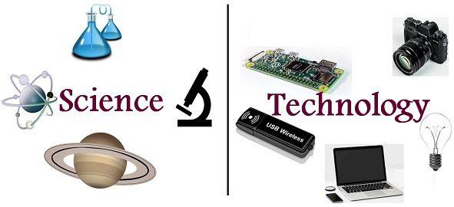
Differentiating Science and Technology
Chapter
01
www.midocean.ae

Slide 35
Differentiating Science and Technology:
Science and Technology are two different terms which have two different
meanings
  • Science is a knowledge that explains natural phenomena.
  • Technology is a field that is closely related to the world created by human to develop systematic ways in controlling either the natural world or the man made world, as well as involving the process of doing something.
Chapter
01
www.midocean.ae

Slide 36
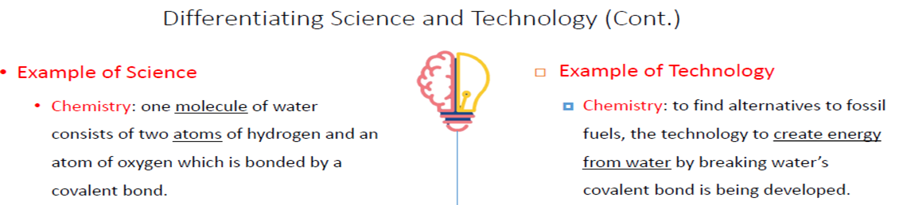
Chapter
01
www.midocean.ae

Slide 37
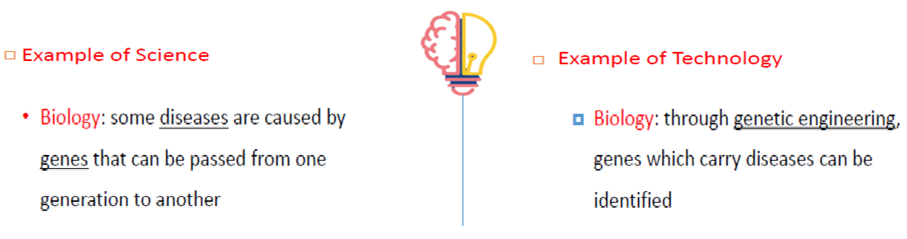
Chapter
01
www.midocean.ae

Slide 38
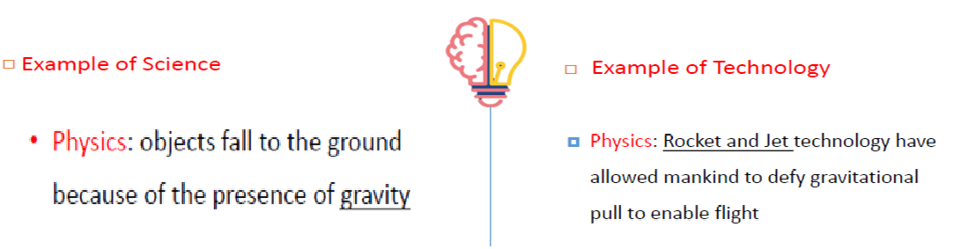
Chapter
01
www.midocean.ae

Slide 39
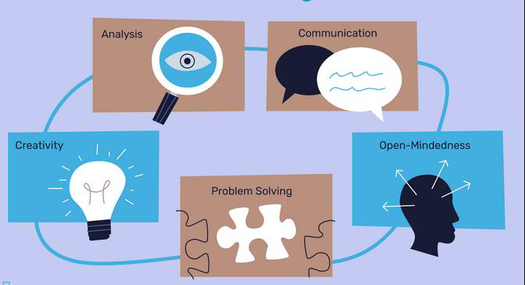
Skills for scientific thinking
Chapter
01
www.midocean.ae

Slide 40




Thank You

