Slide 1


Introduction to Data Analysis
Prepared by Dr. Mohamed Sleem
Subject code : FNT 631
Data Analysis
Lecture 2

Slide 2



Introduction to Data Analysis
Lecture 2
Subject code : FNT 631
Data Analysis
Prepared by
Dr. Mohamed Sleem
www.midocean.ae

Slide 3

Introduces data analysis fundamentals:
Chapter
01
“Data is the new oil” Clive Humby
www.midocean.ae

Slide 4

Chapter
Subject’s Objectives
01
To introduce the foundational concepts underlying data analysis and its significance in diverse fields.
To provide an overview of the applications of data analysis across various domains, illustrating its practical importance.
To elucidate the fundamental terminology and methodologies employed in data analysis, including descriptive statistics, inferential statistics, and data visualization.
To familiarize readers with prevalent data analysis tools and software platforms utilized in research and industry.
To establish a basis for further exploration of advanced data analysis topics in subsequent chapters, thereby facilitating a comprehensive understanding of the subject matter.
www.midocean.ae

Slide 5
Chapter
Data is everywhere
01
Nowadays, everyone has to deal with mounds of data, whether they call themselves “data analysts” or not.
But people who possess a toolbox of data analysis skills have a massive edge on everyone else, because they understand what to do with all that stuff.
They know how to translate raw numbers into intelligence that drives real-world action.
They know how to break down and structure complex problems and data sets to get right to the heart of the problems in their business.
www.midocean.ae

Slide 6
Data defined as factual information used for reasoning, discussion, or calculation.
It can be numerical, textual, or visual and requires interpretation to become meaningful information.
Data collection crucial for setting baselines, identifying actions, setting goals, monitoring progress, and evaluating impacts.

Slide 7
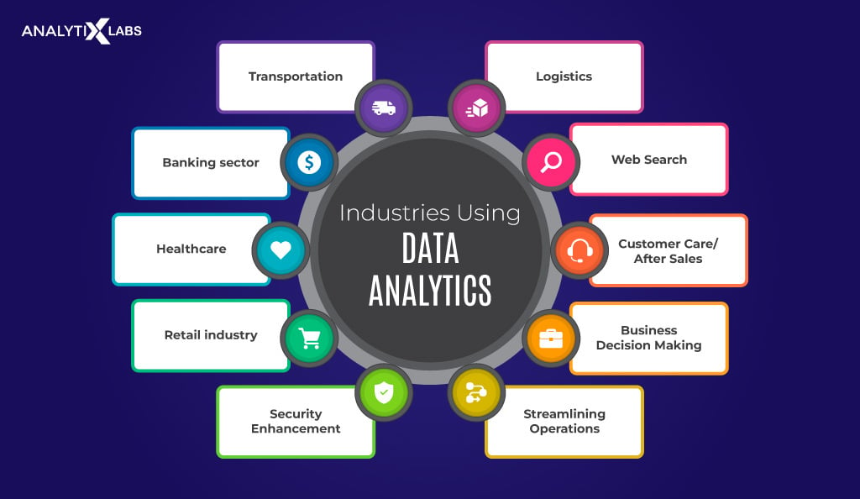

Slide 8
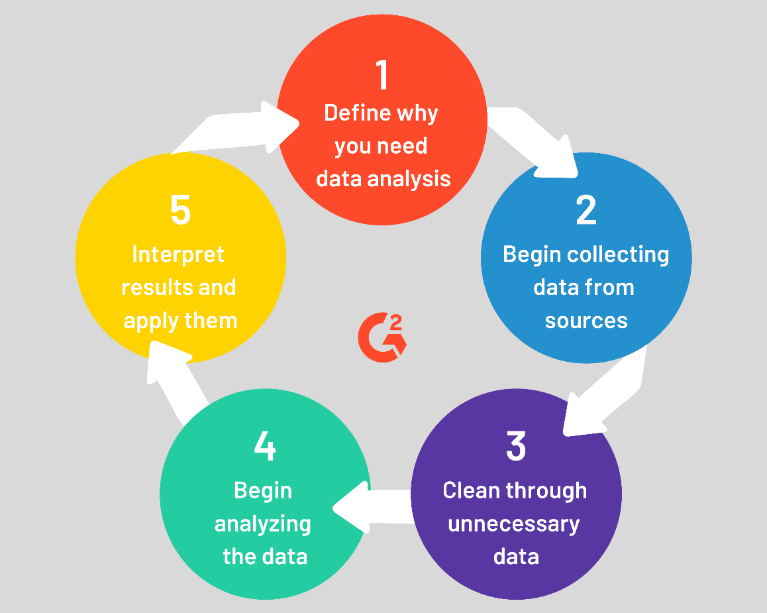

Slide 9
Balancing Quantitative and Qualitative Data
Debate over quantitative vs. qualitative data largely irrelevant; both types necessary for high-quality programs.
Each type has its strengths and should be used based on the questions and purposes at hand.
Combining quantitative and qualitative data can provide a comprehensive understanding and inform decision-making effectively.

Slide 10
Quantitative Data:
Definition: Data expressed in numerical terms, representing specific categories or labels.
  Contrasting Types of Data in the specialized programs.
Qualitative Data:
  Definition: Descriptive data, often non-numeric, providing insights into experiences, opinions, or behaviors.
  Examples: Family Partnership Agreements, Advisory group minutes, Newspaper articles.
www.midocean.ae

Slide 11
Mixed Data:
- Mixed Data:
- Definition: Data containing elements of both qualitative and quantitative information.
- Examples: Enrollment info, Surveys (e.g., Parent, Teacher/Staff, Farmer).
Data Strategies:
- Definition: Various methods for analyzing data, guiding analysts in organizing and interpreting data effectively.
www.midocean.ae

Slide 12
Quantitative Analysis Strategies:
- Examples of Quantitative Analysis Strategies:
1. Descriptive Analysis: Summarizes and describes data using measures of central tendency and dispersion.
2. Inferential Analysis: Draws conclusions and makes predictions based on sample data.
3. Regression Analysis: Examines the relationship between one or more independent variables and a dependent variable.
4. Time-Series Analysis: Analyzes data collected at different points in time to identify patterns or trends.
www.midocean.ae

Slide 13
Cont..:
- Explanation: These strategies provide structured approaches for working with quantitative data, enabling analysts to make sense of the information, draw conclusions, and inform decision-making. They are essential for understanding trends, relationships, and patterns within datasets.
www.midocean.ae

Slide 14
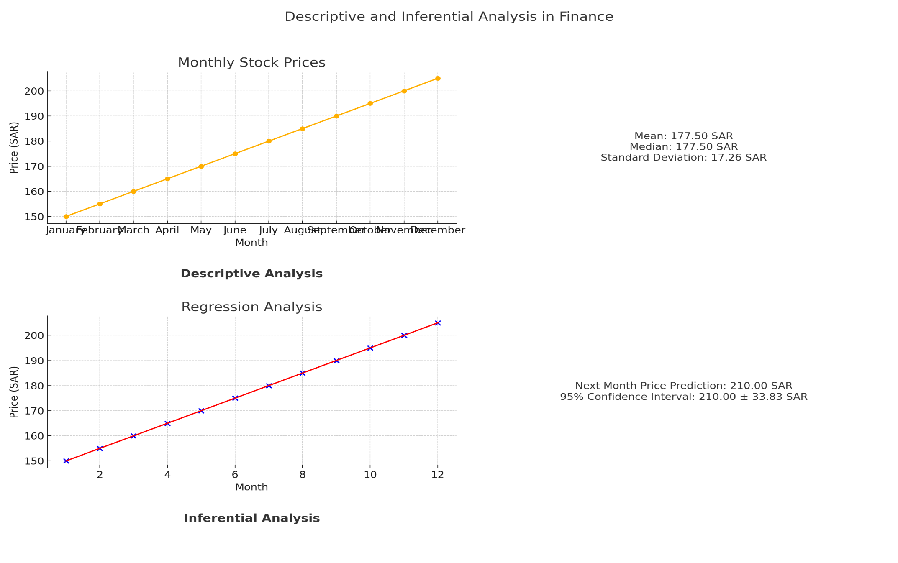
Types of Analysis:
Descriptive Analysis:
  Definition: Summarizes and describes data using measures of central tendency and dispersion.
  Reasons to Consider: Provides an overview of the dataset, revealing patterns and distributions that can inform further analysis.
Inferential Analysis:
  Definition: Draws conclusions and makes predictions based on sample data, extrapolating findings to the larger population.
  Reasons to Consider: Allows for generalization of findings beyond the sample, providing insights into broader trends or phenomena.
www.midocean.ae

Slide 15
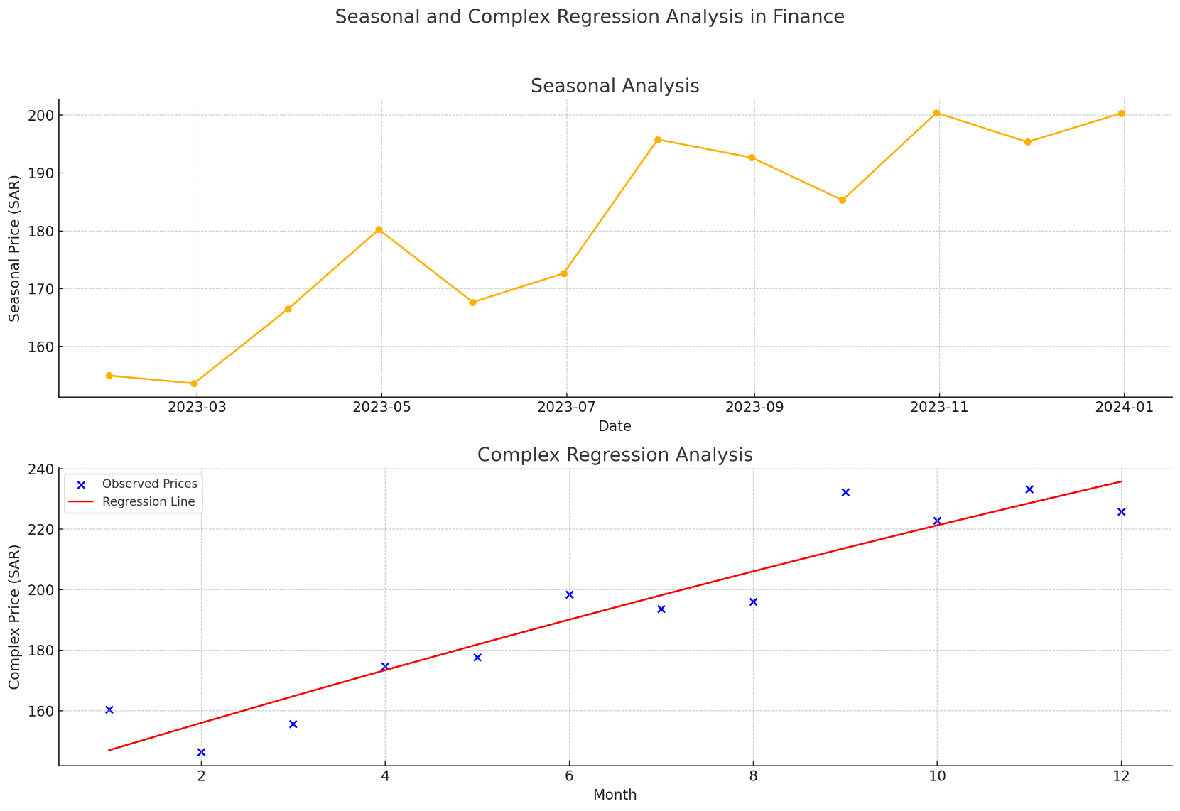
Cont..:
3. Regression Analysis:
  Definition: Examines the relationship between one or more independent variables and a dependent variable.
  Reasons to Consider: Helps understand the influence of independent variables on the dependent variable, enabling prediction and decision-making.
4. Time-Series Analysis:
  Definition: Analyzes data collected at different points in time to
  identify patterns or trends.
  Reasons to Consider: Reveals temporal patterns, such as seasonality
  or trends over time, essential for forecasting and planning.
www.midocean.ae

Slide 16
Data Visualization:
Visualizing Data:
Definition: Visualizing data involves creating and analyzing visual displays of data to gain insights and identify patterns. While it is not a form of analysis, it serves as a useful preliminary step before conducting deeper analysis.
Example: In examining Migrant and Seasonal Head Start (MSHS) funded enrollment across grantees, visualizing the data through bar charts highlights differences. For instance, comparing the sizes of the largest grantees to others in the region provides an initial understanding of enrollment variations.
www.midocean.ae

Slide 17
Exploratory & Trend Analysis:
Exploratory Analysis:
Definition: Exploratory analysis involves examining data when there is limited knowledge about specific indicators or relationships. It aims to understand indicators and potential causes.
Trend Analysis:
Definition: Trend analysis examines data over time to discern patterns or changes in indicators. Comparing indicators across different time periods helps assess their evolution and impact.
www.midocean.ae

Slide 18
Estimation:
Estimation:
Definition: Estimation combines quantitative and qualitative data to project information not directly available. It helps forecast quantities related to demographic characteristics, eligible populations, and social services,
aiding future planning.
Explanation: These analytical approaches—exploratory analysis, trend
analysis, and estimation—provide valuable insights into data. They help
uncover patterns, understand trends, and forecast future outcomes, guiding informed decision-making in various fields. Visualizing data serves as a
precursor to these analyses, offering a visual understanding of the dataset’s
key features.
www.midocean.ae

Slide 19
Linear Data Analysis Process:
Linear Data Analysis Process
Definition: A linear approach to data analysis involves following a fixed sequence of steps from start to finish. Each step is completed before moving on to the next.
Advantages:
  Structured and Organized: The linear process provides a clear structure, ensuring that each component of the analysis is addressed systematically.
  Ease of Learning: The step-by-step nature of the process may make it easier for beginners to understand and follow.
www.midocean.ae

Slide 20
Cont..:
Disadvantages:
  Limited Flexibility: The structured approach may limit the ability to adapt the analysis to changing circumstances or new insights.
  Potential Loss of Analytical Power: Following a strict linear process may constrain creativity and exploration, restricting the depth and breadth of the analysis.
Explanation: The linear data analysis process offers a structured framework for conducting analysis, which can be advantageous for beginners and for ensuring completeness. However, its rigid nature may limit adaptability and the ability to fully explore the data, potentially hindering the effectiveness of the analysis. Finding a balance between structure and flexibility is key to maximizing the insights gained from data analysis.
www.midocean.ae

Slide 21
Data Analysis as a Cyclical Process:
Data Analysis as a Cyclical Process
- Definition: A cyclical approach to data analysis allows for flexibility in decision-making and includes various types of decisions. It emphasizes iterative cycles of analysis rather than a fixed linear sequence.
- Advantages:
- Flexibility: Program staff are not restricted to working on each step in a predetermined order, allowing for adaptability to changing circumstances.
- Learning by Doing: Staff can learn and improve the analysis process through iterative cycles, making adjustments as needed before completion.
- Inclusive of Different Decisions: This approach includes a broader range of decisions and allows for different components of the analysis to be worked on at different times.
www.midocean.ae

Slide 22
Cont..:
- Disadvantages:
- Complexity: The cyclical approach may be more complex to manage, requiring careful coordination and integration of different analysis cycles.
- Potential for Disorganization: Without clear guidance, there is a risk of becoming disorganized or losing focus during the iterative process.
www.midocean.ae

Slide 23
Effective data analysis :
What Do We Do? & Why?
An effective data analysis process is tailored to the organization's mission and team's skills, adding value to services and practices. Compliance with standards like Head Start Program Performance Standards (HSPPS) ensures consistency and guides question formulation, the initial step in the process.
www.midocean.ae

Slide 24
Cont..:
Process Component 2. Question(s): What Do We Want To Know?
- Purpose: Establish specific questions to guide data collection and analysis.
- Importance: Forms the basis for decision-making on data collection and analysis methods.
- Types of Questions: Close-ended (e.g., compliance with mandates) or open-ended (e.g., improving parent involvement).
- Data Collection: Different types of questions require different data collection methods.
- Planning: Based on the questions' scope, programs create a plan for managing and organizing data collection.
- Future Evaluation: Formulating specific questions enables ongoing evaluation and improvement of the data analysis process.
www.midocean.ae

Slide 25
Cont..:
What Information Can Help Us Answer Our Question(s)?
Data collection is a critical process that involves gathering information from various sources such as observations, questionnaires, interviews, documents, tests, and more. Selecting the right questions to examine is essential, as it forms the basis for an effective data collection plan.
- Types of Data Sources: Observations, questionnaires, interviews, documents, tests, and others.
- Importance of Question Selection: The wording of questions lays the foundation for effective data collection.
- Common Pitfalls: Too little data, excessive data, or irrelevant data.
www.midocean.ae
Notes:
ما هي المعلومات التي يمكن أن تساعدنا في الإجابة على أسئلتنا؟
جمع البيانات
جمع البيانات هو عملية حاسمة تتضمن جمع المعلومات من مصادر متنوعة مثل الملاحظات، الاستبيانات، المقابلات، الوثائق، الاختبارات، وغيرها. اختيار الأسئلة المناسبة للفحص هو أمر أساسي، حيث يشكل أساس خطة جمع البيانات الفعالة.
أنواع مصادر البيانات:
1. الملاحظات:
- مثال: مراقبة سلوك الطلاب في الفصل لتقييم المشاركة.
- استخدامها: يمكن أن تكون مفيدة للحصول على بيانات مباشرة وغير منحازة حول السلوك والأنشطة.
2. الاستبيانات:
- مثال: استطلاع آراء الموظفين حول رضاهم عن بيئة العمل.
- استخدامها: يمكن أن تجمع كميات كبيرة من البيانات بشكل فعال وسريع.
3. المقابلات:
- مثال: مقابلة العملاء لمعرفة تجربتهم مع المنتج.
- استخدامها: تتيح جمع بيانات عميقة ونوعية يمكن أن توفر رؤى أكثر تفصيلًا.
4. الوثائق:
- مثال: مراجعة التقارير المالية لتقييم الأداء المالي للشركة.
- استخدامها: توفر معلومات تاريخية وموثقة يمكن الاعتماد عليها.
5. الاختبارات:
- مثال: اختبار مستوى المعرفة لدى الطلاب بعد دورة تدريبية.
- استخدامها: تساعد في قياس الأداء والقدرات بشكل موضوعي.
6. مصادر أخرى:
- مثال: سجلات الأنشطة، وسائل التواصل الاجتماعي، تقارير السوق.
- استخدامها: توفر بيانات متنوعة من زوايا مختلفة يمكن أن تعزز التحليل.
أهمية اختيار الأسئلة:
- صياغة الأسئلة بدقة: صياغة الأسئلة بشكل جيد هو أمر بالغ الأهمية لأن الصياغة الواضحة والدقيقة تساعد في جمع بيانات دقيقة وذات صلة.
- مثال عملي: إذا كان الهدف هو تحسين رضا العملاء، فإن سؤال "ما مدى رضاك عن خدمة العملاء لدينا؟" يكون أكثر فائدة من سؤال عام مثل "كيف تشعر بشأن شركتنا؟".
المخاطر الشائعة:
1. قليل جدًا من البيانات:
- الشرح: جمع بيانات غير كافية يمكن أن يؤدي إلى نتائج غير دقيقة أو غير موثوقة.
- الحل: التأكد من تغطية جميع الجوانب الهامة للموضوع من خلال جمع كمية كافية من البيانات.
2. كميات كبيرة جدًا من البيانات:
- الشرح: جمع بيانات كثيرة جدًا يمكن أن يسبب تعقيدًا غير ضروري ويجعل التحليل صعبًا.
- الحل: تحديد الأسئلة الأكثر أهمية وتركيز الجهود على جمع البيانات ذات الصلة فقط.
3. البيانات غير ذات الصلة:
- الشرح: جمع بيانات غير ذات صلة يمكن أن يضيع الوقت والموارد دون تقديم رؤى مفيدة.
- الحل: التأكد من أن جميع البيانات التي يتم جمعها مرتبطة مباشرة بالأسئلة المطروحة والأهداف المحددة للتحليل.
التخطيط لجمع البيانات:
- إنشاء خطة جمع البيانات:
- الشرح: التخطيط الجيد لجمع البيانات يتضمن تحديد الأهداف، واختيار الأسئلة المناسبة، وتحديد المصادر والأدوات التي سيتم استخدامها.
- مثال عملي: إذا كان الهدف هو تحسين أداء الموظفين، فإن خطة جمع البيانات قد تتضمن استبيانات للموظفين، مقابلات مع المديرين، ومراجعة سجلات الأداء السابقة.
التقييم المستقبلي:
- التقييم المستمر:
- الشرح: من خلال التقييم المستمر للبيانات والأسئلة، يمكن تحسين عملية التحليل بشكل مستمر.
- مثال عملي: بعد تحليل البيانات المجمعة، قد يكتشف الفريق أن بعض الأسئلة تحتاج إلى تعديل للحصول على بيانات أكثر دقة وذات صلة.
الخلاصة:
جمع البيانات الفعال يعتمد على اختيار الأسئلة المناسبة وتحديد المصادر المثلى للحصول على البيانات. من خلال تجنب المخاطر الشائعة وإنشاء خطة جمع بيانات محكمة، يمكن للشركات ضمان جمع بيانات دقيقة وذات صلة تدعم اتخاذ قرارات مستنيرة وفعالة. التقييم المستمر للعملية يضمن تحسينها بشكل مستمر لتحقيق أفضل النتائج.

Slide 26
Data Collection..:
Key Considerations for Data Collection Plan:
- Types of data most appropriate for answering the questions.
- Amount of data needed.
- Personnel responsible for data collection.
- Timing and location of data collection.
- Data compilation and storage methods.
www.midocean.ae

Slide 27
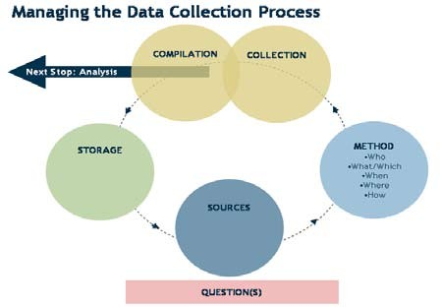
www.midocean.ae

Slide 28
Before Data Collection..:
Process Component 4. Data Analysis:
Once data are collected, the next step is to analyze them using various procedures or methods to obtain results. The analysis is influenced by the nature of the questions and the collected data. Matching analytical procedures with data involves judgment and reflection.
Process Component 5. Interpretation:
Interpreting the results involves presenting and understanding their meaning. Results may speak for themselves or require additional context. Findings, agreed upon by the data analysis team, represent the main results disseminated to stakeholders.
www.midocean.ae

Slide 29
Cont..:
Process Component 6: Writing, Reporting & Dissemination:
After analysis and interpretation, programs decide how to write, report, and disseminate findings. Good writing is structured, strategic, and tailored to the audience. It presents the story of the data collected, analyzed, and interpreted, informing stakeholders of discoveries.
www.midocean.ae

Slide 30
Cont..:
Process Component 7. Evaluation:
The final step of the data analysis process involves evaluating the preceding steps. Program staff reflect on the purpose, questions, data collection, analysis methods, interpretation, and reporting to ensure consistency, effectiveness, and compliance with regulations.
Purpose: Was the process consistent with federal standards and other regulations?
Questions: Were they effective in guiding data collection and analysis?
www.midocean.ae

Slide 31
Important Questions..:
Data Collection: Was the plan effective? Were enough data collected? Were sources utilized effectively?
Analysis Methods: Did they align with the purpose and questions? Were there alternative methods?
Interpretation: How well did the team interpret results? Was relevant information used?
Reporting: Did the writing effectively convey the data story? Was the audience engaged?
Data analysis is a decision-making process based on meaningful information obtained from collected data, crucial for informed program planning and implementation.
www.midocean.ae

Slide 32
Data Analysis Process Management ..:
Developing a Team:
Director’s Role:
  The director ensures data analysis is completed and implemented effectively.
Active Participation:
  Staff, including policy council and board members, actively participate in data collection and analysis.
Stakeholder Involvement:
  Form a data analysis team with representatives from staff, parents, board members, policy council, and the community.
www.midocean.ae

Slide 33
Cont..:
- Teaming Models: Utilize existing committees or establish a special data analysis team for comprehensive analysis.
- Team Approach: Distribute tasks among team members to strengthen the process and match responsibilities with individual abilities.
- Regular Meetings: Schedule meetings to discuss progress, with experienced members mentoring others on the team.
Training and Engagement:
- Training: Ensure all team members are trained in data analysis procedures.
www.midocean.ae

Slide 34
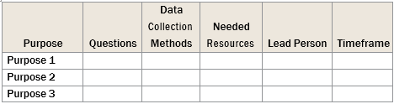
Planning:
Planning
Planning is crucial for a successful data analysis process. Develop a detailed plan outlining the purpose, questions, data collection methods, resources, lead person, and timeline.
Sample Planning Table:
www.midocean.ae

Slide 35
Key Points:
- Priority: Give priority to the data analysis process amidst other tasks.
- Resource Identification: Identify necessary resources such as translation services, clerical support, and meeting scheduling.
- Consultation with Policy Council: Discuss the plan with the Policy Council before implementation and solicit ideas and assistance.
www.midocean.ae

Slide 36
Cont..:
- Communication Strategy: Include a strategy for updating the Board of Directors, Policy Council, and other key stakeholders on the progress of the data analysis process.
- Team Training: Ensure all team members are oriented and trained to understand the importance of data analysis in providing services to migrant and seasonal children and families.
www.midocean.ae

Slide 37

www.midocean.ae
Conclusion..:
Today, we explored the importance of tailored data analysis processes, starting with question formulation and proceeding through data collection, analysis, interpretation, and reporting. Effective management involves team development, planning, and stakeholder engagement, ensuring meaningful insights drive program decisions.
Chapter
01
Summary of chapter
www.midocean.ae

Slide 38
Review Questions:
What is the difference between quantitative data and qualitative data?
What are the four strategies of data analysis?
Data analysis is a cyclical process “explain”.
Chapter
www.midocean.ae

Slide 39



Thank You

