Slide 1


DIGITAL MEDIA ETHICS
DGM 723
Prepared by:
Dr. Sherihan Mohamed
Lecture 8

Slide 2



DMG 723
DIGITAL MEDIA ETHICS
Chapter 4
Friendship, Slow/Fair Technology, and Democracy
Prepared by:
Dr. Sherihan Mohamed

Slide 3

Lecture 7
Remember:
** Democracy, Freedom and Truth at a Time of Digital Disruption:
- Freedom of information and freedom of expression: a conceptual and legal framework.
** “Information, the key to democracy”:
- Media at the intersection of democratic culture and technological progress.
- Information and the need for truth.

Slide 4
Lecture 8
Outlines:
** Fake news on Social Media: the Impact on Society:
- What is Fake News?
- Fake News Spread, and Social Media
- Contributors of fake news.
** Five types of misinformation:
1- Satire. 2- False context. 3- Imposter content.
4- Fabricated content. 5- Manipulated content.

Slide 5

Fake news on Social Media:
the Impact on Society
Lecture 8

Slide 6
Lecture 8
Fake news on Social Media: the Impact on Society
What is fake news?
Fake news is the deliberate spread of misinformation via traditional news media or via social media. False information spreads extraordinarily fast. This is demonstrated by the fact that, when one fake news site is taken down, another will promptly take its place. In addition, fake news can become indistinguishable from accurate reporting since it spreads so fast.

Slide 7
People can download articles from sites, share the information, re-share from others and by the end of the day the false information has gone so far from its original site that it becomes indistinguishable from real news.
False information can deceive people by looking like trusted websites or using similar names and web addresses to reputable news organisations.

Slide 8
Lecture 8
Fake news on Social Media: the Impact on Society
Lots of things you read online especially in your social media feeds may appear to be true, often is NOT.
False information is news, stories or hoaxes created to deliberately misinform or deceive readers. Usually, these stories are created to either influence people’s views, push a political agenda or cause confusion and can often be a profitable business for online publishers.

Slide 9
Many people now get news from social media sites and networks and often it can be difficult to tell whether stories are credible or not. Information overload and a general lack of understanding about how the internet works by people has also contributed to an increase in fake news or hoax stories. Social media sites can play a big part in increasing the reach of these type of fake stories.

Slide 10
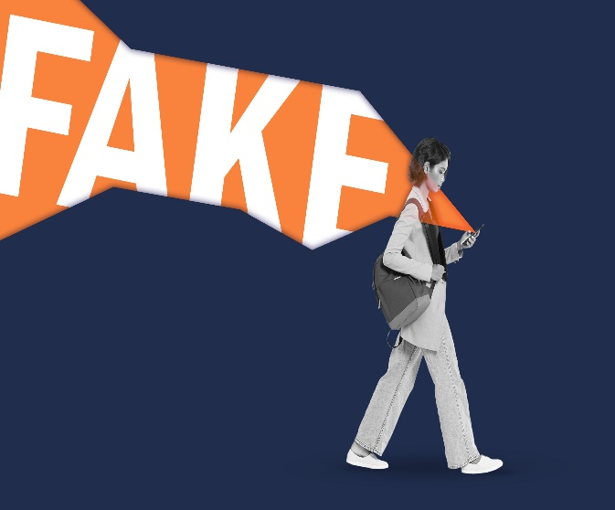
Lecture 8
Fake news on Social Media: the Impact on Society
False information is not new, however it has become a hot topic since 2016. Traditionally we got our news from trusted sources, journalists and media outlets that are required to follow strict ethical codes of practice. However, the internet has enabled a whole new way to publish, share and consume information and news with very little regulation or editorial standards.

Slide 11
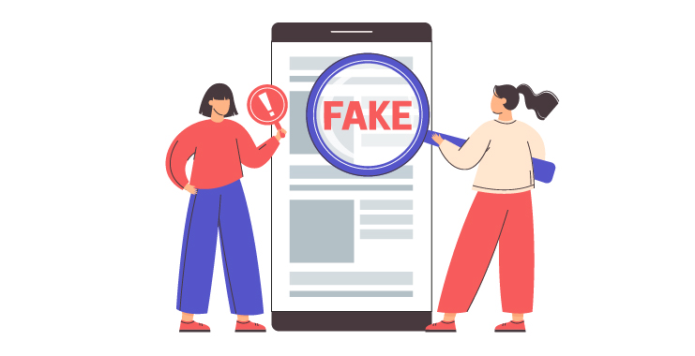
Using social media as a medium for news updates is a double-edged sword. On one hand, social media provides for easy access, little to no cost, and the spread of information at an impressive rate.

Slide 12
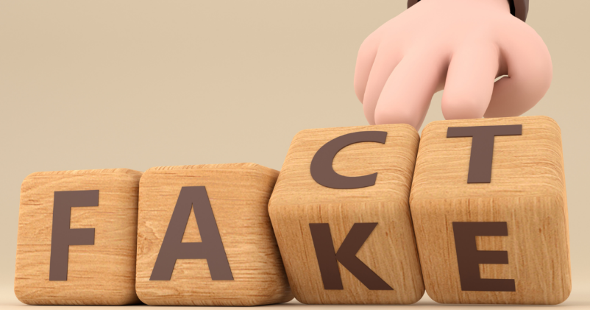
Lecture 8
Fake news on Social Media: the Impact on Society
However, on the other hand, social media provides the ideal place for the creation and spread of fake news. Fake news can become extremely influential and has the ability to spread exceedingly fast.
With the increase of people using social media, they are being exposed to new information and stories every day.

Slide 13
Misinformation can be difficult to correct and may have lasting implications.
For example, people can base their reasoning on what they are exposed to either intentionally or subconsciously, and if the information they are viewing is not accurate, then they are establishing their logic on lies.

Slide 14
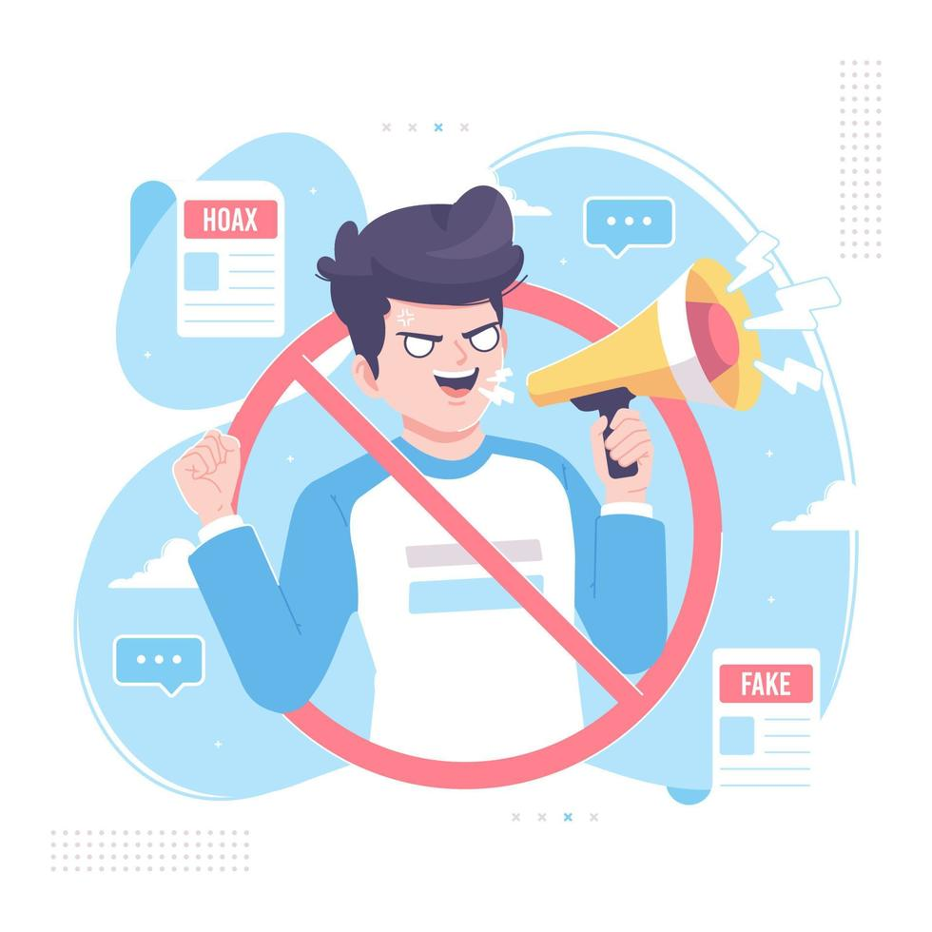
Lecture 8
Fake news on Social Media: the Impact on Society
In addition, since false information is able to spread so fast, not only does it have the ability to harm people, but it can also be detrimental to huge corporations and even the stock market.

Slide 15
The biggest reason why false information is able to thrive continuously is that humans fall victim to Truth-Bias.
When referring to people being naturally “truth-biased” this means that they have “the presumption of truth” in social interactions, and “the tendency to judge an interpersonal message as truthful, and this assumption is possibly revised only if something in the situation evokes suspicion”.

Slide 16
Lecture 8
Fake news on Social Media: the Impact on Society
Basically, humans are very poor lie detectors and lack the realization that there is the possibility they are being potentially lied to.
Users of social media tend to be unaware that there are posts, tweets, articles or other written documents that have the sole purpose of shaping the beliefs of others in order to influence their decisions.

Slide 17

Information manipulation is Not a well-understood topic and generally not on anyone’s mind, Especially when fake news is being shared by a friend. Users tend to let their guard down on social media and potentially absorb all the false information as if it were the truth.

Slide 18
Lecture 8
Fake news on Social Media: the Impact on Society
This is also even more detrimental considering how young users tend to rely on social media to inform them of politics, important events, and breaking news.
For instance, “62% of U.S. adults get news on social media in 2016, while in 2012, only 49% reported seeing news on social media” which demonstrates how more and more people are becoming tech savvy and relying on social media to keep them updated.

Slide 19
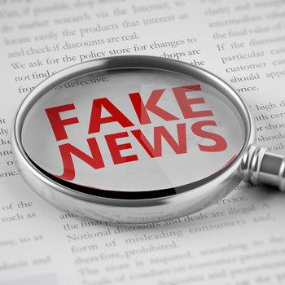
The Effect Of AI On Spreading Fake News:
AI technologies, particularly those related to natural language processing, machine learning, and deep learning, have made it easier than ever to create and distribute misleading, false, or sensationalized content.

Slide 20
Lecture 8
Fake news on Social Media: the Impact on Society
AI-driven tools can generate highly convincing fake news articles, images, videos, and even deepfake content. With advancements in natural language generation (NLG), AI systems can write news articles that appear legitimate at first glance, often mimicking the tone and style of reputable journalists.
These algorithms are trained on vast amounts of data, enabling them to generate content that closely mirrors real-world news. For example, AI can create a fake story about a political figure’s alleged scandal or a false health claim, which can be shared and spread widely before being debunked.

Slide 21
AI also plays a significant role in the rapid spread of fake news across the internet. Machine learning algorithms used by social media platforms prioritize content that generates high engagement, such as sensational headlines or emotionally charged material. This can lead to a greater spread of fake news, as these algorithms are designed to amplify content that garners clicks, likes, shares, or comments—often irrespective of the truthfulness of the content.

Slide 22
Lecture 8
Fake news on Social Media: the Impact on Society
Bots, which are powered by AI, can automate the process of spreading fake news by generating thousands of fake accounts that engage with and share content. These bots create the illusion of widespread support for certain narratives, influencing public opinion and amplifying misinformation. The scale of these operations can be massive, enabling fake news to go viral in a matter of hours or even minutes.

Slide 23
Contributors Of Fake News:
While many social media users are very much real, those who are malicious and out to spread lies may or may NOT be real people. There are Three main types of fake news contributors:
* Social bots.
* Trolls.
* Cyborg users.

Slide 24
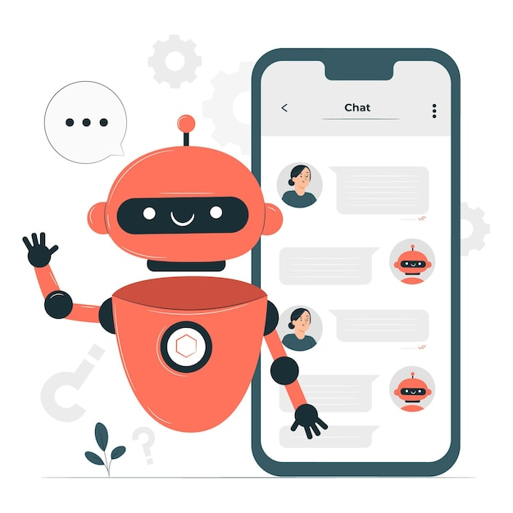
Lecture 8
Fake news on Social Media: the Impact on Society
Social bots:
Since the cost to create social media accounts is very low, the creation of malicious accounts is NOT discouraged. If a social media account is being controlled by a computer algorithm, then it is referred to as A Social Bot.

Slide 25
A social bot can automatically generate content and even interact with social media users.
Social bots may or may not always be harmful but it entirely depends on how they are programmed.
If a social bot is designed with the sole purpose of causing harm, such as spreading fake news in social media, then they can be very malicious entities and contribute greatly to the creation of fake news.

Slide 26
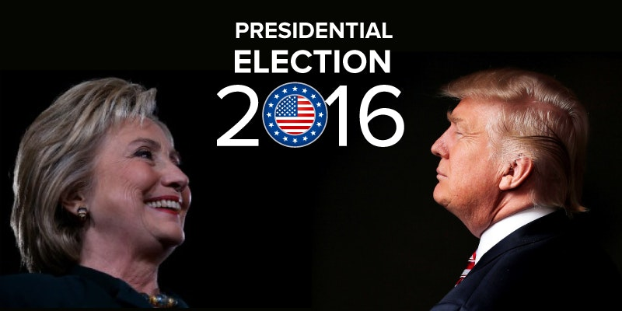
Lecture 8
Fake news on Social Media: the Impact on Society
For example, “studies shows that social bots distorted the 2016 US presidential election discussions on a large scale, and around 19 million bot accounts tweeted in support of either Trump or Clinton in the week leading up to the election day,” which demonstrates how influential social bots can be on social media.

Slide 27
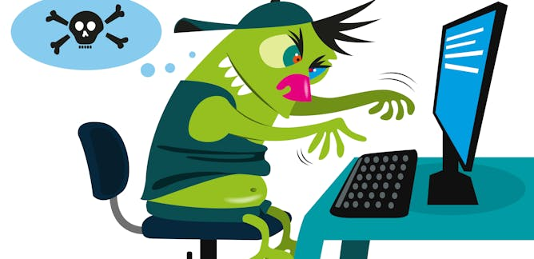
Trolls:
However, fake humans are NOT the only contributors to the dissemination of false information; real humans are very much active in the domain of fake news.
As implied, trolls are real humans who “aim to disrupt online communities” in hopes of provoking social media users into an emotional response.

Slide 28
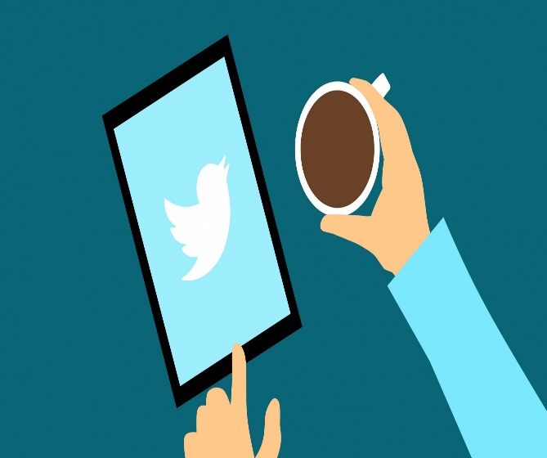
Lecture 8
Fake news on Social Media: the Impact on Society
The main goal of trolling is to resurface any negative feelings harvested in social media users, such as fear and even anger, so that users will develop strong emotions of doubt and distrust.
When a user has doubt and distrust in their mind, they won’t know what to believe and may start doubting the truth and believing the lies instead.

Slide 29

Cyborg users:
While contributors of fake news can be either real or fake, What happens when it’s a blend of both? Cyborg users are a combination of “automated activities with human input”, The accounts are typically registered by real humans AS a cover, but use programs to perform activities in social media.

Slide 30

Lecture 8
Fake news on Social Media: the Impact on Society
What makes cyborg users even more powerful is that they are able to switch the “functionalities between human and bot” which gives them a great opportunity to spread false information.

Slide 31
Lecture 8
Five Types of Misinformation

Slide 32
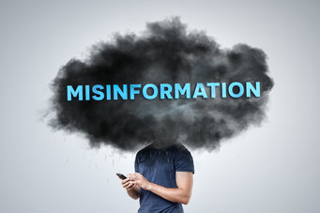
Five Types of Misinformation
Lecture 8
There are Five types of misinformation:
1- Satire.
2- False context.
3- Imposter content.
4- Fabricated content.
5- Manipulated content.

Slide 33
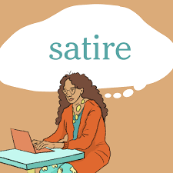
1- Satire: Uses humor or exaggeration to critique or mock a person, organization or policy.
Satire is a genre of the visual, literary, and performing arts, usually in the form of fiction and less frequently non-fiction, in which vices, follies, abuses, and shortcomings are held up to ridicule, often with the intent of shaming or exposing the perceived flaws of individuals, corporations, government, or society itself into improvement.

Slide 34
Five Types of Misinformation
Lecture 8
Although satire is usually meant to be humorous, its greater purpose is often constructive social criticism, using wit to draw attention to both particular and wider issues in society.
A feature of satire is strong irony or sarcasm —"in satire, irony is militant", according to literary critic Northrop Frye, but parody, burlesque, exaggeration, juxtaposition, comparison, analogy, and double entendre are all frequently used in satirical speech and writing.

Slide 35
In September 2024, Dan's Papers published a satirical article claiming that the Hamptons would implement congestion pricing over Labor Day weekend based on vehicle value, exempting cars worth over $250,000. Despite the article’s clear satirical nature, many readers believed it to be true and expressed outrage, with some even contacting the governor’s office to complain. This incident highlights how satire can be misinterpreted, leading to the spread of misinformation.

Slide 36
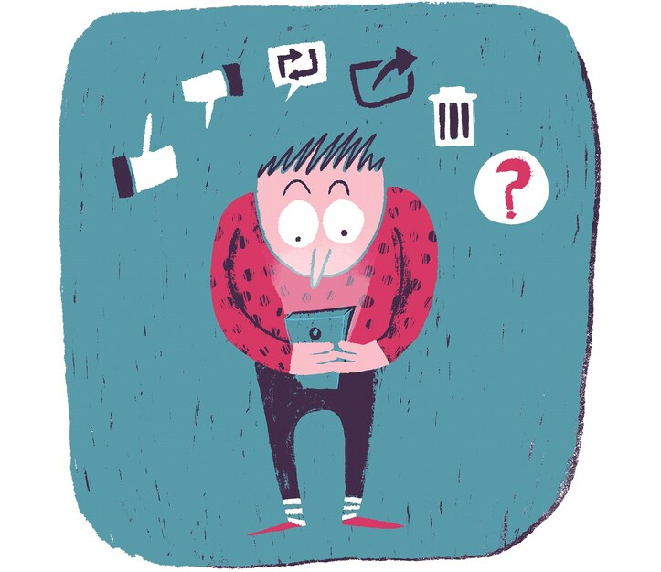
Lecture 8
Five Types of Misinformation
2- False context: Takes an image, a quote or other piece of content and puts it into a New, False Context to change its meaning.
This category is used to describe content that is genuine BUT has been reframed in dangerous ways.

Slide 37
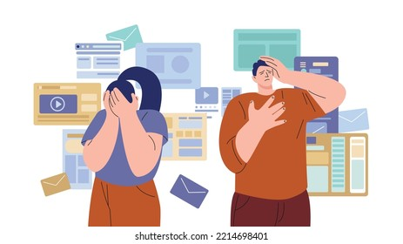
1. a misleading use of information to frame an issue or individual.
2. when genuine content is shared with false contextual information.
3. when genuine information or imagery is manipulated to deceive.
4. when headlines, visuals, and captions do not support the content..

Slide 38
Lecture 8
Five Types of Misinformation
An example that caused significant outrage was this image of a child inside a cage that circulated in the summer of 2018, It received over 20,000 retweets. A similar post on Facebook received over 10,000 shares. The picture was actually staged as part of a protest at Dallas City Hall against immigration policies — another example of a genuine image where the context got framed and warped. In this example, however, the author did not realize it was part of a protest when he shared the image.

Slide 39
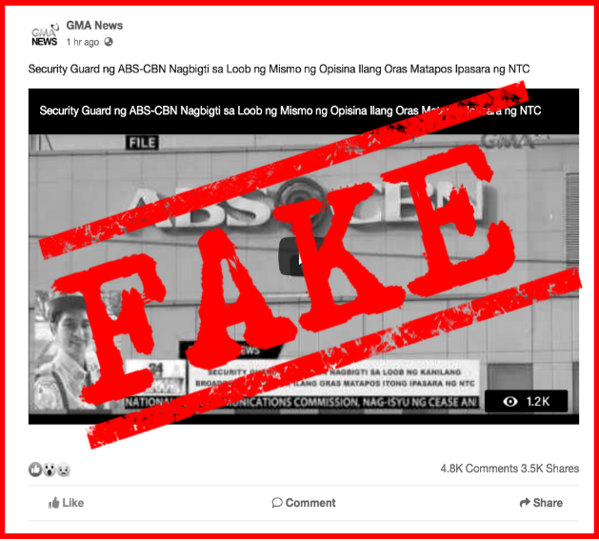
3- Imposter content: Falsely uses a well-known name, brand or logo to fool people into believing that it is authentic content.
When genuine sources are impersonated with false, made-up sources. This is dangerous as it relates to information with no factual basis being presented in the style of a credible news source or article to make it look like a legitimate source.

Slide 40
Five Types of Misinformation
Lecture 8
As discussed earlier, our brains are always looking for heuristics to understand things like credibility when it comes to information. Heuristics are mental shortcuts that help us make sense of the world.
Seeing a brand that we already know is a very powerful heuristic. It is for this reason that we’re seeing an increase in imposter content — false or misleading content that uses well-known logos or the news from established figures or journalists.

Slide 41
​ A recent instance of imposter content occurred during the 2024 U.S. presidential election. In the days leading up to the election, the FBI reported that Russia was behind several false viral claims, including a video that purported to show ballots for former President Donald Trump being destroyed. This video was fabricated to resemble authentic news footage, misleading viewers into believing it was genuine. Such imposter content exploits the credibility of legitimate news organizations to spread misinformation and manipulate public perception.

Slide 42
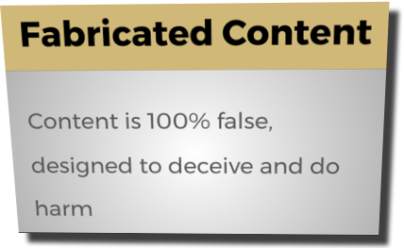
Five Types of Misinformation
Lecture 8
4- Fabricated content: is entirely made up and is designed to deceive you into thinking that it’s real.
When the content is completely false, the only limit is the imagination of the creator’s of such content. Distinguishing between the real and fabricated content is extremely difficult to the naked eye. If you have seen any “deepfakes”, that can be often categorized as “fabricated content”, you know how deeply it impacts our trust in the messages we see.

Slide 43

AI-Generated Fake News Used for Blackmail (2025): In January 2025, scammers leveraged artificial intelligence to create fabricated news videos as a means of blackmailing individuals. These AI-generated videos were designed to appear as legitimate news reports, falsely portraying victims in compromising situations to extort money from them.

Slide 44

Five Types of Misinformation
Lecture 8
5- Manipulated content: When genuine information or imagery is manipulated to deceive. and usually it concerns photos and videos that are altered in such way that they seem real enough, but the overall meaning of the genuine content is different than intended. This can be used to mislead people or create a false narrative about something or someone.

Slide 45
Here is an example from the lead-up to the US presidential election in 2016, when two genuine images were stitched together. The location is Arizona, and the image of the people standing in line to vote came from the primary vote in March 2016. The image of the ICE officer making the arrest is a stock image that, at that time, was the first result on Google Images when searching for “ICE arrest.” The second image was cropped and layered on top of the first and disseminated widely ahead of the election.

Slide 46
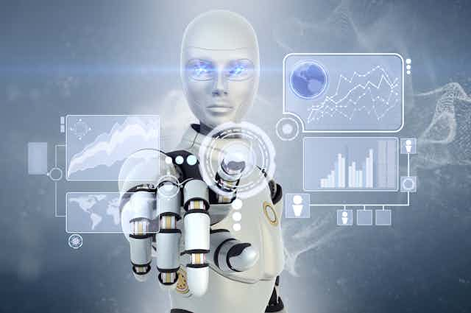
Lecture 8
Five Types of Misinformation
Artificial Intelligence (AI) can play a significant role in tracking and reducing the spread of fake news through various techniques, including:
1. Detecting Patterns and Unnatural Language AI models can analyze text and identify linguistic patterns commonly found in fake news, such as exaggeration or misleading headlines, helping to detect them quickly.

Slide 47
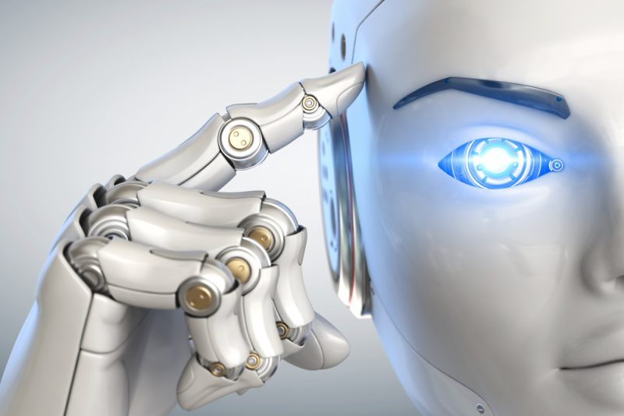
2. Analyzing Images and Videos (Deepfake Detection): AI can analyze images and videos to verify digital manipulations using advanced algorithms such as facial recognition and digital distortion analysis. Companies like Google and Microsoft use AI-powered tools to combat deepfake videos, which are sometimes used to spread false information.

Slide 48
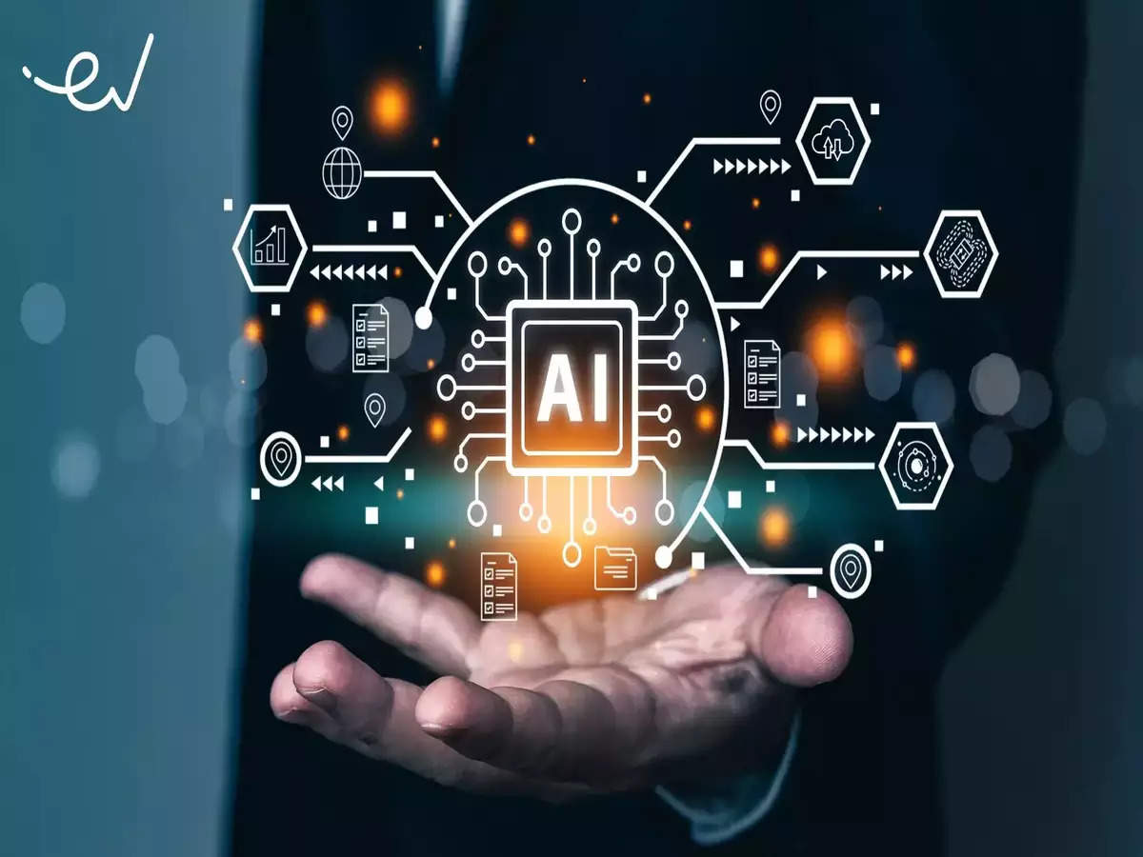
Five Types of Misinformation
Lecture 8
3. Verifying Sources and Credibility: AI can check the source of a news story, compare it with a database of trusted platforms, and Alert users if the source is unknown or suspicious. Some tools, like NewsGuard and Google Fact Check Explorer, use AI to assess the credibility of news websites.

Slide 49
4. Monitoring Social Media: AI can analyze viral posts and comments on platforms like Twitter and Facebook to detect fake news before it spreads widely. Social media companies use deep learning algorithms to quickly identify and remove misleading content.
5. Detecting Voice Manipulation: Some fake news utilizes AI voice cloning to mimic well-known figures. AI systems can detect differences between real and fake voices by analyzing sound frequencies.

Slide 50
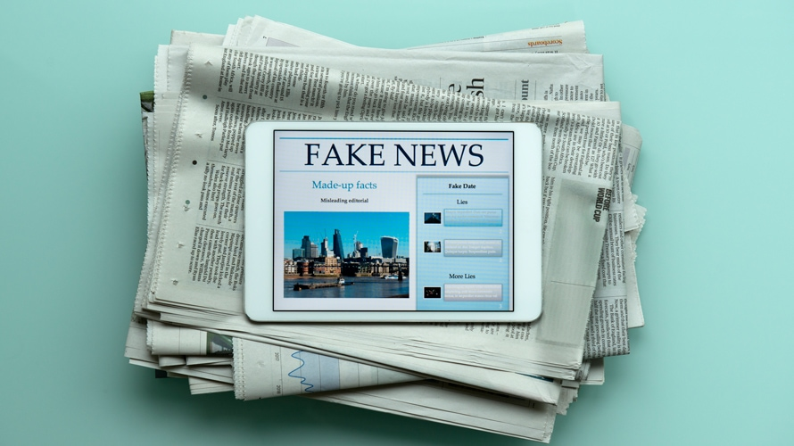
Five Types of Misinformation
Lecture 8
6. Providing Reports and Analysis for Journalists and Fact-Checkers: News agencies rely on AI tools such as ClaimBuster and Full Fact to help journalists verify news before publication.

Slide 51
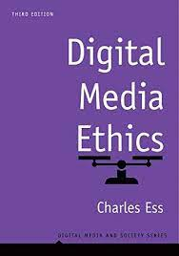

Digital Media Ethics (Digital Media and Society Series), 3rd Edition, by Charles Ess
Intro
Recommended Reference

Slide 52
Lecture 8
Outlines:
** Fake news on Social Media: the Impact on Society:
- What is Fake News?
- Fake News Spread, and Social Media
- Contributors of fake news.
** Five types of misinformation:
1- Satire. 2- False context. 3- Imposter content.
4- Fabricated content. 5- Manipulated content.

Slide 53



Thank You

Slide 54
DIGITAL MEDIA ETHICS
Lecture 8
DMG 723
Prepared by:
Dr. Sherihan Mohamed

