Slide 1



HCIA-AI Huawei
Lecture 10
AI Frameworks
Prepared by
Eng. Eman Elgallad
www.midocean.ae

Slide 2

Lecture
Content:
10
Introduction to AI Frameworks
Tensor
Types of AI Frameworks
Popular AI Frameworks
www.midocean.ae

Slide 3
AI Frameworks
AI frameworks, also known as machine learning frameworks, are software libraries or platforms that offer a collection of tools, functions, and pre-built algorithms to facilitate the development of AI and machine learning applications. They are designed to simplify the complex tasks associated with training and deploying machine learning models, making it accessible to a broader audience, including AI, ML, DL and Data Science Engineers.
www.midocean.ae

Slide 4
Pre-Built Functions and Libraries:
One of the primary advantages of AI frameworks is the availability of pre-built functions and libraries. These libraries contain a wide range of machine learning and deep learning algorithms, mathematical operations, and data manipulation tools. For instance, libraries like TensorFlow, PyTorch, and scikit-learn provide ready-to-use implementations of popular algorithms such as neural networks, decision trees, and support vector machines.
www.midocean.ae

Slide 5
Importance of AI Frameworks:
AI frameworks hold significant importance in the development of AI and machine learning applications for several reasons:
a. Efficiency: AI frameworks help developers avoid reinventing the wheel. They offer pre-built implementations of common tasks, allowing engineers to focus on high-level design and optimization rather than starting from scratch.
b. Scalability: Many AI frameworks are designed to work efficiently with large datasets and distributed computing resources. This scalability is crucial for training complex models on extensive datasets.
c. Community Support: Leading AI frameworks have vibrant communities of developers and researchers. This means that you can find extensive documentation, tutorials, and a wealth of resources to assist you in your AI projects.
www.midocean.ae

Slide 6
Importance of AI Frameworks Cont. :
d. Flexibility: AI frameworks offer flexibility in terms of model architecture and customization. You can build and experiment with a wide range of models tailored to your specific use case.
e. Deployment: Many AI frameworks provide tools for deploying models to various platforms, including cloud services and edge devices, making it easier to bring AI applications to the real world.
www.midocean.ae

Slide 7
Acceleration of AI Development:
AI frameworks significantly accelerate AI development in several ways:
Rapid Prototyping: With pre-built functions and libraries, developers can quickly prototype and test different machine learning models, saving time and resources.
b. Parallel Processing: Many AI frameworks are optimized for parallel processing, allowing you to leverage multiple GPUs or TPUs to speed up model training.
c. AutoML: Some frameworks incorporate AutoML (Auto Machine Learning) features that automate tasks like hyperparameter tuning and model selection, further reducing development time.
d. Transfer Learning: AI frameworks often support transfer learning, enabling you to fine-tune pre-trained models for specific tasks, which is faster than training from scratch.
www.midocean.ae

Slide 8

What is Tensor?

Slide 9
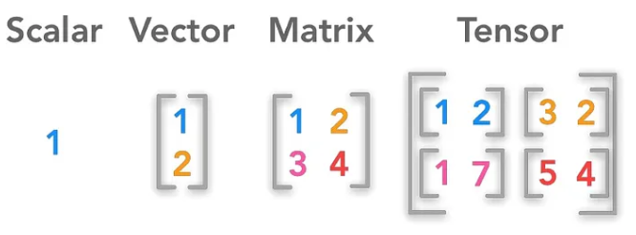
What is Tensor?
Tensor is a multi-dimensional array or data structure that can hold and represent data in multiple dimensions. In essence, it is a generalization of scalars, vectors, and matrices to higher-dimensional spaces.
www.midocean.ae

Slide 10
Key Characteristics of Tensors:
Rank or Order: The rank or order of a tensor refers to the number of dimensions it has. Scalars have a rank of 0, vectors have a rank of 1, matrices have a rank of 2, and tensors can have a rank greater than 2. For example, a 3D tensor has a rank of 3, indicating that it has three dimensions.
Shape: The shape of a tensor defines the number of elements along each dimension. For a 2D tensor (matrix), the shape might be (m, n), where "m" represents the number of rows, and "n" represents the number of columns. In higher-dimensional tensors, the shape specifies the size along each dimension.
A square matrix can have dimensions (2, 2).
The level 3 tensor (3, 5, 8) can have dimensions.
www.midocean.ae

Slide 11
Key Characteristics of Tensors:
Data Type: Tensors can hold data of various types, such as integers, floating-point numbers, or even more complex data types like strings. The data type of a tensor determines the kind of data it can store.
float32
float64
uint8
int32
int64
Operations: Tensors support various mathematical operations, including addition, subtraction, multiplication, and more. These operations are defined to work element-wise, which means they operate on corresponding elements of tensors with the same shape.
www.midocean.ae

Slide 12
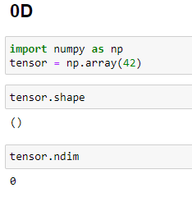
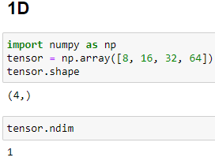
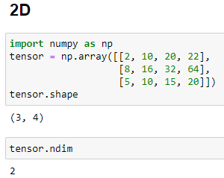
How To Create Tensor Using NumPy?
NumPy is a Python library that can be used for scientific and numerical applications and is the tool to use for linear algebra operations.
➔ When working with NumPy, data in an ndarray is simply referred to as an array. It is a fixed-sized array in memory that contains data of the same type, such as integers or floating point values
0D tensor using NumPy 1D tensor using NumPy 2D tensor using NumPy
www.midocean.ae

Slide 13
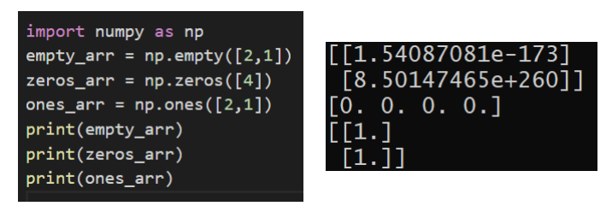
Numpy functions:
empty(): It will create a new array of the specified shape with random numbers each time.
zeros(): It will create a new array of the specified size with the contents filled with zero values
ones(): It will create a new array of the specified size with the contents filled with one values.
www.midocean.ae

Slide 14
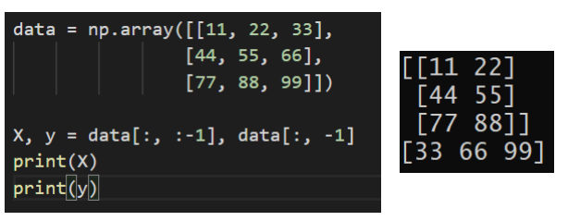
Numpy array Splitting data into X,y:
➔ It is common to split your loaded data into input variables (X) and the output variable (y).
➔ We can do this by slicing all rows and all columns up to, but before the last column, then separately indexing the last column.
www.midocean.ae

Slide 15
AI Frameworks

Slide 16

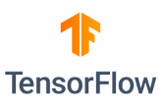




categories of AI frameworks :
The two main categories of AI frameworks:
1-Deep Learning Frameworks: These are specialized for neural network-based deep learning tasks.
2-General-Purpose Frameworks: These are adaptable and support a wide range of machine learning tasks.
www.midocean.ae

Slide 17
Lecture
10
DL Frameworks:
Deep learning frameworks are specialized software tools that play a pivotal role in the development of artificial intelligence (AI) systems, particularly those based on neural networks. These frameworks provide a comprehensive ecosystem for designing, training, and deploying deep neural networks such as TensorFlow, PyTorch, and Keras.
www.midocean.ae

Slide 18
Lecture
10
DL Frameworks Cont. :
Layer Abstractions: These frameworks provide high-level abstractions for creating different types of layers in neural networks, such as convolutional, recurrent, and fully connected layers. This simplifies the process of defining network architectures.
Automatic Differentiation: Deep learning frameworks implement automatic differentiation, allowing gradients to be computed efficiently during the training process. This is crucial for optimizing network parameters through techniques like backpropagation.
www.midocean.ae

Slide 19
Lecture
10
DL Frameworks:
Optimized GPU/TPU Support: Most deep learning frameworks are optimized to leverage powerful hardware accelerators like GPUs (Graphics Processing Units) and TPUs (Tensor Processing Units), speeding up the training of large neural networks significantly.
Pre-trained Models: Many deep learning frameworks offer access to pre-trained models, which can be fine-tuned for specific tasks. This transfer learning approach saves time and computational resources.
www.midocean.ae

Slide 20

PyTorch
PyTorch is a Python-based machine learning computing framework developed by Meta.
It is developed based on Torch, a scientific computing framework supported by a large number of machine learning algorithms.
Torch is a tensor operation library similar to NumPy, featured by high flexibility, but is less popular because it uses the programming language Lua. This is why PyTorch is developed.
In addition to Meta, institutes such as Twitter, GMU also use PyTorch.
http://PyTorch123.com/FirstSection/PyTorchIntro/
www.midocean.ae

Slide 21
Features of PyTorch
Python first: PyTorch does not simply bind Python to a C++ framework. PyTorch directly supports Python access at a fine grain. Developers can use PyTorch as easily as using NumPy or Pandas. This not only lowers the threshold for understanding Python, but also ensures that the code is basically consistent with the native Python implementation.
Dynamic neural network: Many mainstream frameworks such as TensorFlow 1.x do not support this feature. To run TensorFlow 1.x, developers must create static computational graphs in advance, and run the feed and run commands to repeatedly execute the created graphs. In contrast, PyTorch with this feature is free from such complexity, and PyTorch programs can dynamically build/adjust computational graphs during execution.
Easy to debug: PyTorch can generate dynamic graphs during execution. Developers can stop an interpreter in a debugger and view output of a specific node.
PyTorch provides tensors that support CPUs and GPUs, greatly accelerating computing.
www.midocean.ae

Slide 22
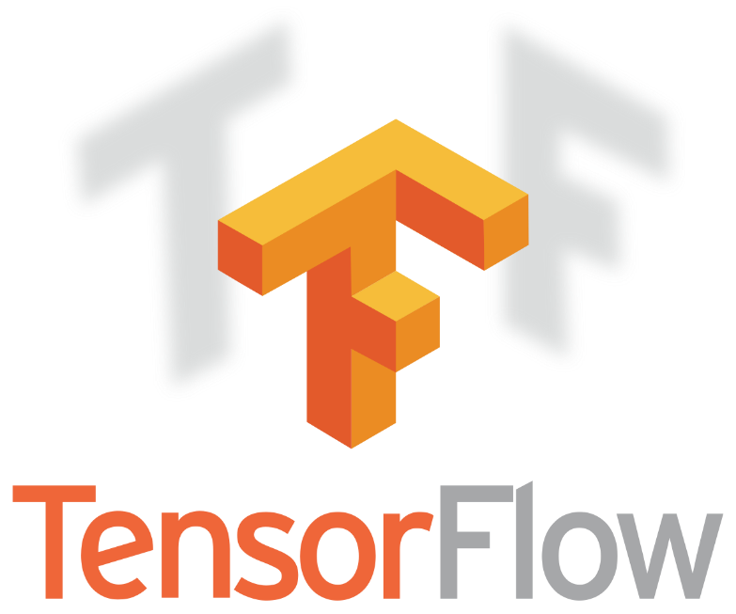
Lecture
10
TensorFlow:
TensorFlow: It is an open-source software library for numerical computation Developed by Google, TensorFlow is one of the most widely used deep learning frameworks. It provides a versatile platform for building various types of neural networks and is known for its scalability, making it suitable for both research and production applications.
https://www.TensorFlow.org/
www.midocean.ae

Slide 23
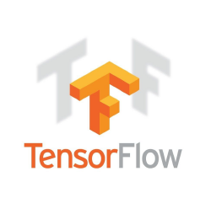
Features of TensorFlow
Scalability
Multi-lingual
GPU
Multi-platform
Powerful computing
Distributed
www.midocean.ae
Notes:
Multi-platform: All platforms that support the Python development environment support TensorFlow. However, TensorFlow depends on other software such as the NVIDIA CUDA Toolkit and cuDNN to access a supported GPU.
GPU: TensorFlow supports certain NVIDIA GPUs, which are compatible with NVIDIA CUDA Toolkit versions that meet specific performance standards.
Distributed: TensorFlow supports distributed computing, allowing graphics to be computed on different processes. These processes may be located on different servers.
Multi-lingual: TensorFlow primarily uses Python for programming. It also supports C++, Java, and Go application programming interfaces (APIs), but cannot guarantee stability when these languages are used. Similarly, TensorFlow cannot ensure stability when third parties use TensorFlow based on C#, Haskell, Julia, Rust, Ruby, Scala, and R (even PHP). Google recently released a mobile-optimized TensorFlow Lite library for running TensorFlow applications on Android.
Powerful computing: TensorFlow can achieve optimal performance on Google TPUs, but still strives to deliver high performance on various platforms, which include not only servers and desktops, but also embedded systems and mobile devices.
Scalability: One of the main advantages of TensorFlow lies in its modular, scalable, and flexible design. Developers can easily port models among the CPU, GPU, and TPU with a few code changes. Python developers can develop their own models by using native and low-level APIs (or core APIs) of TensorFlow, or develop built-in models by using advanced API libraries of TensorFlow. TensorFlow has many built-in and distributed libraries. TensorFlow can be overlaid with an advanced deep learning framework (such as Keras) to serve as an advanced API.

Slide 24
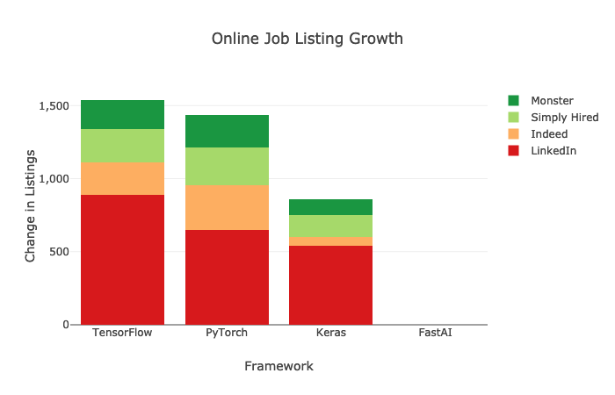
Why TensorFlow?
TensorFlow is considered as one of the best libraries for neural networks and can reduce difficulty in deep learning development. In addition, as it is open-source, it can be conveniently maintained and updated, thus the efficiency of development can be improved.
Keras, ranking third in the number of stars on GitHub, is packaged into an advanced API of TensorFlow 2.0, which makes TensorFlow 2.x more flexible, and easier to debug.
Demand on the recruitment market
www.midocean.ae

Slide 25
TensorFlow 2.x vs. TensorFlow 1.x
Disadvantages of TensorFlow 1.0:
  After a tensor is created in TensorFlow 1.0, the result cannot be returned directly. To obtain the result, the session mechanism needs to be created, which includes the concept of graph, and code cannot run without session.run. This style is more like the hardware programming language VHDL.
  Compared with some simple frameworks such as PyTorch, TensorFlow 1.0 adds the session and graph concepts, which are inconvenient for users.
  It is complex to debug TensorFlow 1.0, and its APIs are disordered (mixed ), making it difficult for beginners. Learners will come across many difficulties in using TensorFlow 1.0 even after gaining the basic knowledge. As a result, many researchers have turned to PyTorch.
www.midocean.ae

Slide 26
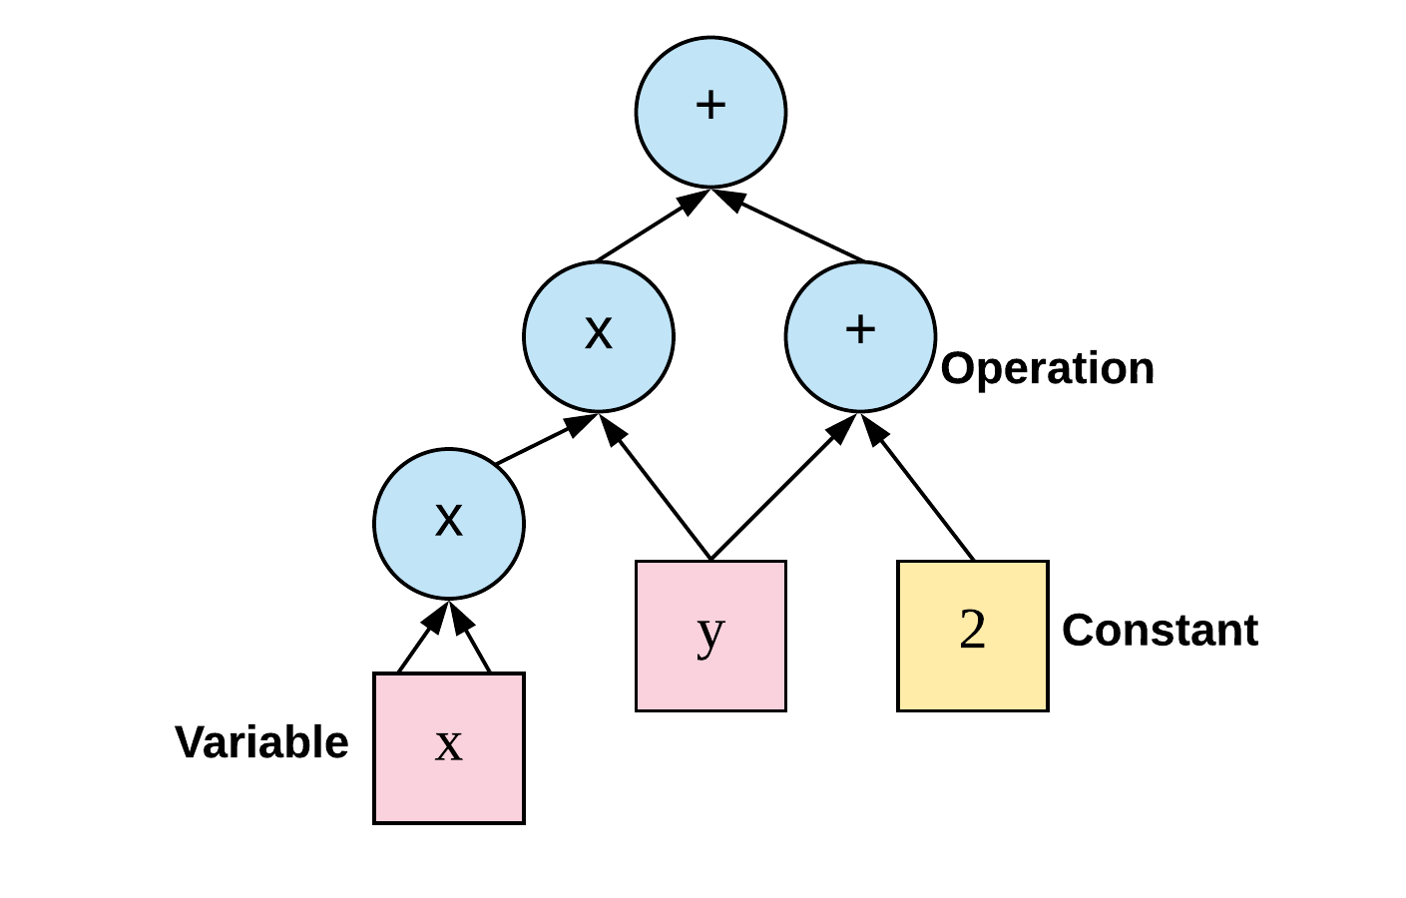
TF1
TensorFlow 1 Graph consist of nodes and edges
Session consist of two operations fetch for retrieving values and feed to give nodes value
Tensor (name , shape , Type)
www.midocean.ae

Slide 27
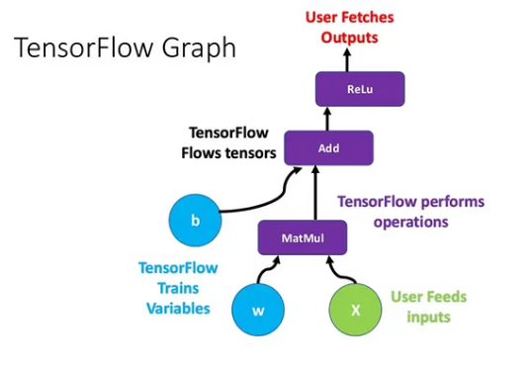
Lecture
10
TensorFlow1 Cont. :
For example, this image represents a graph in TensorFlow. W, x and b are tensors over the edges of this graph.
MatMul is an operation over the tensors W and x, after that
Add is called and add the result of the previous operator with b.
The resultant tensors of each operation
cross the next one until the end
where it’s possible to get the wanted result.
www.midocean.ae

Slide 28
TensorFlow 2.x vs. TensorFlow 1.x
Features of TensorFlow 2.x:
  Advanced API Keras:
    Easy to use: The graph and session mechanisms are removed. What you see is what you get, just like Python and PyTorch.
Major improvements:
    The core function of TensorFlow 2.x is the dynamic graph mechanism called eager execution. It allows users to compile and debug models like normal programs, making TensorFlow easier to learn and use.
    Multiple platforms and languages are supported, and compatibility between components can be improved via standardization on exchange formats and alignment of APIs.
    Compatibility and continuity: TensorFlow 2.x provides a module enabling compatibility with TensorFlow 1.x.
    The tf.contrib ( It is meant to contain features and contributions that eventually should get merged into core TensorFlow ) module is removed. Maintained modules are moved to separate repositories. Unused and unmaintained modules are removed.
www.midocean.ae

Slide 29
Basic Operations of TensorFlow 2.x
The following describes common APIs in TensorFlow by focusing on code. The main content is as follows:
  Methods for creating constants and variables
  Tensor slicing and indexing
  Dimension changes of tensors
  Arithmetic operations on tensors
  Tensor concatenation and splitting
  Tensor sorting
www.midocean.ae
Notes:
The following describes common APIs in TensorFlow by focusing on code.

Slide 30
Auto Graph
Eager execution is enabled in TensorFlow 2.x by default. Eager execution is intuitive and flexible for users (easier and faster to run a one-time operation), but may compromise performance and deployability.
Eager execution is a command-based programming method, which is the same as native Python. A result is returned immediately after an operation is performed.
To achieve optimal performance and make a model deployable anywhere, you can run @tf.function to add a decorator to build a graph from a program, making Python code more efficient.
tf.function can build a TensorFlow operation in the function into a graph. In this way, this function can be executed in graph mode. Such practice can be considered as encapsulating the function as a TensorFlow operation of a graph.
www.midocean.ae

Slide 31

Lecture
10
TensorFlow Importing :
Importing TensorFlow
To use TensorFlow, we need to import the library. We imported it and optionally gave it the name “tf”, so the modules can be accessed by tf.module-name
.
www.midocean.ae

Slide 32
Keras Interface
  TensorFlow 2.x recommends Keras for network building. Common neural networks are included in Keras.layers.
  Keras is the high-level API of the TensorFlow platform. It provides an approachable, highly-productive interface for solving machine learning (ML) problems, with a focus on modern deep learning.
  Keras covers every step of the machine learning workflow, from data processing to hyperparameter tuning to deployment. It was developed with a focus on enabling fast experimentation.
www.midocean.ae

Slide 33
Keras Interface
  Keras is designed to reduce cognitive load by achieving the following goals:
  Offer simple, consistent interfaces.
  Minimize the number of actions required for common use cases.
  Provide clear, actionable error messages.
  Follow the principle of progressive disclosure of complexity: It's easy to get started, and you can complete advanced workflows by learning as you go.
  Help you write concise, readable code.
www.midocean.ae

Slide 34
Common Keras Methods and Interfaces
The following describes common methods and interfaces of tf.keras by focusing on code. The main content is as follows:
  Dataset processing: datasets and preprocessing
  Neural network model creation: Sequential, Model, Layers...
  Network compilation: compile, Losses, Metrics, and Optimizers
  Network training and evaluation: fit, fit_generator, and evaluate
www.midocean.ae

Slide 35
Common Keras Methods and Interfaces
The tf.keras.Model class features built-in training and evaluation methods:
tf.keras.Model.fit: Trains the model for a fixed number of epochs.
tf.keras.Model.predict: Generates output predictions for the input samples.
tf.keras.Model.evaluate: Returns the loss and metrics values for the model; configured via the tf.keras.Model.compile method.
www.midocean.ae

Slide 36

Lecture
10
General Purpose Frameworks:
General-purpose AI frameworks are versatile tools that support a broader range of machine learning tasks, including both traditional machine learning algorithms and deep learning. They are not limited to neural networks and can handle various types of data analysis and modeling. example: Scikit-Learn
https://scikit-learn.org/stable/
www.midocean.ae

Slide 37
Lecture
10
General Purpose Frameworks:
Scikit is Python package that can perform many useful machine learning tasks:
Linear regression
Decision tree regressions
Random Forest regressions
K-Nearest neighbor
SVMs
Stochastic Gradient Descent models And more
Scikit provides model analysis tools like the confusion matrix for assessing how well a model performed. Many times, you can start an ML job in scikit-learn and then move to another framework.
For example, scikit-learn has excellent data pre-processing tools for one-hot encoding categorical data. Once the data is pre-processed through Scikit, you can move it into TensorFlow or PyTorch.
www.midocean.ae

Slide 38
Choosing the right framework :
Choosing the right framework for your AI project is a crucial decision that can impact the efficiency and success
of your work. Here are the steps to help to choose the most suitable framework:
Understand Your Project Requirements:
Start by clearly defining the goals and requirements of your project. Consider factors such as:
The nature of your data (structured, unstructured, images, text).
The complexity of the model you need (simple regression, deep neural network).
The scale of your project (research, prototype, production).
Any specific libraries or tools required for your domain (e.g., natural language processing libraries for NLP tasks).
www.midocean.ae

Slide 39
Choosing the right framework Cont. :
Know Your Skill Set:
Evaluate your team's expertise and familiarity with different frameworks. Choose a framework that aligns with your team's skills to reduce the learning curve and increase productivity.
Consider Community and Support:
Check the availability of community support and resources for the frameworks you're considering. A strong community can provide valuable documentation, tutorials, and assistance when you encounter problems.
Scalability and Performance:
Assess the scalability and performance requirements of your project. Some frameworks are optimized for distributed computing and can handle large datasets more efficiently. Consider whether you need GPU or TPU support for accelerated training.
www.midocean.ae

Slide 40

Thank You
www.midocean.ae

