Slide 1


IELTS Preparation
Mini-Course
Lecture 4
Prepared by
Ahmed Soliman

Slide 2
Mastering the IELTS Reading Test

Slide 3
🎯 Objectives
By the end of the lesson, students will be able to:
Understand the format, timing, and difficulty of the Reading test.
Apply key strategies: skimming, scanning, detailed reading, paraphrasing.
Identify and answer 10 question types confidently.
Use time management techniques to finish all 40 questions.
Avoid common traps, such as matching distractors and paraphrase confusion.

Slide 4
Lead-in
Why is IELTS Reading difficult for you?
Vocabulary➡ Time pressure➡ Long passages➡ Similar words (paraphrasing)

Slide 5
IELTS Listening and Reading Answer Sheet

Slide 6
Test Structure
Feature | Academic Reading
Passages | 3 long texts
Questions | 40 total
Time | 60 minutes (no extra transfer time)
Sources | Journals, magazines, newspapers, textbooks

Slide 7
Difficulty increases from Passage 1 → 2 → 3.
Key skills:
Understanding paraphrasing
Recognizing synonyms
Reading fast with accuracy

Slide 8
Types of questions:
A- Multiple choices Focus on: synonyms distractors eliminating wrong answers Tip: Underline the part of the text that supports the answer.

Slide 9
Types of questions:
B- True / False / Not given (Identify Information) True : You can find it in the text. False: You can find it in the text, but it has incorrect / false information, the passage states the opposite of the statement. Not Given : You cannot find it in the text, or there are not information regarding it. C- Yes / No / Not Given (same as TFNG but tests the writer’s opinion / claims)

Slide 10
Types of questions:
D- Matching Headings
Steps:
Read headings first → underline keywords
Read first & last sentences of each paragraph
Choose the main idea, not details
E- Matching Information
Find specific detail in the paragraph, not the heading.

Slide 11
Types of questions:
F- Matching features:
Match a statement to a list of options. Ex. Countries with culture, research with research findings, age group to a characteristic.
G- Sentence Completion / Summary Completion

Slide 12
Types of questions:
H- Diagram / Table / Flowchart Completion
Predict what kind of word fits before reading.
I- Short Answer Questions
Maximum number of words must be respected.
E.g., "NO MORE THAN TWO WORDS" → (2 words max).

Slide 13
Time Management Techniques
Spend 15 minutes per passage.
Do easy questions first (sentence completion, matching).
Guess if unsure (no negative marking).
Last 5 minutes: check spelling & word count.
Don’t spend a lot of time on one question, you have to balance. If You don’t know the answer, just mark it and come back to it later.

Slide 14
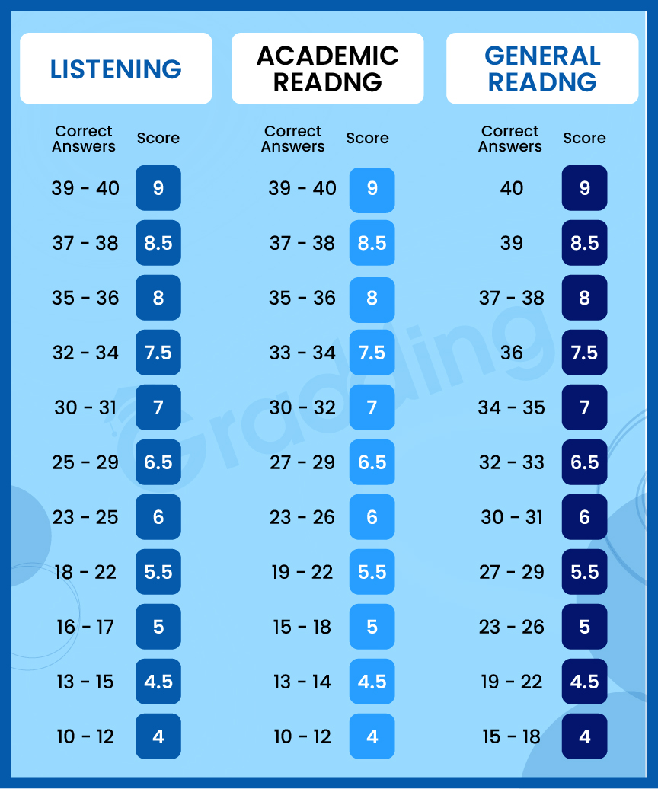
IELTS Listening & Reading Band Score

Slide 15
Essential Reading Strategies
1️⃣ Skimming
Purpose: To get the general idea or overall meaning of a text.
When to use it: Before reading in detail, or when the question asks about the main idea, purpose, or general topic.
How to skim:
Read the title, headings, and subheadings.
Read the first and last paragraph quickly.
Read the first sentence of each paragraph (topic sentence).
Let your eyes move fast—don’t stop for unknown words.

Slide 16
2️⃣ Scanning
Purpose: To find specific information quickly.
When to use it:
When the question asks about:
a name
a number
a date
a place
a percentage
How to scan:
Don’t read everything.
Move your eyes quickly down the page.
Look for keywords or numbers.
Use capital letters, bold words, and numbers to guide you.

Slide 17
3️⃣ Understanding Paraphrasing
Examples:
“rise” → “increase”
“young people” → “the youth”
“causes” → “leads to”
“dangerous” → “poses a risk”

Slide 18
4️⃣ Read the Instructions carefully
Sometimes they will tell you write 3 words or less
For example, if the answer is “The tomb of the pharaoh” and you write it as it is, 5 words, it will be marked wrong, but if you write “The pharaoh’s tomb” it will be marked right because it is only 3 words.
Sometime, in multiple answers, they ask you to choose two answers, if you choose only one it is marked wrong.
Sometime the true/false/not given is replaced with Yes/No/Not given.
If you write true instead of yes, it is marked wrong.

Slide 19
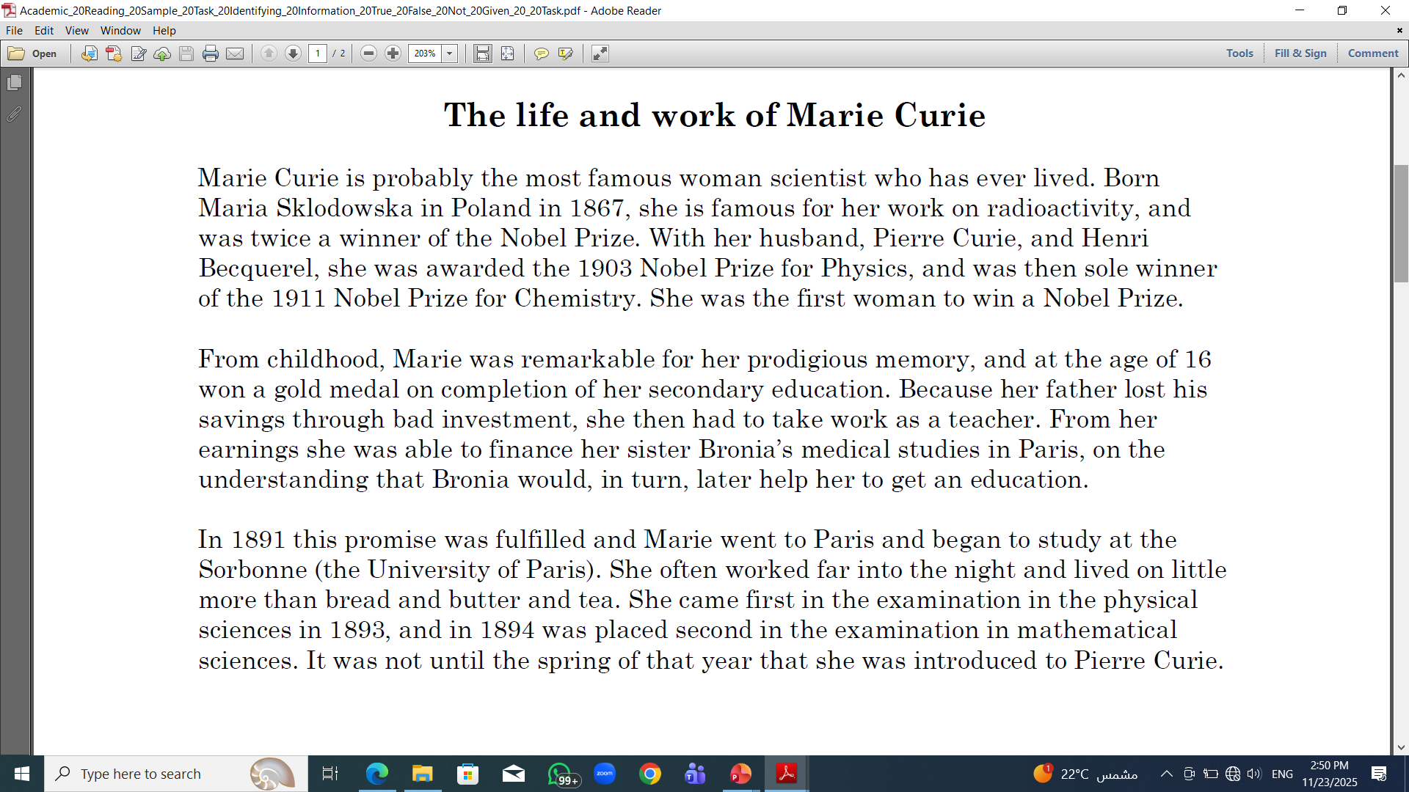
Practice

Slide 20
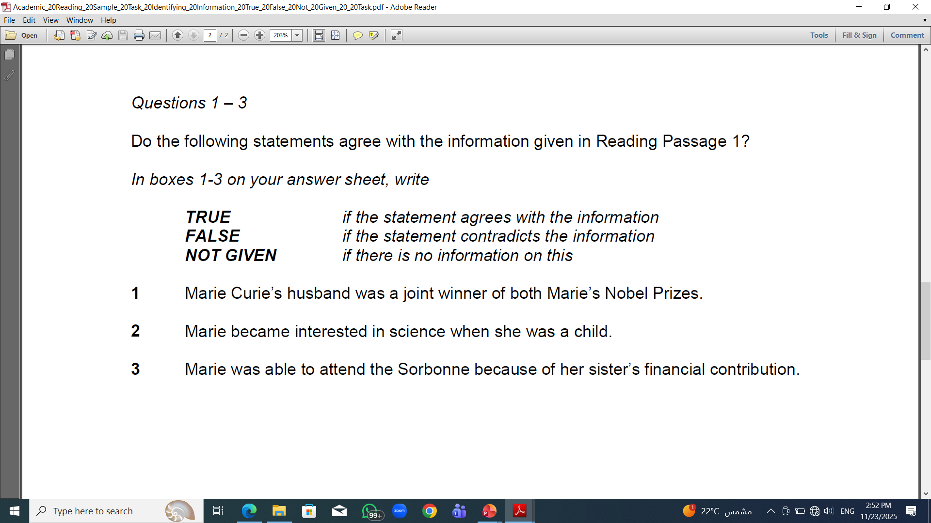

Slide 21
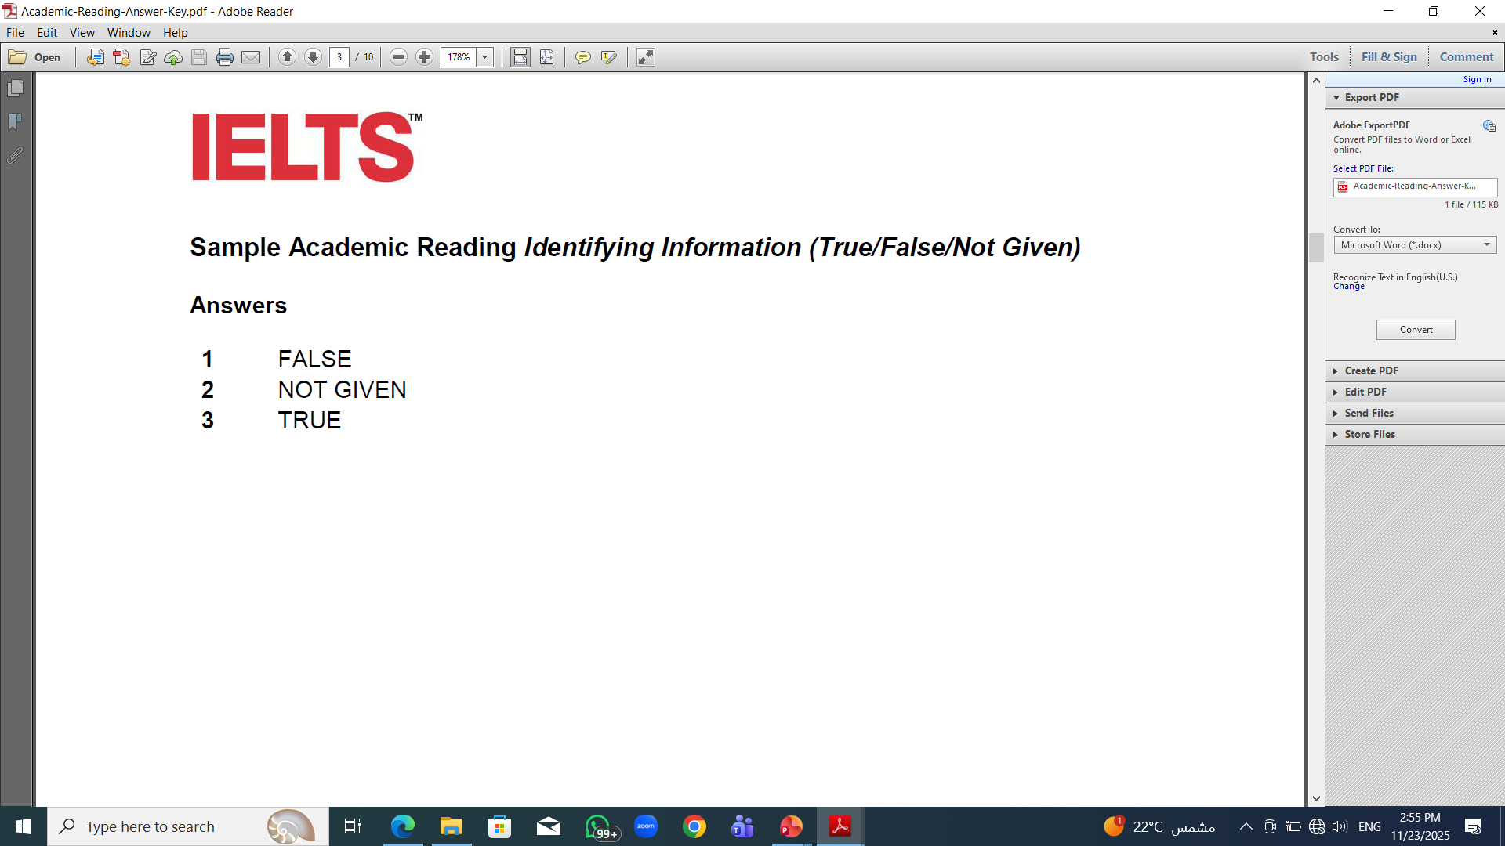
Answers

Slide 22
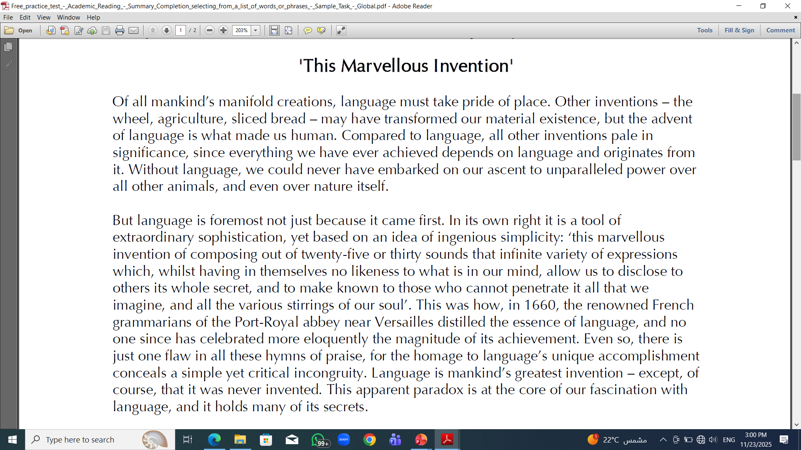

Slide 23
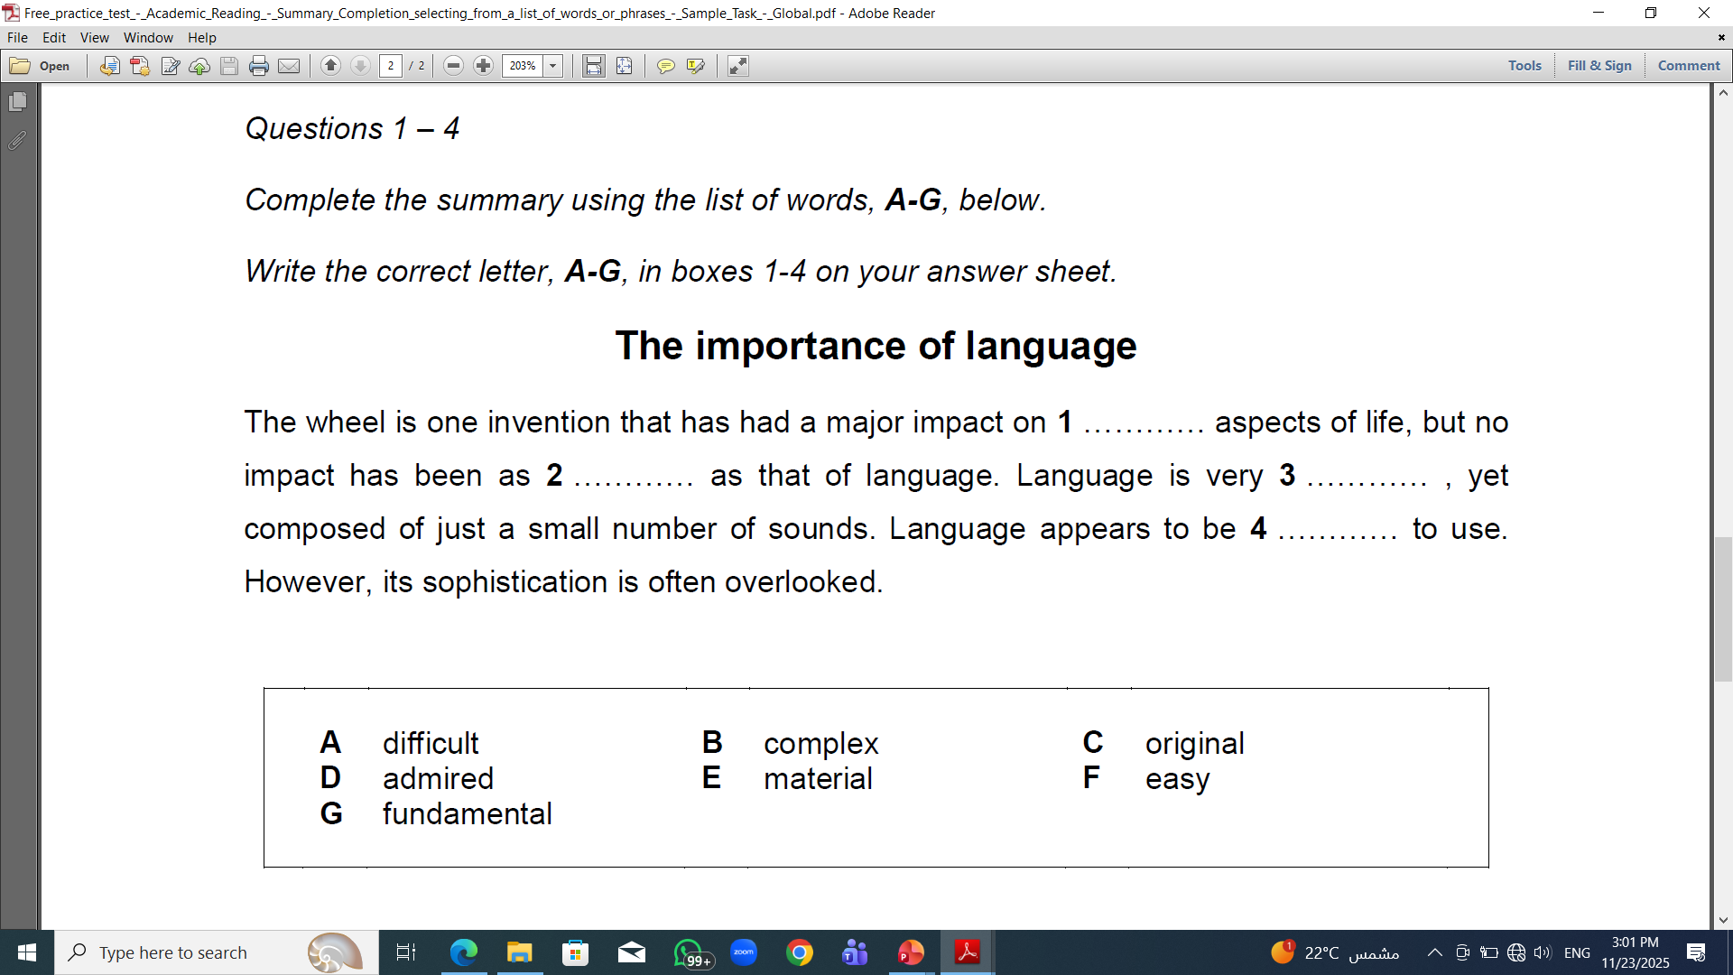

Slide 24
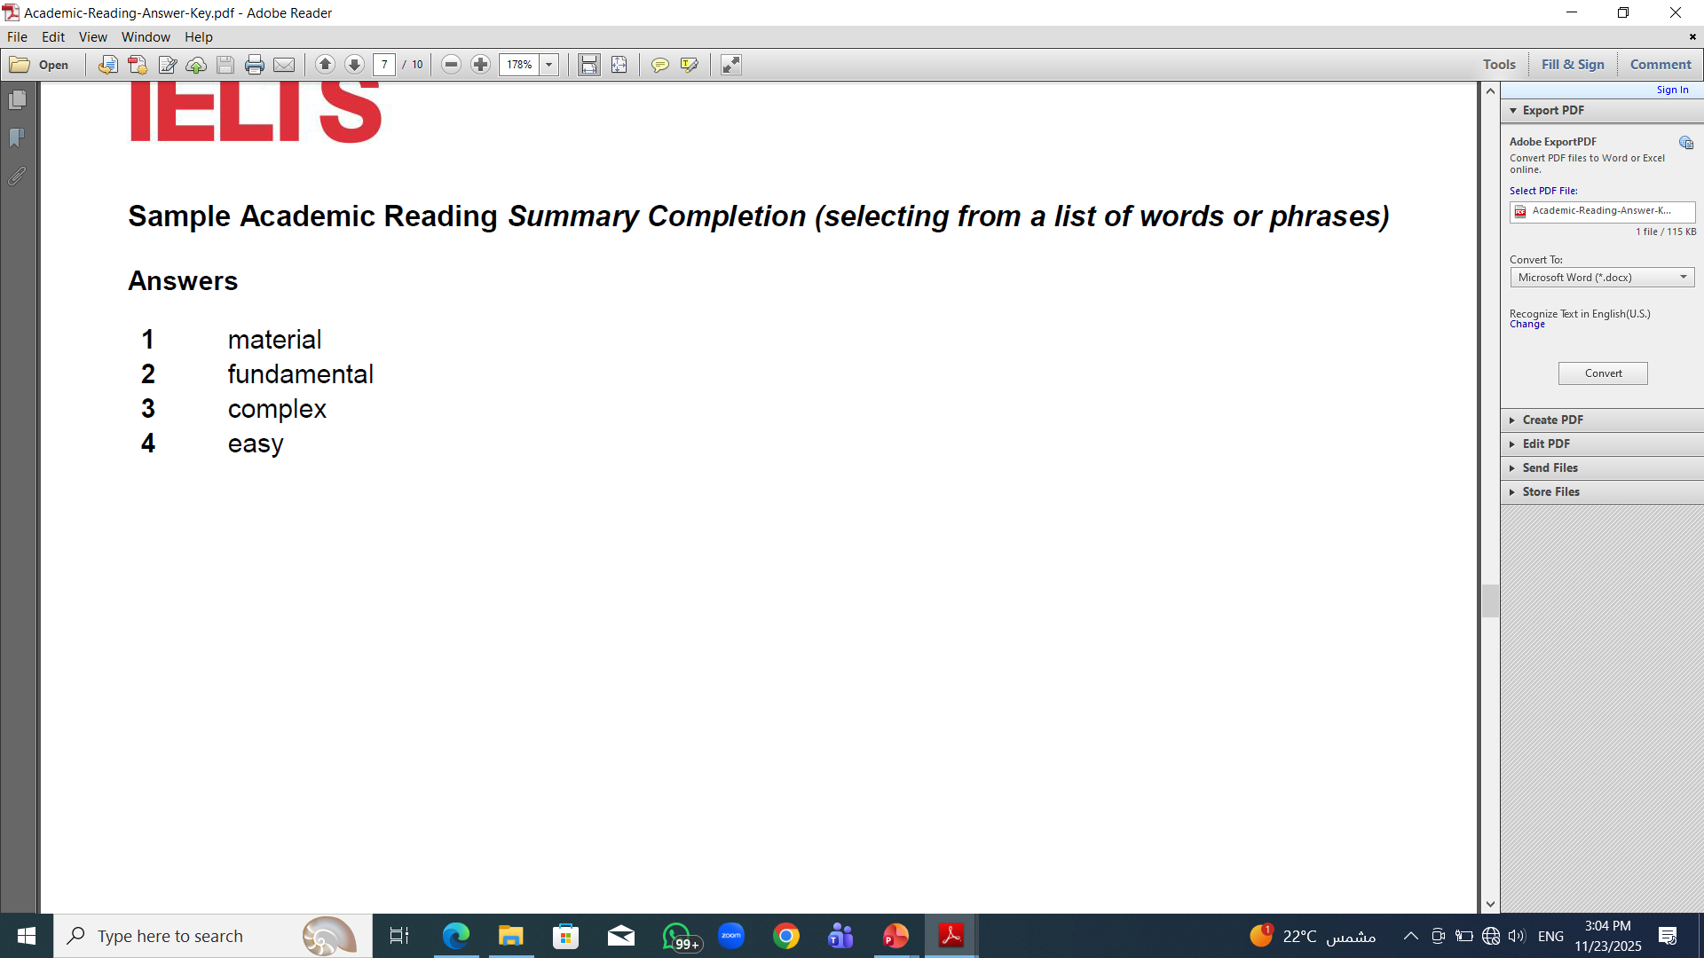
Answers

Slide 25
Assignment
Complete Cambridge 19 IELTS Academic Reading Test 1

Slide 26
Websites
https://www.ieltsolve.com/
https://ieltstrainingonline.com/
https://takeielts.britishcouncil.org/
https://www.ielts.org/about-the-test/sample-test-questions
https://learnenglish.britishcouncil.org/skills/reading
https://ieltsonlinetests.com/
https://mini-ielts.com/
https://www.examenglish.com/IELTS/IELTS_reading.html
https://www.cambridgeenglish.org/learning-english/exams/ielts/

Slide 27


Thank You

