Slide 1



Social Media and Crises
Prepared by: Dr. Doaa Rady
DGM 730
Introduction
Orientation Lecture

Slide 2
Orientation Lecture
OUTLINE
I. Course Description.
II. Course Objectives.
III. Learning Outcomes.
IV. Student Assessment.
V. Topics.
VI. Social media role in crisis.
VII. Conclusion.
VIII. Recommended References

Slide 3
Orientation Lecture
I. Course description
Social media has changed the way we look at crisis management. There are many examples of large reputable brands going through challenging times and poorly dealing with crises, especially in the digital domain. A huge percentage of issues now start within social media platforms and spread through this space very quickly. Social media has become the preferred outlet where opinion is formed and also where a crisis is managed, in a very public manner. Therefore, if businesses and organizations have not made their crisis management plan social media compliant, it may now be ineffective and out of date.

Slide 4
Orientation Lecture
II. Course Objectives
This course will teach what to do in order to create a crisis management plan that is social media compliant and effective when so exposed via online platforms and channels. It will also provide an understanding of how customers and citizens use social media to vent opinions and give feedback, as well as how organizations can respond in crisis situations, including areas such as correcting negative brand perceptions as well as removing abuse and spam content on social media platforms.

Slide 5
Orientation Lecture
III. Learning Outcomes
Following this course, you will have a deeper understanding of:
Understand How social media is changing crisis communications.
understand the framework to manage a social media crisis.
Identify and assess online reputational vulnerabilities.
know social media crisis and issues communications protocols.
Classify different types of social media crisis and plan and allocate the resources accordingly.
Moving From Crisis to Opportunity.

Slide 6

Orientation Lecture
III. Learning Outcomes
Following this course, you will have a deeper understanding of:
Understand how to manage the crisis without further escalation.
The emerging field of digital activism and how this can impact on the way organizations manage their relationships with the customers, consumers or stakeholders.
How to create a real-time monitoring dashboard.
What tools and platforms you will need to deploy.
How a crisis plan can become a bridge into developing an effective social media strategy for the organisation as a whole.

Slide 7
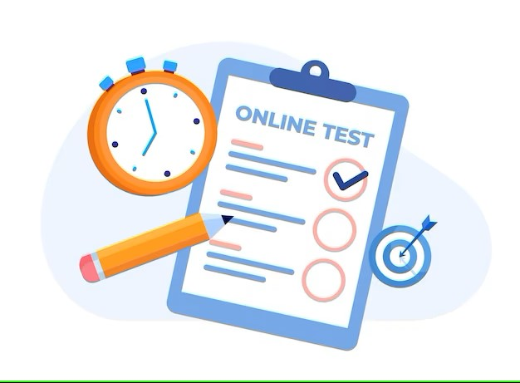
Orientation Lecture
IV. Student Assessment.
10 weekly Quizzes
Final Exam

Slide 8

Orientation Lecture
IV. Student Assessment.
Weekly Discussion session – Live Sessions

Slide 9
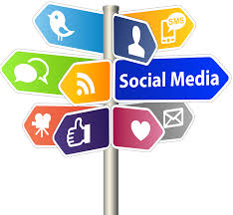
Orientation Lecture
V. Topics
Social Media and Ethics
Social Media Policy and adherence
Understanding copyright and creative commons
Disclosure and Transparency
Social Media risks and rewards

Slide 10
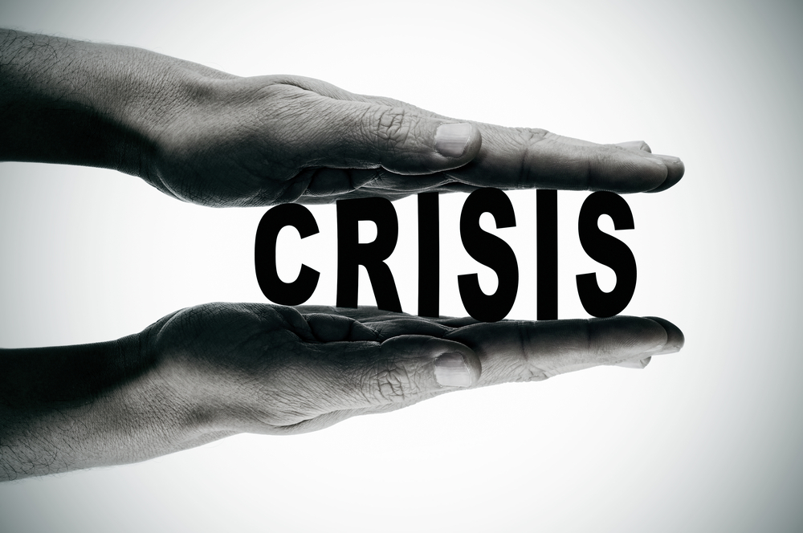
Orientation Lecture
V. Topics
Understanding Types of Crisis
Conventional crises which now play-out differently
Crisis created by use of social media by customers, citizens or employees
‘Own goals’ triggered by organizations misuse of social media
The importance of speed of response

Slide 11
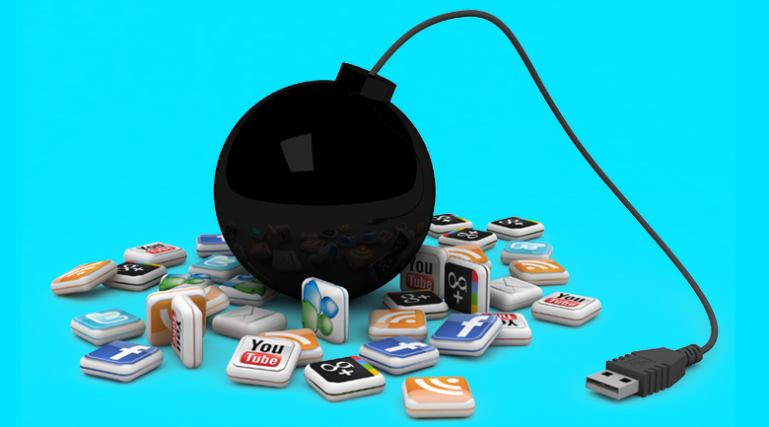
Orientation Lecture
V. Topics
Social Media Crisis
The categories of Social Media Crisis
The levels of Social Media Crisis
The life cycle of Social Media Crisis
The influencer impact on Social Media Crisis

Slide 12

Orientation Lecture
V. Topics
Crisis Communication and Crisis Management
Approaches and theories

Slide 13

Orientation Lecture
V. Topics
Creating the right tone of communication
Creating socially acceptable behavior
Managing accessibility
Creating a plan
Managing a 24/7 information stream
How to appear transparent, visible and accessible

Slide 14

Orientation Lecture
V. Topics
The Social Media Crisis Plan
Assessing Social Media Issues and Risks
Managing and mitigating issues and risks
Social Media Escalation Plans
Handle Negative Publicity on Social Media Forums

Slide 15
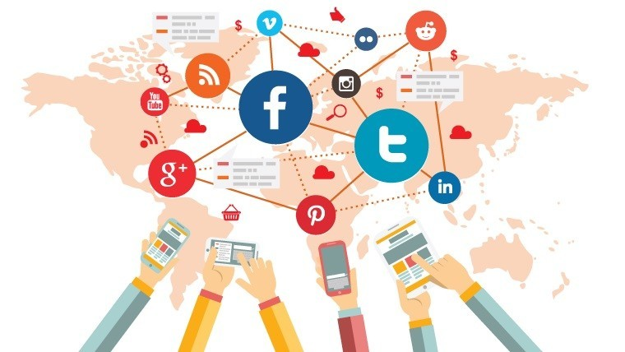
Orientation Lecture
V. Topics
Digital activism
Avoiding appearing as a remote and inflexible organisation
What is digital activism and who are digital activists?
How to respond to ‘radicalized’ customers or stakeholders
The importance of monitoring
A look at available monitoring tools

Slide 16
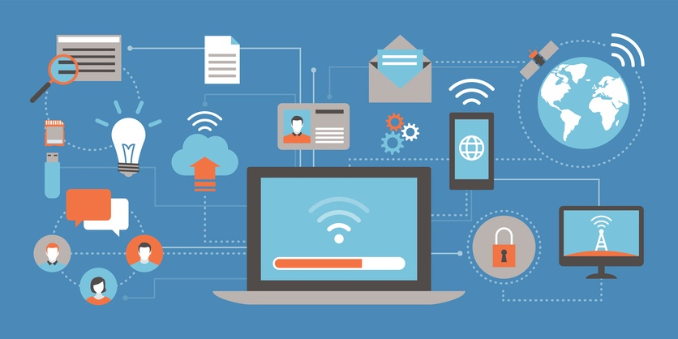
Orientation Lecture
V. Topics
Managing real-time publication
A lesson in establishing a real-time monitoring dashboard
Managing real-time publication
A look at the tools required to manage real time information publication

Slide 17

V. Topics
Orientation Lecture
V. Topics
Social Media Strategy
The role of platforms such as Facebook and Youtube.
A look at the processes required to use these tools effectively.

Slide 18

Orientation Lecture
V. Topics
Crisis Communication and Management
Internal Communication
Media Communication
Influencer Communication
Communication on Social Channels
Crisis Scenario Planning

Slide 19
Social media role in crisis
Orientation Lecture
Today, social media play an important role in disaster and crisis events with significant national security implications, enabling citizens’ involvement through the provision, seeking and brokering of information, connecting those within and outside the event’s geographical space, with implications for both the informal and the formal response effort.
In this context, often characterized by underdeveloped and degraded operational environments, public safety and security organizations are required to deal with the new trend of a digitally enabled social arena in disasters and crises. Social media indeed qualify as changing the rules of the game, forging a loudly silent transformation from a need-to-know to a need-to-share principle and from a command and control to a connect and collaborate paradigm.

Slide 20
Social media role in crisis
Orientation Lecture
Social media can provide a window into social networks in times of crisis or disaster. The rapid reaction time of microblogging creates potential to track reactions to such events in near real time, to assess damage and suffering, and to identify individuals and networks of interest, if the relevant communications can be recognized from within the larger stream.
This provides opportunities for performance improvements in emergency management, law-enforcement, and for more effective government communication and improved transparency.
If such knowledge were available to everyday citizens, they might benefit from a richer understanding of information and resource flow in extreme circumstances.

Slide 21
Social media role in crisis
Orientation Lecture
They might be better able to contribute to response and recovery by sharing personal knowledge or observation more effectively. Their ability to gather critical information or resources in a timely fashion could be magnified. To the degree that the social networks that emerge in times of crisis have some common core prior to the emergency, it might even be possible to proactively nurture, or plug into, these networks.
In today’s current digital age where an estimated 3.53 billion people worldwide are active on at least one social media platform (Statista 2019), the power of social media for crisis communication cannot and should not be ignored. Social media is a tool that enables information about a crisis to reach global audiences within seconds.

Slide 22
Social media role in crisis
Orientation Lecture
Through the power of the Internet and Web people are able to obtain, comment on, and share information about a crisis even when they are not directly involved or impacted. As more and more users share crisis news, information can easily become distorted. Therefore, it is critical that organizations use social media to both monitor the discussions surrounding the crisis and communicate reliable information.
While social media enables crisis information to spread rapidly and vastly, it also provides organizations and destination managers with the opportunity to use these tools effectively to mitigate the negative outcomes of a crisis. Therefore, employing social media in crisis communication is vital to crisis management and the management of perceptions.

Slide 23
Orientation Lecture
VII. Conclusion.
Social media is an increasingly important element in a successful crisis management.
The power of the social web has created both opportunities and threats that management need to consider.
A business’ reputation never only depends on company management, but also on what is said about it in social media.
Social Media has become a powerful tool for communicating directly with consumers and engaging them with targeted content and creative contests. PR professionals have adapted to the usage of social media platforms to enhance the reach of the organizations they represent.

Slide 24
Orientation Lecture
VIII. Recommended References
Akhgar, B., Staniforth, A., & Waddington, D. (2018). Application of social media in Crisis Management Advanced Sciences and Technologies for Security Applications. Springer International Publishing.
Al Jaberi, A. M., & Qawasmeh, F. (2020). The impact of using social media in crisis management according to employees perspectives. International Journal of Academic Research in Business and Social Sciences, 10(11). https://doi.org/10.6007/ijarbss/v10-i11/8130
Austin, L. L., & Jin, Y. (2022). Social Media and Crisis Communication. Routledge.
Barbe, D., & Pennington-Gray, L. (2020). Social Media and Crisis Communication in Tourism and Hospitality.
BradleyPenuel, K., Statler, M., & Hagen, R. (2013, March 1). Encyclopedia of crisis management. Sage Knowledge. Retrieved May 6, 2023, from https://doi.org/10.4135/9781452275956
Christopher Chan, J. (n.d.). 1 THE ROLE OF SOCIAL MEDIA IN CRISIS PREPAREDNESS, RESPONSE AND RECOVERY . Retrieved May 6, 2023, from https://www.oecd.org/governance/risk/The%20role%20of%20Social%20media%20in%20crisis%20preparedness,%20response%20and%20recovery.pdf

Slide 25
Orientation Lecture
VIII. Recommended References
Civelek, Mustafa & Çemberci, Murat & Eralp, Erdem. (2016). The Role of Social Media in Crisis Communication and Crisis Management. International Journal of Research in Business and Social Science. 5. 111-120. 10.20525/ijrbs.v5i3.279.
Erdemir, A. (2019). Chapter One. In Crisis communication in the digital age: Manage or rampage (pp. 1–28). essay, Cambridge Scholars Publishing. Retrieved May 6, 2023, from https://www.cambridgescholars.com/resources/pdfs/978-1-5275-2156-8-sample.pdf.
Eriksson, M. (2018). Lessons for crisis communication on Social Media: A systematic review of what research tells the practice. International Journal of Strategic Communication, 12(5), 526–551. https://doi.org/10.1080/1553118x.2018.1510405
Ford, T. N. (2011). (dissertation). Social Media and Crisis Communication: Theories and Best Practices. Retrieved May 2023, from https://curve.carleton.ca/system/files/etd/ddcff2d7-8736-42cd-95e9-49ff576ae048/etd_pdf/4f7d21a69ae0c0bbca5189a840d2e106/ford-socialmediaandcrisiscommunicationtheories.pdf.
John, B. S., & Pearson, Y. E. (2017). Crisis communication and crisis management: An ethical approach. Sage.

Slide 26
Orientation Lecture
VIII. Recommended References
MARIE VAN DEN HURK, A. N. N. (2013). New Dynamics in Social and Crisis Communications. In Social Media Crisis Communications (pp. 31–42). essay, Pearson Education. Retrieved May 6, 2023, from https://mindthegapcyber.com/social-media-crisis-communications/.
Timothy Coombs, W., & J. Holladay, S. (2010). The Handbook of Crisis Communication. Retrieved May 6, 2023, from https://www.unisabana.edu.co/fileadmin/Archivos_de_usuario/Imagenes/Imagenes_Programas/Imagenes_Posgrados/Facultad_de_Educacion/Maestria_Dir_Gestion_Inst_Educativas/The_Handbook_of_Crisis_Communication.Coombs_y_Holladay.pdf
Ward, C. A. (2011, June). Social Media and Crisis Communication: Are organizations using social media in times of crisis? (dissertation). SOCIAL MEDIA AND CRISIS COMMUNICATION: ARE ORGANIZATIONS USING SOCIAL MEDIA IN TIMES OF CRISIS? Retrieved May 2023, from https://cardinalscholar.bsu.edu/bitstream/handle/123456789/195041/WardC_2011-3_BODY.pdf?sequence=1.
Wedlock, B. C. (2012, May). (dissertation). The diffusion of social media in public relations: Use of social media in crisis response strategies. ProQuest. Retrieved May 2023, from https://www.researchgate.net/publication/295547824_The_Diffusion_of_Social_Media_in_Public_Relations_Use_of_Social_Media_In_Crisis_Response_Strategies.

Slide 27



Thank You

