Slide 1



Common Server Types and Threats
Lecture 5
HCIA-Security
Prepared by
Dr. Abdelrhman Ahmed

Slide 2
Chapter
05
Foreword
• In a broad sense, a server is a computer system that provides services to other machines over a network.
• More specifically, a server is a high-performance computer that provides business services to external computers through a network. Therefore, servers require higher stability, security, and performance than common PCs.

Slide 3
Chapter
05
Objectives
• Upon completion of this course, you will be able to describe:
□ Categories of servers
□ Functions of common servers
□ Security threats to common servers
□ Vulnerabilities and patches

Slide 4
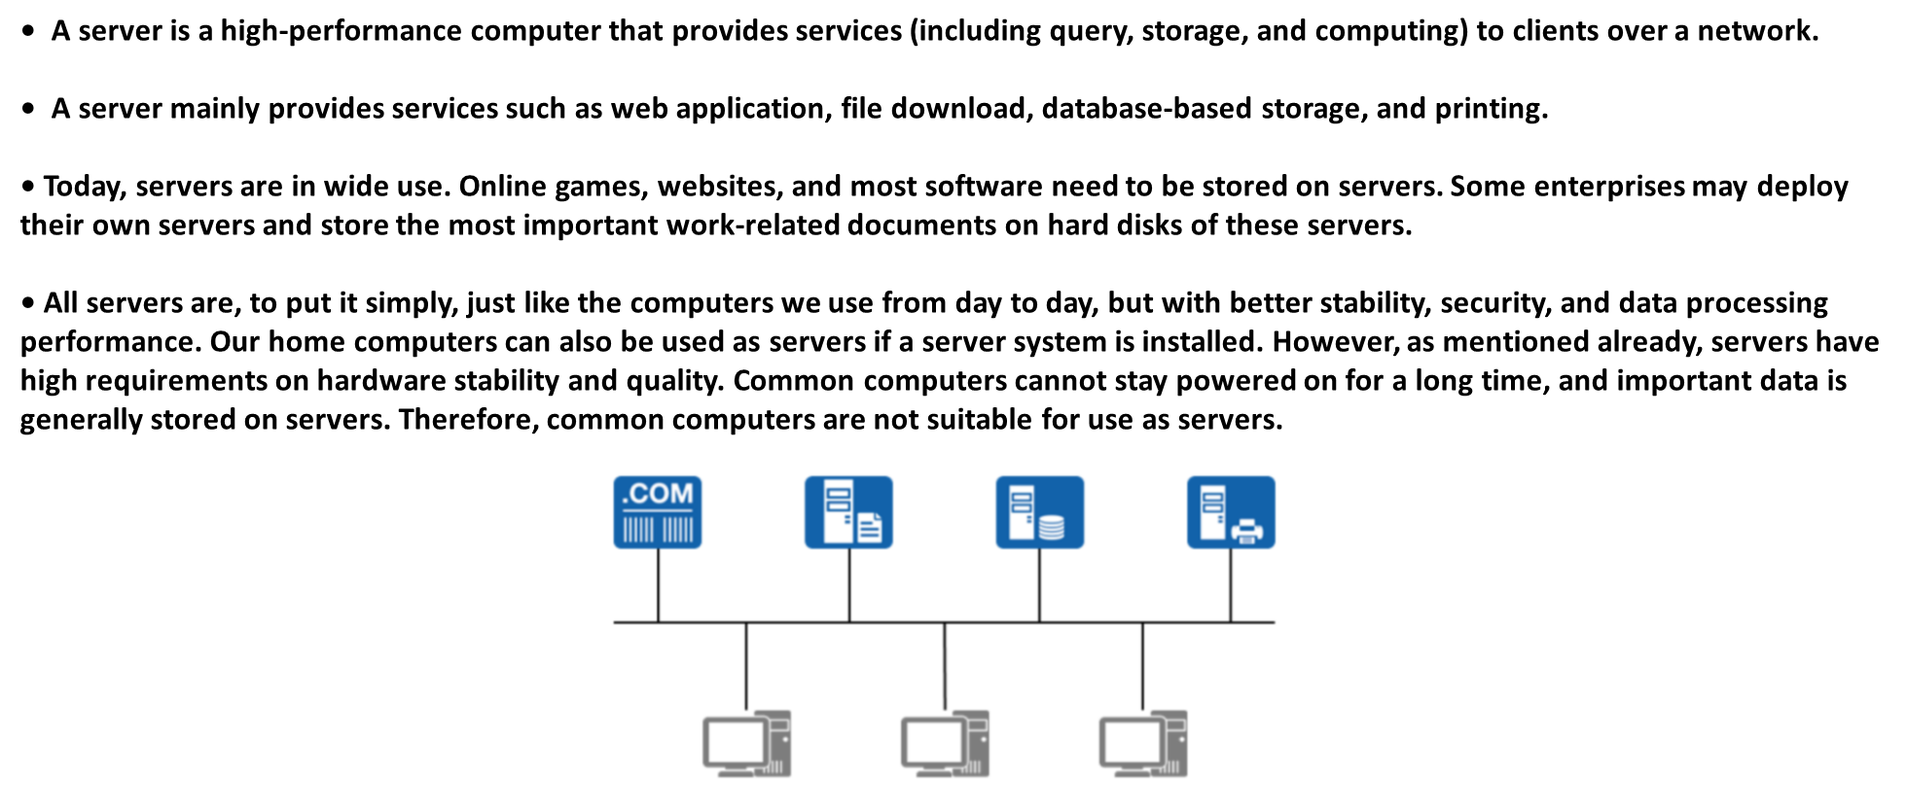
Chapter
05
What is a Server?

Slide 5
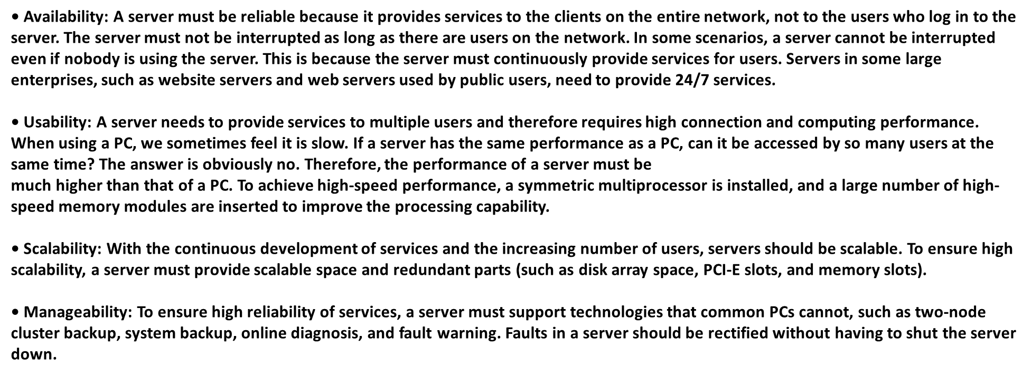
Chapter
05
Features of a Server

Slide 6
Chapter
05
Servers vs PCs

Slide 7
Chapter
05
Server Classification

Slide 8
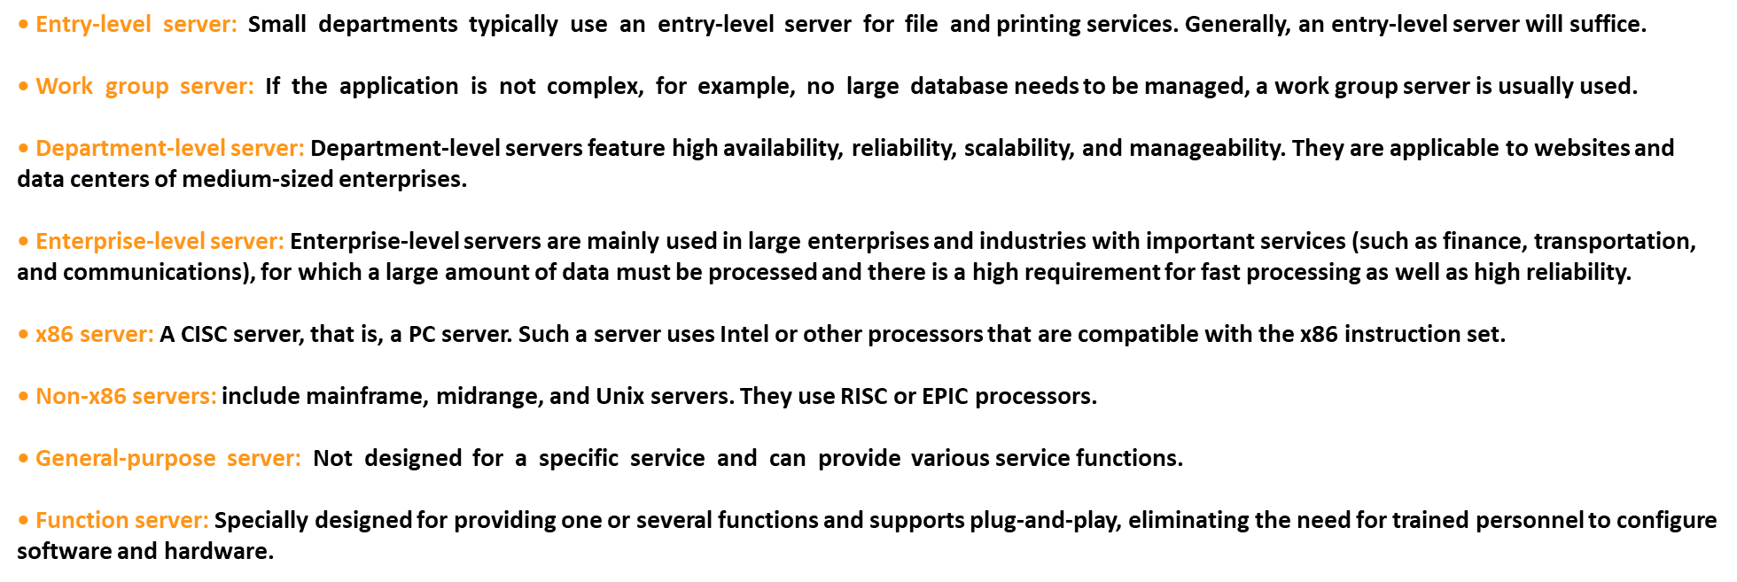
Chapter
05
Server Classification

Slide 9
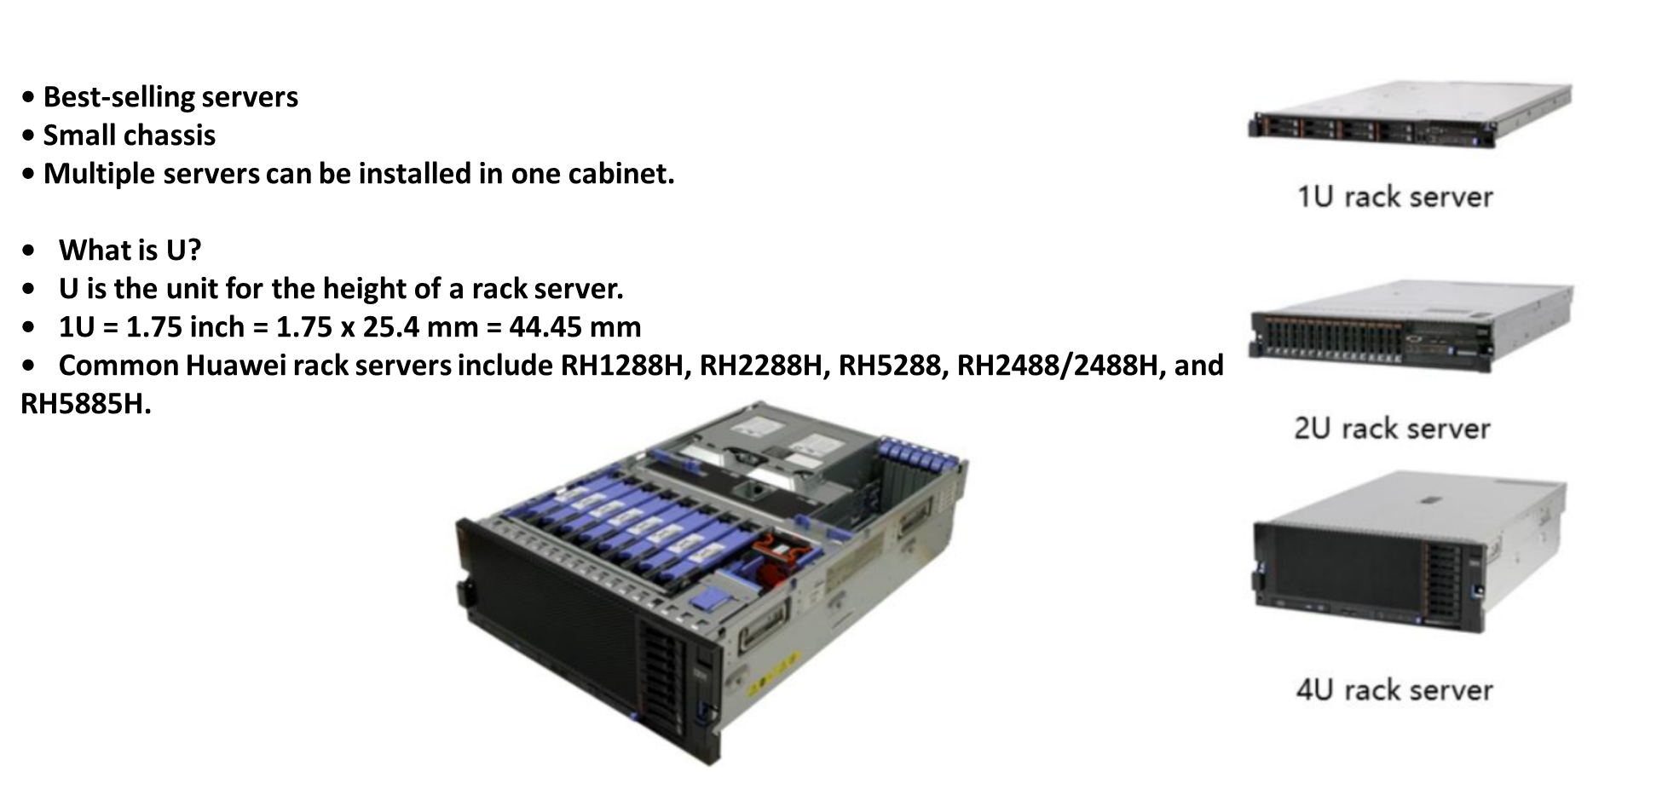
Chapter
05
Rack Servers

Slide 10
Chapter
05
Tower Server
• Traditional server type
• Large chassis dimensions
• Strong internal scalability
• Large area occupied

Slide 11
Chapter
05
Blade Server
• High-density server
• Energy efficient
• Centralized management
• Quick deployment

Slide 12
Chapter
05
Cabinet Server
• High-end enterprise server with a complex internal structure that includes a large number of devices
• With a cabinet server, many different device units or several servers may be placed in the same cabinet.

Slide 13
Chapter
05
Server Software
• Server software works in client/server (C/S) or browser/server (B/S) mode.
There are many forms of servers, including
□ File server
□ Database server
□ Mail server
□ Web server
□ FTP server
□ Domain Name System (DNS) server
□ Time synchronization server (NTP server)
□ Proxy server

Slide 14
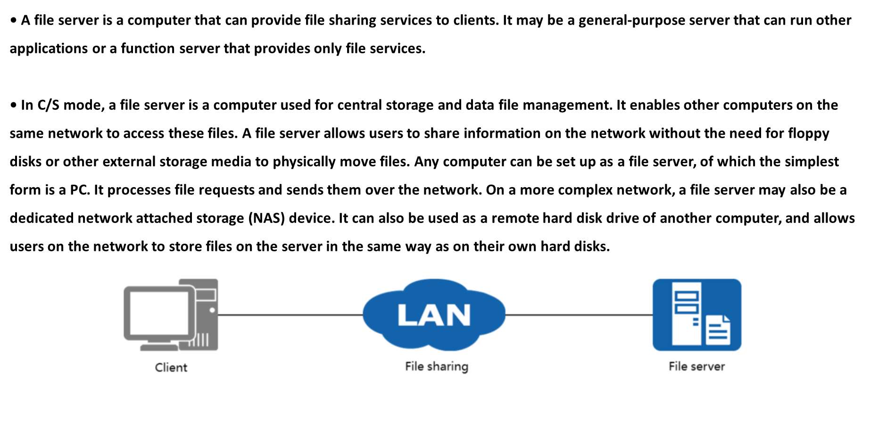
Chapter
05
File Server

Slide 15
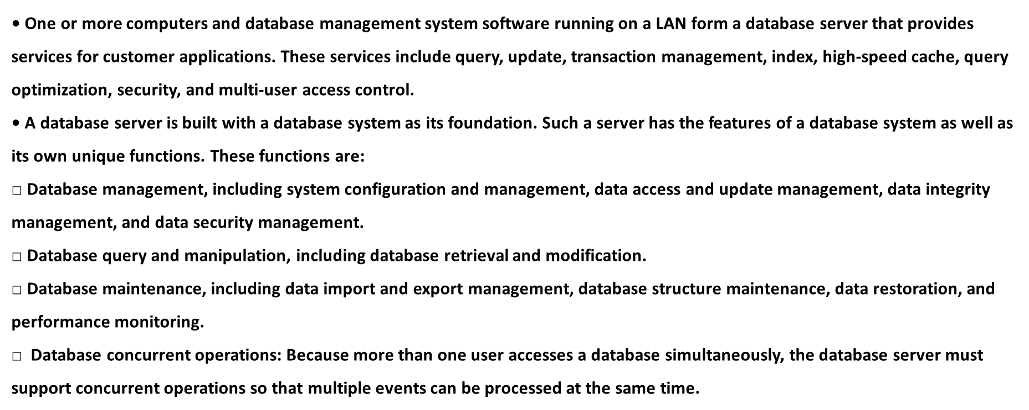
Chapter
05
Database Server

Slide 16
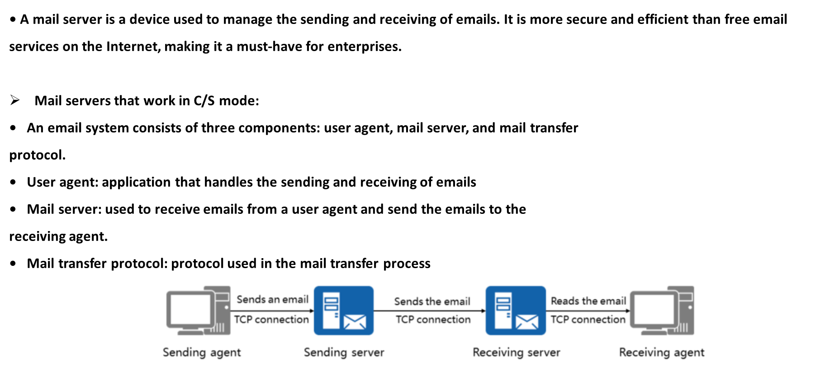
Chapter
05
Mail Server

Slide 17
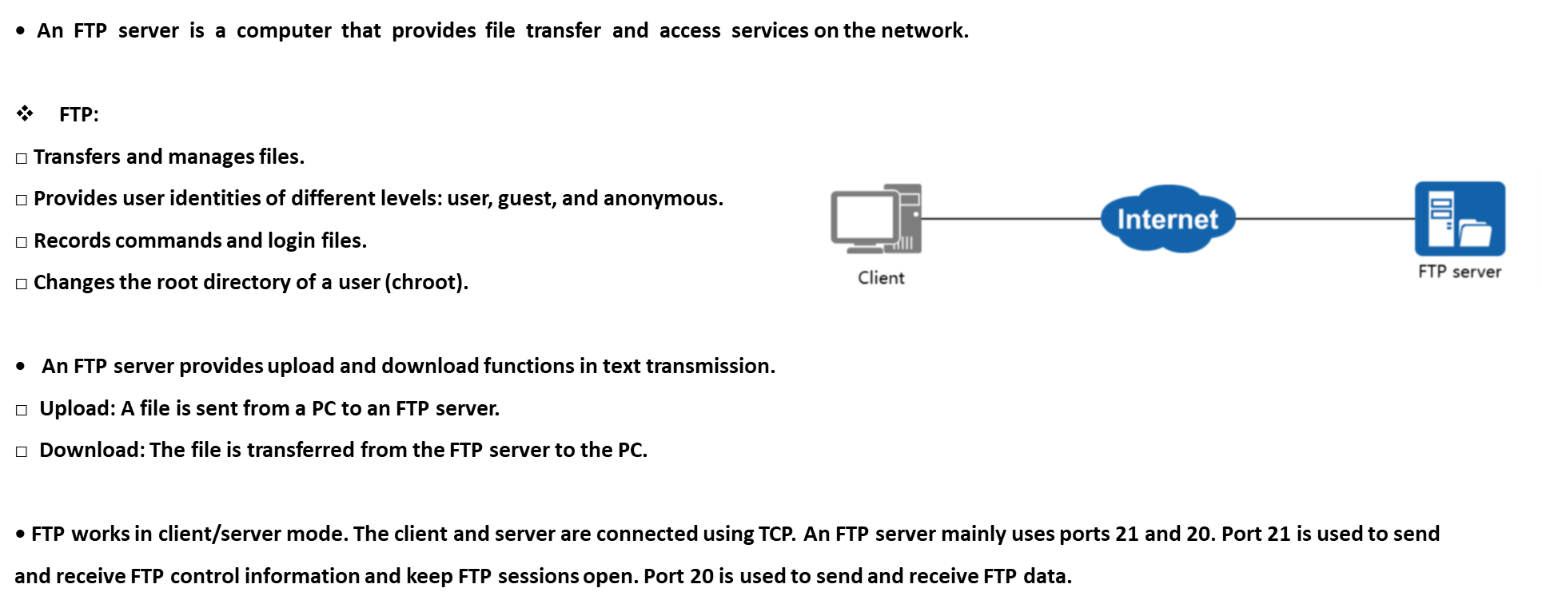
Chapter
05
FTP Server

Slide 18
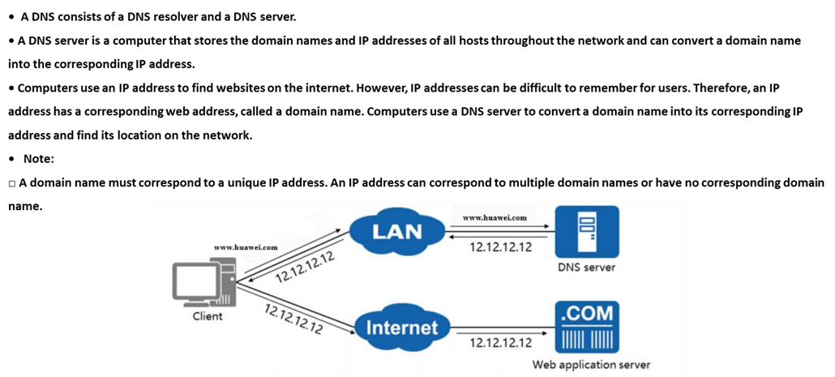
Chapter
05
DNS Server

Slide 19
Chapter
05
Server Security Threats
• Which security threats may affect the running of a server?

Slide 20
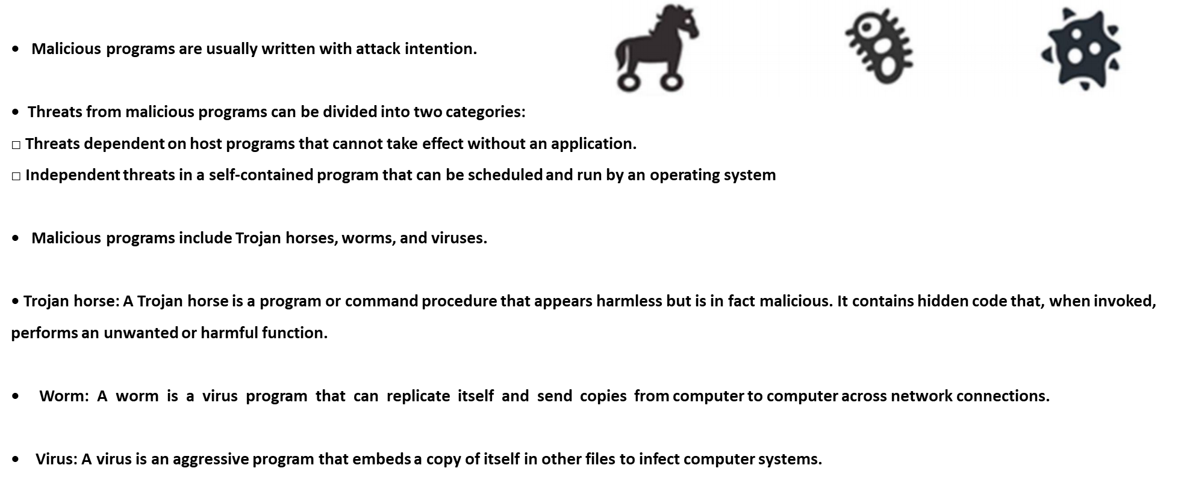
Chapter
05
Malicious Programs

Slide 21
Chapter
05
Brute Force Cracking by Hackers
• If hackers fail to acquire a password by conventional means, they may use
brute force to crack the password.
• Brute force cracking is an exhaustive search method in which a hacker tries
many combinations to obtain the password.

Slide 22
Chapter
05
SQL Injection Attacks
• An SQL injection attack inserts malicious SQL commands into the input field of a web form or the query string of a page request to deceive the server to execute malicious SQL commands.
• The commands entered are used to build (or manipulate) dynamic SQL commands or as input parameters for storage procedures. Such forms are particularly vulnerable to SQL injection attacks. For non-web CS framework systems, SQL injection risks also exist.

Slide 23
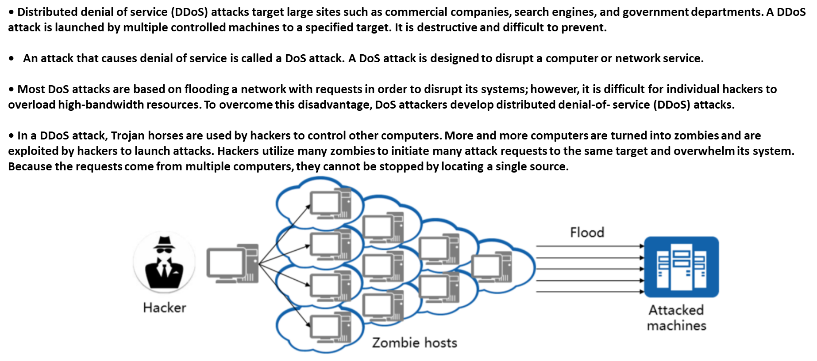
Chapter
05
DDoS Attacks

Slide 24
Chapter
05
Common Security Threat Defense Methods

Slide 25
Chapter
05
Definition of Vulnerability
• A vulnerability is a defect or weakness in the hardware, software, or protocols of computer systems or in system security policies.
• In 1990, Dennis Longley and Michael Shain defined vulnerability as follows in The Data and Computer Security Dictionary of Standard, concepts, and Terms:
□ In computer security, a weakness in automated system security procedures, administrative controls, internal controls, etc. that could be exploited by a threat to gain unauthorized access to information or to disrupt critical processing.
• Vulnerabilities are unknown and cannot be discovered in advance.
• Vulnerabilities are security risks, which may expose computers to attacks by viruses or hackers.
• If a vulnerability is exploited, the consequences are unpredictable.
• Vulnerabilities can be exploited remotely.
• Generally, vulnerabilities can be fixed.

Slide 26
Chapter
05
Vulnerability Hazards

Slide 27
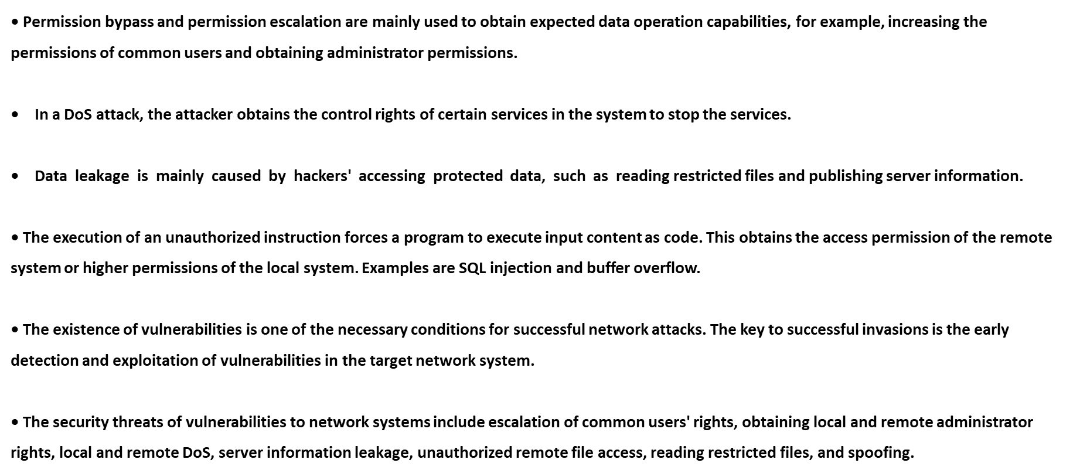
Chapter
05
Vulnerability Hazards

Slide 28
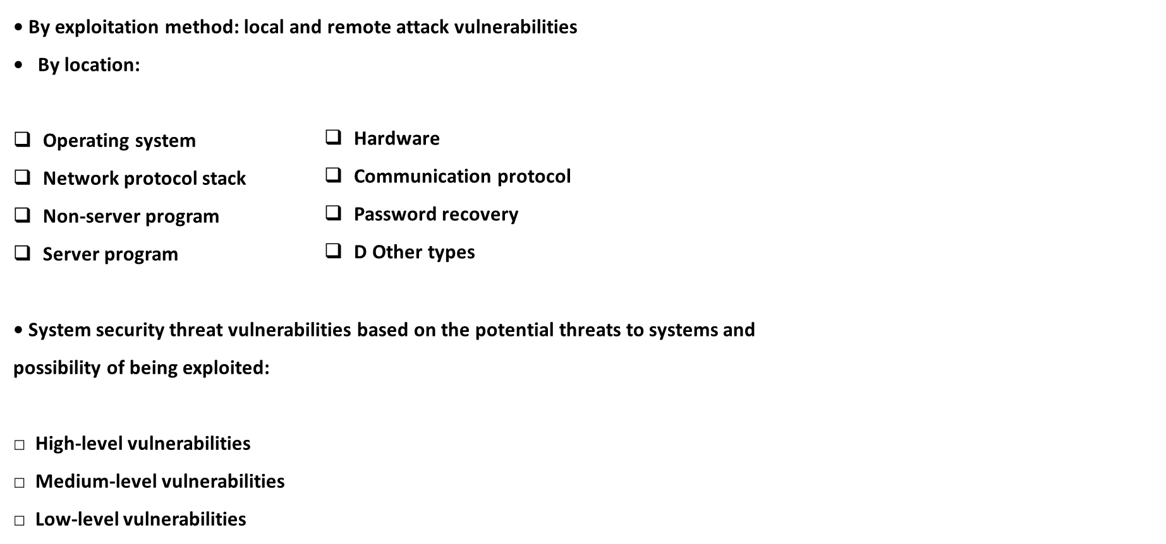
Chapter
05
Vulnerability Classification

Slide 29
Chapter
05
Vulnerability Classification
• Attackers who exploit local attack vulnerabilities can be local authorized users or unauthorized users who have obtained local rights through other methods.
• Attackers who exploit remote attack vulnerabilities attack remote hosts on networks.
• High-level vulnerabilities can be exploited to obtain administrator permissions.
• Medium-level vulnerabilities can be exploited to obtain the permissions of common users, read restricted files, and reject services.
• Low-level vulnerabilities can be exploited to read unrestricted files and leak server information.
• Of course, there are more vulnerability categories. For example, the status of a vulnerability can be known, unknown, and zero-day. Vulnerabilities can also be classified by user groups, such as Windows, Linux, Internet Explorer, and Oracle vulnerabilities.

Slide 30
Chapter
05
Causes of System Vulnerabilities
• Defects in software or protocol design
• Bugs in software compilation
• Improper system configuration
• Limited security awareness
• Vulnerabilities are "inevitable". This is determined by the complexity of systems.

Slide 31
Chapter
05
Vulnerability Scanning

Slide 32
Chapter
05
Common scanning methods

Slide 33
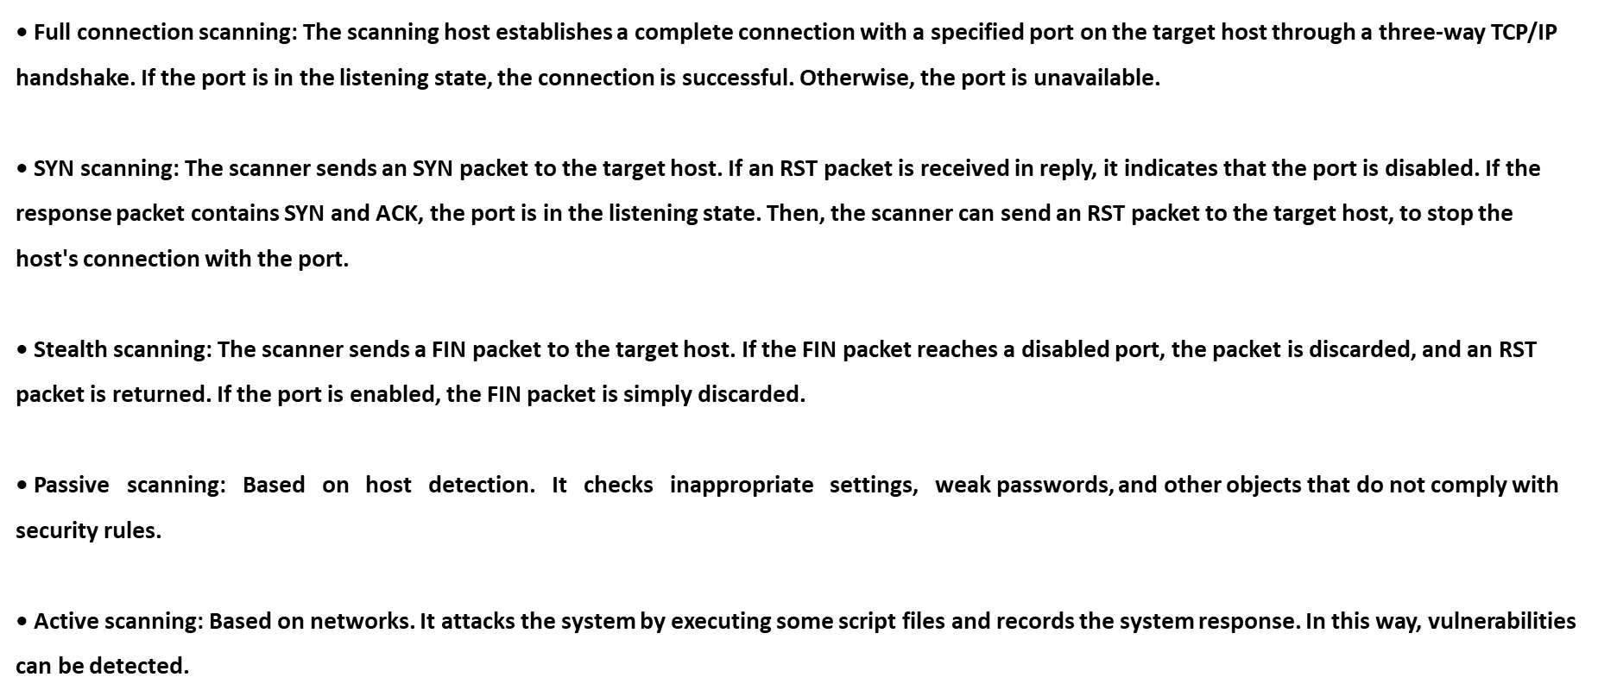
Chapter
05
Common scanning methods

Slide 34
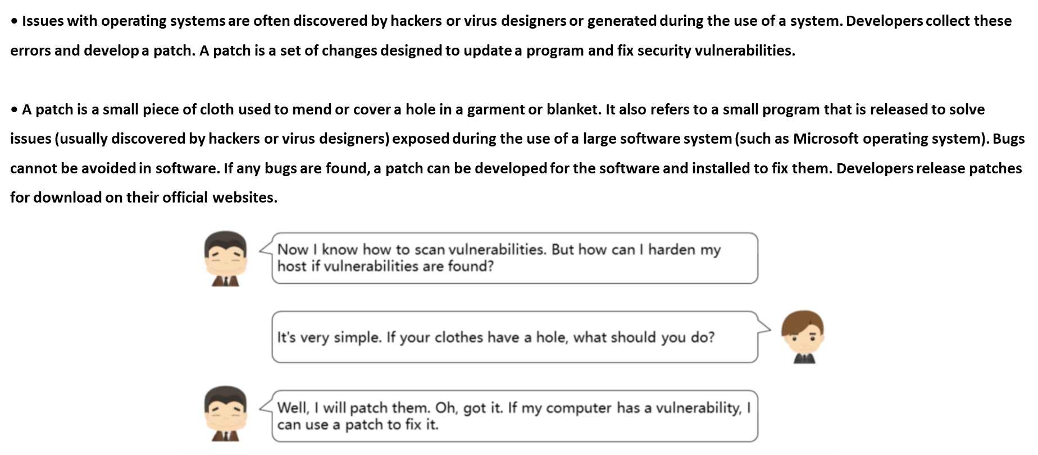
Chapter
05
Definition of Patch

Slide 35
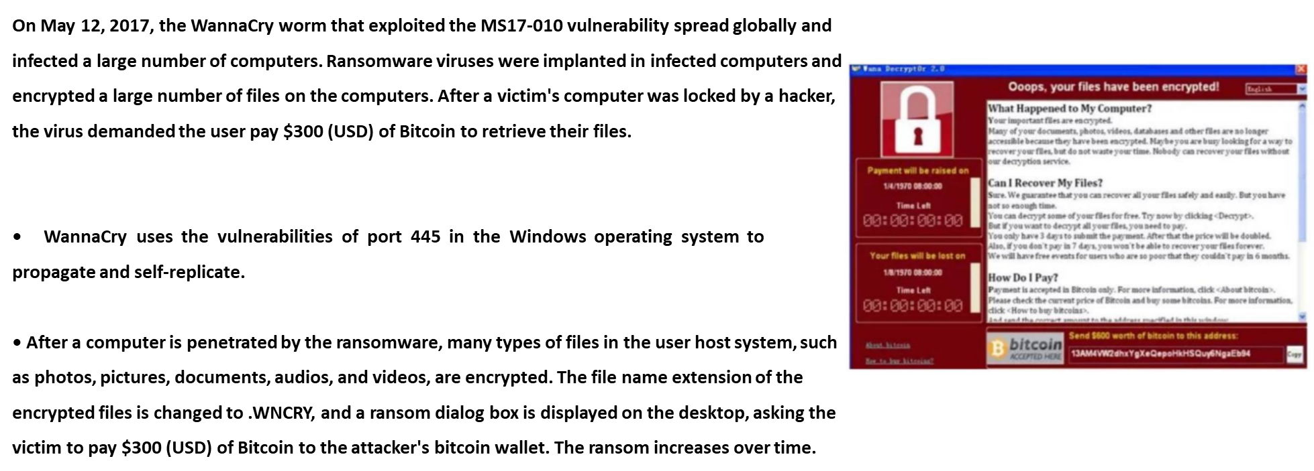
Chapter
05
WannaCry Ransomware Attack

Slide 36
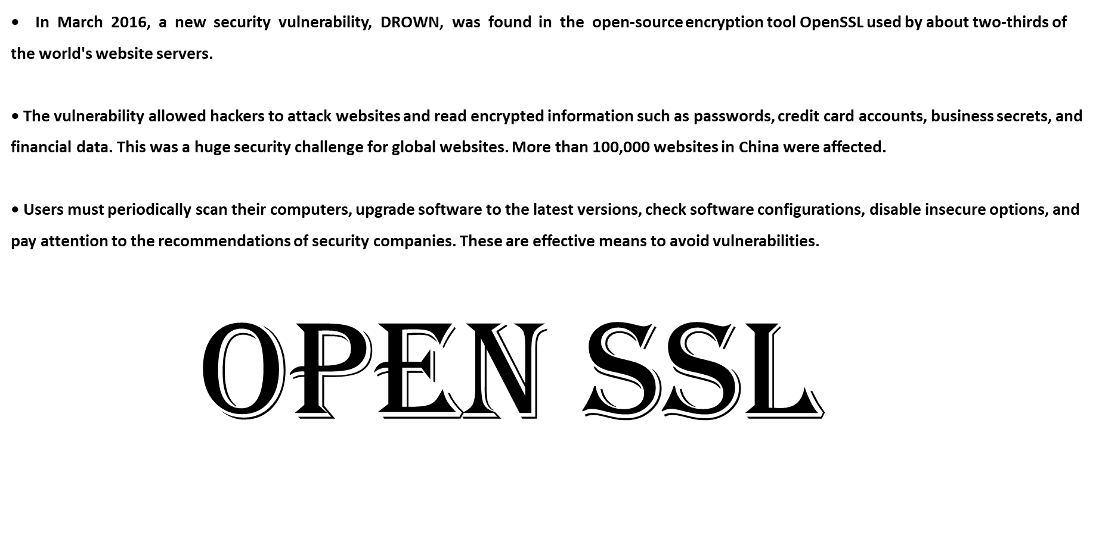
Chapter
05
DROWN Vulnerability

Slide 37
Chapter
05
How Do You Defend Against These Vulnerabilities?
• How to implement these defenses?

Slide 38



Thank You

