Slide 1



Planning
Lecture 4
MGM111
Principle of Management
Prepared by
Dr. Bothaina Mahmoud Fouad
www.midocean.ae
www.midocean.ae

Slide 2

www.midocean.ae
planning definition and its benefits
Planning elements
types of plans do managers use.
useful planning tools and techniques.
Learning Outcomes of the Lecture

Slide 3
A job well planned is half done
www.midocean.ae

Slide 4
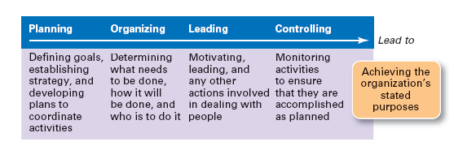
www.midocean.ae

Slide 5
Planning bridges the gap from where we are to where we want to go .
Planning decide in advance:
What to do, how to do
Why to do
Where to do
Who will be responsible for doing
www.midocean.ae

Slide 6
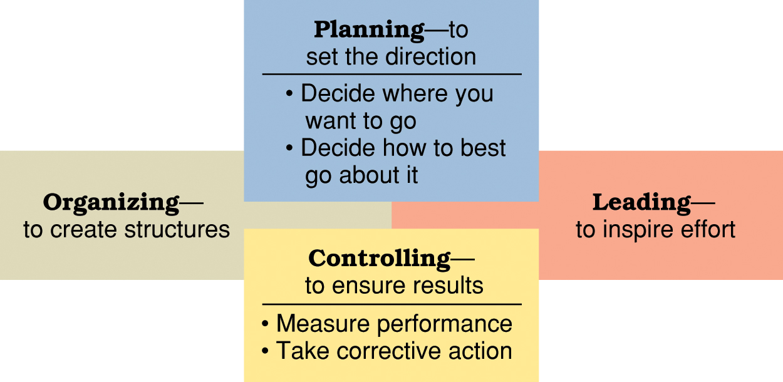
The roles of planning and controlling in the management process.
www.midocean.ae

Slide 7
What is planning
  Identifying and selecting appropriate goals and courses of action for an organization.
    The organizational plan that results from the planning process details the goals and specifies how managers will attain those goals
www.midocean.ae

Slide 8
Planning is determining
the objectives and formulating the methods to achieve them.
And
how they’ll be met
www.midocean.ae

Slide 9
Before You Plan
Mission Statement
what we do; purpose of organization
Vision Statement
how we want it to be; future state of organization
Values
what do we stand for; culture framework
Primary Objectives
how to get there; translated into goals and action plans
www.midocean.ae

Slide 10
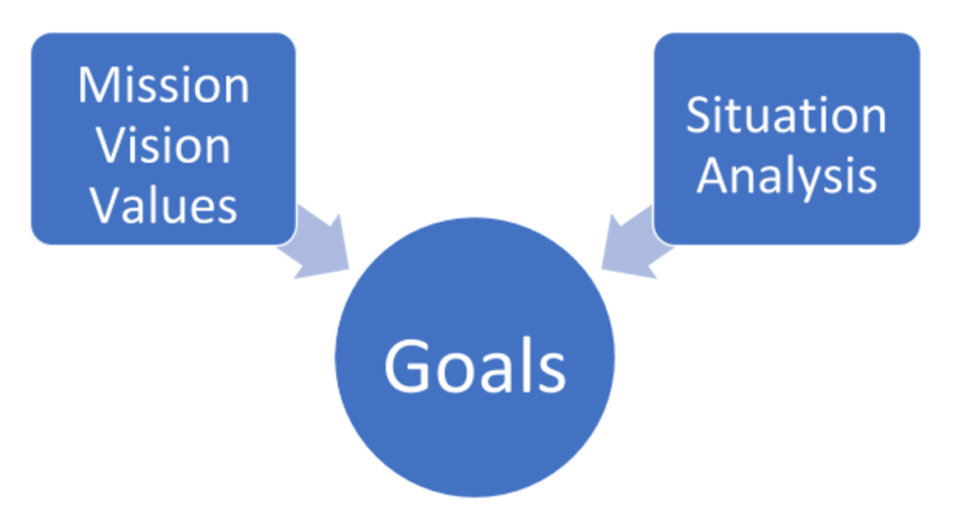
Understanding Mission
Mission Statement
  describes what organization needs to do to achieve vision
  will be more specific than vision statement
  conveys to stakeholders why the organization exists
  explains how it creates value for the market or the larger community
www.midocean.ae

Slide 11
Understanding Vision
Vision Statement
  is a statement of organization’s overarching aspirations of what it hopes to achieve
  should inspire people
  motivate people to want to be part of and contribute to the organization.
  should be clear and concise, usually not longer than a short paragraph
www.midocean.ae

Slide 12
Understanding Values
Values Statement
  defines what organization believes in
  describes how people should behave
  must be reinforced at all levels of organization
  called the “code of ethics”
  provides a standard for employees to judge violations.
www.midocean.ae

Slide 13
Planning Benefits
Planning helps identify goals
Planning Controls the organization standard
Planning provides direction and improves action orientation.
Planning involves choice
www.midocean.ae

Slide 14
Planning Benefits, Con’t
Planning improves efficiency, control and time management
Planning allows flexibility and improve focus
Planning Enhances cooperation and coordination
Planning Optimizes resource allocation and improves resource utilization
Planning gives Effective results
www.midocean.ae

Slide 15
Why Should We Plan?
To set the organization up for positive outcomes
To directly address issues/threats
www.midocean.ae

Slide 16
Why Should We Plan?, Con’t
Better leadership and Gives the organization a sense of direction
A clearly defined mission, vision, and strategy
A clear picture of trends which may impact the organization now and in the future
Identification of short- and long-term “attention” areas
Specific plans to improve performance and to anticipate future change
Consistent, sustained success, as opposed to marginal success
Involve staff in decision making and more cohesive team
Helps coordinate the different functions and departments
Facilitate control and demonstrate accountability
Want to plan change, not become a victim of change
www.midocean.ae

Slide 17
Elements of Planning
Goals (also Objectives)
  Desired outcomes for individuals, groups, or entire organizations
  Provide direction and evaluation performance criteria
Plans
  Documents that outline how goals are to be accomplished
  Describe how resources are to be allocated and establish activity schedules
www.midocean.ae

Slide 18
Types of Goals
Financial Goals
related to the expected internal financial performance of the organization.
Strategic Goals
related to the performance of the firm relative to factors in its external environment (e.g., competitors).
www.midocean.ae

Slide 19
Managers have to follow six steps when setting goals
  Review the organization's mission and the employee’s key job tasks.
  Evaluate available resources.
  Determine the goals individually or with input of others.
  Make sure goals are well-written and then communicate them to all who need to know.
  Build in feedback mechanisms to assess goal progress.
  Link rewards to goal attainment.
www.midocean.ae

Slide 20
Remember you should have Well-Written Goals
To have well-written goals, you have to take in your consideration :
  Written in terms of outcomes rather than actions
  Measurable and quantifiable
  Clear as to time frame
  Challenging yet attainable
  Communicated to all necessary organizational members
www.midocean.ae

Slide 21
Managers plan
Planning
The process of setting objectives and determining how to best accomplish them.
Objectives
Identify the specific results or desired outcomes that one intends to achieve.
A statement of action steps to be taken in order to accomplish the objectives.
Plan
www.midocean.ae

Slide 22
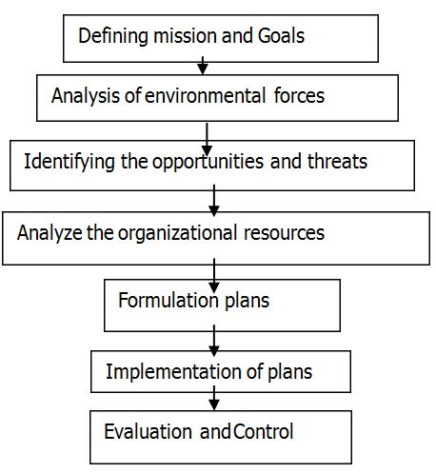
Planning is a process consisting of several steps.
www.midocean.ae

Slide 23
Planning is a process consisting of several steps.
Understand the Mission and Vision - The mission and vision identify the values and purpose of the organization. They will drive the development of goals and objectives. These objectives will serve as benchmarks as to whether you are furthering the companies mission and moving toward its vision.
Identify Objective - These are the things that a company wishes to achieve.
Courses of Action - What are the alternative courses of action for achieving the desired objectives.
Planning Steps
Understand the Mission and Vision
Identify Objective
Courses of Action
+ Evaluate Alternatives
Choosing a Course of Action
Implement Plan and tasks
Determine tracking and Evaluate Results
www.midocean.ae

Slide 24
Planning is a process consisting of several steps, Con’t
4. Evaluate Alternatives - Evaluate the various alternatives to identify characteristics, requirements, and likely outcomes.
5. Choosing a Course of Action - Based on the characteristics of each alternative, the planner must make decisions about the best courses of action for achieving objectives.
6. Implement Plan - The planner must now execute the chosen course of action.
7. Determine tracking and Evaluate Results - After implementing the plan, planners must continually evaluate the success of their plans and take corrective action when necessary.
Planning Steps
Understand the Mission and Vision
Identify Objective
Courses of Action
+ Evaluate Alternatives
Choosing a Course of Action
Implement Plan and tasks
Determine tracking and Evaluate Results
www.midocean.ae

Slide 25
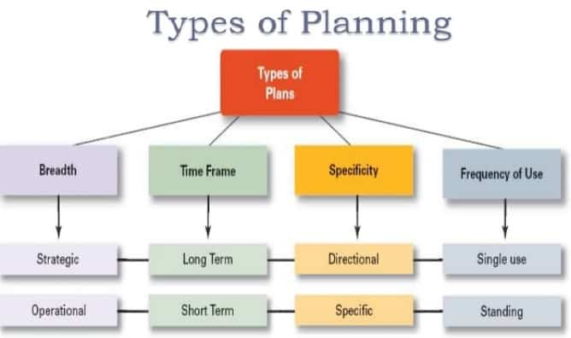
Types of Planning
www.midocean.ae

Slide 26
Essential Aspects of the Planning Cycle
Maintaining organizational focus
  Defining specific goals to consider the vision, mission, and values of the organization
Encouraging diverse participation
  Provides opportunity for input
  Establish planning committees that intentionally include people from diverse backgrounds
Empowering and motivating employees
  Empowers people to contribute
  Motivates them to support outcomes
www.midocean.ae

Slide 27
What types of plans do managers use(by time frame)?
Short, Intermediate and long-range plans:
  Short-range plans = 1 year or less
  Intermediate-range plans = 1 to 2 years
  Long-range plans = 3 or more years
People vary in their capability to deal effectively with different time horizons.
Higher management levels focus on longer time horizons.
www.midocean.ae

Slide 28
Long-range plans
= 3 or more years
Intermediate-range plans = 1 to 2 years
Short-range plans = 1 year or less
www.midocean.ae

Slide 29
What types of plans do managers use?
Strategic plans
operational plans
Policies and procedures
Budgets and project schedules
www.midocean.ae

Slide 30
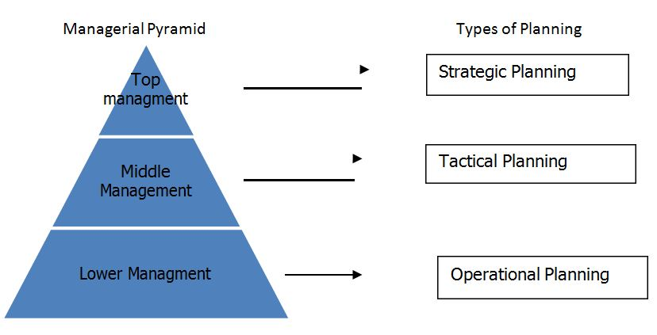
Managerial Hierarchy and planning system
www.midocean.ae

Slide 31
Managerial Hierarchy and planning system
Strategic Plan:
Strategic plan is also called grand plan.
It has a strong external orientation and covers the total organization.
It begins by asking question regarding the purpose or mission and the operation to which an organization is devoted.
Senior executives are responsible for the development of these plans.
www.midocean.ae

Slide 32
Remember
There is a difference between
Strategic planning
  A set of procedures for making decisions about the organization’s long-term goals and strategies
Strategic goals
  major targets or end results that relate to the long-term survival, value, and growth of the organization.
www.midocean.ae

Slide 33
Managerial Hierarchy and planning system
2. Tactical plan:
Tactical plans translate broad strategic goals and plans into specific goals and plans.
It mainly focuses on functional areas of the organization.
Middle level managers who are responsible for major division or branches in an organization develop the tactical plan.
Tactical plans focus on the major actions that a unit must take to fulfill its parts of the strategic plan.
www.midocean.ae

Slide 34
Managerial Hierarchy and planning system
3. Operational plan:
Operational plans identify the specific procedures and process required at the lower level of the organization.
These plans are prepared by frontline managers and supervisors. It mainly focuses on daily activities and routine jobs.
They translate the tactical objectives into specific operational activities to be assigned to individual or groups
www.midocean.ae

Slide 35
Operational Plans Examples
    Production plans
    Financial plans
    Facilities plans
    Marketing plans
    Human resource plans
www.midocean.ae

Slide 36
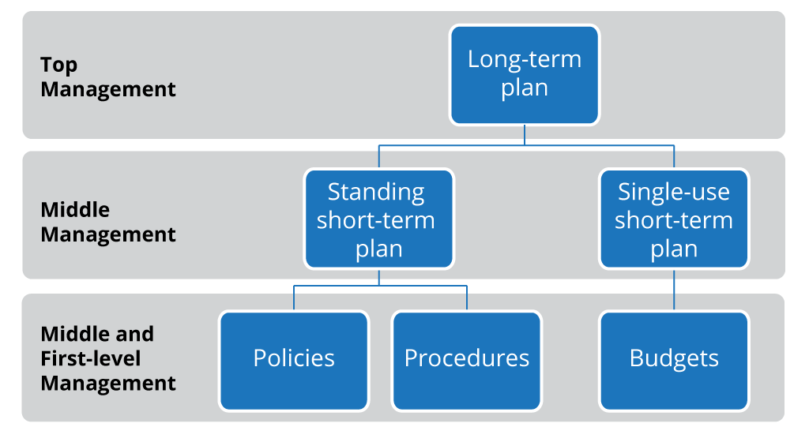
Long-Term & Short-Term Plans and its relation with the management levels
Budgets and Projects Schedules
www.midocean.ae

Slide 37
Standing plans
are plans designed to be used again and again. Examples include policies, procedures, and regulations.
Single-use plans
The obvious advantage of a single-use plan is that it can be very specific in how it addresses the needs of a particular situation.
Policies, Procedures, and Regulations,
These plans are usually published and handed out to new hires or posted on the organization’s employee website for easy reference.
www.midocean.ae

Slide 38
useful planning tools and techniques
1- Forecasting
2- Contingency planning
3- Scenario planning
4- Benchmarking
5- Use of staff planners
www.midocean.ae

Slide 39
Forecasting
  Making assumptions about what will happen in the future.
  Qualitative forecasting uses expert opinions.
  Quantitative forecasting uses mathematical and statistical analysis.
  All forecasts rely on human judgment.
  Planning involves deciding on how to deal with the implications of a forecast.
Contingency planning
  Identifying alternative courses of action that can be implemented to meet the needs of changing circumstances.
  Contingency plans anticipate changing conditions.
  Contingency plans contain trigger points.
www.midocean.ae

Slide 40
Scenario planning
  A long-term version of contingency planning.
  Identifying alternative future scenarios.
  Plans made for each future scenario.
  Increases organization’s flexibility and preparation for future shocks.
Benchmarking
  Use of external comparisons to better evaluate current performance and identify possible actions for the future.
  Adopting best practices of other organizations that achieve superior performance.
www.midocean.ae

Slide 41
Use of staff planners
  Coordinating the planning function for the total organization or one of its major components.
  Possible communication gaps between staff planners and line management.
www.midocean.ae

Slide 42
“If you don’t know where you’re going, any road will get you there?”
“If you don’t know where you’re going, how will you know when you get there?”
Strategic planning solves these problems.
www.midocean.ae

Slide 43
Planning in a Dynamic Environment
Plans need to be specific and flexible
Planning should be an ongoing process
Managers need to stay alert to environmental changes
Make the organizational hierarchy flatter
www.midocean.ae

Slide 44



Thank You

