Slide 1

MGM 112
Introduction to Economics
Prepared by Dr. Maryem ZORGUI
Lecture 11:
Economic Measurements

Slide 2
Syllabus
Part I:
The Measurement and
Structure of the
National Economy
Part II:
Globalisation &
Human and Suistainble Development

Slide 3
Part I:
The Measurement and
Structure of the
National Economy
C / I / S /unemployment

Slide 4
I- The GDP Componenets
Economists and statisticians use several methods to track economic growth. The most well-known and frequently tracked is the Gross Domestic Product (GDP).
Over time, however, some economists have highlighted limitations and biases in the GDP calculation.
Organizations such as the Bureau of Labor Statistics (BLS) and the Organization for Economic Co-operation and Development (OECD) also keep relative productivity metrics to gauge economic potential.
Notes:
1-The Bureau of Labor Statistics (BLS) is an American government agency tasked with collecting and disseminating a range of economic and employment data.
2- The Organisation for Economic Co-operation and Development (OECD) is a group of 37 member countries that discuss and develop economic and social policy

Slide 5
I- The GDP Componenets
The expenditure approach to measuring GDP
Measures total spending on final goods and services produced within a nation during a specified period of time
Four main categories of spending: consumption (C), investment (I), Government purchases of goods and services (G), and net exports (NX)
Y = C + I + G + NX
  the income-expenditure identity
  exports minus imports

Slide 6
I- The GDP Componenets
I- 1- Consumption
Consumption can be defined in different ways, but is usually best described as the final purchase of goods and services by individuals. It is also often referred to as consumer spending.
Consumption is one of the biggest concepts in economics and is extremely important because it helps determine the growth and success of the economy.
  Businesses can open up and offer all kinds of great products, but if we don't purchase or consume their products, they won't stay in business very long

Slide 7
I-1-1- Theories of Consumption
Absolute Income Theory (Keynes) | Relative Income Theory of Consumption
According to Keynes, of all the factors it is the current level of income that determines the consumption of an individual and also of society. Keynes put forward a psychological law of consumption, according to which, as income increases consumption increases but not by as much as the increase in income. In other words, marginal propensity to consume is less than one. | Because his relative income has remained the same the individual will spend the same proportion of his income on consumption as he was doing before the absolute increase in his income. That is, his average propensity to consume (APC) will remain the same despite the increase in his absolute income

Slide 8
Demonstration Effect: individuals or households try to imitate or copy the consumption levels of their neighbours or other families in a particular community. | Ratchet Effect: when income of individuals or households falls, their consumption expenditure does not fall much
 | this is partly due to the demonstration effect partly due to the fact that they become accustomed to their previous higher level of consumption and it is quite hard and difficult to reduce their consumption expenditure when their income has fallen. the fall in their income, as during the period of recession or depression, does not result in decrease in consumption expenditure very much as one would conclude from family budget studies
if incomes of all families increase in the same proportion, distribution of relative incomes would remain unchanged and therefore the proportion of consumption expenditure to income which depends on relative income will remain constant.
family with a given income would devote more of his income to consumption if it is living in a community in which that income is regarded as relatively low because of the working of demonstration effect.

Slide 9
I-1-2-Life Cycle Theory of Consumption ( Ando & Modigliani)
Idea: the consumption in any period is not the function of current income of that period but of the whole lifetime expected income
Assumptions:
  to plan a pattern of consumption expenditure based on expected income in their entire lifetime
  individual maintains a more or less constant or slightly increasing level of consumption
  his level of consumption is limited by his expectations of lifetime income

Slide 10
A typical individual in this theory in his early years of life spends on consumption either by borrowing from others or spending the assets bequeathed from his parents.
It is in his main working years of his lifetime that he consumes less than the income he earns and therefore makes net positive savings. He invests these savings in assets, that is, accumulates wealth which he consumes in the future years. In his lifetime after retirement he again dissaves, that is, consumes more than his income in these later years of his life but is able to maintain or even slightly increase his con­sumption in the lifetime after retirement

Slide 11
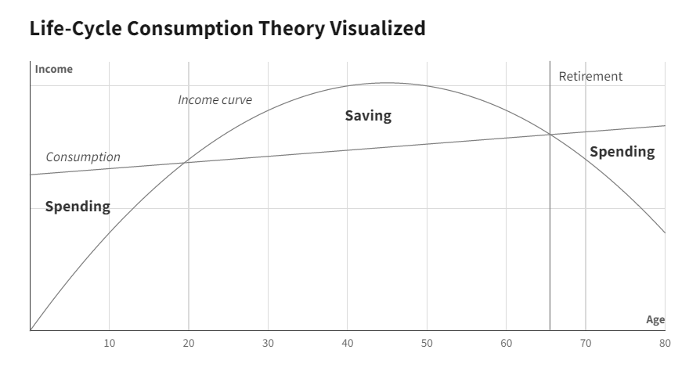

Slide 12
I-1-3- the Consumer Price Index (CPI)
The Consumer Price Index (CPI) is a measure of the changes in the average price of goods and services that consumers normally purchase such as food, clothing, medicals and others. ...
The value of money is the purchasing power of the consumer, or the ability to buy goods and Services.
The CPI is one of the most frequently used statistics for identifying periods of inflation or deflation. It may be compared with the Producer Price Index (PPI), which, instead of considering prices paid by consumers, looks at what businesses pay for inputs.

Slide 13
I-1-4- The Producer Price Index (PPI)
The Producer Price Index (PPI), published by the Bureau of Labor Statistics (BLS), is a group of indexes that calculates and represents the average movement in selling prices from domestic production over time.
It is a measure of inflation based on input costs to producers
Notes:
The Bureau of Labor Statistics (BLS) is an American government agency tasked with collecting and disseminating a range of economic and employment data.
The BLS is responsible for two key inflation indicators: the Consumer Price Index (CPI) and Producer Price Index (PPI).

Slide 14
I-2- Savings
saving, process of setting aside a portion of current income for future use, or the flow of resources accumulated in this way over a given period of time. Saving may take the form of increases in bank deposits, purchases of securities, or increased cash holdings. The extent to which individuals save is affected by their preferences for future over present consumption, their expectations of future income, and to some extent by the rate of interest.
Saving involves income that is not consumed
Savings can be turned into further increased income through investing in different investment vehicles.

Slide 15
  Saving is often confused with investing, but they are not the same.
  Although most people think of purchases of stocks and BONDS as investments, economists use the term “INVESTMENT” to mean additions to the real stock of capital: plants, factories, equipment….
Types of Saving
Personal savings What people save, avoiding to consume all their income, is called "personal savings". These savings can remain on the bank accounts for future use or be actively invested in houses, real estate, bonds, shares and other financial instruments | National savings National savings = personal savings + the business savings + public savings. Business savings can be measured by the value of undistributed corporate profits. Public savings are basically tax revenues less public expenditure.

Slide 16
I-3- Investments
Investment is the Money committed or property acquired for future income.
An investment is an asset or item that is purchased with the hope that it will generate income or will appreciate in the future.
In an economic sense, an investment is the purchase of goods that are not consumed today but are used in the future to create wealth.
In finance, an investment is a monetary asset purchased with the idea that the asset will provide income in the future or will be sold at a higher price for a profit.

Slide 17
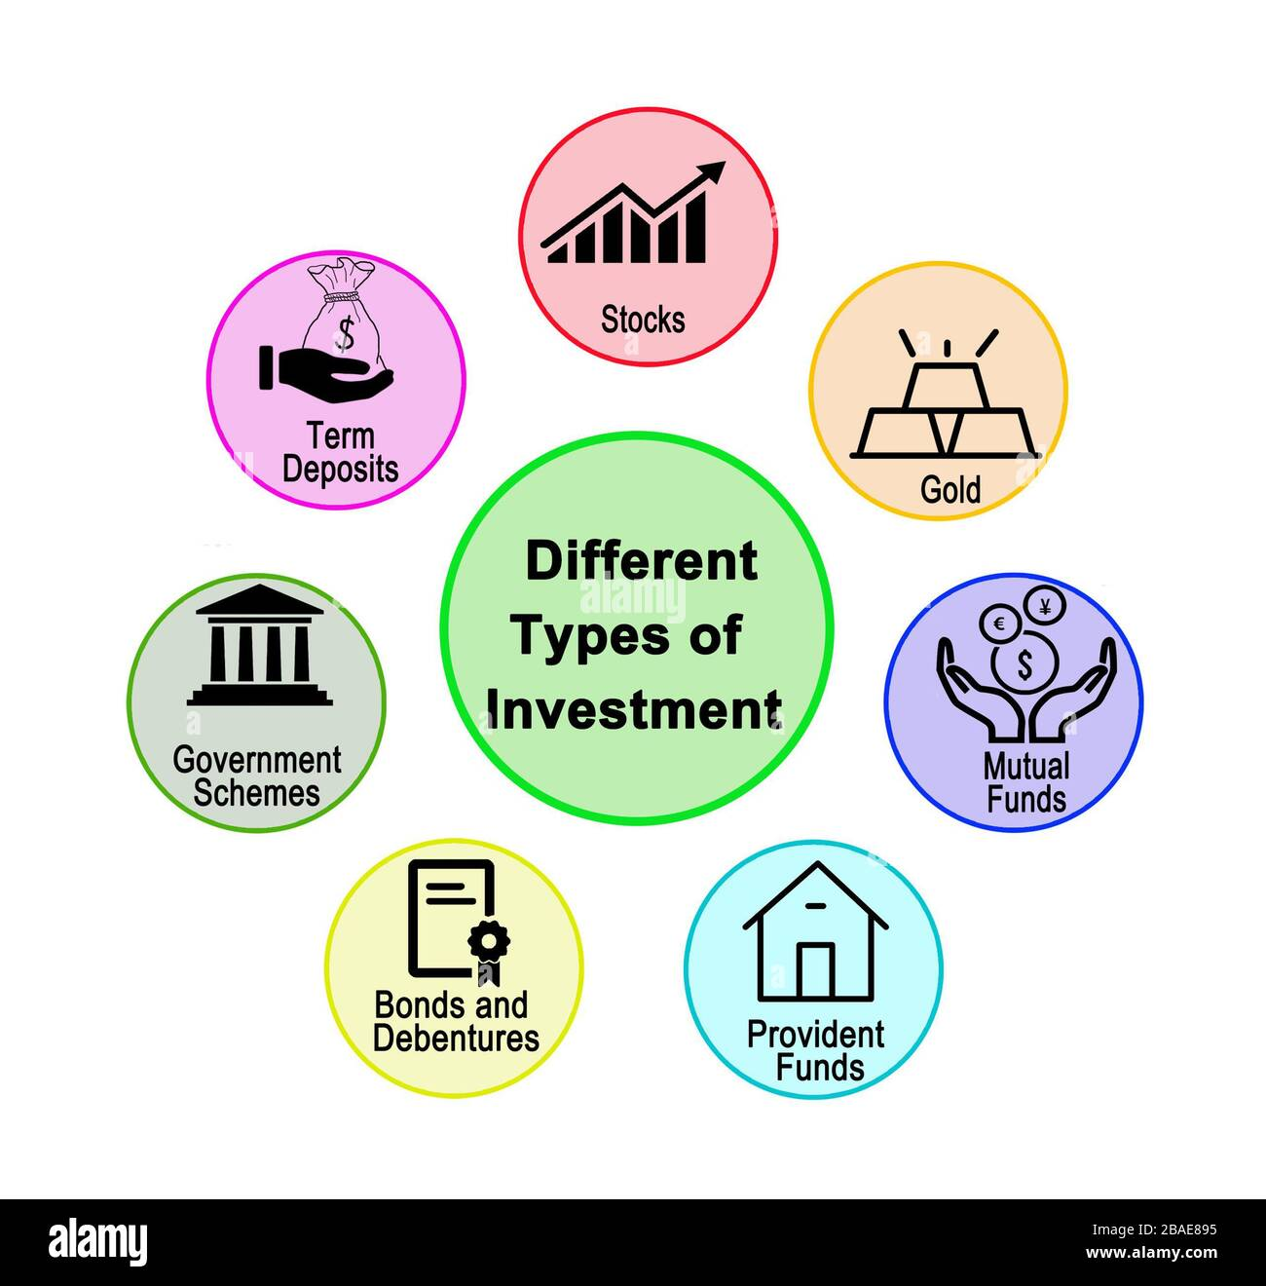
Leverage Firms (Companies) are the best place to invest, because it’s Earning per share is high. So, the high amount you put the more profit you gain from your share or stock.
    Always invest in that firm or thing whose rate of return or profitability in future is high
Fixed Investment - is spending on new capital machinery and plant, construction, housing, vehicles, etc.
Working Capital - is spending on stocks/ inventories of finished goods and raw materials. The accumulation of stocks by firms, whether voluntary or involuntary, is counted as investment

Slide 18
High consumption makes any product to stay long in market.
If consumption is not high then product will failed.
    Saving is what you have after all your expenses.
    Saving is not what you invest.
Investment is for the future profits.
.

Slide 19
II- The Unemployment
Unemployment is defined by the International Labor Organization (ILO) as a situation in which people are without jobs and they have actively looked for a job for the past four weeks.
According to this definition, people who do not look for a job will not be considered unemployed.
It’s an indicator based on the The working-age population which is
defined as those aged 15 to 64.
This indicator measures the share of the
working age population in total population.
Productive population
In the labor force
Not in the labor force
Employed
Unemployed
Notes:
The International Labour Organization (ILO) is a United Nations agency whose mandate is to advance social and economic justice through setting international labour standards.^{[1]} Founded in October 1919 under the League of Nations

Slide 20
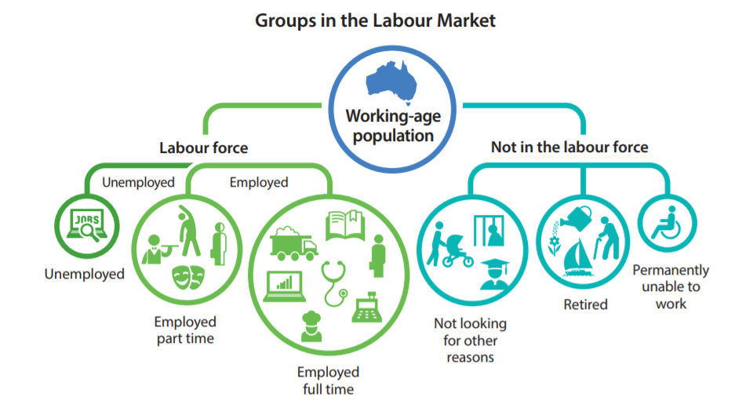

Slide 21
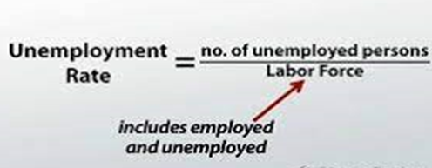
The main types of unemployment
Frictional Unemployment | Structural Unemployment | Seasonal Unemployment
Occurs when people change jobs, get laid off from their current jobs, take some time to find the right job after they finish their schooling, or take time off from working for a variety of other reasons | Occurs when workers' skills do not match the jobs that are available. Technological advances are one cause of structural unemployment | Occurs when industries slow or shut down for a season or make seasonal shifts in their production schedules
Cyclical Unemployment
Unemployment that rises during economic downturns and falls when the economy improves
The Unemployment Rate

Slide 22
III- The Business Cycle
The business cycle is the cycle ups and downs in the economy.
The main measure of how an economy is doing is aggregate output
  (the total quantity of goods and services produced in an economy in a given period)
The Business cycle is the rise and fall of economic activity relative to the long-term growth trend of the economy

Slide 23
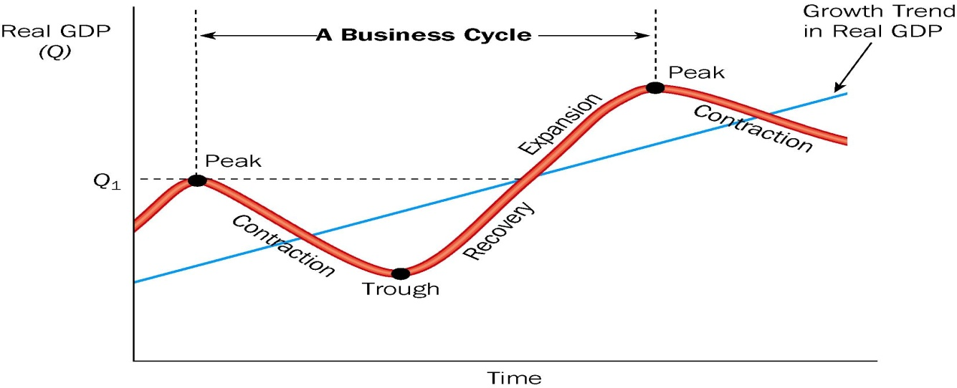
III- The Business Cycle
Ups and downs of the Business Cycle
Peak: at the peak of the business cycle, Real GDP is at a temporary high.
Contraction: A decline in the real GDP. If it falls for two consecutive quarters, it is said the economy to be in a recession.
Trough: The Low Point of the GDP, just before it begins to turn up.
Recovery: When the GDP is rising from the trough.
Expansion: when the real GDP expands beyond the recovery
Recession : two consecutive quarter declines in Real DP

Slide 24
IV- THE DIFFERENT GOVERNMENT POLICIES
There are three kinds of policies that the Government has used to influence the macroeconomics:
Fiscal policy refers to government policies concerning taxes and spending.
Monetary policy consists of tools used by the Federal Reserve to control the quantity of money in the economy.
Growth policies are government policies that focus on stimulating aggregate supply instead of aggregate demand

Slide 25
Part II:
Globalisation &
Human and Suistainble Developement

Slide 26
I- Globalisation
I- What Is Globalization
Globalization is defined as a process that, based on international strategies, aims to expand business operations on a worldwide level, and was precipitated by the facilitation of global communications due to technological advancements, and socioeconomic, political and environmental developments.
  economic globalization
  cultural globalization
  political globalization

Slide 27
I- Globalisation
In 2000, the International Monetary Fund (IMF) identified four basic aspects of globalization:
* trade and transactions,
* Capital and investment movements,
* Migration and movement of people,
* the dissemination of knowledge
Globalizing processes affect and are affected by business and work organization, economics, sociocultural resources, and the natural environment

Slide 28
I- Globalisation
2- The Globalization’s Impacts
Economic impact
  Improvement in standard of living
  Increased competition among nations
  Widening income gap between the rich and poor
Social impact
  Increased awareness of foreign cultures
  Loss of local culture
Environmental impact
  Environmental degradation
  Environmental management

Slide 29
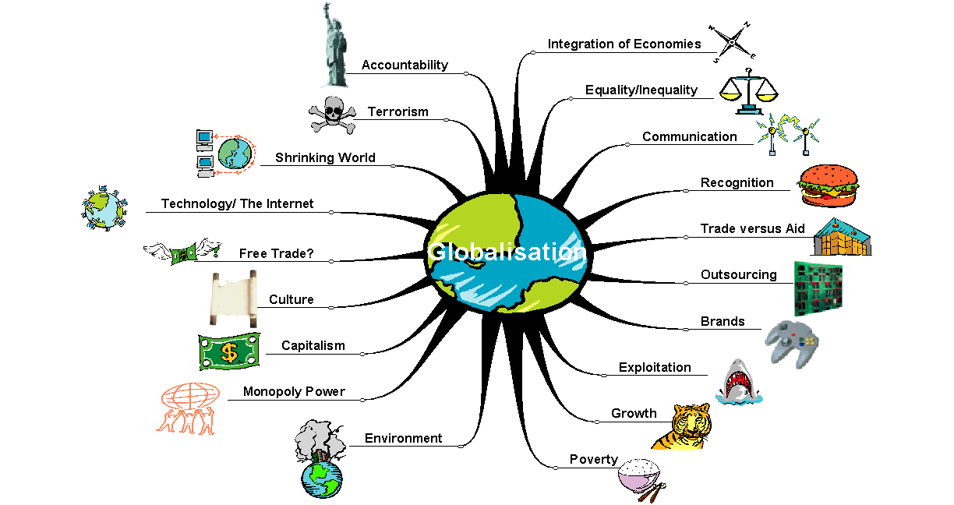
I- Globalisation
Globalisation

Slide 30
I- Globalisation
3- Factors which help the spread of globalisation
Low transport costs, containerization
Telecommunications
Internet
Low trade barriers
Political stability
Increasing role of TNCs

Slide 31
I- Globalisation
4- Specialization
Specialization is a method of production whereby an entity focuses on the production of a limited scope of goods to gain a greater degree of efficiency. Many countries, for example, specialize in producing the goods and services that are native to their part of the world, and they trade them for other goods and services.
This specialization is thus the basis of global trade, as few countries have enough production capacity to be completely self-sustaining.

Slide 32
I- Globalisation
5- Comparative Advantage
Comparative advantage is an economy's ability to produce a particular good or service at a lower opportunity cost than its trading partners.
The theory of comparative advantage introduces opportunity cost as a factor for analysis in choosing between different options for production.
Comparative advantage suggests that countries will engage in trade with one another, exporting the goods that they have a relative advantage in.
Absolute advantage refers to the uncontested superiority of a country to produce a particular good better.

Slide 33
II-The Human Development
II-The Human Development
Human development is defined as the process of enlarging people's freedoms and opportunities and improving their well-being. ... Central to the human development approach is the concept of capabilities.
Capabilities, what people can do and what they can become, are the equipment one has to pursue a life of value.

Slide 34
II-The Human Development
This Human Development can be calculated with The Human Development Index (HDI) which is a summary measure of average
achievement in key dimensions of human development:
* a long and healthy life,
* being knowledgeable and
* have a decent standard of living.

Slide 35
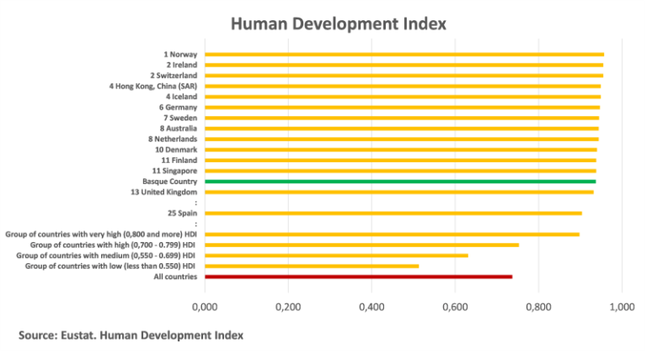
II-The Human Development

Slide 36
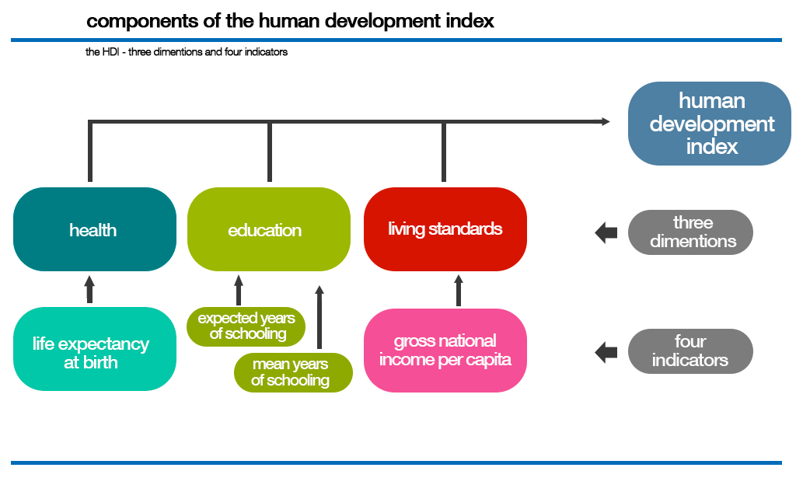
II-The Human Development

Slide 37
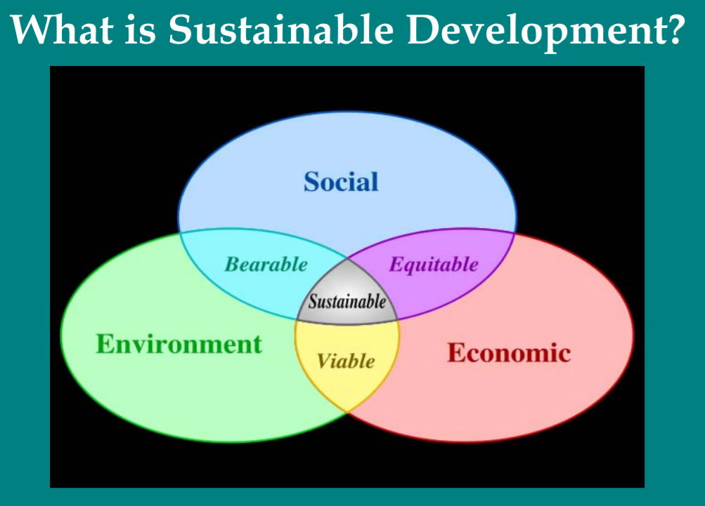
II-The Human Development
II- Sustainable development
Sustainable Development is an organizing principle
for meeting human development goals while
simultaneously sustaining the ability of natural systems
to provide the natural resources and ecosystem services
on which the economy and society depend.

Slide 38
II-The Human Development
The Sustainable Development Goals (SDGs)
The 17 Sustainable Development Goals (SDGs) and their related 169 targets, which are at the heart of the UN's 2030 Agenda for Sustainable Development, provide a new policy framework worldwide towards ending all forms of poverty, fighting inequalities and tackling climate change, while ensuring that no one is left behind.

Slide 39
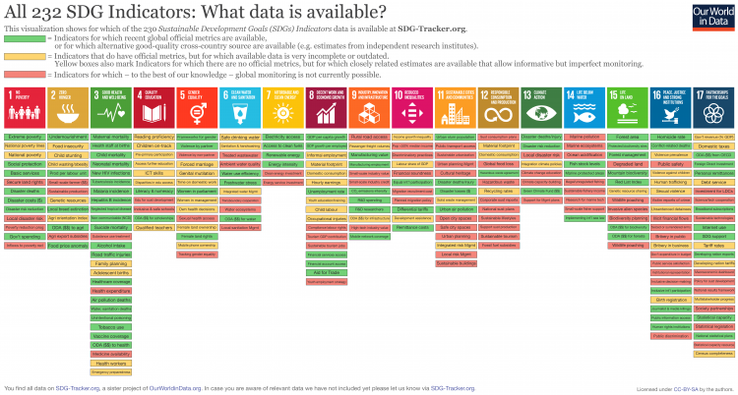

Slide 40
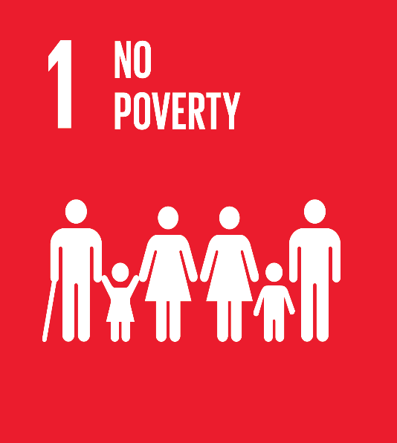
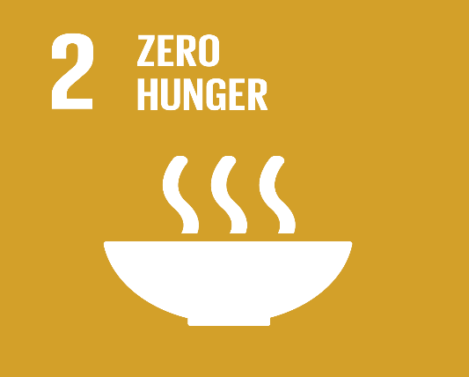



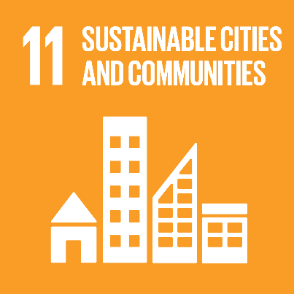






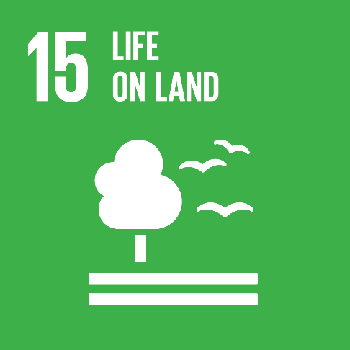

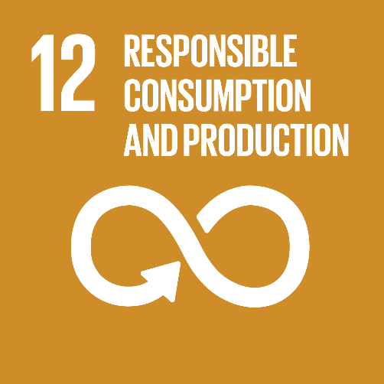



Slide 41


Slide 42
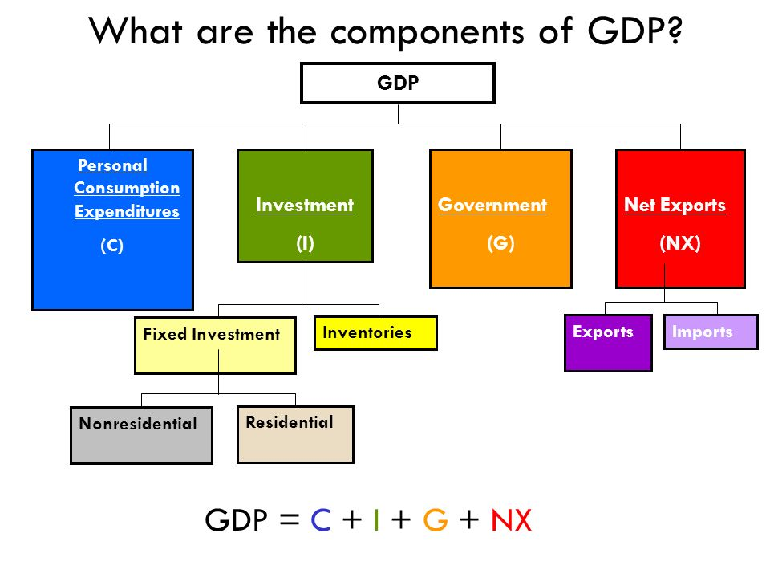
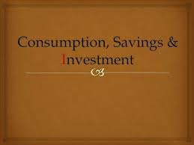
The GDP Componenets

Slide 43
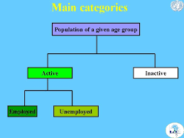
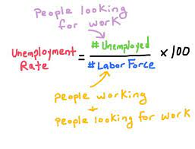
The Unemployment

Slide 44
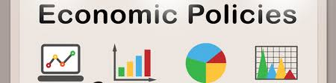
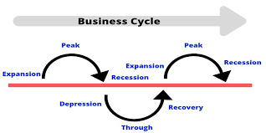
THE DIFFERENT GOVERNMENT POLICIES
&The Business Cycle

Slide 45
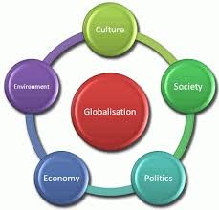
Globalisation

Slide 46
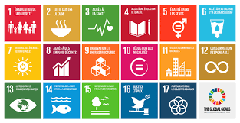

Human & SUSTAINABLE Development

Slide 47


Slide 48


