Slide 1

Project Feasibility Study
Lecture 5
Everyone’s Smart
University
PMG201
THE MANAGER, THE ORGANIZATION, AND THE TEAM

Slide 2

Out line
THE MANAGER, THE ORGANIZATION, AND THE TEAM
The PM’s Roles
The PM’s Responsibilities to the Project
Selection of a Project Manager
Project Management as a Profession
Fitting Projects Into the Parent Organization
The Project Team
Effective Team Management

Slide 3
1- THE PM ’ S ROLES
Once a project has been selected, the next step is for senior management to choose a project manager (PM). It is the PM ’ s job to make sure that the project is properly planned, implemented, and completed

Slide 4
THE PM ’ S ROLES
The PM is a facilitator, unlike the traditional manager who is a supervisor. The PM must adopt the systems approach to making decisions and managing projects. Trying to optimize each part of a project, sub optimization, does not produce an optimized project. Multiple communication paths exist in any project, and some paths bypass the PM, causing problems. Much project communication takes place in meetings that may be run effectively if some simple rules are followed. In virtual projects much communication is via high technology channels. Above all, the PM must keep senior management informed about the current state of the project.

Slide 5
THE PM ’ S ROLES
Facilitator
Communicator
Virtual Project Manager
Meetings, Convener and Chair

Slide 6
PM’s Role in Procurement
Know the procurement process; seek support early from specialists in contracting, purchasing, law, and technical disciplines.
Involvement should begin at the start of the procurement process
Understand contract terms and conditions
Ensure the contract contains all project management requirements and scope for the product or services being procured.
Identify risks and incorporate ways to avoid, mitigate, transfer to seller, or share the potential risk within the contract.
Fit the schedule for completion of the procurement process into the schedule for the project
Be engaged during contract negotiation to establish a relationships with the seller.
Manage the entire project, not just the contract statement of work
Work with the contract or procurement manager to manage contract change control

Slide 7
2- THE PM ’ S RESPONSIBILITIES TO THE PROJECT
The PM has three overriding responsibilities to the project. First is the acquisition of resources and personnel. Second is dealing with the obstacles that arise during the course of the project. Third is exercising the leadership needed to bring the project to a successful conclusion and making the trade - offs necessary to do so.

Slide 8
THE PM ’ S RESPONSIBILITIES TO THE PROJECT con…
The PM is responsible for acquiring the human and material resources needed by the project. The PM is also responsible for exercising leadership, fi re fighting, and dealing with obstacles that impede the project ’ s progress. Finally, the PM is responsible for making the trade - offs between budget, schedule, and scope that are needed to ensure project success. To be successful at meeting this responsibilities, the PM must be skilled at negotiation, conflict resolution, and persuasion.

Slide 9
THE PM ’ S RESPONSIBILITIES TO THE PROJECT cont…
Fighting Fires and Obstacles
Leadership and Making Trade – Offs
Negotiation, Conflict Resolution, and Persuasion

Slide 10
3- SELECTION OF A PROJECT MANAGER
A note to senior management: It is rarely a good idea to select a project manager from a list of engineers (or other technical specialists) who can be spared from their current jobs at the moment. Unfortunately, in many firms this appears to be the primary criterion for choice. We do not argue that current availability is not one among several appropriate criteria, but that it is only one of several — and never the most important. Neither does the list of criteria begin with “ Can leap over tall buildings with a single bound. ”

Slide 11
SELECTION OF A PROJECT MANAGER cont..
The most important criterion, by far, is that the prospective PM, in the language of sales people, is a “ closer. ” Find individuals who complete the tasks they are given. As any senior manager knows, hard workers are easy to find. What is rare is an individual who is driven to finish the job.

Slide 12
SELECTION OF A PROJECT MANAGER cont..
Given a set of such people, select those who meet the following criteria at reasonably high levels:
Credibility
Sensitivity
Leadership, Style, Ethics

Slide 13
SELECTION OF A PROJECT MANAGER cont..
Successful PMs have some common characteristics. They are “ closers. ” They also have high administrative and technical credibility, show sensitivity to interpersonal conflict, and possess the political know - how to get help from senior management when needed. In addition, the PM should be a leader, and adopt a participatory management style that may have to be modified depending on the level of technological sophistication and uncertainty involved in the project. Another critical project management skill is the ability to direct the project in an ethical manner.

Slide 14
4- PROJECT MANAGEMENT AS A PROFESSION
It should be obvious to the reader that project management is a demanding job. Planning and controlling the complexities of a project ’ s activities, schedule, and budget would be difficult even if the project had the highest claim on the parent organization ’ s knowledge and resources, and if the PM had full authority to take any action required to keep the project on course for successful completion.

Slide 15
5 - FITTING PROJECTS INTO THE PARENT ORGANIZATION
The rapid growth in the use of projects has made the traditional ways of creating an interface between projects and the parent organization inadequate in many cases. Pure project organizations, unless very large, are too costly and lack technological depth. Functionally organized projects lack technological breadth, are slow to act, and have other faults.
Linking the two forms into matrix organized projects combines the strengths of the traditional forms and avoids most of their weaknesses. It has severe problems of its own, however, caused by split responsibility for the project with the PM controlling what must be done and when, and the functional manager controlling who will do things and how. It also violates the principle of Unity of Command.

Slide 16
FITTING PROJECTS INTO THE PARENT ORGANIZATION cont. …
Some organizations operate all three types of projects simultaneously. Project management offices may be set up to achieve consistent project administration when the firm is operating a number of differently organized projects.
Project maturity measurement models have been developed to measure the degree to which individual organizations have mastered state - of- the- art project management practices.

Slide 17
FITTING PROJECTS INTO THE PARENT ORGANIZATION cont. …
More on “ Why Projects? ”
Pure Project Organization
Functional Project Organization
Matrix Project Organization
Mixed Organizational Systems
The Project Management Office and Project Maturity

Slide 18
6- THE PROJECT TEAM
We have mentioned the project team several times in the foregoing sections. Effective team members have some characteristics in common. Only the first of these is usually taken into account.

Slide 19
THE PROJECT TEAM cont. …
1. They must be technically competent . This is so obvious that it is often the only criterion applied. While the functional departments will always remain the ultimate source of technological problem solving for the project, it requires a technically competent person to know exactly when additional technical knowledge may be required by the project.

Slide 20
THE PROJECT TEAM cont. …
2. Senior members of the project team must be politically sensitive . It is rarely possible to complete a project of reasonable size and complexity without incurring problems that require aid from the upper echelons of executive row; that is, from a project champion (Pinto and Slevin, 1989). Getting such aid depends on the PM ’ s ability to proceed without threatening, insulting, or bullying important people in the functional groups. To ensure cooperation and assistance, there is a delicate balance of power that must be maintained between the project and the functional departments, and between one project and others.

Slide 21
THE PROJECT TEAM cont. …
3. Members of the project team need a strong problem orientation . This characteristic will be explained in more detail shortly. For now, take the phrase to mean that the team ’ s members should be concerned about solving any problems posed by the project, not merely about those sub problems that concern their individual academic or technical training.

Slide 22
THE PROJECT TEAM cont. …
4. Team members need a strong goal orientation . Projects are uncomfortable environments for people with a 9 - to - 5 view of work. In particular, neither project teams nor PMs can succeed if their focus is on activity rather than results. On the other hand, the project will not be successful if the project team dies from overwork.

Slide 23
THE PROJECT TEAM cont. …
5. Project workers need high self - esteem . Project members who hide mistakes and failure are disasters waiting to happen. Team members must be sufficiently self – confident and have sufficient trust in their fellow team members (Lencioni, 2002) that they can immediately acknowledge their own errors and point out problems caused by the errors of others.

Slide 24
Effective Team Management

Slide 25
Groups, Teams and
Organizational Effectiveness
Group
  Two or more people who interact with each other to accomplish certain goals
  or meet certain needs
Team
  A group whose members work intensely with each other to achieve a specific, common goal or objective
Notes:
Two characteristics that distinguish teams from groups are the intensity with which team members work together and the presence of a specific overriding team goal or objective

Slide 26
Groups, Teams and
Organizational Effectiveness
Groups and teams can help an organization gain a competitive advantage because they can:
1) enhance its performance
2) increase its responsiveness to customers
3) increase innovation
4) increase employees’ motivation and satisfaction

Slide 27
Groups and Teams as
Performance Enhancers
Synergy
  performance gains that result when individuals and departments coordinate their actions
Performance Enhancement
  Making use of the synergy from employees in a group producing more or better output than employees working separately.

Slide 28
Groups and Teams as
Performance Enhancers
Factors that contribute to synergy
Ability to bounce ideas off one another
Correct each other’s errors
Bring more new ideas to bear on problems
Accomplish projects beyond the scope of individuals

Slide 29
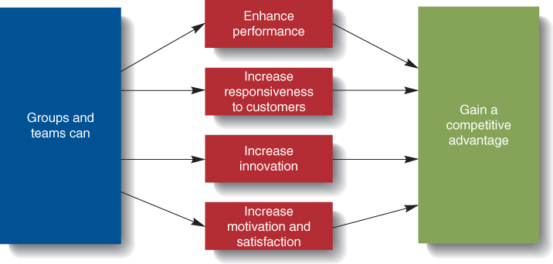
Groups’ and Teams’ Contributions to Organizational Effectiveness

Slide 30
Teams and Innovation
Innovation
  The implementation of creative ideas for new products, new technologies, new services, or even new organizational structures essential for gaining and maintaining a competitive advantage
Notes:
Managers should empower the team and make it accountable for the innovation process.
Individuals rarely possess the wide variety of skills needed for successful innovation.
Team members can uncover each other’s flaws and balance each other’s strengths and weaknesses

Slide 31
Groups and Teams as Motivators
Team members are more motivated and satisfied than if they were working alone.
Team members can see the effect of their contribution to achieving team and organizational goals.
Teams provide needed social interaction and help employees cope with work-related stressors.
11-31

Slide 32
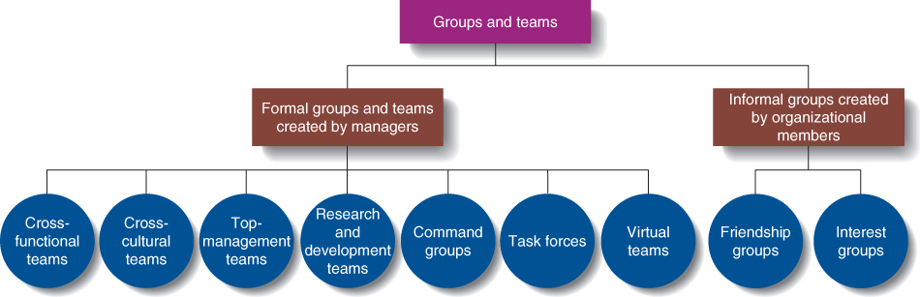
Types of Groups and Teams

Slide 33
Types of Groups and Teams
Formal Group
  A group that managers establish to achieve organization goals.
Informal Group
  A group that managers or non managerial employees form to help achieve their own goals or to meet their own needs.

Slide 34
Types of Groups and Teams
Top-management team
  A group composed of the CEO, the president, and the heads of the most important departments
Research and Development team
  A team whose members have the expertise and experience needed to develop new products
11-34

Slide 35
Types of Groups and Teams
Command Groups
  A group composed of subordinates who report to the same supervisor, also called a department or unit
Task Forces
  A committee of managers or non-managerial employees from various departments or divisions who meet to solve a specific, mutual problem; also called an “ad hoc” committee
11-35

Slide 36
Types of Groups and Teams
Self-Managed Work Team
  A group of employees who supervise their own activities and monitor the quality of the goods and services they provide
Virtual Team
  A team whose members rarely meet face-to-face
  Interact by using various forms of information technology
  Email, computer networks, telephone, fax, and videoconferences
11-36
Notes:
Keys to effective self managed teams:
Give the team enough responsibility and autonomy to be self-managing.
The team’s task should be complex enough to include many different steps.
Select members carefully for their diversity, skills, and enthusiasm.
Keys to effective self managed teams:
Managers should guide and coach, not supervise.
Determine training needs and be sure it is provided.

Slide 37
Types of Groups and Teams
Interest Groups
  An informal group of employees seeking to achieve a common goal related to their membership in an organization
Friendship Groups
  An informal group composed of employees who enjoy one another’s company and socialize with one another
11-37

Slide 38
Group Dynamics
Group Dynamics
  The characteristics and processes that affect how a group or team functions.
  Group size affects how a group performs.
Normally, small groups (2 to 9 members) interact better and tend to be more motivated
Larger groups can be used when more resources are needed and division of labor is possible.
11-38

Slide 39
Group Dynamics
Division of labor
  splitting the work to be performed into particular tasks and assigning tasks to individual workers
11-39

Slide 40
Group Roles
Group Roles
  The set of behaviors and tasks that a group member is expected to perform because of his position in the group
Role making
  taking the initiative to modify an assigned role by assuming additional responsibilities
11-40
Notes:
In cross-functional teams, members are expected to perform roles in their specialty.
Managers should clearly describe expected roles to group members when they are assigned to the group.
Role-making occurs as workers take on more responsibility in their roles as group members.
Self-managed teams may assign the roles to members themselves.

