Slide 1


System Administration 1
Prepared by Dr. Ahmed Omar
IT391
System Administration 1
Lecture 10

Slide 2



managing Linux groups, controlling file permissions
Managing Linux Groups & Controlling File Permissions
Lecture 10
IT391
System Administration 1
Prepared by
Dr. Ahmed Omar

Slide 3

Agenda
Linux Groups
Linux File Permission Control
Monitoring and Managing Processes
Disaster Recovery & Backup Strategies
The Power of Automation

Slide 4
Linux Group
A group in Linux is a collection of user accounts that share common permissions and access rights to files, directories, and system resources.
Groups provide an efficient way to manage permissions for multiple users without having to set individual permissions for each user.

Slide 5
Linux Group
Primary vs Secondary Groups
Each user has one primary group (usually created automatically when the user account is made)
Users can belong to multiple secondary groups for additional permissions

Slide 6
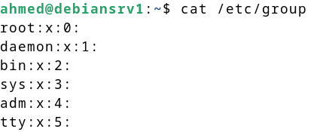
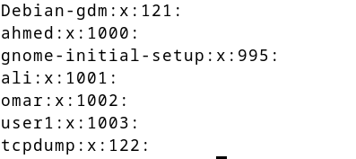
Linux Group
Group Information Storage:
Group definitions are stored in /etc/group
cat /etc/group

Slide 7
Create and manage groups
sudo groupadd [options] groupname
-f exit successfully if the group already exists,
-g use GID for the new group
-h display this help message and exit
-K KEY=VALUE override /etc/login.defs defaults
-o allow to create groups with duplicate (non-unique) GID
-p PASSWORD use this encrypted password for the new group
-r create a system account
-R CHROOT_DIR directory to chroot into
-P, PREFIX_DI directory prefix
-U list of user members of this group

Slide 8
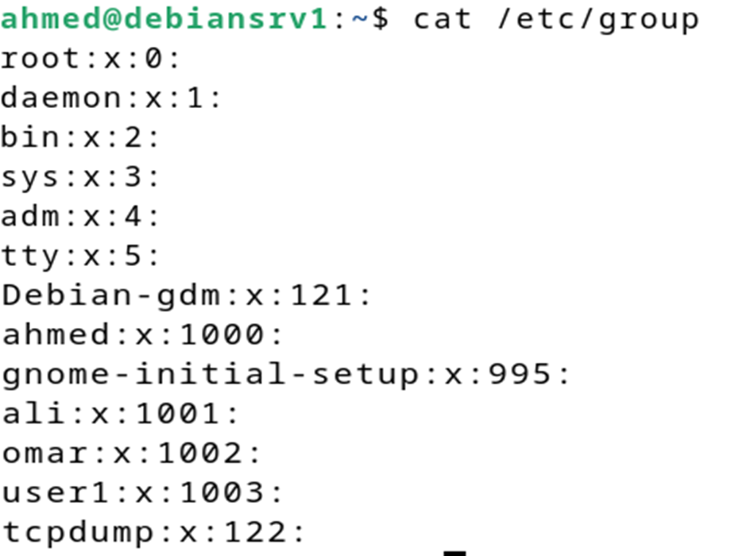
Create and manage groups
Group GID
GID 0: root group
System Groups (0-999)
User Groups (1000+)

Slide 9
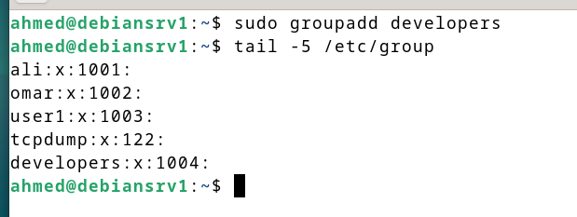
Create and manage groups
sudo groupadd developers

Slide 10
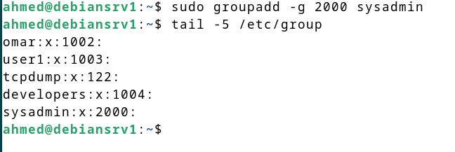
Create and manage groups
Creating Groups with Specific GIDs
sudo groupadd -g 2000 sysadmin

Slide 11
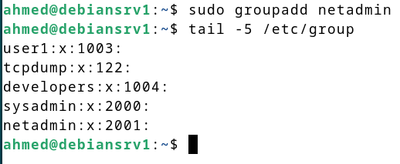
Create and manage groups
When you create a new group without specifying a GID, Linux automatically assigns the next available GID by continuing from the highest currently used GID within the allowed range.

Slide 12
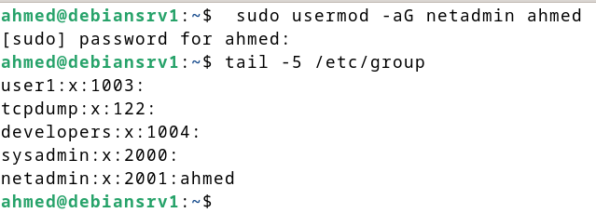
Create and manage groups
Add user to group
sudo usermod -aG netadmin ahmed
Remove user from group
sudo gpasswd -d netadmin ahmed

Slide 13
Create and manage groups
Change primary group
The newgrp command allows a user to temporarily switch their primary group (effective group) without logging out. This is useful when you need to create files with a different group ownership.
When you run newgrp, it:
Starts a new shell session
Changes your effective group ID to the specified group
New files/directories will be owned by this group
You must be a member of the target group

Slide 14
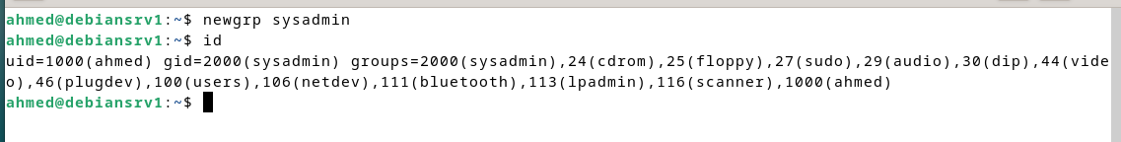
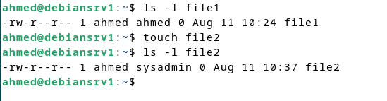
Create and manage groups
Change primary group
Basic Syntax : newgrp [groupname]

Slide 15
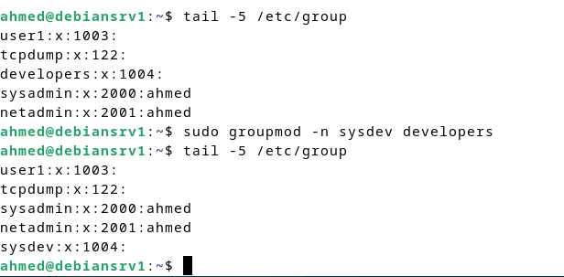
Create and manage groups
Change group name
Linux doesn't have a direct "rename group" command, but you can effectively rename a group using the groupmod command to change the group name.
sudo groupmod -n new_name old_name

Slide 16
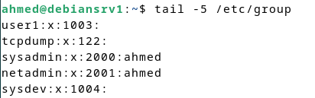
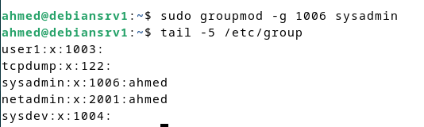
Create and manage groups
Change group id
You can change a group's GID using the groupmod command with the -g option.
sudo groupmod –g new_gid groupname

Slide 17
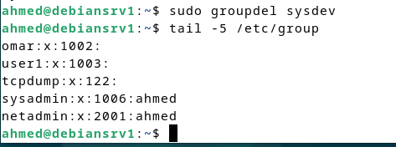
Create and manage groups
Removing Groups
You can remove (delete) groups using the groupdel command.
sudo groupdel groupname

Slide 18
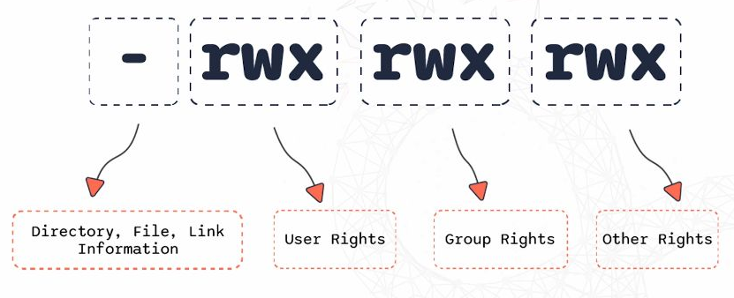
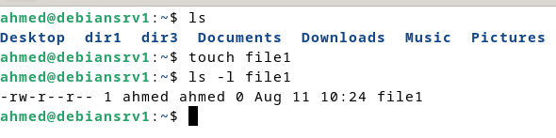
File Permission Control
Default File Permission Assignment
File Owner and Group:
Owner (User): The user who created the file
rw-: Owner (ahmed) permissions - read and write, no execute
Group: The user's primary group (from /etc/passwd)
r--: Group (ahmed) permissions - read only
Others: Everyone else on the system
r--: Others permissions - read only

Slide 19
File Permission Control
Purpose : Secure files/directories by modifying access rights for users, groups, and others
Permission Basics
Three Entities:
  u → Owner
  g → Group
  o → Others
  a → all (user + group + others)
Three Permissions:
  r = Read (4)
  w = Write (2)
  x = Execute (1)
-rw-r--r-- 1 user group 4096 Aug 11 file.txt
Owner: read+write
Group: read
Others: read

Slide 20
File Permission Control
What is chmod?
chmod stands for Change Mode — it’s the command used in Linux to set file and directory permissions.
Symbolic Mode
+ Adds the given permission(s) without changing existing ones.
- Removes the given permission(s) but leaves others unchanged.
= Replaces all permissions for the category with exactly what you specify.
chmod u+x file.txt # Add execute for user
chmod g-w file.txt # Remove write for group
chmod o=r file.txt # Set read only for others
chmod a+rw file.txt # Add read/write for everyone

Slide 21
File Permission Control
chmod
Numeric Mode
Uses numbers:
r = 4, w = 2, x = 1 , - =0 Sum them to get permission values.
chmod 754 file.txt
7 → user: 4+2+1 = rwx
5 → group: 4+0+1 = r-x
4 → others: 4+0+0 = r--

Slide 22
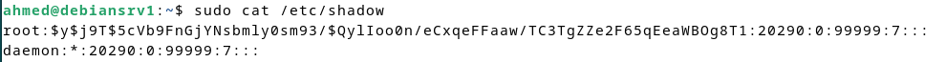
Users Passwords
Show users passwords
user passwords are not stored in plaintext for security reasons. Instead, they are stored as encrypted hashes in a protected file. You cannot "show" the actual passwords, only their hashed versions.
Hashed passwords are stored in /etc/shadow, which is readable only by root (or with sudo privileges)
sudo cat /etc/shadow

Slide 23
Users Passwords
ahmed:$y$j9T$aXNiJKojofhMtZlS9Xmv/0$KJ6Zalb/o2/k62mqEgQgcBYMIQn8ydPHpssVaC1SKEA:20290:0:99999:7:::
Username: ahmed
Hash Type: $y$ = yescrypt algorithm (modern, secure)
Cost Parameter: j9T (computational cost for yescrypt)
Salt: aXNiJKojofhMtZlS9Xmv/0 (unique random salt)
Hash: KJ6Zalb/o2/k62mqEgQgcBYMIQn8ydPHpssVaC1SKEA (password hash)
Last Password Change: 20290 - Days since January 1, 1970
Minimum Days: 0 - User can change password immediately (no waiting period)
Maximum Days: 99999 - Password effectively never expires
Warning Days: 7 -User gets warned 7 days before password expiration

Slide 24
Configure Password Aging
Password aging is a way to control how long a user’s password remains valid before they must change it. It’s part of security best practices, preventing users from keeping the same password forever.
With password aging, you can:
  Set the minimum number of days before a user can change their password.
  Set the maximum number of days a password is valid.
  Set a warning period before expiration.
  Force password expiration immediately.

Slide 25
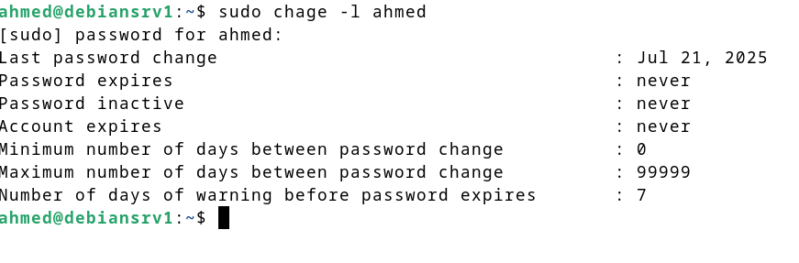
Configure Password Aging
View a user’s password aging info
sudo chage -l username

Slide 26
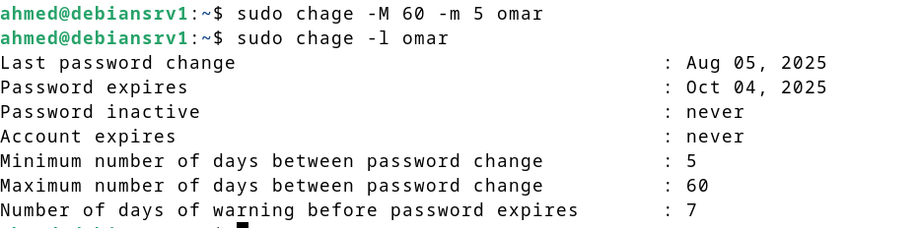
Configure Password Aging
Set maximum and minimum password days
sudo chage -M 60 -m 5 omar
Set a warning before expiration
sudo chage -W 7 omar
Expire password immediately (forces change on next login)
sudo chage -d 0 omar

Slide 27
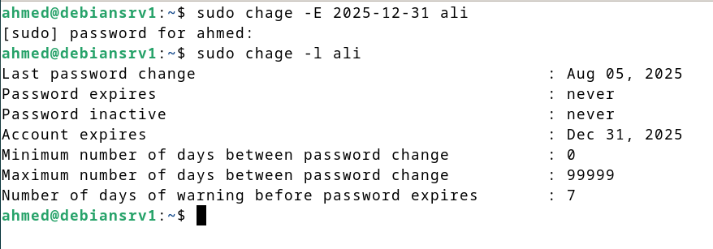
Configure Password Aging
Account Expiration
Unlike password aging, account expiration means the entire account becomes inactive after a certain date — the user can’t log in at all, even with a correct password.
sudo chage -E 2025-12-31 ali

Slide 28
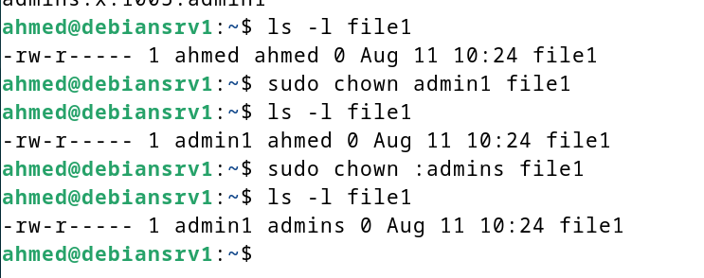
Change User or Group Ownership
To change user or group ownership of files and directories in Linux, the primary commands is chown (change owner)
chown [user][:group] file_or_directory
chown -R user:group directory

Slide 29
Monitoring and Managing Processes
What is a Process in Linux?
A process is simply a running instance of a program.
Each process has:
PID (Process ID) — unique identifier.
State (running, sleeping, stopped, zombie).
Owner (user who started it).
Priority and niceness value.
Resource usage (CPU, memory, I/O).

Slide 30
Monitoring and Managing Processes
The ps a command in Linux lists all running processes associated with terminals
This command output typically includes columns such as:
PID: Process ID
TTY: Terminal associated with the process
STAT: Process state (e.g., S for sleeping, R for running)
TIME: CPU time used by the process
COMMAND: The command that started the process
Command | Description
ps a | Lists processes with terminals
ps u | Lists processes with user details
ps x | Lists processes without terminals
ps aux | Lists all processes with details

Slide 31
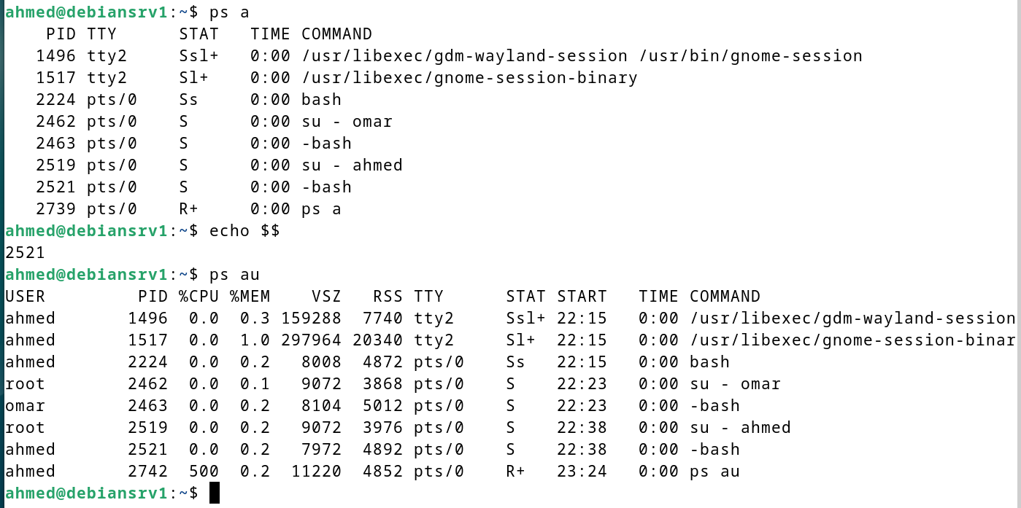
Monitoring and Managing Processes

Slide 32
Monitoring and Managing Processes
Controlling Processes
kill -9 1234 # Force kill by PID
pkill -f "pattern" # Kill by process name/pattern
kill -STOP 1234 # Pause process
kill -CONT 1234 # Resume process

Slide 33
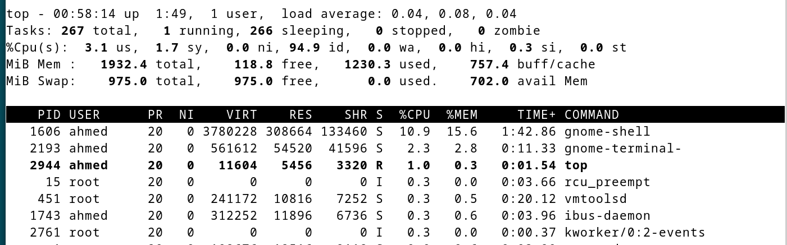
CPU Usage Monitoring
Consistent high CPU usage can lead to performance degradation. Several command-line tools offer insights into CPU load.
top: This ubiquitous tool provides a real-time, dynamic view of the processes running on a system. It displays a summary of system information, including load averages and a list of the most CPU-intensive tasks. You can press '1' within top to see statistics for individual CPU cores.

Slide 34
Disaster Recovery & Backup
Strategies
Failure Types
Hardware: Disk failures, RAM errors, power supply issues
Software: OS corruption, file system errors, bad updates
Human: Accidental file deletion, improper commands (rm -rf)
Natural: Fire, flood, power surges, physical site damage

Slide 35
Disaster Recovery & Backup
Strategies
Backup Types
Full Backup Complete copy of all selected data, creates independent backup sets, slower but simplest to restore.
Incremental Only backs up changes since last backup (any type), fastest & smallest, but complex restore
Snapshot Point-in-time image of file system state, fast creation, uses features like LVM, Btrfs, ZFS

Slide 36
Disaster Recovery & Backup
Strategies
Common Linux Backup Tools
  tar → Archive & compress files
  rsync → Sync files/directories
  dd → Bit-by-bit copy (disk cloning)
  cp → Simple copy
  Timeshift → System snapshot for desktops

Slide 37
Disaster Recovery & Backup
Strategies
tar -cf backup.tar.gz /home/user
  c → create archive
  f → filename
Restore : tar -xzf backup.tar.gz -C /

Slide 38
The Power of Automation
Automation in system management refers to the process of creating systems and software that reduce or eliminate the need for human intervention in IT services.
By automating routine tasks, system administrators can:
Reduce human error and increase reliability
Improve efficiency and response times
Scale operations without proportional staff increases
Focus on strategic initiatives rather than routine
Key Benefit: Time Savings
Studies show that automation can reduce system administration workload by up to 70% for routine tasks.

Slide 39
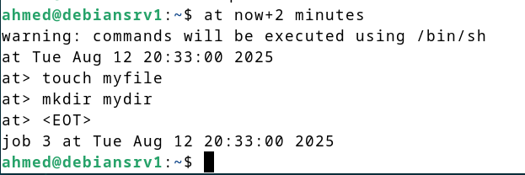
The Power of Automation
The Linux at command is used to schedule one-time tasks or jobs to be executed at a specific time in the future. Unlike cron which is for recurring jobs, at is designed for single execution at a given time.
The general syntax is: at [options] time
After entering this command, you will get an interactive prompt (at>) to enter the commands you want to execute at the scheduled time. Press Ctrl+D to finish and save the job.
Not you need to install at package:
sudo apt update
sudo apt install at

Slide 40
Summary
Linux Groups
Linux File Permission Control
Monitoring and Managing Processes
Disaster Recovery & Backup Strategies
The Power of Automation

Slide 41



Thank You

