Slide 1



Introduction to Financing
Prepared by Dr. Sara Ahmed
MGM 611
Orientation Lecture

Slide 2



Introduction to Financing
Orientation Lecture
MGM 611
Prepared by
Dr. Sara Ahmed
www.midocean.ae

Slide 3

LEARNING OBJECTIVES
Differentiate between primary and secondary markets
Differentiate between money and capital markets
Understand the concept of foreign exchange markets
Understand the concept of derivative security markets
Distinguish between the different types of financial institutions
Know the services financial institutions perform
Know the risks financial institutions face
Appreciate why financial institutions are regulated
Recognize that markets are become increasingly global
www.midocean.ae

Slide 4
Why Study Financial Markets and Institutions?
Markets and institutions are primary channels through which capital is allocated in our society
    Investment and financing decisions require managers and individual investors to understand the flow of funds throughout the economy
    Managers and individuals must also understand the operation and structure of domestic and international financial markets

Slide 5
Financial Markets
Financial markets are structures through which funds flow
Financial markets can be distinguished along two major dimensions:
  Primary versus secondary markets
  Money versus capital markets

Slide 6
Primary versus Secondary Markets
Primary markets
  Markets in which users of funds (e.g., corporations) raise funds through new issues of financial instruments, such as stocks and bonds
  Include issues of equity by firms initially going public, referred to as initial public offerings (IPOs)
Secondary markets
  Markets that trade financial instruments once they are issued

Slide 7
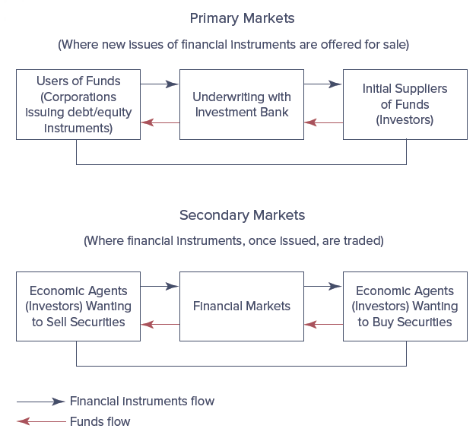
Primary and Secondary Market Transfer of Funds Time Line

Slide 8
Primary versus Secondary Markets (Continued)
How were primary markets affected by the financial crisis?
Secondary markets offer the following:
  Liquidity, or the ability to turn an asset into cash quickly at its fair market value
  Information about the prices or the value of investments
  Trading with low transaction costs
Notes:
The financial crisis had a significant impact on primary market sales by firms. New issues fell to $1,068.0 billion in 2008, during the worst of the crisis, from $2,389.1 billion in 2007, pre-crisis. As of 2018, primary market sales had still not recovered as only $1,725.2 billion new securities were issued for the year.

Slide 9
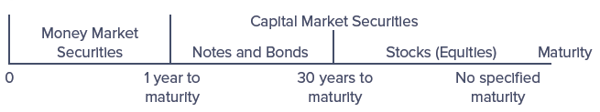
Money versus Capital Markets
Money markets trade debt securities or instruments with maturities of one year or less
  Most U.S. money markets are over-the-counter (OTC) markets
Capital markets trade debt (bonds) and equity (stocks) instruments with maturities of more than one year
  Wider price fluctuations than money market instruments

Slide 10
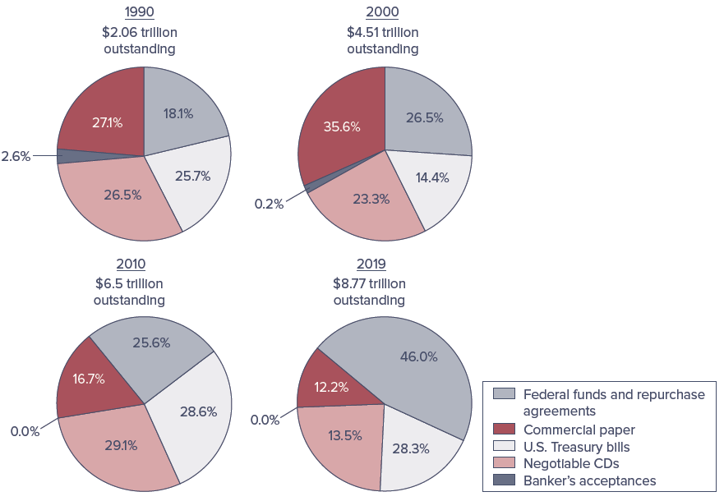
Money Market Instruments Outstanding
Notes:
Notice that, in 2019, federal funds and repurchase agreements, followed by Treasury bills, negotiable CDs, and commercial paper, had the largest amounts outstanding.

Slide 11
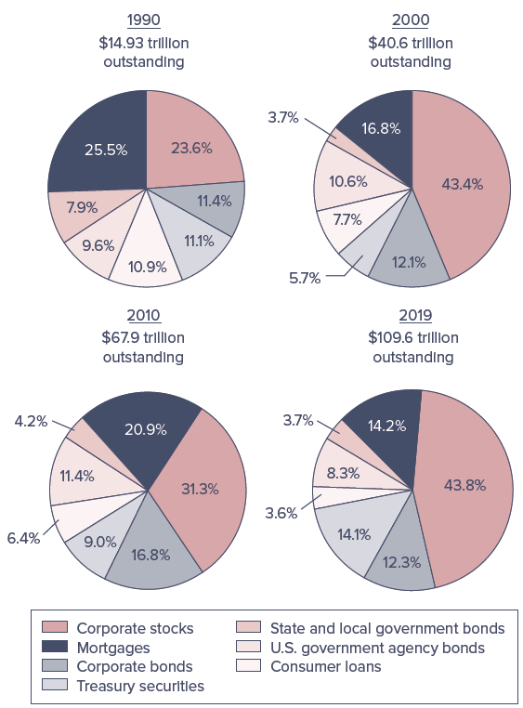
Capital Market Instruments Outstanding
Notes:
Stock prices fell precipitously during the financial crisis of 2008–2009. As of mid-March 2009, the Dow Jones Industrial Average (DJIA) had fallen 53.8 percent in value in less than 1½ years, larger than the decline during the market crash of 1929 when it fell 49 percent. However, stock prices recovered, along with the economy, in the last half of 2009, rising 71.1 percent between March 2009 and April 2010.

Slide 12
Foreign Exchange Markets
Foreign exchange risk is the sensitivity of the value of cash flows on foreign investments to changes in the foreign currency’s price in terms of dollars
  U.S. dollars received on a foreign investment depends on the exchange rate between the U.S. dollar and the foreign currency when the nondollar cash flow is converted into U.S. dollars

Slide 13
Derivative Security Markets
A derivative security is a financial security (e.g., future, option, swap, or mortgage-backed security) whose payoff is linked to another, previously issued security, such as a security traded in capital or foreign exchange markets
  Derivatives are traded in derivative security markets
  Generally involves agreement between two parties to exchange a standard quantity of an asset or cash flow at a predetermined price and at a specified future date
  Derivative markets are the newest of financial security markets and are also potentially the riskiest security
Notes:
Indeed, at the center of the recent financial crisis were losses associated with off-balance-sheet mortgage-backed (derivative) securities created and held by FIs. Losses from the falling value of subprime mortgages and the derivative securities backed by these mortgages reached $700 billion worldwide by early 2009 and resulted in the failure, acquisition, or bailout of some of the largest FIs and the near collapse of the world’s financial and economic systems.

Slide 14
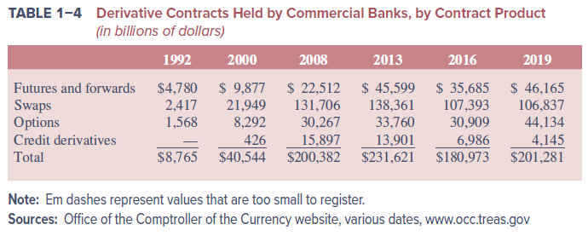
Derivative Security Markets (Continued)
Derivative activity:
  Tremendous growth between 1992-2013
  Large drop from 2013 to 2019, due largely to the 2014 implementation of the Volcker Rule
Notes:
The Volcker Rule prohibits bank holding companies from engaging in proprietary trading.

Slide 15
Financial Market Regulation
Financial instruments are subject to regulations imposed by regulatory agencies, such as the Securities and Exchange Commission (SEC)
  Main emphasis of SEC regulations is on full and fair disclosure of information on securities issues to actual and potential investors
  SEC monitors trading on the major exchanges to ensure stockholders and managers do not trade on inside information about their own firms

Slide 16
Overview of Financial Institutions (FIs)
Financial institutions perform the essential function of channeling funds from those with surplus funds to those with shortages of funds
In a world without FIs, the level of funds flowing between suppliers and users would likely be quite low due to the following reasons:
  Monitoring costs
  Liquidity costs
  Price risk

Slide 17
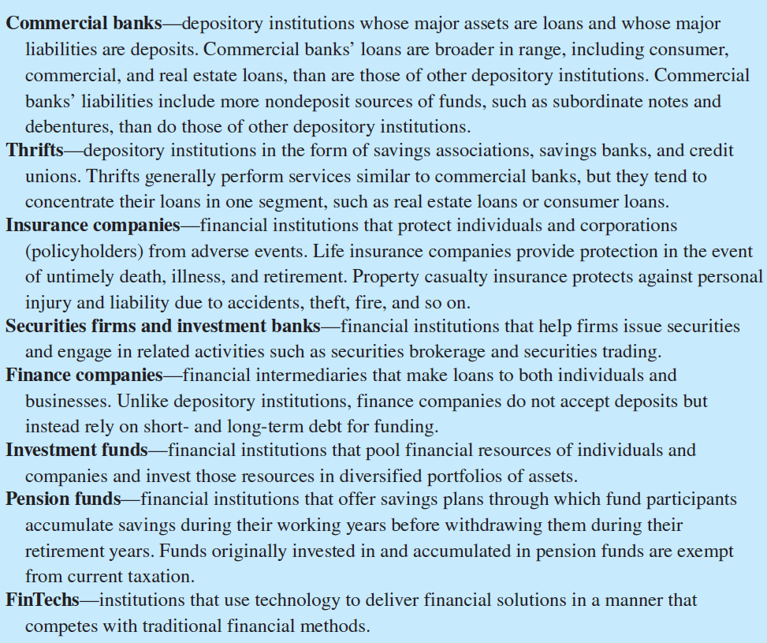
Types of Financial Institutions

Slide 18
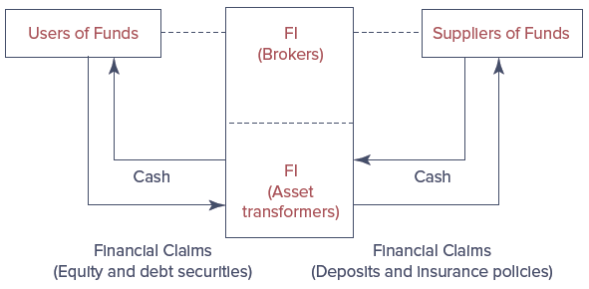
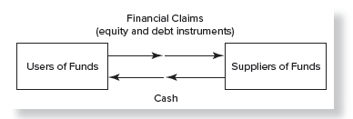
Flow of Funds
Flow of Funds in a World without FIs
Flow of Funds in a World with FIs
Notes:
In a world without FIs, we have a direct transfer of funds from suppliers of funds to users of funds. Likewise, financial claims would flow directly from users of funds to suppliers of funds.
With FIs, we have indirect transfers, a transfer of funds between suppliers and users of funds through a financial intermediary.

Slide 19
Monitoring Costs
A supplier of funds who directly invests in a fund user’s financial claims faces a high cost of monitoring the fund user’s actions in a timely and complete fashion
  A solution is for many small investors to group their funds together by holding the claims issued by a FI (i.e., aggregation of funds)

Slide 20
Liquidity and Price Risk
FIs act as asset transformers, financial claims issued by an FI that are more attractive to investors than are the claims directly issued by corporations
Often, claims issued by FIs have liquidity attributes that are superior to those of primary securities
FIs diversify away some, but not all, of their investment risk

Slide 21
Additional Benefits and Functions of FIs
Additional benefits FIs provide to suppliers of funds:
  Reduced transaction cost
  Maturity intermediation
  Denomination intermediation

Slide 22
Risks Incurred by Financial Institutions
FIs face various types of risks:
  Default risk (i.e., credit risk)
  Foreign exchange risk and country (i.e., sovereign) risk
  Interest rate risk
  Market risk, or asset price risk
  Off-balance sheet risk
  Liquidity risk
  Technology and operational risk
  Insolvency risk

Slide 23
Regulation of Financial Institutions
Failures of FIs can cause widespread panic and withdrawal runs on institutions
  The 2008 increase in the deposit cap (to $250,000 per person per bank) was intended to instill confidence in the banking system
FIs are regulated to prevent market failures, as well as associated costs on the economy and society at large

Slide 24
Trends in the United States
The following trends are evident in the U.S. between 1948-2019:
  Share of depository institutions declined from 62.7% to 30.9%
  Insurance companies also witnessed a decline in their share, from 23.4% to 13.8%
  Investment companies increased their share from 1.1% to 31.0%, while pension funds increased from 9.1% to 13.2%
  Overall assets increased from $0.27t to $75.21t
Notes:
Investment companies and pension funds differ from banks and insurance companies in that they give savers cheaper access to the direct securities market.

Slide 25
Trends in the United States (Continued)
Rise of financial services holding companies
  Savers increasingly prefer investments that closely mimic diversified investments in the direct securities markets over the transformed financial claims offered by traditional FIs
Shift away from risk measurement and management and the financial crisis
  Under the traditional originate-and-hold banking model, banks may have been reluctant to so aggressively pursue low-credit-quality borrowers for fear of default

Slide 26
Enterprise Risk Management
Enterprise risk management
  Recognizes the importance of managing the combined impact of the full spectrum of risks as an interrelated risk portfolio
  Seeks to embed risk management as a component in all critical decisions throughout FI
  Popularity rose as a result of the failure of advanced risk measurement and management systems to detect exposures that led to the financial crisis
  Stresses importance of building strong risk culture

Slide 27
Fintech
Financial technology, or fintech, refers to the use of technology to deliver financial solutions in a manner that competes with traditional financial methods
  Includes services such as cryptocurrencies (e.g., bitcoin) and blockchain
  Fintech risk involves the risk that fintech firms could disrupt business of financial services firms in the form of lost customers and lost revenue
  Supports models of peer-to-peer mass collaboration

Slide 28
Globalization of Financial Markets and Institutions
U.S. markets are the world’s largest, but international markets have seen rapid growth in recent years as a result of various factors:
  Pool of savings in foreign countries has increased
  International investors have turned to U.S. and other markets to expand their investment opportunities
  Information on foreign investments and markets is now more accessible and thorough
  Some U.S. FIs offer their customers opportunities to invest in foreign securities and emerging markets at relatively low transaction costs

Slide 29
Globalization of Financial Markets and Institutions (Continued)
U.S. markets are the world’s largest, but international markets have seen rapid growth in recent years as a result of various factors:
  The euro is having a notable impact on the global financial system
  Economic growth in Pacific Basin countries, China, and other emerging countries has resulted in significant growth in their stock markets
  Deregulation in many foreign countries has allowed international investors greater access and allowed the deregulating countries to expand their investor base

Slide 30
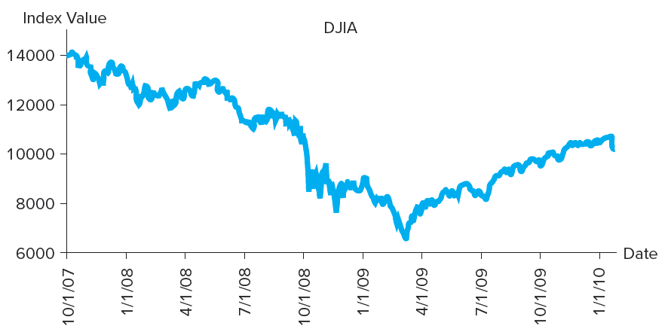
The Dow Jones Industrial Average, October 2007 – January 2010
Notes:
The Dow fell more than 500 points as news spread that Lehman Brothers would not survive. This was the largest drop in over seven years.

Slide 31
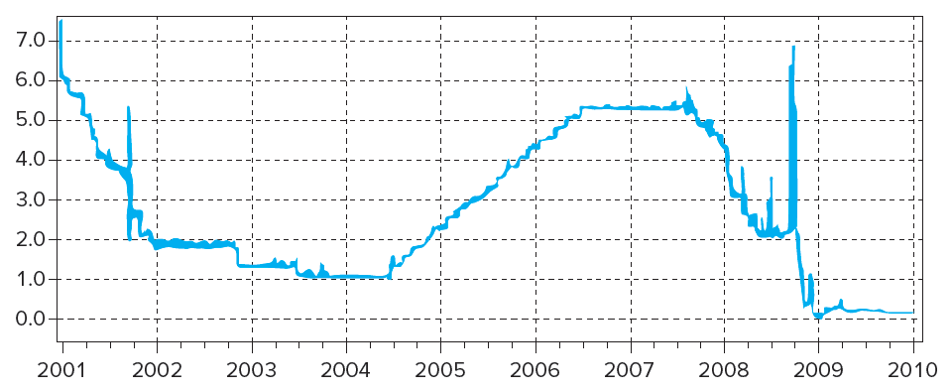
Overnight LIBOR, 2001-2010
Notes:
By mid-September 2008, financial markets froze, and banks stopped lending to each other at anything but exorbitantly high rates. The overnight London Interbank Offered Rate (LIBOR, a benchmark rate that reflects the rate at which banks lend to one another) more than doubled (see figure above).

Slide 32


Thank You

