Slide 1


Final Project-2
Lecture 5
L5- Statistical Analysis- P1
Prepared by
Dr. Mona Moustafa Elashry
www.midocean.ae

Slide 2

Session Outline
Chapter 1: The Where, why, and How of Data Collection
Chapter 2 : Graphs, Charts, and Tables – Describing Your Data
Chapter 3 : Describing Data Using Numerical Measures
Chapter 9: Introduction to Hypothesis Testing
Chapter 14: Introduction to Linear Regression and Correlation Analysis
Chapter 15: Multiple Regression Analysis and Model Building
Business Statistics: A Decision-Making Approach, 7e © 2008 Prentice-Hall, Inc.
www.midocean.ae

Slide 3


Chapter 1-
The Where, why, and How of Data Collection
1
www.midocean.ae

Slide 4
Chapter Goals
After completing this chapter, you should be able to:
Describe key data collection methods
Know key definitions:
  ♦Population vs. Sample ♦Primary vs. Secondary data types
  ♦Qualitative vs. Qualitative data ♦Time Series vs. Cross-Sectional data
Explain the difference between descriptive and
inferential statistics
Describe different sampling methods

Slide 5
Tools of Business Statistics
Descriptive statistics
  Collecting, presenting, and describing data
Inferential statistics
  Drawing conclusions and/or making decisions concerning a population based only on sample data

Slide 6
Descriptive Statistics
Collect data
  e.g., Survey, Observation,
  Experiments
Present data
  e.g., Charts and graphs
Characterize data
  e.g., Sample mean =

Slide 7
Inferential Statistics
Making statements about a population by examining sample results
Sample statistics Population parameters
(known) Inference (unknown, but can
be estimated from
sample evidence)

Slide 8
Inferential Statistics
Drawing conclusions and/or making decisions concerning a population based on sample results.
Estimation
  e.g., Estimate the population mean weight using the sample mean weight
Hypothesis Testing
  e.g., Use sample evidence to test the claim that the population mean weight is 120 pounds

Slide 9


Tools for Collecting Data
Data Collection Methods
Experiments
Written questionnaires
Telephone surveys
Direct observation and personal interview

Slide 10
Survey Design Steps
Define the issue
  what are the purpose and objectives of the survey?
Define the population of interest
Develop survey questions
  make questions clear and unambiguous
  use universally-accepted definitions
  limit the number of questions

Slide 11
Survey Design Steps
(continued)
Pre-test the survey
  pilot test with a small group of participants
  assess clarity and length
Determine the sample size and sampling method
Select sample and administer the survey

Slide 12
Types of Questions
Closed-end Questions
  Select from a short list of defined choices
    Example: Major: __business __liberal arts
    __science __other
Open-end Questions
  Respondents are free to respond with any value, words, or statement
    Example: What did you like best about this course?
Demographic Questions
  Questions about the respondents’ personal characteristics
  Example: Gender: __Female __ Male

Slide 13
Populations and Samples
A Population is the set of all items or individuals of interest
  Examples: All likely voters in the next election
All parts produced today
All sales receipts for November
A Sample is a subset of the population
  Examples: 1000 voters selected at random for interview
        A few parts selected for destructive testing
        Every 100th receipt selected for audit

Slide 14
Key Definitions
A population is the entire collection of things under consideration
  A parameter is a summary measure computed to describe a characteristic of the population
A sample is a portion of the population selected for analysis
  A statistic is a summary measure computed to describe a characteristic of the sample

Slide 15
Population vs. Sample
Population
Sample
a b c d
ef gh i jk l m n
o p q rs t u v w
x y z
b c
g i n
o r u
y

Slide 16
Why Sample?
Less time consuming than a census
Less costly to administer than a census
It is possible to obtain statistical results of a sufficiently high precision based on samples.

Slide 17
Sampling Techniques
Sampling Techniques
Nonstatistical Sampling
Statistical Sampling
Convenience
Simple
Random
Systematic
Judgment
Cluster
Stratified

Slide 18
Statistical Sampling
Items of the sample are chosen based on known or calculable probabilities
Statistical Sampling
(Probability Sampling)
Simple Random
Stratified
Systematic
Cluster

Slide 19
Simple Random Sampling
Every possible sample of a given size has an equal chance of being selected
Selection may be with replacement or without replacement
The sample can be obtained using a table of random numbers or computer random number generator

Slide 20
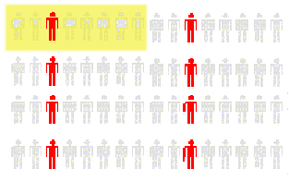
Systematic Random Sampling
Decide on sample size: n
Divide frame of N individuals into groups of k individuals: k=N/n
Randomly select one individual from the 1st group
Select every k^{th} individual thereafter
N = 64
n = 8
k = 8
First Group

Slide 21
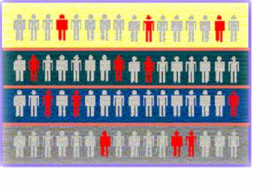

Stratified Random Sampling
Divide population into subgroups (called strata) according to some common characteristic
Select a simple random sample from each subgroup
Combine samples from subgroups into one
Population
Divided
into 4
strata
Sample

Slide 22
Data Types
Data
Qualitative
(Categorical)
Quantitative
(Numerical)
Examples:
Marital Status
Political Party
Eye Color
(Defined categories)
Discrete
Continuous
Examples:
Number of Children
Defects per hour
(Counted items)
Examples:
Weight
Voltage
(Measured characteristics)

Slide 23
Data Types
Time Series Data
  Ordered data values observed over time
Cross Section Data
  Data values observed at a fixed point in time

Slide 24
Data Types
 | Sales (in $1000’s)
 | 2003 | 2004 | 2005 | 2006
Atlanta | 435 | 460 | 475 | 490
Boston | 320 | 345 | 375 | 395
Cleveland | 405 | 390 | 410 | 395
Denver | 260 | 270 | 285 | 280
Time Series Data
Cross Section Data

Slide 25
Data Measurement Levels
Highest Level
Complete Analysis
Measurements
Ratio/Interval Data
Rankings
Ordered Categories
Higher Level
Mid-level Analysis
Ordinal Data
Categorical Codes ID Numbers Category Names
Lowest Level
Basic Analysis
Nominal Data

Slide 26
Chapter 2
Graphs, Charts, and Tables – Describing Your Data
2
www.midocean.ae

Slide 27
Chapter Goals
After completing this chapter, you should be able to:
Construct a frequency distribution
Construct and interpret a histogram

Slide 28
Frequency Distributions
What is a Frequency Distribution?
A frequency distribution is a list or a table …
containing the values of a variable (or a set of ranges within which the data fall) ...
and the corresponding frequencies with which each value occurs (or frequencies with which data fall within each range)

Slide 29
Why Use
Frequency Distributions?
A frequency distribution is a way to summarize data
The distribution condenses the raw data into a more useful form...
and allows for a quick visual interpretation of the data

Slide 30

Frequency Distribution: Discrete Data
Discrete data: possible values are countable
Example: An advertiser asks 200 customers how many days per week they read the daily newspaper.
Number of days read | Frequency
0 | 44
1 | 24
2 | 18
3 | 16
4 | 20
5 | 22
6 | 26
7 | 30
Total | 200

Slide 31
Relative Frequency
Relative Frequency: What proportion is in each category?
Number of days read | Frequency | Relative Frequency
0 | 44 | .22
1 | 24 | .12
2 | 18 | .09
3 | 16 | .08
4 | 20 | .10
5 | 22 | .11
6 | 26 | .13
7 | 30 | .15
Total | 200 | 1.00
22% of the people in the sample report that they read the newspaper 0 days per week

Slide 32
Frequency Distribution: Continuous Data
Continuous Data: may take on any value in some interval
Example: A manufacturer of insulation randomly selects 20 winter days and records the daily high temperature
24, 35, 17, 21, 24, 37, 26, 46, 58, 30,
32, 13, 12, 38, 41, 43, 44, 27, 53, 27
(Temperature is a continuous variable because it could
be measured to any degree of precision desired)

Slide 33
Grouping Data by Classes
  Sort raw data from low to high:
12, 13, 17, 21, 24, 24, 26, 27, 27, 30, 32, 35, 37, 38, 41, 43, 44, 46, 53, 58
Find range: 58 - 12 = 46
Select number of classes: 5 (usually between 5 and 20)
Compute class width: 10 (46/5 then round off)
Determine class boundaries:10, 20, 30, 40, 50
(Sometimes class midpoints are reported: 15, 25, 35, 45, 55)
Count the number of values in each class

Slide 34
Frequency Distribution Example
Data from low to high:
12, 13, 17, 21, 24, 24, 26, 27, 27, 30, 32, 35, 37, 38, 41, 43, 44, 46, 53, 58
Frequency Distribution
Class Frequency
Relative
Frequency
10 but under 20 3 .15
20 but under 30 6 .30
30 but under 40 5 .25
40 but under 50 4 .20
50 but under 60 2 .10
Total 20 1.00

Slide 35
Frequency Histograms
The classes or intervals are shown on the horizontal axis
frequency is measured on the vertical axis
Bars of the appropriate heights can be used to represent the number of observations within each class
Such a graph is called a histogram

Slide 36
Histogram Example
Data in ordered array:
12, 13, 17, 21, 24, 24, 26, 27, 27, 30, 32, 35, 37, 38, 41, 43, 44, 46, 53, 58
No gaps between bars, since continuous data
0 10 20 30 40 50 60
Class Endpoints
Class Midpoints
www.midocean.ae

Slide 37
Chapter 3
Describing Data Using
Numerical Measures
3
www.midocean.ae

Slide 38
Chapter Goals
After completing this chapter, you should be able to:
Compute and interpret the mean, median, and mode for a set of data
Compute the range, variance, and standard deviation and know what these values mean

Slide 39
Chapter Topics
Measures of Center and Location
  Mean, median, mode
Measures of Variation
  Range, variance and standard deviation

Slide 40
Summary Measures
Describing Data Numerically
Center and Location
Variation
Mean
Range
Median
Variance
Mode
Standard Deviation

Slide 41
Measures of Center and Location
Overview
Center and Location
Mean
Median
Mode

Slide 42
Mean (Arithmetic Average)
The Mean is the arithmetic average of data values
  Population mean
  Sample mean
N = Population Size
n = Sample Size

Slide 43
Mean (Arithmetic Average)
(continued)
The most common measure of central tendency
Mean = sum of values divided by the number of values
Affected by extreme values (outliers)
0 1 2 3 4 5 6 7 8 9 10
0 1 2 3 4 5 6 7 8 9 10
Mean = 3
Mean = 4

Slide 44
Median
In an ordered array, the median is the “middle” number, i.e., the number that splits the distribution in half
The median is not affected by extreme values
0 1 2 3 4 5 6 7 8 9 10
0 1 2 3 4 5 6 7 8 9 10
Median = 3
Median = 3

Slide 45
Median
(continued)
To find the median, sort the n data values from low to high (sorted data is called a data array)
Find the value in the i = (1/2)n position
The i^{th} position is called the Median Index Point
  If i is not an integer, round up to next highest integer
www.midocean.ae

Slide 46
Median Example
(continued)
Data array:
4, 4, 5, 5, 9, 11, 12, 14, 16, 19, 22, 23, 24
Note that n = 13
Find the i = (1/2)n position:
i = (1/2)(13) = 6.5
Since 6.5 is not an integer, round up to 7
The median is the value in the 7th position:
M_{d} = 12
www.midocean.ae

Slide 47
Shape of a Distribution
Describes how data is distributed
Symmetric or skewed
Left-Skewed
Symmetric
Right-Skewed
Mean < Median
Mean = Median
Median < Mean
(Longer tail extends to left)
(Longer tail extends to right)

Slide 48
Mode
A measure of location
The value that occurs most often
Not affected by extreme values
Used for either numerical or categorical data
There may be no mode
There may be several modes
0 1 2 3 4 5 6 7 8 9 10 11 12 13 14
0 1 2 3 4 5 6
Mode = 5
No Mode

Slide 49
Review Example
Five houses on a hill by the beach
House Prices:
$2,000,000
500,000
300,000
100,000
100,000
www.midocean.ae

Slide 50
Summary Statistics
House Prices:
$2,000,000
500,000
300,000
100,000
100,000
Sum 3,000,000
Mean: ($3,000,000/5)
= $600,000
Median: middle value of ranked data
= $300,000
Mode: most frequent value
= $100,000
www.midocean.ae

Slide 51
Which measure of location is the “best”?
Mean is generally used, unless extreme values (outliers) exist
Then Median is often used, since the median is not sensitive to extreme values.
  Example: Median home prices may be reported for a region – less sensitive to outliers
www.midocean.ae

Slide 52
Distribution Shape and Box and Whisker Plot
Left-Skewed
Symmetric
Right-Skewed
Q1
Q2
Q3
Q1
Q2
Q3
Q1
Q2
Q3

Slide 53
Measures of Variation
Variation
Range
Variance
Standard Deviation
Population
Variance
Population
Standard
Deviation
Sample
Variance
Sample
Standard
Deviation

Slide 54
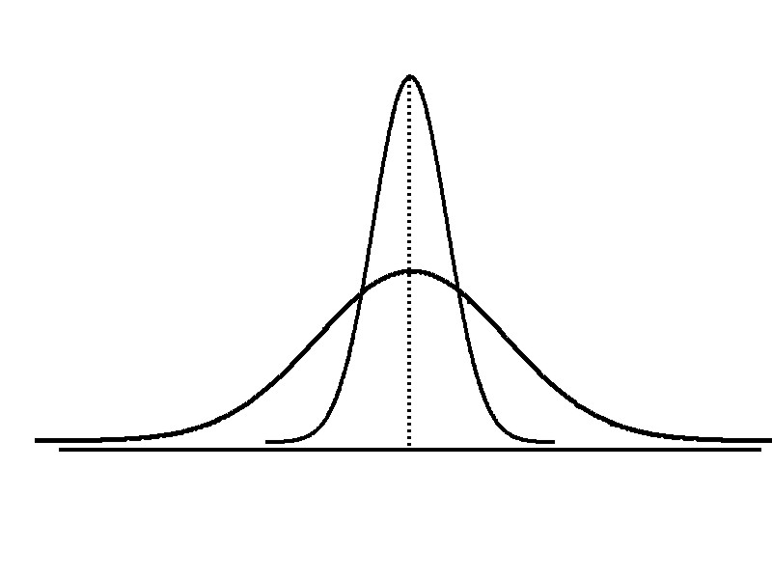
Variation
Measures of variation give information on the spread or variability of the data values.
Same center,
different variation
www.midocean.ae

Slide 55
Range
Simplest measure of variation
Difference between the largest and the smallest observations:
Range = x_{maximum} – x_{minimum}
Example:
0 1 2 3 4 5 6 7 8 9 10 11 12 13 14
Range = 14 - 1 = 13

Slide 56
Disadvantages of the Range
Ignores the way in which data are distributed
Sensitive to outliers
7 8 9 10 11 12
7 8 9 10 11 12
Range = 12 - 7 = 5
Range = 12 - 7 = 5
1,1,1,1,1,1,1,1,1,1,1,2,2,2,2,2,2,2,2,3,3,3,3,4,5
Range = 5 - 1 = 4
1,1,1,1,1,1,1,1,1,1,1,2,2,2,2,2,2,2,2,3,3,3,3,4,120
Range = 120 - 1 = 119

Slide 57
Variance
Average of squared deviations of values from the mean
  Population variance:
  Sample variance:

Slide 58
Standard Deviation
Most commonly used measure of variation
Shows variation about the mean
Has the same units as the original data
  Population standard deviation:
  Sample standard deviation:

Slide 59
Calculation Example: Sample Standard Deviation
Sample
Data (X_{i}) : 10 12 14 15 17 18 18 24
n = 8 Mean = x = 16

Slide 60
Chapter 9
Introduction to
Hypothesis Testing
4
www.midocean.ae

Slide 61
Chapter Goals
After completing this chapter, you should be able to:
Formulate null and alternative hypotheses for applications involving a single population mean or proportion
Formulate a decision rule for testing a hypothesis
Know how to use the test statistic, critical value, and p-value approaches to test the null hypothesis
Know what Type I and Type II errors are
Compute the probability of a Type II error

Slide 62
What is a Hypothesis?
A hypothesis is a claim
(assumption) about a
population parameter:

Slide 63
The Null Hypothesis, H₀
(continued)
Begin with the assumption that the null hypothesis is true
  Similar to the notion of innocent until
  proven guilty
Refers to the status quo
May or may not be rejected

Slide 64
The Alternative Hypothesis, H_{A}
Is the opposite of the null hypothesis
  e.g.: Challenges the status quo
May or may not be accepted
Is generally the hypothesis that is believed (or needs to be supported) by the researcher – a research hypothesis

Slide 65
Errors in Making Decisions
Type I Error
  Reject a true null hypothesis
  Considered a serious type of error
  The probability of Type I Error is α
    Called level of significance of the test
    Set by researcher in advance

Slide 66
Errors in Making Decisions
(continued)
Type II Error
  Fail to reject a false null hypothesis
  The probability of Type II Error is β
  β is a calculated value, the formula is discussed later in the chapter

Slide 67
Outcomes and Probabilities
Possible Hypothesis Test Outcomes
State of Nature
Decision
H₀ True
H₀ False
Do Not
No error
(1 - )
Type II Error
( β )
Reject
Key:
Outcome
(Probability)
α
H
0
Reject
Type I Error
( )
No Error
( 1 - β )
H
α
0

Slide 68
Type I & II Error Relationship
Type I and Type II errors cannot happen at
the same time
  Type I error can only occur if H₀ is true
  Type II error can only occur if H₀ is false

Slide 69
Level of Significance, α
Defines unlikely values of sample statistic if null hypothesis is true
  Defines rejection region of the sampling distribution
Is designated by α , (level of significance)
  Typical values are .01, .05, or .10
Is selected by the researcher at the beginning
Provides the critical value(s) of the test

Slide 70
Process of Hypothesis Testing
1. Specify population parameter of interest
2. Formulate the null and alternative hypotheses
3. Specify the desired significance level, α
4. Define the rejection region
5. Take a random sample and determine whether or not the sample result is in the rejection region
6. Reach a decision and draw a conclusion

Slide 71
P-Value Approach to Testing
Determine the p-value from a table or computer
Compare the p-value with α
  If p-value < α , reject H₀
  If p-value ≥ α , do not reject H₀

Slide 72
P-Value Approach to Testing
(continued)
p-value: Probability of obtaining a test statistic more extreme ( ≤ or ≥ ) than the observed sample value given H₀ is true
  Also called observed level of significance
  Smallest value of α for which H₀ can be rejected

Slide 73
P-value example
(continued)
Compare the p-value with α
  If p-value < α , reject H₀
  If p-value ≥ α , do not reject H₀
α = .05
Here: p-value = .0228
α = .05
Since .0228 < .05, we reject the null hypothesis
p-value =.0228
2.8684
3
2.84

Slide 74
P -Value Solution
(continued)
Calculate the p-value and compare to α
p-value = .1894
Reject H₀
α = .10
0
Do not reject H₀
1.28
Reject H₀
z = .88
Do not reject H₀ since p-value = .1894 > α = .10

Slide 75
Chapter 14
Introduction to Linear Regression and Correlation Analysis
5
www.midocean.ae

Slide 76
Chapter Goals
After completing this chapter, you should be able to:
Calculate and interpret the simple correlation between two variables
Determine whether the correlation is significant
Calculate and interpret the simple linear regression equation for a set of data
Understand the assumptions behind regression analysis
Determine whether a regression model is significant

Slide 77
Scatter Plots and Correlation
A scatter plot (or scatter diagram) is used to show the relationship between two variables
Correlation analysis is used to measure strength of the association (linear relationship) between two variables
  Only concerned with strength of the relationship
  No causal effect is implied

Slide 78
Scatter Plot Examples
Linear relationships
Curvilinear relationships
y
y
x
x
y
y
x
x

Slide 79
Scatter Plot Examples
(continued)
Strong relationships
Weak relationships
y
y
x
x
y
y
x
x

Slide 80
Scatter Plot Examples
(continued)
No relationship
y
x
y
x

Slide 81
Correlation Coefficient
(continued)
Correlation measures the strength of the linear association between two variables
The sample correlation coefficient r is a measure of the strength of the linear relationship between two variables, based on sample observations

Slide 82
Features of r
Range between -1 and 1
The closer to -1, the stronger the negative linear relationship
The closer to 1, the stronger the positive linear relationship
The closer to 0, the weaker the linear relationship

Slide 83
Examples of Approximate r Values
y
y
y
x
x
x
r = -1
r = -.6
r = 0
y
y
x
x
r = +.3
r = +1

Slide 84
Calculating the Correlation Coefficient
Sample correlation coefficient:
or the algebraic equivalent:
where:
r = Sample correlation coefficient
n = Sample size
x = Value of the independent variable
y = Value of the dependent variable

Slide 85
Calculation Example
Tree Height | Trunk Diameter
y | x | xy | y² | x²
35 | 8 | 280 | 1225 | 64
49 | 9 | 441 | 2401 | 81
27 | 7 | 189 | 729 | 49
33 | 6 | 198 | 1089 | 36
60 | 13 | 780 | 3600 | 169
21 | 7 | 147 | 441 | 49
45 | 11 | 495 | 2025 | 121
51 | 12 | 612 | 2601 | 144
Σ=321 | Σ=73 | Σ=3142 | Σ=14111 | Σ=713

Slide 86
Calculation Example
(continued)
Tree
Height,
y
r = 0.886 → relatively strong positive
linear association between x and y
Trunk Diameter, x

Slide 87
Excel Output
Excel Correlation Output
Tools / data analysis / correlation…
Correlation between
Tree Height and Trunk Diameter

Slide 88
Significance Test for Correlation
Hypotheses
  H₀: ρ = 0 (no correlation)
  H_{A}: ρ ≠ 0 (correlation exists)
Test statistic
  (with n – 2 degrees of freedom)
The Greek letter ρ (rho) represents the population correlation coefficient

Slide 89
Example: Produce Stores
Is there evidence of a linear relationship between tree height and trunk diameter at the .05 level of significance?
H₀: ρ = 0 (No correlation)
H₁: ρ ≠ 0 (correlation exists)
α =.05 , df = 8 - 2 = 6

Slide 90
Example: Test Solution
Decision:
Reject H₀
Conclusion:
There is sufficient evidence of a linear relationship at the 5% level of significance
d.f. = 8-2 = 6
α/2=.025
α/2=.025
Reject H₀
-t_{α/2}
Do not reject H₀
t_{α/2}
Reject H₀
0
-2.4469
2.4469
4.68

Slide 91
Introduction to Regression Analysis
Regression analysis is used to:
  Predict the value of a dependent variable based on the value of at least one independent variable
  Explain the impact of changes in an independent variable on the dependent variable
Dependent variable: the variable we wish to explain
Independent variable: the variable used to explain the dependent variable

Slide 92
Simple Linear Regression Model
Only one independent variable, x
Relationship between x and y is described by a linear function
Changes in y are assumed to be caused by changes in x

Slide 93
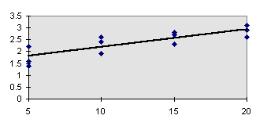
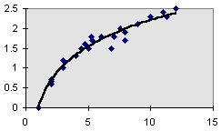
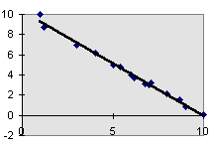
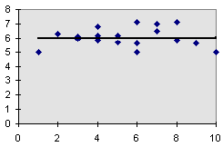
Types of Regression Models
Positive Linear Relationship
Relationship NOT Linear
Negative Linear Relationship
No Relationship

Slide 94
Population Linear Regression
The population regression model:
Population Slope
Coefficient
Random Error term, or residual
Population
y intercept
Independent Variable
Dependent Variable
Linear component
Random Error
component

Slide 95
Estimated Regression Model
The sample regression line provides an estimate of the population regression line
Estimated (or predicted) y value
Estimate of the regression
intercept
Estimate of the regression slope
Independent variable
The individual random error terms e_{i} have a mean of zero

Slide 96

Simple Linear Regression Example
A real estate agent wishes to examine the relationship between the selling price of a home and its size (measured in square feet)
A random sample of 10 houses is selected
  Dependent variable (y) = house price in $1000s
  Independent variable (x) = square feet

Slide 97
Sample Data for House Price Model
House Price in $1000s (y) | Square Feet (x)
245 | 1400
312 | 1600
279 | 1700
308 | 1875
199 | 1100
219 | 1550
405 | 2350
324 | 2450
319 | 1425
255 | 1700

Slide 98
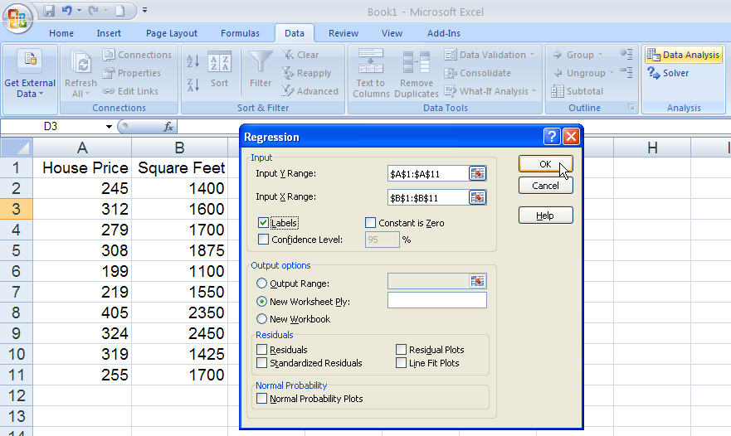
Regression Using Excel
Data / Data Analysis / Regression

Slide 99
Excel Output
Regression Statistics
Multiple R | 0.76211
R Square | 0.58082
Adjusted R Square | 0.52842
Standard Error | 41.33032
Observations | 10
ANOVA | df | SS | MS | F | Significance F
Regression | 1 | 18934.9348 | 18934.9348 | 11.0848 | 0.01039
Residual | 8 | 13665.5652 | 1708.1957
Total | 9 | 32600.5000
 | Coefficients | Standard Error | t Stat | P-value | Lower 95% | Upper 95%
Intercept | 98.24833 | 58.03348 | 1.69296 | 0.12892 | -35.57720 | 232.07386
Square Feet | 0.10977 | 0.03297 | 3.32938 | 0.01039 | 0.03374 | 0.18580
The regression equation is:

Slide 100
Interpretation of the Intercept, b₀
b₀ is the estimated average value of Y when the value of X is zero (if x = 0 is in the range of observed x values)
  Here, no houses had 0 square feet, so b₀ = 98.24833 just indicates that, for houses within the range of sizes observed, $98,248.33 is the portion of the house price not explained by square feet

Slide 101
Interpretation of the Slope Coefficient, b₁
b₁ measures the estimated change in the average value of Y as a result of a one-unit change in X
  Here, b₁ = .10977 tells us that the average value of a house increases by .10977($1000) = $109.77, on average, for each additional one square foot of size

Slide 102
Coefficient of Determination, R²
The coefficient of determination is the portion of the total variation in the dependent variable that is explained by variation in the independent variable
The coefficient of determination is also called R-squared and is denoted as R²
where

Slide 103
Coefficient of Determination, R²
(continued)
Coefficient of determination
Note: In the single independent variable case, the coefficient of determination is
where:
R² = Coefficient of determination
r = Simple correlation coefficient

Slide 104
Examples of Approximate R² Values
y
R² = 1
Perfect linear relationship between x and y:
100% of the variation in y is explained by variation in x
x
R² = 1
y
x
R² = +1

Slide 105
Examples of Approximate R² Values
(continued)
y
0 < R² < 1
Weaker linear relationship between x and y:
Some but not all of the variation in y is explained by variation in x
x
y
x

Slide 106
Examples of Approximate R² Values
(continued)
R² = 0
y
No linear relationship between x and y:
The value of Y does not depend on x. (None of the variation in y is explained by variation in x)
x
R² = 0

Slide 107
Chapter 15
Multiple Regression Analysis
and Model Building
6
www.midocean.ae

Slide 108
The Multiple Regression Model
Idea: Examine the linear relationship between
1 dependent (y) & 2 or more independent variables (x_{i})
Population model:
Y-intercept
Population slopes
Random Error
Estimated multiple regression model:
Estimated
(or predicted)
value of y
Estimated
intercept
Estimated slope coefficients

Slide 109
The Correlation Matrix
Correlation between the dependent variable and selected independent variables can be found using Excel:
  Formula Tab: Data Analysis / Correlation
Can check for statistical significance of correlation with a t test

Slide 110
Example
A distributor of frozen desert pies wants to evaluate factors thought to influence demand
  Dependent variable: Pie sales (units per week)
  Independent variables: Price (in $)
    Advertising ($100’s)
Data are collected for 15 weeks

Slide 111
Pie Sales Model
Week | Pie Sales | Price ($) | Advertising ($100s)
1 | 350 | 5.50 | 3.3
2 | 460 | 7.50 | 3.3
3 | 350 | 8.00 | 3.0
4 | 430 | 8.00 | 4.5
5 | 350 | 6.80 | 3.0
6 | 380 | 7.50 | 4.0
7 | 430 | 4.50 | 3.0
8 | 470 | 6.40 | 3.7
9 | 450 | 7.00 | 3.5
10 | 490 | 5.00 | 4.0
11 | 340 | 7.20 | 3.5
12 | 300 | 7.90 | 3.2
13 | 440 | 5.90 | 4.0
14 | 450 | 5.00 | 3.5
15 | 300 | 7.00 | 2.7
Multiple regression model:
Sales = b₀ + b₁ (Price)
+ b₂ (Advertising)
Correlation matrix:
 | Pie Sales | Price | Advertising
Pie Sales | 1
Price | -0.44327 | 1
Advertising | 0.55632 | 0.03044 | 1

Slide 112
Pie Sales Correlation Matrix
 | Pie Sales | Price | Advertising
Pie Sales | 1
Price | -0.44327 | 1
Advertising | 0.55632 | 0.03044 | 1
Price vs. Sales : r = -0.44327
  There is a negative association between
  price and sales
Advertising vs. Sales : r = 0.55632
  There is a positive association between
  advertising and sales

Slide 113
Multiple Regression Output
Regression Statistics
Multiple R | 0.72213
R Square | 0.52148
Adjusted R Square | 0.44172
Standard Error | 47.46341
Observations | 15
ANOVA | df | SS | MS | F | Significance F
Regression | 2 | 29460.027 | 14730.013 | 6.53861 | 0.01201
Residual | 12 | 27033.306 | 2252.776
Total | 14 | 56493.333
 | Coefficients | Standard Error | t Stat | P-value | Lower 95% | Upper 95%
Intercept | 306.52619 | 114.25389 | 2.68285 | 0.01993 | 57.58835 | 555.46404
Price | -24.97509 | 10.83213 | -2.30565 | 0.03979 | -48.57626 | -1.37392
Advertising | 74.13096 | 25.96732 | 2.85478 | 0.01449 | 17.55303 | 130.70888

Slide 114
The Multiple Regression Equation
where
Sales is in number of pies per week
Price is in $
Advertising is in $100’s.
b₁ = -24.975: sales will decrease, on average, by 24.975 pies per week for each $1 increase in selling price, net of the effects of changes due to advertising
b₂ = 74.131: sales will increase, on average, by 74.131 pies per week for each $100 increase in advertising, net of the effects of changes due to price

Slide 115
Using The Model to Make Predictions
Predict sales for a week in which the selling price is $5.50 and advertising is $350:
Note that Advertising is in $100’s, so $350 means that x₂ = 3.5
Predicted sales is 428.62 pies

Slide 116
Is the Model Significant?
F-Test for Overall Significance of the Model
Shows if there is a linear relationship between all of the x variables considered together and y
Use F test statistic
Hypotheses:
  H₀: β₁ = β₂ = … = β_{k} = 0 (no linear relationship)
  H_{A}: at least one β_{i} ≠ 0 (at least one independent
  variable affects y)

Slide 117
F-Test for Overall Significance
(continued)
Regression Statistics
Multiple R | 0.72213
R Square | 0.52148
Adjusted R Square | 0.44172
Standard Error | 47.46341
Observations | 15
ANOVA | df | SS | MS | F | Significance F
Regression | 2 | 29460.027 | 14730.013 | 6.53861 | 0.01201
Residual | 12 | 27033.306 | 2252.776
Total | 14 | 56493.333
 | Coefficients | Standard Error | t Stat | P-value | Lower 95% | Upper 95%
Intercept | 306.52619 | 114.25389 | 2.68285 | 0.01993 | 57.58835 | 555.46404
Price | -24.97509 | 10.83213 | -2.30565 | 0.03979 | -48.57626 | -1.37392
Advertising | 74.13096 | 25.96732 | 2.85478 | 0.01449 | 17.55303 | 130.70888
P-value for the F-Test

Slide 118
F-Test for Overall Significance
(continued)
H₀: β₁ = β₂ = 0
H_{A}: β₁ and β₂ not both zero
α = .05
df₁= 2 df₂ = 12
Test Statistic:
Decision:
Conclusion:
Critical Value:
F_{α} = 3.885
Reject H₀ at α = 0.05
The regression model does explain a significant portion of the variation in pie sales
(There is evidence that at least one independent variable affects y )
α = .05
0
F
Do not
reject H₀
Reject H₀
F_{.05} = 3.885

Slide 119
Are Individual Variables Significant?
Use t-tests of individual variable slopes
Shows if there is a linear relationship between the variable x_{i} and y
Hypotheses:
  H₀: β_{i} = 0 (no linear relationship)
  H_{A}: β_{i} ≠ 0 (linear relationship does exist
  between x_{i} and y)

Slide 120
Are Individual Variables Significant?
(continued)
Regression Statistics
Multiple R | 0.72213
R Square | 0.52148
Adjusted R Square | 0.44172
Standard Error | 47.46341
Observations | 15
ANOVA | df | SS | MS | F | Significance F
Regression | 2 | 29460.027 | 14730.013 | 6.53861 | 0.01201
Residual | 12 | 27033.306 | 2252.776
Total | 14 | 56493.333
 | Coefficients | Standard Error | t Stat | P-value | Lower 95% | Upper 95%
Intercept | 306.52619 | 114.25389 | 2.68285 | 0.01993 | 57.58835 | 555.46404
Price | -24.97509 | 10.83213 | -2.30565 | 0.03979 | -48.57626 | -1.37392
Advertising | 74.13096 | 25.96732 | 2.85478 | 0.01449 | 17.55303 | 130.70888
t-value for Price is t = -2.306, with p-value .0398
t-value for Advertising is t = 2.855, with p-value .0145

Slide 121
Inferences about the Slope: t Test Example
From Excel output:
H₀: β_{i} = 0
H_{A}: β_{i} ≠ 0
 | Coefficients | Standard Error | t Stat | P-value
Price | -24.97509 | 10.83213 | -2.30565 | 0.03979
Advertising | 74.13096 | 25.96732 | 2.85478 | 0.01449
d.f. = 15-2-1 = 12
= .05
t_{α/2} = 2.1788
The test statistic for each variable falls in the rejection region (p-values < .05)
Decision:
Conclusion:
α/2=.025
α/2=.025
Reject H₀ for each variable
There is evidence that both Price and Advertising affect pie sales at α = .05
Reject H₀
Do not reject H₀
Reject H₀
-t_{α/2}
t_{α/2}
0
-2.1788
2.1788

Slide 122
Confidence Interval Estimate for the Slope
Confidence interval for the population slope β₁
(the effect of changes in price on pie sales):
 | Coefficients | Standard Error | … | Lower 95% | Upper 95%
Intercept | 306.52619 | 114.25389 | … | 57.58835 | 555.46404
Price | -24.97509 | 10.83213 | … | -48.57626 | -1.37392
Advertising | 74.13096 | 25.96732 | … | 17.55303 | 130.70888

Slide 123


Thank You

