Slide 1

Assistant professor of Business Administration
Department of Management
(MGM 212)
E-Commerce
Dr. Adam Yagoub
جامعة الجميع الذكية

Slide 2
Lecture 1
Introduction to e-business and e-commerce
1. Introduction.
2. The impact of the electronic communications on traditional businesses.
3. What is the difference between e-commerce and e-business?
4. Define electronic commerce (EC) and Electronic business.
5. Traditional Commerce v/s E-Commerce.
6. Benefits of Doing Business Electronically.

Slide 3
Lecture 2
E-commerce fundamentals
1. Introduction.
2. The e-commerce environment.
3. Location of trading in the marketplace.
4. Business models for e-commerce.
5. Focus on auction business models.

Slide 4
Lecture 3
E-business infrastructure
1. Introduction.
2. Internet technology.
3. Web technology.
4. Managing e-business infrastructure.

Slide 5
Lecture 4
E-environment
1. Introduction
2. Social and legal factors
3. Environmental and green issues related to Internet
4. Taxation
5. Economic and competitive factors
6. e-commerce and globalization
7. Political factors
8. E-government
9. Technological innovation and technology assessment

Slide 6
Lecture 5
E-business strategy
1.Introduction.
2. What is e-business strategy?
3. Strategic analysis.
4. Strategic objectives.
5. Strategy definition.
6. Strategy implementation.
7. Information systems strategy and e-business strategy.

Slide 7
Lecture 6
E-procurement
1.Introduction.
2. What is e-procurement?
3. Estimating Focus on e-procurement costs.
4. Risks and impacts of e-procurement.
5. Implementing e-procurement.
6. Electronic B2B marketplaces.
7.The future of e-procurement?

Slide 8
Lecture 7
E-marketing.
1. Introduction.
2. What is e-marketing?
3. E-marketing planning.
4. Situation analysis.
5. Objective setting.
6. Strategy.
7. Characteristics of new-m Focus on edia marketing communications.
8. Tactics.
9. Online branding.
10. Actions.
11. Control.

Slide 9
Lecture 8
Customer relationship management.
1. Introduction.
2. What is e-CRM?
3. Conversion marketing.
4. The online buying process.
5. Customer acquisition management.
6. Customer retention management.
7. Excelling in Focus on e-commerce service quality.
8. Customer extension.
9. Technology solutions for CRM.

Slide 10
Lecture 9
Analysis and design.
1. Introduction.
2. Analysis for e-business.
3. Process modelling.
4. Data modelling.
5. Design for e-business.
6. User-centred site design.
7. Security design for e-business.

Slide 11
Lecture 10
Implementation and maintenance
1. Introduction.
2. Alternatives for acquiring e-business systems.
3. Testing.
4. Changeover.
5. Content management and maintenance.
6. Measuring and improving performance Focus on of e-business systems.

Slide 12
Course Learning Outcomes
- Identify and apply relevant problem-solving methodologies
- Design components, systems and/or processes to meet required specifications for a web presence
- Demonstrate research skills
- Communicate effectively in ways appropriate to the discipline, audience and purpose.

Slide 13
Course Learning Outcomes
- Work as an effective member or leader of diverse teams within a multi-level, multi- disciplinary and multi-cultural setting for the Group Website Research Project
- Appreciate ethical implications of professional practice
- Be aware of global perspectives (needs, rules/regulations, and specifications).

Slide 14

1. E-Business and E-Commerce Management : strategy, implementation and practice, fourth edition.
By: dave chaffey.
References

Slide 15
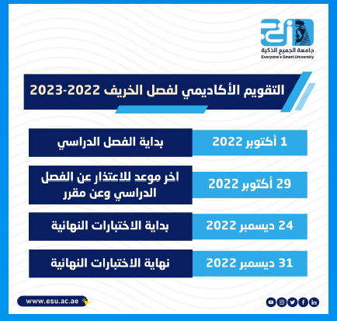

Slide 16
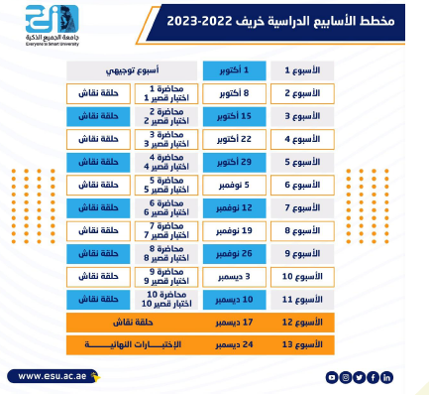

Slide 17


Slide 18
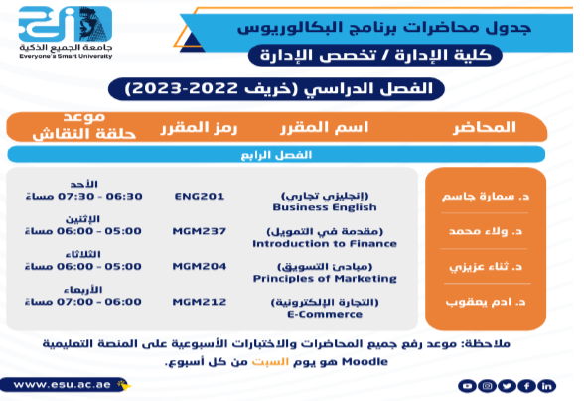

Slide 19


Slide 20


