Slide 1



Management of technologies
Lecture 9

Slide 2

Section 2
ESTABLISHING A PRACTICAL COMPANY INNOVATIVE BENCHMARK
Lecture
Section 1
PRODUCT DEVELOPMENT STRATEGIES FOR HIGH-TECH PRODUCTS IN A GROWTH MARKET

Slide 3
Section 1
PRODUCT DEVELOPMENT STRATEGIES FOR HIGH-TECH PRODUCTS IN A GROWTH MARKET

Slide 4
Introduction
A new product is recognized in a market just after the product introduction. Shortly thereafter, a rapid market expansion occurs. This market condition is known as the growth stage in a product life cycle. Two major characteristics of this market condition can be identified in this fast growing market. One is an increase in the number of competitors, and the other is a change in the customers' product preferences. This competitive situation continues until at least the middle of the growth stage. Therefore, organizations must develop new product development strategies for successful new market entry for this stage. The market characteristics in the growth stage are analyzed in detail and the product development strategies corresponding to the market characteristics are developed by considering current products of each organization in the market.

Slide 5
TARGET CUSTOMER AND MARKET POSITION
Classification of product adopters
After the new products are introduced to the market, the products are purchased by the customers and penetrate the market. In the new product adoption process, the product adopters are classified by the characteristics of their product adoption manners. By the spreading process of new products to the market, the target customers are classified into five types, from the product introduction to withdrawal.

Slide 6
TARGET CUSTOMER AND MARKET POSITION
Classification of product adopters
In the growth stage, three out of five customer types can be recognized. The corresponding customer groups are explained as follows:
Innovators. They recognize the brand-new products as products with potential flaws due to its newness, but they are willing to buy the products. The value of product's newness attracts this customer group. Innovators are the adventurous customers and/or risk takers.
Early adopters. For spreading the new products smoothly to the market, early adopters are the most important customer group because they are the opinion leaders. They are moderately reformist customers.
Early majority. They are influenced by the early adopter group. They are prudent and purchase new products carefully to avoid risks such as product flaws.

Slide 7
Competitive position in growth stage
The strategies are developed for the each competitive position in a growth stage. The speed of market growth in a growth stage is faster than the speed of a maturity stage. Therefore, the market predominance among organizations is made by their market entry time. A new exploitation of the market is also preferentially acquired by the early entry organizations. The late market entry organizations' targets are the customers outside of the market which the preceding entry organizations do not cover. The products of late entry organizations should be differentiated with the products of early entries. By focusing on the characteristics differences of target customers and market entry time, the strategic market positioning for the growth stage can be selected. The detailed explanation in each market position is explained below.

Slide 8
Competitive position in growth stage
Leader. Since the leader carries out quick market entry, the first target customer in the growth stage is in the process of changing from the innovators to the early adopters. Therefore, market leaders must introduce new products to a new market to capture this customer movement. Less product quality which does not lower the customers' good impression of the products is acceptable. The early adopters purchase new products upon considering some risks in the most of cases.
Challenger. A challenger follows in the leader's footsteps and enters into the new market. The target markets are the customers in the early adopters and early majority groups. The products for the targets must be with mid to high quality level. The new products with a full line like a leader's product line are necessary for the early majority.

Slide 9
Competitive position in growth stage
Follower. As a strategy for the market follower, a market share from the leader and the challenger is gained by the competitive products. The product quality of price suitability is made by imitating the popular products, which the leader produces for the customers of the early majority.

Slide 10
CONCEPT FOR STRATEGY CLASSIFICATION
In the case of aiming at the whole market, Organizations must have the product development ability corresponding to the rapid increase in product preferences. New products introduction with sufficient price width which covers a wide variety of product preferences is necessary. In this condition, organizations must have the product development ability corresponding to introduce a wider variety of products.
On the other hand, as the target is only a part of the market, an identification of customer's product preferences is important. The developed strategies in this research differ greatly depending on selection of the target market and the time of the market entry.

Slide 11
CONCEPT FOR STRATEGY CLASSIFICATION
The target customers for the suggested strategies are set from innovators to early majority. When setting innovators as a target, it is necessary to gain customer's interests by the newness of the products and the products distinction from past products. On the other hand, in the case of the target of early majority, it is necessary to analyze popular products in detail. After the popular products are analyzed, similar products should be introduced to the market quickly.
The products must be lower priced than the current products in the market. If the target market is small, introduced products must fit the specific product preference. The developed products must have a higher level of product originality as well as be reasonable priced. Analysis of degree of product variety In the concept of product development strategies in a growth stage, the organization's target customer differs by the market entry time. The target market size is also selected depending on the product characteristics and varieties of each organization.

Slide 12
CONCEPT FOR STRATEGY CLASSIFICATION
Then, measurement of the product variety is used in order to measure the size of the organization's target market. After the new products are introduced to the market, customers begin to buy the products. The first customers are called innovators, next are the early adopters, and the last customer group is the early majority. The introduced product variety needs to be expanded gradually; and the product variety must cover the whole market, which includes a large variety of product preferences.
For the late entry organizations, the organizations must select their targets whether the whole market or focused areas within the market. In order to identify the range of the target customers, it is necessary to analyze the product features, which are in the current products introduced by each organization.

Slide 13
CONCEPT FOR STRATEGY CLASSIFICATION
Two factors are used for this analysis. Each factor is analyzed for each organization in the market. In the growth stage, customer preferences change quickly. The amount of product variety is to follow this customer movement. The range of the product price indicates the width of the target customer groups, because the expected price level is different from each customer group.

Slide 14
Analysis of degree of product similarity
The product similarity of each organization is analyzed by the product characteristics of other organizations which exist in the same market. In the growth stage, the organizations can roughly be categorized into two types by each characteristic. One attains product differentiation by the other organizations and aims at establishment of the de-facto industry standard. The other introduces the products which are similar to popular models in the market, in order to reduce the market penetration mistake of the new products. Especially, the product line of similar products with small variety enables the introduction of low-priced products. However, it cannot correspond to a change in target customers during the entire product life cycle period. Two factors are used to measure product similarity.

Slide 15
Analysis of degree of product similarity
Product specification is used as a factor which judges products as a total system. Product function is used as a measurement factor of the practical usability of a product. Both factors are developed to observe the product similarity from the customer's viewpoint. This analysis method enables evaluation of both the internal and the external comprehensive level of product similarity.

Slide 16
FOUR PRODUCT DEVELOPMENT STRATEGIES FOR GROWTH STAGE
During a growth stage, organizations must figure out clearly the target market and customers preferences. Because the speed of market growth is faster, organization need to track the target market characteristics change to adapt the customers' product requirements. The strategies are developed by focusing on two main points; the target customer types and the target customer size. The organizations with the selection of the each point define the competitive movements in growth stage.
These points are carefully considered to fit the current market characteristics and four types of new product development strategies are developed. The strategies are leader strategy, proactive challenger strategy, reactive challenger strategy, and follower strategy.

Slide 17
FOUR PRODUCT DEVELOPMENT STRATEGIES FOR GROWTH STAGE
Leader strategy
The target customers of the organization which takes leader strategy are mostly late innovators, early adopters, and early majority. In the case at the beginning of growth stage, innovators and early majority is recognized as major customers. In this case, the organizations need to supply the products corresponding to product preferences of the customers in the new market. The customers in the early growth stage prefer newness and originalities of products. Supplying the new products which are with high technology or/and high level of originality are required to attract the customers in this period.

Slide 18
FOUR PRODUCT DEVELOPMENT STRATEGIES FOR GROWTH STAGE
Leader strategy
After the market condition moves into the late growth stage, other types of customers are identified as additional customer groups. The new customers have different product preferences from the customers of early growth stage. The additional customers prefer to select the new products carefully from the large variety of products.
The organizations need to adapt the preferences of the new types of customer's. The new products of the organizations with leader strategy require not only the high level of product variety but also new and high technology products and/or original products.

Slide 19
FOUR PRODUCT DEVELOPMENT STRATEGIES FOR GROWTH STAGE
Proactive challenger strategy
The proactive challenger strategy focuses on the customer preference which is in the first half of growth stage. In this period in a product life cycle, the types of customer are categorized in innovators and early adopters. The both customer types have similar product preferences and are attracted by newness and originality of the product. In this condition, the organization taking proactive challenger strategy should produce the new products including new technology and originalities.

Slide 20
FOUR PRODUCT DEVELOPMENT STRATEGIES FOR GROWTH STAGE
Proactive challenger strategy
The product differentiation for creating product originalities is developed by the analysis of products in the current market. The detailed market analysis helps to find the direction of new product concept. The introducing distinctive products to the market leads the potential to take a de-fact industry standard, also. Offering the high quality products using different industry standard might attracts the customers especially who are in early growth stage. In addition publicity of new products are very important to overtake the most popular products in the target market.
The new products of the organizations with proactive challenger strategy require high technology and/or original unique ideas for the creation of distinctive product features.

Slide 21
FOUR PRODUCT DEVELOPMENT STRATEGIES FOR GROWTH STAGE
Reactive challenger strategy
The organizations taking reactive challenger strategy introduce the new products after the target market is clearly identified by the early entry organizations. The major targets of the organization with this strategy are late early adopters and early majority. Both customer types are not high-risk takers and organization must satisfy the corresponding customers' requirements of high quality standard. The target customers of the organizations taking reactive challenger strategy prefer selecting the products from large variety of products. The new product line for the target customer should be organized by large variety of products. In this case, the product variety is developed by the similar products of major products in the market. Introduction of similar products of higher sales products reduces the risk of market penetration mistake.

Slide 22
FOUR PRODUCT DEVELOPMENT STRATEGIES FOR GROWTH STAGE
Reactive challenger strategy
The new products of the organizations with reactive challenger strategy require high level of product variety and the products must be similar products of major products of current market. The reasonable priced products are also necessary, because the products are late introduced products with no product originality.

Slide 23
FOUR PRODUCT DEVELOPMENT STRATEGIES FOR GROWTH STAGE
Follower strategy
Follower strategy aims at the one particular part of the target market during the last half of growth stage. The customer type in this period is mostly early majority. This customer type is very careful about product qualities and tends to buy only popular products which have good reputation in the market. Follower strategy introduces the products to the some selected parts of market and the products should be very similar to popular products in the market. The produced products are already well known in the market and the speed of market penetration is easy and very fast. The large sales promotion is not necessary because the products are promoted by other organizations already.

Slide 24
FOUR PRODUCT DEVELOPMENT STRATEGIES FOR GROWTH STAGE
Follower strategy
The new products of the organizations with follower strategy require high level of product similarity and quality. The product variety is minimized to focus on only profitable customer target. The setting of adequate and precise customer target is required to succeed by this strategy.

Slide 25
STRATEGY CLASSIFICATION
After the analysis of the product variety, and the product similarity, the product development strategy is selected with consideration of each strategy concept, as shown in Fig.3.
Large number of product variety and low level of product similarity
In this case, leader strategy is suggested. The organization with these product characteristics has a good reputation as a de-facto standard in the market by early entry into the new market. In order to obtain or maintain a market leader in a market, the organization should supply continuously new products, which prevents easy market entry of following organizations. In this case, unique products with new technological features must be developed and introduced to the market continuously.

Slide 26
STRATEGY CLASSIFICATION
After the analysis of the product variety, and the product similarity, the product development strategy is selected with consideration of each strategy concept, as shown in Fig.3.
Large number of product variety and high level of product similarity
In this case, reactive challenger strategy is suggested. The purpose of an organization falling under this category is covering the whole market with the product containing the popular product functions which were previously introduced to the market by the early entry organizations. The product introduction with a large number of varieties is effective in obtaining the market share. A popular product model is selected quickly from the market, and organizations produce similar products only. This method reduces the possibility of sales failure.

Slide 27
STRATEGY CLASSIFICATION
After the analysis of the product variety, and the product similarity, the product development strategy is selected with consideration of each strategy concept, as shown in Fig.3.
Small number of product variety and low level of product similarity
The proactive challenger strategy is suggested for this section. The product introduction with small product variety focuses on a specific customer type. In addition, the product with a low level of product similarity assign innovators to one of the target customers. The introduction of this type of product has a potential to obtain the de facto standard in a market.

Slide 28
STRATEGY CLASSIFICATION
After the analysis of the product variety, and the product similarity, the product development strategy is selected with consideration of each strategy concept, as shown in Fig.3.
Small number of product variety and high level of product similarity
The follower strategy is suggested for this section. This type of strategy does not aim at the acquisition of a de-facto standard since the market entry time is later than other organizations. The purpose of this strategy is to obtain certain returns of the new product introduction. Introducing products should be only similar products with small product variety. The introduced products must be the most popular products in the market.

Slide 29
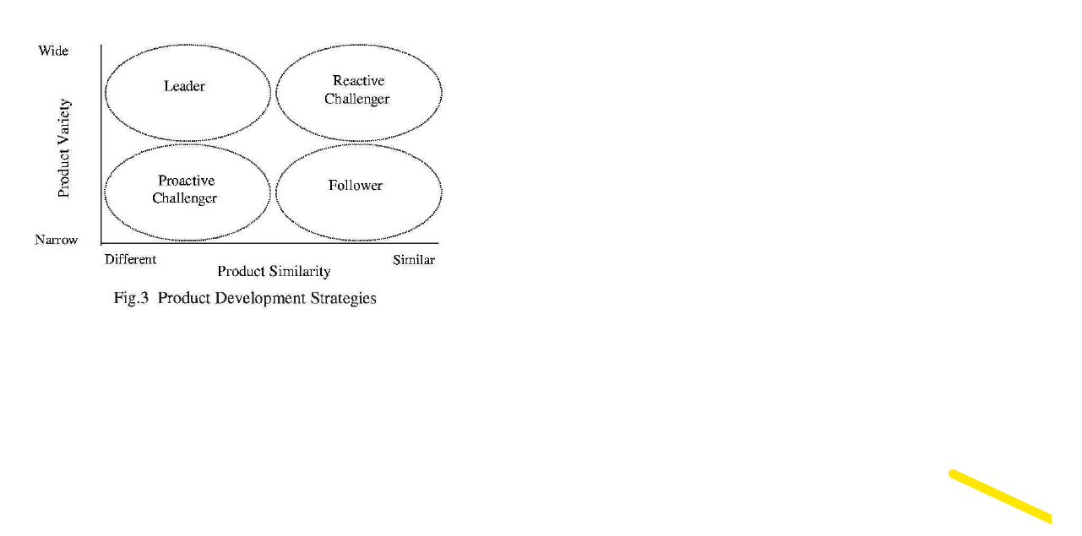

Slide 30
Section 2
ESTABLISHING A PRACTICAL COMPANY INNOVATIVE BENCHMARK

Slide 31
INTRODUCTION
Innovation is a major driving force for the economic growth and expansion of companies. The globalisation of markets has raised strong competitive pressures. The rapid evolving technology, the fast changing markets and the more demanding customers, require developing high quality new products more efficiently and effectively. Taken that every firm can be represented as a bundle of resources, skills and competencies, the effect of innovation is to transform a firm's inner capabilities, making it more adaptive, better able to learn, to exploit new ideas.
This need to innovate has become clear by now. One of the latest European Union Innovation policy studies reported that over half of all the European enterprises (51%) are technological innovators. Furthermore In the European Union, new products or services renewed within the years 2000-2001, account on average for approximately one fifth (20.4%) of companies' turnover. Two companies out of every three introduced new products and services over this period and almost 12% of companies can be considered highly innovative, with over half their turnover generated by new products.

Slide 32
INTRODUCTION
Small and Medium Enterprises (SMEs), have shorter lines of communication, relatively informal decision making and more flexibility, which seems to give them an advantage for rapid innovation over large co operations.
Large companies have responded early to the need of management of innovation. This was the only way to be competitive and remain in business, since most of those who failed to realise this need, didn't survived. They have examined themselves and in doing so have created a range of tools and techniques to help them adapt to changed circumstances and meet new market challenges. SME's on the other hand, even if they are very well aware of the importance of innovation have been rather slow in adopting these tools and techniques, which often are very difficult or even impossible to be applied to them.

Slide 33
INTRODUCTION
There is certainly no shortage of product ideas and concepts flowing within SMEs. However, in a large number of cases, there exists an inability to bring successful innovations to the marketplace in a controlled and coordinated way. Vision and drive are not enough for successful on-going product developments. A large number of studies over the past decade have indicated that SMEs frequently suffer in the management of their product innovation process through a lack of structure. Constantly successful innovation requires discipline, good teamwork and the careful assessment of progress at each phase.

Slide 34
PART I - MEASURING INNOVATION
Since the importance of innovation in SME's is by now very clear, one major issue is how can we measure innovation? Many studies have focused in this issue, but the measurement of innovation is still clouded with statistical and conceptual problems.
Since now the most commonly used measures of innovative activities are: R&D expenditures, patent counts and counts of major or minor innovations, but the task of applying these measures to SME's has many difficulties and may result to misleading conclusions.

Slide 35
PART I - MEASURING INNOVATION
R&D data are usually collected in the OECD economies according to the procedures and categories described in the "Frascati Manual". R&D statistics do not cover all aspects of technological change. It has been stressed that they underestimate the innovative potential of small and medium sized firms, which seldom have formal R&D laboratories. R&D numbers measure only an input, which has no necessary relation to innovation outcomes. There are many examples of successful innovating SME's which perform relatively little R&D. Patent data can be retrieved in the records of US Patent Office and the European Patent Office.

Slide 36
PART I - MEASURING INNOVATION
The weaknesses of patent measuring are that each country has a different patent legislation, not all inventions are patent or patentable and patents do not necessary represent a commercially exploited innovation. A recent EU Innovation policy study for enforcing small firms' patent rights confirms fears that the current patent system works poorly for SMEs. For SME's, patenting is currently not cost effective as a means of protecting intellectual property making the patent measuring unreliable for SME's.

Slide 37
Benchmarking
Benchmarking is a method for comparing firms. Benchmarking provides to a firm a useful tool for allowing them to compare their performance relative to an average or to other firms. Benchmarking is a continuous process. According to the Oslo manual benchmarking leads to better understanding of the organisation's current practices, and makes use of systematic comparison of practices and performance with those of others to develop improvement actions, which will bring performance levels up to or beyond those of the 'best in class'.
Despite benchmarking has become very popular in successful firms it remains a relatively underused tool in the field of innovation. A vast number of studies identified success or failure factors in product development, but few have tried to incorporate innovation to performance benchmarking. As an exception we can refer Coopers studies who present on a benchmarking to identify critical success factors that set successful companies apart from the not so successful ones.

Slide 38
Benchmarking
Benchmarking is a method for comparing firms. Benchmarking provides to a firm a useful tool for allowing them to compare their performance relative to an average or to other firms. Benchmarking is a continuous process. According to the Oslo manual benchmarking leads to better understanding of the organisation's current practices, and makes use of systematic comparison of practices and performance with those of others to develop improvement actions, which will bring performance levels up to or beyond those of the 'best in class'.
One main feature that appears in benchmarking and related studies within the innovation is the bias towards quantitative definition of best practices rather than softer definition. Some researchers try to illustrate the need to break away from sole reliance on hard metrics of benchmarking measurement to a soft metrics or to more balanced use of soft and hard metrics. In order to apply benchmarking to SME,s the methodology should be short and clearly defined.

Slide 39
PART 2 - THE PIP-SCORE APPROACH
All initiatives on improving the innovation within the organization in the past, have addressed ways of improving the product innovation process, through a wide spectrum of methods, techniques and tools without quantifying the degree of change of "innovativeness". This paper presents a methodology based on the 'pip score1 process, which is used to position an organization in terms of its level of product innovation maturity.
The Three Axes of Innovation
According to the EU Green Paper on Innovation, innovation is:
• the renewal and enlargement of the range of products and services and the associated markets;
• the establishment of new methods of production, supply and distribution;
• the introduction of changes in management, work organisation, and the working conditions and skills of the workforce" EC(1995:2).

Slide 40
PART 2 - THE PIP-SCORE APPROACH
Product Innovation occurs when a new or improved product is introduced to the market. Process innovation is an adoption of new ways of making products or services. The innovation process is the combination of activities - such as market research, communication, design, process development, organisational restructuring, and so on - which are necessary to develop and support an innovative product. There is a strong correlation between product innovation and process innovation. Process innovation may result in product innovation and similarly, product innovation may force process innovation.
Organizational innovation follows these two dimensions. Since now innovation surveys discount the importance of role of organisation in innovation. They focus instead on the process of technology acquisition and sources of information for innovation. Recent studies also emphasises the need to broaden the concept of innovation, ie., should organisational change be included? (Klomp 2001). Since now there are no initiatives or schemes, which have addressed all three dimensions, in a holistic approach to a company innovation and attempted to resolve them in order to determine their independency. Not in any case has the emphasis of the research been placed on 'what is the value, level of the innovation within an organisation considering their products, innovation process and project management of the process?'

Slide 41
PART 2 - THE PIP-SCORE APPROACH
The pip-score approach the addresses three interrelated, but separately measurable dimensions of innovation in a company:
• The product axis
• The process axis
• The management or organizational axis.
There are ten attributes for each axis. There is a strong correlation between the three attributes of each row (Table 1).
The range for each attribute is between 0 and 4 having discrete fraction of 0.1. By resolving the above three axes values you acquire a PIP SCORE. This value represents the "innovationness" of the company in a specific sector

Slide 42
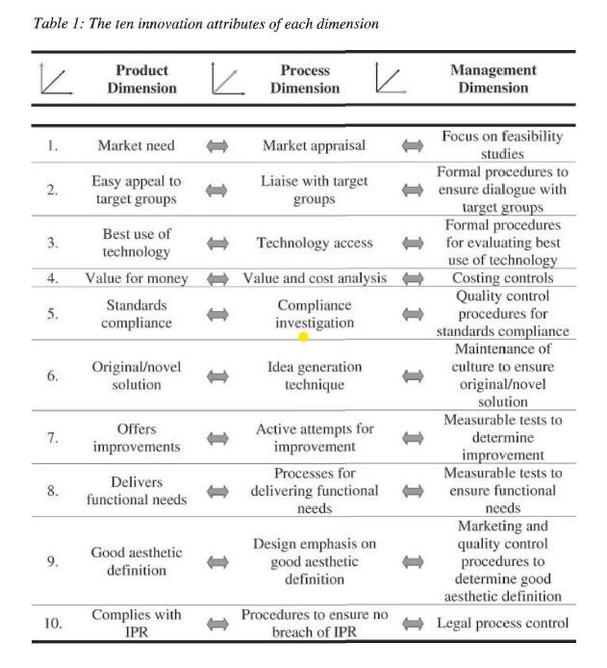

Slide 43
PART 2 - THE PIP-SCORE APPROACH
Scoring on these 3 axes is at the heart of creating a replicable innovation register and benchmark. The approach itself focuses on using non-intrusive assessment and diagnostics methods and techniques to examine the organization and determine their level of innovation in respect of product and/or service development. The company's current "position" is then evident together with the capability to set targets whereby the enterprise can improve such a score / profile and benefit from this initiative. Previous experience, piloting such techniques, indicates it is possible to offer a very fast track process - 2-3 days - to determine the register. Designing a framework for improvement of this scoring (ie. the targets) can be achieved within a single day (or less). An average three months period to implement changes and re-orientate the culture is followed by a re-test of the PIP scoring process to achieve a measure of change against the original register and benchmark. On average, significant changes (for the better) can be achieved within four months; with a climate shift in terms of continuous improvement in approximately 6-9 months

Slide 44



Thank You

