Slide 1


Human Resources
Analytics
Prepared by Dr. Samah Abdelfatah
HRM 623
Lecture 9

Slide 2



Impacting Productivity
and the Bottom Line
Chapter
7
Lecture 09
HRM 623
Prepared by
Dr. Samah Abdelfatah
www.midocean.ae

Slide 3

Chapter
MAIN TOPICS
7/8
Application On Two Case Studies
Case Study 1 —Ingram Content Group
Case Study 2—Enterprise Rent-A-Car
www.midocean.ae

Slide 4
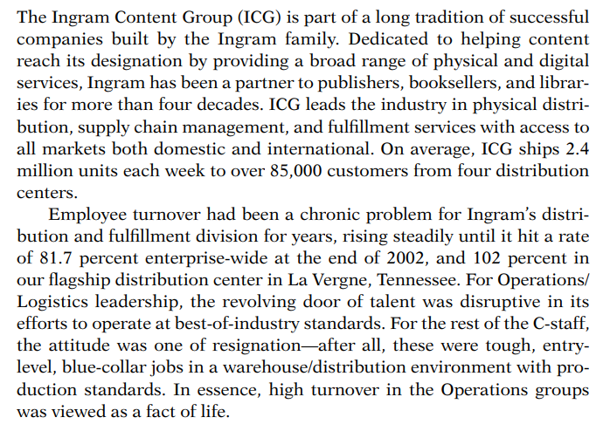

Case Study 1
Chapter
07
www.midocean.ae

Slide 5
Chapter
Getting the Attention of Leadership
07
For Operations/Logistics leadership, excessive turnover was a disruptive factor in its efforts to effectively manage its facilities.
They track the turnover data and benchmarking that against the data provided by the Department of Labor for Wholesale Trade.
They explored two highly accepted methods for determining the cost of turnover:
Capturing the individual expense items impacted by a separation event,
Using the more simple calculation of six months of base pay plus benefits for each nonexempt separation and one year for each exempt separation.
www.midocean.ae

Slide 6
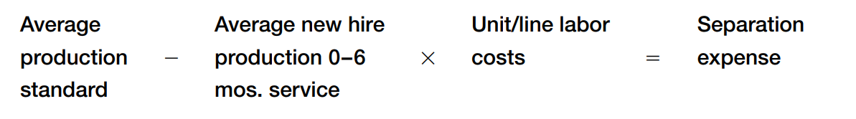
Chapter
Crafting the Right Formula to Gain Leadership Support
07
The challenge faced was to construct a formula that would capture the expense analytics used by the Operations and Finance groups in measuring operational performance.
www.midocean.ae

Slide 7

The Causes, the Metrics, and the Intervention Strategies
.
A. Staffing
Established quality-of-hire metrics measuring turnover at ninety days and one year.
Utilizing the Activity Vector Analysis (AVA) assessment tool, it identified the behaviors required for each of the roles that would enhance the potential for retention.
They implemented a robust screening process for all hourly positions.
Chapter
07
www.midocean.ae

Slide 8
The Causes, the Metrics, and the Intervention Strategies
B. Leadership Development
Chapter
07
Partnering with a local college, they delivered a tailored ongoing development program for all levels of management in the Operations/ Logistics group.
In partnership with the ICG Legal team, they delivered a series of learning events to enhance communication and to educate leadership on key issues that impact associates.
They assessed effectiveness of learning initiatives through follow up evaluations measuring learning and on-the-job application of newly acquired knowledge, skills, and abilities, as well as continued management inventory assessments.
www.midocean.ae

Slide 9
The Causes, the Metrics, and the Intervention Strategies
B. Leadership Development
Chapter
07
4. They redesigned performance management to include a focus on turnover.
A turnover reduction goal was added to every member of the Operations/Logistics management team, as well as the HR team, as part of their annual performance management reviews.
5. They established cross-functional turnover teams to create strategies, implement action items, and measure effectiveness as a means of achieving turnover goals.
www.midocean.ae

Slide 10
The Causes, the Metrics, and the Intervention Strategies
C. Rewards
Chapter
07
1.They ensured that base pay was competitive with local market conditions.
2. They implemented a pay-for-performance program system for the hourly team that was based on production and quality standards.
3. They secured their futures through education and communication of the important programs. For the Operations/Logistics group during this five-year period, participation rose from 25 to 84 percent, surpassing the Wholesale Trade benchmark of 72 percent.
www.midocean.ae

Slide 11
The Causes, the Metrics, and the Intervention Strategies
D. Associate Relations
Chapter
07
They established quarterly roundtables chaired by the executive for each department; notes were published, along with specific action items to be addressed.
They implemented a retraining program to assist associates who were struggling with production standards. Instead of treating associates who fell short of production standards as a disciplinary problem, they gave them an opportunity to improve through additional training.
www.midocean.ae

Slide 12
The Causes, the Metrics, and the Intervention Strategies
D. Associate Relations
Chapter
07
3. Management and HR were trained to identify personal issues that
may drive associates to leave, and to intervene as appropriate.
4. They increased employee engagement opportunities through inclusion on teams such as the Safety Committee and process improvement/LEAN teams
www.midocean.ae

Slide 13
The Causes, the Metrics, and the Intervention Strategies
D. Associate Relations
Chapter
07
Within five years of implementing the strategies to address excessive turnover, turnover for the Operations/Logistics groups dropped from 81.7 to 25.5 percent, thereby achieving a cost savings tied to added productivity of $13.4 million over the five-year period. See Figure 7.1.
www.midocean.ae

Slide 14
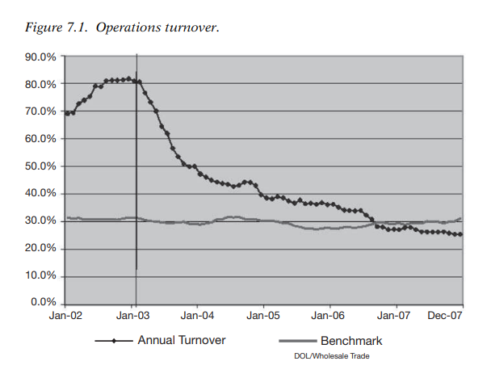
www.midocean.ae

Slide 15
Final Thoughts
Chapter
07
While the issue of excessive turnover has been addressed, they continue to focus on the quality of the hires in the Operations/Logistics groups in order to attract the best talent.
They also continue exerting efforts to retain that talent by enhancing onboarding process, ensuring that the rewards system and benefits are competitive, and through a robust communication program, ensuring that Ingram management never loses touch with its associates.
In addition, they continue to ensure that those who have the most direct contact with the associates—the Team Leads and Supervisors—are provided with effective ongoing leadership development.
www.midocean.ae

Slide 16
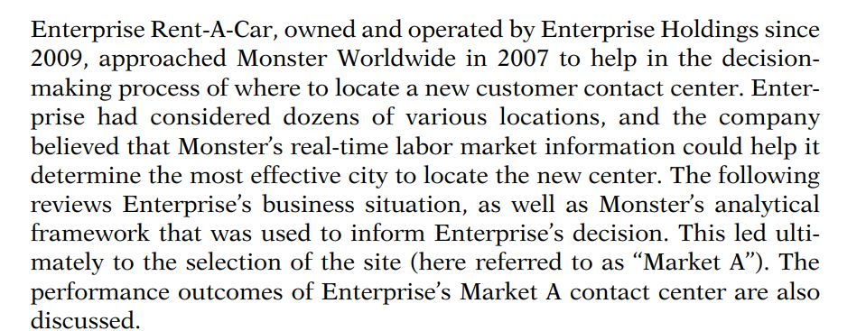

LEVERAGING HUMAN CAPITAL
ANALYTICS FOR SITE SELECTION
Chapter
08
Case Study 2
www.midocean.ae

Slide 17
Enterprise Holdings
Chapter
08
if they know what is expected and where they are going—it is also smart
from a performance perspective. Both clear links between individual
goals and company performance and having a clear career path are
strong drivers of employee engagement. Then, organizations are pushing
performance directly through the review process, as well as through
potential increased employee engagement.
Enterprise Holdings, through its subsidiaries, owns and operates more than 1 million cars and trucks, including the largest fleet of passenger. vehicles in the world today, under the Alamo Rent A Car, Enterprise Rent A-Car, and National Car Rental brands.
As North America’s largest and most comprehensive car rental company, Enterprise Holdings also operates a network of more than 8,000 car rental locations in neighborhoods and at airports worldwide, and leads the industry with more than a third of all airport business in the United States and Canada.
www.midocean.ae

Slide 18
Chapter
The Business Need and the Capabilities Required
08
The initial step in any workforce planning–related exercise is to identify the business need being addressed and the capabilities and/or occupations that will help satisfy that business need.
This step can take many forms, but at the most basic level it involves specifying the types of occupations likely to have the skills required to build the needed capabilities in the organization.
www.midocean.ae

Slide 19
Chapter
The Business Need and the Capabilities Required
08
Once those occupations have been identified, then a broad occupational overview for each is provided that includes:
Projected occupational growth
Typical candidate profiles for this occupation
Sector-specific information that impacts hiring (e.g., increased outsourcing, technology advances, generational makeup of the workforce)
www.midocean.ae

Slide 20
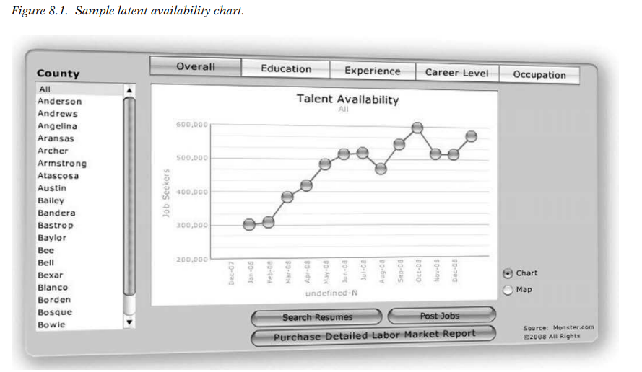
www.midocean.ae

Slide 21
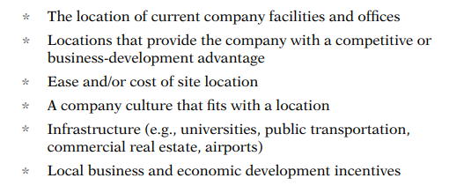
A Short List of Possible Site Locations
Chapter
In order to analyze options efficiently, it is recommended that an organization identify three to six locations that will then be analyzed in detail to make a site recommendation.
This is best done with a mix of qualitative and quantitative factors. Qualitative factors include things such as:
www.midocean.ae

Slide 22
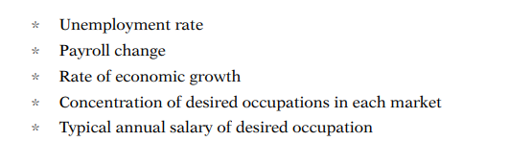
A Short List of Possible Site Locations
A short list of locations can also be created by identifying quantitative factors for each location and then sorting through them on the basis of those factors.
Quantitative factors that can be used to rank locations in order of priority include:
www.midocean.ae

Slide 23
Chapter
Talent Supply
08
After three to six locations have been selected for consideration, the next step is to evaluate and compare the talent pool across the locations.
This is done in several ways.
Calculate the talent density for each critical occupation.
Talent density = The total number of people working in an occupation in a location X 100
The total workforce for that location, then multiplied.
This figure is used to understand, all other things being equal, how difficult it would be for a company to recruit talent in one location compared to another location.
The time series trend of this metric should also be examined to understand whether market conditions are changing for the better or for the worse.
www.midocean.ae

Slide 24
Chapter
Talent Supply
08
2. Compare a national job search index for each critical occupation to a local job search index for each occupation.
The job search index = Total number of job searches by occupation and by location X 100
The total number of jobs at that location
This metric is a direct measure of job-seeking activity and is an indicator of how likely a person with a particular occupation in a specific location is to apply for a job opening.
www.midocean.ae

Slide 25
Chapter
Talent Supply
08
3. Prepare a talent profile for each critical occupation.
Factors to profile include:
* Mobility of talent (e.g., willingness to relocate)
* Full-time versus part-time or contract workers
* Career level
* Education level
* Media habits and job-seeking behavior of talent
* Salary requirements
www.midocean.ae

Slide 26
The Demand for Talent
Chapter
08
The demand for talent represents the amount of competition your company will experience if it choose to enter the local market.
Therefore, knowing the demand trend is critical to understanding how successful a major recruiting initiative will be in each market. To do this:
Evaluate posting trends over time for each critical occupation in order to understand whether demand for talent is slowing or intensifying.
Calculate the talent demand index for each occupation.
The talent demand index = The number of job postings X 100
The total number in the occupation workforce
This metric should be compared to the national average, in existing corporate locations, as well as evaluated over time to understand whether the local market is in a state of transition.
www.midocean.ae

Slide 27
Chapter
The Demand for Talent
08
Consider supply versus demand.
Look at the labor conditions for each of the markets by plotting the markets in a graph similar to that shown in Figure 8.2, showing a simple talent-market plot.
This will help you identify the relative competition for talent in each market.
www.midocean.ae

Slide 28
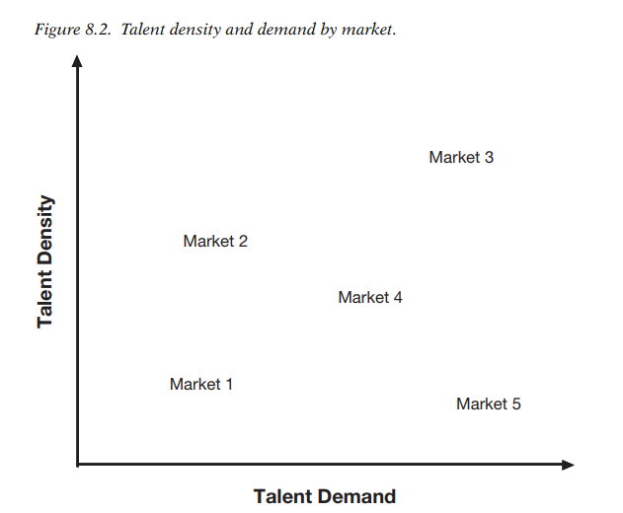
Chapter
www.midocean.ae

Slide 29
Chapter
The Economic Situation
08
1. Preparation
It is helpful to summarize the economic conditions for each market as an aid in understanding the economic backdrop for each proposed site. Include the following in each market summary:
* Unemployment and payroll trends
* Major industries and employers of the region
* Rate of economic growth or decline in the market
* Basic demographics of the workforce
* Economic incentives for companies to locate in the region
* Cost of facilities/office space in the market
www.midocean.ae

Slide 30
The Competition
Chapter
08
An important step is to evaluate the potential competitors for talent in each market.
This should be done in several ways:
  Use job-posting trends to identify your close competitors’ presence and recruitment activities in each location being considered.
  Identify which industries hire the most for the occupations your company will recruit to fill. Identify and profile top companies in each location being considered.
www.midocean.ae

Slide 31
The Enterprise Analysis
Chapter
08
Identify the business need and capabilities required.
Enterprise selected a short list of four possible site locations. For purposes of the case study, they call them Markets A, B, C, and D.
At the time of the analysis, Monster analyzed millions of candidates who would help fill Enterprise’s needs and uncovered the following:
    There were more than 3.5 million customer-service resumes in the Monster database, with an average of over 99,000 new resumes being added each month.
    On average, there were over 4.3 million customer-service job searches each month, and there were over 2 million job-search agents sent to candidates looking for similar jobs.
www.midocean.ae

Slide 32
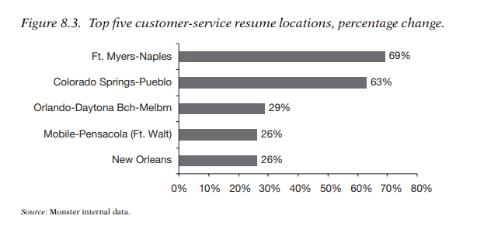
Chapter
Monster reviewed the top locations with customer-service candidates listed on Monster and also the top locations with the largest year-over-year growth in customer-service resumes (see Figure 8.3). Monster also evaluated growth metrics for over 200 locations, allowing for market-to-market comparisons
www.midocean.ae

Slide 33
Chapter
The Enterprise Analysis
08
Monster evaluates additional talent-related metrics to assess a market for clients.
Some of these additional talent-related factors include:
    Desired Salary. For example, if a key occupation in one market has a median salary of $27,000 and an alternative market has a median salary of $44,500, the company could use this information to forecast its operating expenses.
    Flexibility in Scheduling. The percentage of workers who desire a temporary, part-time, or full-time opportunity may differ significantly from market to market. If a company wishes to leverage a flexible workforce as part of its staffing strategy, this may be an important factor.
www.midocean.ae

Slide 34
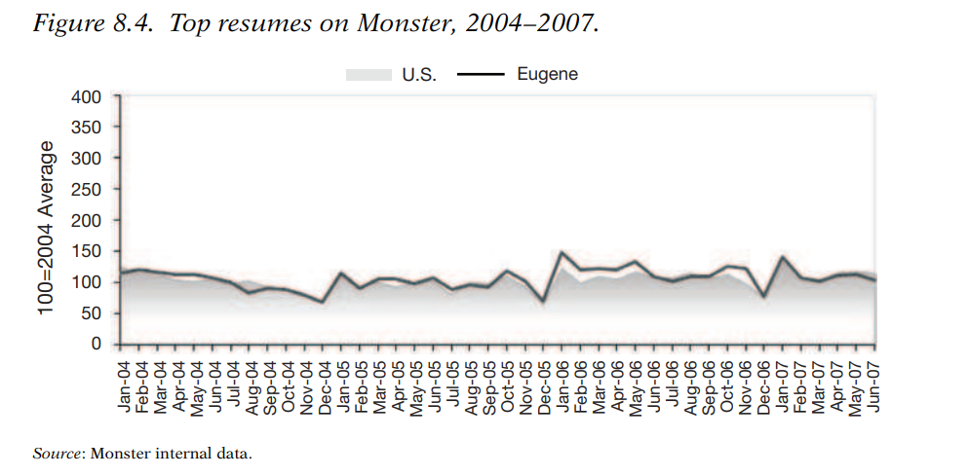
www.midocean.ae

Slide 35
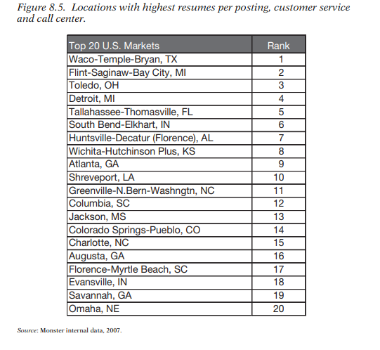
www.midocean.ae

Slide 36
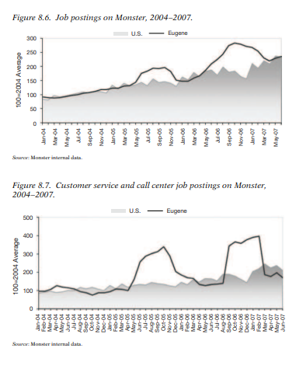
www.midocean.ae

Slide 37
Chapter
The Enterprise Analysis
08
Analysis for the key markets at a national level, as well as for the key markets that were under consideration
  As an industry, dedicated call centers had experienced a dip in employment over the past ten years. The last recession (2000–2002) hastened the automation and offshoring of traditional call-center services by a large contingent of American companies.
  By the end of 2004, there were approximately 2.1 million customer-service representatives employed in the United States, which was 1.5 percent of the overall workforce.
  Projected employment growth between 2004 and 2014 for the customer-service occupation was 23 percent greater than the average of all occupations (see Figure 8.8).
www.midocean.ae

Slide 38
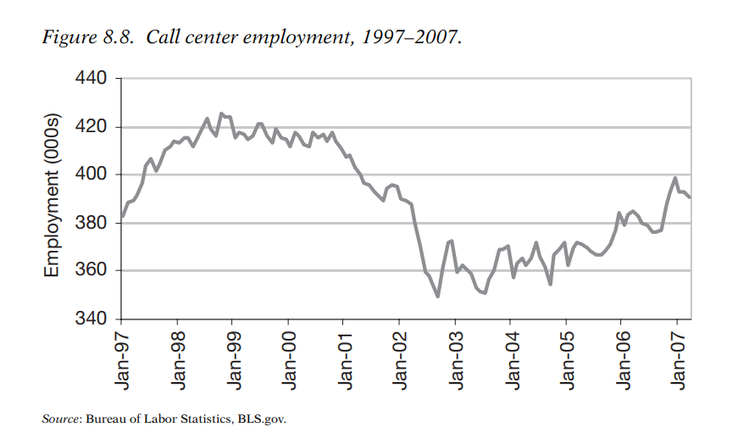
www.midocean.ae

Slide 39
Chapter
The Outcome
06
Now the information is gathered, the causes of turnover are understood, and ideas have been generated for reducing turnover. A
As a result of the thoughtful consideration of many factors, Enterprise selected Market A for its contact center. Enterprise chose that market for several reasons, including:
A strong labor supply relative to demand.
Enterprise also found Market A to be a good site because of its proximity to a university, which provides a consistent source of educated and skilled employees who have flexible schedules and need part-time opportunities.
Enterprise chose a downtown location because of its business friendly environment, great building, and accessibility to public transportation.
The contact center brings hundreds of people to work downtown, which means that more people are spending money in the downtown area and encouraging further development in the process.
www.midocean.ae

Slide 40
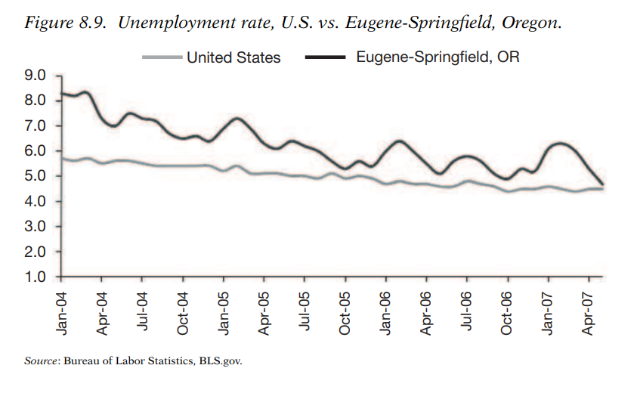
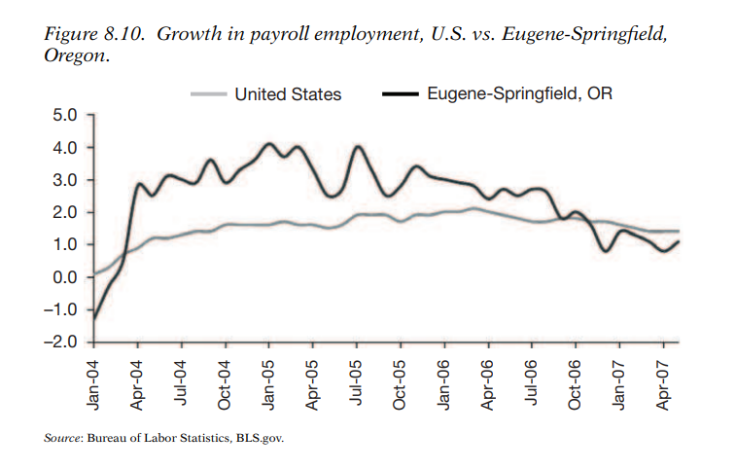
The Outcome
Chapter
www.midocean.ae

Slide 41



Thank You

