Slide 1

Principle of Management
MGM111
Dr. Magdy alhaj
Human Resource Management

Slide 2

Learning Objectives
Human resources define
Function of human resources
Human Resource Management
Human resource planning
Dynamic Human Resource Management Environment
Human Resource Management Functions

Slide 3
The Management Process
Planning
Controlling
Organizing
Leading
Staffing
Most experts agree that managing involves five functions: planning, organizing, staffing, leading, and controlling. In total, these functions represent the management process.

Slide 4
Human Resources (HR)
Human resources define:
Human resources (HR) is the division of a business that is charged with finding, screening, recruiting, and training job applicants, as well as administering employee-benefit programs.
Human Resources (HR) are the people an organization employs to carry out various jobs, tasks, and functions in exchange for wages, salaries, and other rewards.

Slide 5
Function of human resources
Human resource planning
Recruitment and selection
Training and development
Maintenance of personnel records
Legislation
Employee relations
Grievance and discipline

Slide 6

Human Resource Management
Human Resource Management The process of planning, organizing, directing (motivating), and controlling the procurement, development, compensation, integration, maintenance, and separation of organizational human resources to the end that organizational, individual, and societal needs are satisfied.
Human Resource Management The process of acquiring, training, appraising, and compensating employees, and of attending to their labor relations, health and safety, and fairness concerns.

Slide 7

Human Resource Management activities
Human Resource Management includes all activities used to attract & retain employees and to ensure they perform at a high level in meeting organizational goals.
These activities are made up of:
    1. Recruitment & selection.
    2. Training and development.
    3. Performance appraisal and feedback.
    4. Pay and benefits.
    5. Labor relations.

Slide 8

Importance of human resource management
Formulation of HR policies
Implementation of HR Policies
Review of employee needs
Development of social welfare
Utilization of Human Resources
Development of Labor-Management Relations
Overall development of organization

Slide 9

Contemporary Human Resource Management Perspectives
In most organizations today, the role of human resource management has become quite important. This results partly from a growing realization of the importance of people as a source of competitive advantage, but there are more practical reasons, such as:

Slide 10

Human Resource Management in Larger and small Organizations
Larger Organizations
Smaller Organizations
As the organization grows a separate human resource unit becomes a necessity.
When an organization reaches 200 to 250 employees, it generally establishes a self-contained human resource department.
As the organization continues to grow the human resource department grow as well into specialized departments.
Small organizations still use operating managers to handle their basic human resource functions.
Small independent businesses are generally operated in the same way as small organizations.
Very small organizations are exempt from many legal regulations.

Slide 11

Human Resource Management Functions
1
Staffing
Human Resource Management
Human Resource Development
EmployeeRelations and Labor
Compensation
Safety and Health

Slide 12
1-Staffing
Job Analysis
Human Resource Planning
Recruitment
Selection

Slide 13
Staffing (Cont.)
Staffing - Process through which organization ensures it always has proper number of employees with appropriate skills in right jobs at right time to achieve organizational objectives
Job analysis - Systematic process of determining skills, duties, and knowledge required for performing jobs in organization

Slide 14

Staffing (Cont.)
Recruitment
Process of attracting individuals on a timely basis, in sufficient numbers, and with appropriate qualifications, to apply for jobs with an organization
Selection
Process of choosing from a group of applicants the individual best suited for a particular position and the organization

Slide 15
Job Analysis
Job Analysis-the act of examining positions within an organization
Job Description-narrative explaining the scope of a position
Job Characteristics-tasks involved in a position
Job Requirements-personal characteristics necessary to fill a position

Slide 16
Human resource planning
Factors affecting human resource planning
Changing goals of a business
Changes in market
Changes in technology
Competition
Population changes
Trades unions
Government legislation

Slide 17
Human Resource Planning
HR Planning includes all activities managers do to forecast current and future HR needs:
  Must be done prior to recruitment and selection
  Demand forecasts made by managers estimate the number & qualifications the firm will need.
  Supply forecasts estimate the availability and qualifications of current workers and those in the labor market.

Slide 18

HRM Planning: Outsourcing
  Outsourcing benefits :
      managers can decide to contract with outside workers rather than hiring them.
      Outsourcing is more flexible for the firm.
      Outsourcing often provides human capital at a lower cost.
    Outsource problems:
      managers lose control over output.
      Outsource contractors are not committed to the firm.
      Unions typically are against outsourcing that has potential to eliminate member’s jobs.

Slide 19
Recruitment
  External recruiting: managers look outside the firm for people who have not worked at the firm before.
    Managers advertise in newspapers, hold open houses, recruit at universities, and on the Internet.
      External recruitment is difficult since many new jobs have specific skill needs.
      A multi-prong approach to external recruiting works best.
  Internal Recruiting: positions filled within the firm.
    Internal recruiting has several benefits:
      Workers know the firm’s culture, may not have new ideas.
      Managers likely already know the candidates.
      Internal advancement can motivate employees.

Slide 20
Selection Tools
Background
Information
Interviews
References
Selection
Performance tests
Paper tests
PAbilityhysical
tests

Slide 21
2-Human Resource Development
Training
Development
Career Planning
Career Development
Organizational Development
Performance Management
Performance Appraisal

Slide 22
Human Resource Development (Cont.)
Training - Designed to provide learners with knowledge and skills needed for their present jobs
Development - Involves learning that goes beyond today's job; it has more long-term focus
Career planning - Ongoing process whereby individual sets career goals and identifies means to achieve them
Career development - Formal approach used by organization to ensure that people with proper qualifications and experiences are available when needed
Organization development - Planned process of improving organization by developing its structures, systems, and processes to improve effectiveness and achieving desired goals

Slide 23
Human Resource Development (Cont.)
Performance management - Goal-oriented process directed toward ensuring organizational processes are in place to maximize productivity of employees, teams, and ultimately, the organization
Performance appraisal - Formal system of review and evaluation of individual or team task performance

Slide 24
3- Compensation
Compensation
- All rewards that individuals receive as a result of their employment

Slide 25
Compensation cont..
Direct Financial Compensation - Pay that person receives in form of wages, salaries, bonuses, and commissions.
Indirect Financial Compensation (Benefits) - All financial rewards not included in direct compensation such as paid vacations, sick leave, holidays, and medical insurance.
Nonfinancial Compensation - Satisfaction that person receives from job itself or from psychological and/or physical environment in which person works.

Slide 26
4- Safety and Health
* Employees who work in safe environment and enjoy good health are more likely to be productive and yield long-term benefits to organization.
Safety - Involves protecting employees from injuries caused by work-related accidents
Health - Refers to employees' freedom from illness and their general physical and mental well being

Slide 27

5-Employee and Labor Relations
Private-sector union membership has fallen from 39 percent in 1958 to 7.8 percent in 2005.
Business is required by law to recognize a union and bargain with it in good faith if the firm’s employees want the union to represent them
Human resource activity is often referred to as industrial relations
Most firms today would rather have a union-free environment

Slide 28
Human Resource Research
Human resource research is not separate function.
It pervades all HR functional areas.

Slide 29
Interrelationships of HRM Functions
All HRM functions are interrelated
Each function affects other areas

Slide 30
Dynamic Human Resource Management Environment

Slide 31
Environment of Human Resource Management
Unions
Society
EXTERNAL ENVIRONMENT
INTERNAL ENVIRONMENT
Technology
Marketing
1
Operations
Legal Considerations
Staffing
Human Resource Management
Human Resource Development
Unanticipated Events
Employee and Labor Relations
Finance
Compensation
Other Functional Areas
Economy
Safety and Health
Shareholders
Customers
Competition
Labor Market

Slide 32
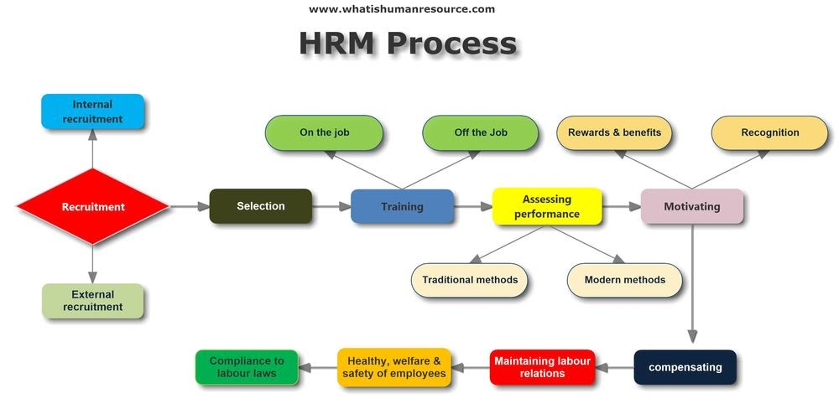

Slide 33
THANKS

