Slide 1

PRESENTATION AND WRITING SKILLS lecture No. 9
BY
Dr. Manal El-Sayed
MGM223

Slide 2

lecture No. 9
المحاضرة رقم 9
بناء الوظائف وكتابة السير الذاتية
Building Careers and Writing Résumés

Slide 3

Test your knowledge for the previous lecture
Describe the three-step writing process and explain why it will help you create better messages in less time
Explain what it means to analyze the situation when planning a message
Describe the techniques for gathering information for simple messages and identify three attributes of quality information
Compare the four major classes of media and list the factors to consider when choosing the most appropriate medium for a message
Explain why good organization is important to both you and your audience and explain how to organize any business message
Notes:
LEARNING OBJECTIVES
After studying this chapter, you will be able to:
Describe the three-step writing process and explain why it will help you create better messages in less time
Explain what it means to analyze the situation when planning a message
Describe the techniques for gathering information for simple messages and identify three attributes of quality information
Compare the four major classes of media and list the factors to consider when choosing the most appropriate medium for a message
Explain why good organization is important to both you and your audience and explain how to organize any business message

Slide 4
Learning Objectives
Finding the ideal opportunity
Define your personal strategy.
Know the Employer prespective
How to conduct your internet research.
How to build your network
Planning your résumé
العثور على الفرصة المثالية
حدد استراتيجيتك الشخصية.
تعرف على صاحب العمل
كيفية إجراء البحث الخاص بك على الإنترنت.
كيفية بناء شبكتك
تخطيط سيرتك الذاتية
Notes:
LEARNING OBJECTIVES
After studying this chapter, you will be able to:
Describe the three-step writing process and explain why it will help you create better messages in less time
Explain what it means to analyze the situation when planning a message
Describe the techniques for gathering information for simple messages and identify three attributes of quality information
Compare the four major classes of media and list the factors to consider when choosing the most appropriate medium for a message
Explain why good organization is important to both you and your audience and explain how to organize any business message

Slide 5
Finding the Ideal Opportunity in Today’s Job Market
إيجاد الفرصة المثالية في سوق العمل اليوم
Notes:
Finding and landing the ideal job opportunity can be a complex process, with lots of stress and frustration along the way. The good news is that it is all about communication, so the skills you’re developing in this course will give you a competitive advantage. This section offers a general job-search strategy with advice that applies to just about any career path you might want to pursue.

Slide 6

Get Organized
Get Started
Be Persistent
كن منظما
ابدأ الآن
كن مثابرا
Notes:
As you craft your personal strategy, keep these two points in mind:
Get organized. Your job search could last many months and involve multiple contacts with dozens of companies. You need to keep all the details straight to make sure you don’t miss opportunities or make mistakes such as losing someone’s e-mail address or forgetting an appointment.
Start now and stick to it. Even if you are a year or more away from graduation, now is not too early to get started with some of the essential research and planning tasks. If you want until the last minute, you will miss opportunities and you won’t be as prepared as the candidates you’ll be competing against.

Slide 7
Get Organized
Your job search could last many months and involve multiple contacts with dozens of companies.
You need to keep all the details straight to make sure you don’t miss opportunities or make mistakes such as losing someone’s e-mail address or forgetting an appointment.
قد يستمر بحثك عن وظيفة لعدة أشهر ويتضمن اتصالات متعددة مع عشرات الشركات.
تحتاج إلى الحفاظ على جميع التفاصيل مباشرة للتأكد من عدم تفويت الفرص أو ارتكاب أخطاء مثل فقدان عنوان البريد الإلكتروني لشخص ما أو نسيان موعد.

Slide 8
Get started and be persistent
ابدأ وكن مثابرا
Start now and stick to it. Even if you are a year or more away from graduation, now is not too early to get started with some of the essential research and planning tasks
ابدأ الآن والتزم به. حتى لو كنت على بعد عام أو أكثر من التخرج ، فليس من السابق لأوانه الآن البدء في بعض مهام البحث والتخطيط الأساسية

Slide 9
Write Your Story
اكتب قصتك
Your Passions
Your Skills
Your Abilities
Your Experiences
Your Objectives
شغفك
مهاراتك
قدراتك
تجاربك
أهدافك
Notes:
If all you want to do is get a job, you will struggle to focus your job search efforts and to present yourself as a compelling candidate. If you do get a job, chances are you’ll wind up with something you don’t like and will have to start the process all over again before long.
Take the time you have now to explore the possibilities, to find your passion, and identify appealing career paths.
Writing “the story of you” is a valuable planning exercise that can help you think about where you want to go and how to present yourself to target employers. Begin by writing the things you are passionate about, the skills you possess, your ability to help an organization reach its goals, the path you’ve been on so far, and the path you want to follow in the future. Think in terms of an image or a theme you’d like to project. Are you academically gifted? An effective leader? A creative problem solver? A technical wizard?

Slide 10
Write Your Story
اكتب قصتك
Take the time you
have now to explore the
possibilities, to find your passion,
Identify appealing career paths.
خذ الوقت الذي تستغرقه
يجب أن تستكشف الآن الاحتمالات ،
للعثور على شغفك ،
تحديد المسارات الوظيفية الجذابة.
Notes:
If all you want to do is get a job, you will struggle to focus your job search efforts and to present yourself as a compelling candidate. If you do get a job, chances are you’ll wind up with something you don’t like and will have to start the process all over again before long.
Take the time you have now to explore the possibilities, to find your passion, and identify appealing career paths.
Writing “the story of you” is a valuable planning exercise that can help you think about where you want to go and how to present yourself to target employers. Begin by writing the things you are passionate about, the skills you possess, your ability to help an organization reach its goals, the path you’ve been on so far, and the path you want to follow in the future. Think in terms of an image or a theme you’d like to project. Are you academically gifted? An effective leader? A creative problem solver? A technical wizard?

Slide 11
Write Your Story
Begin by writing the things you are
passionate about,
the skills you possess,
your ability to help an organization
reach its goals, the path you’ve been on
so far, the path you want to follow in the future
ابدأ بكتابة الأشياء التي أنت عليها متحمسا
المهارات التي تمتلكها ،
قدرتك على مساعدة مؤسسة
الوصول إلى أهدافها ، المسار الذي سلكته
حتى الآن ، المسار الذي تريد اتباعه في المستقبل

Slide 12
Employer Perspective
منظور صاحب العمل
Performance
اداء
Reliability
موثوقيه
Motivation
الحافز

Slide 13
Employer Perspective
companies take risks with
every hiring decision
الشركات تخاطر مع
كل قرار توظيف
Many companies judge
the success of their recruiting
efforts by quality of hire,
a measure of how closely new
Employees meet the company’s needs.
العديد من الشركات تحكم
نجاح جهود التوظيف من خلال
جودة التوظيف ، مقياس لمدى حدة
يلبي الموظفون احتياجات الشركة.
Notes:
Look at the hiring equation from an employer’s perspective. To begin with, recognize that companies take risks with every hiring decision—the risk that the person hired may not meet expectations and the risk that they could let a better candidate slip through their fingers. Many companies judge the success of their recruiting efforts by quality of hire, a measure of how closely new employees meet the company’s needs.
What steps can you take to present yourself as the low-risk, high-reward choice, as someone who can make a meaningful contribution to the organization?
Of course, your perceived ability to perform the job is an essential part of your potential quality as a new hire. However, hiring managers consider more than just your ability to handle the job. They want to know if you’ll be reliable and motivated; that is, if you’re somebody who “gets it” when it comes to being a professional in today’s workplace.

Slide 14
you can take steps to present
yourself as the low-risk, high-reward
choice, as someone who can
make a meaningful contribution to
the organization.
يمكنك اتخاذ خطوات لتقديم
نفسك بصفتك منخفضة المخاطر وعالية المكافأة
الاختيار ، كشخص يمكنه
تقديم مساهمة ذات مغزى في
المنظمة.

Slide 15
Employer Perspective
منظور صاحب العمل
Performance
اداء
your perceived ability to
Perform the job is an
essential part of your
potential quality as
a new hire
قدرتك المتصورة على
أداء الوظيفة ضروري
جزء من جودتك المحتملة
موظف جديد

Slide 16
Lecture 9
Employer Perspective
Reliability and motivation
الموثوقية والتحفيز
Hiring managers
consider more
than just your ability to
handle the job.
They want to know
if you’ll be reliable
and motivated
يفكر مديرو التوظيف في المزيد
من مجرد قدرتك على
التعامل مع المهمة.
يريدون أن يعرفوا
إذا كنت ستكون موثوقا ومتحمسا

Slide 17

Internet Research
أبحاث الإنترنت
Industries
الصناعات
Companies
الشركات
Notes:
Learning more about professions, industries, and individual companies is easy to do with the library and online resources available to you. Don’t limit your research to easily available sources, however. Companies are likely to be impressed by creative research, such as interviewing their customers to learn more about how the firm does business.
Table 13.1 in the textbook lists some of the many websites where you can learn more about companies and find job openings. Start with The Riley Guide, which offers advice for online job searches as well as links to hundreds of specialized websites that post openings in specific industries and professions. In addition, thousands of bloggers and podcasters offer news and commentary on the business world. To learn more about contemporary business topics, peruse some periodicals and newspapers with significant business sections.

Slide 18
Internet Research
Don’t limit your research to easily available sources
لا تقصر بحثك على المصادر المتاحة بسهولة
Companies are likely to be impressed by creative research, such as interviewing their customers to learn more about how the firm does business
من المرجح أن تتأثر الشركات بالأبحاث الإبداعية ، مثل إجراء مقابلات مع عملائها لمعرفة المزيد حول كيفية قيام الشركة بأعمالها
Notes:
Learning more about professions, industries, and individual companies is easy to do with the library and online resources available to you. Don’t limit your research to easily available sources, however. Companies are likely to be impressed by creative research, such as interviewing their customers to learn more about how the firm does business.
Table 13.1 in the textbook lists some of the many websites where you can learn more about companies and find job openings. Start with The Riley Guide, which offers advice for online job searches as well as links to hundreds of specialized websites that post openings in specific industries and professions. In addition, thousands of bloggers and podcasters offer news and commentary on the business world. To learn more about contemporary business topics, peruse some periodicals and newspapers with significant business sections.

Slide 19

Internet Research
you can learn more about companies and find job openings. Start with The Riley Guide, which offers advice for online job searches as well as links to hundreds of specialized websites that post openings in specific industries and professions
يمكنك معرفة المزيد عن الشركات والعثور على فرص عمل. ابدأ بدليل رايلي ، الذي يقدم نصائح للبحث عن الوظائف عبر الإنترنت بالإضافة إلى روابط لمئات المواقع المتخصصة التي تنشر وظائف شاغرة في صناعات ومهن محددة
Notes:
Learning more about professions, industries, and individual companies is easy to do with the library and online resources available to you. Don’t limit your research to easily available sources, however. Companies are likely to be impressed by creative research, such as interviewing their customers to learn more about how the firm does business.
Table 13.1 in the textbook lists some of the many websites where you can learn more about companies and find job openings. Start with The Riley Guide, which offers advice for online job searches as well as links to hundreds of specialized websites that post openings in specific industries and professions. In addition, thousands of bloggers and podcasters offer news and commentary on the business world. To learn more about contemporary business topics, peruse some periodicals and newspapers with significant business sections.

Slide 20
Translate Potential
إمكانية الترجمة
Skills
Attributes
Experience
المهارات
سمات
تجربة
Notes:
Customizing your résumé to each job opening is an important step in showing employers that your skills, attributes, and experience are relevant to an employer’s business challenges. From your initial contact all the way through the interviewing process, you will have opportunities to impress recruiters by explaining how your general potential translates to the specific needs of the position.

Slide 21
Translate Potential
Customizing your résumé to each job opening is an important step in showing employers that your skills, attributes, and experience are relevant to an employer’s business challenges.
يعد تخصيص سيرتك الذاتية لكل وظيفة شاغرة خطوة مهمة في إظهار أصحاب العمل أن مهاراتك وسماتك وخبراتك ذات صلة بتحديات العمل التي يواجهها صاحب العمل.

Slide 22
Translate Potential
the way through the interviewing process, you will have opportunities to impress recruiters by explaining how your general potential translates to the specific needs of the position.
في عملية إجراء المقابلات ، ستتاح لك فرص لإقناع مسؤولي التوظيف من خلال شرح كيف تترجم إمكاناتك العامة إلى الاحتياجات المحددة للوظيفة.

Slide 23
Take the Initiative
خذ زمام المبادرة
Target companies of interest
Contact human resources
Contact company managers
Describe what you can offer
Ask to be considered for opportunities
الشركات المستهدفة ذات الأهمية
الاتصال بالموارد البشرية
اتصل بمديري الشركة
صف ما يمكنك تقديمه
اطلب أن يتم النظر في الفرص
Notes:
When it comes to finding the right opportunities for you, the easiest ways are not always the most productive ways. The major job boards such as Monster and classified services such as Craigslist might have thousands of openings—but thousands of job seekers are looking at and applying for these same openings. Moreover, posting job openings on these sites is often a company’s last resort, after it has exhausted other possibilities.
Instead of searching through the same job openings as everyone else, take the initiative and find opportunities. Identify the companies you want to work for and focus your efforts on them. Contact their human resources departments (or individual managers if possible), describe what you can offer the company, and ask to be considered if any opportunities come up. Your message might appear right when a company is busy looking for someone but hasn’t yet advertised the opening to the outside world.

Slide 24
Build Your Network
بناء شبكتك
Networking
الشبكات
is the process of making informal connections with
mutually beneficial business contacts.
هي عملية إجراء اتصالات غير رسمية مع
اتصالات تجارية متبادلة المنفعة.
Notes:
Networking is the process of making informal connections with mutually beneficial business contacts. Networking takes place wherever and whenever people talk: at industry functions, at social gatherings, at alumni reunions—and all over the Internet.
Start building your network now. Your classmates could end up being valuable contacts. Then branch out by identifying people with similar interests in your target professions, industries, and companies. Read news sites, blogs, and other online sources. Follow industry leaders on Twitter. Connect with people on LinkedIn and Facebook, particularly in groups dedicated to particular career interests. Participate in student business organizations. Visit trade shows to learn about various industries and rub shoulders with people who work in those industries. Don’t overlook volunteering; you not only meet people but also show your ability to solve problems, manage projects, and lead people.

Slide 25
Build Your Network
بناء شبكتك
Networking
الشبكات
Networking takes place wherever
and whenever people talk:
at industry functions,
at social gatherings,
at alumni reunions—
and all over the Internet.
يتم التواصل أينما
وعندما يتحدث الناس:
في وظائف الصناعة ،
في التجمعات الاجتماعية ،
في لم شمل الخريجين -
وفي جميع أنحاء الإنترنت.
Notes:
Networking is the process of making informal connections with mutually beneficial business contacts. Networking takes place wherever and whenever people talk: at industry functions, at social gatherings, at alumni reunions—and all over the Internet.
Start building your network now. Your classmates could end up being valuable contacts. Then branch out by identifying people with similar interests in your target professions, industries, and companies. Read news sites, blogs, and other online sources. Follow industry leaders on Twitter. Connect with people on LinkedIn and Facebook, particularly in groups dedicated to particular career interests. Participate in student business organizations. Visit trade shows to learn about various industries and rub shoulders with people who work in those industries. Don’t overlook volunteering; you not only meet people but also show your ability to solve problems, manage projects, and lead people.

Slide 26
Build Your Network
بناء شبكتك
Classmates
زملاء الدراسه
Workplace Contacts
العمل جهات الاتصال
Online Sources
مصادر عبر الإنترنت
Student Organizations
المنظمات الطلابية
Trade Shows
المعارض التجارية
Volunteering
العمل التطوعي
Notes:
Networking is the process of making informal connections with mutually beneficial business contacts. Networking takes place wherever and whenever people talk: at industry functions, at social gatherings, at alumni reunions—and all over the Internet.
Start building your network now. Your classmates could end up being valuable contacts. Then branch out by identifying people with similar interests in your target professions, industries, and companies. Read news sites, blogs, and other online sources. Follow industry leaders on Twitter. Connect with people on LinkedIn and Facebook, particularly in groups dedicated to particular career interests. Participate in student business organizations. Visit trade shows to learn about various industries and rub shoulders with people who work in those industries. Don’t overlook volunteering; you not only meet people but also show your ability to solve problems, manage projects, and lead people.

Slide 27
Lecture 9
Network Etiquette
Protocol
Value
Judgment
بروتوكول
قيمة
قرار
Notes:
Remember that networking is about people helping each other, not just about other people helping you. Pay close attention to networking protocol:
Try to learn something about the people you want to connect with
Don’t overwhelm others with too many messages or requests
Be succinct in all your communication efforts
Don’t give out other people’s names and contact information without their permission
Never e-mail your résumé to complete strangers
Remember to say thank you every time someone helps you
To become a valued network member, you need to be able to help others in some way. The more you network, the more valuable you become in your network—and the more valuable your network becomes to you.
Finally, be aware that your online network reflects who you are in the eyes of potential employers, so exercise some judgment in making connections.

Slide 28

  Protocol
انتبه جيدا لبروتوكول الشبكات:
حاول أن تتعلم شيئا عن الأشخاص الذين تريد التواصل معهم
لا تربك الآخرين بالكثير من الرسائل أو الطلبات
كن موجزا في جميع جهود الاتصال الخاصة بك
لا تعطي أسماء الآخرين ومعلومات الاتصال بهم دون إذنهم
لا ترسل سيرتك الذاتية بالبريد الإلكتروني إلى الغرباء الكاملين
تذكر أن تقول شكرا لك في كل مرة يساعدك فيها شخص ما
Pay close attention to networking protocol:
Try to learn something about the people you want to connect with
Don’t overwhelm others with too many messages or requests
Be succinct موجزًا in all your communication efforts
Don’t give out other people’s names and contact information without their permission
Never e-mail your résumé to complete strangers
Remember to say thank you every time someone helps you
Notes:
Remember that networking is about people helping each other, not just about other people helping you. Pay close attention to networking protocol:
Try to learn something about the people you want to connect with
Don’t overwhelm others with too many messages or requests
Be succinct in all your communication efforts
Don’t give out other people’s names and contact information without their permission
Never e-mail your résumé to complete strangers
Remember to say thank you every time someone helps you
To become a valued network member, you need to be able to help others in some way. The more you network, the more valuable you become in your network—and the more valuable your network becomes to you.
Finally, be aware that your online network reflects who you are in the eyes of potential employers, so exercise some judgment in making connections.

Slide 29
Value
To become a valued network member, you need to be able to help others in some way. The more you network, the more valuable you become in your network—and the more valuable your network becomes to you.
لكي تصبح عضوا قيما في الشبكة ، يجب أن تكون قادرا على مساعدة الآخرين بطريقة ما. كلما زادت اتصالاتك، زادت قيمتك في شبكتك، وزادت قيمة شبكتك بالنسبة لك.
Notes:
Remember that networking is about people helping each other, not just about other people helping you. Pay close attention to networking protocol:
Try to learn something about the people you want to connect with
Don’t overwhelm others with too many messages or requests
Be succinct in all your communication efforts
Don’t give out other people’s names and contact information without their permission
Never e-mail your résumé to complete strangers
Remember to say thank you every time someone helps you
To become a valued network member, you need to be able to help others in some way. The more you network, the more valuable you become in your network—and the more valuable your network becomes to you.
Finally, be aware that your online network reflects who you are in the eyes of potential employers, so exercise some judgment in making connections.

Slide 30
Judgment
قرار
Finally, be aware that your online network reflects who you are in the eyes of potential employers, so exercise some judgment in making connections.
أخيرا ، كن على دراية بأن شبكتك عبر الإنترنت تعكس هويتك في نظر أصحاب العمل المحتملين ، لذا مارس بعض الحكم في إجراء الاتصالات.
قرار
Notes:
Remember that networking is about people helping each other, not just about other people helping you. Pay close attention to networking protocol:
Try to learn something about the people you want to connect with
Don’t overwhelm others with too many messages or requests
Be succinct in all your communication efforts
Don’t give out other people’s names and contact information without their permission
Never e-mail your résumé to complete strangers
Remember to say thank you every time someone helps you
To become a valued network member, you need to be able to help others in some way. The more you network, the more valuable you become in your network—and the more valuable your network becomes to you.
Finally, be aware that your online network reflects who you are in the eyes of potential employers, so exercise some judgment in making connections.

Slide 31

Career Counseling
الإرشاد المهني
College Career
Center
المركز المهني بالكلية
Online Career
Planning
تخطيط مهنة عبر الإنترنت
Notes:
Your college’s career center probably offers a wide variety of services, including individual counseling, job fairs, on-campus interviews, and job listings. Counselors can give you advice on career planning and provide workshops in job search techniques, résumé preparation, job readiness training, interview techniques, self-marketing, and more. You can also find career planning advice online.

Slide 32
Avoiding Mistakes
تجنب الأخطاء
Overlooking résumé errors
Misspelling the hiring manager’s name
Arriving late for an interview
Tweeting something unprofessional
Completing application forms incorrectly
Not doing your own research
التغاضي عن أخطاء السيرة الذاتية
خطأ إملائي في اسم مدير التوظيف
الوصول متأخرا لإجراء مقابلة
تغريد شيء غير احترافي
استكمال استمارات الطلب بشكل غير صحيح
عدم إجراء البحث الخاص بك
Notes:
While you’re making all these positive moves to show employers you will be a quality hire, take care to avoid the simple blunders الأخطاء البسيطة that can torpedo a job search—not catching mistakes in your résumé, misspelling the name of a manager you’re writing to, showing up late for an interview, tweeting something unprofessional, failing to complete application forms correctly, asking for information that you can easily find yourself on a company’s website, or making any other error that could flag you as someone who is careless or disrespectful.

Slide 33
Planning Your Résumé
تخطيط الملخص الخاص بك
Notes:
Although you will create many messages during your career search, your résumé will be most important document in this process. You will be able to use it directly in many instances, adapt it to a variety of uses such an e-portfolio or a social media résumé, and reuse pieces of it in social networking profiles and online application forms.
Writing a résumé is one of those projects that really benefits from multiple planning, writing, and completing sessions spread out over several days or weeks. You are trying to summarize a complex subject (yourself!) and present a compelling story to complete strangers in a brief document. Follow the three-step writing process (see Figure 13.1) and give yourself plenty of time.

Slide 34
A résumé is
A Structured, written summary of a person’s education, employment background, and job qualifications. Before you begin writing a résumé, make sure you understand its true function—as an advertisement intended to stimulate an employer’s interest in meeting you and learning more about you.
السيرة الذاتية هي
ملخص منظم ومكتوب لتعليم الشخص وخلفيته الوظيفية ومؤهلاته الوظيفية. قبل البدء في كتابة السيرة الذاتية ، تأكد من فهمك لوظيفتها الحقيقية - كإعلان يهدف إلى تحفيز اهتمام صاحب العمل بمقابلتك ومعرفة المزيد عنك.

Slide 35
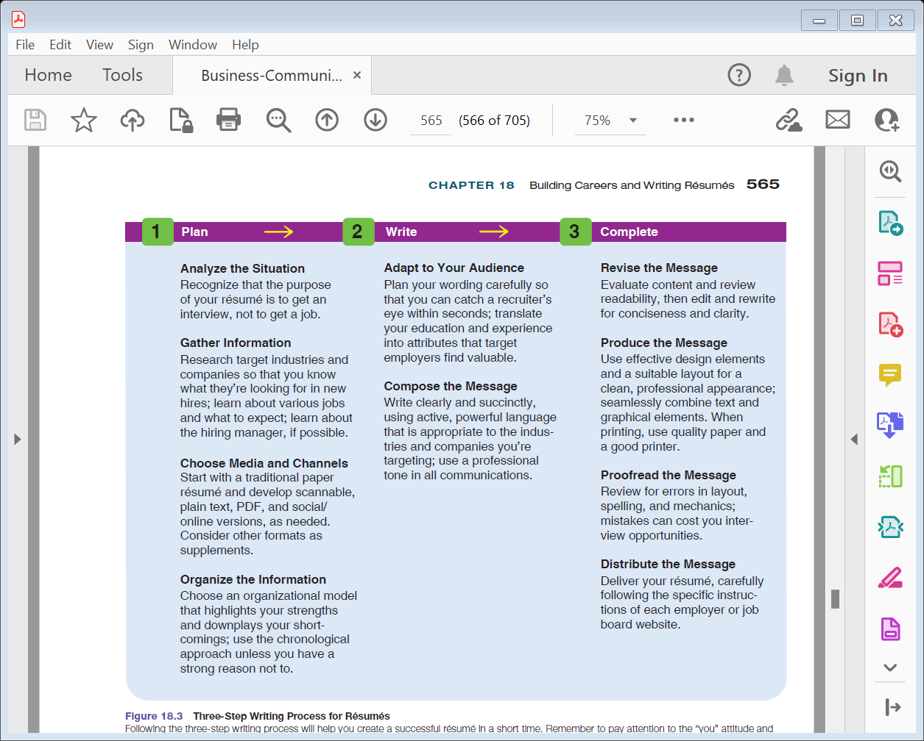
Three-Step Résumé Process
Notes:
To distinguish yourself from all the other people looking for work, start with a well-written résumé. A résumé is just another specialized business message. Follow the three-step writing process, and it will be easier than you think:
Planning résumés. First, analyze the situation, recognizing that the purpose of your résumé is to get an interview, not to get a job. As you gather information, research target industries, learn about various jobs and what to expect, and learn about the hiring managers, if possible. In order to choose the best medium, start with a traditional, paper résumé, then develop scannable, plain text, HTML, and PDF versions, as needed. Choose a model of organization that highlights your strengths and downplays your shortcomings; use the chronological approach, unless you have a good reason not to.
Writing résumés. Adapt to your audience by planning to catch a recruiter’s eye within seconds. In order to do so, translate your education and experience into attributes that employers value. Write clearly and succinctly as you compose your message by using language that is appropriate to the companies and industries you are targeting; moreover, use a professional tone.
Completing résumés. After writing your first draft, revise your résumé to make sure it is clear, concise, and correct. Next, produce your résumé, giving it an attractive, professional appearance. Proofread the final product for typos, spelling errors, and other mechanical problems. Finally, distribute your résumé following the specific instructions of each employer or job-search website.

Slide 36
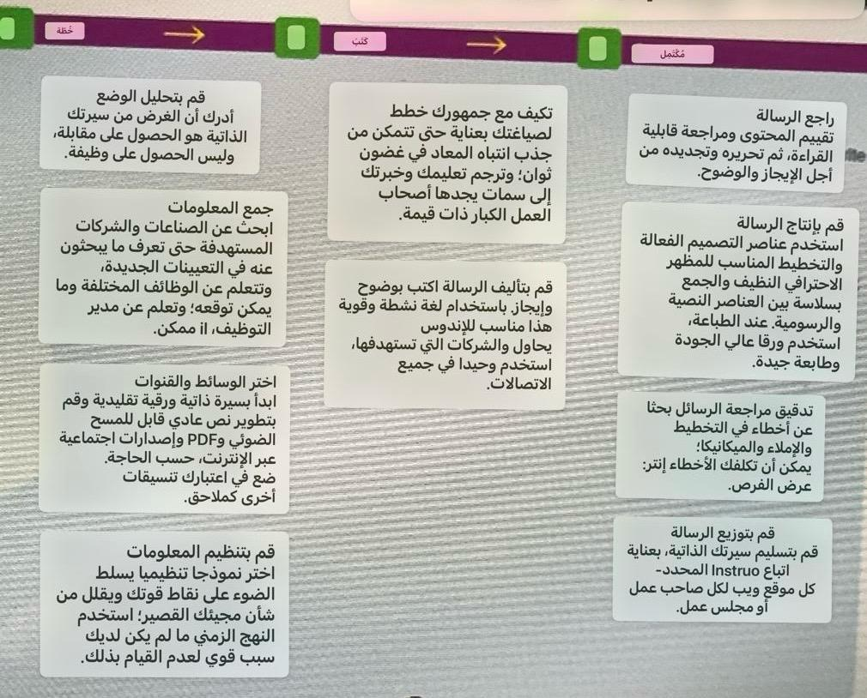

Slide 37

Purpose and Audience
الغرض والجمهور
Employers
أصحاب الاعمال
Interviews
المقابلات
Notes:
A résumé is a structured, written summary of a person’s education, employment background, and job qualifications. Before you begin writing a résumé, make sure you understand its true function—as an advertisement intended to stimulate an employer’s interest in meeting you and learning more about you. A successful résumé inspires a prospective employer to invite you to interview with the company.
As you conduct your research on various professions, industries, companies, and individual managers, you will have a better perspective on your target readers and their information needs.
Learn as much as you can about the individuals who may be reading your résumé. Many professionals and managers are bloggers, Twitter users, and LinkedIn members, for example, so you can learn more about them online even if you’ve never met them. Any bit of information can help you craft a more effective message.

Slide 38

Gather Informationجمع المعلومات
Employment
التوظيف
Education
التعليم
Personal
الشخصية
Notes:
If you have not been keeping a log or journal of your accomplishments so far, you may need to do some research on yourself. Gather all the information you need to document your work and education history, including all the specific dates, duties, and accomplishments from any previous jobs you have held. Itemize your
educational experience, including degrees, skills certificates, academic awards, and scholarships. Also, gather any relevant information about personal endeavors such as offices held in nonprofit organizations or speeches given. You will save time by having all this material readily available before you begin composing your résumé.

Slide 39
Choose the Medium
اختيار الوسيط
Multiple Media
وسائط متعددة
Multiple Formats
تنسيقات متعددة
Notes:
You should expect to produce your résumé in several media and formats—
printed traditional résumé,
printed scannable résumé,
electronic plain-text file,
MS Word file,
online résumé,
or PDF file.
Whatever the format may be, remember that effective résumé designs are simple, clean, and professional.

Slide 40

Organize the Résumé
Chronological
Functional
Combination
الزمني
وظيفي
تركيبه
Notes:
Although you will see several ways to organization a résumé, most are some variation of chronological, functional, or a combination of the two. التسلسل الزمني أو الوظيفي أو مزيج من الاثنين The right choice depends on your background and your goals.
In a chronological résumé, the "Work Experience" section dominates and is placed in the most prominent slot. This approach is the most common way to organize a résumé. It has three advantages:
(1) employers are familiar with it,
(2) it highlights growth and career progression, and
(3) it highlights continuity and stability. This approach is especially appropriate if you have a strong employment history and are aiming for a job that builds on your career path.
A functional résumé emphasizes skills and accomplishments,
identifying employers and academic experience in subordinate sections. This pattern stresses individual areas of competence, so it's useful for people who are just entering the job market, want to redirect their careers, or have little continuous career-related experience. T
he functional approach also has three advantages:
without having to read through job descriptions, employers can see what you can do for them,
(2) you can emphasize earlier job experience, and
(3) you can de-emphasize any lack of career progress or lengthy unemployment.
A combination résumé includes the best of the chronological and functional approaches. Nevertheless, it is not commonly used for two reasons: it tends to be longer, and it can be repetitious if you have to list your accomplishments and skills in both the functional section and the chronological job descriptions.

Slide 41
Organize the Résumé
تنظيم السيرة الذاتية
Chronological
In a chronological résumé, the "Work Experience" section dominates and is placed in the most prominent slot. This approach is the most common way to organize a résumé. It has three advantages:
(1) employers are familiar with it,
(2) it highlights growth and career progression, and
(3) it highlights continuity and stability. This approach is especially appropriate if you have a strong employment history and are aiming for a job that builds on your career path.
في السيرة الذاتية الزمنية ، يهيمن قسم "تجربة العمل" ويوضع في الفتحة الأبرز. هذا النهج هو الطريقة الأكثر شيوعا لتنظيم السيرة الذاتية. لها ثلاث مزايا:
(1) أصحاب العمل على دراية به ،
(2) يسلط الضوء على النمو والتقدم الوظيفي ، و
(3) يسلط الضوء على الاستمرارية والاستقرار. هذا النهج مناسب بشكل خاص إذا كان لديك تاريخ وظيفي قوي وتهدف إلى الحصول على وظيفة تعتمد على مسار حياتك المهنية.
Notes:
Although you will see several ways to organization a résumé, most are some variation of chronological, functional, or a combination of the two. التسلسل الزمني أو الوظيفي أو مزيج من الاثنين The right choice depends on your background and your goals.
In a chronological résumé, the "Work Experience" section dominates and is placed in the most prominent slot. This approach is the most common way to organize a résumé. It has three advantages:
(1) employers are familiar with it,
(2) it highlights growth and career progression, and
(3) it highlights continuity and stability. This approach is especially appropriate if you have a strong employment history and are aiming for a job that builds on your career path.
A functional résumé emphasizes skills and accomplishments,
identifying employers and academic experience in subordinate sections. This pattern stresses individual areas of competence, so it's useful for people who are just entering the job market, want to redirect their careers, or have little continuous career-related experience. T
he functional approach also has three advantages:
without having to read through job descriptions, employers can see what you can do for them,
(2) you can emphasize earlier job experience, and
(3) you can de-emphasize any lack of career progress or lengthy unemployment.
A combination résumé includes the best of the chronological and functional approaches. Nevertheless, it is not commonly used for two reasons: it tends to be longer, and it can be repetitious if you have to list your accomplishments and skills in both the functional section and the chronological job descriptions.

Slide 42
Organize the Résumé
Functional
تؤكد السيرة الذاتية الوظيفية على المهارات والإنجازات ،
تحديد أصحاب العمل والخبرة الأكاديمية في الأقسام التابعة. يؤكد هذا النمط على مجالات الكفاءة الفردية ، لذلك فهو مفيد للأشخاص الذين يدخلون سوق العمل للتو ، أو يرغبون في إعادة توجيه حياتهم المهنية ، أو لديهم القليل من الخبرة المستمرة المتعلقة بالمهنة. يحتوي النهج الوظيفي أيضا على ثلاث مزايا:
دون الحاجة إلى قراءة الوصف الوظيفي ، يمكن لأصحاب العمل معرفة ما يمكنك القيام به من أجلهم ،
يمكنك التأكيد على الخبرة الوظيفية السابقة ، و
يمكنك تقليل التأكيد على أي نقص في التقدم الوظيفي أو البطالة الطويلة.
A functional résumé emphasizes skills and accomplishments,
identifying employers and academic experience in subordinate sections. This pattern stresses individual areas of competence, so it's useful for people who are just entering the job market, want to redirect their careers, or have little continuous career-related experience. The functional approach also has three advantages:
without having to read through job descriptions, employers can see what you can do for them,
you can emphasize earlier job experience, and
you can de-emphasize any lack of career progress or lengthy unemployment.
Notes:
Although you will see several ways to organization a résumé, most are some variation of chronological, functional, or a combination of the two. التسلسل الزمني أو الوظيفي أو مزيج من الاثنين The right choice depends on your background and your goals.
In a chronological résumé, the "Work Experience" section dominates and is placed in the most prominent slot. This approach is the most common way to organize a résumé. It has three advantages:
(1) employers are familiar with it,
(2) it highlights growth and career progression, and
(3) it highlights continuity and stability. This approach is especially appropriate if you have a strong employment history and are aiming for a job that builds on your career path.
A functional résumé emphasizes skills and accomplishments,
identifying employers and academic experience in subordinate sections. This pattern stresses individual areas of competence, so it's useful for people who are just entering the job market, want to redirect their careers, or have little continuous career-related experience. T
he functional approach also has three advantages:
without having to read through job descriptions, employers can see what you can do for them,
(2) you can emphasize earlier job experience, and
(3) you can de-emphasize any lack of career progress or lengthy unemployment.
A combination résumé includes the best of the chronological and functional approaches. Nevertheless, it is not commonly used for two reasons: it tends to be longer, and it can be repetitious if you have to list your accomplishments and skills in both the functional section and the chronological job descriptions.

Slide 43
Organize the Résumé
Combination
A combination résumé includes the best of the chronological and functional approaches. Nevertheless, it is not commonly used for two reasons: it tends to be longer, and it can be repetitious if you must list your accomplishments and skills in both the functional section and the chronological job descriptions.
تتضمن السيرة الذاتية المركبة أفضل الأساليب الزمنية والوظيفية. ومع ذلك ، لا يتم استخدامه بشكل شائع لسببين: يميل إلى أن يكون أطول ، ويمكن أن يكون متكررا إذا كان يجب عليك سرد إنجازاتك ومهاراتك في كل من القسم الوظيفي والأوصاف الوظيفية الزمنية.
Notes:
Although you will see several ways to organization a résumé, most are some variation of chronological, functional, or a combination of the two. التسلسل الزمني أو الوظيفي أو مزيج من الاثنين The right choice depends on your background and your goals.
In a chronological résumé, the "Work Experience" section dominates and is placed in the most prominent slot. This approach is the most common way to organize a résumé. It has three advantages:
(1) employers are familiar with it,
(2) it highlights growth and career progression, and
(3) it highlights continuity and stability. This approach is especially appropriate if you have a strong employment history and are aiming for a job that builds on your career path.
A functional résumé emphasizes skills and accomplishments,
identifying employers and academic experience in subordinate sections. This pattern stresses individual areas of competence, so it's useful for people who are just entering the job market, want to redirect their careers, or have little continuous career-related experience. T
he functional approach also has three advantages:
without having to read through job descriptions, employers can see what you can do for them,
(2) you can emphasize earlier job experience, and
(3) you can de-emphasize any lack of career progress or lengthy unemployment.
A combination résumé includes the best of the chronological and functional approaches. Nevertheless, it is not commonly used for two reasons: it tends to be longer, and it can be repetitious if you have to list your accomplishments and skills in both the functional section and the chronological job descriptions.

Slide 44


