Slide 1


Lecture 1 Introduction
IT111 - Introduction to Information Technology
Bachelor of Science in Information Technology
Prof. Lamiaa Fattouh Ibrahim
Everyone Smart University
Faculty of INFORMATICS
Spring 2023

Slide 2
Introduction
CHAPTER 1
Introduction

Slide 3
Objectives
After studying this chapter, the student should be able to:
Define the Turing model of a computer.
Define the von Neumann model of a computer.
Describe the three components of a computer: hardware,
data, and software.
List topics related to computer hardware.
List topics related to data.
List topics related to software.
Give a short history of computers.

Slide 4
1-1 TURING MODEL
The idea of a universal computational device was first
described by Alan Turing in 1937.
He proposed that all computation could be performed
by a special kind of a machine, now called
a Turing machine.
He based the model on the actions that people perform
when involved in computation.
He abstracted these actions into a model for a
computational machine that has really changed the
world.

Slide 5
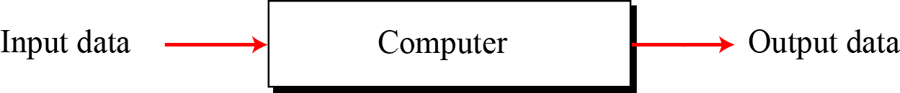
1.1.1 Data processors
Define a computer as a data processor. Using this definition, a computer acts as a black box that accepts input data, processes the data, and creates output data (Figure 1.1).
Figure 1.1 A single purpose computing machine

Slide 6
Problem with the Data processors Definitions
1- It is too general. In this model, a pocket calculator is also a computer.
2- Is it a specific-purpose machine or a general-purpose machine?
This model could represent a specific-purpose computer (or processor) that is designed to do a single job, such as controlling the temperature of a building or controlling the fuel usage in a car.
Notes:
However, computers, as the term is used today, are general-purpose machines. They can do many different types of tasks. This implies that we need to change this model into the Turing model to be able to reflect the actual computers of today.

Slide 7
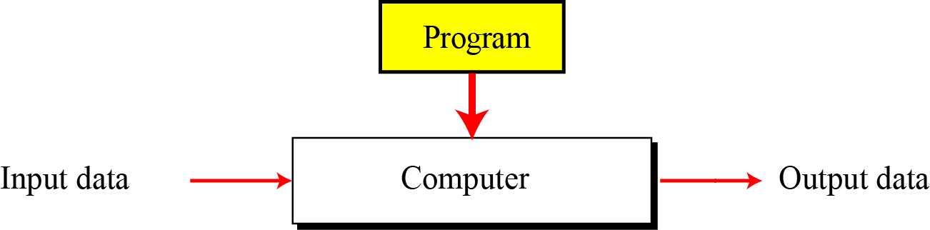
1.1.2 Programmable data processors
The Turing model is a better model for a general-purpose computer. This model adds an extra element to the specific computing machine: the program.
A program is a set of instructions that tells the computer what to do with data.
Figure 1.2 A computer based on the Turing model

Slide 8
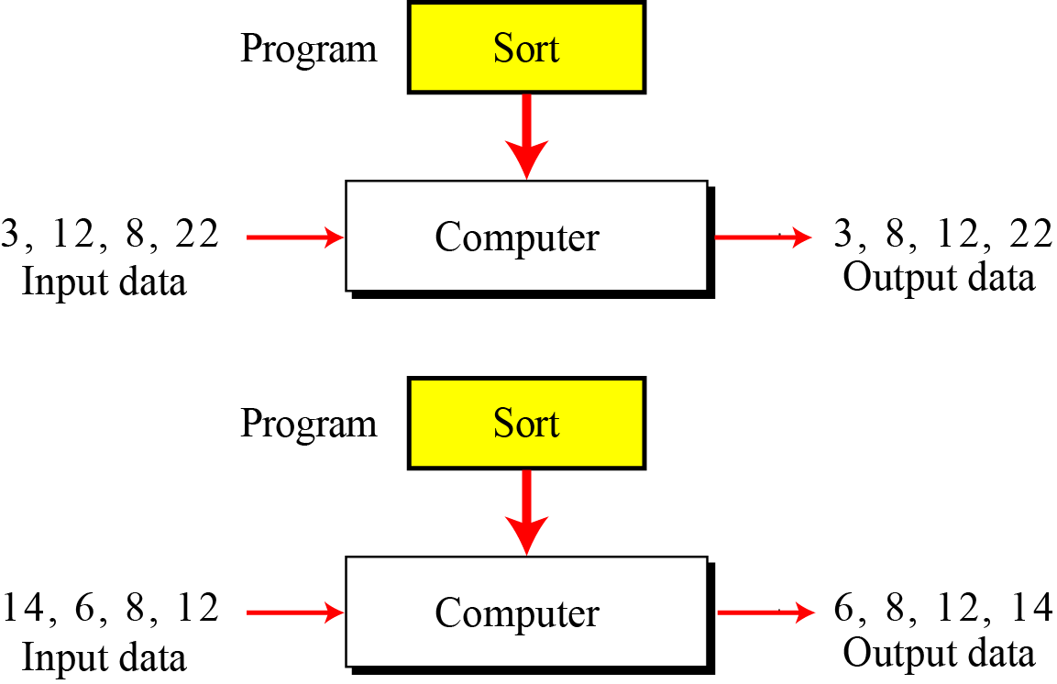
Figure 1.3 The same program, different data

Slide 9
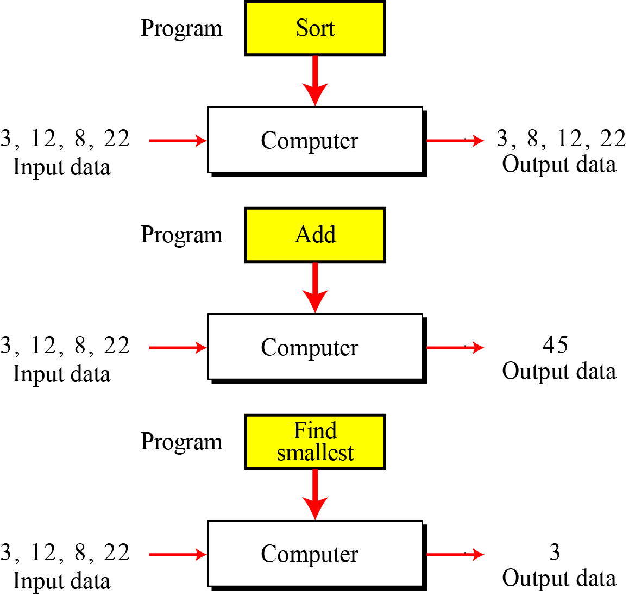
Figure 1.4 The same data, different programs

Slide 10
The same program, different data→ different output
The same data, different programs → different output
The same data, same programs → same output

Slide 11
1.1.3 The universal Turing machine
A universal Turing machine, a machine that can do any computation if the appropriate program is provided, was the first description of a modern computer.
It can be proved that a very powerful computer and a universal Turing machine can compute the same thing. We need only provide the data and the program—the description of how to do the computation—to either machine.
In fact, a universal Turing machine is capable of computing anything that is computable.

Slide 12
1-2 VON NEUMANN MODEL
Computers built on the Turing universal machine store data in their memory.
Around 1944–1945, John von Neumann proposed that, since program and data are logically the same, programs should also be stored in the memory of a computer.

Slide 13
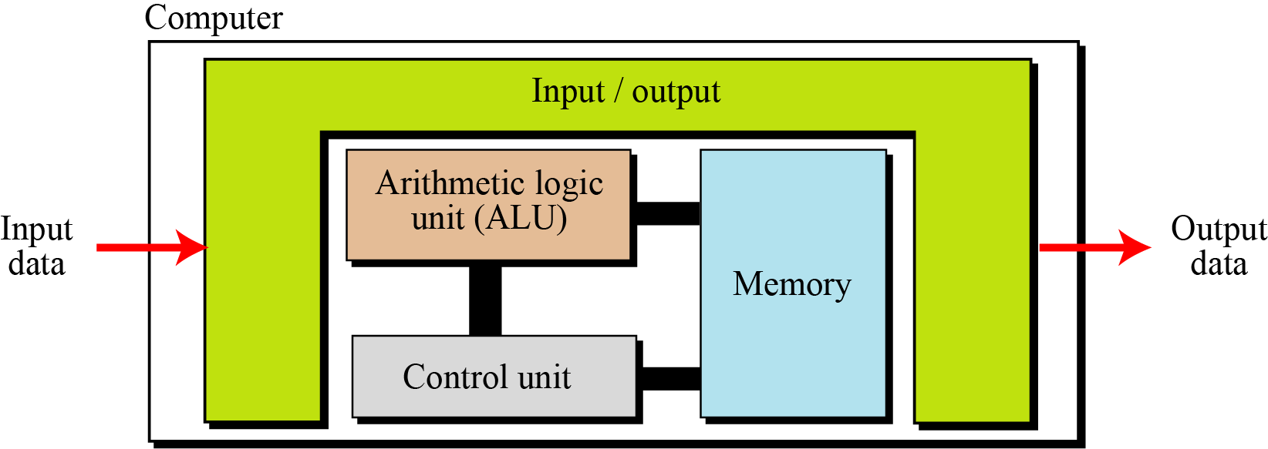
1.2.1 Four subsystems
Computers built on the von Neumann model divide the computer hardware into four subsystems: memory, arithmetic logic unit, control unit, and input/output (Figure 1.5).
Figure 1.5 The von Neumann model

Slide 14
Memory
Memory is the storage area. This is where programs and data are stored during processing.
The arithmetic logic unit (ALU) is where calculation and logical operations take place. For a computer to act as a data processor, it must be able to do arithmetic operations on data (such as adding a list of numbers). It should also be able to do logical operations on data.
Control unit The control unit controls the operations of the memory, ALU, and the input/output subsystem.

Slide 15
Input / output The input subsystem accepts input data and the program from outside the computer, while the output subsystem sends the result of processing to the outside world. The definition of the input/output subsystem is very broad: it also includes secondary storage devices such as disk or tape that stores data and programs for processing. When a disk stores data that results from processing, it is considered an output device: when it reads data from the disk, it is considered an input device.

Slide 16
1.2.2 The stored program concept
The von Neumann model states that the program must be stored in memory. This is totally different from the architecture of early computers in which only the data was stored in memory: the programs for their task was implemented by manipulating a set of switches or by changing the wiring system.
The memory of modern computers hosts both a program and its corresponding data. This implies that both the data and programs should have the same format, because they are stored in memory. In fact, they are stored as binary patterns in memory—a sequence of 0s and 1s.

Slide 17
1.2.3 Sequential execution of instructions
A program in the von Neumann model is made of a finite number of instructions.
In this model, the control unit:
1- fetches one instruction from memory,
2- decodes it,
3- then executes it.

Slide 18
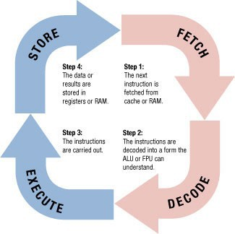
The System Clock and the Machine Cycle
•
Machine cycle: The series of operations involved in the execution of a single machine level instruction
Fetch: The program instruction is fetched
Decode: The instructions are decoded so the control unit, ALU, and FPU can understand them
Execute: The instructions are carried out
Store: The original data or the result from the ALU execution is stored in the CPU’s registers

Slide 19
Add A , B, C
Sub A, B, D

Slide 20
1.2.3 Sequential execution of instructions
In other words, the instructions are executed one after another. Of course, one instruction may request the control unit to jump to some previous or following instruction, but this does not mean that the instructions are not executed sequentially. Sequential execution of a program was the initial requirement of a computer based on the von Neumann model. Today’s computers execute programs in the order that is the most efficient.

Slide 21
1-3 COMPUTER COMPONENTS
We can think of a computer as being made up of three components: computer hardware, data, and computer software.

Slide 22
1.3.1 Computer hardware
Computer hardware today has four components under the von Neumann model, although we can have different types of memory, different types of input/output subsystems, and so on. We discuss computer hardware in more detail in Chapter 5.
1.3.2 Data
The von Neumann model clearly defines a computer as a data processing machine that accepts the input data, processes it, and outputs the result.

Slide 23
1.3.3 Computer software
The main feature of the Turing or von Neumann models is the concept of the program. Although early computers did not store the program in the computer’s memory, they did use the concept of programs. Programming those early computers meant changing the wiring systems or turning a set of switches on or off. Programming was therefore a task done by an operator or engineer before the actual data processing began.

Slide 24
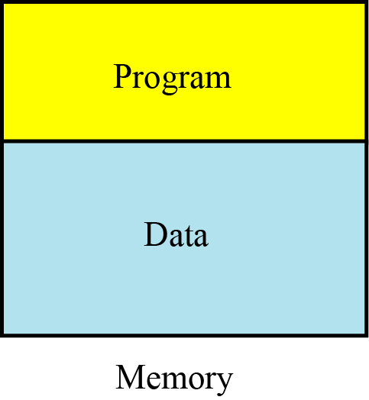
Figure 1.6 Program and data in memory

Slide 25
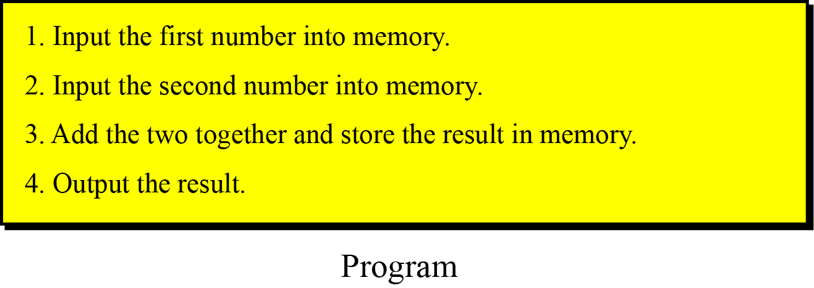
Figure 1.7 A program made of instructions

Slide 26
COMPUTER SOFTWARE
Requirements …
  Programs must be stored in memory.
  A Sequence of instructions should be used in a program.
  Why should a program have made by instructions? “reusability”
Algorithms: a step-by-step solution to solve a problem before implement a program.
Languages: using symbols and words to write instructions rather than binary (0 and 1).
Software Engineering: is the design and writing of structured programs.
Operating Systems: working as a manager to facilitate access of the computer components by a program.

Slide 27
1-4 HISTORY
In this section we briefly review the history of computing and computers. We divide this history into three periods.

Slide 28
1.4.1 Mechanical machines (before 1930)
During this period, several computing machines were invented that bear little resemblance to the modern concept of a computer.
In the 17th century, Blaise Pascal, a French mathematician and
philosopher, invented Pascaline.
In the late 17th century, German mathematician Gottfried Leibnitz
invented Leibnitz’ Wheel.
The first machine that used the idea of storage and programming
was the Jacquard loom, invented by Joseph-Marie Jacquard at the
beginning of the 19th century.

Slide 29
In 1823, Charles Babbage invented the Difference Engine. Later,
he invented a machine called the Analytical Engine that parallels
the idea of modern computers.
In 1890, Herman Hollerith, working at the US Census Bureau,
designed and built a programmer machine that could automatically
read, tally, and sort data stored on punched cards.

Slide 30
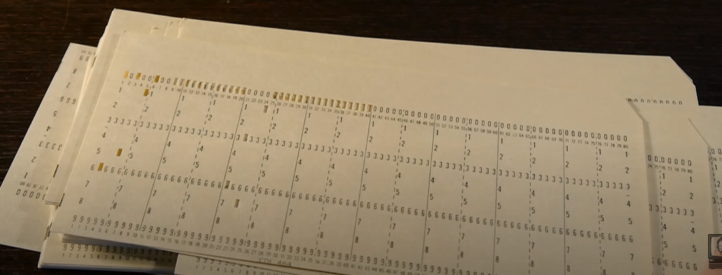
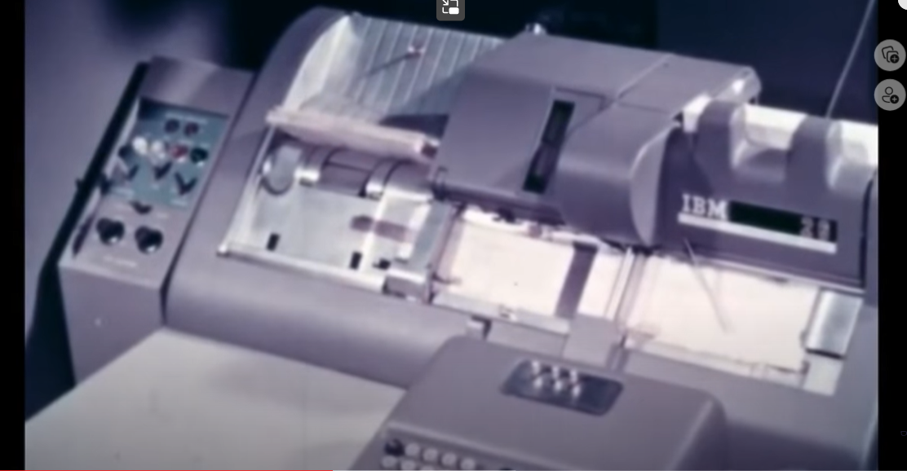

Slide 31
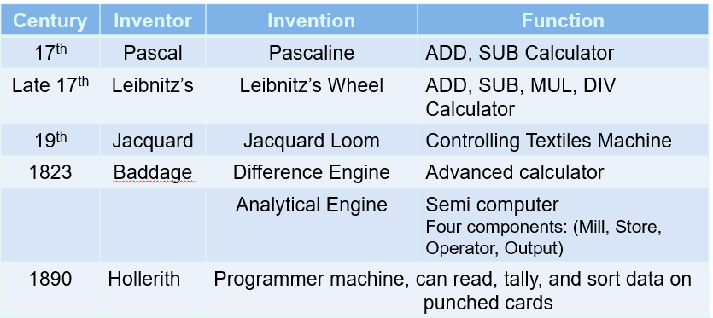
1.4 HISTORY
MECHANICAL MACHINES (before 1930)

Slide 32
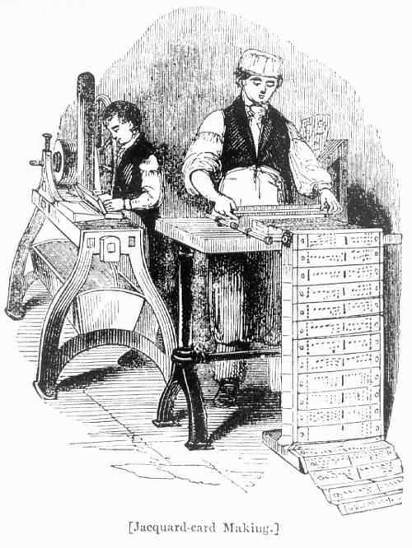

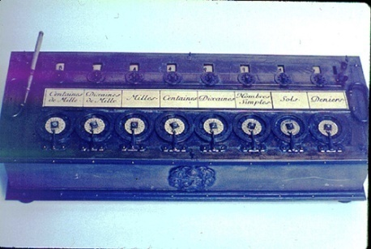
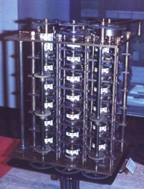
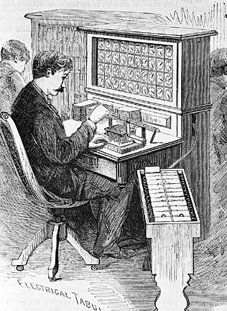
Pascaline
Leibnitz’s Wheel
Jacquard’s Loom
Difference Engine
Hollerith Desk

Slide 33
1.4.2 The birth of electronic computers (1930–1950)
Between 1930 and 1950, several computers were invented by scientists who could be considered the pioneers of the electronic computer industry.
Early Electronic Computers (Turing Model)
The early computers of this period did not store the program in memory—all were programmed externally. Five computers were prominent during these years:
ABC (solve a system of linear equations)
Z1
Mark1 (used both electrical and mechanical components)
Colossus
ENIAC (first general-purpose, totally electronic computer)

Slide 34
Computers based on the von Neumann model
The preceding five computers used memory only for storing data, and were programmed externally using wires or switches. John von Neumann proposed that the program and the data should be stored in memory. That way, every time we use a computer to do a new task, we need only change the program instead of rewiring the machine or turning hundreds of switches on and off.
The first computer based on von Neumann’s ideas was made in 1950 at the University of Pennsylvania and was called EDVAC. At the same time, a similar computer called EDSAC was built by Maurice Wilkes at Cambridge University in England.

Slide 35
1.4.3 Computer generations (1950–present)
Computers built after 1950 more or less follow the von Neumann model. They have become faster, smaller, and cheaper, but the principle is almost the same. Historians divide this period into generations, with each generation witnessing some major change in hardware or software (but not in the model).
First generation
The first generation (roughly 1950–1959) is characterized by the emergence of commercial computers. It used vacuum tubes as electronic switches

Slide 36
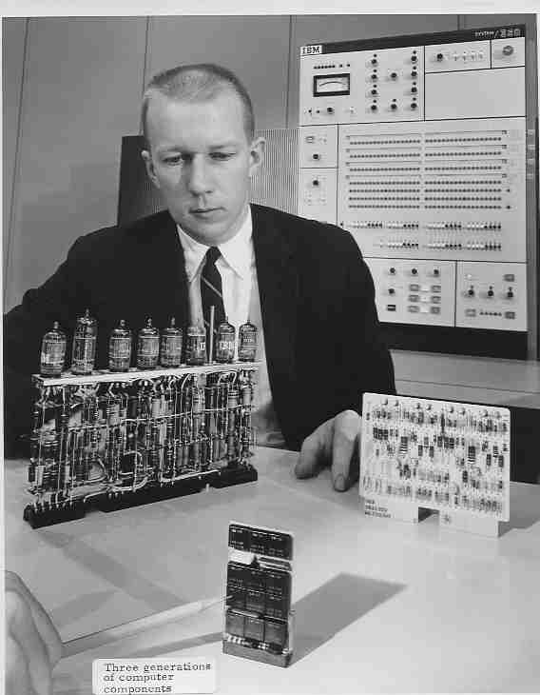
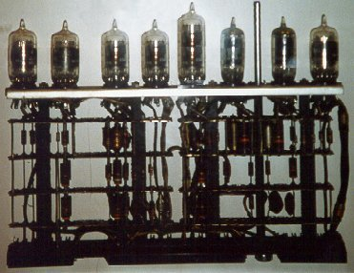
vacuum tubes

Slide 37
Second generation
Second-generation computers (roughly 1959–1965) used transistors instead of vacuum tubes. Two high-level programming languages, FORTRAN and COBOL invented and made programming easier. This reduced the size of computers, as well as their cost, and made them affordable to small and medium-size corporations.

Slide 38
Third generation
The invention of the integrated circuit reduced the cost and size of computers even further. Minicomputers appeared on the market. Canned programs, popularly known as software packages, became available. This generation lasted roughly from 1965 to 1975. A small corporation could buy a package.

Slide 39
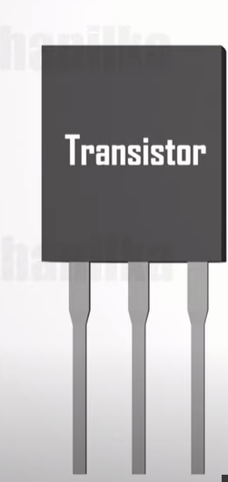
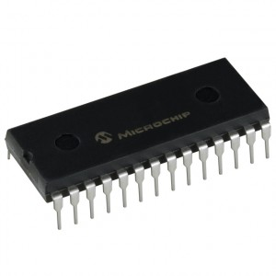
transistors integrated circuit
(transistors, wiring, and other components on a single chip)

Slide 40
Fourth generation
The fourth generation (approximately 1975–1985) saw the appearance of microcomputers. The first desktop calculator, the Altair 8800, became available in 1975. This generation also saw the emergence of computer networks.
Fifth generation
This open-ended generation started in 1985. It has witnessed the appearance of laptop and palmtop computers, improvements in secondary storage media (CDROM, DVD and so on), the use of multimedia, and the phenomenon of virtual reality.

Slide 41
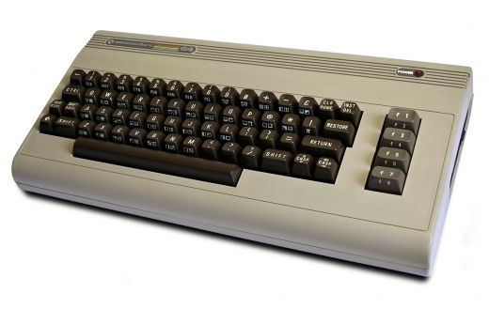
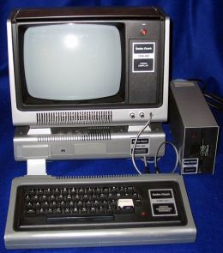
microcomputers.

Slide 42
1.5 Ethical issues
Computers have created some ethical issues. We introduce some of these here.
Privacy
Computers allow communication between two parties to be done electronically. However, much needs to be done to make this type of communication private. Society is paying a big price for private electronic communication.
Copyright
Another ethical issue in a computerized society is copyright: who owns data? The internet has created opportunities to share ideas, but has also brought a further ethical issue: electronic copyright.
Computer crime
Like any innovation, computers and information technology have created new types of crime.
Hackers have been able to access many computers in the world and have stolen a lot of money.
- Virus creators design new viruses to be sent through the internet and damage the information stored in computers. Although there are many anti-virus programs in use today, society is paying a big price for this type of crime, which did not exist before the computer and internet era.

Slide 43
1-6 COMPUTER SCIENCE AS A DISCIPLINE
With the invention of computers, a new discipline has evolved: computer science. Like any other discipline, computer science has now divided into several areas. We can divide these areas into two broad categories:
systems areas and
applications areas.

Slide 44
COMPUTER SCIENCE AS A DISCIPLINE
Systems areas cover those areas that directly related to the creation of hardware and software, such as computer architecture, computer networking, security issues, operating systems, algorithms, programming languages, and software engineering. Applications areas cover those that are related to the use of computers, such as databases and artificial intelligence.

Slide 45
1-6 OUTLINE OF THE COURSE
After this introductory chapter, the book is divided into five parts.
1.6.1 Part I: Data representation and operation
This part includes Chapters 2, 3, and 4.
Chapter 2 discuss number systems, how a quantity can be represented using symbols.
Chapter 3 discusses how different data is stored inside the computer.
Chapter 4 discusses some primitive operations on bits.

Slide 46
1.6.2 Part II: Computer hardware
This part includes Chapters 5 and 6.
Chapter 5 gives a general idea of computer hardware, discussing different computer organizations.
Chapter 6 shows how individual computers are connected to make computer networks, and internetworks (internets).

Slide 47
1.6.3 Part III: Computer software
This part includes Chapters 7, 8, 9, and 10.
Chapter 7 discusses operating systems.
Chapter 8 shows how problem solving is reduced to writing an algorithm for the problem. Chapter 9 programming languages.
Chapter 10 is a review of software engineering.

Slide 48
1.6.4 Part IV: Data organization and abstraction
Part IV includes Chapters 11, 12, 13, and 14.
Chapter 11 discuss data structure, collecting data of the same or different type under one category.
Chapter 12 discusses abstract data types.
Chapter 13 shows how different file structures can be used for different purposes.
Chapter 14 discusses databases.

Slide 49
1.6.5 Part V: Advanced topics
This part covers Chapters 15, 16, 17, and 18.
Chapter 15 discusses data compression.
Chapter 16 explores some issues to do with security. Chapter 17 discusses the theory of computation.
Chapter 18 gives some idea of artificial intelligence, a topic with day-to-day challenges in computer science.

Slide 50
SUMMARY
A computer is a programmable data processor that accepts input data and programs and outputs data.
A program is a set of instructions executed sequentially that tells the computer what to do with data.
Every computer today is based on the von Neumann model.

Slide 51
SUMMARY
The von Neumann model specifies a memory subsystem, an arithmetic logic unit subsystem, a control unit subsystem, and an input/output subsystem.
Data and programs are stored in computer memory.
A step-by-step solution to a program is called an algorithm.
A program is written in a computer language.
Software engineering is the design and writing of programs in a structured form

Slide 52

THANK YOU
Introduction to Information Technology, Prof. Lamiaa Fattouh Ibrahim, Spring 2022-2023

