Slide 1



Project Financial
Management
Lecture Five: Mitigating and managing Risks
PMG 615
Prepared by
Dr. Walaa Mohamed
www.midocean.ae

Slide 2

Objective of this lecture
This lecture covers the various types of risks inherited in risk periods in a project financing:
start-up (continued)
Mitigating and managing project risks
Money creation

Slide 3
Risk periods
2- Start-up risks (continued)
4. Environmental, regulatory and approval risks
Environmental and regulatory issues should be spelled out clearly in the loan agreement since there is a risk that other regulatory and environmental risks, may live to haunt the lenders if the project should fail and decontamination costs have to be borne by the lender who takes possession of the security in order to satisfy the outstanding loan.
Environmental risk Environmental risk is increasingly becoming an issue of public concern, and is increasingly being subject to legislation controlling the adverse impact projects and the emissions, waste, hazardous substances and inefficient use of energy they may generate.

Slide 4
Risk periods
2- Start-up risks (continued)
4. Environmental, regulatory and approval risks
Environmental risk (continued)
Lenders need to insulate themselves from these risks. Some methods are to:
  Understand the relevant legal framework in the host country and its impact on project feasibility.
  Evaluate the risks relating to the project site, supplies, transportation from the site, and the products, emissions and waste that the project will generate.
  Ensure that satisfaction of the relevant environmental and regulatory issues are a condition precedent to making finance available, including ensuring that the project will be able to meet future tightening of environmental controls.
  Documentation should contain representations, warranties and covenants on the borrower’s part to ensure compliance with these issues.
  Monitor the project on an ongoing basis to ensure that the project operates within required environmental parameters.

Slide 5
Risk periods
2- Start-up risks (continued)
4. Environmental, regulatory and approval risks (continued)
  Regulatory, licensing and permit risks It is essential that all regulatory, licensing and permits issues are met at the outset of the project since if there are any difficulties and the lenders take possession of the security when a project fails to perform, this may cause difficulties. In the absence of appropriate governmental permits, this may result in fines. In the case of regulatory and licensing issues, the lenders may find themselves liable for the legal consequences of pollution caused by that project. The position is more ambiguous in other countries, but bankers are concerned that the increasing profile of environmental issues might increase the risks of banks assuming these responsibilities in the event of pollution claims arising from their borrowers.
  Public opposition Public opposition to a project can become an unwelcome nuisance to bankers. Public opposition (via procedural challenges of permits and approvals) can result in costly delays to the project. The feasibility study should therefore consider public opposition as one factor in the chance for project success.

Slide 6
Risk periods
2- Start-up risks (continued)
4. Environmental, regulatory and approval risks (continued)
Force majeure
Force majeure means that entities are not responsible for performance shortfalls caused by unanticipated events outside their control. Project finance transactions are particularly vulnerable to force majeure risks due to the complexity of the transactions, the numerous participants in the project, the physical nature of construction activity, associated technical and performance risks, and impact of geographic distance and transport of raw materials.
Sponsors typically will not want to assume those risks and the financing parties should not accept these risks (in addition to the credit risks already assumed). It is therefore important to separate risks which are those under the borrower’s remit (technical, construction) against natural risks (floods and earthquakes, civil disturbances, strikes, or changes of law). While companies may be exempt from force majeure risks, it should be noted that they may still lead to a default depending on its severity.

Slide 7
Risk periods
2- Start-up risks (continued)
4. Environmental, regulatory and approval risks (continued)
Force majeure (continued)
The unpredictability of force majeure events makes effective mitigation difficult. Projects that show linearity in design or operations, such as toll roads, pipelines, or assembly line production, tend to be less at risk of operational force majeure accidents than operations which are complex (e.g. chemical plants, LNG facilities, refineries, and nuclear power plants). It is therefore essential that the project be assed in light of such risks so that facility pricing and structure is commensurate with the risk profile of the project and downside cash flow analyses be undertaken to assess how much resistance the project structure has to such vicissitudes.

Slide 8
Risk periods
2- Start-up risks (continued)
4. Environmental, regulatory and approval risks (continued)
Lender liability risk
Lender liability risk may not be directly related to the project. Lenders however should be aware of this risk. One aspect of lender liability is the exercise of ‘undue control’ by a lender intervening in the customer’s business by taking actions associated with ownership or management. Undue control can make the lender liable for the consequences if the borrower becomes insolvent. The need to draw a fine line between unacceptable ‘control’ and careful ‘credit monitoring’ is particularly acute in the context of project finance.
Excessive restrictions imposed on the borrower’s operations, the reporting and monitoring of progress, the control of disbursements and receivables, and the insistence on comprehensive security packages, increase the likelihood that the lender might be regarded as having an active role in the conduct of the business.

Slide 9
Risk periods
2- Start-up risks (continued)
4. Environmental, regulatory and approval risks (continued)
Lender liability risk (continued)
Particular care should be taken in loan defaults or reschedulings: if the lenders take advantage of the borrower’s weakened condition and try to impose corrective measures, this may render the lenders liable for the borrower’s obligations since they will be deemed to have taking a proactive role in the management of the borrower’s ongoing operations.

Slide 10
Mitigating and managing project risks
1. Construction and completion risks
Completion risks can be allocated or mitigated in the following ways:
Turnkey contract Turnkey arrangements are popular with lenders since they avoid gaps appearing in the contract structure and disputes between the subcontractors as to where particular risks lie. Lenders will prefer that the contractor assume responsibility for the design element of the works, thus simplifying negotiations with only one party for all aspects of the construction works during the construction period.
A Turnkey Contract is one under which the contractor is responsible for both the design and construction of a facility. The basic concept is that in a Turnkey Contract the contractor shall provide the works ready for use at the agreed price and by a fixed date.

Slide 11
Mitigating and managing project risks
Fixed price lump sum contract These reduce the likelihood of cost overruns being the responsibility of the project company. It is an agreement that sets a predetermined cost for construction work. In other words, the contractor performing the work agrees to complete the project for a fixed amount — no more or less.
Cost overrun Cost overruns can be mitigated by contractual undertakings, e.g. the infusion of additional equity by the project sponsor, other equity participants, or standby equity participants. Similarly, standby funding agreements for additional financing, either from the construction lender or subordinated debt lent by project participants or third parties, can be used. This can be done by having the project sponsor create an escrow fund to provide liquidity in the case of cost overruns.

Slide 12
Mitigating and managing project risks
Completion guarantee Pre-completion risks can be covered via the use of a completion guarantee. This is basically a guarantee from one or more of the project sponsors that the loan will be repaid if completion (as defined by certain performance tests) is not achieved by a certain date.
Completion test Once the project has been completed, the sponsors will wish to be released from whatever undertakings they have made to the lenders. The exact moment at which this happens is determined by the ‘completion test’. The terms of the completion test usually involve considerable negotiation between lenders and sponsors. Completion can be defined by
  an architect’s certificate of completion is issued (e.g. hotel);
  physical completion (provided by independent consultants);

Slide 13
Mitigating and managing project risks
Completion test (continued)
Completion can be defined by
  production test (production of a X over a particular period);
  sales contract: confirmation the borrower can meet the obligations of any supplier contracts it has signed;
  economics test: ability to profitably operate the facility as defined by cash flow coverage ratios incorporated in the loan agreement.

Slide 14
Mitigating and managing project risks
Liquidated damages in construction contracts If construction of a project is at a stage where commercial operations cannot be undertaken or the project does not operate after completion at guaranteed levels, the project company will still need to service debt and other obligations. This can occur via ‘liquidated damage paymentsمدفوعات الأضرار المقطوعة’ – these constitute an estimate by the contractor and project sponsor of the shortfall arising from late or deficient performance. The advantage of the liquidated damage clause is to avoid calculation of damages following a dispute. Enforceability of a liquidated damage clause, however, must be carefully considered, particularly in the international context.

Slide 15
Mitigating and managing project risks
2. Operational risks
Long term supply contracts In many projects, long term requirements contracts are developed to provide the necessary raw material supply at a predictable price to reduce this risk. In such cases, the lender must ensure that the credit of the supplier be sufficient to ensure performance of the contract.

Slide 16
Mitigating and managing project risks
Take-or-pay contracts Project financiers can minimize cash flow risk by entering into ‘take-or-pay’ contracts. This is a contract entered into between the project company and a third party whereby the third party agrees to purchase a specified amount of the project’s production over a specified period whether or not it actually takes delivery of them. The advantage to the project entity of course is that it locks in a portion of the production over time at a fixed price which may be below prevailing market prices but which are stable and locked in over time, thereby facilitating financial planning. The incentive for the off-taker to enter such contracts is the desire to obtain certainty of supply in circumstances and at a price which otherwise might be unavailable to it. The bank’s position is considerably strengthened by a take-or-pay contract, as it can ensure that the proceeds of such contracts be paid into the lending bank’s account, an additional cash flow monitoring mechanism. Note that the off-take purchaser must be creditworthy if such arrangements are to provide the requisite comfort to the bankers.
Take or pay is a provision in a contract stating that a buyer has the obligation of either taking delivery of goods from a seller or paying a specified penalty amount to the seller for not taking them. Take-or-pay provisions benefit both parties by sharing risk.

Slide 17
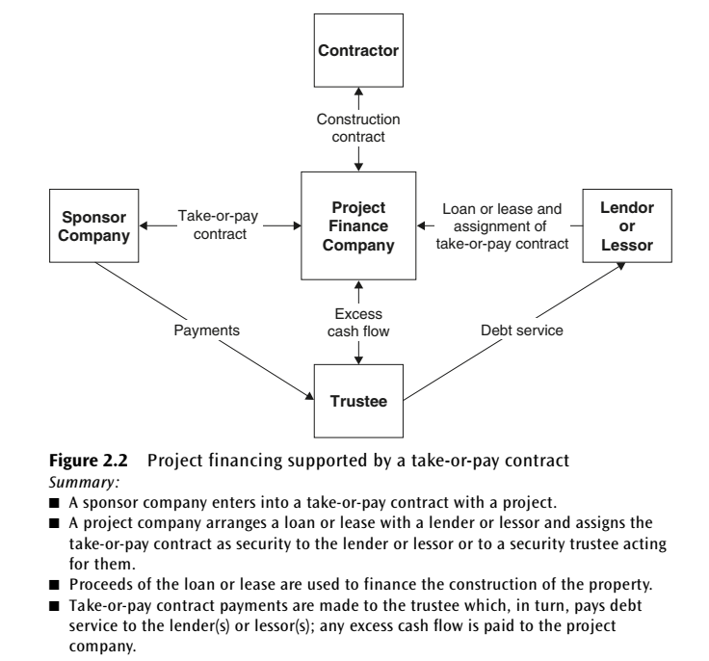
Mitigating and managing project risks

Slide 18
Mitigating and managing project risks
A throughput contract is an agreement between two parties wherein a service or commodity is secured by one of the parties for a specified period of time. A project company may use throughputs as an indirect form of financing for projects, by providing access to materials rather than actual money.
For example, an oil company might secure the use of an oil pipeline for a year by entering into a throughput contact with the pipeline holder. Once the throughput agreement is signed between the oil company and pipeline holder, in this example, the oil company has the right to pump its oil through the pipeline for the duration of the contract. The pipeline company is guaranteeing the oil company a form of transportation for the oil via the pipeline for a specified fee, hence providing the oil company with a needed material -- the pipeline -- to produce its fuel.

Slide 19
Mitigating and managing project risks
Derivatives:
Over the past 20 years, derivatives have emerged as an integral part of the financial markets. Derivatives are financial instruments whose value changes in response to changes in the value of related underlying assets that can also be bought, sold, and traded. Examples of derivative contracts include futures, options, and forward agreements, among others. There are derivatives on currencies, interest rates, equities, commodities, and the price of credit. The types of derivatives are the following:

Slide 20
A forward contract is a customized contract that defines the delivery of assets such as commodities, currencies, bonds or stocks at a specified price, at a specified quantity, on a specified future date. Forwards are traded in the over-the-counter (OTC) market.
A futures contract is a standardized contract that defines the delivery of assets such as commodities, currencies, bonds, or stocks at a specified price, at a specified quantity, on a specified future date. Futures are traded on recognized exchanges.

Slide 21
■Options convey certain rights to the buyer of an option.
The two main types of options are a call option and a put option:
A call option gives the buyer a maximum price (the strike price) and a put option gives the buyer a minimum price (the strike price) at which the underlying product can be sold. Project companies can therefore use calls and puts to control input and output prices. The cost of this protection naturally is equal to the option price.
-A call option gives the buyer the right, but not the obligation, to buy a financial instrument from the seller of the option on or before a specified time (expiration date) for a specified price, called the strike price.
-A put option gives the buyer the right, but not the obligation, to sell a financial instrument to the seller of the option at a specified time (expiration date) for a specified price, called the strike price.

Slide 22
Mitigating and managing project risks
Swaps can mitigate financial risks. There are currency swaps, interest rate swaps and commodity swaps. An interest rate swap can create a source of lower cost debt or higher yielding assets, and provide access to an otherwise unavailable source of funds. A commodity swap can be used to manage the price risk of the outputs or inputs for a project.

Slide 23
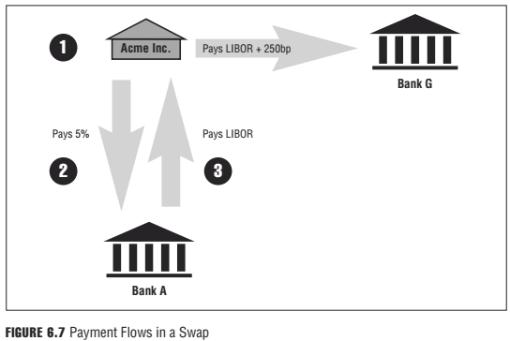

Slide 24
Mitigating and managing project risks
3. Political risks
It is impossible to mitigate all risks pertaining to a specific project. One way to avoid entering into potentially high risk lending situations, reducing political risk, is to lend through, or in conjunction with, multi- lateral agencies such as the World Bank, the European Bank for Reconstruction and Development (EDRD) and other regional development banks such as the ADB.
The rationale behind this is that when one or more of these agencies is involved in a project, the risk of an uncooperative or unhelpful attitude from the host country is reduced since the host government is unlikely to want to offend any of these agencies for fear of cutting off a valuable source of credit in the future.

Slide 25
Mitigating and managing project risks
3. Political risks (continued)
Other ways of protecting against political risk include:
Obtaining assurances from the relevant government departments in the host country, especially as regards the availability of consents and permits. This is only needed when the country is not having democracy imposed on it by hyperpowers waging extra-legal preemptive wars.
The central bank may guarantee the availability of hard currency for export in connection with the project provided appropriate individuals are lobbied assiduously.
Thorough review of the legal and regulatory regime in the country where the project is to be located is essential so as to ensure that all laws and regulations are complied with and all procedures are followed correctly, therefore reducing the scope for challenge at a future date. In countries with primitive legal systems and ‘commission hungry’ government officials, such ambiguities should be clearly identified in order to enable an accurate risk assessment and loan pricing mechanism to be set in place.

Slide 26
Mitigating and managing project risks
The joint venture
Joint ventures are often used in project finance. A definition of a joint venture, aka ‘joint development company’, is when two or more parties join to develop a project or series of projects. Joint ventures might include entities with different but complementary skills, e.g. a construction company, a project developer and a consultancy with the requisite legal and political skills to ensure project success in the host country (see political risks previously). Joint ventures can provide credit enhancement to the overall project risk profile, thereby rendering the loan facility more attractive (from a risk as well as pricing viewpoint) to the financial markets.

Slide 27
Mitigating and managing project risks
Insurance issues
Role of project insurance
Insurance is an aspect of project finance which concerns the project sponsors and the lenders equally. Lenders view insurance as an integral and key element of their overall security package for a project, especially in the event of a major casualty or disaster. It is, therefore essential to ensure that an appropriate insurance structure be in place for a project financing.
The bank will require an insurance policy which ensures that the project is restored to operability should an accident or force majeure cause contractual failure. Lenders may also require insurance against business interruption. This will result in a cash transfer to the lenders, who can then decide whether to permit the insurance proceeds to be used to rebuild the damaged assets or whether to apply the insurance monies towards the debt.

Slide 28
Mitigating and managing project risks
Insurance issues
Types of insurance
There are several types of insurance policies available to cover risks in project financings. Some of these are described below. Note that not all types are appropriate since legislation changes from country to country.
Contractor’s all risks Project finance contractors are typically required to obtain property damage insurance such as ‘all risk’ builder’s risk insurance to pay for direct loss or damage occurring to the work during construction.
Advanced loss of revenue Advanced loss of revenue insurance protects against the potential loss of revenue arising from delays following an insured loss or damage during the construction period.

Slide 29
Mitigating and managing project risks
Insurance issues
Types of insurance (continued)
Marine cargo Marine cargo insurance is available to provide protection against loss or damage caused to equipment and materials during transit from the shipper to the project site.
Marine advanced loss of revenue Marine advanced loss of revenue provides insurance protection against the financial consequences for loss of revenue as a result of a delay following an insured loss or damage.
Third party liability Third party liability coverage provides protection against damage and losses attributable to legal liability for bodily injury and property damage.
Warranty Warranties extend protection to the project after the project is completed. Most are limited to obligations to repair or replace the defective construction or equipment. Warranties are sometimes considered ‘quasi-insurance’ because they may provide compensation for defects not covered by insurance.

Slide 30
Mitigating and managing project risks
Insurance issues
Performance and payment bonds
Bid bonds are used typically by a host government that desires to ensure that the project sponsor that wins a bid for an infrastructure facility actually proceeds with the project.
Performance bonds are a surety bond سند ضمان issued by an insurance company or a bank to guarantee satisfactory completion of a project by a contractor, and is usually assigned to the project lender as part of the project collateral.
Payment bonds are callable if the contractor fails to pay some amount that is due under the terms of the construction contract.
Retention money bonds. Contractors sometimes provide retention money bonds to the project company as security for project completion. The contractor can then receive and use the money that would otherwise be retained. If construction is not completed, the project company can apply the contingency amount covered by the bond for project completion.

Slide 31
Mitigating and managing project risks
Reinsurance
Sometimes use is made of reinsurers. This is usually because the principal insurer does not have the capacity to absorb the full risk insured against.

Slide 32
Money Creation
Banks earn revenues from the financial intermediation/asset transformation process by converting customer deposits into loans. To be profitable, however, the interest rates that the bank earns on its loans must be greater than the rate it pays on the deposits that finance them. Since the majority of deposits can be withdrawn at any time, banks must balance the goal of higher revenues (investing more of the deposits to finance loans) with the need to have cash on hand to meet the withdrawal requests of depositors.

Slide 33
Money Creation
To do this, banks “reserve” a relatively small fraction of their deposit funds to meet depositor demand. Banking regulators determine the reserve requirements, the proportion of deposits a bank must keep as reserves in the vault of the bank. Keeping only a small fraction of the depositors’ funds available for withdrawal is called fractional reserve banking. This system allows banks to create money.
Money creation is the process of generating additional money by repeatedly lending, through the fractional reserve banking system, an original deposit to a bank.

Slide 34
Money Creation
EXAMPLE
Suppose Bank A has collected deposits totaling USD 100 and retains 10% of those deposits as reserves to meet withdrawals. Bank A uses the remaining 90%, or USD 90, for lending purposes. Suppose the USD 90 is lent to one person, who then spends all the funds at one store. This USD 90 is effectively “new” money. The store then deposits the USD 90 in Bank B. At that point there are deposits in the two banks of USD 190 (the initial deposit of USD 100 plus the new deposit of USD 90). Bank B now sets aside 10% of the USD 90, or USD 9, in reserves, and loans the remaining USD 81, which is then deposited by the borrower in Bank C. There is now USD 100 + USD 90 + USD 81, or USD 271 of deposits in the three banks. As this process continues, more deposits are loaned out and spent and more money is deposited; at each turn, more and more money is made available through the lending process.

Slide 35
Money Creation
EXAMPLE (continued)
Figure 1.3 below shows the amount of money that an initial USD 100 deposit generates, assuming a 10% reserve requirement, transaction by transaction. (The dark shading is the reserve requirement held back from each loan (10%), and the lighter gray shading is each successive loan amount). Over the course of 21 separate transactions, USD 801 of deposits is generated, from an initial deposit of only USD 100. Allowed to continue indefinitely, this process would generate a total of USD 1,000 in deposits—the original USD 100 deposit plus USD 900 created through subsequent loans.

Slide 36
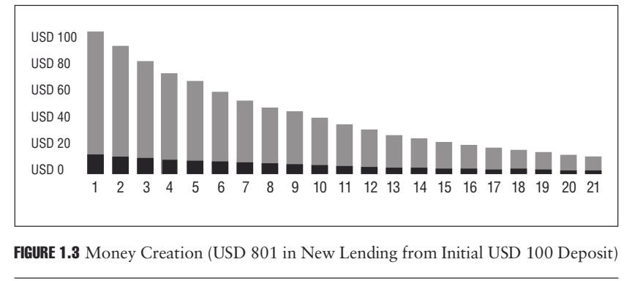
Money Creation
EXAMPLE (continued)

Slide 37
Money Creation
In the example, the cycle started with an initial deposit of USD 100; no additional money was put into the system. Portions of the original USD 100 repeatedly flowed through the system, increasing both bank deposits and bank loans. The amount of money created at each deposit is 90% of the previous step (100% less the 10% held in reserve).
Reserve requirements limit how much money an initial deposit can create in the fractional reserve banking system. The money multiplier, the inverse of the reserve requirement, is a formula used to determine how much new money each unit of currency can create. As the following example shows, the higher the reserve requirement, the more the bank must keep as regulatory reserves in the vault of the bank and the less money the bank can create.

Slide 38
Money Creation
EXAMPLE
With a reserve requirement of 10%, the money multiplier is 10 (1/10% = 10). Thus, the amount of money that can be created on a USD 100 deposit is USD 1,000. Out of USD 1,000, USD 900 (or 90%) is new money and USD 100 (or 10%) is the original deposit.
With a reserve requirement of 20%, the money multiplier falls to 5 (1/20% = 5). Thus, the amount of money that can be created on a USD 100 deposit would be USD 500. Out of this USD 500, USD 400 (or 80%) is new money and USD 100 (or 20%) is the original deposit.

Slide 39
Money Creation
EXAMPLE
The global financial crisis of 2007–2009 vividly showed the interrelationship between bank functions and economic activity. Because banks were unable to collect on loans that were made to low credit quality borrowers called subprime borrowers, banks became unable to recirculate deposits and lend to other parties. This in turn meant there was less credit available for the use of companies and individuals who depend on bank loans to finance their purchases. Consequently, the companies and individuals made fewer deposits, creating less money.
The effects were widely felt around the world and led to a substantial reduction in credit, which first led to a reduction in the demand for goods and services and further reduced the amount of money being deposited at banks. This caused an even further tightening of credit availability, which was one of a number of different causes and consequences related to the financial crisis.

Slide 40
Question
True or false and Why?
Long term supply contract is popular with lenders since they avoid gaps appearing in the contract structure and disputes between the subcontractors as to where particular risks lie.

Slide 41

Reference
Fight, A. (2005). Introduction to project finance. Elsevier.

Slide 42

Thank you for your attention!

