Slide 1


Slide 2


Slide 3
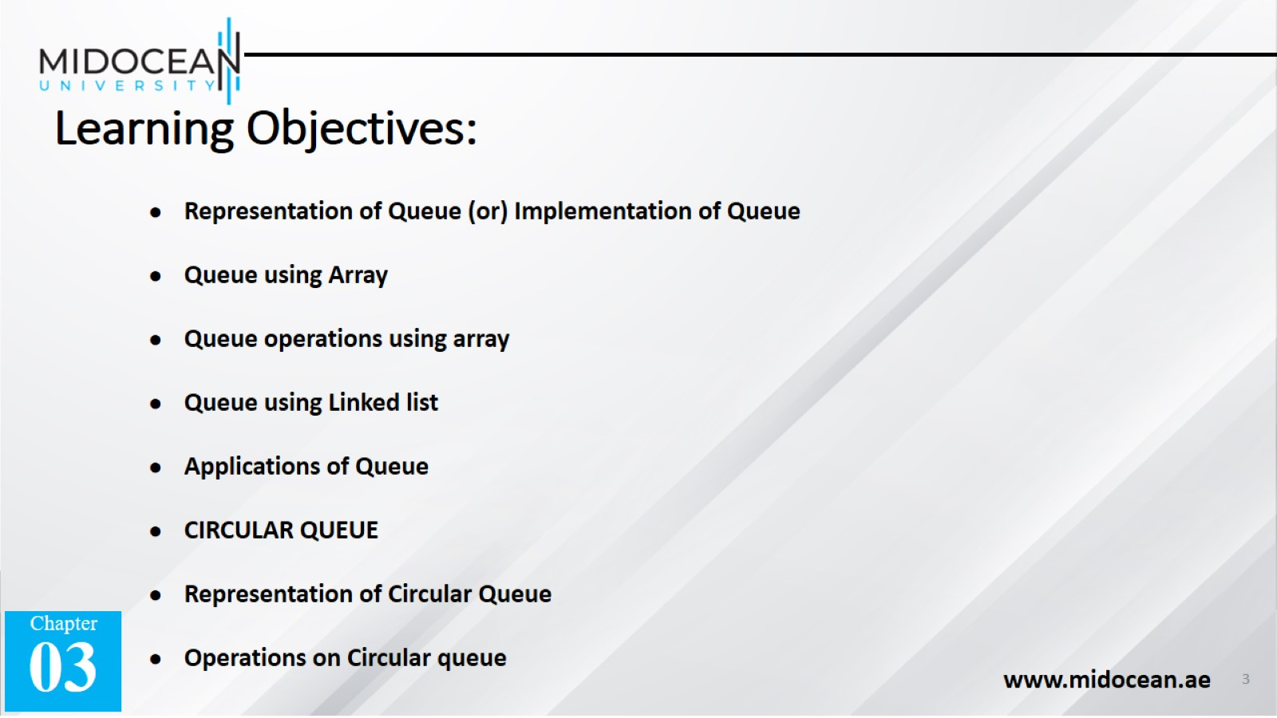
Learning Objectives:

Slide 4
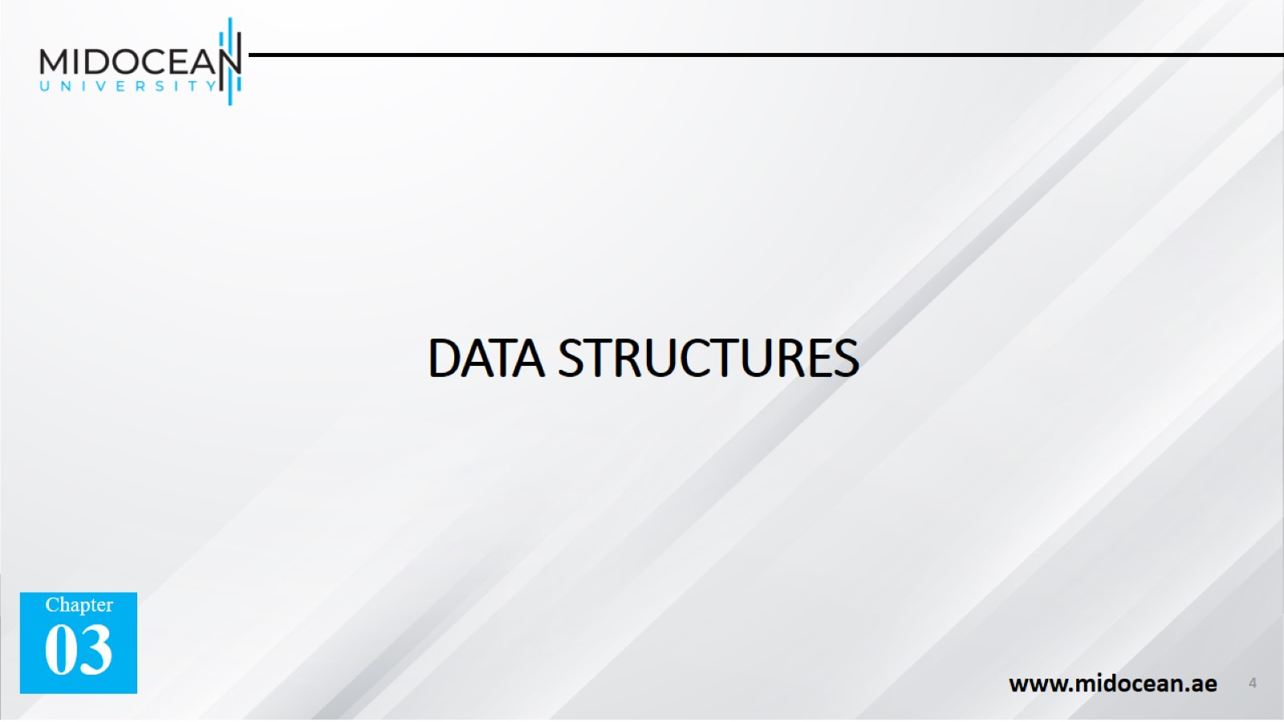
DATA STRUCTURES

Slide 5
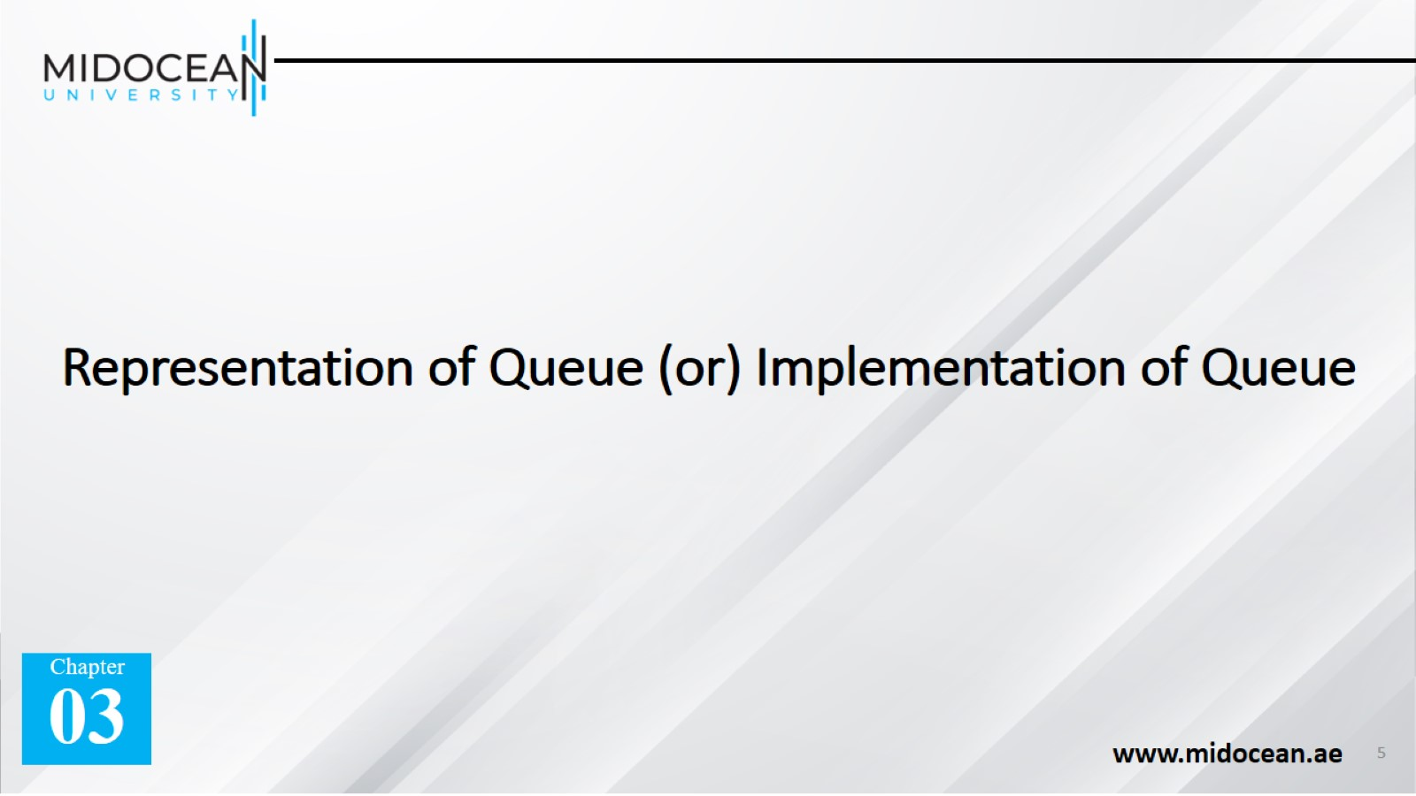
Representation of Queue (or) Implementation of Queue

Slide 6
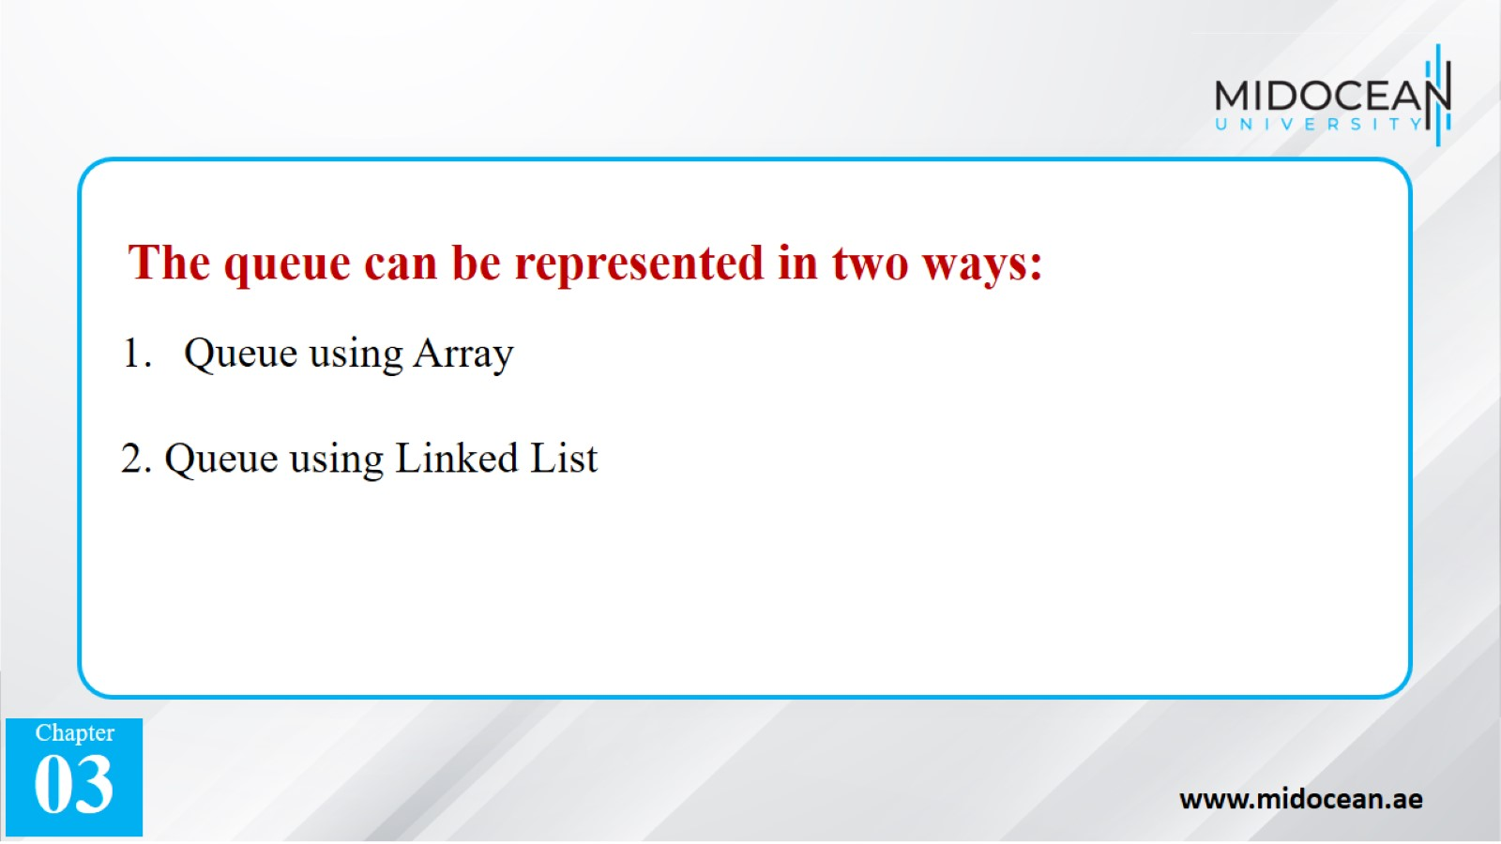

Slide 7
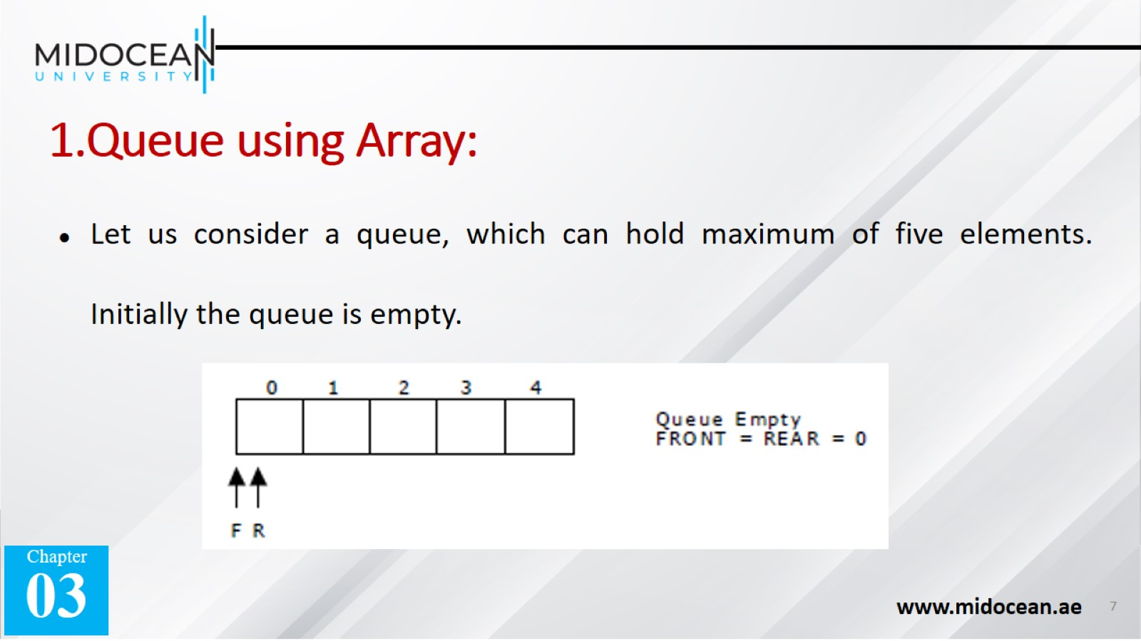
1.Queue using Array:

Slide 8
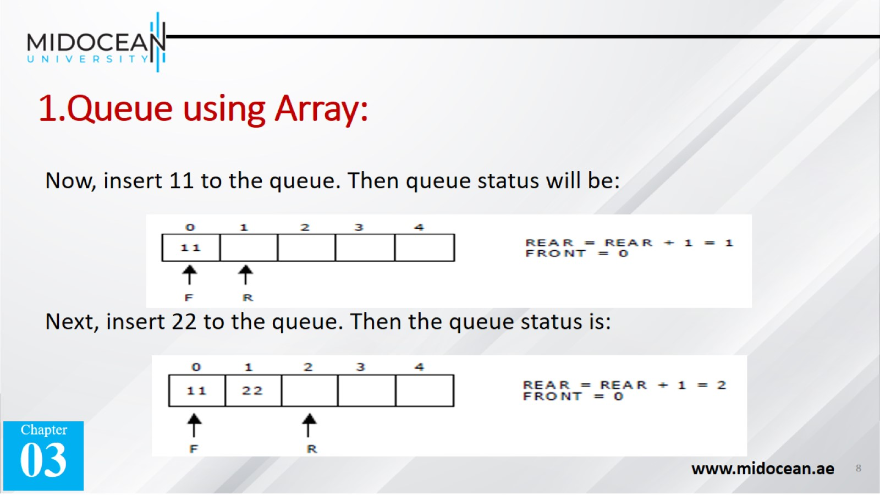
1.Queue using Array:

Slide 9
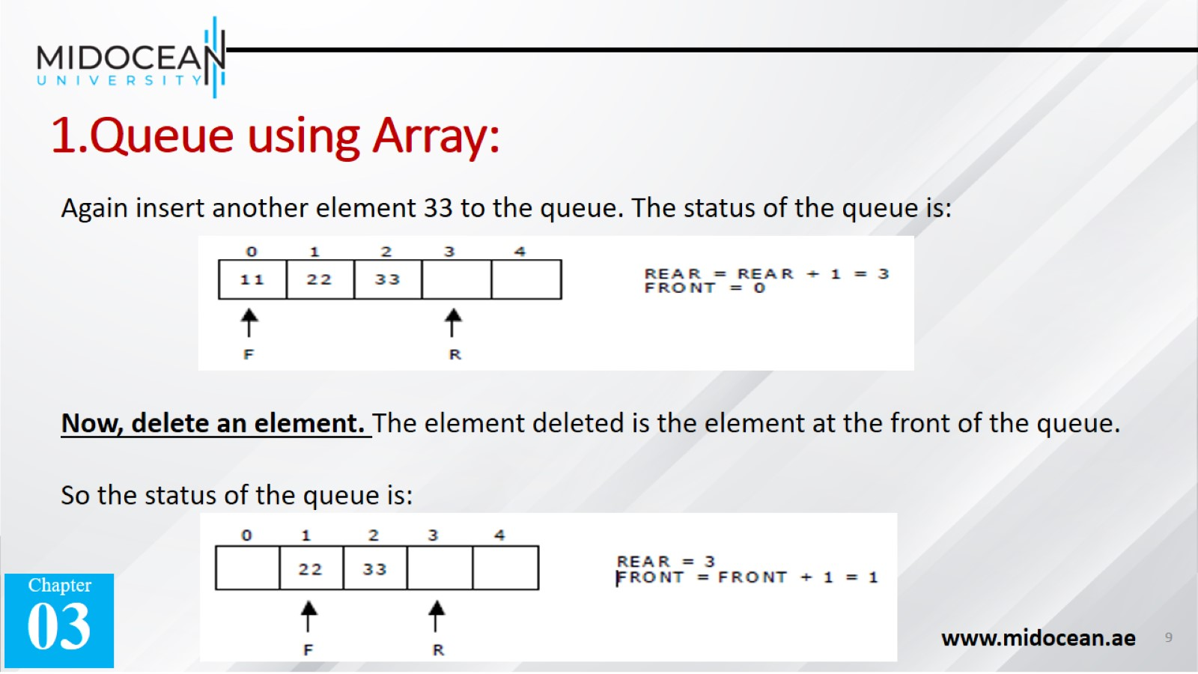
1.Queue using Array:

Slide 10
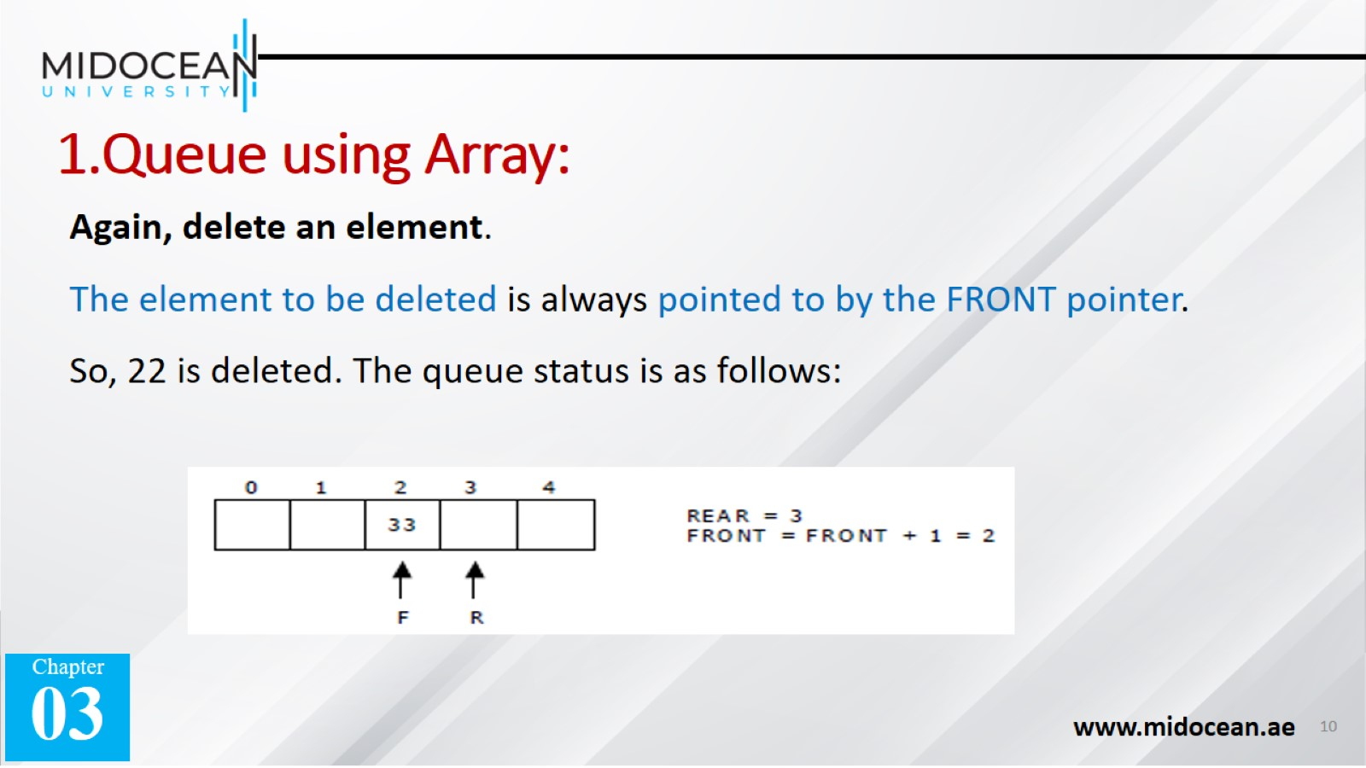
1.Queue using Array:

Slide 11
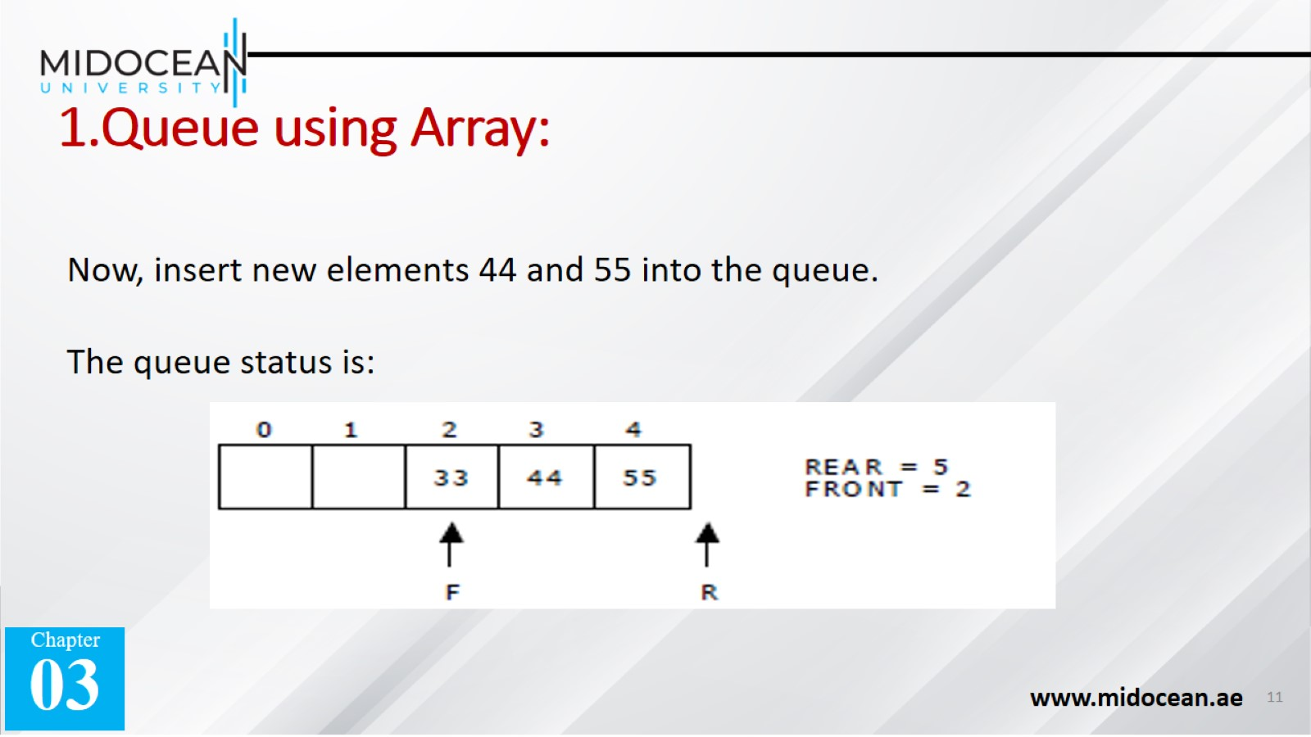
1.Queue using Array:

Slide 12
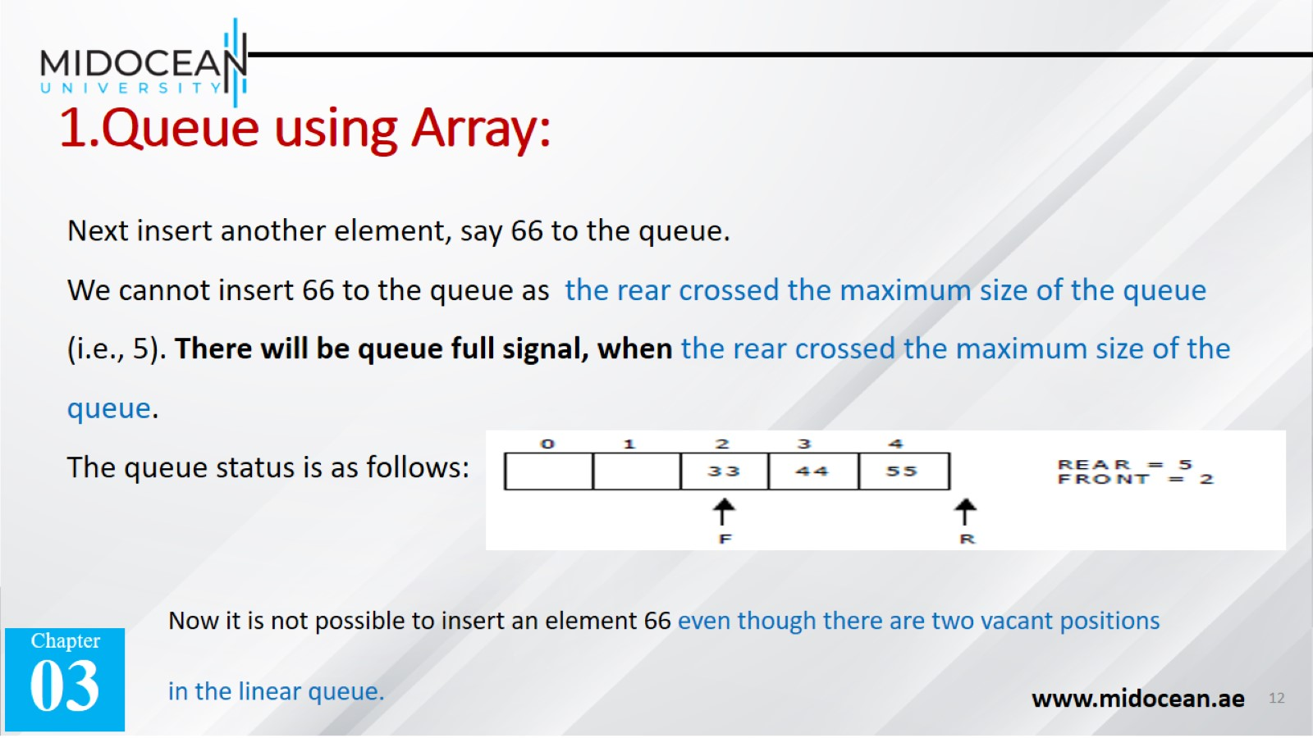
1.Queue using Array:

Slide 13
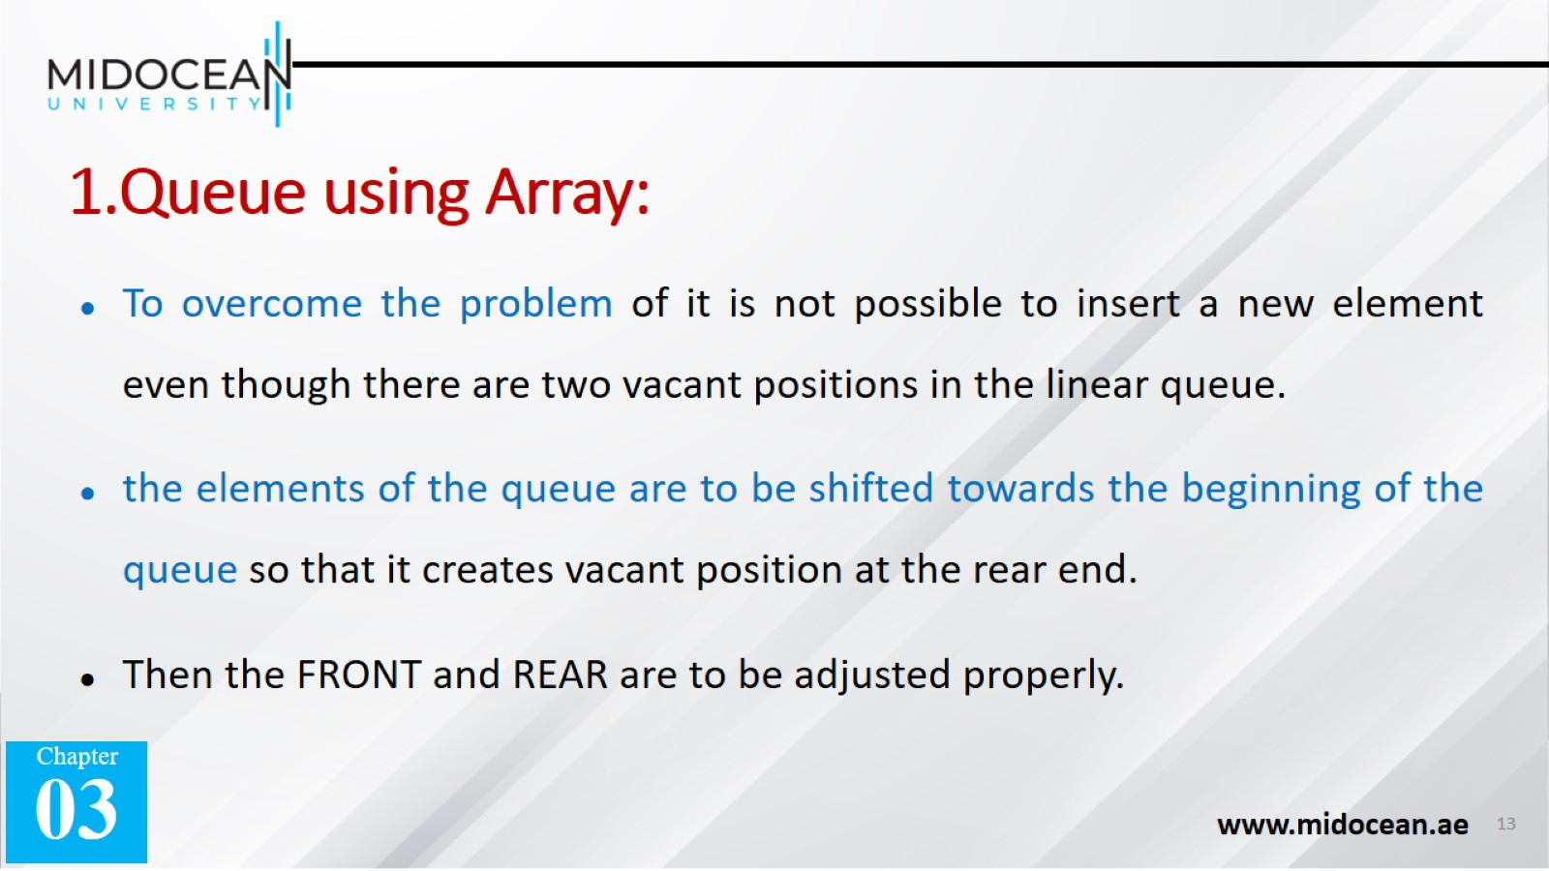
1.Queue using Array:

Slide 14
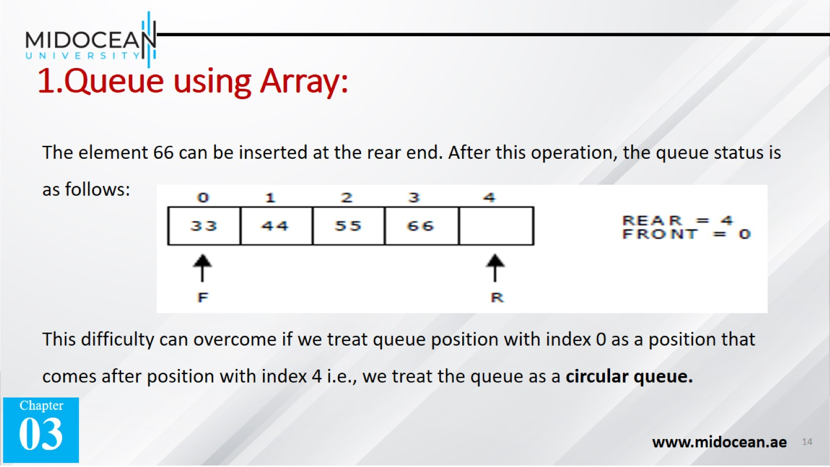
1.Queue using Array:

Slide 15


Slide 16
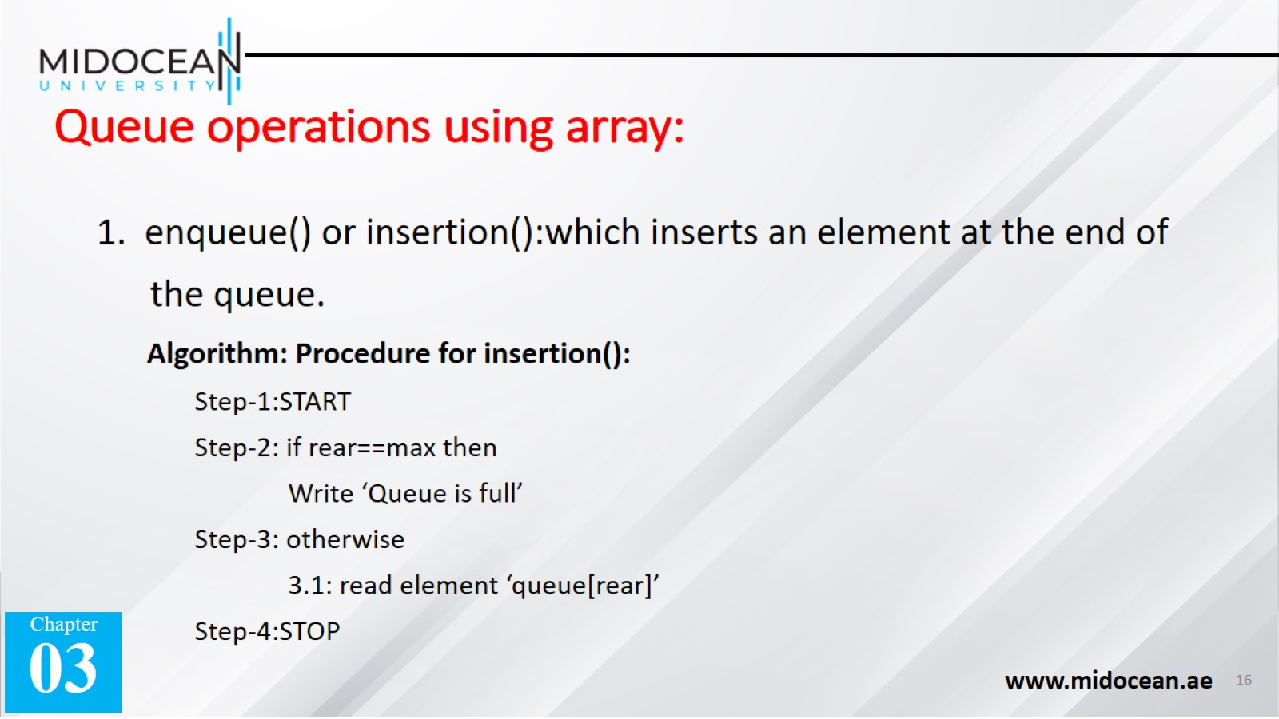
Queue operations using array:

Slide 17
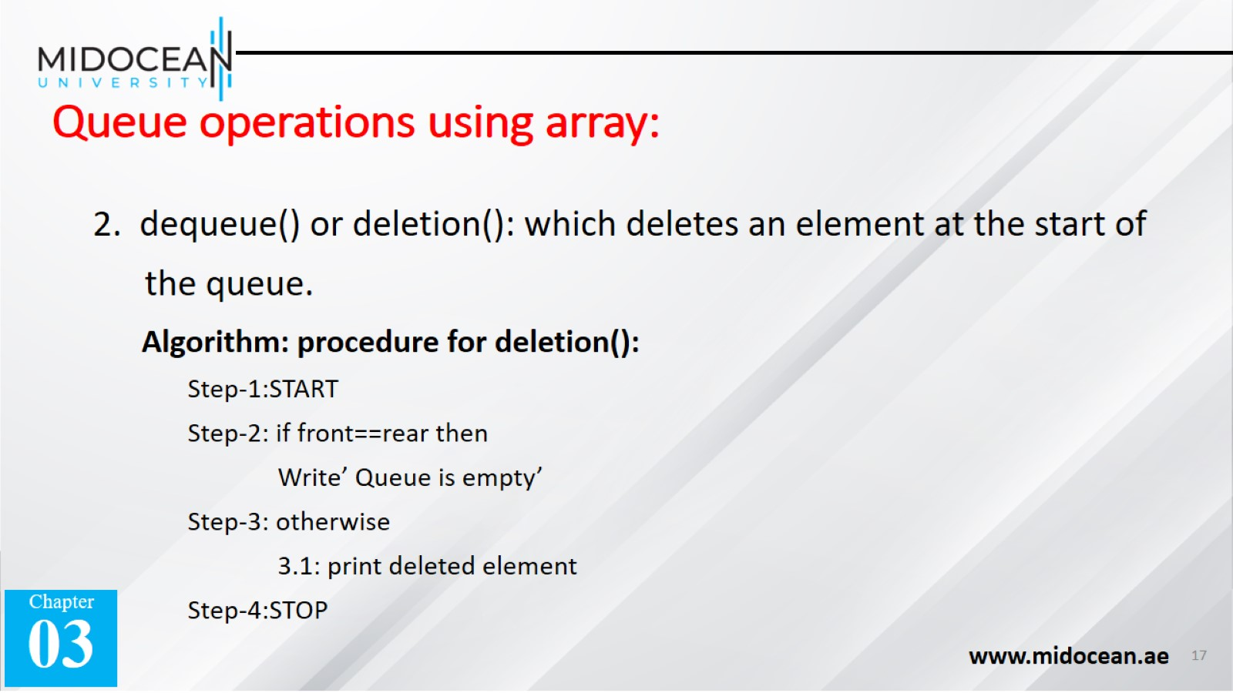
Queue operations using array:

Slide 18
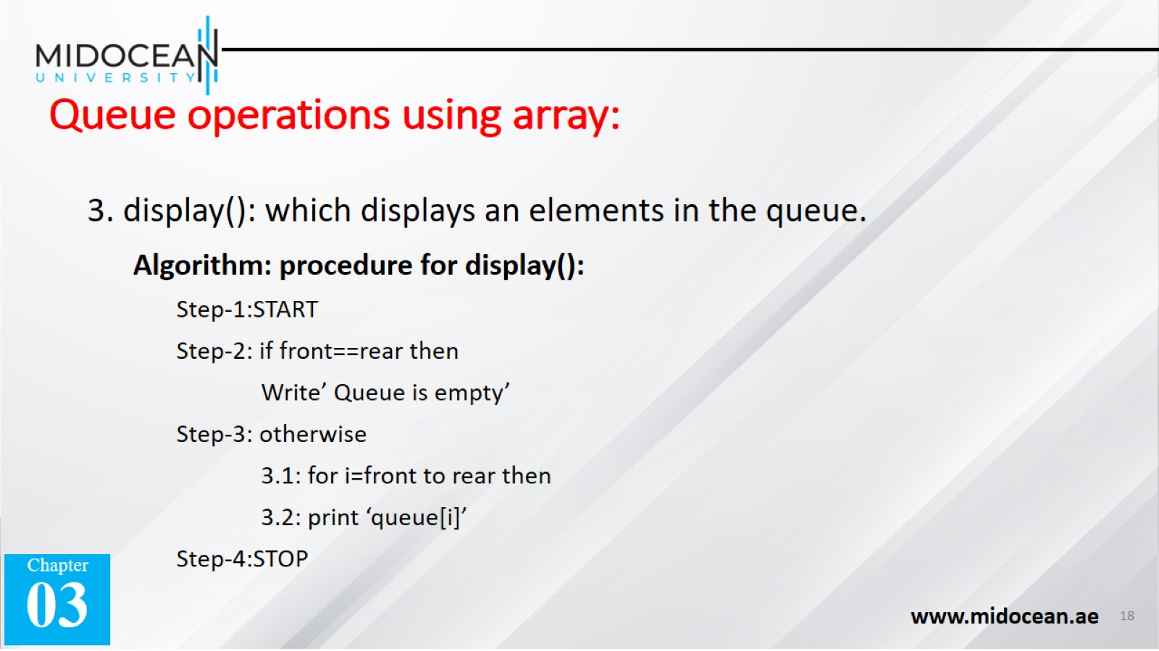
Queue operations using array:

Slide 19


Slide 20
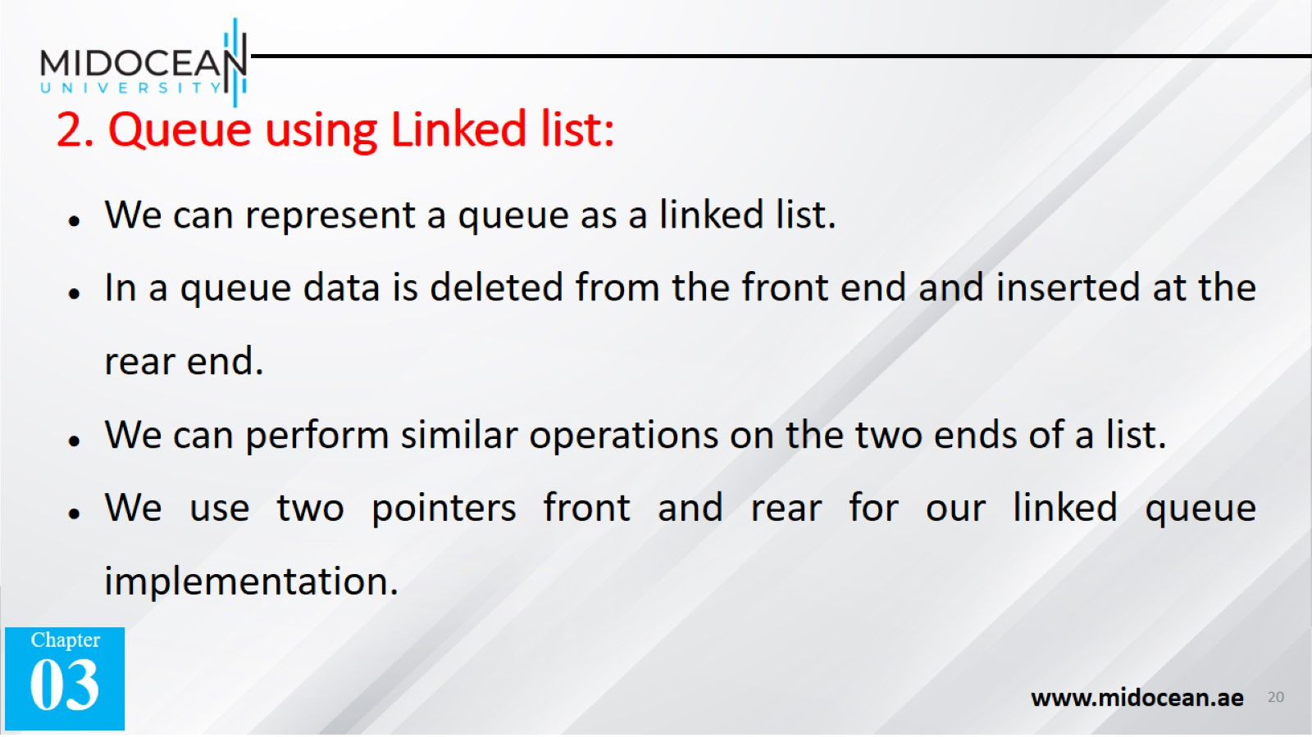
2. Queue using Linked list:

Slide 21
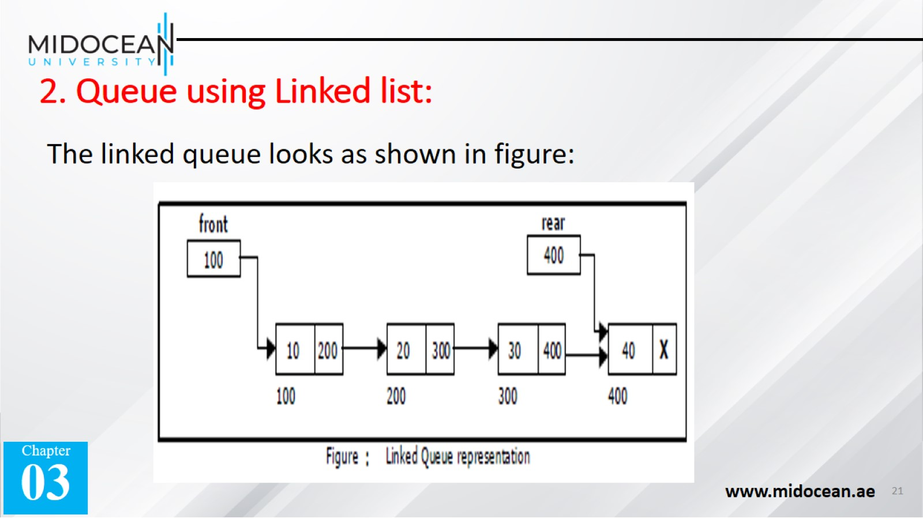
2. Queue using Linked list:

Slide 22
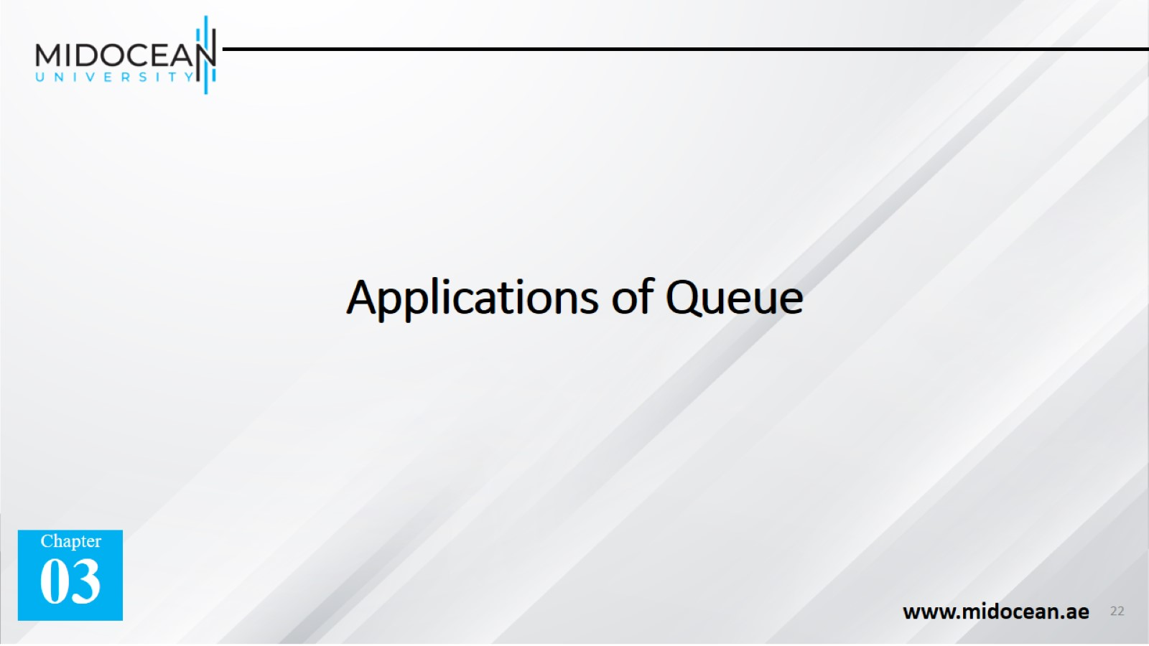
Applications of Queue

Slide 23
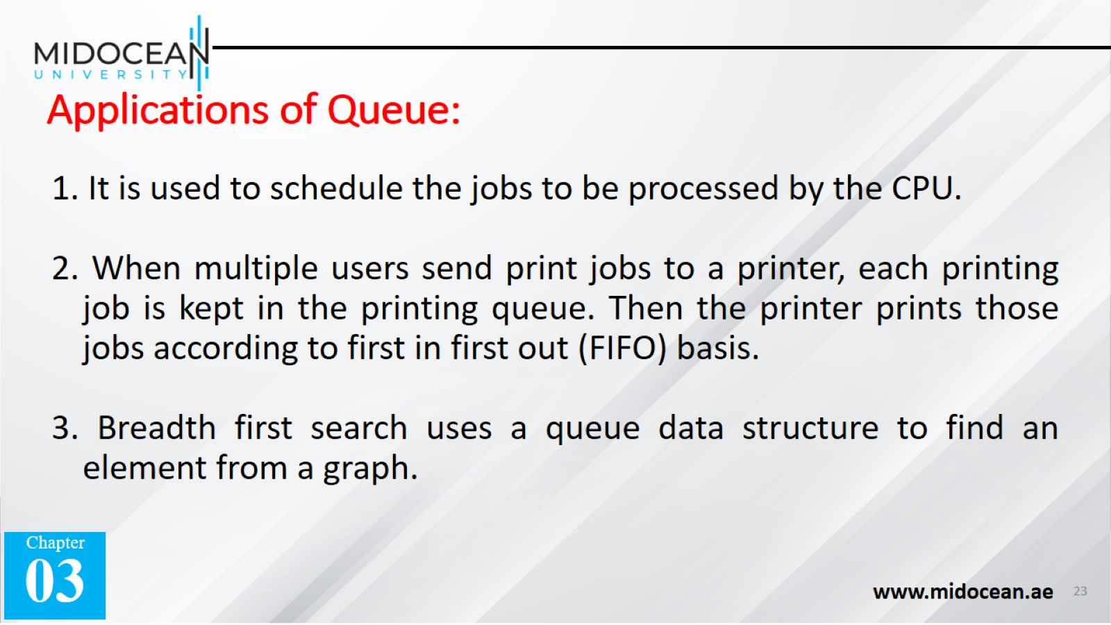
Applications of Queue:

Slide 24


Slide 25
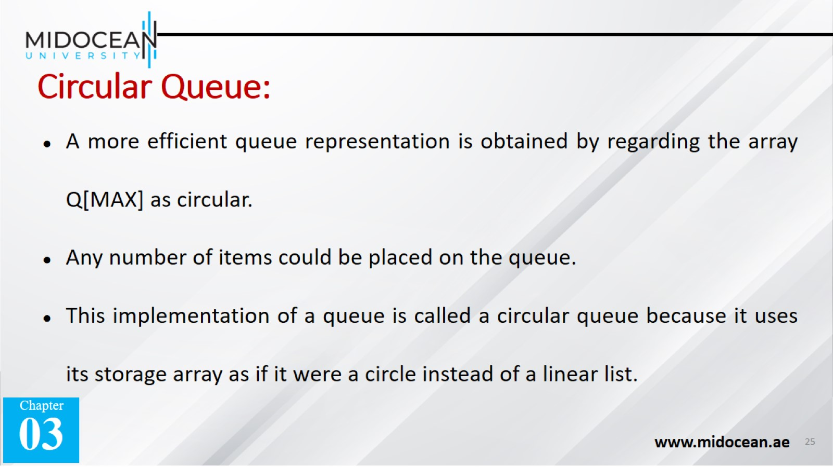
Circular Queue:

Slide 26
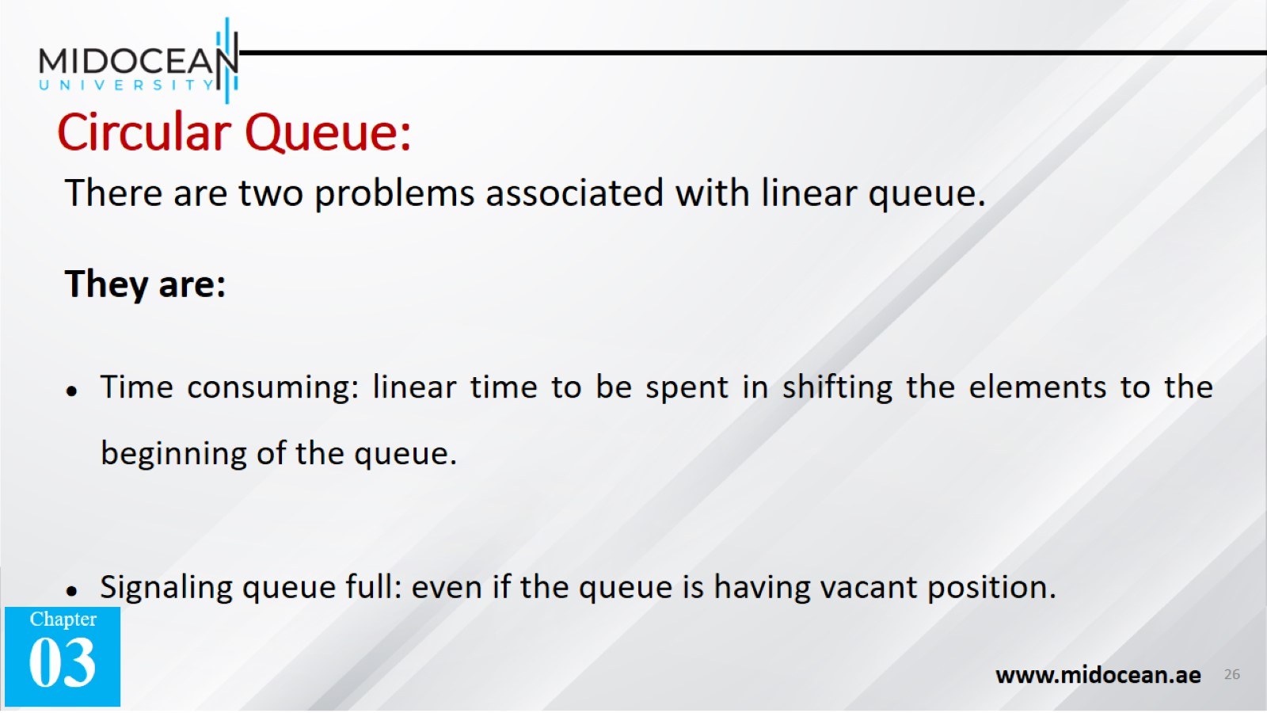
Circular Queue:

Slide 27
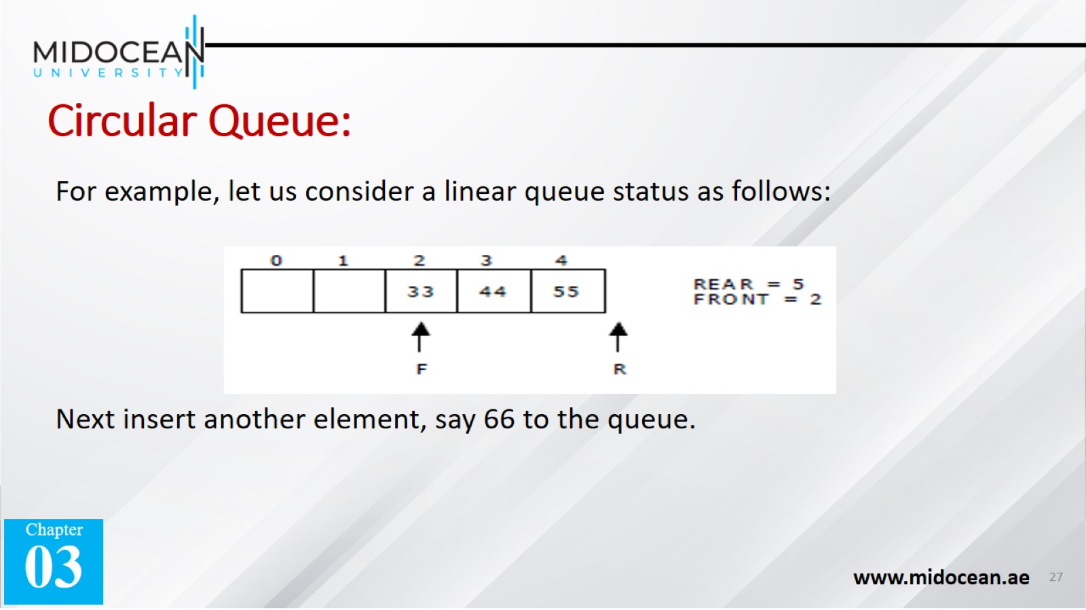
Circular Queue:

Slide 28
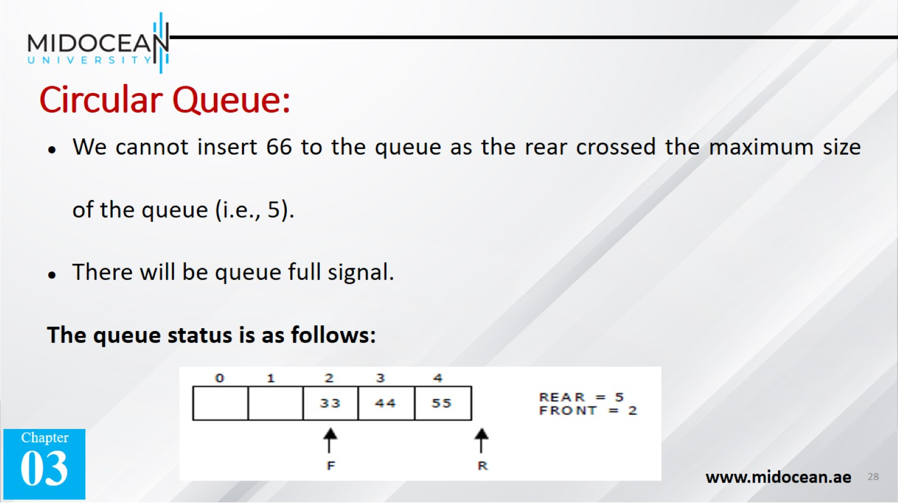
Circular Queue:

Slide 29
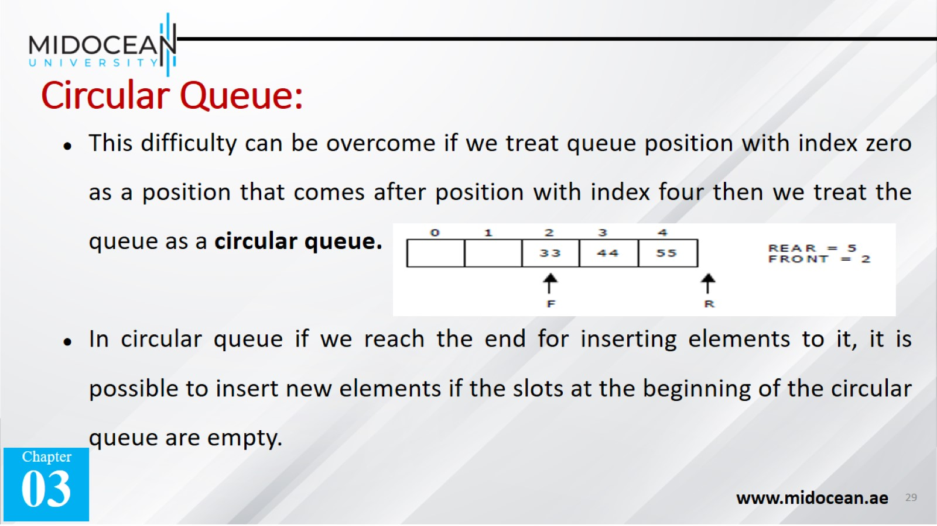
Circular Queue:

Slide 30
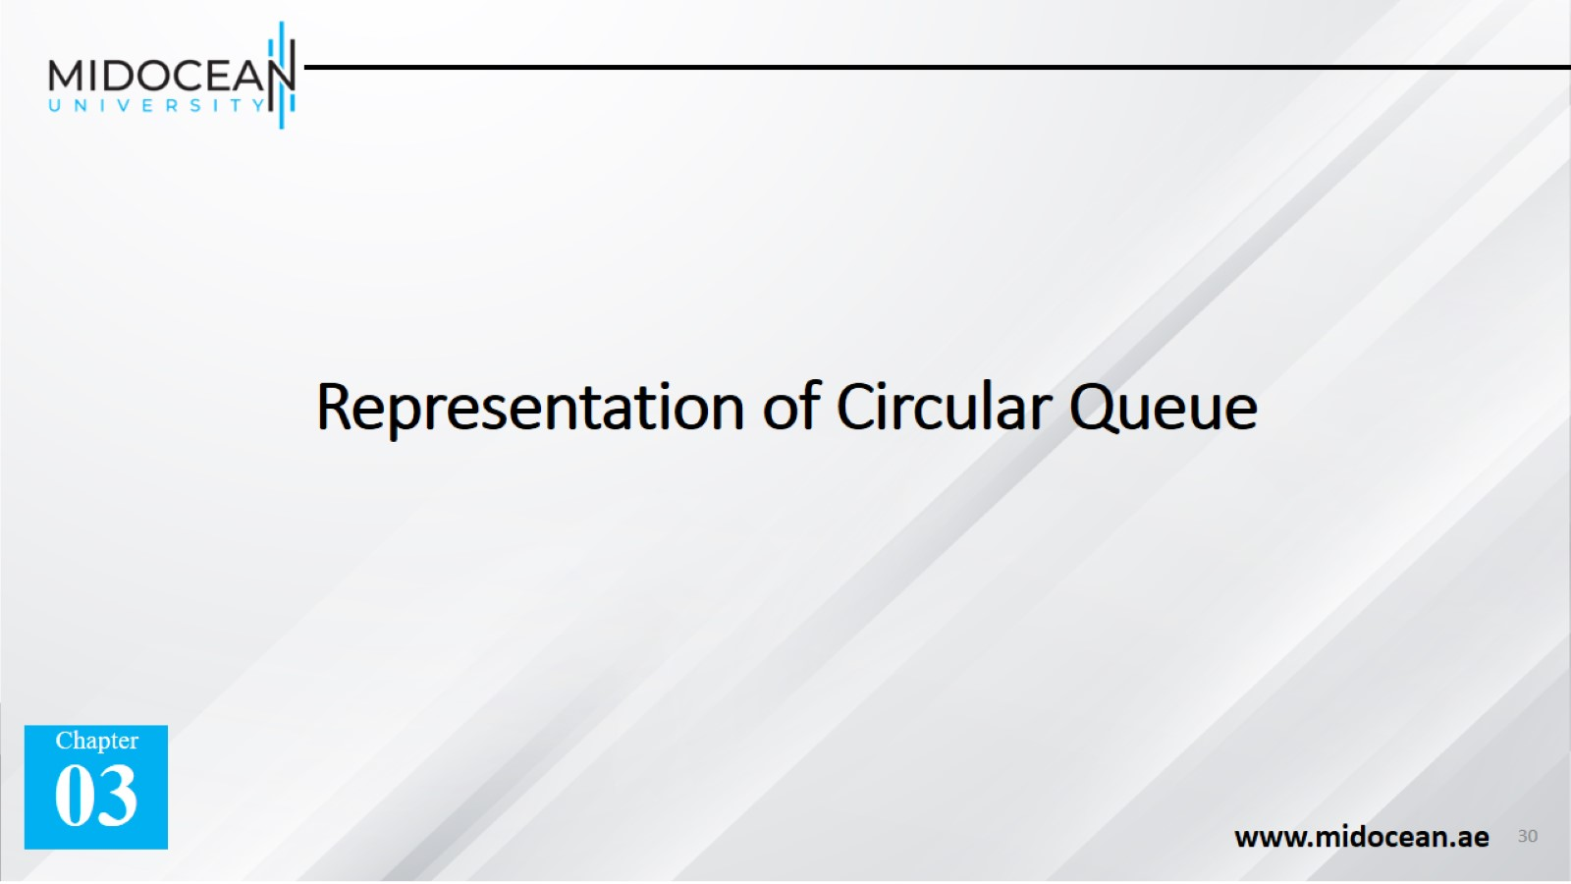
Representation of Circular Queue

Slide 31
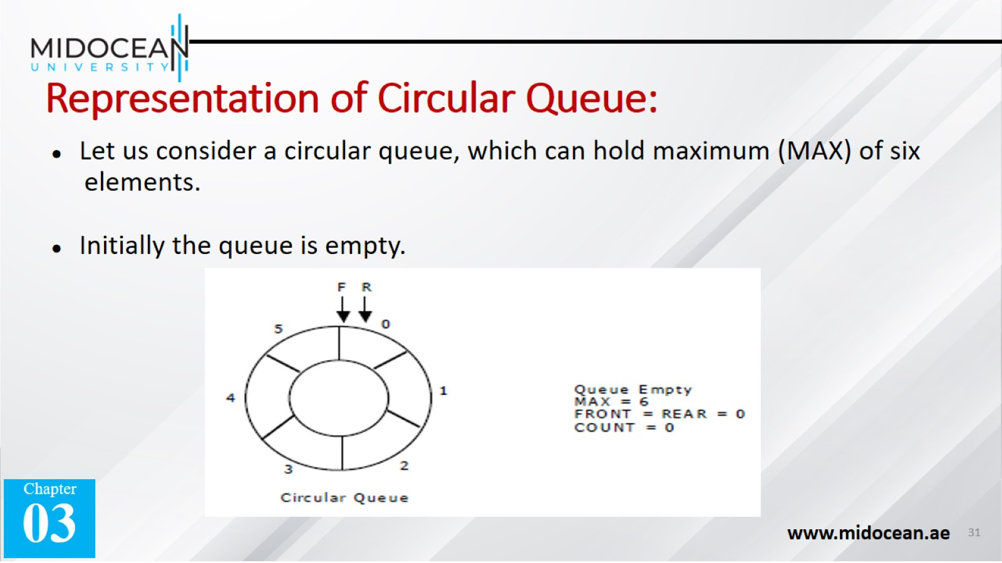
Representation of Circular Queue:

Slide 32
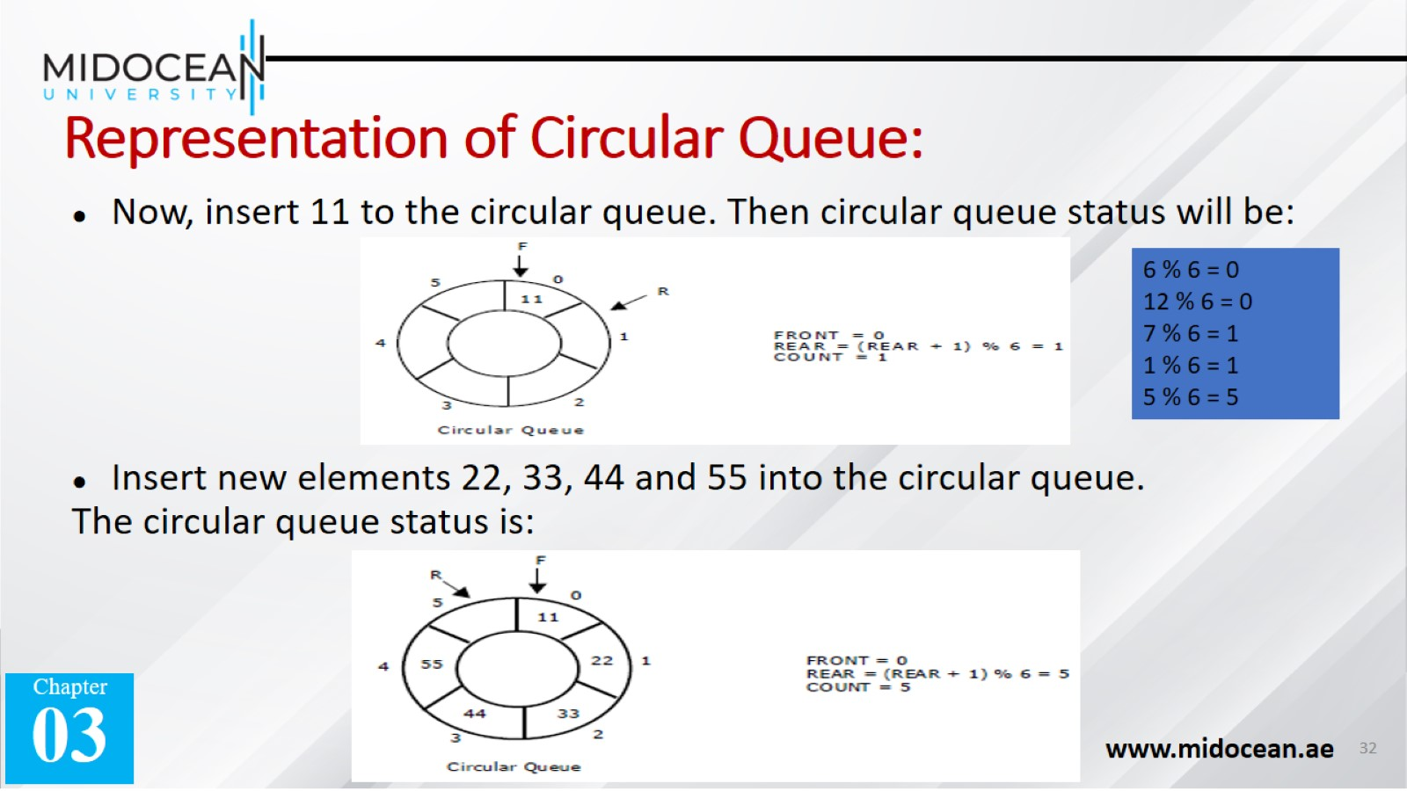
Representation of Circular Queue:

Slide 33
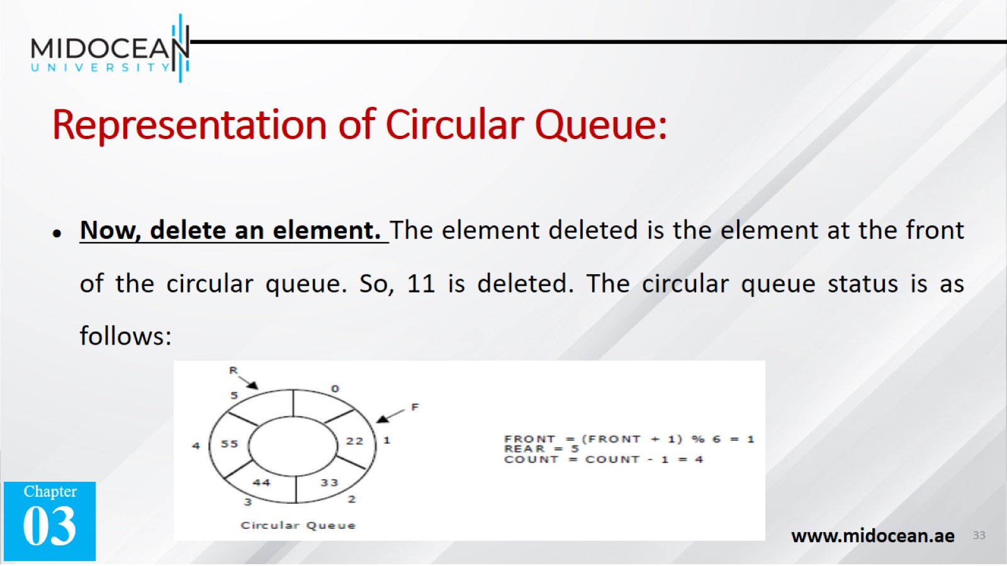
Representation of Circular Queue:

Slide 34
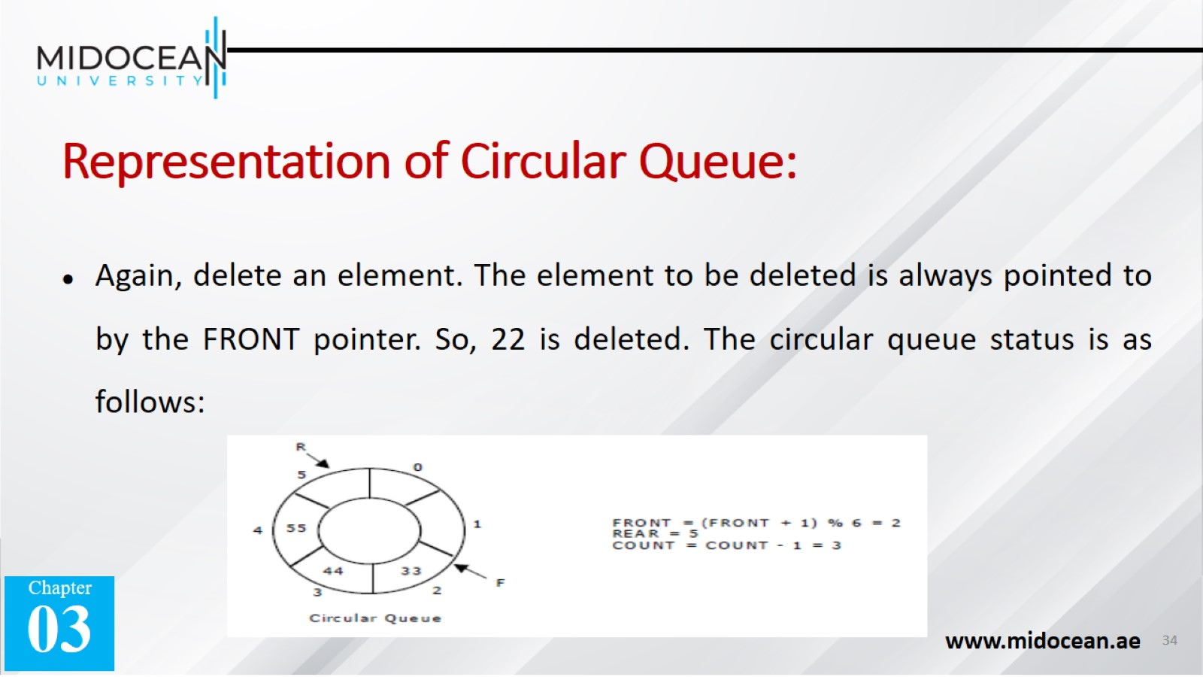
Representation of Circular Queue:

Slide 35
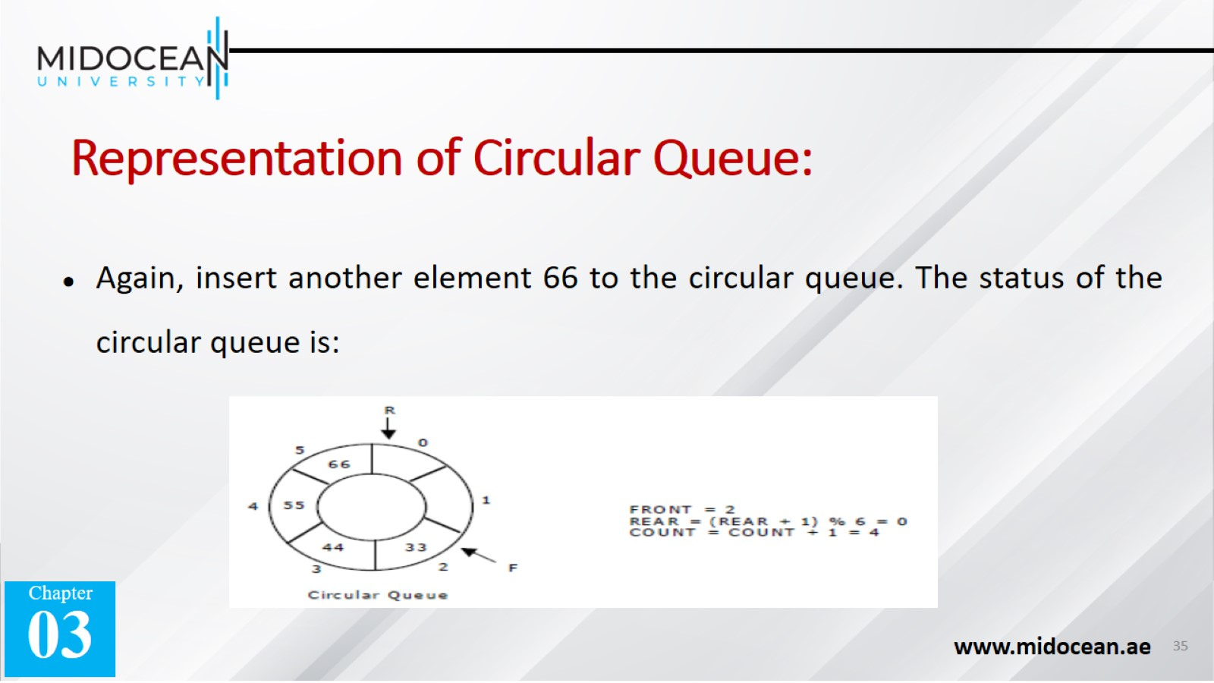
Representation of Circular Queue:

Slide 36
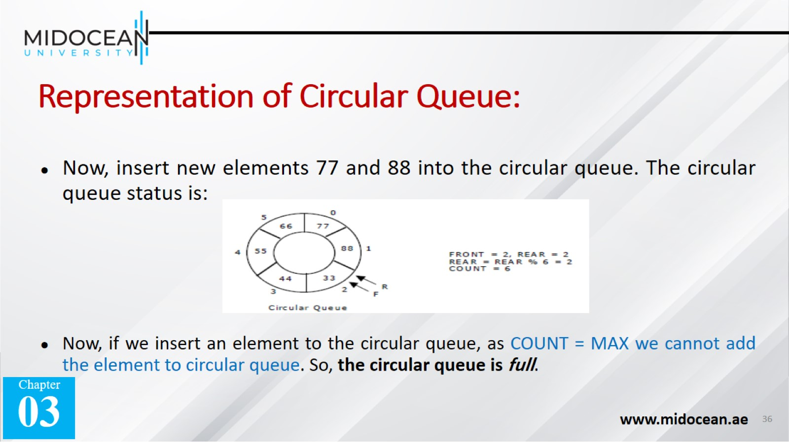
Representation of Circular Queue:

Slide 37

Operations on Circular queue

Slide 38
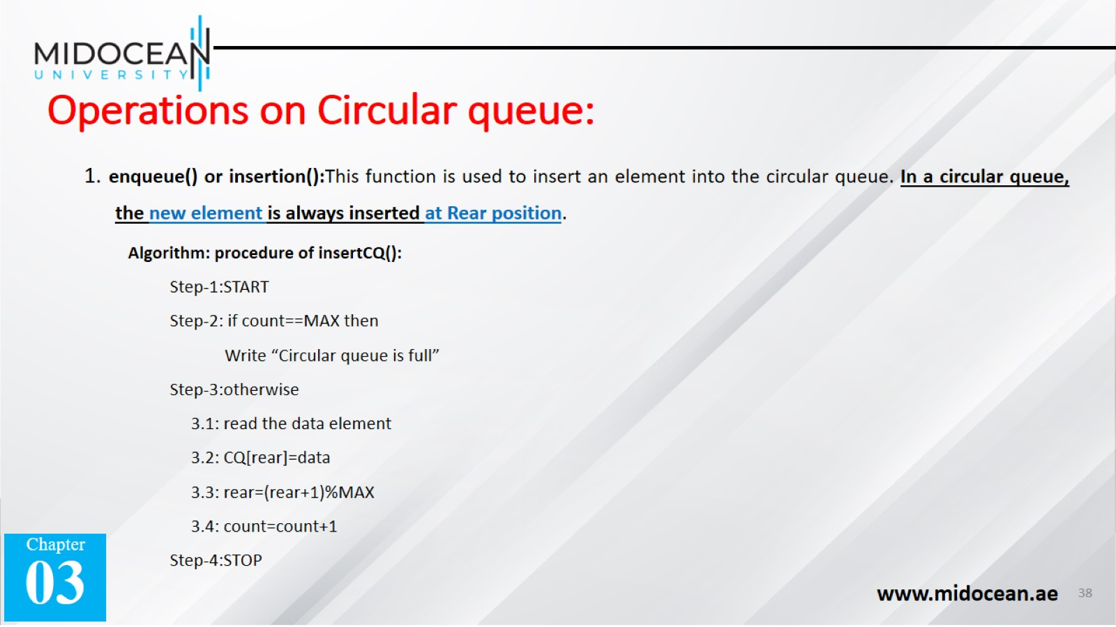
Operations on Circular queue:

Slide 39
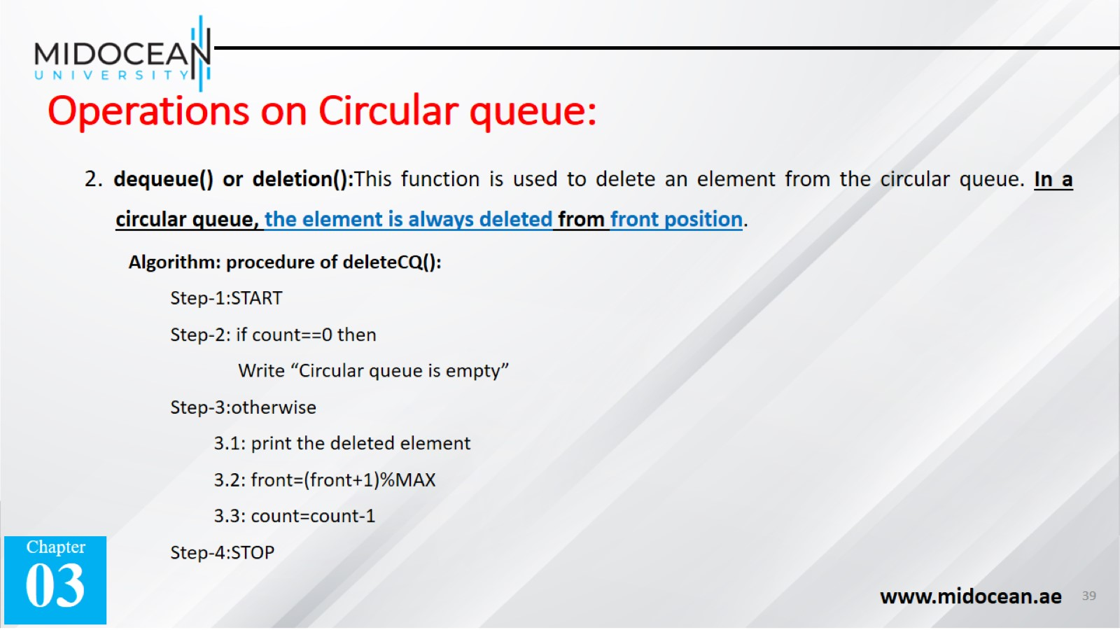
Operations on Circular queue:

Slide 40
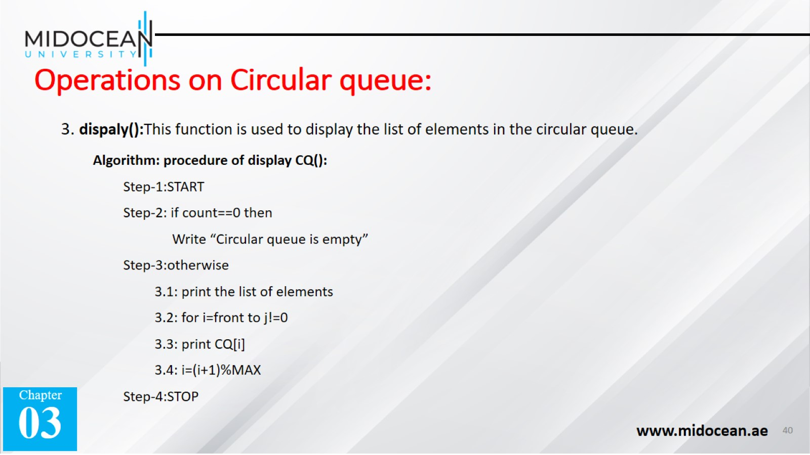
Operations on Circular queue:

Slide 41


