Slide 1



Project Planning
Orientation Lecture
PMG202
Prepared by
Lec. Dina ElWakkad
www.midocean.ae

Slide 2


GENERAL INFORMATION
Course Name: Project Planning
Course Instructor: Dina Samir ElWakkad
Email: dina.elwakkad@esu.ac.ae
www.midocean.ae

Slide 3
GENERAL INFORMATION
v
ترفع المحاضرات الأسبوعية علي المنصة التعليمية Moodleيوم السبت من كل أسبوع في تمام الساعة 12 ظهرًا بتوقيت الرياض
www.midocean.ae

Slide 4
GENERAL INFORMATION
v
حلقات النقاش وهي حلقات أسبوعية اختيارية للطالب وغرضها مناقشة ما تم طرحه خلال المحاضرة المسجلة لكل أسبوع ستكون بأذن الله علي رابط زوم والذي سوف يتم الإعلان عنه علي المنصة التعليمية Moodle
www.midocean.ae

Slide 5
GENERAL INFORMATION
v
يفتح الاختبار القصير الأسبوعي يوم السبت في تمام الساعة العاشرة مساءً وهو متاح لمدة أسبوع ثم يقفل يوم السبت الذي يليه في تمام الساعة التاسعة مساءً
الاختبار يشمل أسئلة كتابية وصوتية
تعد الإجابة علي الاختبار القصير بمثابة حضور للطلاب والطالبات
الاختبار القصير من 8 درجات (بمجموع 80 درجة)
فترة السماحية للاختبار القصير 24 دقيقة.
www.midocean.ae

Slide 6
Quizzes
v
Exams & Marks | 80% Short exams during the semester
 | 20% Final Exam
www.midocean.ae

Slide 7
Course Content
LEC 1 - Project Preparation and Implementation Plan
LEC 2 Project Initiation
LEC 3 Feasibility Study
LEC 4 Project Planning- Risk management
LEC 5 Project Planning- Quality management
LEC 6 Project Planning- Human Resource management
LEC 7 Project Planning- The Project Schedule, and budget
LEC 8 Project Execution
LEC 9 Monitoring & Controlling
LEC 10 Project Closure
www.midocean.ae

Slide 8
Learning Outcomes
At the end of this course, students should be able to:
How to initiate, define and organize a project.
How to develop a project plan, including scoping, sequencing tasks, and determining a critical path.
How to assess, prioritize and manage project risk.
How to execute projects and use the earned value approach for monitoring and controlling progress.
www.midocean.ae

Slide 9
What is the meaning of a Project?
Project:
A piece of planned work or an activity which is done over a period of time and intended to achieve a particular purpose.

Slide 10
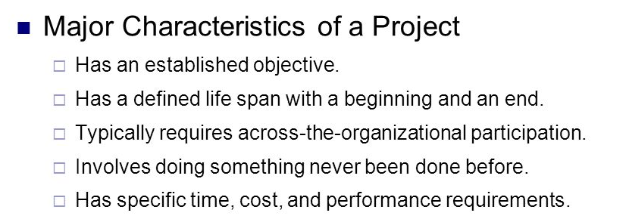
What is the meaning of a Project?

Slide 11
What is the meaning of a Project Planning?
Project Planning:
Project planning is a crucial part of project management focused on creating a detailed plan that outlines the steps and resources necessary to achieve the project's objectives, including identifying the project's scope, establishing a timeline, assigning tasks and resources, and budgeting for the project

Slide 12
What is the meaning of a Project Planning?
Project Planning:
After the project charter is approved, the Project Initiation phase is complete, and you are ready to proceed to the Project Planning phase.
When the Project Planning phase is complete, you are ready to proceed to Project Implementation.

Slide 13
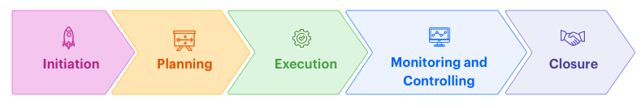
What is the meaning of a Project Planning?

Slide 14
What is the meaning of a Project Planning?
Purpose of the project planning phase
Establishing business requirements.
Establishing cost, schedule, list of deliverables, and delivery dates.
Establishing resources plan.
Getting management approval and proceeding to the next phase.

Slide 15
What are the responsibilities of the project manager?
Budget and cost Control
Allocating resources
Tracking project expenditure

Slide 16
What difficulties will the project manager face?
Managing team members as they come from different departments
risk of instability in the team
Create an effective team environment
Building a team from a group of individuals who do not know each other
Poor communication and information exchange due to team members not knowing each other
Create a team identity to encourage team members to meet regularly

Slide 17
What approach best suits your role as a project manager?
There is no specific appropriate method to follow, the appropriate method is the one that works with individuals at some point in time.
The project manager must know the appropriate method at the right time to obtain the required results.
And all this because:
    The nature of work with time and cost
    The difference in the skills and experience of individuals whom you do not know well in the initial stages

Slide 18
What approach best suits your role as a project manager?
Therefore, we must focus on three aspects:

Slide 19
What approach best suits your role as a project manager?
Ensure that all project work is clearly defined and completed on time according to the required quality.
Ensure good coordination of work and distribute it equitably among team members to encourage them to work together effectively.
To ensure that each team member understands their role and responsibilities and is given direction and opportunity to develop their skills.

Slide 20
How to become a successful project manager?
To be a responsible, effective, and non-hesitating person.
To be someone who can do anything.
To be clear and specific.
See people as your helpers, not your enemies.
respecting others
think more
Think about the details
Advertising good performance
Be a manager and leader

Slide 21


Slide 22
Questions
A___________ is a set of activities which are networked in an order and aimed towards achieving the required goals.
A) Project
B) Process
C) Project management
D) Project Cycle
Which of the Following is / are the responsibility/ies of the project manager?
Budget and cost Control
Allocating resources
Tracking project expenditure
All answers are correct.

Slide 23
Questions
Following are the stages of the project?
Initiation, planning, execution, monitoring and controlling, closure.
Designing, planning, execution, monitoring and controlling, closure
Designing, planning, Marketing, monitoring, and controlling, closure
Marketing, planning, execution, analysis, closure
________ is a crucial part of project management focused on creating a detailed plan.
Project Plan
Project
Project management
Project Cycle

Slide 24
Questions
Coordination describes one of the concepts that is crucial for the smooth running of an organization.
ANSWER: False
There is a specific appropriate method to be followed in managing the project.
ANSWER: False
Allocating resources is one of the responsibilities of the project manager.
ANSWER: True
It does not matter that the project manager thinks about the details
ANSWER: False

Slide 25


Thank You

