Slide 1

Lecture 2
Vision and Communication

Slide 2

Lecture outline
Lec.2
Know about
Are you a Leader?
How to Be a Leader?
Developing a Vision
Understanding People's Needs
Influencing People
Communication
  Definition
    Elements of Communication

Slide 3
Introduction & Learning Outcomes
Learn how to gain more followers, members, and support for your organization by learning how to develop and communicate your organization’s vision.
Learn how to understand people’s needs and be prepared to act on those needs to boost morale and successfully reach your organization’s goals.
Learn how to influence an audience successfully by using our overview of some general ideas behind the science of persuasion.
Lec.2

Slide 4


Lec.2

Slide 5

Lec.1
Jack Ma Life Story ( CEO of Alibaba)

Slide 6

Live
للاستزادة
Lec.2
Case Study
Amani ElTunsi

Slide 7

Live
للاستزادة
Lec.2
Case Study
Entrepreneur:
Amani ElTunsi
The owner of Banat9Bas online radio station and Shababooks publishing house

Slide 8
Live
للاستزادة
Lec.2
Background
Amani ElTunsi graduated from computer science in 2004.
She worked in advertisements designing since 2000 (before her graduation).
She said that : "However, I got good grades in my study; I preferred to be designer than programmer. After 2004, I worked as advertisements designer and art director in magazines.“
The idea
Although the readers of the magazine, that Amani worked in , were asking the magazine to discuss some issues, the owner ignored it in order to focus on issues that bring ads.
Because Amani was caring about women issues, when she was listening to international online radio stations, she asked herself : "can I make something to girls in Egypt to be listened in the entire world?"

Slide 9

Live
للاستزادة
Lec.2
Banat 9 bas station
Amani aimed through the station to gather girls to express themselves and their problems. Amani said that: “girls should have the chance to find others who can reply them and suggest solutions. At this time, I felt I want to do something to girls. So, I decided to make online radio station.”
Amani aimed to target women in Arab countries even who are living outside their country.
She started designing the station's website in May 2004 and called all her friends in the magazine -that she worked at- and they supported the idea.
She launched the station's website in June 2004 and she got 15 thousands visitors and listeners by launching the first program.
Then the famous Egyptian talk show El Bait Baitak interviewed the station team; most of the team was Amani’s friends from the magazine that she worked at.

Slide 10
Live
للاستزادة
Lec.2
Challenges
The magazine's owner fired Amani from the magazine after watching her with most of her stuff in El Bait Baitak TV show.
Amani said in sorrow “What happened affected me too much.”
Financial Challenges
She took a loan from the bank then sold her car and bought a smaller one.
In 2009 , she lost the advertisers due to the global economic crisis happened.
Technical Challenges
when the money was finished, the live streaming of the broadcast stopped because, it is expensive. She said: "It was the most dramatic sad moment."

Slide 11

Live
للاستزادة
Lec.2
Turning Point
The meeting with Mostafa Fathy, the managing editor of the magazine that she was fired from, is a turning point in her life.
She found that he also was fired from the magazine because, he wrote a book and wanted to publish it.
"Because he is creative, he was fired," said Amani sarcastically .

Slide 12

Live
للاستزادة
Lec.2
Turning Point
She decided to establish youth book publishing house. She called it ShabaBooks , and this is referring to books published by and to youth.
She suffered to find a printing house that accepts to print the book.
After printing it, the bookstores refused to buy the book so; she was disappointed .
She decided to market the book on the station’s website.
Then, she received many orders and delivered it by herself.
Many people asked about the book in the bookstores which push book stores to ask for buying it.
She admired the idea of publishing books because she got money supported her station.

Slide 13


Live
للاستزادة
Lec.2
Amani wrote two books:
This book translated into
English and German

Slide 14

Live
للاستزادة
Lec.2
Awards
May 2010, the BMW Foundation Young Leaders Award.
Nov. 2010, the designation of the smallest publisher in the Middle East by the European Union.
September 2011, World Summit Youth Award (WSYA) under the category of power to women.
  Amani said proudly: "There were 999 people from the world nominated to (WSYA) award and only four were the winners I was one of them."

Slide 15

Live
للاستزادة
Lec.2
Success
Amany ElTunsi said that:
"I see my success secret lies in my insistence to succeed and hating failure."

Slide 16
Live
للاستزادة
Lec.2
Conclusion
Finally, Amani achieved success:
Success
Strong will
vision
Facing challenges
Flexibility

Slide 17

Live
للاستزادة
Lec.2
What’s your expectations about her success now?

Slide 18
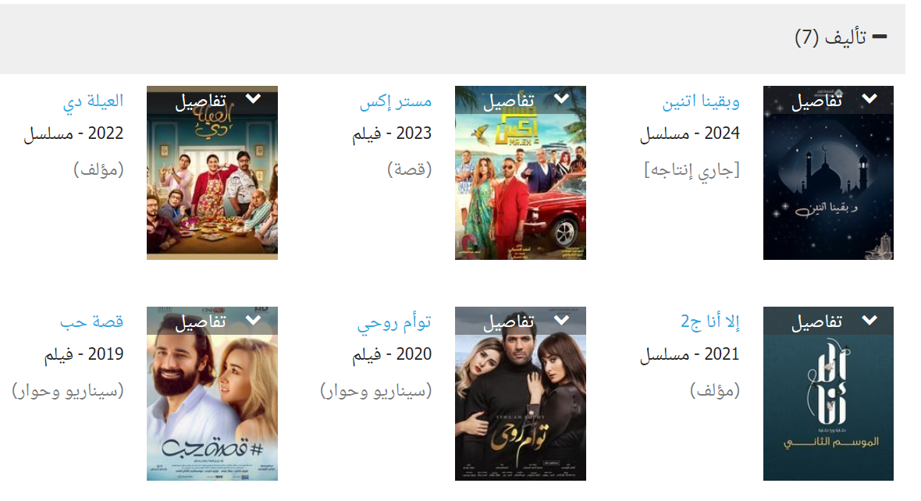
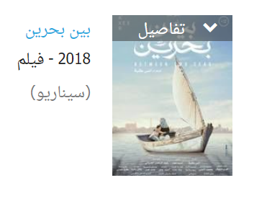
Live
للاستزادة
Lec.2
What’s your expectations about her success now?
أماني التونسي، مؤلفة وكاتبة مصرية، كتبت سيناريو فيلم بين بحرين عام 2018، وسيناريو وحوار فيلم قصة حب عام 2019، وسيناريو وحوار فيلم توأم روحي عام 2020.
Influence Audience

Slide 19
Lec.2
Are you a Leader?

Slide 20

Lec.2
Are you a Leader?
Are you someone who:
  Wants to improve your community?
  Has something to contribute?
  Doesn't wait around for someone else to get the job done?

Slide 21
Lec.2
How to Be a Leader?

Slide 22
Lec.2
How to Be a Leader?
Why should you be a community leader?
  To make a difference.
  To grow.
  To fill the need for community leaders.

Slide 23
Lec.2
How to Be a Leader?
You can always lead
When should you Lead?
If you take initiative to improve a situation, you will almost always delight, relieve, and surprise people.
You don't have to take over someone's leadership role in order to help things go well. In fact, one way of helping a group function better is by supporting the official leader. You can do this by organizing others to help with the work, by listening to the leader, and by encouraging the leader when she or he feels discouraged.

Slide 24
Lec.2
How to Be a Leader?
How do people learn how to lead?
Even the people who seem to do it naturally had to learn the skills of leadership. They might have learned by watching their parents, teachers,…... They might have been given a lot of responsibility when they were young and might have been expected to take charge.
You can become a leader by:
        Jumping in and practicing
        Observing others lead
        Finding a mentor
        Taking a class or workshop
        Reading books about leaders and leadership
        Remembering that people who are now successful leaders, once weren't leaders at all

Slide 25
Lec.2
How to Be a Leader?
  Dream big
      Maybe you didn't think that day dreaming was part of being a leader. Young people often have big hopes and dreams for what they can do to improve their worlds.
  Listen to people
      Listen to what people have to say. You need their thoughts and input. They will grow in confidence and become more engaged if they know their opinions are valued.
  Take responsibility
      You have to make a decision to lead and view yourself as a community leader. No one else can contribute what you can. You have a point of view that no one else has. You have a set of skills that is unique. Your corner of the world will be different if you decide to act on its behalf.

Slide 26
Lec.2
How to Be a Leader?
  Set goals
    Give your vision a sharper image. Turn up the focus. Set some long-term and short-term goals. That is how you carve a real path to your vision.
  Think about individuals
    As a leader, you need to think about how each individual is affecting the group. Are there individuals whose talents are not being well used? Is someone acting in a way that is divisive or is draining the group of its energy? Is there a person who needs some help learning how to work in a team?
  Think about the group as a whole
    Someone has to think about the group as a whole. Is the group cohesive? Do people in the group have a shared vision? Is there trust and a sense of mutual support? Does the group need some training to help it function better? Are there some policies the group needs to strengthen it?

Slide 27
Lec.2
How to Be a Leader?
  Propose programs
    Groups need direction and policies to keep them moving towards their goals. You don't have to be a dictator to make proposals. You can make proposals, then listen to people's responses and then make appropriate changes. Someone needs to take responsibility for moving the whole group forward.
  Get the work done
    This includes getting others to help and making sure that all the bases are covered so that the job gets done right.
  Recruit and teach others to become leaders
    One of the central and long-term jobs of a community leader is to develop other leaders. Developing leaders is how we build a strong community of individuals that can work together to achieve goals. It is the basis for how a democracy works.

Slide 28
Lec.2
How to Be a Leader?
  Leadership development is a long-term investment. Often community leaders have to put the development of other leaders ahead of achieving short-term goals.
    For example, it may be more important to take the risk of letting a relatively inexperienced person chair a small meeting and acquire new skills. If the meeting gets messy, perhaps that is not so bad. Leadership development is not a tidy endeavor.

Slide 29
Lec.2
Leader’s Qualities

Slide 30
Lec.2
Qualities of successful leaders
Integrity
Courage
Commitment
Care for others
Creativity
Flexibility
نزاهة
شجاعة
التزام
رعاية الآخرين
إِبداع
المرونة

Slide 31
Lec.2
Qualities of successful leaders
Integrity: To trust you, people have to know that you say what you believe and act accordingly. If people trust you, they may follow you to the ends of the earth.
Courage: Leadership means that you show others the way through the dark, scary, forest. Go ahead and speak the truth--even when it's not popular.
Commitment: You have to stick with a task through the good times and the bad. Your commitment will serve as a model.
Ability to care about others: People will follow you if they know you care about them and about others. The greater your ability to care about all types of people, the more confidence they will have in you.
Creativity and flexibility: Every situation will call for a different response. Be ready to change and come up with new solutions.

Slide 32
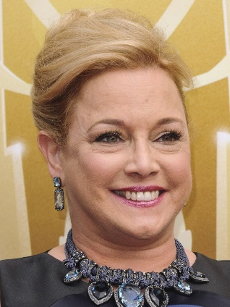
Lec.2
How to Be a Leader?
If you are going to be a leader, it is necessary to dream big for yourself and for what you want to accomplish.
Lili Fini Zanuck, a film director and producer, said, "Nothing happens without a dream. The daydreaming mind will wander to something greater than the conscious mind could ever have imagined. The more you visualize your dream, the more you understand it. That's how you begin. Soon you're on the road to realizing your dream."
"لا شيء يحدث بدون حلم. سوف يهيم العقل الحالم إلى شيء أعظم مما يمكن أن يتخيله العقل الواعي. كلما تصورت حلمك أكثر، كلما فهمته أكثر. هكذا تبدأ. وسرعان ما تكون على الطريق إلى تحقيق حلمك."

Slide 33

Lec.2

Slide 34
Lec.2
How to Be a Leader?
Try these exercises:
  Interview a young person. Ask him or her what they would do to change the world if they could. Ask them what they wish were different.
  Try to remember when you were a teenager. What did you want to change in the world?
  Put aside practical considerations and fears. Brainstorm a list of dreams you would like to see come true.

Slide 35
Lec.2
Developing a Vision

Slide 36
Lec.2
Developing a Vision
What is a vision?
  It is a statement that communicates how you would like things to be.
  A vision is your big picture of the way things ought to be. It is your billboard image of what you are working towards.
What is the vision process?
  Developing your vision.
  Communicating your vision to others.
  Developing the group's vision.

Slide 37
Lec.2
Developing a Vision
Why do you need to communicate a vision to others?
  People have to know what direction you’re going in before they will follow you.
When do you need to communicate your vision?
  All the time.

Slide 38
Lec.2
Developing a Vision
How do you create a vision?
  Dream big
  Brainstorm many ideas
  Clarify your vision
  Trust your hunches
  Think without limits
إطمح للكثير
طرح العديد من الأفكار
وضح رؤيتك
ثق بحدسك
فكر بلا حدود

Slide 39
Lec.2

Slide 40
Lec.2
Developing a Vision
Exercise
  What do you envision for yourself in the next five years?
    • How do you want to grow?
    • What do you envision for your work?
    • What do you envision for your family life or friendships?
    • What do you envision for where you live?
    • What do you envision for fun and recreation?
    • What do you envision for yourself as a leader?
  A vision for your own life is simply a picture of where you want to be in the future. And a vision for your community, group, or organization is simply your picture of where you want that group to be in the future.
تصور

Slide 41
Lec.2
Developing a Vision
Help people take ownership of a vision
As a leader, you have to help people take your vision and make it their own. This is an important step in bringing people together to work toward a common goal.
Members of a group need to have a shared vision and a sense of ownership in order to be committed to the group. That is key in helping people stay with a group for a long time.

Slide 42
Lec.2
Understanding People's Needs

Slide 43
Lec.2
Developing a Vision
Kinds of needs:
  Large-scope community needs. احتياجات المجتمع واسعة النطاق
  Root or causal needs. ("real needs“, basic facts and knowledge)
  Informational needs. (basic facts and knowledge)
  Physical needs. (money for the organization, volunteers,…)
  Personal needs. (appreciation, understanding, personal caring, etc.)
الاحتياجات الجذرية أو السببية
الاحتياجات المعلوماتية
الاحتياجات المادية
الاحتياجات الشخصية

Slide 44
Lec.2
Developing a Vision
Why should the leader try to understand people's needs?
  To keep the group moving forward towards shared and desired goals.
  To strengthen connections with the group and increase the likelihood of success .
  To keep morale high. إبقاء الروح المعنوية عالية
  To reinforce members' belief in the leader.

Slide 45
Lec.2
Developing a Vision
Understanding people's needs:
  Ask people their needs.
  Maintain good relationships.
  Do your research.
  Make connections.
  Be accessible.
  Institutionalize the process of getting feedback.
  To reinforce members' belief in the leader.

Slide 46
Lec.2
Influencing People

Slide 47
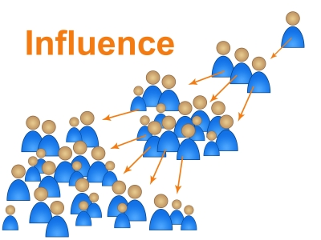
Lec.2
Influencing People
Influence:
    Is the ability to persuade someone to act or think in the way you want.
  Elements of influence
    Communicator
    Message
    Audience

Slide 48
Lec.2
Communication

Slide 49
Lec.2
Communication
Communication = sending ideas and opinions from one person to another.
People communicate by…talking, writing, moving bodies or eye contact.

Slide 50
Lec.2
Communication
Importance of Communication
Communication is important for all beings that lead community life and form relationship.
Communication is essential for development of the society. We attain cultural, social and economic prosperity by sharing out experiences.
How can we share experience without better communication?
Personal enjoyment is communication based. Communication helps us interact with our surroundings, thus create positive relationships, share love and build up friendship to enjoy life.

Slide 51
Lec.2
Elements of Communication

Slide 52
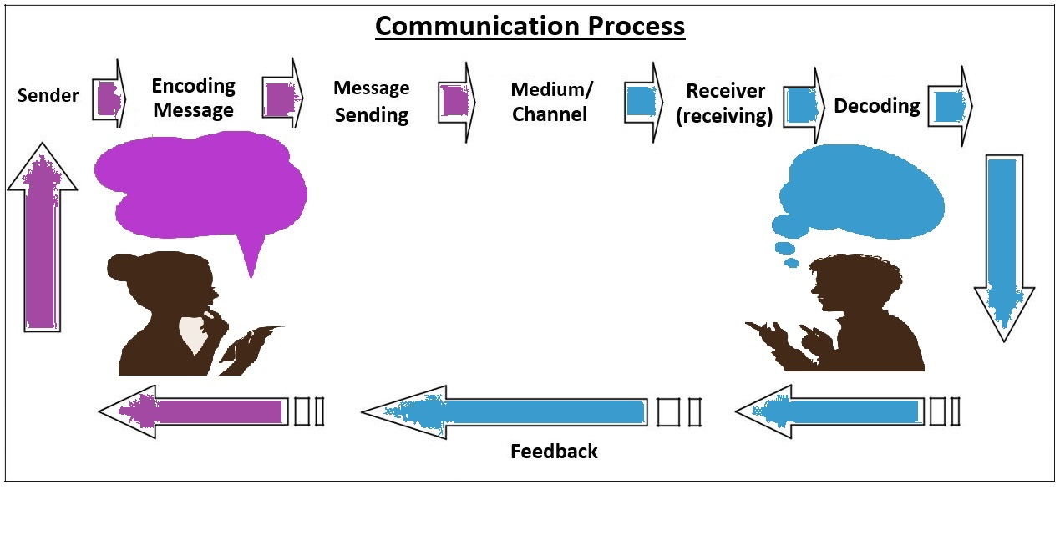
Lec.2
Elements of Communication
a) Sender
b) Message
c) Channel
d) Receiver
e) Noise
f) Feedback
g) Context
h) Effect

Slide 53
Lec.2
Elements of Communication
A) Sender:
Sender may be a person or persons who create or formulate the message to be sent to the receiver. Being the primary source of the message, sender is also termed as source.
In mass media, for example, news reporter is the sender or source as he/she constructs the message (news story).
In a musical performance, the singer is the sender as his message is enjoyed by the audience.

Slide 54
Lec.2
Elements of Communication
A) Sender:
Sender is a critical component in communication as his/her social background, personality status, education etc., influence the quality of the message he/she creates. The message is created from the idea generated in the mind of the sender. The idea generation process is called encoding.
The source/sender has three functions:
  a) To decide what is to be communicated
  b) Encoding (Put the idea in such a way that the receiver understands it)
  c) Transmitting the message to the receiver

Slide 55
Lec.2
Elements of Communication
B) Message:
The message is any verbal or non-verbal method that produces meaning in the mind of the receiver. Simply, it is the meaning transferred from sender’s mind to receiver’s mind. This happens mainly in two ways: verbal and non-verbal methods.
Verbal message means written or oral messages. They are composed of words. Example: A newspaper report or a lecture by a teacher.
Non-verbal messages are those communicated through our behavior, movements, actions, clothes, style of conversation, pitch of the sound etc.

Slide 56
Lec.2
Elements of Communication
B) Message:
      What is fundamental in message construction is the agreement between sender and receiver in the code used for it.
                What is the Code?
                Symbols of the Language used in the message
                If the receiver cannot identify the language or meaning of the message, the communication will be defective.

Slide 57
Lec.2
Elements of Communication
C) Channel:
The channel means medium by which sender transmits the message to the receiver. Our five senses such hearing, touching, smelling , tasting , seeing are basic natural channels of human communication. Communication can be classified based on five basic natural channels. They are:
  Tactile communication: Communication by touch or taste
  Olfactory communication: communication by smell
  Audio communication: Communication through sound waves
  Visual communication: Communication through visual elements.

Slide 58
Lec.2
Elements of Communication
C) Channel:
We use any technically developed medium (like television, newspaper, books etc) with the help of one or more of these five senses.
Similarly, sender uses one or more channels to maximize the communication effect.
For example: multimedia classroom where teacher uses projector, blackboard, lecture, gestures etc. simultaneously.

Slide 59
Lec.2
Elements of Communication
D) Receiver:
Idea receiving end in communication process is called receiver. A person or thing may be at the receiving end. The receiver’s role is as important as a sender’s role. As in the case of a sender, receiver has also three roles to play:
To receive the message
To decode the message
  Decoding is the process of extracting a message from a code and interprets it. For this, sender and receiver should have knowledge about the code (for example: language) used in communication.
c) To respond to the message through feedback

Slide 60
Lec.2
Elements of Communication
D) Receiver:
Receivers may be audience watching movies, persons listening to music, students hearing a lecture or a computer getting E-mail from a remote server.
Communication fails or remains faulty when message is rejected or misinterpreted by the receiver.

Slide 61
Lec.2
Elements of Communication
E) Feedback:
Information or message that is fed back to the source is called feedback. If you get clapping for your singing, clapping is the feedback. Questions raised by students in a classroom for more information is another example for feedback.
Feedback originated either from the sources’ own message is called self feedback.
Example: When you talk to somebody, you hear yourself and evaluate your tone, pitch etc.

Slide 62
Lec.2
Elements of Communication
E) Feedback:
Sometimes you may think that you could have sharpened or softened your tone or pitch or text, because of your own feedback.
Another type of feedback is that originated from the receiver. It may be in the form of questions, applauses, puzzled look etc.
Feedback may be negative or positive, immediate or delayed.
Receiver’s indication to the sender that the message was not received well is called negative feedback.
Eg. Looks of indifference, rejection or boredom may be considered as negative feedback.

Slide 63
Lec.2
Elements of Communication
E) Feedback:
Receiver’s favorable responses like acceptance, applauses etc.
are positive feedback.
Feedback at the time of the communication itself or just after
it is immediate feedback.
Eg. Applauses a singer gets during the performance.
Receiver’s response relatively much after the communication
is delayed feedback.
Eg. Letters to the Editor.

Slide 64
Lec.2
Elements of Communication
F) Noise:
Noise or communication barrier is any thing that distorts message. Noise may originate in any of the components of communication like source, message, channel, context, receiver etc.
Noise is present when there is difference between the message sent and received.
Communication is not possible without noise, but its effects may be reduced through various methods such as using good grammar, clear voice, simple language, quality signal etc.
Noise is of different types depending on the nature and reasons of the distortion.

Slide 65
Lec.2
Elements of Communication
F) Noise: There are four types
تشويش القناة/تقني
Psychological noise | Semantic noise | Contextual noise | Channel noise (Static/Technical)
Any communication error due to the psychological reasons. | Language related problems in communication. | If communication takes place in inappropriate time or place, message is not conveyed well. | Medium related communication barrier.
Eg. A fearful audience can’t enjoy the musical program. | Eg. Poor grammar, complex sentence structure, rare vocabulary etc. | Eg. Wishing compliments during a funeral function. Or An outdoor meeting at noon in a hot summer. | Eg. Poor signal affecting picture clarity of television.
تشويش نفسي
تشويش دلالي
تشويش سياقي

Slide 66
Lec.2
Elements of Communication
E) Context:
Communication takes place in a context. At times it is noticeable and at other times not.
In other words, time, place, culture, physical and social condition and psychology of the participants are important in determining communication effect. If we try to interpret a message out of its context, we may get an entirely different meaning which may result in communication error.
Rules and roles are two important factors related to communication context.

Slide 67
Lec.2
Elements of Communication
G) Effect:
      Why do we communicate? It is a fundamental question.
      To make some effect on the receiver is the answer.
          Effect is consequence or result of communication.
Every communication act makes some effect on the person/s.
Effect may be positive or negative.
Communication is said to be successful when we achieve the intended effect.
التأثير هو نتيجة للاتصال.

Slide 68
Lec.2
Elements of Communication
G) Effect: Communication effects are of three types
Cognitive effects تأثيرات إدراكية | Affective effects تأثيرات عاطفية | Behavioral effects تأثيرات سلوكية
The consequences take place in the receiver’s intelligence due to communication. | The consequences occurred in the emotions of the person/s due to communication. | The change in the receiver’s behavior or actions due to communication.
Example : Knowledge acquisition | Eg. Compassion تعاطف , love etc. | Eg. Political campaign and change in people’s voting behavior or purchasing new products inspired by the advertisements.

Slide 69

Lec.2
Leadership Self-Assessment

Slide 70
Lec.2
Leadership Self-Assessment
How Flexible Are You?
Instructions: To succeed as a managerial leader, a person needs a flexible style: an ability to be open to others and a willingness to listen. Where do you stand on being flexible? Test yourself by answering often, sometimes, or rarely to the following questions.

Slide 71
Lec.2
Leadership Self-Assessment
How Flexible Are You?
8 Statements
Scoring and interpretation:
If you answered "rarely" to seven to eight questions, you are unusually adaptable. If you answered "sometimes" to at least five questions, you are on the right track, but more flexibility would benefit your leadership. If you answered "often" to more than four questions, you have a long way to go to improve your flexibility and adaptability. You are also brutally honest about your faults, which could be an asset.

Slide 72
Lec.2
Leadership Self-Assessment
How Flexible Are You?
Scale Statements
Do you tend to seek out only those people who agree with your analysis of issues? هل تميل إلى البحث فقط عن الأشخاص الذين يتفقون مع تحليلك للقضايا؟
Do you ignore most of the advice from coworkers about process improvements? هل تتجاهل معظم النصائح من زملاء العمل حول تحسينات العملية؟
Do your team members go along with what you say just to avoid an argument? هل يوافق أعضاء فريقك على ما تقوله فقط لتجنب الجدال؟
4. Have people referred to you as "rigid" or "close-minded" on several occasions? هل أشار إليك الناس على أنك " صارم " أو "منغلق الذهن" في عدة مناسبات

Slide 73
Lec.2
Leadership Self-Assessment
How Flexible Are You?
Scale Statements
When presented with a new method, do you immediately look for a flaw? عند تقديم طريقة جديدة ، هل تبحث على الفور عن عيب؟
Do you make up your mind early on with respect to an issue, and then hold firmly to your opinion? هل تتخذ قرارك في وقت مبكر فيما يتعلق بقضية ما ، ثم تتمسك برأيك بحزم؟
When people disagree with you, do you tend to belittle them or become argumentative? عندما يختلف الناس معك ، هل تميل إلى التقليل من شأنهم أو تصبح جدليا؟
Do you often feel you are the only person in the group who really understands the problem? هل تشعر في كثير من الأحيان أنك الشخص الوحيد في المجموعة الذي يفهم المشكلة حقا؟

Slide 74
Conclusion
Lec.2
We learned about
Are you a Leader?
How to Be a Leader?
Developing a Vision
Understanding People's Needs
Influencing People
Communication
  Definition
    Elements of Communication

Slide 75


Lec.2
References
Rabinowitz, P. (n.d.). Leadership and Management chapter 13:16. Community Tool Box. Retrieved January 4, 2023, from https://ctb.ku.edu/en/table-of-contents
Bli-Group-Wp. (2011). Leadership Course material. Amideast Egypt. Business Intelligence, Training & Consulting, http://bli-group.com/
Abou Oaf, M. (2011). Introduction to Mass Communication Course; AUC.
  Biagi, Shirley. ‘Media Impact: An Introduction to Mass Communication,’ 7th ed.
Waggoner, D. (n.d.). Leadership & Executive coaching. Garfinkle Executive Coaching. Retrieved January 31, 2023, from https://garfinkleexecutivecoaching.com/leadership-coaching-that-makes-an-impact

Slide 76



Thank You

