Slide 1


Introduction to Economics
Lecture 9
MGM112
MEASURING GDP AND ECONOMIC GROWTH
Prepared by
Lec. Dina ElWakkad
www.midocean.ae

Slide 2

Chapter
MEASURING GDP AND ECONOMIC GROWTH
09
After studying this chapter, you will be able to
  Define GDP
  Explain the way of measuring GDP
  Explain how we measure real GDP and the GDP deflator
  Explain how we use real GDP to measure economic growth and describe the limitations of our measure
www.midocean.ae

Slide 3
Chapter
MEASURING GDP AND ECONOMIC GROWTH
09
1) Gross Domestic Product
www.midocean.ae

Slide 4
Chapter
Gross Domestic Product
09
GDP Defined
  GDP or gross domestic product is the market value of all final goods and services produced in a country in a given time period.
  This definition has four parts:
  Market value
  Final goods and services
  Produced within a country
  In a given time period
www.midocean.ae

Slide 5
Chapter
Gross Domestic Product
09
  1- Market value
  GDP is a market value—goods and services are valued at their market prices.
  To add apples and oranges, computers and popcorn, we add the market values, so we have a total value of output in dollars.
www.midocean.ae

Slide 6
Chapter
Gross Domestic Product
09
  2- Final goods and services
  GDP is the value of the final goods and services produced.
  A final good (or service) is an item bought by its final user during a specified time period.
  Ex: Bread sold to a consumer is a final good
  A final good contrasts with an intermediate good, which is an item that is produced by one firm, bought by another firm, and used as a component of a final good or service.
  Ex: Wheat sold to a baker to make the bread is an intermediate good
  Excluding intermediate goods and services avoids double counting.
www.midocean.ae

Slide 7
Chapter
Gross Domestic Product
09
  3- Produced within a country
  GDP measures production within a country—domestic production.
  4- In a given time period
  GDP measures production during a specific time period, normally a year or a quarter of a year.
www.midocean.ae

Slide 8
Chapter
Measuring Gross Domestic Product
09
  Aggregate expenditure
  Total expenditure on final goods and services equals the value of output of final goods and services, which is GDP.
  GDP= Total expenditure = C + I + G + (X – M).
www.midocean.ae

Slide 9
Chapter
Measuring Gross Domestic Product
09
  Aggregate income
  Aggregate income earned from production of final goods, Y, equals the total paid out for the use of resources, wages, interest, rent, and profit.
  Firms pay out all their receipts from the sale of final goods, so income equals expenditure,
  GDP = Y = C + I + G + (X – M).
www.midocean.ae

Slide 10
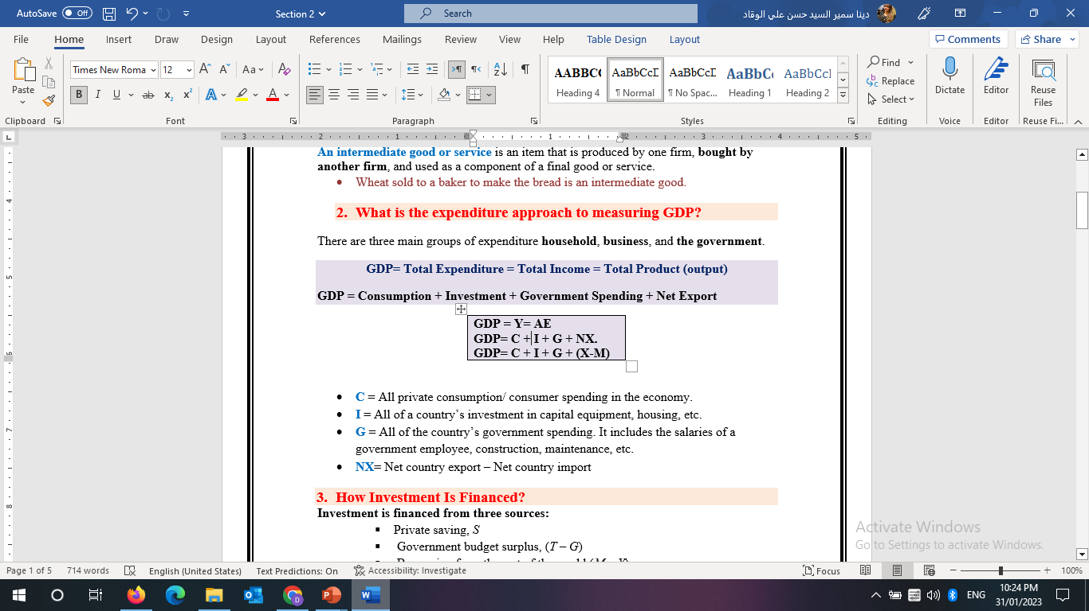
Chapter
Measuring Gross Domestic Product
09
  GDP= Total Expenditure = Total Income = Total Product (output)
  GDP = Consumption + Investment + Government Spending + Net Export
  GDP = Y= AE
  GDP= C + I + G + NX.
  GDP= C + I + G + (X-M)
www.midocean.ae

Slide 11

Chapter
Measuring Gross Domestic Product
09
www.midocean.ae

Slide 12
Chapter
Measuring Gross Domestic Product
09
  Net Export = Exports - Imports
  NX = (X-M)
Exports > Imports Surplus
Exports < Imports Deficit
Exports = Imports Balanced
www.midocean.ae

Slide 13
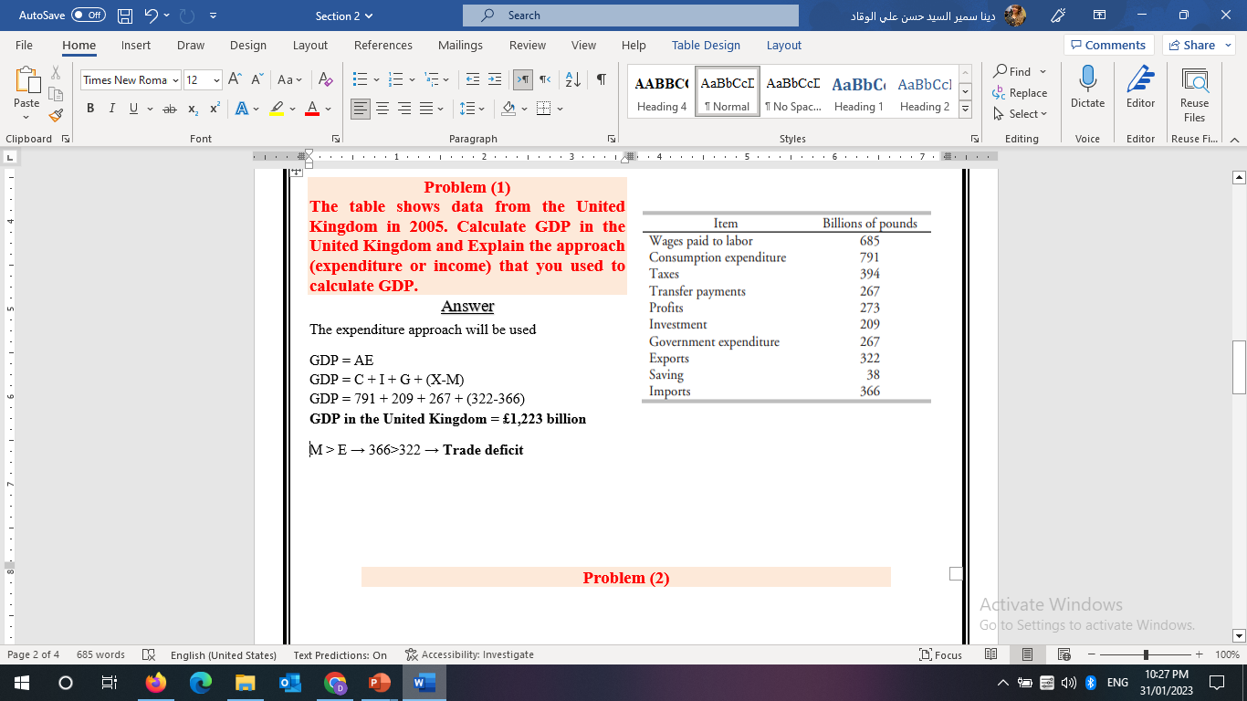

Think
www.midocean.ae

Slide 14
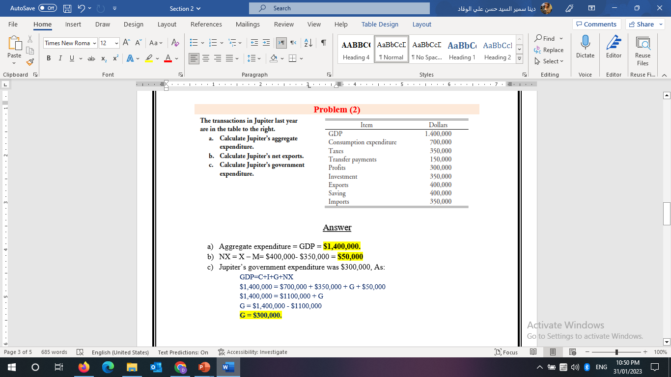
Think
www.midocean.ae

Slide 15
Think
Gross Domestic Product can be measured as the sum of
a. final goods and services, intermediate goods, transfer payments, and rent.
b. consumption, investment, government purchases, and net exports.
c. consumption, transfer payments, wages, and profits.
d. investment, wages, profits, and intermediate production.
www.midocean.ae

Slide 16
Think
Gross Domestic Product is the sum of the market value of the
a. intermediate goods.
b. final goods and services.
c. manufactured goods.
d. inferior goods and services.
www.midocean.ae

Slide 17
Think
If a cobbler buys leather for €100 and thread for €50 and uses them to produce and sell €500 worth of shoes to consumers, the contribution to GDP is
a.€50.
b.€100.
c.€650.
d.€500.
If your grandparents buy a newly built retirement home, this transaction will affect
a. investment.
b. net exports.
c. government purchases.
d. consumption.
www.midocean.ae

Slide 18
Think
Intermediate goods are not included to calculate the final output because:
a) they do not have value
b) they have unknown value
c) their value is included in final goods, so they are not added to avoid the problem of double counting
d) none of the above
A country with a larger GDP per person generally has a greater standard of living or quality of life than a country with a smaller GDP per person. True
If company A, an American corporation, produces sneakers in Thailand this would add to Thailandʹs GDP but not to U.S. GDP. True
www.midocean.ae

Slide 19
Chapter
Real GDP and the Price Level
09
2) Real GDP and the Price Level
www.midocean.ae

Slide 20
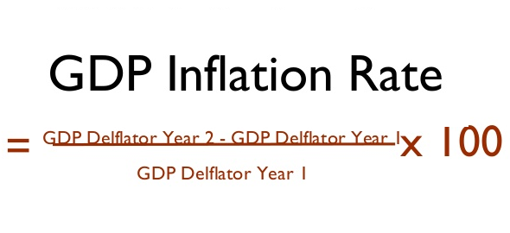
Chapter
Real GDP and the Price Level
09
  Steps to measure GDP inflation rate/ price level:
  Measure Nominal GDP
  Measure Real GDP
  Measure GDP deflator (1/2)*100
  .
www.midocean.ae

Slide 21
Chapter
Real GDP and the Price Level
09
  Real GDP is the value of final goods and services produced in a given year when valued at constant prices.
Calculating Real GDP
  The first step in calculating real GDP is to calculate Nominal GDP, which is the value of goods and services produced during a given year valued at the prices of that year.
www.midocean.ae

Slide 22
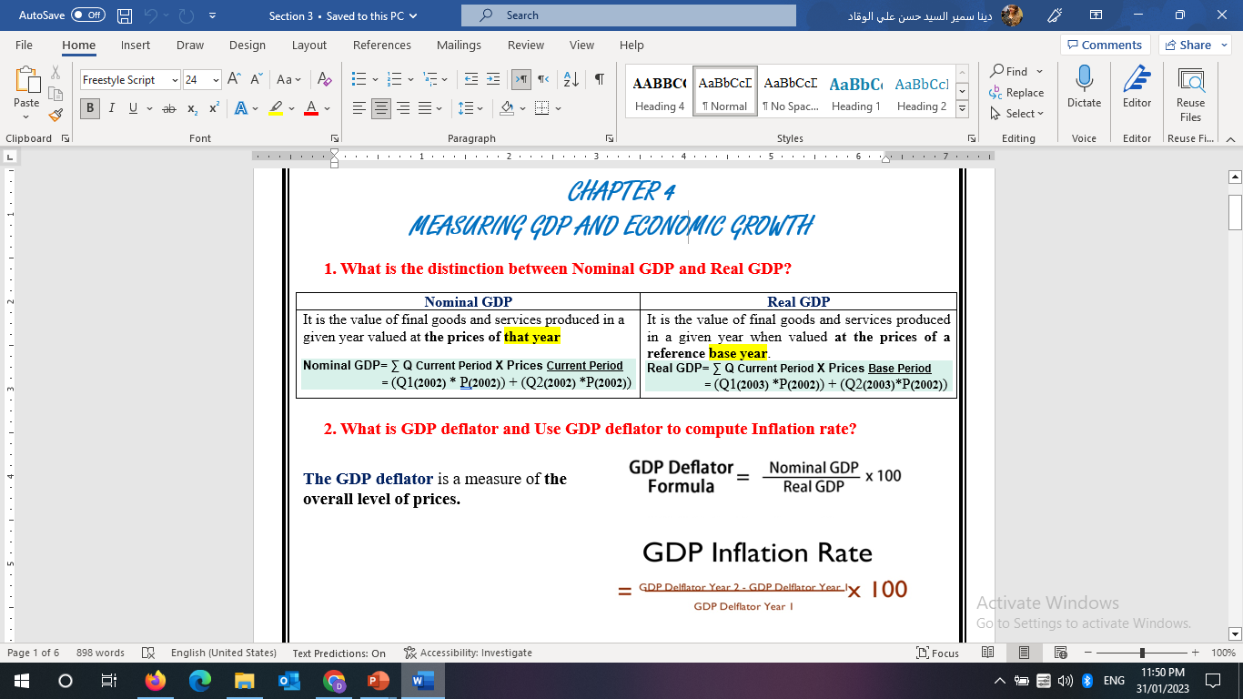
Chapter
Real GDP and the Price Level
09
www.midocean.ae

Slide 23
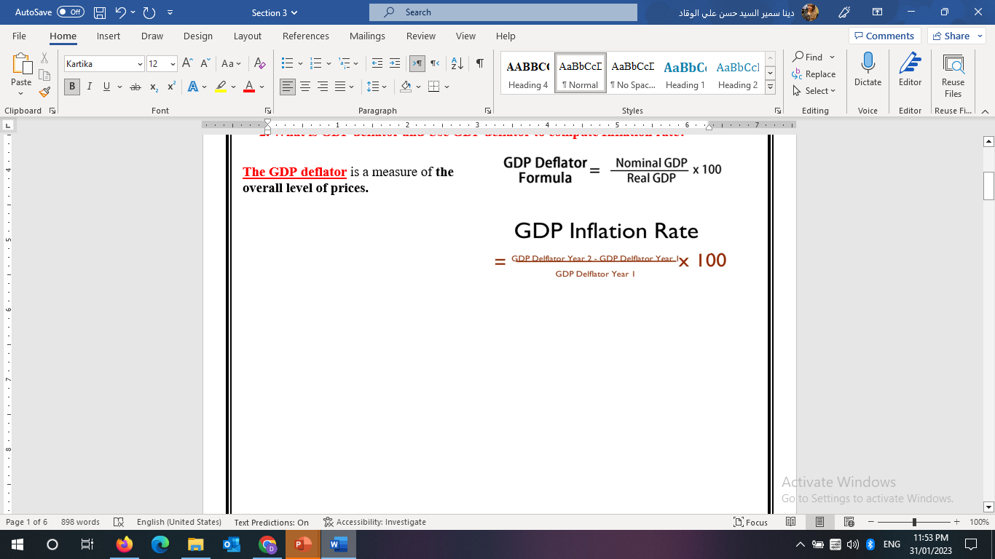
Chapter
Real GDP and the Price Level
09
www.midocean.ae

Slide 24
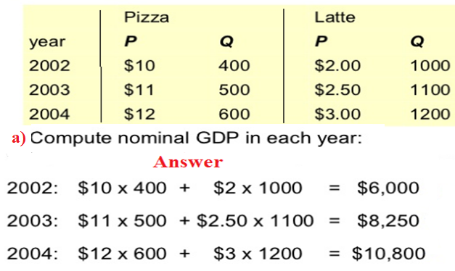
Chapter
Real GDP and the Price Level
09
www.midocean.ae

Slide 25
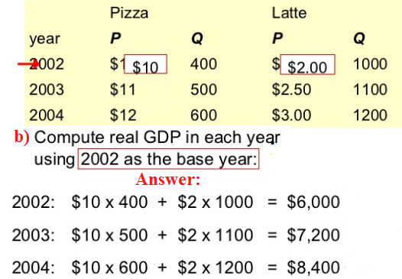
Chapter
Real GDP and the Price Level
09
www.midocean.ae

Slide 26
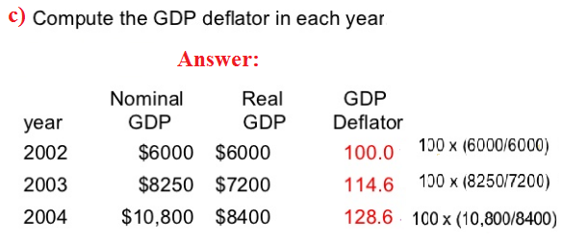
Chapter
Real GDP and the Price Level
09
www.midocean.ae

Slide 27
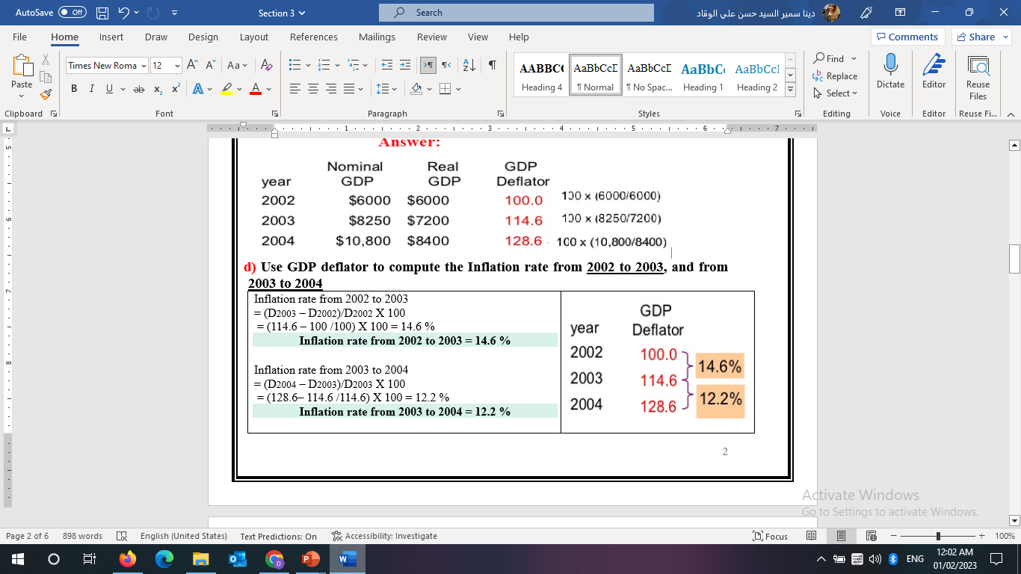
Chapter
Real GDP and the Price Level
09
www.midocean.ae

Slide 28
Chapter
09
3) Measuring Economic Growth
www.midocean.ae

Slide 29
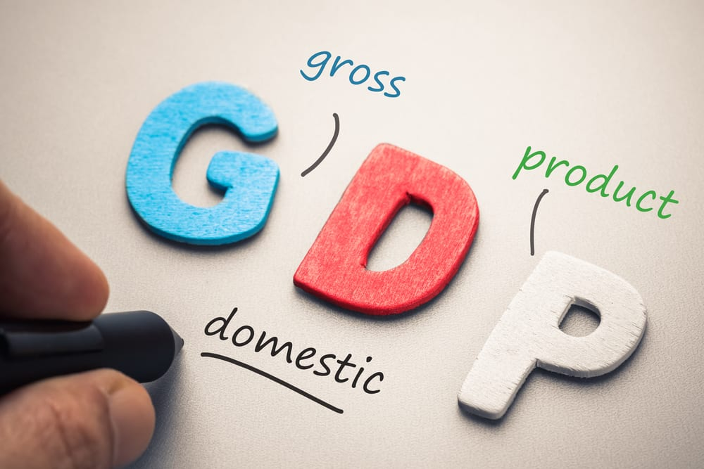
Chapter
Measuring Economic Growth
09
GDP - What in it for me?
Economic Growth
Is your main indicator of the economic activity
Sales Leaders as to use the expected growth as base to their sales forecasting.
Countries with high rate of Economic growth are attractive for new investment.
www.midocean.ae

Slide 30
Chapter
Measuring Economic Growth
09
  We use real GDP to calculate the economic growth rate.
  The economic growth rate is the percentage change in the quantity of goods and services produced from one year to the next.
  We measure economic growth so we can make:
  Economic welfare comparisons
  International welfare comparisons
Economic Growth = (Real GDP Current Period – Real GDP Last)/ Real GDP Last
www.midocean.ae

Slide 31
Chapter
Measuring Economic Growth
09
Economic Welfare Comparisons
  Economic welfare measures the nation’s overall state of economic well-being.
  Real GDP is not a perfect measure of economic welfare for seven reasons:
Real GDP does not include Quality improvements
Real GDP does not include household production
Real GDP does not include the underground economy, illegal economic activity.
  The underground economy means that GDP will understate the actual level of economic welfare.
www.midocean.ae

Slide 32
Chapter
Measuring Economic Growth
09
Economic Welfare Comparisons
  Real GDP is not a perfect measure of economic welfare for seven reasons:
Real GDP does not account for people’s health and life expectancy
Real GDP does not consider the value of leisure time.
Real GDP does not consider Environmental Quality / damage
Real GDP does not indicate the extent of political freedom and social justice enjoyed by a nation’s citizens
www.midocean.ae

Slide 33
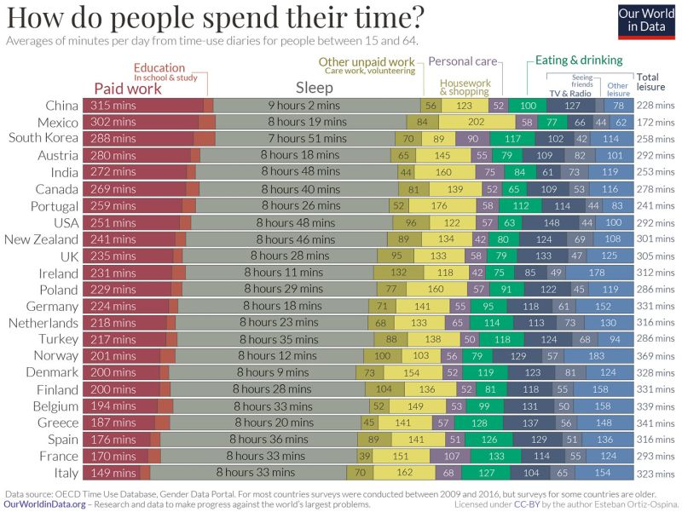
www.midocean.ae

Slide 34
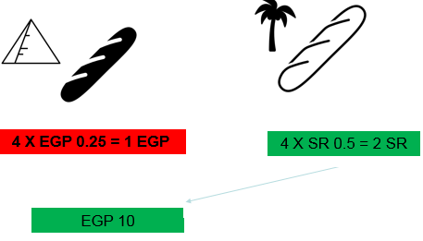
Chapter
Measuring Economic Growth
09
International Comparisons
When Real GDP is used to compare economic welfare in one country with that in another, there are two special problems arise:
Real GDP of one country must be converted into the same currency units as the real GDP of the other country, so an exchange rate must be used.
The same prices should be used to value the goods and services in the countries being compared, but prices of particular products in one country may be much less or much more than in the other country
www.midocean.ae

Slide 35
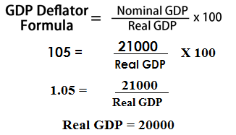
Think
Suppose that nominal GDP is $21,000 in 2002, the 1998 GDP deflator is 100, and the 2002 deflator is 105. The approximate real GDP in 2002 is
A) $20,000.
B) $21,000.
C) $19,048.
D) $22,050.
www.midocean.ae

Slide 36
Think
Which of the following is NOT included in real GDP?
A) Production of services, such as the services of doctors.
B) Production of goods that last more than one year, such as television sets.
C) Production of goods that do not last more than one year, such as gasoline.
D) Production in the home.
www.midocean.ae

Slide 37
Think
Which of the following is NOT a reason that real GDP is a poor measure of a nation’s economic welfare?
A) Real GDP omits measures of political freedom.
B) Real GDP does not take into account the value of people’s leisure time.
C) Real GDP does not include the underground economy.
D) Real GDP overvalues household production.
www.midocean.ae

Slide 38
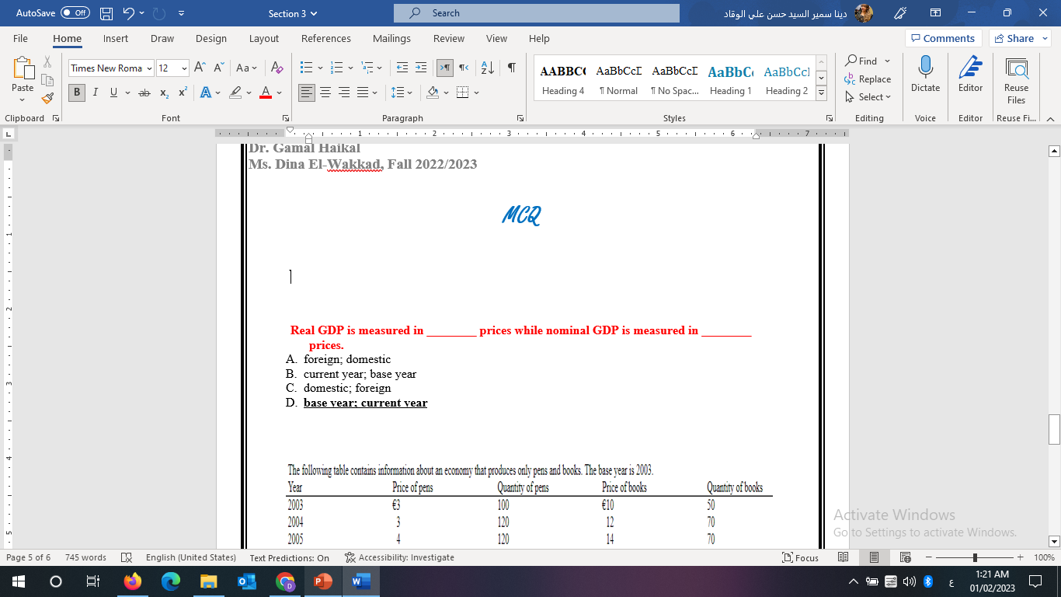
Think
www.midocean.ae

Slide 39
Chapter
Summary outlines
09
Definition of GDP
Measuring GDP
Real GDP and the Price Level
Measuring Economic Growth
Limitations of Real GDP as a measure of economic welfare
www.midocean.ae

Slide 40


Thank You

