Slide 1





Critical Thinking
Prepared by Dr. Ahmed Alqarni
MGM115
Critical Thinking

Slide 2


Lecture
About the course:
This course is designed to improve a student's ability to analyze and evaluate the kinds of arguments and theories commonly met with in everyday life. The course also helps students improve their own arguments and presentations by showing them how to draw sound conclusions from available evidence and how to construct well-reasoned cases to support these conclusions.

Slide 3
Lecture
Course Objectives:
▪Demonstrate an understanding of the nature of critical and analytical thinking
▪Create well-written answers and opinions about a variety of topics using critical thinking skills and models
▪Detect errors in reasoning and explain how the reasoning is in error
▪Evaluate evidence and make appropriate inferences from that evidence
▪Experience group dynamics through collaborative learning activities during the semester.
▪Analyze and interpret data.

Slide 4
Lecture
Topics:
Introduction: critical thinking and argument
Basic logical concepts
The language
Logical fallacies
Analyzing argument
Evaluating arguments and truth claims
Categorical and propositional logics
Inductive reasoning
Finding, evaluating, and using sources
Writing argumentative essay

Slide 5
Lecture
Textbook:
The main material and reference for this course will be mainly based on:
Textbook: Critical Thinking, Fourth Edition, Gregory Bassham; William Irwin; Henry Nardone; & James M. Wallace

Slide 6
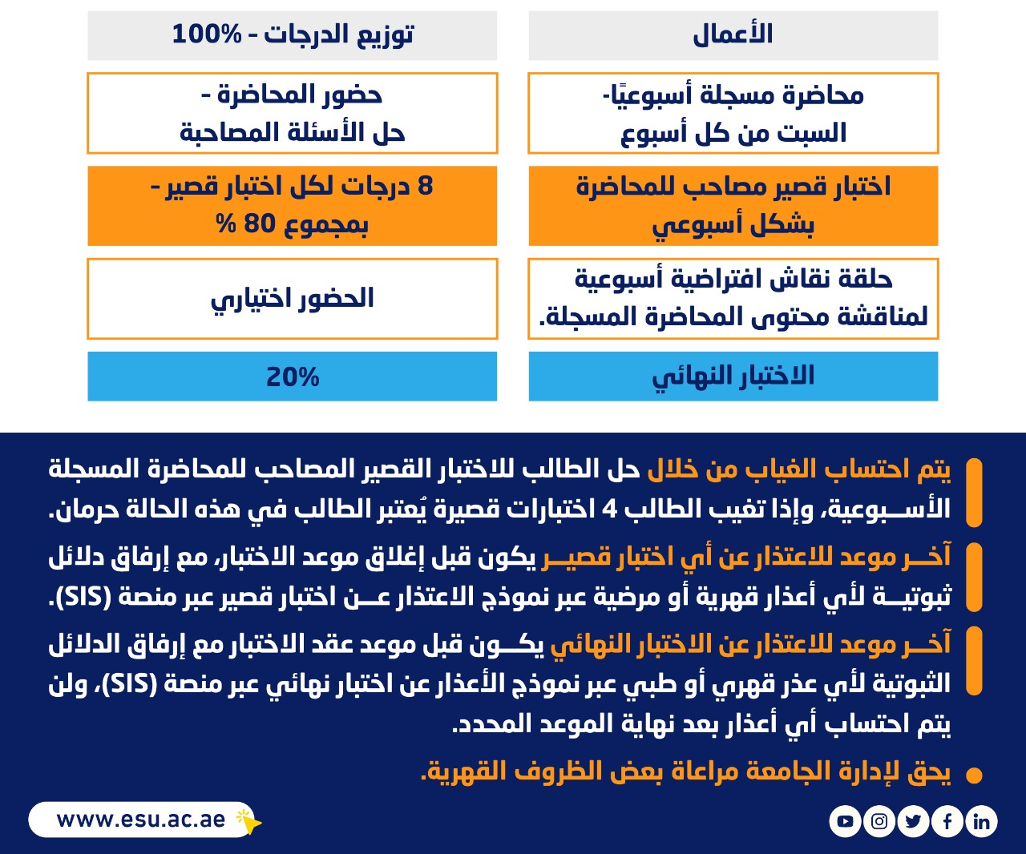
توزيع الدرجات

Slide 7
مخطط الأسابيع الدراسية

Slide 8
Lecture 1
Thank you

