Slide 1



CYB 510 OPERATING SYSTEMS
Prepared by Prof. Dr. Lamiaa Fattouh
Lecture 8
Chapter 7: Deadlocks
CYB 510
MAIN MEMORY PART 2
1

Slide 2
Implementation of Page Table
Page table is kept in main memory
Page-table base register (PTBR) points to the page table
Page-table length register (PRLR) indicates size of the page table
In this scheme every data/instruction access requires two memory accesses. One for the page table and one for the data/instruction.
The two memory access problem can be solved by the use of a special fast-lookup hardware cache called associative memory or translation look-aside buffers (TLBs)

Slide 3
Associative Memory
Associative memory – parallel search
Address translation (A´, A´´)
  If A´ is in associative register, get frame # out
  Otherwise get frame # from page table in memory
Page #
Frame #
associative memory or translation look-aside buffers (TLBs)

Slide 4
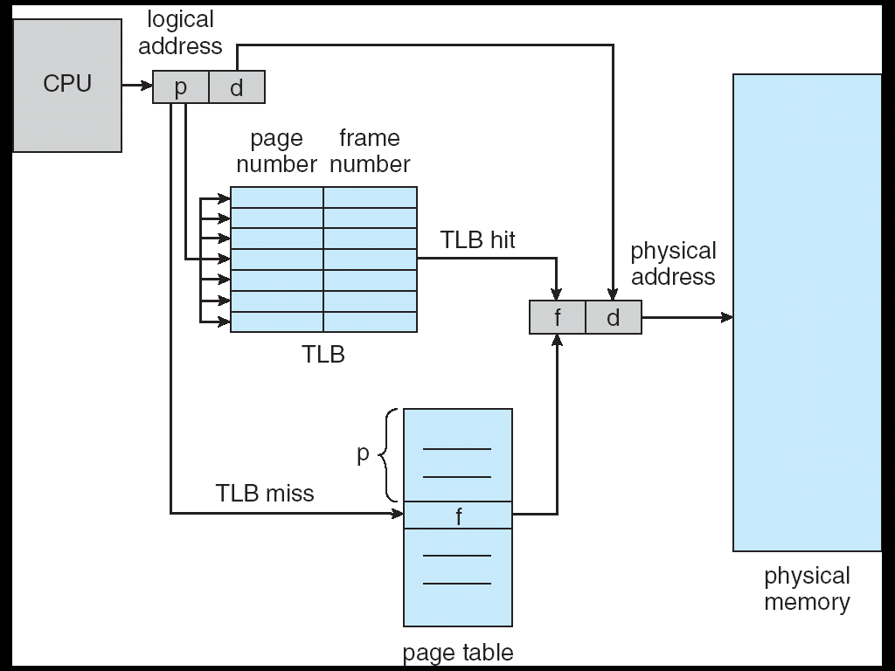
Paging Hardware With TLB
associative memory or translation look-aside buffers (TLBs)

Slide 5
Effective Access Time
Associative Lookup = ε time unit
Assume memory cycle time is 1 microsecond
Hit ratio – percentage of times that a page number is found in the associative registers; ration related to number of associative registers
Hit ratio = α
Effective Access Time (EAT)
EAT = (1 + ε) α + (2 + ε)(1 – α)
= 2 + ε – α

Slide 6
Memory Protection
Memory protection implemented by associating protection bit with each frame
Valid-invalid bit attached to each entry in the page table:
  “valid” indicates that the associated page is in the process’ logical address space, and is thus a legal page
  “invalid” indicates that the page is not in the process’ logical address space

Slide 7
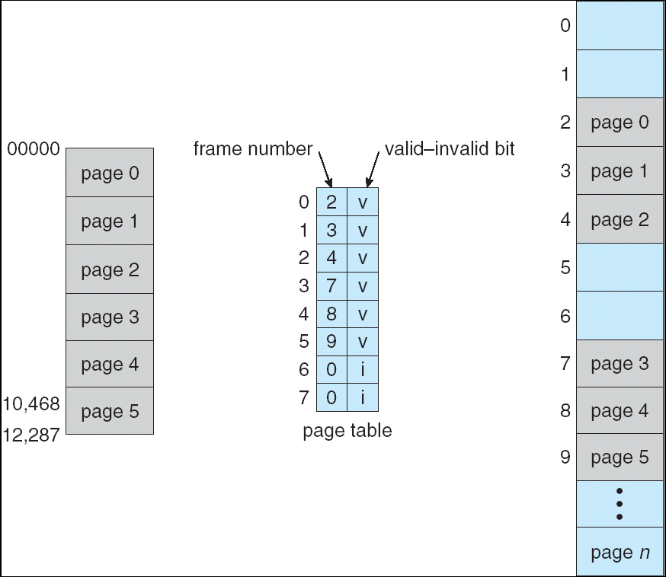
Valid (v) or Invalid (i) Bit In A Page Table

Slide 8
Page Table Structure
Hierarchical Paging
Hashed Page Tables
Inverted Page Tables

Slide 9
Hierarchical Page Tables
Break up the logical address space into multiple page tables
A simple technique is a two-level page table

Slide 10
Two-Level Paging Example
A logical address (on 32-bit machine with 4K page size) is divided into:
  a page number consisting of 20 bits
  a page offset consisting of 12 bits
Since the page table is paged, the page number is further divided into:
  a 10-bit page number
  a 10-bit page offset
Thus, a logical address is as follows:
where p_{i} is an index into the outer page table, and p₂ is the displacement within the page of the outer page table
page number
page offset
p_{i}
p₂
d
10
10
12

Slide 11
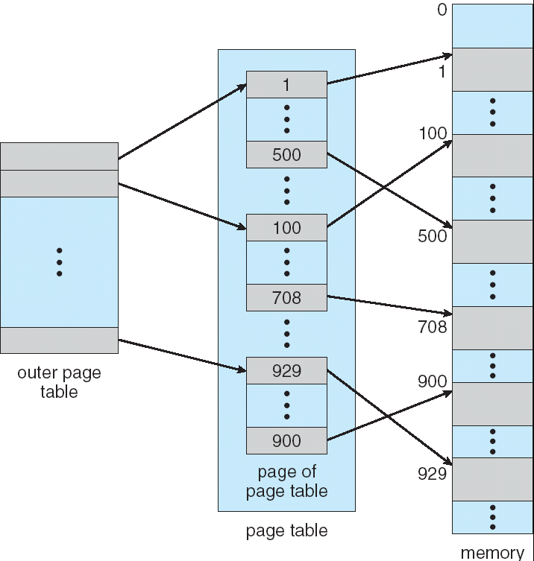
Two-Level Page-Table Scheme

Slide 12
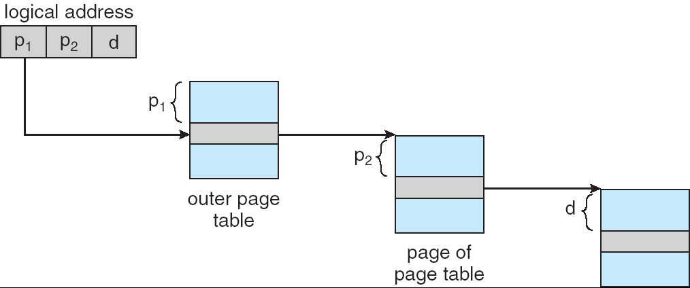
Address-Translation Scheme
Address-translation scheme for a two-level 32-bit paging architecture

Slide 13
Hashed Page Tables
Common in address spaces > 32 bits
The virtual page number is hashed into a page table. This page table contains a chain of elements hashing to the same location.
Virtual page numbers are compared in this chain searching for a match. If a match is found, the corresponding physical frame is extracted.

Slide 14
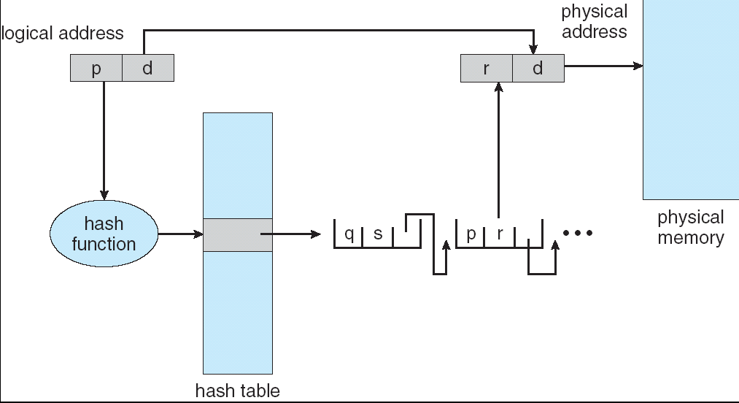
Hashed Page Table

Slide 15
Inverted Page Table
One entry for each real page of memory
Entry consists of the virtual address of the page stored in that real memory location, with information about the process that owns that page
Decreases memory needed to store each page table, but increases time needed to search the table when a page reference occurs
Use hash table to limit the search to one — or at most a few — page-table entries

Slide 16
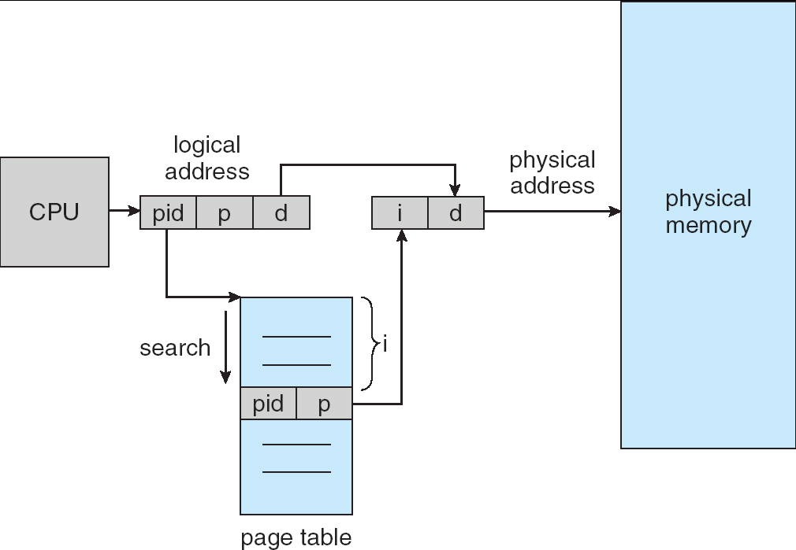
Inverted Page Table Architecture

Slide 17
Shared Pages
Shared code
  One copy of read-only (reentrant) code shared among processes (i.e., text editors, compilers, window systems).
  Shared code must appear in same location in the logical address space of all processes
Private code and data
  Each process keeps a separate copy of the code and data
  The pages for the private code and data can appear anywhere in the logical address space

Slide 18
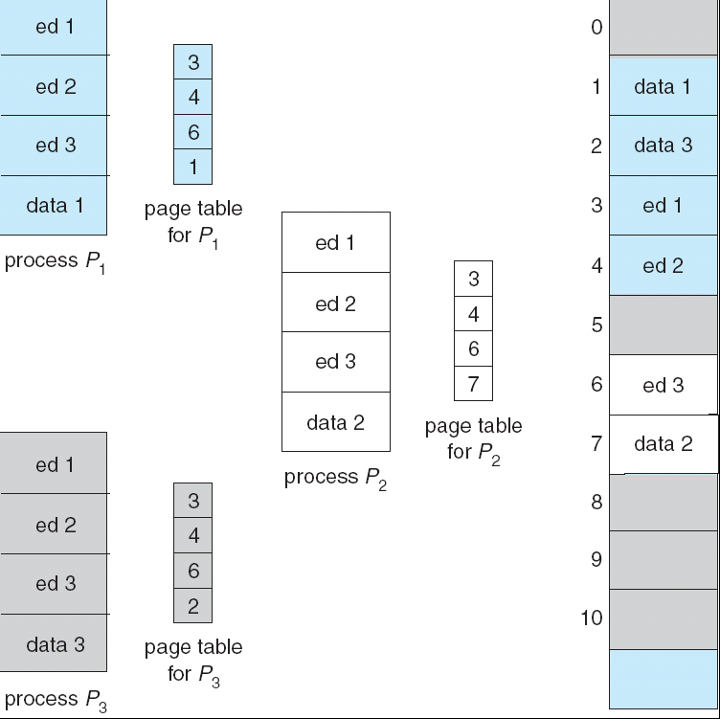
Shared Pages Example

Slide 19
Paging -- Calculating internal fragmentation
Page size = 2,048 bytes
Process size = 72,766 bytes
35 pages + 1,086 bytes
Internal fragmentation of 2,048 - 1,086 = 962 bytes
Worst case fragmentation = 1 frame – 1 byte
On average fragmentation = 1 / 2 frame size
So small frame sizes desirable?
But each page table entry takes memory to track
Page sizes growing over time
  Solaris supports two page sizes – 8 KB and 4 MB

Slide 20
Segmentation
Memory-management scheme that supports user view of memory
A program is a collection of segments. A segment is a logical unit such as:
main program,
procedure,
function,
method,
object,
local variables, global variables,
common block,
stack,
symbol table, arrays

Slide 21
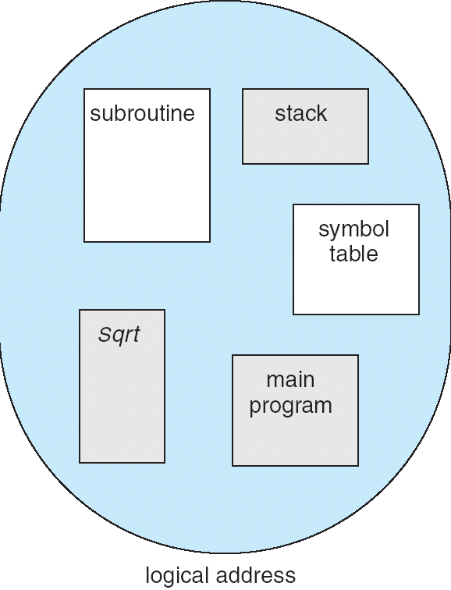
User’s View of a Program

Slide 22
Logical View of Segmentation
1
1
4
2
3
4
2
3
user space
physical memory space

Slide 23
Segmentation Architecture
Logical address consists of a two tuple:
<segment-number, offset>,
Segment table – maps two-dimensional physical addresses; each table entry has:
  base – contains the starting physical address where the segments reside in memory
  limit – specifies the length of the segment
Segment-table base register (STBR) points to the segment table’s location in memory
Segment-table length register (STLR) indicates number of segments used by a program;
segment number s is legal if s < STLR

Slide 24
Segmentation Architecture (Cont.)
Sharing.
  shared segments
  same segment number
Allocation.
  first fit/best fit
  external fragmentation

Slide 25
Segmentation Architecture (Cont.)
Protection. With each entry in segment table associate:
  validation bit = 0 ⇒ illegal segment
  read/write/execute privileges
Protection bits associated with segments; code sharing occurs at segment level
Since segments vary in length, memory allocation is a dynamic storage-allocation problem
A segmentation example is shown in the following diagram

Slide 26
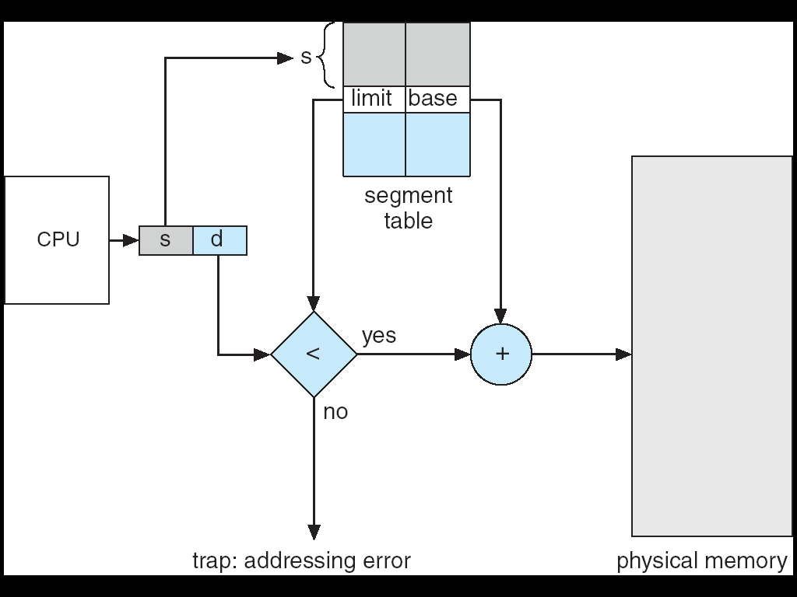
Address Translation Architecture

Slide 27
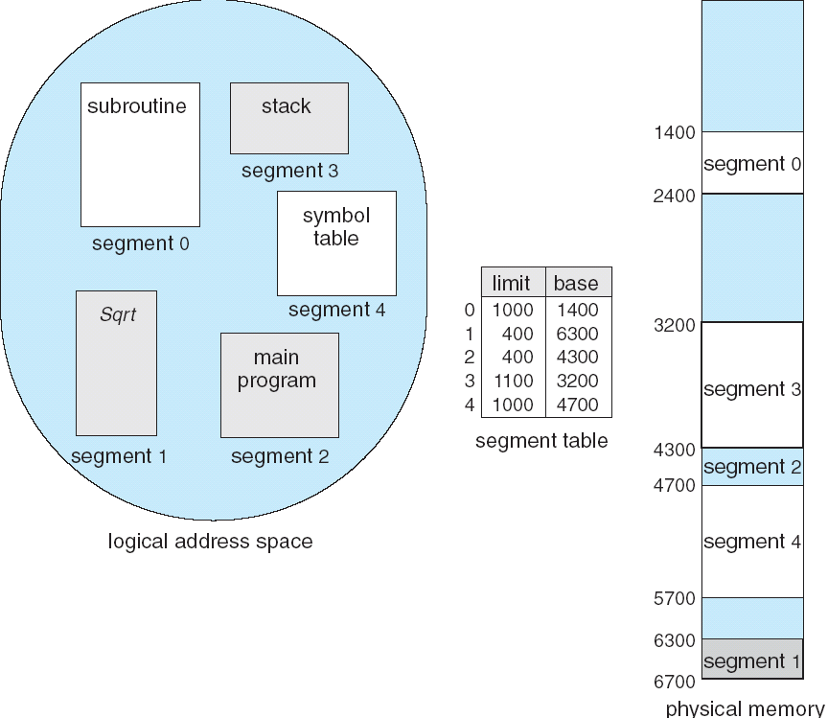
Example of Segmentation

Slide 28
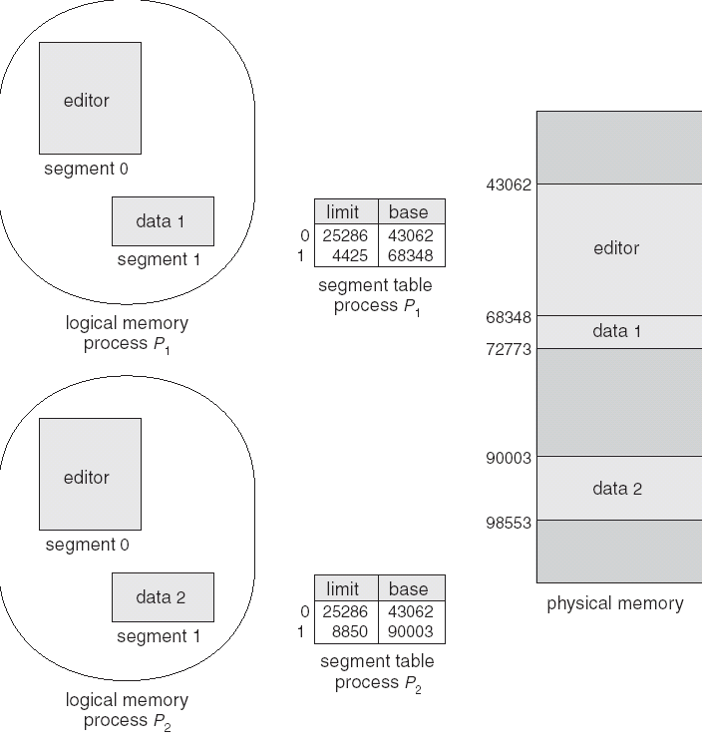
Sharing of Segments

Slide 29
Segmentation with Paging – MULTICS
The MULTICS system solved problems of external fragmentation and lengthy search times by paging the segments
Solution differs from pure segmentation in that the segment-table entry contains not the base address of the segment, but rather the base address of a page table for this segment

Slide 30
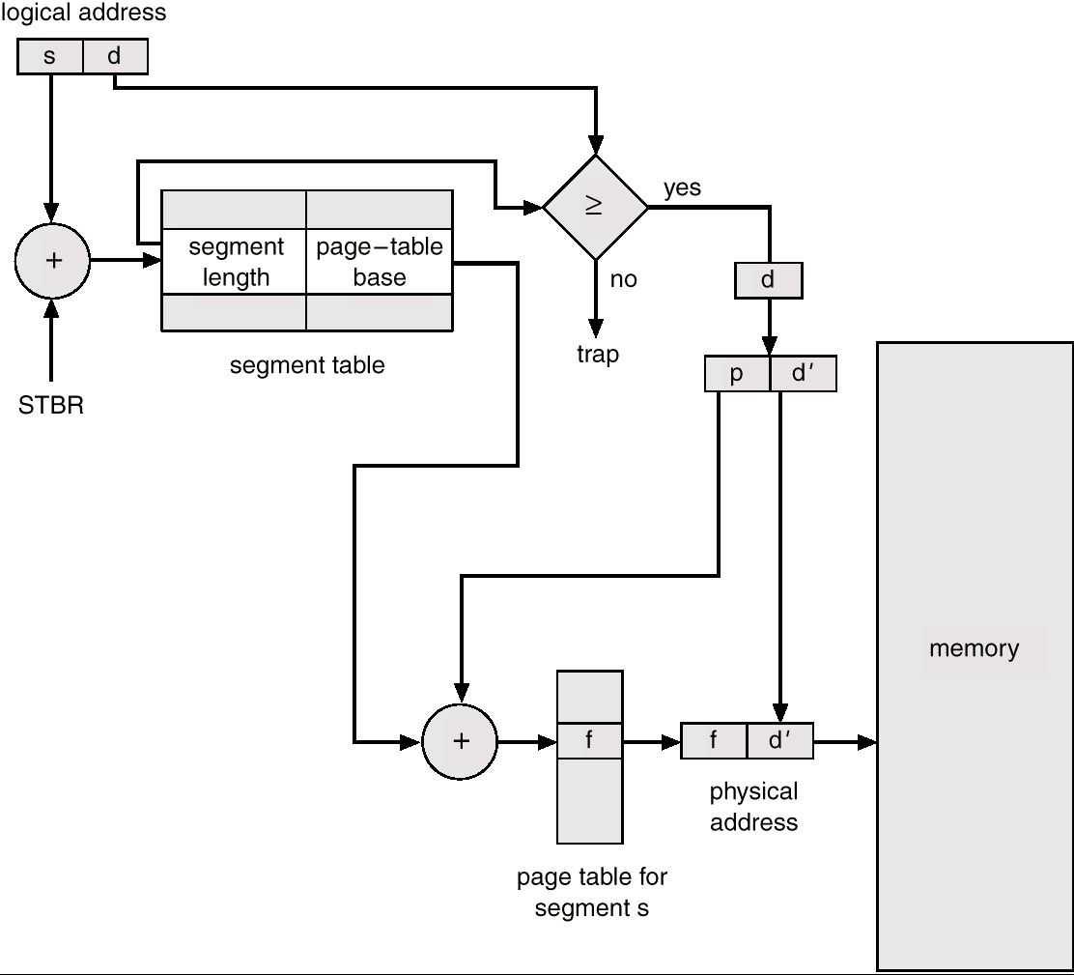
MULTICS Address Translation Scheme

Slide 31
Example: The Intel 32 and 64-bit Architectures
Dominant industry chips.
Pentium CPUs are 32-bit and called IA-32 segmentation architecture.
Current Intel CPUs are 64-bit and called IA-64 paging architecture.
Notably, however, Intel’s dominance has not spread to mobile systems, where the ARM architecture currently enjoys considerable success.

Slide 32
Example: The Intel IA-32 Architecture
Supports both segmentation and segmentation with paging
  Each segment can be as large as 4 GB
  Up to 16 K segments per process
  Pages sizes can be 4 KB or 4 MB

Slide 33
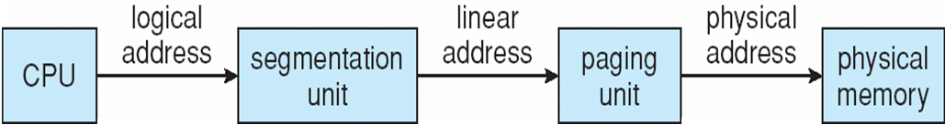
Example: The Intel IA-32 Architecture
Memory management in AI-32 systems is divided into two Components segmentation and paging
Memory Management unit MMU
  Linear address given to paging unit
    Which generates physical address in main memory
    The Segmentation and Paging units form equivalent of MMU

Slide 34
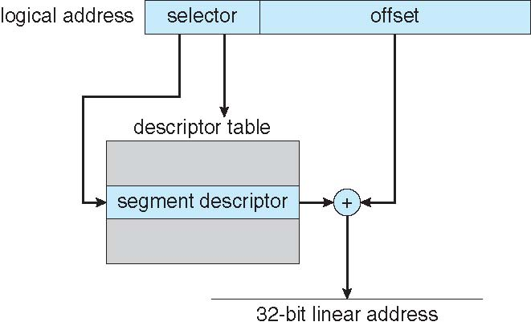
Example: The Intel IA-32 Architecture (Cont.)
  Logical address is Divided into two partitions
    First partition of up to 8 K segments are private to process (kept in local descriptor table (LDT))
    Second partition of up to 8K segments shared among all processes (kept in global descriptor table (GDT))
  Selector given to segmentation unit
    Which produces linear addresses
    Each entry in the LDT and GDT consists
    of an 8-byte segment descriptor with
    detailed information about a particular
    segment, including the base location and
    limit of that segment

Slide 35

Logical to Physical Address Translation in IA-32
Selector is a 16-bit number
S designates the segment number, g indicates whether the segment is in the GDT or LDT, and p deals with protection. The offset is a 32-bit number specifying the location of the byte within the segment in question.

Slide 36
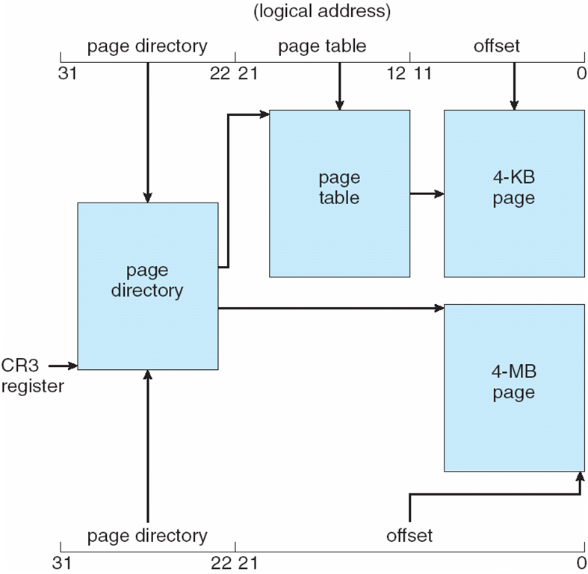
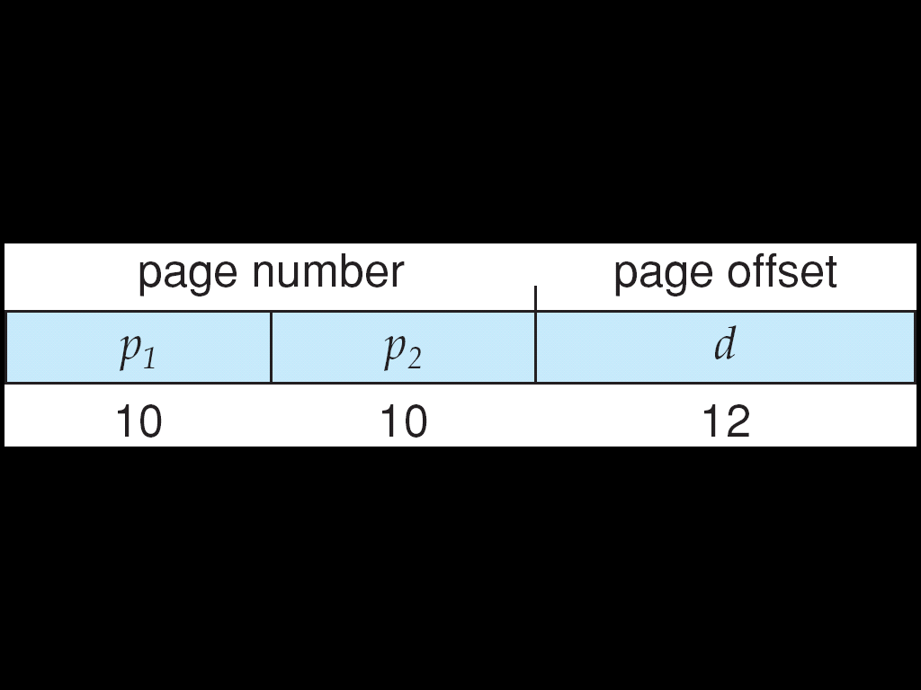
Intel IA-32 Paging Architecture
32-bit linear address
The CR3 register points to the page directory for the current process.
Inner page table
One entry in the page directory is the Page Size flag, which—if set—indicates that the size of the page frame is 4 MB and not the standard 4 KB.
If this flag is set, the page directory points directly to the 4-MB page frame, bypassing the inner page table; and the 22 low-order bits in the linear address refer to the offset in the 4-MB page frame.
Outermost page

Slide 37
Problem 1
Given five memory partitions of 100 KB, 500 KB, 200 KB, 300 KB, and 600 KB (in order), how would each of the first-fit, best-fit, and worst-fit algorithms place processes of 212 KB, 417 KB, 112 KB, and 426 KB (in order)?Which algorithm makes the most efficient use of memory?

Slide 38
Solution
Let p1, p2, p3 & p4 are the names of the processes
First-fit:
  P1>>> 100, 500, 200, 300, 600
  P2>>> 100, 288, 200, 300, 600
  P3>>> 100, 288, 200, 300, 183
  100, 176, 200, 300, 183 <<<<< final set of hole
  P4 (426K) must wait
212 KB, 417 KB, 112 KB, and 426 KB

Slide 39
Solution
Best-fit:
  P1>>> 100, 500, 200, 300, 600
  P2>>> 100, 500, 200, 88, 600
  P3>>> 100, 83, 200, 88, 600
  P4>>> 100, 83, 88, 88, 600
  100, 83, 88, 88, 174 <<<<< final set of hole
212 KB, 417 KB, 112 KB, and 426 KB

Slide 40
Solution
Worst-fit:
  P1>>> 100, 500, 200, 300, 600
  P2>>> 100, 500, 200, 300, 388
  P3>>> 100, 83, 200, 300, 388
  100, 83, 200, 300, 276 <<<<< final set of hole
  P4 (426K) must wait
212 KB, 417 KB, 112 KB, and 426 KB

Slide 41
Solution
In this example, Best-fit turns out to be the best because there is no wait processes.

Slide 42
Problem 2
Assuming a 1-KB page size, what are the page numbers and offsets for the following address references (provided as decimal numbers):
a. 3085
b. 42095
3085→3085 –(3*1024)= 3085- 3072= 13
page number 3 offset 13

Slide 43
Problem 2
b) 42095→ 42095/1024= 41.1
41* 1024= 41984
42095-41984= 111
Page number = 41 and offset= 111

Slide 44
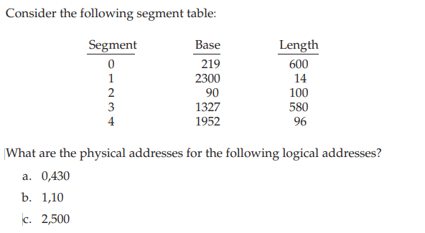
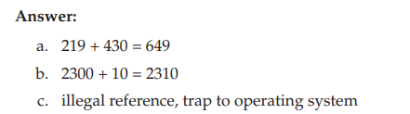
Problem 3

Slide 45
Summary
Memory is central to the operation of a modern computer system and consists of a large array of bytes, each with its own address.
One way to allocate an address space to each process is through the use of base and limit registers. The base register holds the smallest legal physical memory address, and the limit specifies the size of the range.
Binding symbolic address references to actual physical addresses may occur during (1) compile, (2) load, or (3) execution time.
• An address generated by the CPU is known as a logical address, which the memory management unit (MMU) translates to a physical address in memory.

Slide 46
Summary
One approach to allocating memory is to allocate partitions of contiguous memory of varying sizes. These partitions may be allocated based on three possible strategies: (1) first fit, (2) best fit, and (3) worst fit.
• Modern operating systems use paging to manage memory. In this process, physical memory is divided into fixed-sized blocks called frames and logical memory into blocks of the same size called pages.
When paging is used, a logical address is divided into two parts: a page number and a page offset. The page number serves as an index into a per process page table that contains the frame in physical memory that holds the page. The offset is the specific location in the frame being referenced.

Slide 47
Summary
A translation look-aside buffer (TLB) is a hardware cache of the page table. Each TLB entry contains a page number and its corresponding frame.
• Using a TLB in address translation for paging systems involves obtaining the page number from the logical address and checking if the frame for the page is in the TLB. If it is, the frame is obtained from the TLB. If the frame is not present in the TLB, it must be retrieved from the page table.

Slide 48
Summary
Hierarchical paging involves dividing a logical address into multiple parts, each referring to different levels of page tables. As addresses expand beyond 32 bits, the number of hierarchical levels may become large. Two strategies that address this problem are hashed page tables and inverted page tables.
• Swapping allows the system to move pages belonging to a process to disk to increase the degree of multiprogramming.

Slide 49
Summary
◻ Various techniques
  ◉ Fixed partitions – easy to use, but internal fragmentation
  ◉ Variable partitions – more efficient, but external fragmentation
  ◉ Paging – use small, fixed size chunks, efficient for OS
  ◉ Segmentation – manage in chunks from user’s perspective
  ◉ Combine paging and segmentation to get benefits of both

Slide 50
End Lecture 8

