Slide 1





Data Mining (DS601)
Dr. Amjad Qtaish
Faculty of Informatics
Midocean University
Orientation show عرض توجيهي
www.midocean.ae

Slide 2


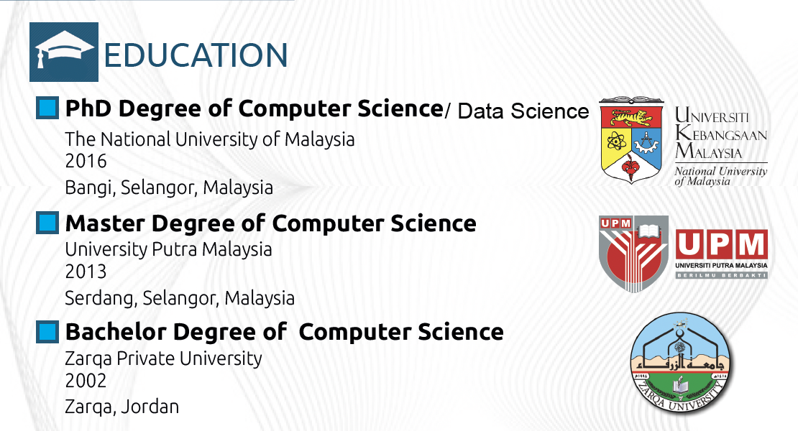
Who am I?
Data Mining, Dr. Amjad Qtaish
www.midocean.ae

Slide 3
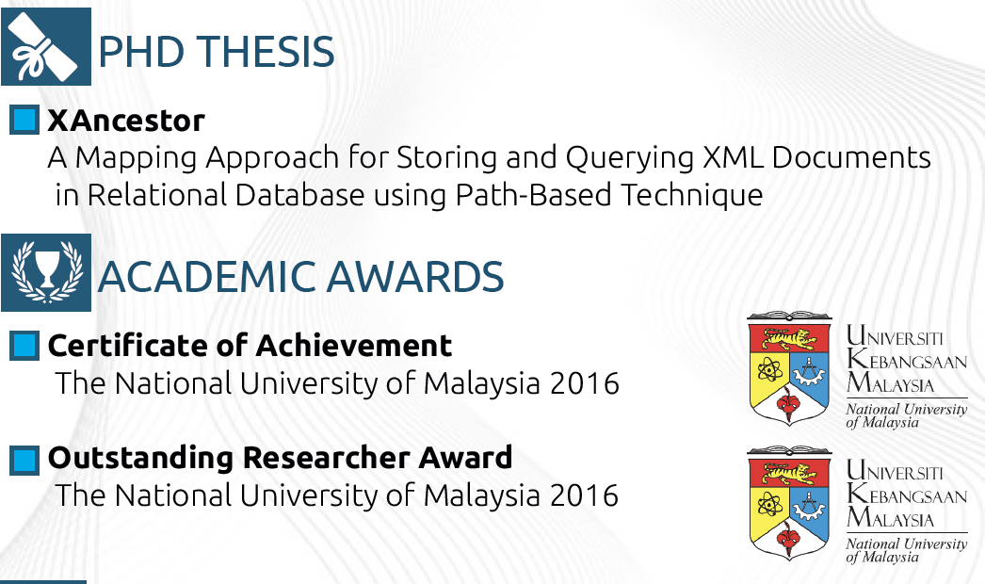
Who am I?
Data Mining, Dr. Amjad Qtaish
www.midocean.ae

Slide 4
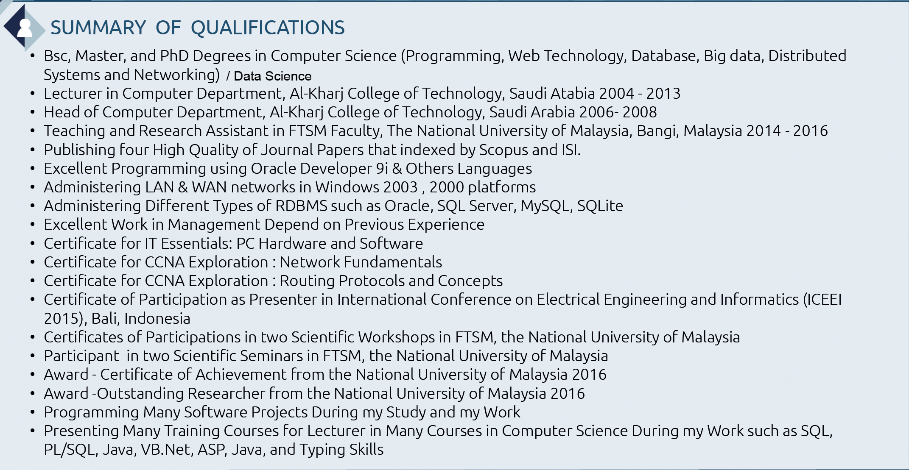
Who am I?
Data Mining, Dr. Amjad Qtaish
www.midocean.ae

Slide 5



My Contact Information
  How to reach me
    By email at amjadqtaish@midocean.edu.km
    ( please include “Data Mining” in subject line)
  Office hours
  Discussion Time (Tuesday at 9:00 PM) every week
  More about me:
https://scholar.google.com/citations?user=JejNDrcAAAAJ&hl=en
https://www.scopus.com/authid/detail.uri?authorId=56720387400
https://orcid.org/0000-0001-5210-7086
Data Mining, Dr. Amjad Qtaish
www.midocean.ae

Slide 6
The course that will be taught
Data Mining
Data Mining, Dr. Amjad Qtaish
www.midocean.ae

Slide 7
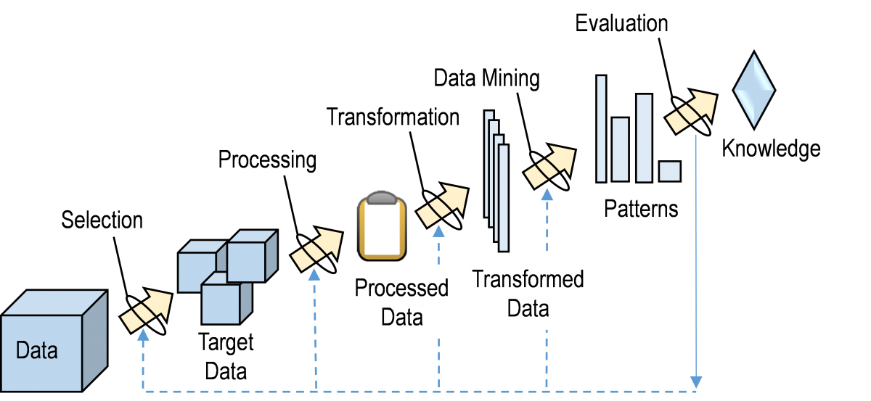
Importance of Data Miningالتنقيب عن البيانات وأهميته
يشير معنى التنقيب عن البياناتData mining الى عملية استخراج الأنماط أو الأفكار المفيدة من كميات كبيرة من البيانات. ويتضمن استخدام تقنيات وخوارزميات مختلفة لاكتشاف الأنماط والاتجاهات المخفية داخل البيانات. بهدف استخراج معلومات قيمة يمكن استخدامها لاتخاذ القرار، حيث يساعد المؤسسات على الكشف عن رؤى قيمة، وتحسين عمليات صنع القرار، وتحديد أنماط سلوك العملاء، واكتشاف الأنشطة الاحتيالية، وتحسين العمليات، وتحسين أداء الأعمال بشكل عام.
Data Mining, Dr. Amjad Qtaish
www.midocean.ae

Slide 8
Primary Goal of This Course
يركز التنقيب عن البيانات على إيجاد أنماط جديدة ومثيرة للاهتمام وربما مفيدة في البيانات. ويهدف إلى تحويل كمية كبيرة من البيانات إلى معرفة. أصبح استخراج البيانات مجالًا مهمًا جدًا في الصناعة وكذلك في الأوساط الأكاديمية. يغطي هذا المقرر معظم تقنيات التنقيب عن البيانات المهمة وتوفر معرفة أساسية حول كيفية إجراء مشروع التنقيب عن البيانات.
بعد ذلك، ستتم مناقشة التقنيات الأساسية لكيفية المعالجة المسبقة لمجموعة بيانات لمهمة استخراج البيانات، وتحديد ماهية اكتشاف المعرفة واستخراج البيانات، ومهام استخراج البيانات مثل التصنيف والتجميع وتحليل الارتباطات بالتفصيل.
Data mining centers on finding novel, interesting, and potentially useful patterns in data. It aims at transforming a large amount of data into a well of knowledge. Data mining has become a very important field in industry as well as academia. The course covers most of the important data mining techniques and provides background knowledge on how to conduct a data mining project.
After, basic techniques of how to preprocess a data set for a data mining task, defining what knowledge discovery and data mining is, data mining tasks such classification, clustering, and association analysis will be discussed in detail.
Data Mining, Dr. Amjad Qtaish
www.midocean.ae

Slide 9
What This Course is About
The course will help students to gauge understanding in :
Data cleaning and preparation: Students will learn how to identify and address errors, inconsistencies, and missing values in data sets to ensure their quality for analysis.
Data analysis techniques: Courses will cover various methods for analyzing data, such as statistical analysis, machine learning algorithms, and data visualization techniques.
Pattern discovery: A core aspect of data mining is finding hidden patterns and relationships within data. Students will learn algorithms for tasks like classification, clustering, association rule learning, and anomaly detection.
Communication and storytelling: Effectively presenting insights from data is crucial. Courses may cover techniques for data visualization and communication to translate complex findings into clear and actionable results.
Data Mining, Dr. Amjad Qtaish
www.midocean.ae

Slide 10
Units of Course Contents
Module | Course Unit | No.of. Weeks | Contact Hours
1 | Lecture 1: Introduction to Data Mining | 1st | 3
2 | Lecture 2: Data Preprocessing | 2nd | 3
3 | Lecture 3: Data Visualization | 3rd | 3
4 | Lecture 4: ETL (Extract Transform Load) | 4th | 3
5 | Lecture 5: DQM (Data Quality Management) | 5th | 3
6 | Lecture 6: Mining Frequent Patterns, Associations, and Correlation | 6th | 3
7 | Lecture 7: Classification and Prediction | 7th | 3
8 | Lecture 8: Classification and Prediction using Orange Tool | 8th | 3
9 | Lecture 9: Dimensional Modeling | 9th | 3
10 | Lecture 10: Cluster Analysis | 10th | 3
Data Mining, Dr. Amjad Qtaish
www.midocean.ae

Slide 11

Teaching Methodology
منهجية التدريس
Recorded Lectures
المحاضرات المسجلة
Live Sessions
جلسات وحلقات النقاش
References
المراجع المعتمدة للمقرر الدراسي
Virtual Labs
المعامل الأفتراضية
Data Mining, Dr. Amjad Qtaish
www.midocean.ae

Slide 12

Study System
Data Mining, Dr. Amjad Qtaish
Cybersecurity Fundamentals, Dr. Redhwan M. A. Saad
www.midocean.ae

Slide 13

Course Information - Evaluation
  Assessment Method:
Short Exam
  80% marks
    Count of short Exam 10 (Weekly)
    8 Marks for each of short Exam.
  20% marks
  Final Examination
Data Mining, Dr. Amjad Qtaish
www.midocean.ae

Slide 14
Learning Outcomes
After completion of this course, the students should be able to:
• Identify and remove missing values, noise and outliers in presented data.
• Characterize and rank the association rules using support, confidence, and lift.
  Understand how classification methods can be used to perform predictive data mining.
  Validate a prediction model using split and cross validation methods.
  Compare and contrast classifiers using various evaluation measures.
  Differentiate between hierarchical and partitioning clustering methods.
Data Mining, Dr. Amjad Qtaish
www.midocean.ae

Slide 15
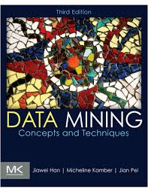
Learning Resources:
Credit Hours:
3 credit hours.
  Required Textbook:
  Jiawei Han, Jian Pei, Hanghang Tong, (2012). Data Mining Concepts and Techniques, The Morgan Kaufmann Series in Data Management Systems. Third Edition.
  Essential References:
  Eibe Frank, Mark A. Hall, and Ian H. Witten (2016). The WEKA Workbench. Online Appendix for "Data Mining: Practical Machine Learning Tools and Techniques", Morgan Kaufmann, Fourth Edition.
  .
Data Mining, Dr. Amjad Qtaish
www.midocean.ae

Slide 16


Thank You

